Slide 1

TDD Workshop
Greg Cook
© 2024 Bow Valley College / Greg Cook

Slide 2


Introductions
Who are you?
What motivated you to enter this program?
What are your goals for this weekend?
Share something about yourself.
What have you learned so far?
Do you have any questions yet unanswered?
About Me?
My Journey?
© 2024 Bow Valley College / Greg Cook

Slide 3
Agenda
Introductions
Application Architecture
Data Flow
Layered Architecture
Separation of Concerns
Domain-Driven Design
Inversion of Control
TDD 101
xUnit 101
Advanced Test Automation
Mocking with Moq
Writing Test
Assertions
Custom Assertions
Software as an Art
Intent Revealing Code
Readability
Fluent Interface
© 2024 Bow Valley College / Greg Cook

Slide 4
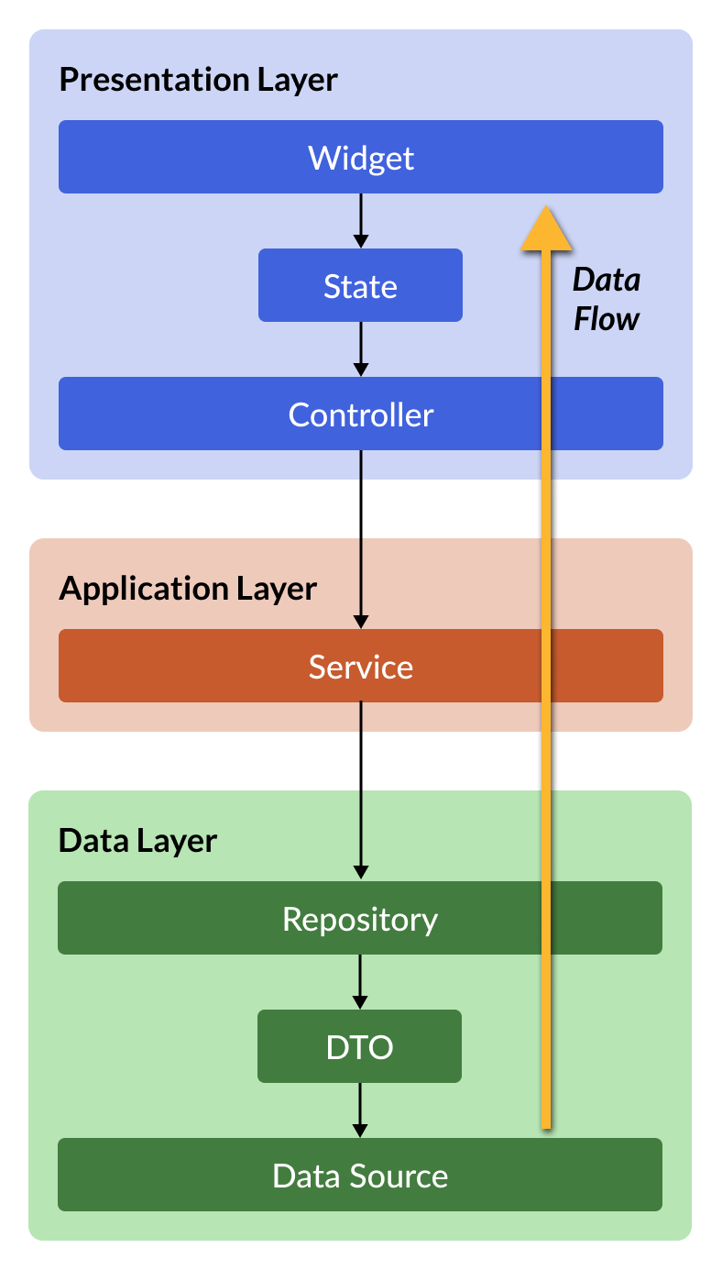
Flow of Application Data
Application data flows between various layers
Each layer represents a different “concern” or ”Layer”.
Data structure varies by concern.
Each layer requests data from the layer directly below it. (no deeper)
Each layer provides data to the layer directly above it (no higher)
Using a agreed-upon Request/Response format. ”MODELS”
© 2024 Bow Valley College / Greg Cook

Slide 5
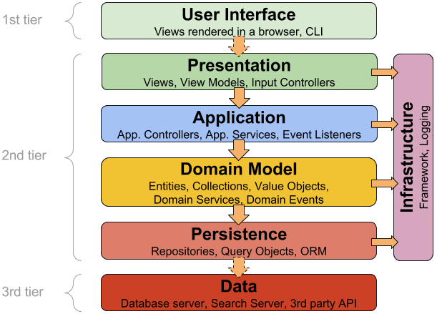
Application Layering
User Interface
Website/Mobile
Presentation
How data is represented on the UI
Application
Loosely coupled over the network: REST, RPC etc.
Domain Model
How your application likes to work with data
Persistence
How you like to store the data
Data
Data storage platform
© 2024 Bow Valley College / Greg Cook

Slide 6

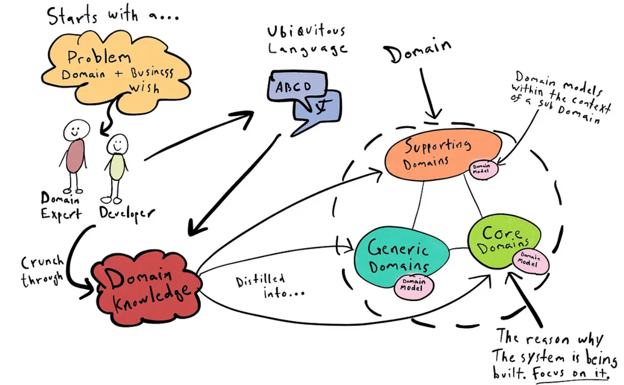
Domain Driven Design
© 2024 Bow Valley College / Greg Cook

Slide 7
Domain-Driven Design (DDD)
Domain
Is the specific areas of knowledge or business activity the software addresses
Model
Is an abstract representation of the domain and captures key concepts and relationships.
Ubiquitous Language
Is a common vocabulary used by both domain experts and developers to ensure a clear understanding.
The DDD problem space
Encompasses the complexities and challenges that arise within the domain that the software needs to address.
Bounded Contexts/Sub-domains
Defined boundaries within the larger domain where specific models and languages apply.
© 2024 Bow Valley College / Greg Cook

Slide 8
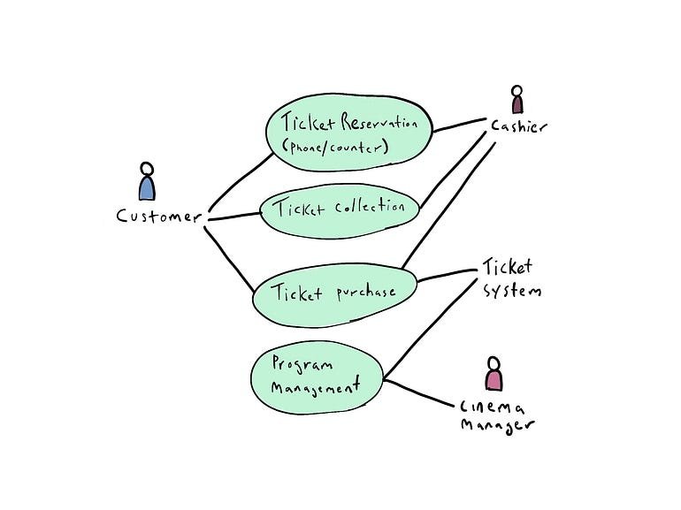
DDD Story Telling
A valuable DDD technique.
Helps teams visualize and understand complex business processes.
Involves creating collaborative narratives
Easier to identify key features
Aligns team members on the domain knowledge
Helps to define the scope of the system.
© 2024 Bow Valley College / Greg Cook

Slide 9
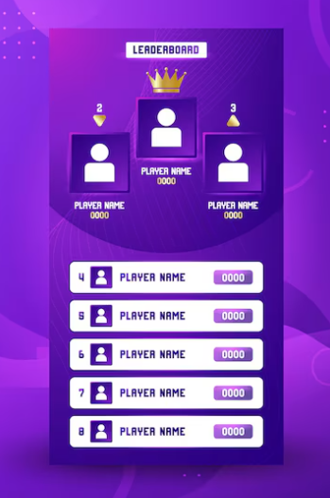
Achievement Feature
Scenario: Gamer earns a new achievement Given the gamer has met the criteria for an achievement When the system processes their latest activity Then the achievement should be added to their profile And they should receive a notification
Gherkin: a structured language used for Behavior-Driven Development (BDD).
Gherkin uses simple a syntax of (Given, When, Then)
Clearly describes user stories and expected behaviors
© 2024 Bow Valley College / Greg Cook

Slide 10
Gamer Leader Board
User Authentication
Signup/Login
User Profile Management
Profile Picture, Social Media links
Viewing Leaderboards
Filter by Game, View Their Rankings
Submitting Scores
Game Integration
Achievements and Badges
New High Score. Top 5 Score, Top of Leaderboard
© 2024 Bow Valley College / Greg Cook

Slide 11
Project Repository
https://github.com/kr0ggg/bvc.game.quest
© 2024 Bow Valley College / Greg Cook

Slide 12
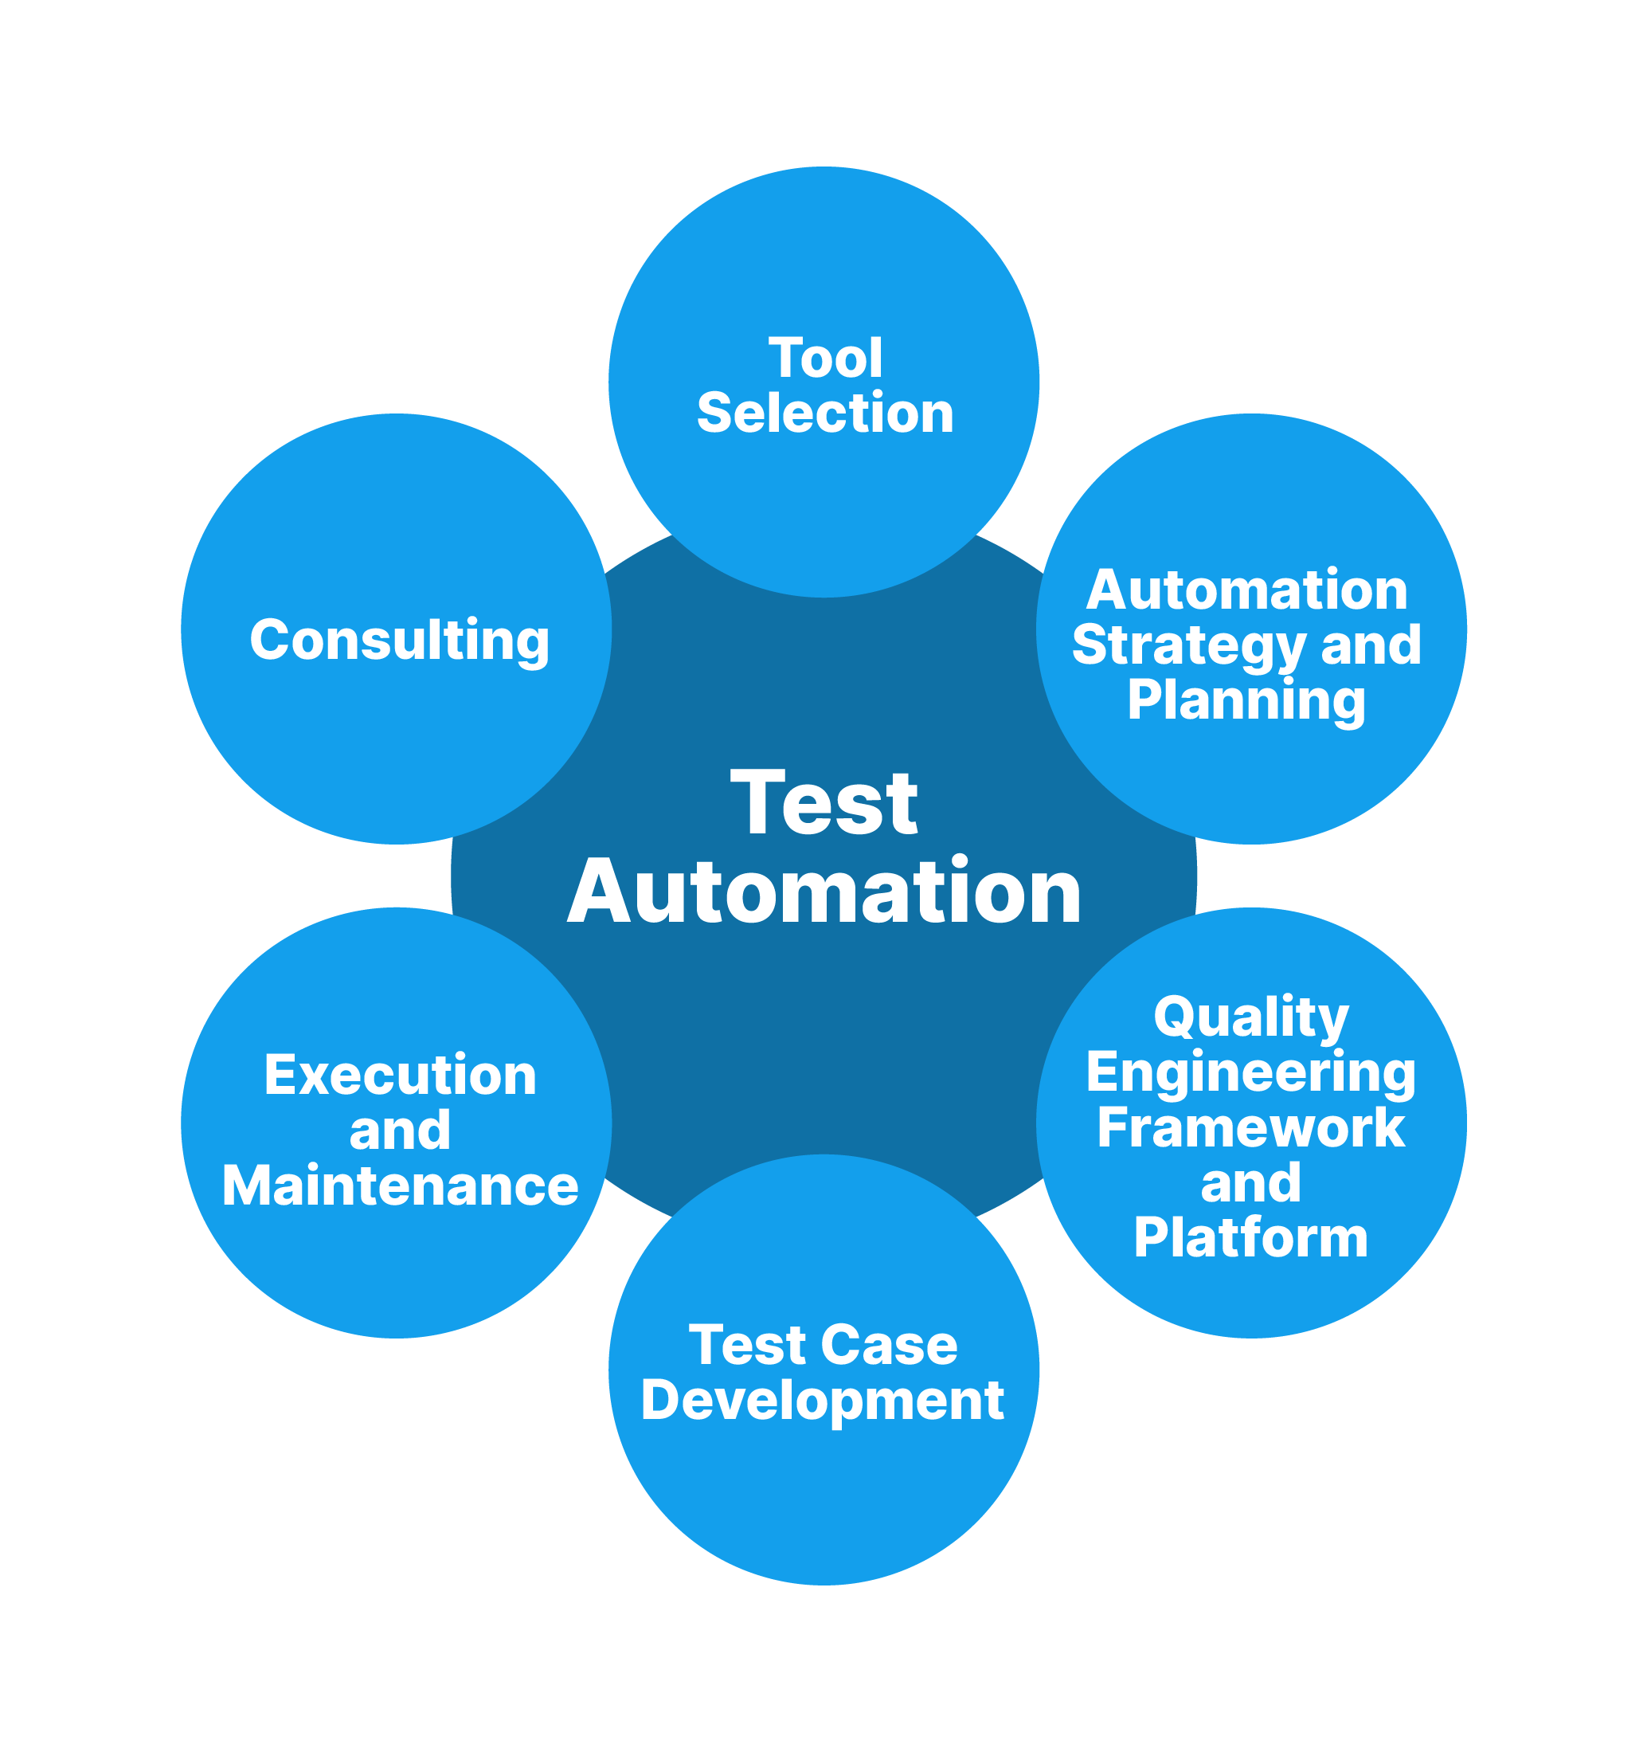
Workshop Day 2
The SDLC
Software Development Lifecycle
Iterative development in “sprints”
The Test Automation as a Practice
Develop tests as part of feature development
Integration tests run on every build
Automated regression suite runs with every build or nightly
Performance/Security testing often
Continuous testing throughout
© 2024 Bow Valley College / Greg Cook

Slide 13
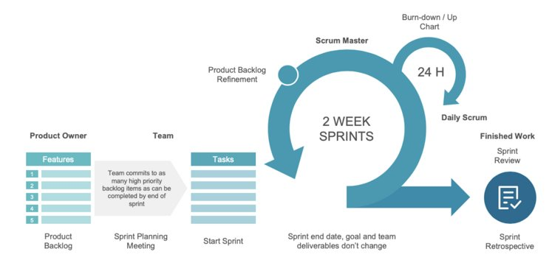
The Agile Sprint
© 2024 Bow Valley College / Greg Cook

Slide 14
Software Development Lifecycle (SDLC)
The Agile Sprint
1-4 Week “Sprints”
Sprint Planning
Design
Development
Testing Deployment
Sprint Demo
Retrospective
Agile Test Automation
Develop tests as part of feature development
Integration tests run on every build
Automated regression suite runs with every build or nightly
Performance/Security testing often
Continuous testing throughout
© 2024 Bow Valley College / Greg Cook

Slide 15
Benefits of Test Automation
Faster feedback on code changes
Increased software quality
Increased code coverage
Improved software design
Improved QA Practices
Less manual regressing testing
More time for exploratory testing
Enables continuous Delivery
Benefits to the “Customer”
Fast “time to market”
Better quality product
A more agile product
Benefits to the “Engineer”
Improved job satisfaction
Improved learning & development
Improved reputation
© 2024 Bow Valley College / Greg Cook

Slide 16
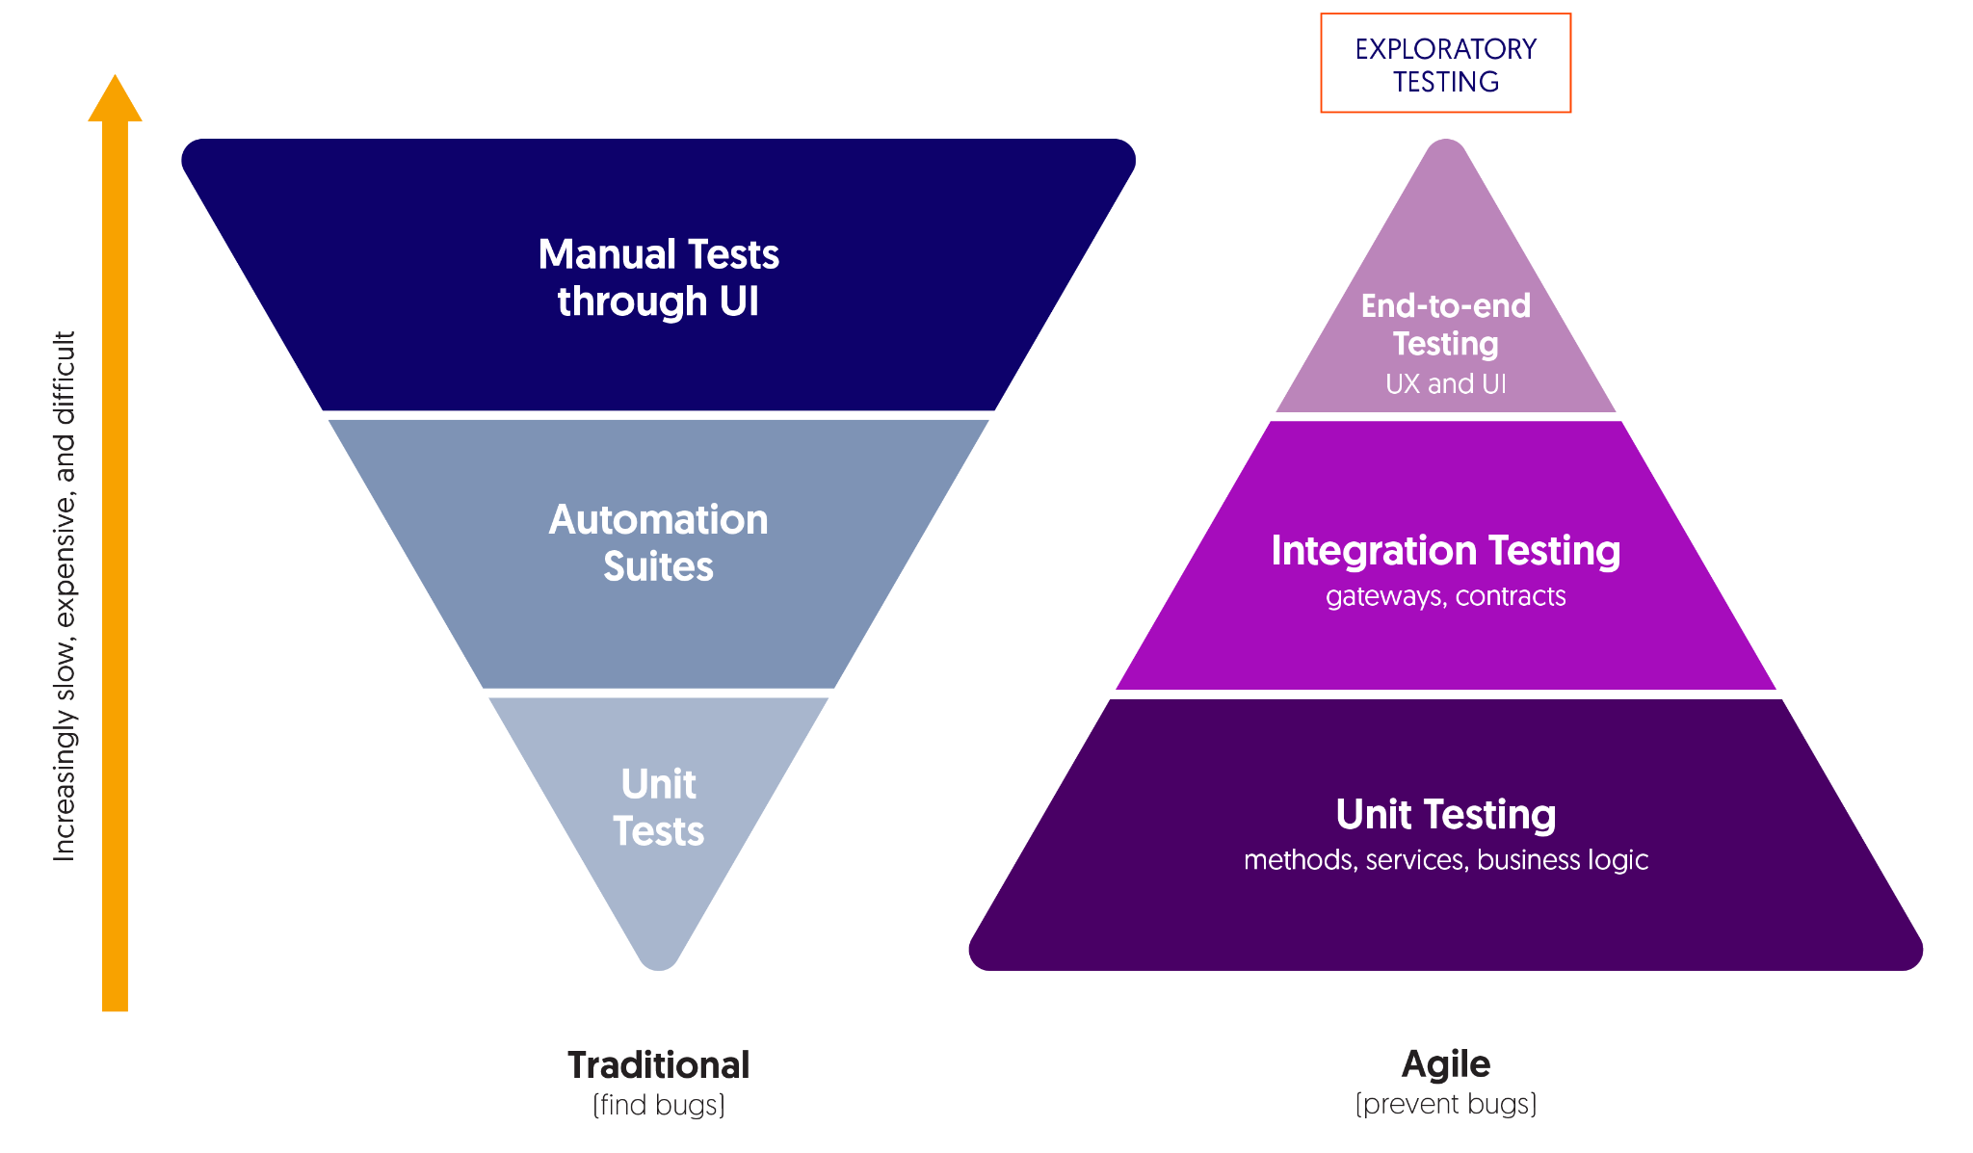
Development Quality Practices
Component Unit Tests: Provide the foundation for quality, allowing for early bug detection, improved continuous integration and deployment, collaboration, fearless refactoring and time and cost savings
Metric: Minimum 80% coverage on front-end and back-end components
Acceptance Testing: Ensuring the software meets the requirements and instills confidence in stakeholders. Acceptance tests also allow for gathering feedback from stakeholders and users and improving subsequent development cycles. They free the QA analysts from non-repeatable manual tests and enable more exploratory testing and user experience testing
Metric: 100% coverage on major features
Code Quality: Static code analysis tools such as SonarQube identify potential issues in the code, such as cyclomatic complexity and allow a team to track trends in code quality over time. Keeping a handle on an application's technical debt reduces the maintainability index and significantly lowers the total cost of ownership
Metric: Maintainability Index of >= 85
Creating a QA Practice: Foster a culture of continuous improvement, collaboration and knowledge sharing across all development pods
Metric: Establish RTO and RPO and measure performance metrics for each application
© 2024 Bow Valley College / Greg Cook

Slide 17
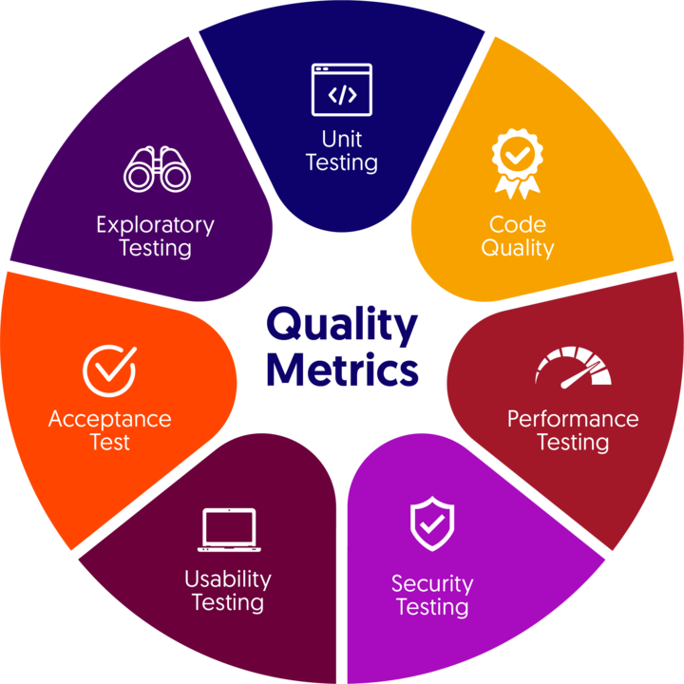
Quality Assurance Practice
Setting The Quality Bar High
Measuring quality involves more than just functional correctness. Quality involves assessing various aspects and methodologies throughout the software development life cycle (SDLC)
Automated Tests and Exploratory Testing
A combination of automated and manual activities to ensure the software meets the functional requirements
Defining a series of metrics to feed back into the development process to improve quality and time to market
Release Management & Operational Readiness
Metrics, alerts and monitors to enable personnel to assess the health of the system in real-time to minimize impact to users
Automated methods for deployment, rollback and incident responses
Runbooks and procedures ensuring operations personnel are properly trained
Non-Functional Requirements
Metrics and guardrails to ensure performance, security, scalability authorization/authentication, data production, auditability and compliance
© 2024 Bow Valley College / Greg Cook

Slide 18
Refactoring 101
Adding a new feature
Changing an existing feature
Refactoring Strategy
Review the current design
Update your design to accommodate the new requirement
Refactor the existing tests so they pass with the new design.
Write the new tests to satisfy the new requirement
Create a GitHub pull-request (PR) of your branch to main
Document your change and assign a reviewer
© 2024 Bow Valley College / Greg Cook

Slide 19
Peer Reviews
Goal
To have another set of eyes look over your changes
Tends to be a project “Tech Lead”
Ensures the Feature meets the criteria of the story
Ensures automated tests are written and ”Tell the Story” of the feature
Ensure standards are met
An integral part of the SDLC process
© 2024 Bow Valley College / Greg Cook

Slide 20
Additional Scenarios
Scenario: Gamer earns another achievement Given the gamer has earned an achievement And the gamer already an achievement When the system processes their latest activity Then the new achievement is added to their profile And they should receive a notification And the gamer should now have 2 achievements
Write the tests for this
Review your current design
What changes are necessary to accomplish this?
© 2024 Bow Valley College / Greg Cook

Slide 21
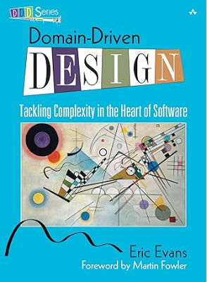


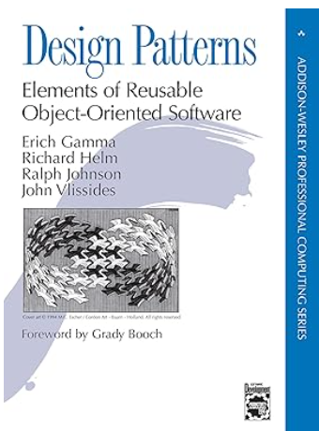
Additional Resources
Domain Driven Design
Refactoring
xUnit Testing Patterns
Design Patterns
© 2024 Bow Valley College / Greg Cook

