Slide 1
AspectJ
Is :
  Black magic
  a seamless aspect-oriented extension to the Java programming language
  Java platform compatible
  easy to learn and use
Use cases :
  error checking and handling
  synchronization
  performance optimizations,
  monitoring, logging, metrics
  debugging support
  security check
  transaction management
  async method execution

Slide 2
Aspect
Pointcuts :
  Defines, in a multitude of different ways, a point in the code. The pointcut defines when an advice should be run.
Advice :
  Method; contains the code that will be run once a pointcut has been triggered.

Slide 3
Weaving
Compile-time
  If you have both the source code of the aspect and the code that you are using aspects in, you can compile your source-code and the aspect directly with an AspectJ compiler.
Load-time
  waits to inject aspects into the code until the class loader loads the class file. This requires one or more weaving class loaders.

Slide 4
Scenarios
Five scenarios
  Before
  After
  AfterReturn
  AfterThrowing
  Around
a method/object is called.
Some of the powerful things that the advice body can do are
  modify any parameters that are passed into the call.
  modify the return value
  choose to not continue the call to the (method/object) in question
  call other (methods/objects)
  catch any exception that is thrown by the (method/object) in question

Slide 5
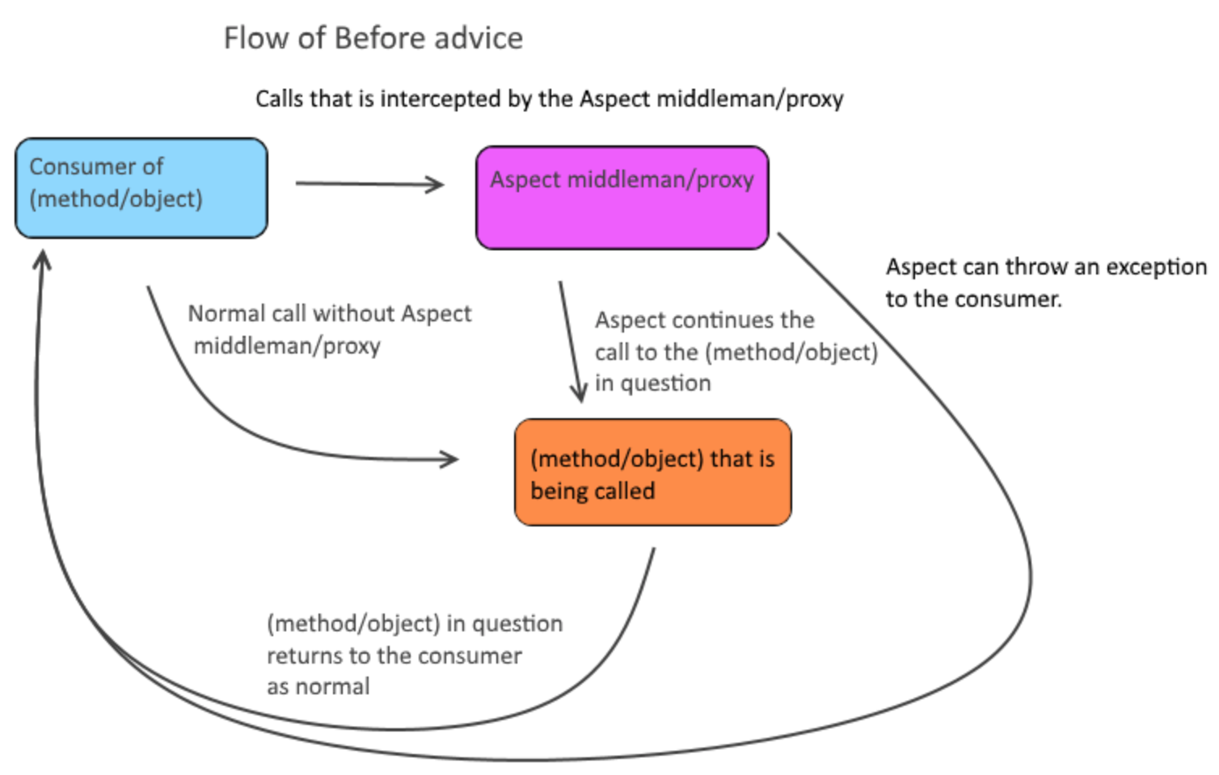
@Before
The before advice can only modify things before the method/object is called.
has the power to throw an exception and cancel the call to the method/object
can modify the parameters of the call.

Slide 6
@After,
@AfterReturning, @AfterThrowing
@After
  Do something after object/method call
  Return custom value
  Doesn't have access to object/method return value or exception
@AfterReturning
  @After + Have access to return value
@AfterThrowing
  @After + Have access to thrown exception

Slide 7
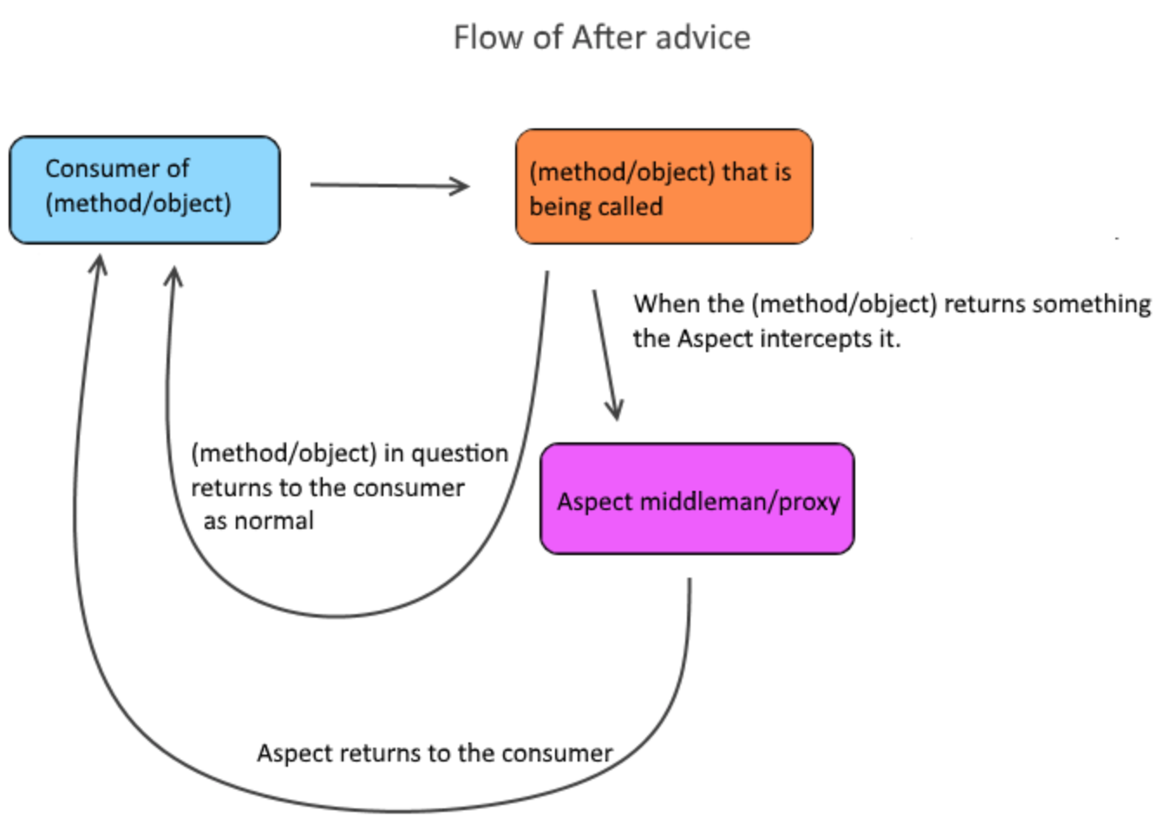
@After,
@AfterReturning, @AfterThrowing

Slide 8
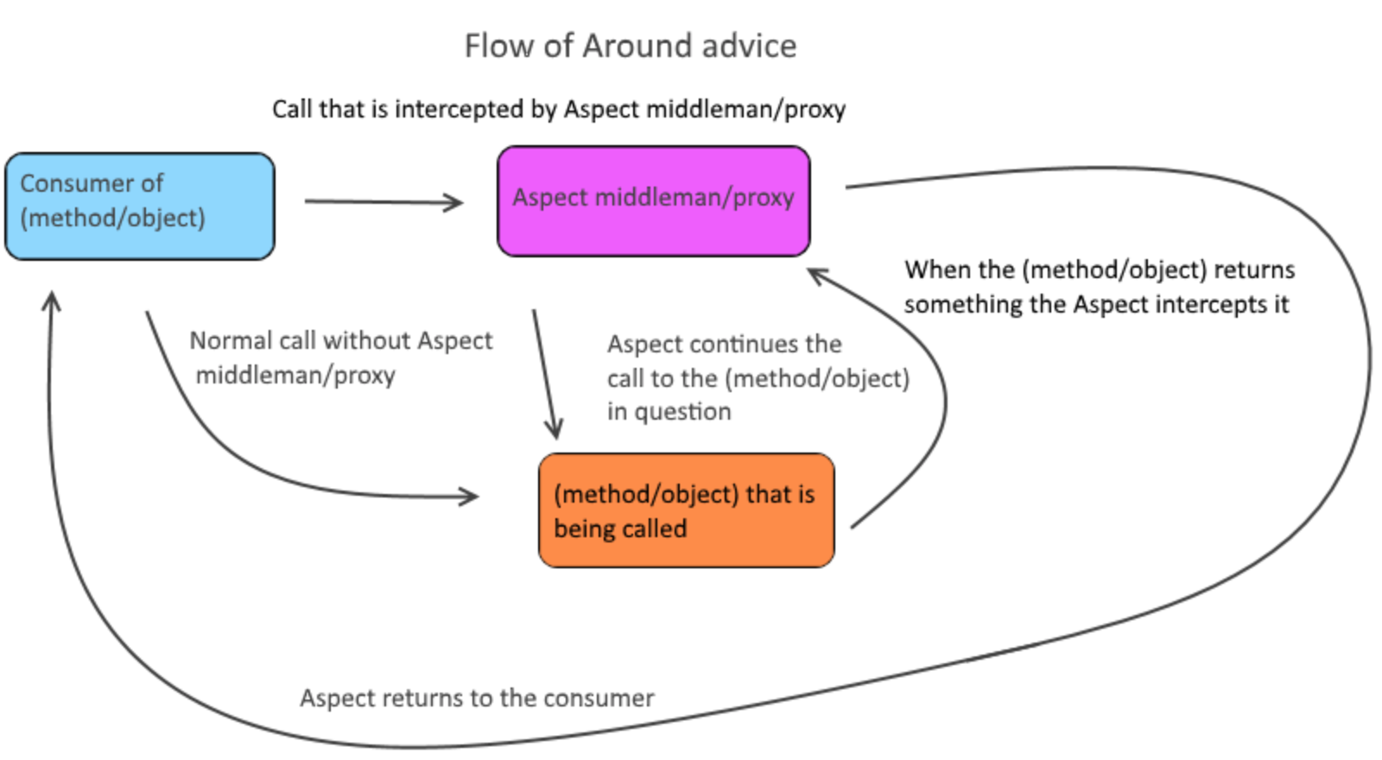
@Around
@Before + @AfterReturning + @AfterThrowing
  Behavior before object/method call
  Have access to return value
  Have access to thrown exception

Slide 9
Pointcuts by pattern
Patterns are designed by the following elements and any element in the pattern can use wildcards *
[modifiers] [return type] [(packageName)(className)(methodName)](parameters)
  [modifiers] - can be left blank; that will be interpreted as *
  [return type] – void, object, primitive type
  [(packageName)(className)(methodName)]
    your.package.structure.ClassName.yourMethod
      You can add * anywhere in that line to extend the search pattern
    your.package.structure.*.*
  (parameters)
    yourMetod(..) - defines any method named yourMethod
    yourMethod(Integer) - and that has one parameter that is an Integer
combinators
  execution (method pattern)
  within (type pattern)
  if (booelan)

Slide 10
Pointcuts by pattern
execution([pattern])
@Around("execution (!private void com.jayway.blog.YourClass.yourMethodAround(Integer,..))")
//ProceedingJointPoint = the reference of the call to the method.
//A ProceedingJointPoint can be continued(proceeded) and is needed for a Around advice
public Object aroundAdvice(ProceedingJoinPoint joinPoint) throws Throwable {
//Default Object that we can use to return to the consumer
Object returnObject = null;
try {
System.out.println("YourAspect's aroundAdvice's body is now executed Before yourMethodAround");
//We choose to continue the call to the method in question
returnObject = joinPoint.proceed();
//If no exception is thrown we should land here and we can modify the returnObject
} catch (Throwable throwable) {
//Here we can catch and modify any exceptions that are called
throw throwable;
}
finally {
//If we want to be sure that some of our code is executed even if we get an exception
System.out.println("YourAspect's aroundAdvice's body is now executed After yourMethodAround");
}
return returnObject;
}

Slide 11
Pointcuts by annotation
execution([pattern])
//Defines a pointcut where the @YourAnnotation exists
//And combines that with a catch all pointcut with the scope of execution
@Around("@annotation(YourAnnotation) && execution(* *(..))")
//ProceedingJointPoint = the reference of the call to the method.
public Object aroundAdvice(ProceedingJoinPoint joinPoint) throws Throwable {
//Default Object that we can use to return to the consumer
Object returnObject = null;
try {
System.out.println("YourAspect's aroundAdvice's body is now executed Before yourMethodAround");
//We choose to continue the call to the method in question
returnObject = joinPoint.proceed();
//If no exception is thrown we should land here and we can modify the returnObject
} catch (Throwable throwable) {
//Here we can catch and modify any exceptions that are called
throw throwable;
}
finally {
//If we want to be sure that some of our code is executed even if we get an exception
System.out.println("YourAspect's aroundAdvice's body is now executed After yourMethodAround");
}
return returnObject;
}

Slide 12
Build automation system
Ant
  Main goal is custom build scripts
Maven
  Main goal is dependency managagement
  XML as the build configuration format is strictly structured and highly standardized.
  build scripts are actually harder to write in Maven than in Ant
Gradle
  Combines good parts of both tools and builds on top of them with DSL and other improvements
  Default build system for Android
  Build scripts uses written in Groovy language and can be extended or overridden

Slide 13
Gradle files
gradle.build
  specifies a project and its tasks.
gradle.properties
  Optional, is used to configure the properties of the build
gradle.settings
  Contains name of project and all modules names (in multi-module projects)

Slide 14
Gradle plugins
Plug-ins extend core functionality.
Is an extension to Gradle which adds some preconfigured tasks
example :
  apply plugin 'java'
    Allows compiling java sources
    Adds properties to project :
      Source compatibility, main class name, group, version...
    Dependency management methods :
      Compile, compileOnly, runtime, testCompile

Slide 15
Gradle plugins
buildscript {
repositories {
jcenter()
maven { url 'https://plugins.gradle.org/m2/' }
}
dependencies {
classpath 'com.github.ben-manes:gradle-versions-plugin:0.17.0'
}
}
apply plugin: 'com.github.ben-manes.versions'
apply plugin: 'java'
External plugin
Standart plugin

Slide 16
Most usable plugins
java
  Adds Java compilation, testing and bundling capabilities to a project
application
  Adds tasks for running and bundling a Java project as a command-line application.
maven-publish
  Provides a new DSL to support publishing artifacts to Maven repositories, which improves on the existing DSL.
distribution
  Adds support for building ZIP and TAR distributions.
checkstyle
  Performs quality checks on your project’s Java source files using Checkstyle and generates reports from these checks.

Slide 17
Repositories
mavenCentral()
jcenter()
google()
or custom
repositories {
google()
// custom internal repo
maven {
url "http://repo.mycompany.com/maven2"
}
}

Slide 18
Dependency management
compile and implementation
  Compile is deprecated. Compile time dependencies.
compileOnly
  Compile time only dependencies, not used at runtime.
annotationProcessor
  Annotation processors used during compilation. Can be replaced by compileOnly
runtimeOnly
  Runtime only dependencies.

Slide 19
Dependency management
testCompile and testImplementation
  testCompile id deprecated. Additional dependencies for compiling tests.
testImplementation
  Implementation only dependencies for tests.
testCompileOnly
  Additional dependencies only for compiling tests, not used at runtime.
testRuntimeOnly
  Runtime only dependencies for running tests.

Slide 20
Adding functionality
task invokedAfterCompileJava(dependsOn: 'compileJava') {
doLast {
println 'This will be invoked right after the compileJava task is done'
}
}
clean{
delete "new/location"
}

Slide 21
JNI
An interface that allows Java to interact with code written in another language
Motivation for JNI
  Code reusability
    Reuse existing/legacy code with Java (mostly C/C++)
  Performance
    Native code used to be up to 20 times faster than Java, when running in interpreted mode
  Allow Java to tap into low level O/S, H/W routines

Slide 22
JNI Components
javah
  JDK tool that builds C-style header files from a given Java class that includes native methods
  Adapts Java method signatures to native function prototypes
jni.h -
  C/C++ header file included with the JDK that maps Java types to their native counterparts
  javah automatically includes this file in the application header files

Slide 23
JNI Components
javah
  JDK tool that builds C-style header files from a given Java class that includes native methods
  Adapts Java method signatures to native function prototypes
jni.h -
  C/C++ header file included with the JDK that maps Java types to their native counterparts
  javah automatically includes this file in the application header files

Slide 24
Example
class Hello {
public native void sayHi(String who, int times);
static {
System.loadLibrary("HelloImpl");
}
public static void main (String[] args) {
Hello hello = new Hello();
hello.sayHi(args[0], Integer.parseInt(args[1]));
}
}
Use the JDK javah utility to generate the header file
package_name_classname.h
with a function prototype for the sayHi method:
1. Compile java class
javac -d ./classes/ ./src/com/marakana/jniexamples/Hello.java
2. Generate header om_marakana_jniexamples_Hello.h :
javah -jni com.marakana.jniexamples.Hello
3. Create C implementation com_marakana_jniexamples_Hello.c

Slide 25
Example
The file com_marakana_jniexamples_Hello.h looks like:
...
#include <jni.h>
...
JNIEXPORT void JNICALL Java_com_marakana_jniexamples_Hello_sayHi
(JNIEnv *, jobject, jstring, jint);
...
The file Hello.c looks like:
JNIEXPORT void JNICALL
Java_com_marakana_jniexamples_Hello_sayHi(JNIEnv *env, jobject obj, jstring who, jint times) {
jint i;
jboolean iscopy;
const char *name;
name = (*env)->GetStringUTFChars(env, who, &iscopy);
for (i = 0; i < times; i++) {
printf("Hello %s\n", name);
}
}

Slide 26
Native Method Arguments
JNIEnv *env:
  Is a pointer that points to another pointer pointing to a function table (array of pointer). Each entry in this function table points to a JNI function. These are the functions we are going to use for type conversion
The second argument is different depending on whether the native method is a static method or an instance method
  jobject
  jclass

Slide 27
Native Method Arguments
JNIEnv *env:
  Is a pointer that points to another pointer pointing to a function table (array of pointer). Each entry in this function table points to a JNI function. These are the functions we are going to use for type conversion
The second argument is different depending on whether the native method is a static method or an instance method
  jobject
  jclass
public native void sayHi(String who, int times);
Java_com_marakana_jniexamples_Hello_sayH (JNIEnv *, jobject, jstring, jint)

