Slide 1
JUnit
Junit
  unit testing and integration testing framework
Mockito
  Mock library
Hamcrest
  Additional matchers for Junit and Mockito
H2
  In-memory database
DBUnit
  Database assertions
WireMock
  local http server for mocking http requests

Slide 2
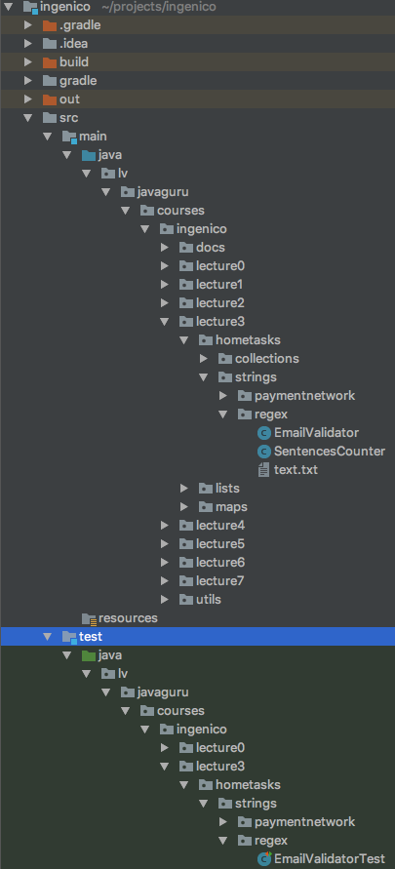
Tests location in java
lv.javaguru.courses.ingenico.lecture3.hometasks.strings.regex.EmailValidator
lv.javaguru.courses.ingenico.lecture3.hometasks.strings.regex.EmailValidatorTest
For Java these 2 classes exist in one package.
That means they are visible to each other.
So from test you access to Protected and Default access

Slide 3
JUnit Annotations
@RunWith
@Test
@Rule
@FixMethodOrder
@Before
@After
@BeforeClass
@AfterClass

Slide 4
@Test
Annotation for test suit
Properties
  timeout (set timeout for this test suit)
  expected (expect class of thrown exception)
@Test(timeout = 100)
public void shouldAddIntegers() throws Exception {
int result = calculator.add(1, 2, 3);
assertEquals(6, result);
}
@Test(expected = IllegalArgumentException.class)
public void shouldThrowExceptionWhenTypeNotSupported() throws Exception {
calculator.add(new DoubleAccumulator(null, 0), new DoubleAccumulator(null, 2));
}

Slide 5
@BeforeClass @AfterClass
Annotation on public static method with some preparation and tear down for all test suits in the class
Propagates on all derived classes when used in parent class
Executes once for class or once for inheritance hierarchy
Derived class can have his own setup method, then 2 methods will be executed : in parent class and his own

Slide 6
@BeforeClass @AfterClass
class BaseTestClass {
protected static Connection connection;
@BeforeClass
public static void setUpClass(){
connection = new Connection();
}
@AfterClass
public static void tearDownClass(){
connection.close();
}
}
class RepositoryTest extends BaseTestClass {
@BeforeClass
public static void setUpClass(){
// prepare something else
}
}
for RepositoryTest will be executed 2 preparations :
BaseTestClass.setUpClass()
RepositoryTest.setUpClass()

Slide 7
Test case execution
@RunWith
@BeforeClass
@Before
@Test
@After
@Before
@Test
@After
@AfterClass

Slide 8
public class TransactionServiceTest {
@BeforeClass
public static void setUpClass() throws Exception{
openDatabaseConnection();
}
@AfterClass
public static void tearDownClass() throws Exception{
closeDatabaseConnection();
}
@Before
public void setUp() throws Exception {
mockCommonBehavior();
}
@After
public void teasDown() throws Exception {
resetMocks();
}
@Test
public void shouldFailIfCardNotFound() throws Exception {
// implement test
}
@Test
public void shouldReturnZeroIfInsufficientFunds() throws Exception {
// implement test
}
}
Executes once before for all test cases
Executes once after for all test cases finished
Executes before each test case
Executes after each test case finished
Test case
Test case

Slide 9
@RunWith
Runners are used for running test classes.
  IDE uses custom runner to build graphical reports
  Gradle or Maven use theirs runners to build console reports
You can create your own Runner and add some logic into tests execution
  warm-up application
  run application without full context
  most frameworks have their runners to start application, load components,
  make proxy objects
  ...
In most cases you can avoid of creating custom runner and move logic into base class with methods
  @BeforeClass
  @AfterClass

Slide 10
@RunWith
Runners are used for running test classes.
  IDE uses custom runner to build graphical reports
  Gradle or Maven use theirs runners to build console reports
You can create your own Runner and add some logic into tests execution
  warm-up application
  run application without full context
  most frameworks have their runners to start application, load components,
  make proxy objects
  ...
In most cases you can avoid of creating custom runner and move logic into base class with methods
  @BeforeClass
  @AfterClass

Slide 11
@FixMethodOrder
By default test suits execution order is not predictable.
If you need order you should annotate test class with
@FixMethodOrder(value = MethodSorters.NAME_ASCENDING)

Slide 12
@Rule
A JUnit rule is a component that intercepts test method calls
and allows us to do something before a test method is invoked
and after a test method has been invoked.
Must be public field
Two standard rules :
  ExpectedException
    can be used in test suit to catch exception and verify it properties
  Timeout
    value for all test suits in class or for all test suits in all derived classes

Slide 13
Result assertions
org.junit.Assert.assert***
  assertTrue
  assertFalse
  assertEquals
  assertNotEquals
  assertArrayEquals
  assertNotNull
  assertNull
  assertSame
  assertNotSame
  assertEquals
  assertThat

Slide 14
Hamcrest matchers
Matchers make code more readable and avoid of matching logic duplications.
Can be used in assertThat(result, matcher)
  assertThat(object, in(array));
  assertThat(sum, closeTo(2.99, 0.000000001))
    where (0.000000001 possible error)
  assertThat(result, emptyOrNullString())
Matchers can be combined
  both(greaterThanOrEqualTo(400)).and(lessThan(500))

Slide 15
Mockito
Mock behavior
Interactions verification of mock
Arguments intercepting of mock invocation
Supports annotations with
@RunWith(MockitoJUnitRunner.class)

Slide 16
Mockito
Create mock
Create spy
Create argument captor
Mocks created by annotations can be injected into object with
private Calculator calculator = Mockito.mock(Calculator.class);
@Mock
private Calculator calculator;
private Calculator calculator = Mockito.spy(Calculator.class);
@Spy
private Calculator calculator;
private ArgumentCaptor<Integer> captor =
ArgumentCaptor.forClass(Integer.class);
@Captor
private ArgumentCaptor<Integer> captor;
@InjectMocks
To use annotations don't forget add RunWith annotation

Slide 17
Mock behaviour
Mockito.when(mockedObject.doSomething(anyString())).thenReturn(result);
Mock exact method of object
.thenReturn
.thenThrow
.thenAnswer
ArgumentMatcher
anyString()
any() - always true
eq(value) - equals
...
Can be used just object then
compares with ==
Result of mocked behavior
By default will return null

Slide 18
Verification
Mockito.verify(mockedObject, times(2)).doSomething(4);
Mockito.verifyZeroInteractions(mockedObject1, mockedObject2, mockedObject3);
times(number)
never()
ArgumentMatcher
anyString()
any() - always true
eq(value) - equals
...
Can be used just object then
compares with ==

Slide 19
Arguments Capturing
@Captor
ArgumentCaptor<Integer> argumentCaptor;
@Mock
Calculator calculator;
@Before
public void setup(){
Mockito.when(calculator.add(4, 5)).thenReturn(9);
}
@Test
public void shouldReturnCorrectValue(){
...
Mockito.verify(mockedObject).doSomething(argumentCaptor.capture());
int argument = argumentCaptor.getValue();
assertEquals(3, argument);
}
Capture instead of argument verification

