Slide 1
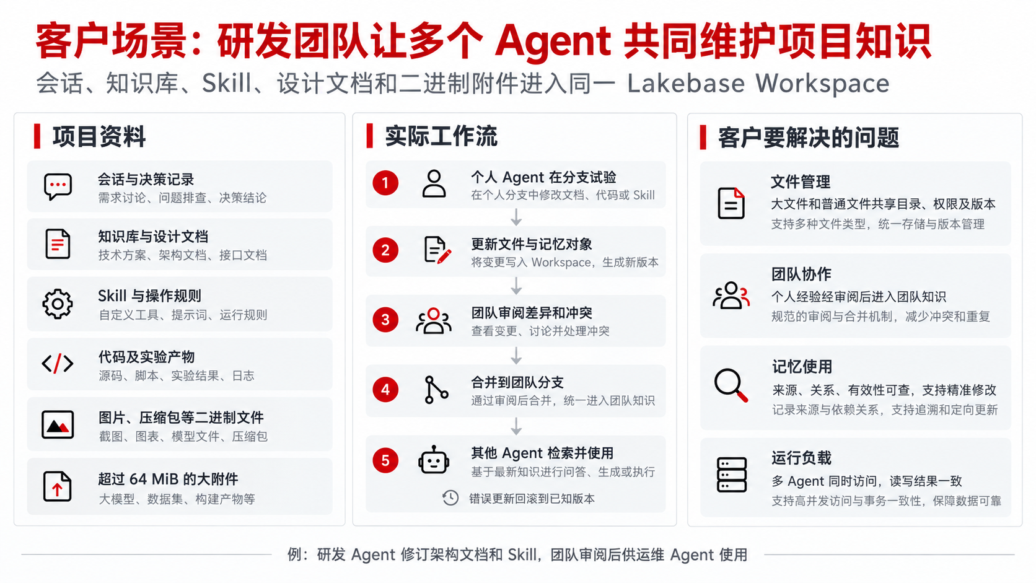
Notes:
[Sources]
User-provided project scenario and requirements in this conversation.
/Users/jacky/code/lakeon/docs/lakebasefs/architecture.md
[/Sources]
Representative R&D customer workflow; no named customer deployment is asserted.

Slide 2
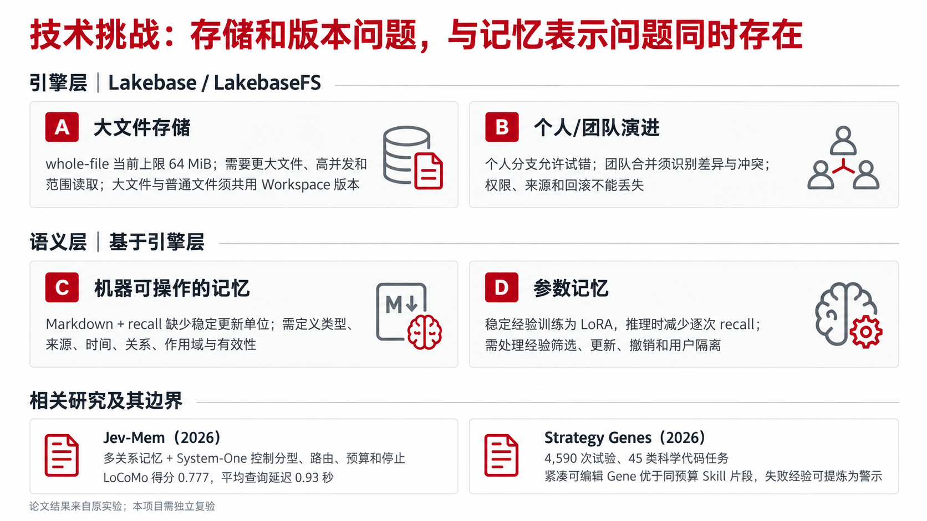
Notes:
[Sources]
/Users/jacky/code/lakeon/docs/lakebasefs/design/kernel/whole-file-content-storage.md (64 MiB current whole-file boundary)
/Users/jacky/code/lakeon/docs/lakebasefs/design/service/workspace-branch-management.md
https://arxiv.org/abs/2609.23986 (Jev-Mem, paper-reported LoCoMo score 0.777 and average query latency 0.93 s)
https://arxiv.org/abs/2604.15097 (Strategy Genes, paper-reported 4,590 trials and 45 scientific code-solving scenarios)
[/Sources]
Paper results are from their own experimental settings and require independent validation here.

Slide 3
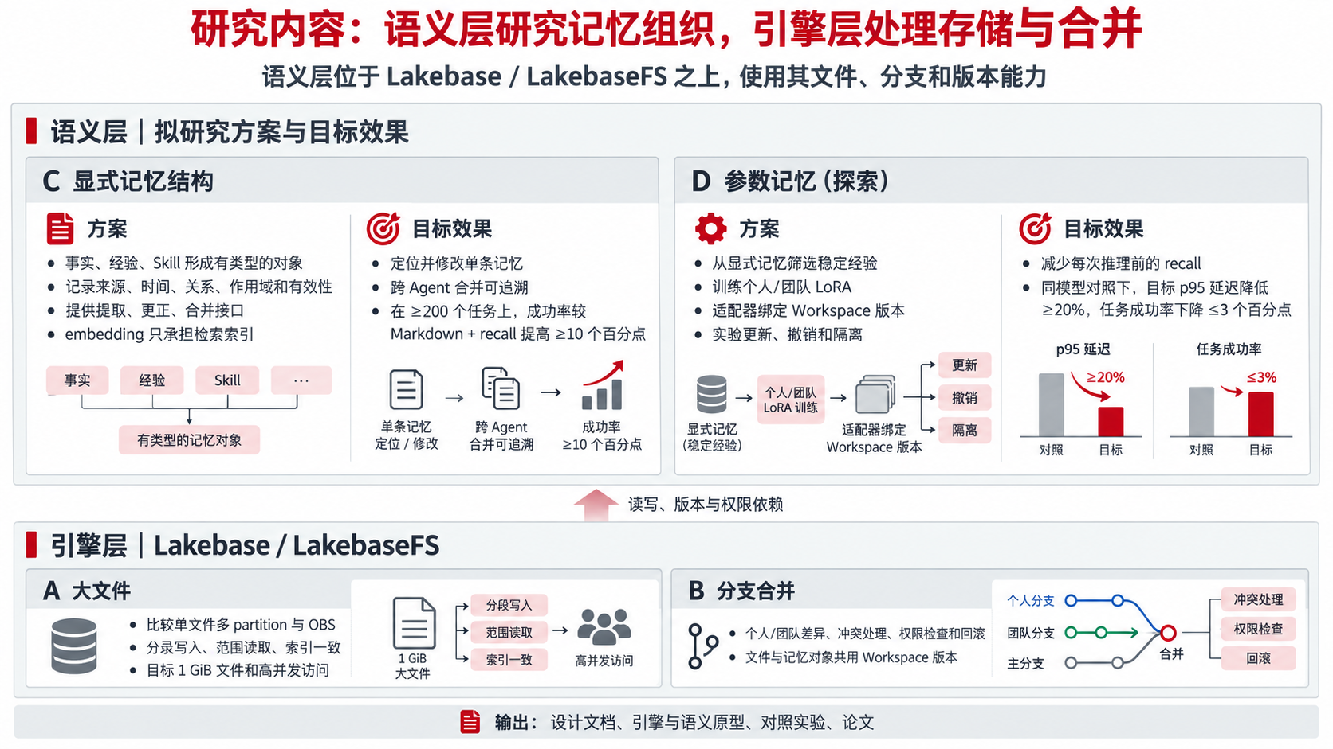
Notes:
[Sources]
User-defined two-layer architecture and four cooperation challenges in this conversation.
/Users/jacky/code/lakeon/docs/lakebasefs/architecture.md
https://arxiv.org/abs/2609.23986
https://arxiv.org/abs/2604.15097
[/Sources]
All stated numerical effect sizes are proposed project targets, not measured Lakebase outcomes.

Slide 4
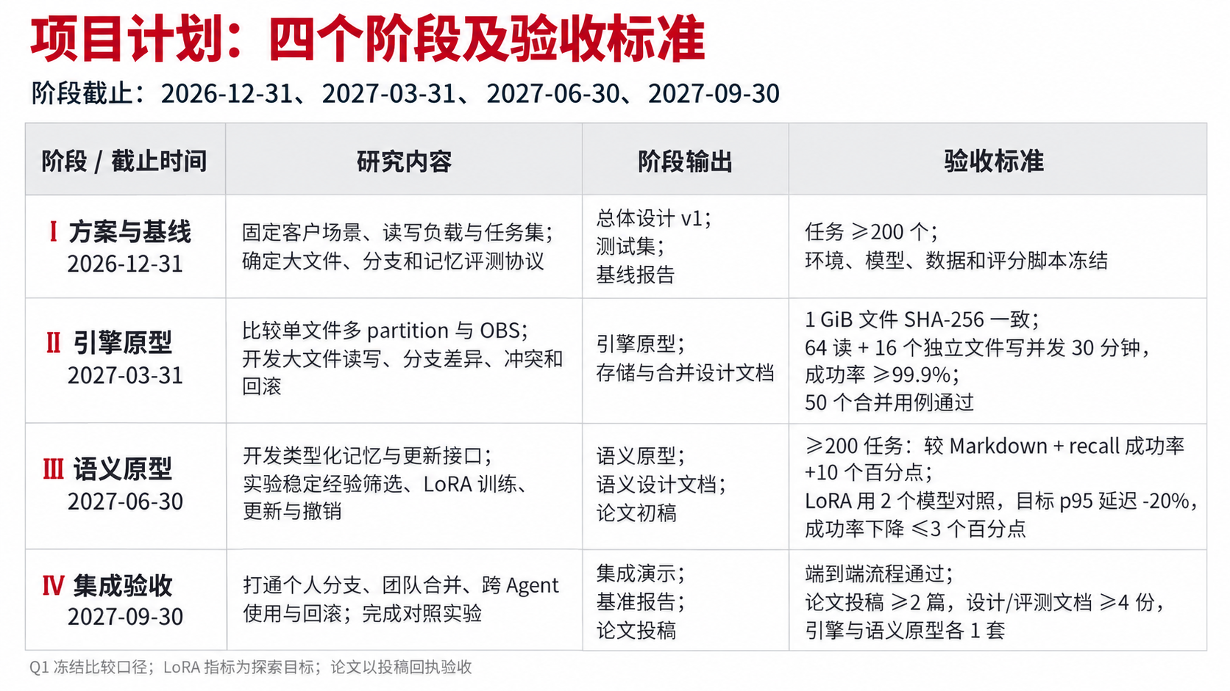
Notes:
[Sources]
User-specified final stage deadline 2027-09-30; first deadline 2026-12-31 inferred from ambiguous 2026 December wording and a four-quarter schedule.
/Users/jacky/code/agent-research/outputs/lakebase-agent-memory-project-proposal-4slides-v2/proposal-content.md
[/Sources]
Dates are stage deadlines. Q1 freezes environment, model, task set, load script and scoring. LoRA goals are exploratory. Papers are accepted as project output on proof of submission, not journal or conference acceptance.

