Slide 1


System Architecture and Implementation of Global Vessel Path Planning Based on ROS2 Framework
Enio Krizman, Nadir Kapetanović, Đula Nađ
ICRA 2025

Slide 2
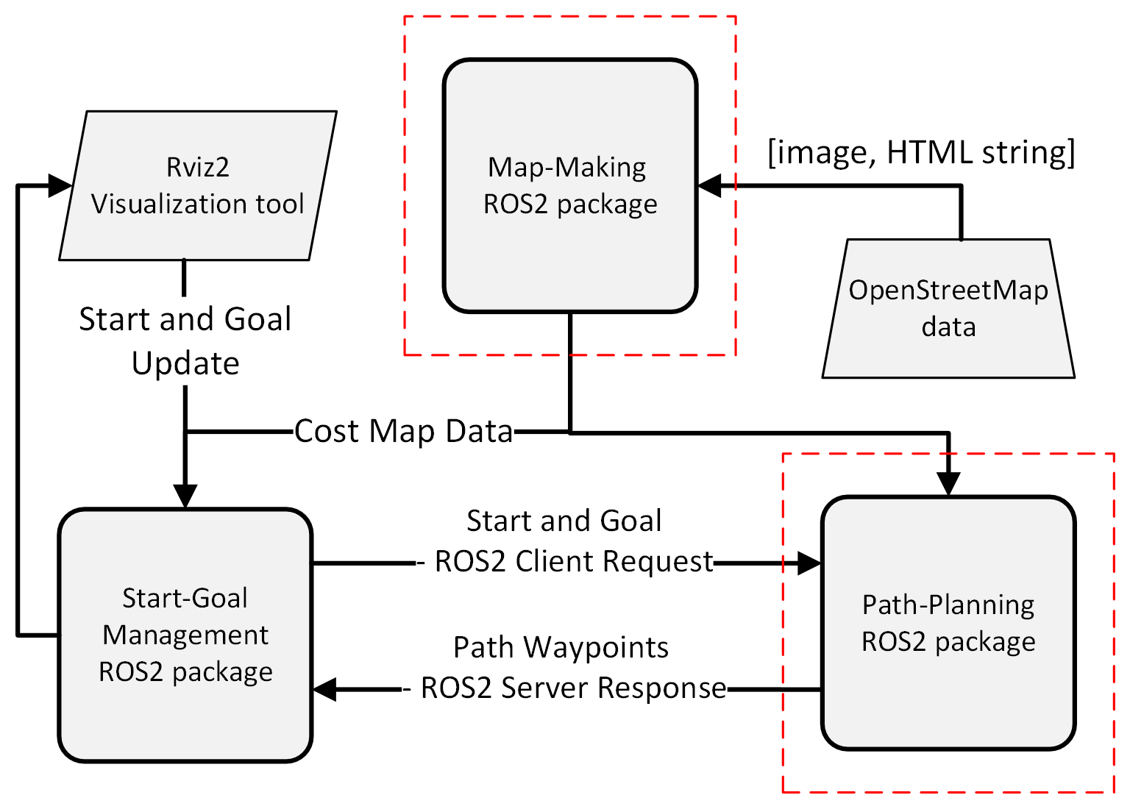
MAIN CONTRIBUTIONS?

Slide 3
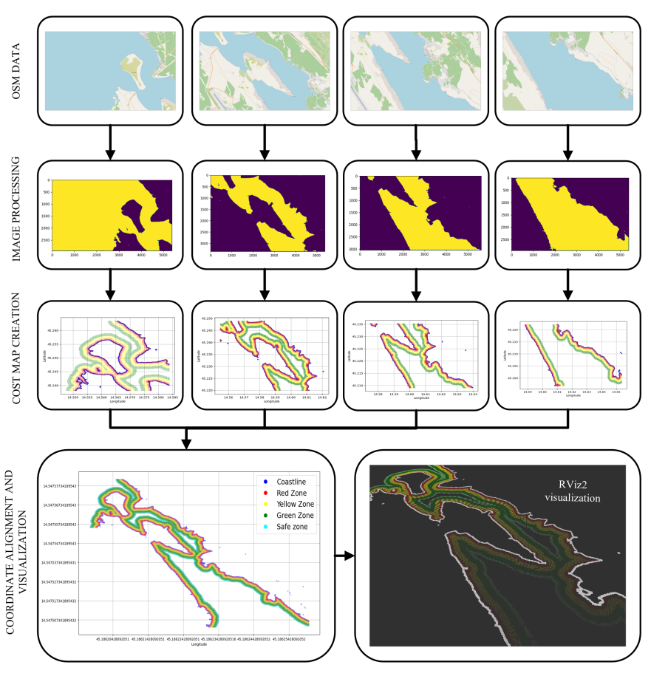
1. COST MAP GENERATION

Slide 4
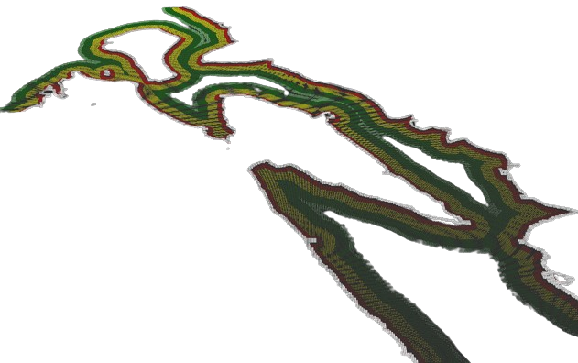
2. SETTING START AND GOAL

Slide 5
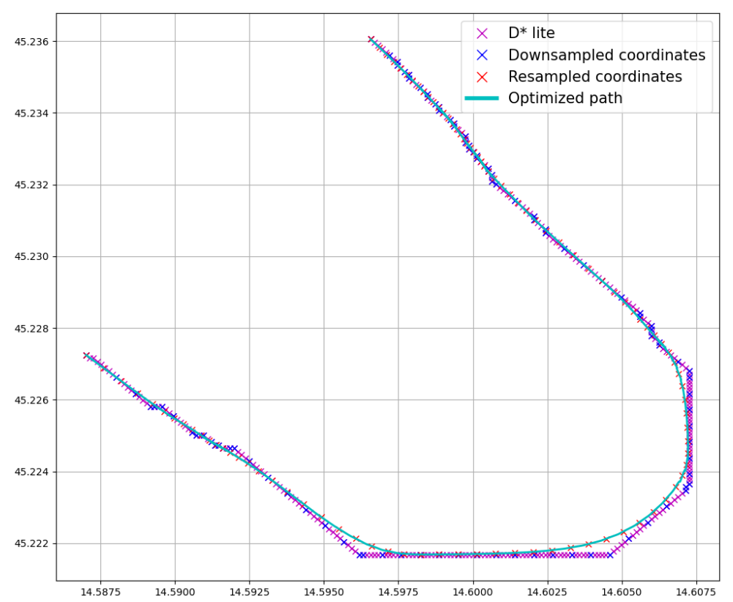
3. PATH PLANNING

Slide 6
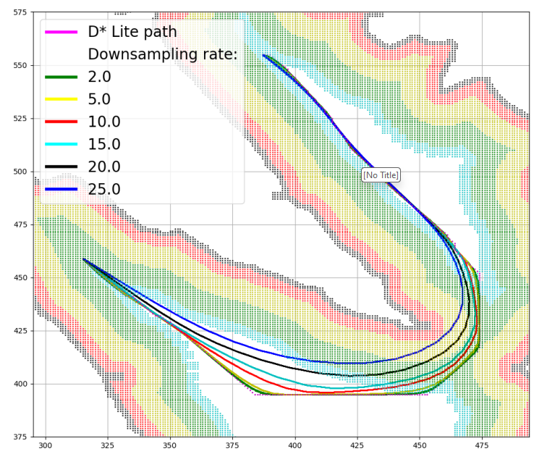
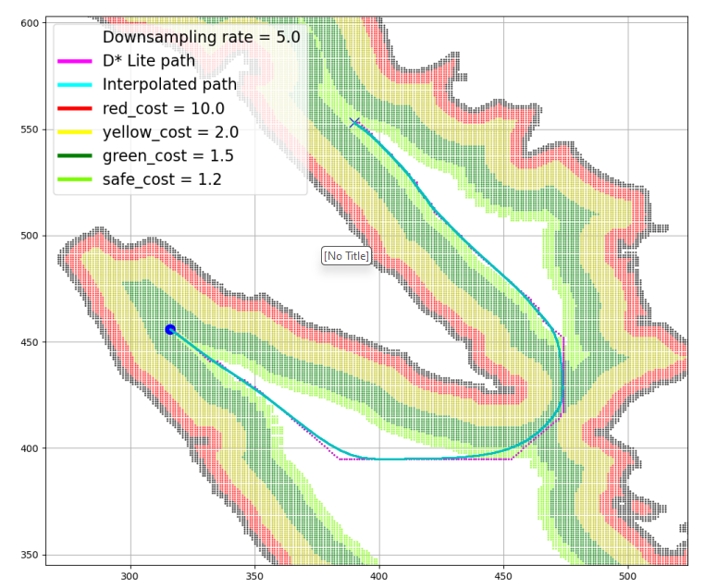
RESULTS

Slide 7
