Slide 1
Kayak Prototype
Developed By:
TEAM 17
VishweshKumar Patel
Sunny Udhani
Varun Shah
Rutvik Pensionwar
Pritam Meher

Slide 2
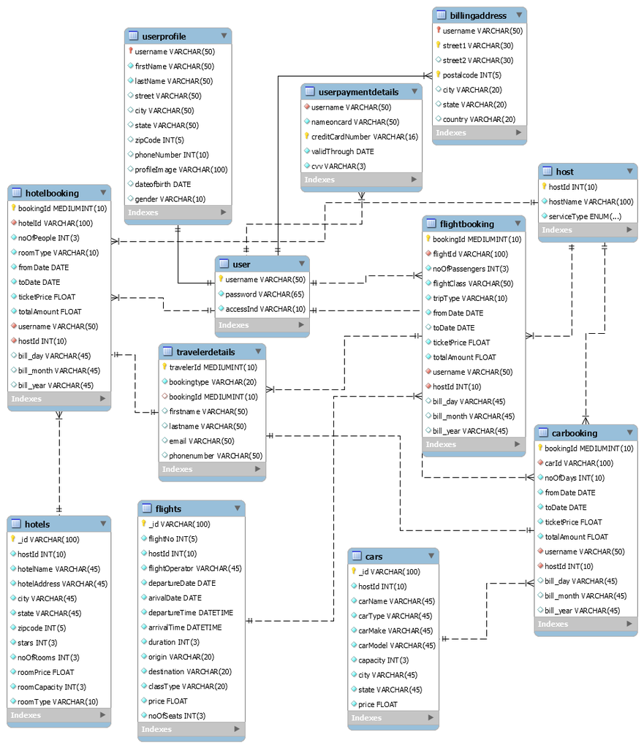

Slide 3
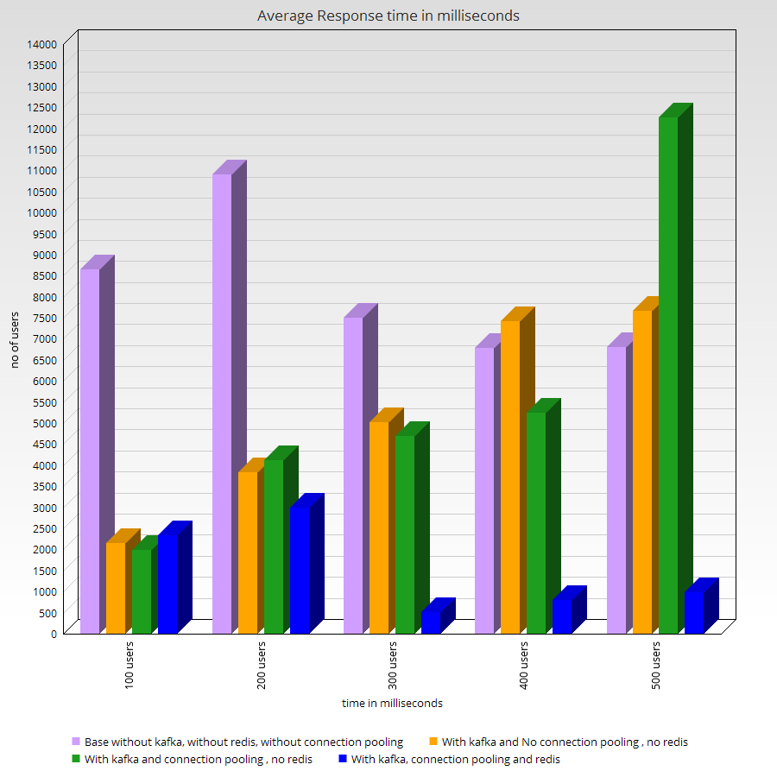

Slide 4
User Trace Diagram algorithm/pseudo code Logging activity of user: Up on Sign In/ Sign Up: 1. store current time as previousTime in 'req.session.previousTime'. 2. store current page as lastPage in 'req.session.lastPage'. 3. initialize 'req.session.flag' to 'true' and 'req.session.pageTime' and 'req.session.pages' as empty arrays. Up on API call for any page loading activity: 1. if req.session.flag is true : I. set 'req.session.flag' to 'false'. 2. else : I. get current time using getTime(), store it in 'temp1' variable. II. get 'req.session.previousTime' from session variable, store it in 'temp2' variable. III. subtract 'temp2' from 'temp1', store it in 'time' variable. // This gives time spent by user in 'lastPage'. IV. set 'req.session.previousTime' to 'temp1'. V. push 'time' in 'req.session.pageTime’. // Array to trace pages in sequential order, explored by user. VI. push 'req.session.lastPage' in 'req.session.pages’. // Array to trace time spent on a page in sequential order, explored by user. VII. set 'req.session.lastPage' to current page for which this API call is made. Up on API call for Sign Out: 1. get current time using getTime(), store it in 'temp1' variable. 2. get 'req.session.previousTime' from session variable, store it in 'temp2' variable. 3. subtract 'temp2' from 'temp1', store it in 'time' variable. // That gives time spent by user in 'lastPage'. 4. push 'time' in 'req.session.pageTime’. // Array to trace pages in sequential order, explored by user. 5. push 'req.session.lastPage' in 'req.session.pages’. // Array to trace time spent on a page in sequential order, explored by user. 6. push 'req.session.pageTime' and 'req.session.pages' to log file. 7. store respective time spent on respective page in separate document in mongoDB collection. // for tracing latest activity of user. Parsing logs: Up on API call for displaying Admin Dashboard: 1. get log file. 2. parse it and place respective time on respective page attribute in document in mongoDB collection. 3. aggregate and find average time spent on each page by a particular user using userId. 4. get latest activity from separate document in mongoDB collection for user trace tree.

