Slide 1
題目： WiFi 學號：1410432007 姓名：林政穎 學號：2410332024 姓名：鄭敬穎

Slide 2
程式碼
#include <ESP8266WiFi.h>
const char* ssid =" ssidssid ";
const char* password =" password ";
WiFiServer server(80);
void setup() {
Serial.begin(115200);
delay(10);
pinMode(12,OUTPUT);
pinMode(13,OUTPUT);
digitalWrite(12,1);
digitalWrite(13,1);
Serial.println("");
Serial.print("連線到");
Serial.println(ssid);
WiFi.begin(ssid,password);
while(WiFi.status()!=WL_CONNECTED){
delay(500) ;
Serial.print(".");
}
Serial.println("WiFi 成功");
server.begin();
Serial.println("開啟伺服器");
Serial.print("IP:");
Serial.print(WiFi.localIP());
}
void loop() {
// put your main code here, to run repeatedly:
WiFiClient client = server.available();
if(!client) return;
String req=client.readStringUntil('\r');
Serial.println(req);
client.flush();
int val;
if(req.indexOf("/LED1_L") != -1){
val=0;
digitalWrite(12,LOW);
}
else if(req.indexOf("/LED1_H") != -1){
val=1;
digitalWrite(12,HIGH);
}
else if(req.indexOf("/LED2_L") != -1){
val=2;
digitalWrite(13,LOW);
}
else if(req.indexOf("/LED2_H") != -1){
val=3;
digitalWrite(13,HIGH);
}
else {
Serial.println("invalid request");
client.stop();
return;
}
}

Slide 3
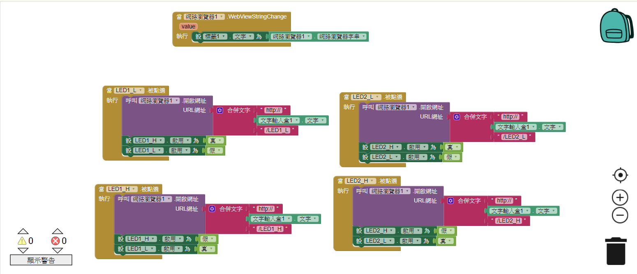
程式碼

Slide 4
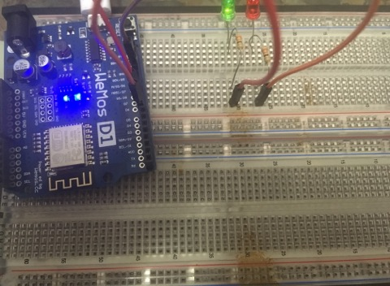
成果

