Slide 1
MENSTROPEDIA
Presented by
Abhijith K R
Abin K J
Vimal Suresh P

Slide 2
ABSTRACT
Everyone might have many doubts about menstruation but too shy to talk about it.
Generally the existing apps only focus on tracking.
Introducing Menstropedia for a healthy period.
.

Slide 3
PROPOSED SYSTEM
Chat bot will be provided only for menstruation .
Options for buying Menstrual products.
Chat bot will reply to different symptoms and will determine if they have any Menstrual disease like PCOD.

Slide 4
MODULE DESCRIPTION
.

Slide 5
USER MODULE
ADMIN MODULE
.
.
AI MODULE
PURCHASING
MODULE
.
.

Slide 6
USER MODULE
Registration & Login :submit login details and personal information
Query Submission: submit doubts and queries as text.
Access resources : Access article provided by the admin.
Purchasing accessibility: Can buy products related to Menstruation

Slide 7
ADMIN MODULE
Content management: Admin can add edit or remove articles to keep the information up to date and relevant.
Account handling: Handling user account, including sign-ups logins, and account related issues will be managed by admin.

Slide 8
AI MODULE
Chatbot :
Chat bot will be provided only for menstruation.

Slide 9
PURCHASING MODULE
Menstrual Product : User can buy menstrual products if they want.

Slide 10
CONCLUSION
.

Slide 11
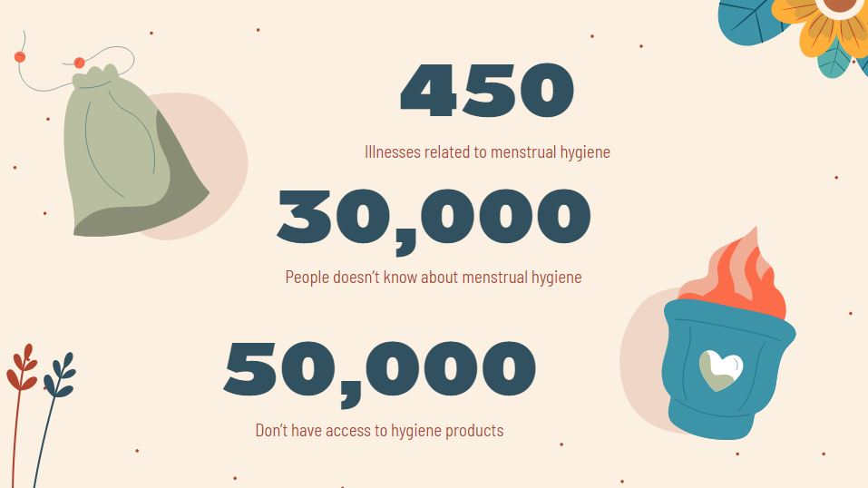
CONCLUSION
We are introducing a solution for all problems related to menstruation in a single application.
The application act as a virtual doctor, mainly focus on female.

