Slide 1
Mounting a payphone onto an enclosure.
Instructions for installing a payphone onto an enclosure. Enclosure must be securely attached to surface.

Slide 2
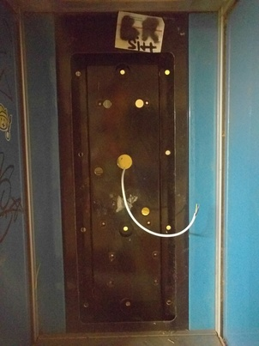
Extend RJ11 cable through backboard.

Slide 3
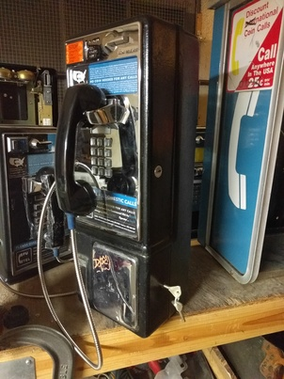
Unlock vault with vault key.

Slide 4
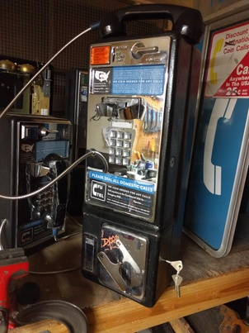
Disengage vault latch with T-bar. Remove vault door and coinbox. Retrieve fasteners from coinbox. Attach two flanged bolts to back of case.

Slide 5
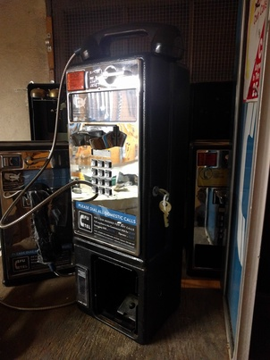
Unlock upper case cover with upper case key.

Slide 6
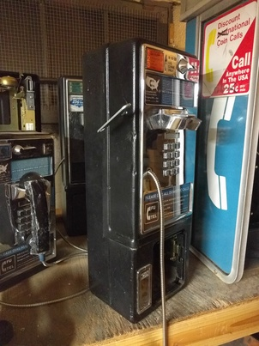
Disengage upper case cover latch with T-bar.

Slide 7
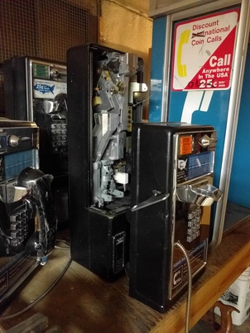
Slide upper case cover forward. Unplug front panel from socket inside case. Remove upper case cover.

Slide 8
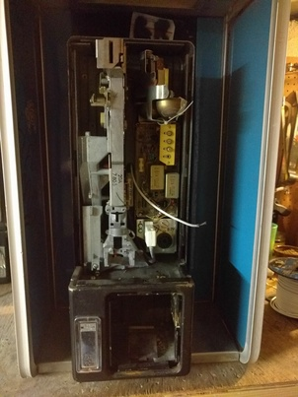
Extend RJ11 cable through hole in case.

Slide 9
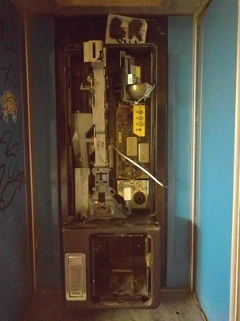
Hang case from backboard with attached flanged bolts.

Slide 10
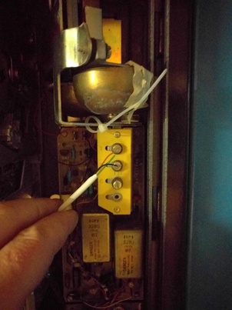
Attach red wire to R terminal. Attach green wire to T terminal.

Slide 11
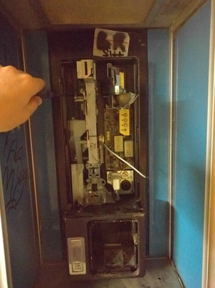
Secure case to backboard with mounting bolt through upper case.

Slide 12
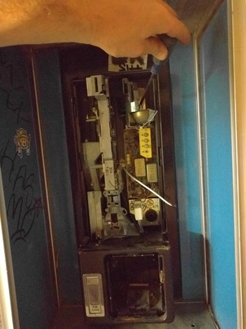
Secure case to backboard with mounting bolt through upper case.

Slide 13
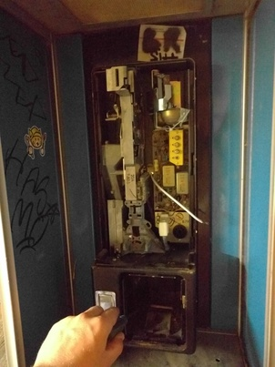
Secure case to backboard with mounting bolt through vault.

Slide 14
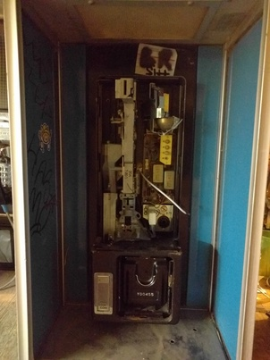
Install coinbox into vault.

Slide 15
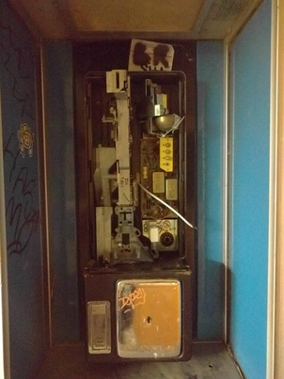
Install vault door. Latch vault door with T-bar. Lock vault door with vault key.

Slide 16
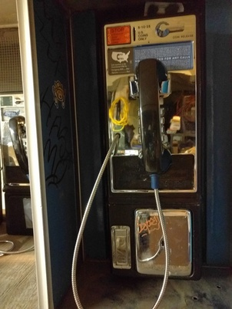
Place upper case cover on case rails. Plug front panel into socket inside case. Attach upper case cover to case. Latch upper case cover with T-bar. Lock upper case cover with upper case cover key.

