Slide 1
Clustering
AB332 - Autumn 2021
Anders K. Krabberød
University of Oslo - Department of Biosciences
a.k.krabberod@ibv.uio.no

Slide 2
Illumina seq. and amplicon data
Illumina HiSeq and MiSeq sequencing has been used extensively for amplicons sequencing in the last years
High yields with relative low cost
HiSeq (and NovaSeq) short fragments 2*150bp
MiSeq a bit longer reads 2*300bp
Low error rate, but due to the high number of sequences generated errors are bound to occur in the library
(About 1% pr 1000 nt, not adjusted for improvements due to overlapping reads. )
How to deal with errors, has been an ongoing discussion for high-throughput data for a quite some time

Slide 3
Why cluster?
Reasons for clustering of metabarcoding data:
Reduce effect of sequencing error
Reduce “noise”

Slide 4
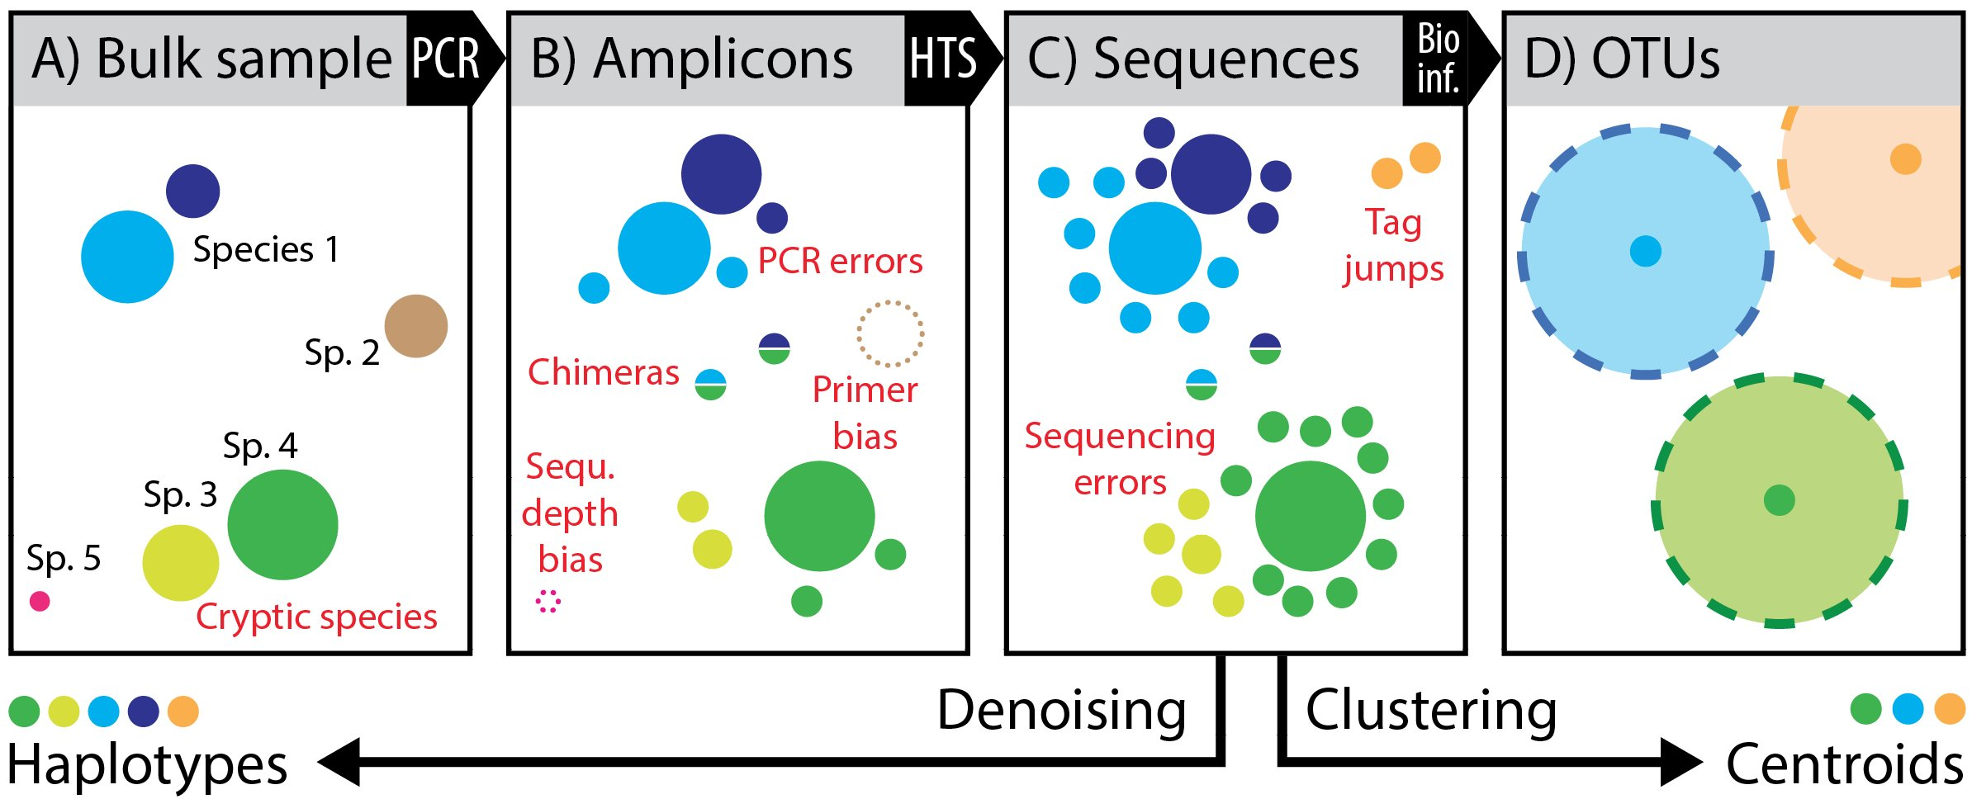
Why cluster?
Reasons for clustering of metabarcoding data:
Reduce effect of sequencing error
Reduce “noise”

Slide 5
Why cluster?
Reasons for clustering of metabarcoding data:
Reduce effect of sequencing error
Reduce “noise”

Slide 6
Why cluster?
Reasons for clustering of metabarcoding data:
Reduce effect of sequencing error
Reduce “noise”

Slide 7
Why cluster?
Reasons for clustering of metabarcoding data:
Reduce effect of sequencing error
Reduce “noise”

Slide 8
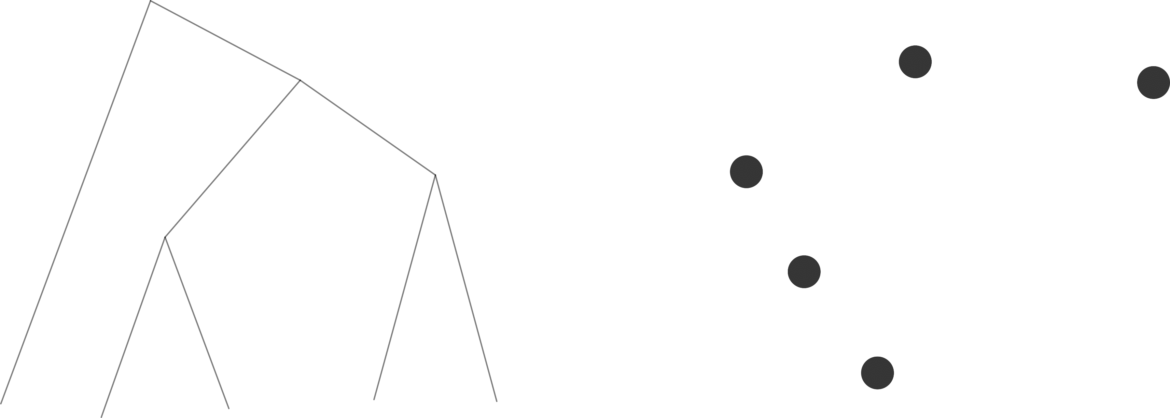
The ideal picture
Species 2
Species 1
Species 3
Trait 2
Species 4
Species 5
Trait 1

Slide 9
The ideal picture
Species 2
Species 1
Species 3
Trait 2
Species 4
Species 5
Species 1
Species 2
Species 3
Species 4
Species 5
Trait 1

Slide 10
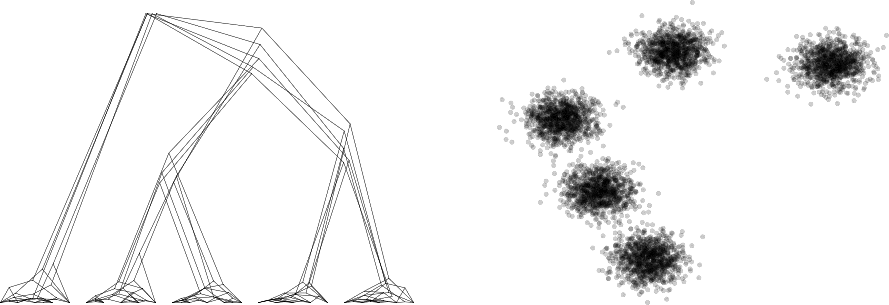
The reality
Trait 2
Trait 1

Slide 11
The reality
OTU 2
OTU 3
OTU 1
Trait 2
OTU 4
OTU 5
Trait 1

Slide 12
Amplicons, OTUs, and species
Clusters of similar amplicons is called OTUs (operational taxonomic units)
Proxies for species, ecotypes, populations or another functional unit
Clustered based on often based on dissimilarity cut-off
But what cut-off to choose?
And how to calculate the similarity/dissimilarity?
One solution is UPGMA-style clustering.
I.e. clustering at a fixed sequence distance
For instance 97%, which is often used for 18S V4

Slide 13
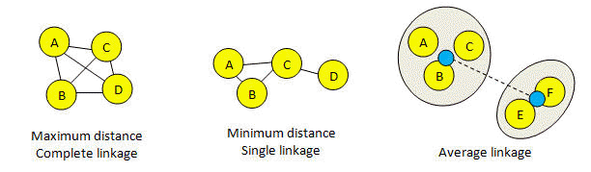
Clustering types
Complete linkage means that all pairs of sequences in a cluster must be closer than the threshold.
Single linkage means that a sequence should be included in a cluster if the distance to any other sequence is below the threshold.
Average linkage (similar to UPGMA) distance between the “average sequence” for a cluster with the other cluster (the average is in fact calculated over all pairs).
With average linkage, clusters tend to be larger than maximum linkage and smaller than minimum linkage.
https://drive5.com/usearch/manual8.1/linkage.html

Slide 14
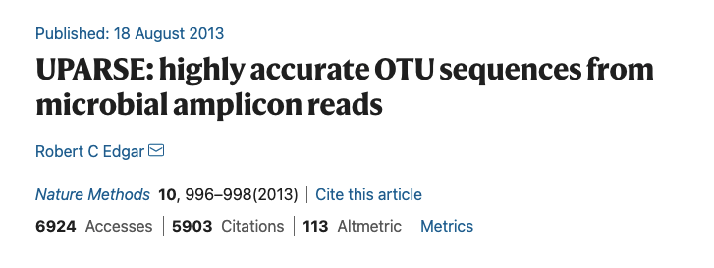
UPARSE - (U/VSEARCH)
UPARSE-OTU takes sequences in order of decreasing abundance as input. This means that OTU centroids tend to be selected from the more abundant reads, and hence are more likely to be correct biological sequences.
All pairs of OTU sequences should have pair-wise sequence identity for a set value (typically 97%)
An OTU sequence should be the most abundant within a 97% neighbourhood.
Chimeric sequences should be discarded.
All non-chimeric input sequences should match at least one OTU with >= 97% identity.
https://drive5.com/usearch/manual/uparseotu_algo.html

Slide 15
UPARSE
UPARSE implements a greedy algorithm that performs OTU clustering
Advantages
Fast and greedy
Similarity threshold is relatively easy to interpret (although not necessarily easy to decide…)
Disadvantages
Arbitrary fixed global clustering threshold. But different lineages evolve at different rate, which means that there is no single cut-off value for the entire tree of life
The input order of the amplicons strongly influences the clustering results. Centroid selections are not re-evaluated during the clustering process, this might lead to inaccurately formed OTUs.
https://drive5.com/usearch/manual/uparseotu_algo.html

Slide 16
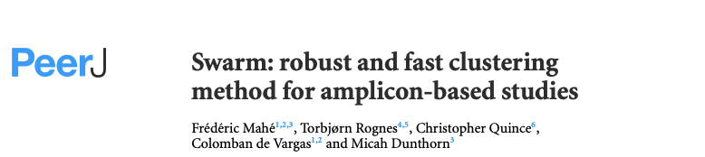
SWARM
Fast and exact, two-phased, agglomerative, unsupervised (de novo) single-linkage-clustering algorithm.
Advantage
No global (and arbitrary) clustering threshold
The result is not dependent on the input sequence order
SWARM builds OTUs in two steps
An initial set of OTUs is constructed by iteratively agglomerating similar amplicons
Amplicon aundances are used to break clusters into sub-OTUs

Slide 17
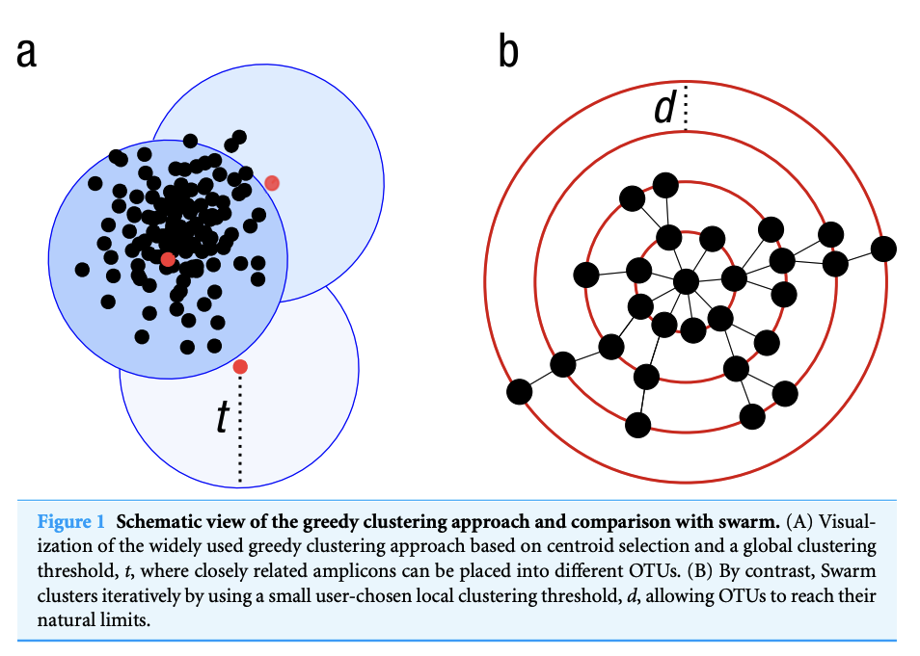
Greedy cluster vs. SWARM

Slide 18
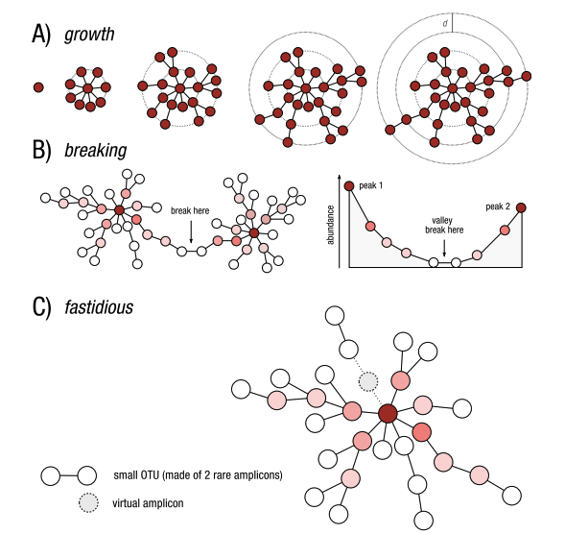
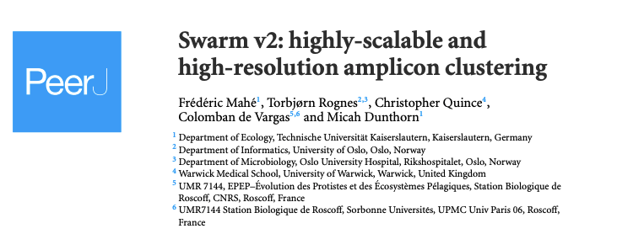
SWARM
(A) Swarm clusters amplicons iteratively by using a small user-chosen local threshold, d, allowing OTUs to grow to their natural limits, where no other amplicons can be added.
(B) Swarm takes into account the abundance of each amplicon to produce higher resolution clusters, by not allowing the formation of amplicon chains. The darker the red, the higher the abundance.
(C) The fastidious option avoids under-grouping (e.g., the production of small OTUs such as singletons and doubletons) by postulating the existence of virtual linking amplicons to graft smaller OTUs onto larger ones.

Slide 19
SWARM
(A) Swarm clusters amplicons iteratively by using a small user-chosen local threshold, d, allowing OTUs to grow to their natural limits, where no other amplicons can be added.
(B) Swarm takes into account the abundance of each amplicon to produce higher resolution clusters, by not allowing the formation of amplicon chains. The darker the red, the higher the abundance.
(C) The fastidious option avoids under-grouping (e.g., the production of small OTUs such as singletons and doubletons) by postulating the existence of virtual linking amplicons to graft smaller OTUs onto larger ones.

Slide 20
SWARM
(A) Swarm clusters amplicons iteratively by using a small user-chosen local threshold, d, allowing OTUs to grow to their natural limits, where no other amplicons can be added.
(B) Swarm takes into account the abundance of each amplicon to produce higher resolution clusters, by not allowing the formation of amplicon chains. The darker the red, the higher the abundance.
(C) The fastidious option avoids under-grouping (e.g., the production of small OTUs such as singletons and doubletons) by postulating the existence of virtual linking amplicons to graft smaller OTUs onto larger ones.

Slide 21
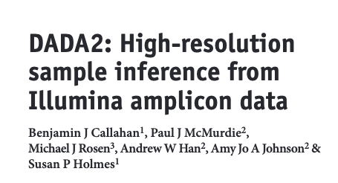
DADA2
An update of DADA (Rosen et al., 2012)
Divisive Amplicon Denoising Algorithm
Originally made for 454 data.
DADA2 Infers ”amplicon sequence variants from Illumina-scale amplicon data data without imposing the arbitrary dissimilarity thresholds that define molecular OTUs”
Callahan et al., Nat.Meth. (2016); Callahan et al., ISMEj (2017)

Slide 22
DADA2
Advantages (according to themselves, aka the selling point…)
Resolution: DADA2 infers exact amplicon sequence variants (ASVs) from amplicon data, resolving biological differences of even 1 or 2 nucleotides.
Accuracy: DADA2 reports fewer false positive sequence variants than other methods report false OTUs.
Comparability: The ASVs output by DADA2 can be directly compared between studies, without the need to reprocess the pooled data.
Computational Scaling: The compute time of DADA2 scales linearly sample number, and memory requirements are essentially flat.
Callahan et al., Nat.Meth. (2016); Callahan et al., ISMEj (2017)

Slide 23

DADA2
How it works:
Infers an error model from the sequencing data.
The error model incorporates (qualitative) abundances
Which are used to divide the amplicon reads into partitions, and calculate the expected error rate for the partition(s) given that these are representatives of true sample-sequence+errors
Iterative process that runs until convergence (i.e. the until the cut-off parameters for expected errors are met)

Slide 24
DADA2
The error model incorporates quality information, which is usually ignored by other methods (after filtering).
The error model incorporates quantitative abundances, whereas most other methods use abundance ranks (if they use abundance at all).
The error model have different error rates for different substitutions,
eg. A->C, is different from A->G whereas other methods merely count the mismatches.
DADA2 can parameterize its error model from the data itself, rather than relying on previous datasets that may or may not reflect the PCR and sequencing protocols used in your study.
Callahan et al., Nat.Meth. (2016); Callahan et al., ISMEj (2017)

Slide 25
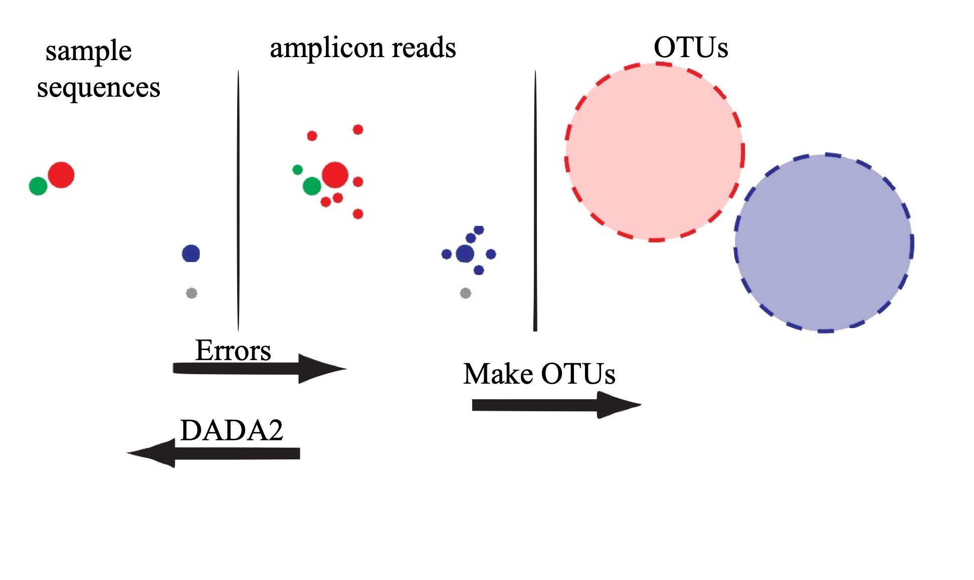

Slide 28
DADA2
The core denoising algorithm in the DADA2 is built on a model of the errors in Illumina-sequenced amplicon reads.
These can be modelled based on the data

Slide 29
DADA2
The core denoising algorithm in the DADA2 is built on a model of the errors in Illumina-sequenced amplicon reads.
However: Clustering might still be needed since there are other sources of noise.
And depends on the marker sequenced
SSU (18S) has multiple copies in many eukaryotes
Intragenomic variation might be around the “usuall” cut-off used for vsearch/usearch type clustering (i.e. 2-3% difference).
ITS is highly variable

Slide 30
Do you still need to cluster?
Clustering might still be needed since there are other sources of “noise”.
I.e. even though an inferred read is a “true sequence” with a discernible abundance it might not by itself represent a species.

Slide 31
The output
For our purpose, the important part is that the output is a table with the read abundance for OTUs across the samples.
Keep in mind that these are Operational Taxonomic Units not necessarily the same as species
Read abundance does not equal organismal abundance
 | Sample_1 | Sample_2 | Sample_3 | Sample_4 | Sample_5 | Sample_6 | etc…
OTU_1 | 1 | 563 | 87 | 459 | 43 | 0
OTU_2 | 213 | 7 | 5 | 3 | 68 | 8
OTU_3 | 15 | 6 | 88 | 95 | 9 | 6
OTU_4 | 762 | 5 | 43 | 1 | 0 | 0
….etc

Slide 32
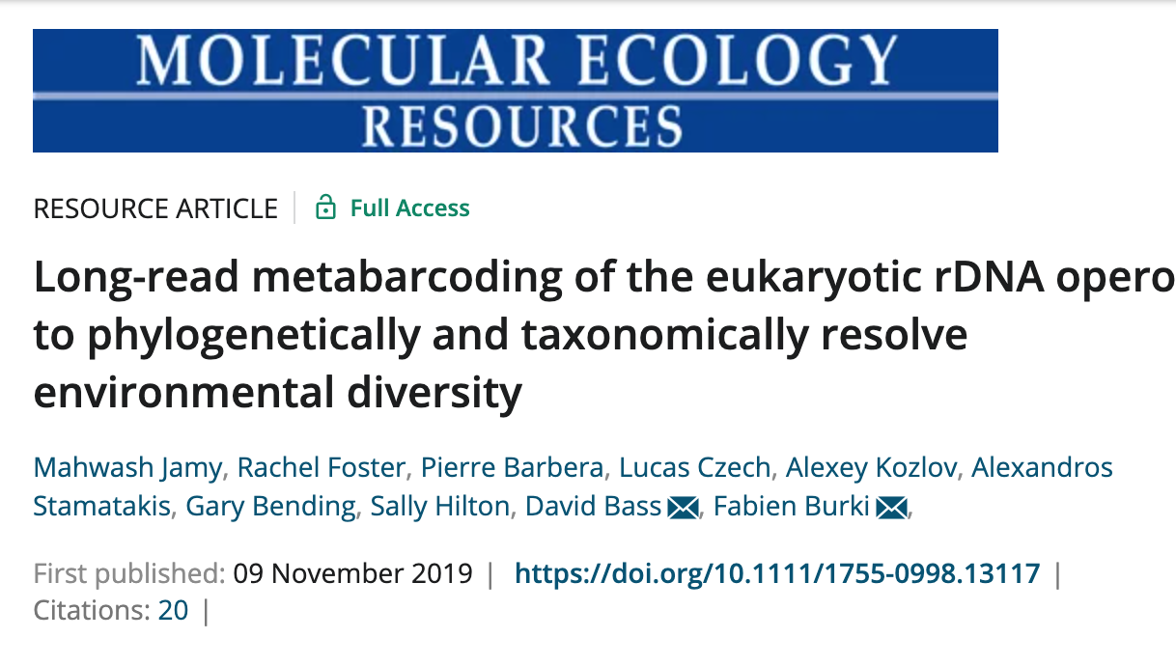
Long read amplicon sequencing
Recent development in long read sequencing technologies:
PacBio HiFi reads are 99.9% accurate and up to 15 kbp long!
Still not as many reads as Illumina sequencing, but there is no need for denoise.
The much longer reads have a higher phylogenetic signal
https://doi.org/10.1111/1755-0998.13117

Slide 33
DADA2
Resources:
The developer has a nice tutorial
https://benjjneb.github.io/dada2/
https://benjjneb.github.io/dada2/tutorial.html
DADA2 for ITS
https://benjjneb.github.io/dada2/ITS_workflow.html

Slide 34
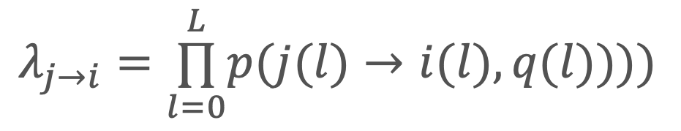
DADA2
Build error model
Assumption: Errors occurs independently within a read
Assumption: Errors occurs independently between reads
The rate at which an amplicon read with sequence i is produced from sample sequence j is the product of the transition probabilities of the aligned nucleotides:
The transition probability between aligned nucleotides depend on the original nucleotide, substituting nucleotide, and associated quality score, for example, p(A→C, 35).
After sequence alignment, the error rate λji is calculated and stored.
$$λ_{j→i}=\overset{L}{\underset{l=0}{∏}}p(j(l)→i(l),q(l))))$$
Callahan et al., (2016)

Slide 35
DADA2 - Error model

Slide 36
DADA2 - Error model

Slide 37
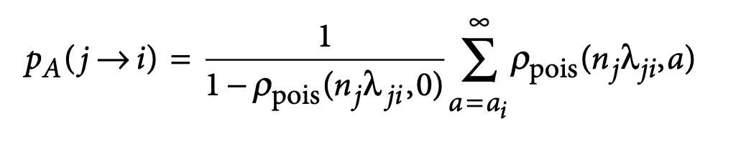
DADA2
The abundance p-value.
The number of amplicon reads with sequence i that will be produced from sample sequence j is Poisson distributed with expectation equal to an error rate λji multiplied by the expected reads of sample sequence j
A low pA indicates that there are more reads of sequence i than can be explained by errors introduced during the amplification and sequencing of nj copies of sample sequence j.

Slide 38
DADA2
The divisive partitioning algorithm.
Amplicon reads with the same sequence are grouped into unique sequences with an associated abundance and consensus quality profiles (aka dereplicated).
The algorithm is initiated by placing all sequences in a single partition with the most abundant as the centre.
All unique sequences are compare to the centre
Calculate error rates
Calculate abundance p-value

Slide 39
DADA2
The divisive partitioning algorithm.
If the smallest p-value falls below a threshold (OMEGA_A= 1e-40 (default)) a new partition is formed
After the new partition is formed, every unique sequence is allowed to join the partition most likely to have produced it
Repeat until all unique sequences are consistent with being produced by amplicon sequencing the center of their partition.

Slide 40
DADA2 - dereplication
“raw” reads
unique
sequences
abundance
mean-Q
100
32
50
32
dereplicate
7
20
5
…
4
…
3
…
2
…
2
…

Slide 41
DADA2 - error model
100
7
50
Initial guess: one real sequence + errors
Borrowed from several online lectures, all citing:
“provided by Benjamin Callahan, not necessarily with permission"

Slide 42
DADA2
100
7
50
Infer initial error model under this assumption
 | A | C | G | T
A | 0.97 | 10⁻² | 10⁻² | 10⁻²
C | 10⁻² | 0.97 | 10⁻² | 10⁻²
G | 10⁻² | 10⁻² | 0.97 | 10⁻²
T | 10⁻² | 10⁻² | 10⁻² | 0.97
Pr(i → j) =

Slide 43
DADA2
100
7
50
not an error
Update the model.
 | A | C | G | T
A | 0.997 | 10⁻³ | 10⁻³ | 10⁻³
C | 10⁻³ | 0.997 | 10⁻³ | 10⁻³
G | 10⁻³ | 10⁻³ | 0.997 | 10⁻³
T | 10⁻³ | 10⁻³ | 10⁻³ | 0.997
Pr(i → j) =

Slide 44
DADA2
not an error
100
7
50
not an error
Update model again
 | A | C | G | T
A | 0.998 | 1x10⁻⁴ | 2x10⁻³ | 2x10⁻⁴
C | 6x10⁻⁵ | 0.998 | 3x10⁻⁴ | 1x10⁻³
G | 1x10⁻⁴ | 1x10⁻⁴ | 0.998 | 6x10⁻⁵
T | 2x10⁻⁴ | 2x10⁻³ | 1x10⁻⁴ | 0.998
Pr(i → j) =

Slide 45
DADA2 - in R
Main steps
Step | Function | Explanation
1 | filterAndTrim() | Filters and trims an input fastq file(s) (can be compressed) based on several user-definable criteria
2 | learnErrors() | Error rates are learned by alternating between sample inference and error rate estimation until convergence.
3 | derepFastq() | A custom interface to FastqStreamer for dereplicating amplicon sequences from fastq or compressed fastq files,
4 | dada() | The dada function takes as input dereplicated amplicon sequencing reads and returns the inferred composition of the sample (or samples).
5 | mergePairs() | This function attempts to merge each denoised pair of forward and reverse reads, rejecting any pairs which do not sufficiently overlap or which contain too many (>0 by default) mismatches in the overlap region.
6 | makeSequenceTable() | This function constructs a sequence table (analogous to an OTU table) from the provided list of samples.
7 | removeBimeraDenovo() | screen for and remove chimeras
8 | assignTaxonomy() | assignTaxonomy implements the RDP Naive Bayesian Classifier algorithm described in Wang et al. Applied and Environmental Microbiology 2007,

Slide 46
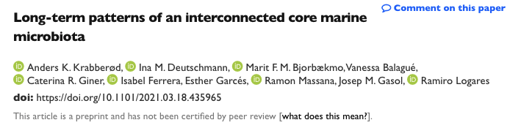
DADA2 – Examples
If you want to try DADA2 with some real data:
Scripts and setup on Github https://github.com/krabberod/BIO9905MERG1_V21
Dataset for the run-through:
Selected samples from Blanes Bay Marine Observatory (BBMO) near Barcelona
Mini-time series: January, April, July and October for 2004 and 2005.
Subsample of a larger dataset: Preprint on BioRxiv:
doi.org/10.1101/2021.03.18.435965

