Slide 1
Introduction to Rstudio
Anders K. Krabberød
a.k.krabberod@ibv.uio.no
https://github.com/krabberod/UNIS_AB332_2021
UNIS - AB332 - 2021

Slide 2
Rstudio
RStudio is an Integrated Development Environment (IDE) for R, a programming language for statistical computing and graphics.
Customizable workbench with all of the tools required to work with R in one place (console, source, plots, workspace, help, history, etc.).
Syntax highlighting editor with code completion.
Execute code directly from the source editor (line, selection, or file).
Runs on Windows, Mac, and Linux, and has a community-maintained FreeBSD port.
Can also be run as a server, enabling multiple users to access the RStudio IDE using a web browser.
(Source https://github.com/rstudio/rstudio)

Slide 3
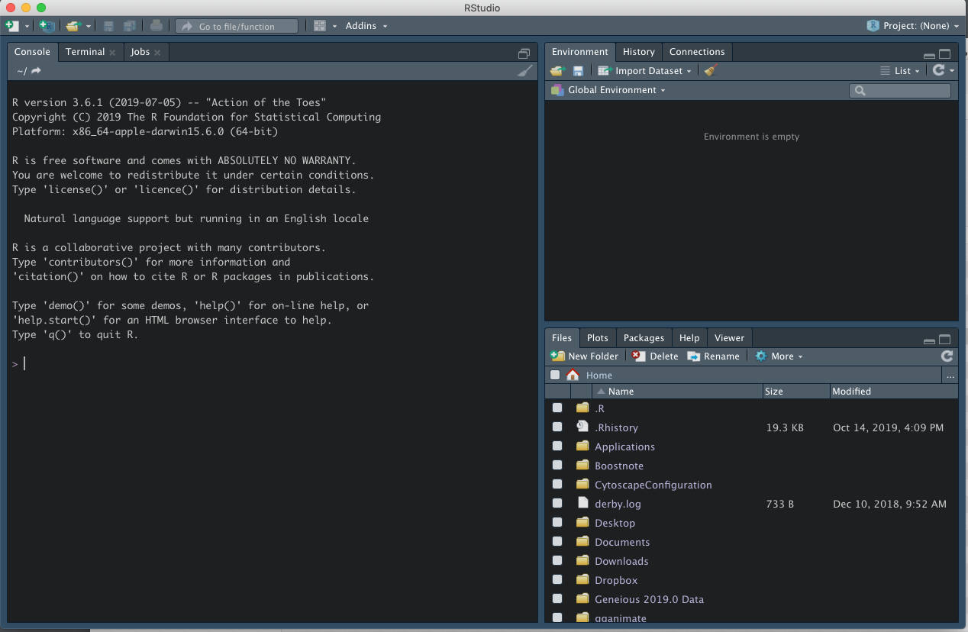
Rstudio - Graphical interface

Slide 4
Rstudio
Environment will show active objects
History commands used so far
The console - here you can type
commands and see output
In this panel you can find files and folders, plots, available packages and the help screen

Slide 5
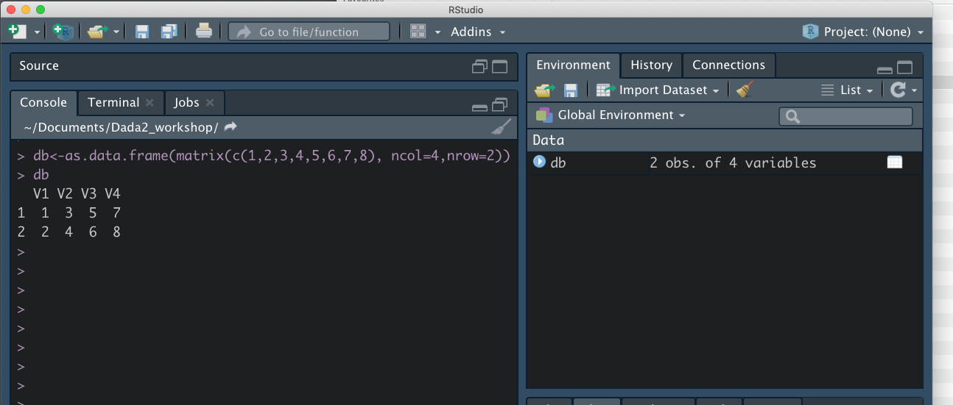
Environment shows the object
Creating an object in the console

Slide 6
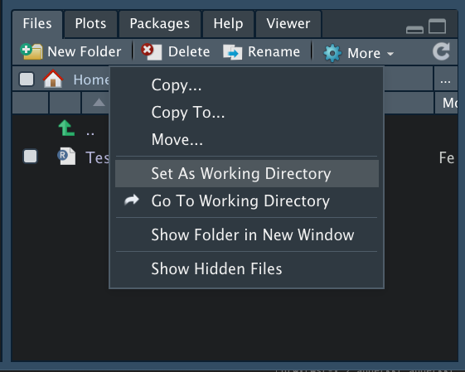
Setting working directory
Navigate to correct folder under the “files” tab
Click “Set As Working Directory” (under More)

Slide 7
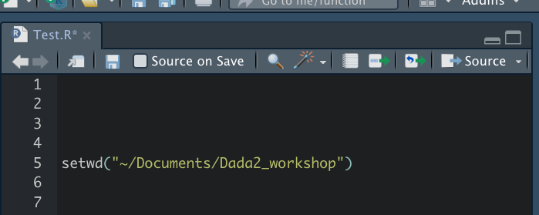
Setting working directory
Alternatively write
MAC:
setwd("~/path/to/my/folder")
WINDOWS
setwd("C:/path/to/my/folder")

Slide 8
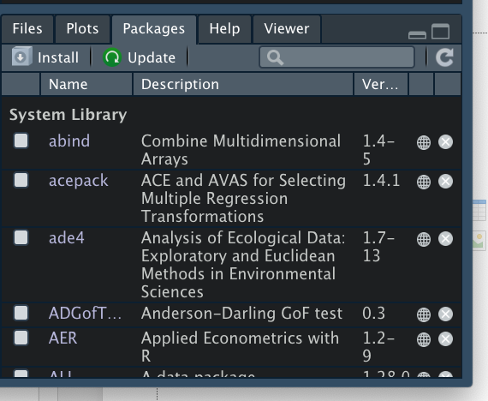
Installing packages

Slide 9
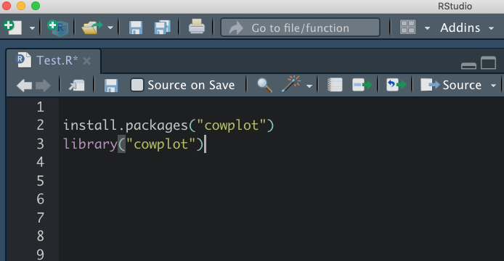
Installing packages 2
Or use the command (with cowplot as example)
install.packages("cowplot")
Installed packages can be loaded with the command
library("cowplot")

Slide 10
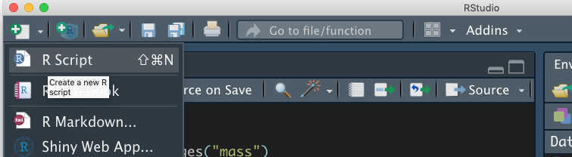
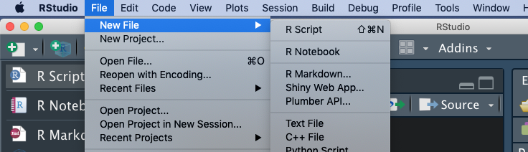
Using Scripts
Click icon with a document and a + sign
OR click File -> New File -> R Script

Slide 11
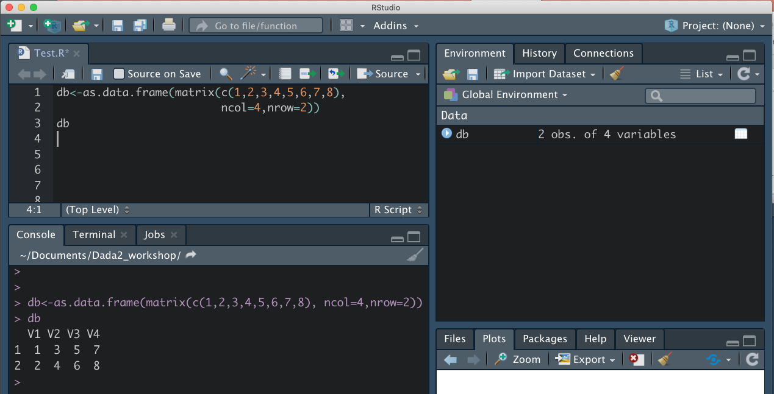
Using Scripts
Write in the script, execute lines by
cmd+R (mac)
Ctrl+R (win)
Remember to annotate!!!
Environment shows the object
Output in the console

Slide 12
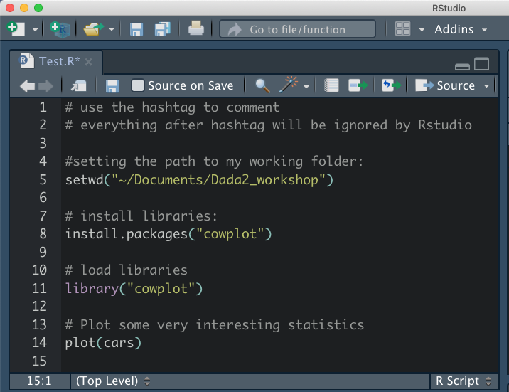
Comment and annotate your script!!!
What the code does
How the code does it
How to use the code

Slide 13
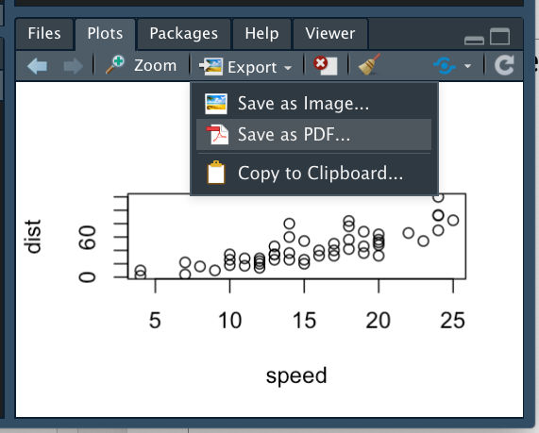
Plotting plots and other dots
Plots will appear in the plots tab and can be exported in various formats

Slide 14
Use R-projects!
This will set the default working directory for the particular project, and makes it easy to save everything in the same folder.
Very helpful when working on several different projects
Also very easy to integrate with github and version control with the option to push and pull repositories (not covered in this lecture)
Or for sharing all data with somebody else using RStudio

Slide 15
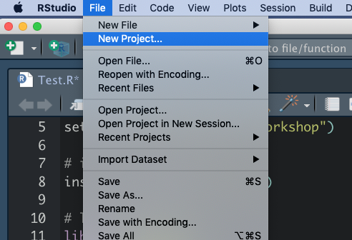
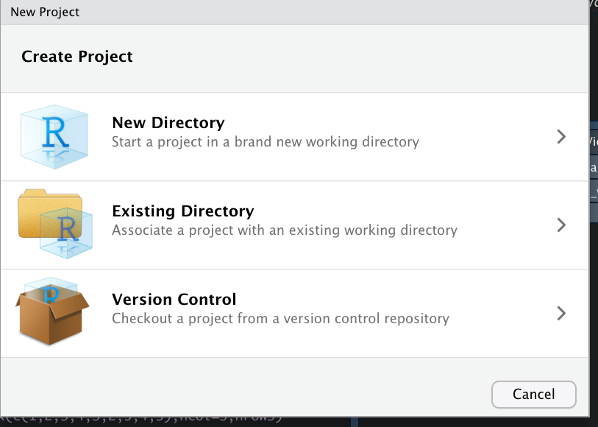
Use R-projects

Slide 16
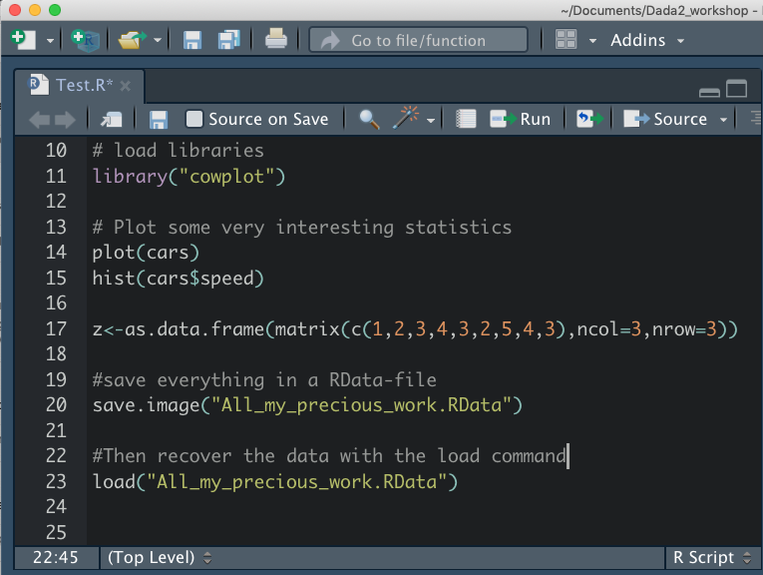
Use R-projects

Slide 17
R Markdown and R notebooks
An alternative to “simple” script in Rstudio.
Advantage: easy to export in other easy-to-read formats (i.e. html, pdf, word, presentations).
Markdown language is an easy way of formatting using plain text
R Notebook is somewhat more powerful with additional options for formatting.
Can run chunks of code from other languages within Rstudio
Disadvantage: Not compatible with (standalone aka. vanilla) R, which is often used on clusters and servers.

Slide 18
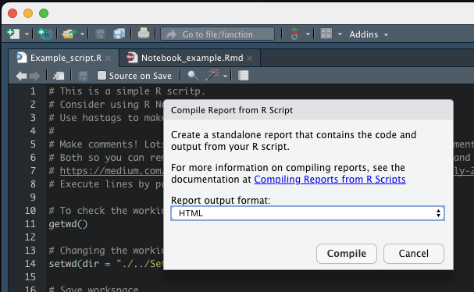
Export a report
This button will help to generate a pdf, html, or word document of your script

Slide 19
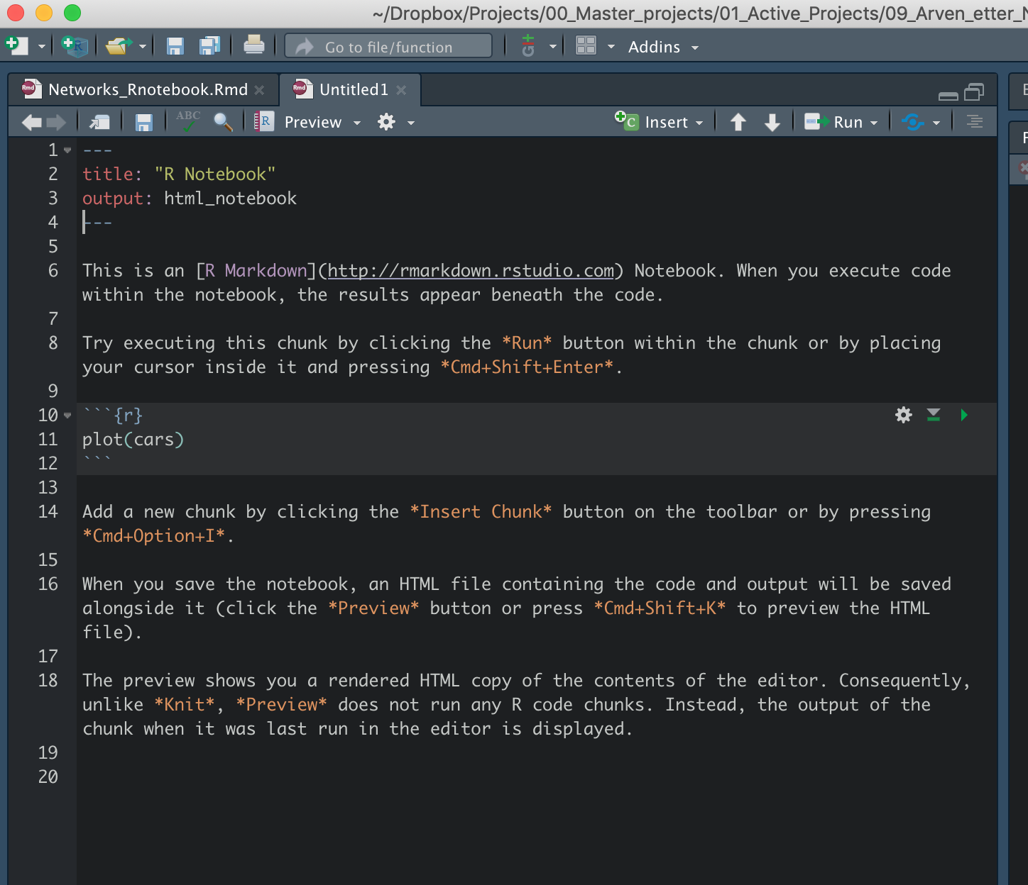
R Notebook

