Slide 1
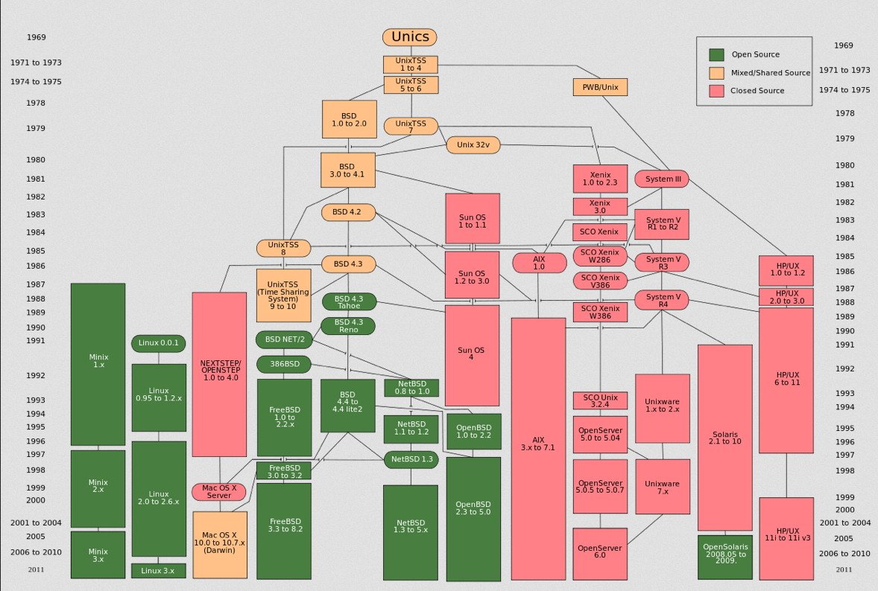

Slide 2
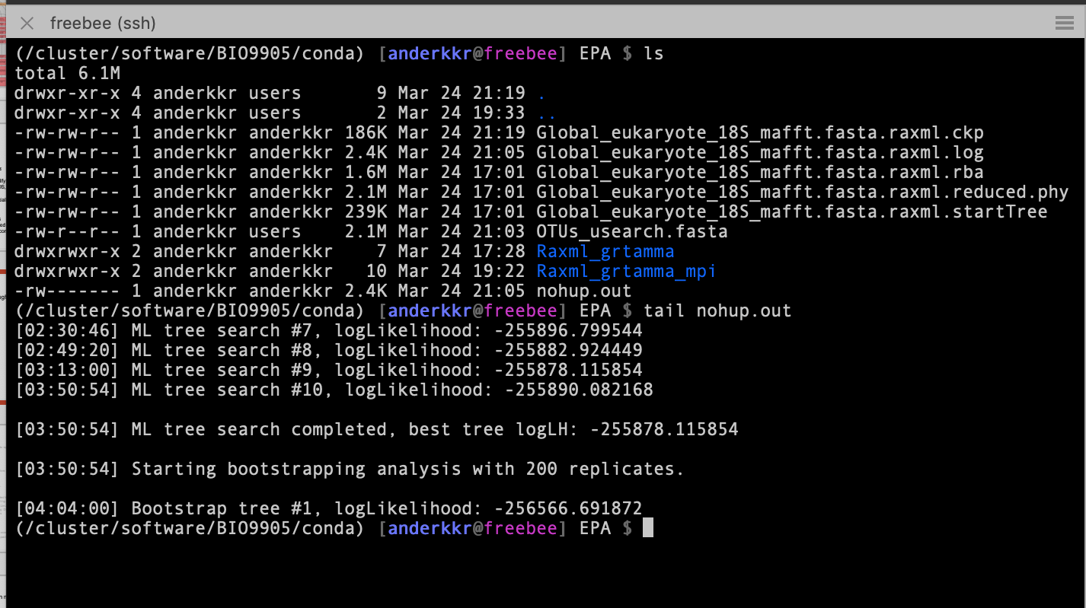
Command line in a terminal

Slide 3
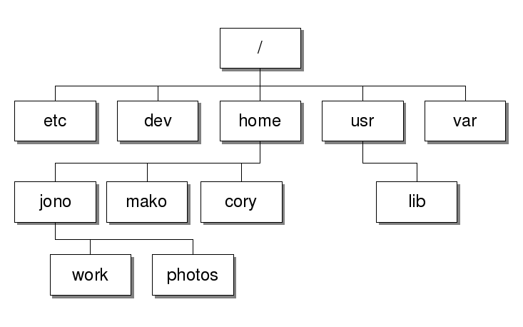
Basics
User: performs several tasks, but has restricted access to specific functions (e.g. installing software)
Has a “home” folder, where most things are allowed
Files belong to users and groups
Root: super-user, can do everything, normally is the system administrator.
Linux Filesystem Hierarchy
/ : root
/bin: or /usr/bin: files needed by Linux (binaries)
/boot: files needed for booting. Contains the kernel.
/etc: configuration files for Linux.
/dev: devices available (e.g. DVD)
/home: contain user homes
/lib: shared libraries
/usr: user applications
/var: variable data
/tmp: temporary files
/lost+found:files related to crashes
/opt: software and add-on packages (you may install software here)

Slide 4
Some basic commands/programs (in no specific order; commands in blue):
ls = list files/folders
cd = change directory (move around)
pwd = see where I am located
cp = copy files
mv = move or rename files
mkdir = make directory
rm = delete a file
rmdir = delete a directory
rm -r = delete a directory
more/less/cat = see what’s inside a file
head/tail = see beginning / end of a file
cat = concatenate files (also print files to the terminal)
grep = search text for a pattern
wc = count the lines, fields and characters in a file

Slide 5
More commands
ssh = remote connection to a machine
vim/nano/emacs : useful text editors
kill = kill a process
man = documentation about a command (also ‘program’ –h)
top = see running processes
clear = clear screen
sudo = request root access for a task (not available for most users on abel)
chmod = change permissions

Slide 6
Many of the commands takes extra arguments
* = a wildcard!
ls –lh start_of_filena*
cd (home) ; cd dir (go to dir); cd .. (one level up, to the parent directory); cd ../../ (two levels up)
mv old_name new_name
mv /old/location/for/my/file /new/location/for/my/file
cp /path/to/file/to/copy/file /new/location/of/file
cp –r /dir/to/copy/dir /location/for/dir/copy
rm file
rm –rf /remove/directory/and/all/contents (use carefully!)
cat file1 file2 > newcatfile
paste file1 file2 > newpastefile
chmod a+x executablefile
chmod 755 file (owner:group:world permissions)

Slide 7
A few other very useful commands:
tail –n 300 file
(see last 300 lines file)
head –n 300 file
(see the first 300 lines of a file)
grep pattern file
(search pattern in file)
grep –c pattern file
(count pattern in file)
grep -f file_with_pattern file
(look up patterns from one file in another)
ssh user@machine
(remote connection)
Execute a program locally
./executable

Slide 8
It is possible to combine commands with a “pipe” |
output | input
ls | grep –c pattern (count patterns in filenames)
ls | grep pattern > file
Send output to file with “>”
grep pattern file > file2
Cut characters from a file
File1 (tab separated):
This is a test 1
This is a test 2
This is a test 3
Cut -f 1 file1
This
This
This

Slide 9
wget (get a remote file)
Make a text file
nano testfile
emacs testfile
vi testfile
Using SED to change content in a file (Debian-Ubuntu)
sed 's/\.//g' infile > outfile (removing . from file)
sed 's/-//g' infile > outfile (removing - from file)

Slide 10
Define variables
VAR1=/route/to/file1
VAR2=“$(ls *fasta -x1)”
Add programs to your search path
Edit .bashrc which is in your home folder
emacs .bashrc
PATH=$PATH:/route/to/my/executable1
export PATH
Or in one line: export PATH=/route/to/my/executable/:$PATH

Slide 11
Loops
Assuming a directory with:
file1, file2,…, filen
We want to run a function over all files, then
for i in $(ls file*); do cut –f 2 $i > $i.out; done
(cuts the field 2 of each file and sends it to an output)
Execute functions in bashscripts
Open a new file and edit it in vim, nano or emacs. Call it bashscript.sh
#!/bin/bash
for i in $(ls file*); do cut –f 2 $i > $i.out; done
for i in $(ls *out); do wc $i > $i.wc: done
Make it executable:
chmod a+x bashscript.sh
./bashscript.sh (execute)

Slide 12
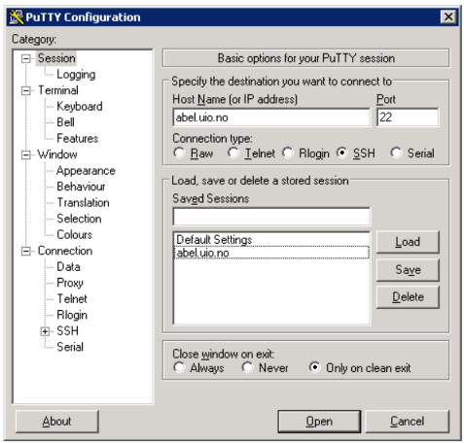
Logging into Abel from Windows
Open Putty
SSH client for Windows
Type abel.uio.no as the “Host Name”
Press Open
Type your UiO username and press enter)

Slide 13
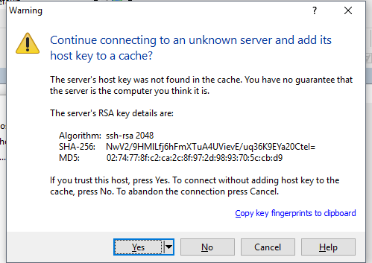
DON’T PANIC - Press

Slide 14
Login into saga terminal
Open terminal
Type ssh <username>@saga.sigma2.no
Type password

Slide 15
