Slide 1
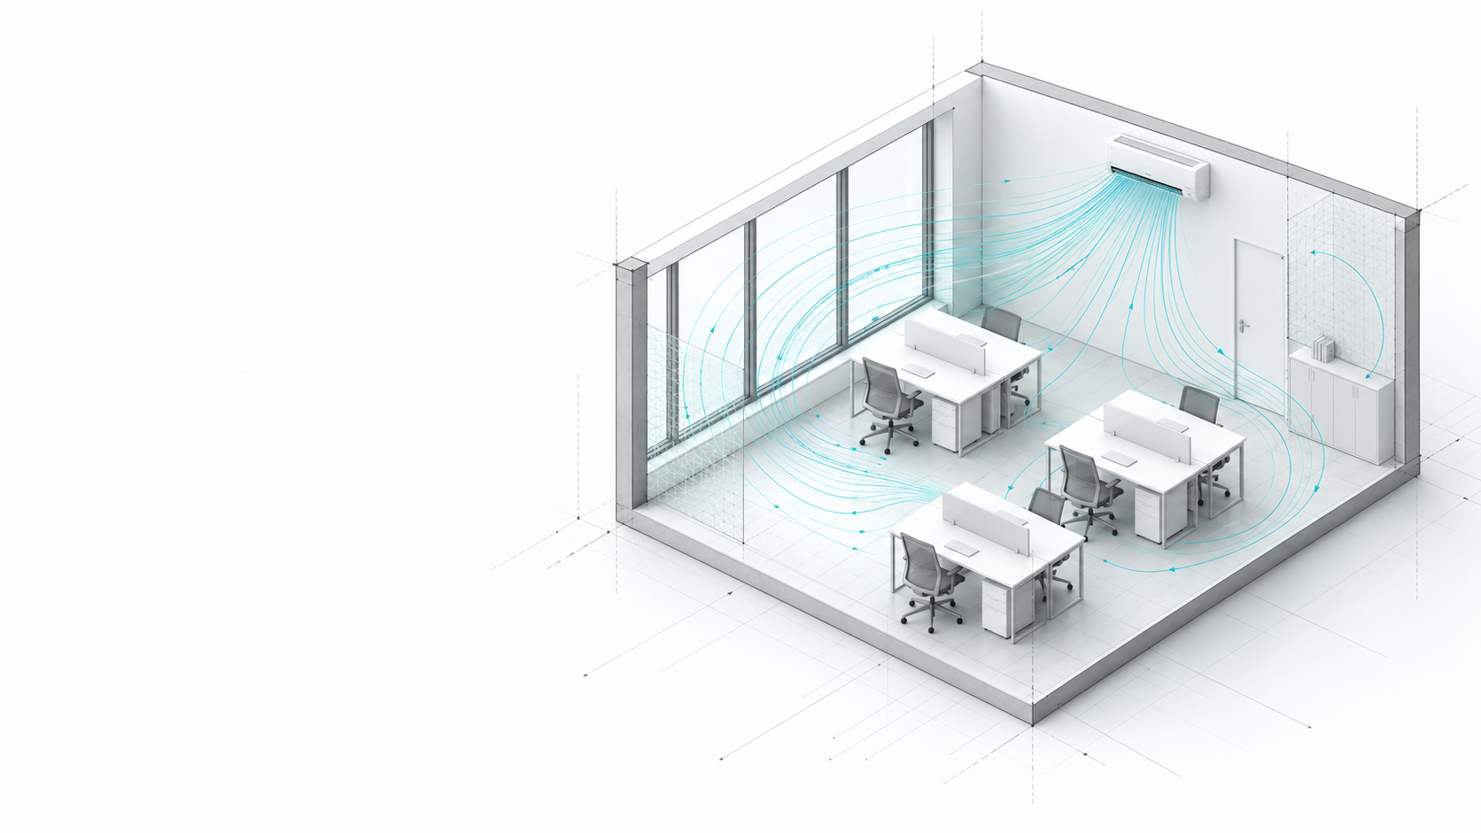
Simulate first.
Design better.
SimuNow
Airflow and energy in one model.
Comfort insights for every seat.
Concept illustration · P0 product foundation
01
Notes:
Cover visual generated with the built-in imagegen tool. Asset: PitchAssets/cover-architecture-airflow.png. Image shows artistic airflow trajectories, not CFD or measured results. Headline and subtitle express the planned product vision: compare HVAC decisions through a common spatial model connecting airflow, energy and seat-level comfort. Numerical engine integration and comfort evaluation are not yet implemented. Sources: README.md; Plans/References/01-product-scope.md; Plans/References/02-architecture.md; Plans/Delivery/status.md.

Slide 2
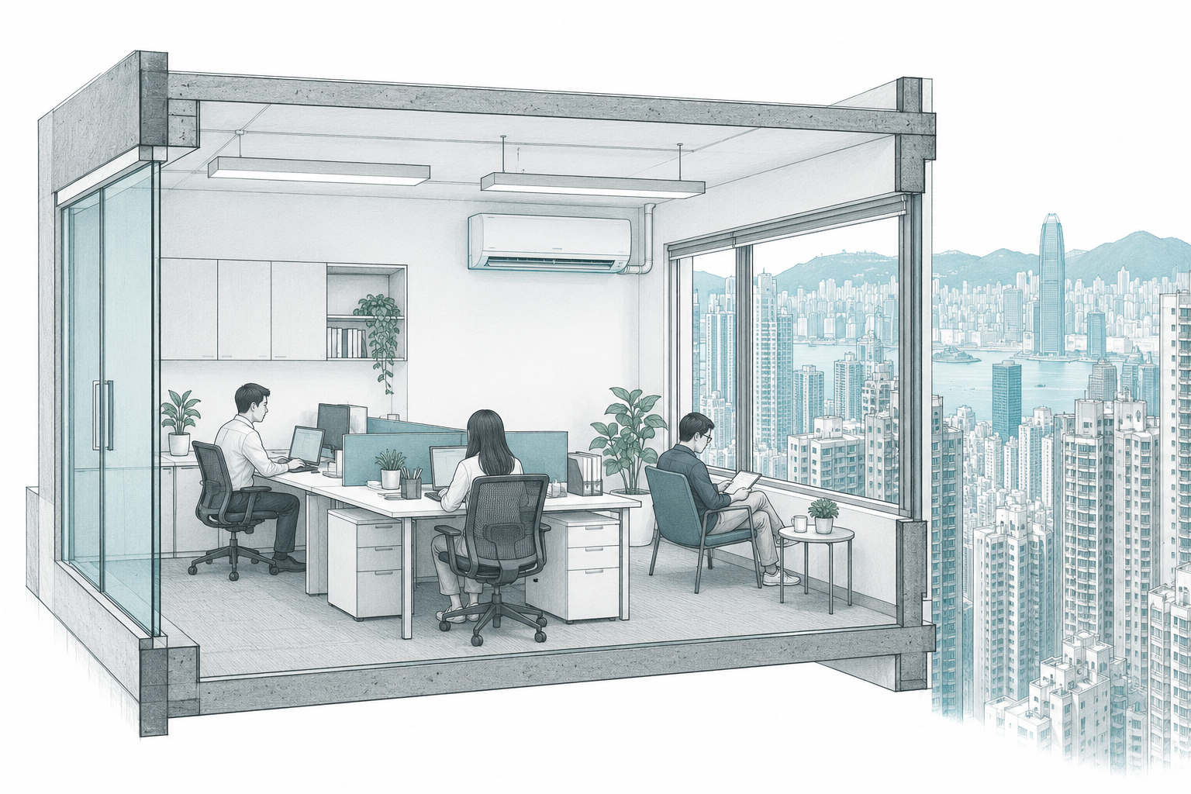
SimuNow
Problem Statement
Cooling is a major electricity load, especially in offices
HONG KONG / 2024
GLOBAL / IEA 2026 ESTIMATE
13.9 TWh
≈2,900 TWh
Electricity for the EMSD “Air Conditioning” category [1]
Annual building space-cooling electricity
Around 50% growth since 2015 [2]
Share of electricity within each scope
Approx. cooling share: annual use vs peak [2]
Room operators need evidence to choose AC placement and settings
that balance electricity use with comfort at each seat.
[1] EMSD (2026), Tables 12 and 39. HK includes heaters, fans, air purifiers and dehumidifiers.
[2] IEA (10 Jul 2026). Space cooling excludes data centres. Annual energy and peak power use different denominators.
02
Notes:
Problem statement. These statistics establish the scale of electricity use, not SimuNow savings or validated performance.
[1] Electrical and Mechanical Services Department (2026). Hong Kong Energy End-use Data 2026. https://www.emsd.gov.hk/filemanager/en/content_762/HKEEUD2026.pdf
Data year: 2024, not 2026. Table 12, printed p. 27 (PDF p. 28): Air Conditioning 50,193 TJ, total electricity 166,931 TJ. Calculation: 50,193 / 3,600 = 13.9425 TWh, displayed 13.9 TWh. 50,193 / 166,931 = 0.3006811197440859, displayed 30.1%. Table 39, printed p. 54 (PDF p. 55): office Air Conditioning 7,837 TJ, office total 17,179 TJ. Ratio 0.45619651900576286, displayed 45.6%. Values are official estimated end-use statistics, not individual-building meter observations. The EMSD category includes air-conditioning units and heaters plus fans, air cleaners/purifiers and dehumidifiers (Chronology item 21, printed p. 78 / PDF p. 79).
[2] International Energy Agency (2026). Cooling a hotter world: El Niño meets strong growth in global electricity demand. Commentary, 10 July 2026. https://www.iea.org/commentaries/cooling-a-hotter-world-el-nino-meets-strong-growth-in-global-electricity-demand
IEA reports around 2,900 TWh of global building space-cooling electricity, 50% growth since 2015, approximately 10% of annual electricity consumption and 30% of peak demand. This commentary excludes cooling in data centres. The slide labels the source vintage because the paragraph does not explicitly assign a year to the 2,900 TWh estimate. Annual electricity is energy and peak power is demand. These shares have different denominators. Hong Kong and IEA categories are not harmonised and should not be used to calculate a direct local/global efficiency ratio.
The room-level decision need is the SimuNow product problem framing, based on Plans/References/01-product-scope.md and 03-experience-design.md. No measured waste fraction, savings percentage or comfort improvement is claimed. Supporting illustration generated with the built-in imagegen tool. Asset: PitchAssets/problem-hong-kong-office.png. Concept art only, without computed airflow, temperatures or measured comfort. Retrieved 3 October 2026.

Slide 3
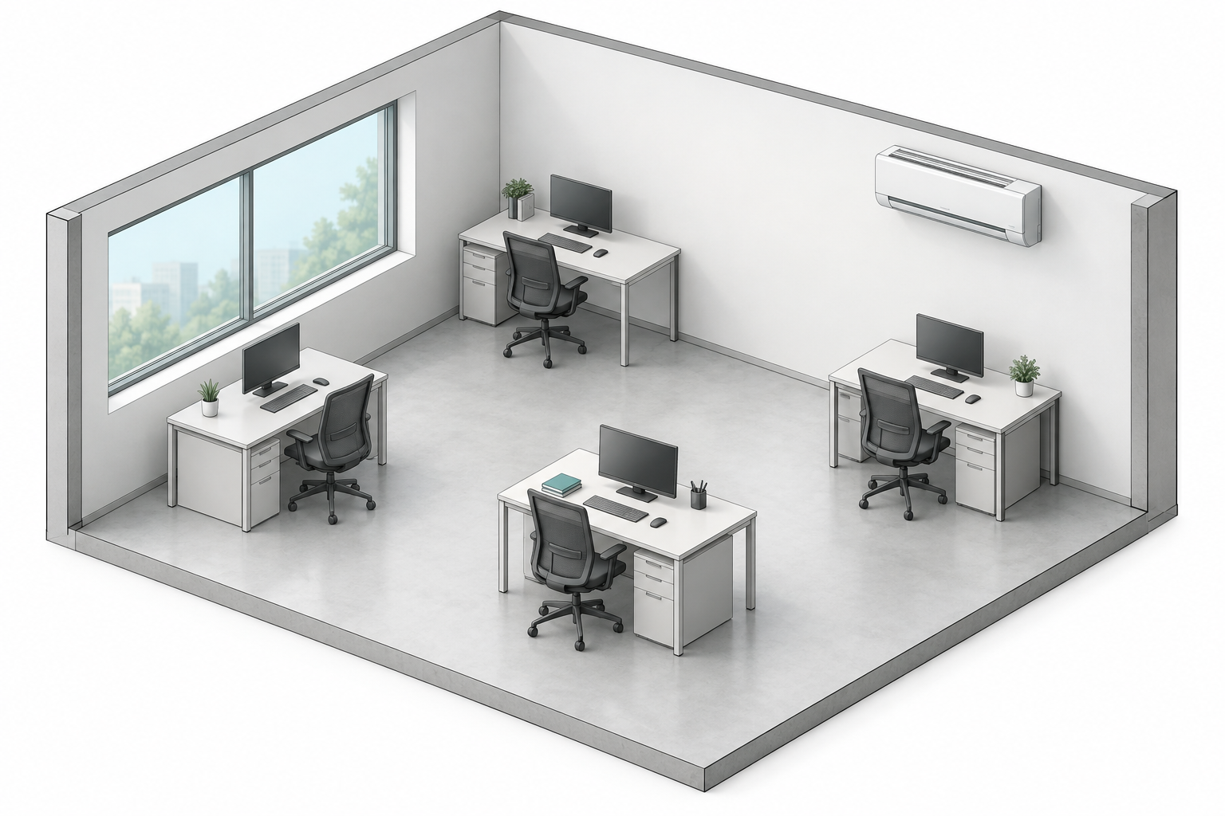
SimuNow
Room-level cooling decisions
AC placement and operating settings affect both electricity use and local comfort
CONFIGURATION / ONE OFFICE
EVIDENCE / THREE DECISION LEVELS
01 / ENERGY kWh per day | Weather, solar + internal gains [7] Schedule + equipment efficiency Representative-day evaluation [4]
02 / COMFORT At each seat | Air + mean radiant temperature; air speed + humidity + clothing; activity; local evaluation [6]
03 / CHOICE Baseline vs options | Same room, weather and occupancy Energy + comfort constraints [3,4] Compare valid, current results
Window, furniture and occupied positions · concept illustration
WHAT OPERATORS CAN ADJUST
Placement
Direction
Airflow rate
Setpoint
m
°
m³/s
°C
Which AC placement and settings can reduce electricity use
while maintaining comfort at occupied seats?
[6] ASHRAE Standard 55-2023, official overview. [7] EnergyPlus Engineering Reference, “Zone Internal Gains”.
[3,4] SimuNow scope and methodology. Proposed evaluation framework; no savings or computed comfort results are shown.
03
Notes:
Purpose: translate the macro electricity problem on slide 2 into a bounded room-level decision, before the room-model architecture on slide 4. This is a proposed evaluation framework, not an implemented or validated optimization result.
Adjustable variables: indoor-unit placement is a position in metres; direction is an orientation in degrees; airflow is volumetric flow in m³/s; setpoint is the thermostat setting in °C. Setpoint is not supply-air temperature. Equipment cooling capacity, electric input power and supply temperature require separate model inputs.
Room electricity is a representative-day quantity in kWh/day. Its weather, solar, internal loads, operating schedule and HVAC performance must be stated. A day is not an annual energy or savings estimate.
Seat comfort requires local air temperature, a radiant-temperature basis, air speed and humidity, with stated clothing and activity. Local draft and other discomfort checks require appropriate model coverage and valid samples. The six basic thermal-comfort factors are cited to [6]; this page does not claim Standard 55 compliance, measured satisfaction, or that every local-discomfort criterion is implemented.
The energy run and representative steady-state airflow/comfort condition are distinct evaluation scopes. Compare baseline and candidates with the same room geometry except the intended configuration change, weather, occupancy, loads and evaluation period. Use only successful, quality-passed, current runs with valid seat samples. Do not infer cooldown time from a steady field. See [3,4] project sources.
[6] ASHRAE (2023). ANSI/ASHRAE Standard 55-2023, Thermal Environmental Conditions for Human Occupancy. Official public overview: https://www.ashrae.org/technical-resources/bookstore/standard-55-thermal-environmental-conditions-for-human-occupancy . Supports the factors temperature, thermal radiation, humidity and air speed, together with activity and clothing. The standard overview also describes local discomfort from vertical gradients. Accessed 3 October 2026.
[7] EnergyPlus (n.d.). Engineering Reference, Zone Internal Gains, Sources and Types of Gains. https://energyplus.readthedocs.io/en/latest/guides/engineering-reference/17.1-zone-internal-gains.html . Supports inclusion of people, lights and equipment in the zone heat balance, and separation of convective, radiant and latent gains. Accessed 3 October 2026. This citation does not establish a savings percentage or a universal relation between placement and electrical efficiency.
[3] Plans/References/01-product-scope.md and 03-experience-design.md. [4] Plans/References/02-architecture.md, 04-data-contracts.md, 05-computation-and-decision.md and AGENTS.md.
Room art generated with the built-in imagegen tool on 3 October 2026. Asset: PitchAssets/room-decision-office.png; full prompt: PitchAssets/room-decision-imagegen-prompt.json. The illustration contains no computed flow or temperature field. All text and the evaluation matrix are native editable PowerPoint objects.

Slide 4
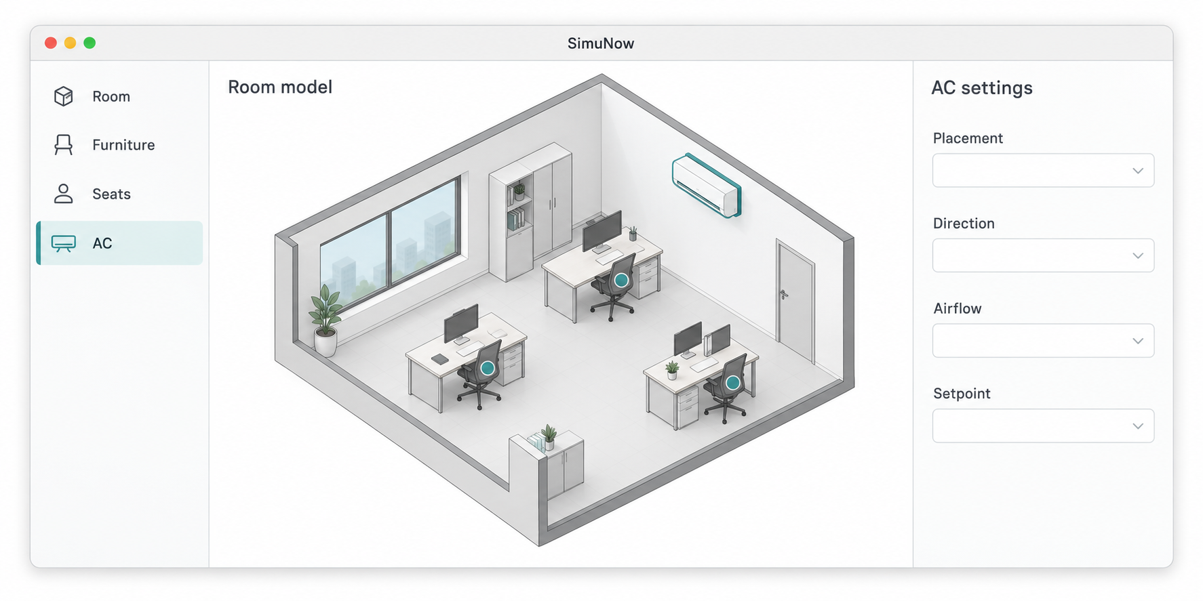
SimuNow
Introducing SimuNow
A Mac-first workspace for indoor AC configuration and analysis
ONE ROOM MODEL
PLANNED ANALYSIS WORKFLOW
Shared room + HVAC model
Geometry, seats and operating settings
EnergyPlus
OpenFOAM
Daily electricity
Thermal loads
Local temperature
Air velocity
Evidence check
Inputs, run record, quality and freshness
Comfort
Electricity
Cost
Planned interface concept. Initial scope: one office or classroom.
At each seat
kWh per day
Tariff + run
PLATFORM DESIGN
Mac workspace and inspector, with adaptive iPad and iPhone views.
04
[4] AGENTS.md: product scope, interface guidelines, physical constraints and run records.
Product vision. Current: native app foundation. Numerical engines and decision evaluation are not connected.
Notes:
Product definition [4]: SimuNow (2026), AGENTS.md. Sections: Project and priorities; Swift and interface guidelines; Physical and result constraints; Data and task conventions. Source snapshot dated 3 October 2026, SHA-256 16e3fd5e2a75c14cb6e7abe5398f4422e370a9bd34879836ebab760fd28d74b4.
SimuNow is a Mac-first tool for indoor air-conditioner configuration and operation analysis, with compatibility goals for iOS and iPadOS. Its stated product vision connects EnergyPlus energy modelling and OpenFOAM airflow through one room model and evaluates comfort at occupied positions, electricity and cost. The initial scene is one office or classroom.
The room model describes geometry, furniture, occupied seats and heat sources, along with AC placement and operating inputs. Setpoint, supply temperature, cooling capacity, electrical input, airflow and air speed remain distinct quantities with units. The depicted inspector is conceptual and contains no numerical values.
EnergyPlus and OpenFOAM are planned analyses. They do not currently form an implemented or validated product pipeline. Spatial comfort requires appropriate temperature, radiation, velocity, humidity, clothing and activity inputs. Cost needs a cited tariff. No savings percentage, measured satisfaction, PMV result, annual extrapolation or cooldown time is claimed.
Traceable evidence follows AGENTS.md: immutable input snapshots, run and scenario identities, input hash, engine versions, solver settings, mesh and quality records. Completion, quality and current inputs are separate conditions. Invalid, unconverged or unsampled results cannot support a valid report or recommendation. These describe planned numerical evidence requirements, not a claim of completed numerical functions.
The planned Mac interface uses a workspace and inspector. iPad uses adaptive panes and iPhone retains accessible navigation. The page introduces this product direction rather than claiming that every platform interface is finished. The native application foundation exists; numerical engines are not connected.
Illustration: PitchAssets/product-workspace-concept.png, generated by the built-in imagegen tool on 3 October 2026. Full prompt in PitchAssets/product-imagegen-prompt.json. Planned interface concept, not an actual application screenshot, measured data or computed simulation output. All slide headings, capability descriptions and disclosures are editable PowerPoint text objects.
Functional schematic: shared room/HVAC inputs feed the two planned analyses. A common evidence check precedes comparison of comfort at occupied seats, representative-day electricity and tariff-based operating cost. Lines indicate information relationships, not an implemented transient coupling or a measured performance result. Source [4] remains the AGENTS.md snapshot cited above. Other necessary comfort inputs are described in the preceding notes. The diagram labels, nodes and attached connectors are native editable PowerPoint objects.

Slide 5
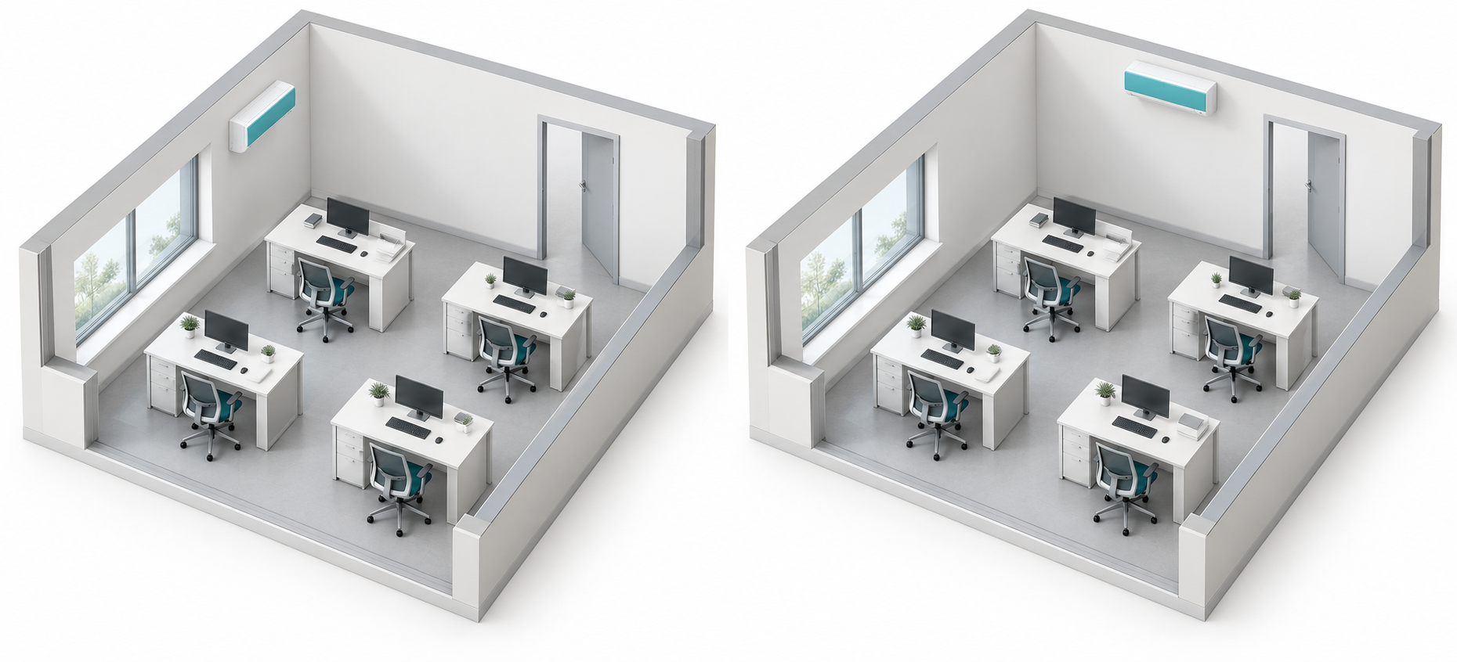
SimuNow
Office cooling scenario
Compare AC placement while holding room and operating inputs fixed
SCENARIO / ONE OFFICE
CONTROLLED COMPARISON
6 × 4 × 2.8 m room, four occupied seats
Parameter | A / Baseline | B / Candidate
AC placement | Side wall | Rear wall
Setpoint | 26 °C | 26 °C
Supply airflow | 0.18 m³/s | 0.18 m³/s
Operating period | 09:00–17:00 | 09:00–17:00
Same furniture, heat loads and weather in both cases
Illustrative inputs. AC placement is the intended change.
EVALUATION / RESULTS PENDING
Seat comfort | Temperature, radiation, air speed Humidity, clothing, activity [6]
Electricity | Representative-day kWh
Operating cost | Daily kWh × sourced tariff
A / SIDE-WALL PLACEMENT
B / REAR-WALL PLACEMENT
Which placement balances comfort and electricity?
05
[4,6] Proposed evaluation. Geometry and input values are hypothetical. Complete inputs and valid runs are required before comparing results.
Notes:
Purpose: follow Introducing SimuNow with a concrete office configuration comparison. This page is a planned application scenario, not a live product screenshot, a measured office, or a computed result.
Internal hypothetical inputs: 6 by 4 by 2.8 metre room, four occupied seats, 26 °C thermostat setpoint, 0.18 m³/s supply airflow and 09:00–17:00 operation. These are illustrative design assumptions chosen for the scenario. They are not measured data, recommended universal settings, a calibrated benchmark or complete solver input. Setpoint is distinct from supply-air temperature; supply airflow is distinct from air speed, cooling capacity and electrical input.
A is the side-wall baseline; B moves one identical AC unit to the rear wall. The illustration preserves the same room, desks, chairs, window and door. Room construction, weather, solar inputs, people/equipment loads, schedule, device performance and other physical inputs should be shared between cases. Placement is the intended changed configuration variable; supply direction relative to the unit and geometry must be documented so incidental differences are not misattributed. All geometries and positions must be defined in the actual model before running an evaluation. The picture is not a dimensioned model.
Proposed comparison: evaluate thermal conditions separately at each occupied seat, representative-day electricity in kWh/day and operating cost using sourced tariffs with matched currency/billing assumptions. No computed values, preferred candidate, savings, measured satisfaction or Standard 55 compliance are shown. A steady field cannot establish cooldown time and a representative day cannot establish annual savings. Evidence requires complete inputs, successful quality-passed current runs and valid samples as described by source [4].
[4] SimuNow (2026). AGENTS.md user-approved product-vision snapshot, SHA-256 16e3fd5e2a75c14cb6e7abe5398f4422e370a9bd34879836ebab760fd28d74b4. Physical and result constraints; Data and task conventions. This page extends the previously approved pitch vision and does not modify the current local-development roadmap or claim numerical engines are connected.
[6] ASHRAE (2023). ANSI/ASHRAE Standard 55-2023, Thermal Environmental Conditions for Human Occupancy. Official public overview: https://www.ashrae.org/technical-resources/bookstore/standard-55-thermal-environmental-conditions-for-human-occupancy . Accessed 3 October 2026. Supports the combination of temperature, thermal radiation, humidity and air speed with clothing and activity as thermal-comfort inputs. It does not establish scenario performance or compliance.
Image provenance: PitchAssets/office-scenario-pair.png, generated by the built-in imagegen tool on 3 October 2026. Exact prompt: PitchAssets/office-scenario-imagegen-prompt.json. Two matched geometric concepts, no computed flow field or thermal outcome. Scenario assumptions and sources: PitchAssets/office-scenario-source.json. Both tables and all labels/disclosures are native editable PowerPoint objects.

Slide 6
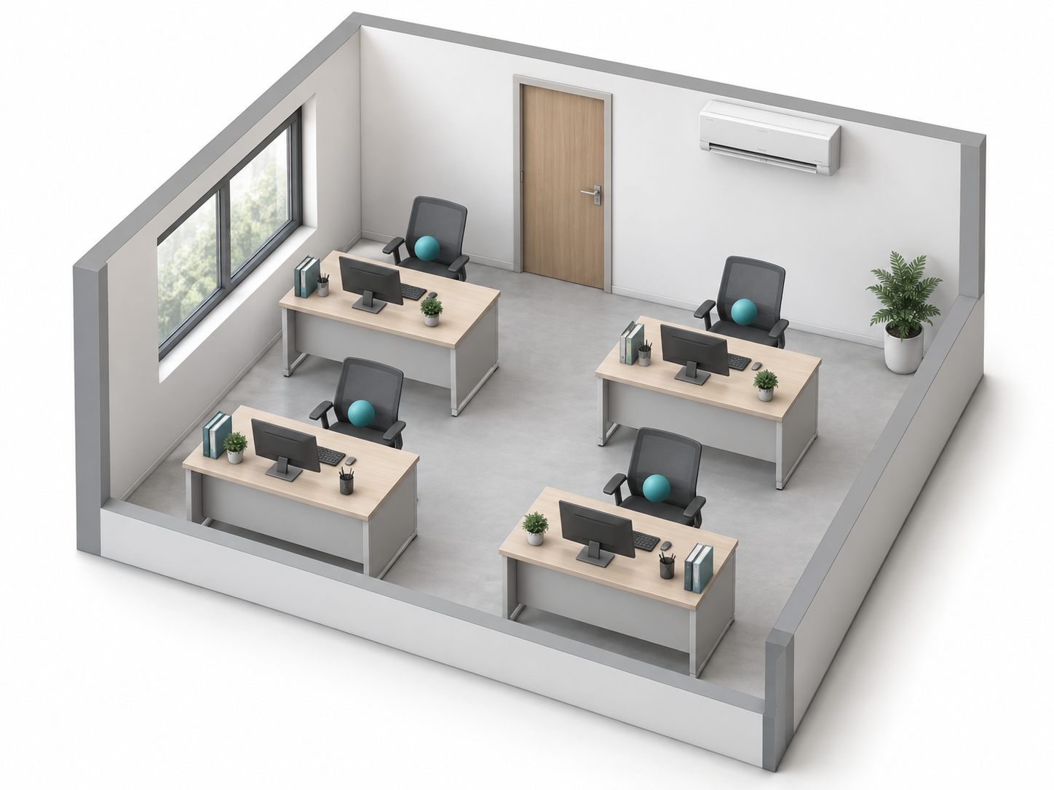
SimuNow
Evaluation method
Planned workflow for comparing baseline and candidate room configurations
01 / SHARED INPUTS
02 / ANALYSIS SCOPES
03 / DECISION EVIDENCE
EnergyPlus [7,8]
Position-level comfort [6]
Representative day
Air + mean radiant temperature
Air speed + humidity
Clothing + activity
AC electricity (kWh/day)
Annual savings need an annual basis
Daily AC electricity
OpenFOAM [9]
Representative-day kWh
Occupied-seat samples (concept)
Geometry + envelope
Weather + internal loads
AC settings + schedule
Representative steady state
Operating cost
Air temperature (°C) + air speed (m/s)
Valid kWh + sourced tariff
Cooldown time needs transient analysis
EVIDENCE BEFORE COMPARISON [4]
Inputs complete
Quality passed
Results current
Seat samples valid
Snapshot + run ID
Convergence + balance
Same input hash
Outside solid geometry
06
[4,6–9] Planned method. No computed fields or outcome claims. Scope and quality checks are required for comparison.
Notes:
Purpose: explain the proposed evaluation basis after the office scenario. This is the user-approved EnergyPlus/OpenFOAM pitch vision, not a claim that the numerical pipeline is implemented, coupled or physically validated.
Shared inputs: room and construction geometry, furniture, occupied positions, weather and solar inputs, people/equipment heat loads, schedules and HVAC performance. Physical fields must distinguish thermostat setpoint, supply-air temperature, cooling capacity, electrical input, volumetric supply airflow and velocity, with units. Input snapshots and coordinate/geometry transformations need consistent identities and units across analyses.
Energy scope: a representative-day EnergyPlus run provides the planned AC electricity quantity in kWh/day, using an explicitly defined AC/device meter scope rather than assuming that a whole-building meter is AC-only. Real equipment performance and operating schedules are needed. Thermal load alone does not establish electrical consumption, and an ideal-load model is not sufficient evidence of actual device electricity. The representative-day choice is a SimuNow evaluation scope; it is not an annual savings result. [7] supports internal gains, and [8] supports energy/load simulation, model/weather inputs, and output variables/meters.
Spatial scope: planned OpenFOAM analysis under a selected representative steady condition provides local air temperature and velocity. Thermal boundary conditions, heat-source consistency, mesh, physical models and solver settings must be documented and quality-checked. [9] is official documentation for an example steady heat-transfer solver with temperature and velocity fields; it is not a selected or tested SimuNow runtime configuration. A steady field does not establish startup cooling time. Links in the diagram show intended information relationships, not an implemented transient or two-way coupling. A placement change does not automatically establish an electricity reduction without a validated method connecting the relevant physics.
Comfort: evaluate occupied positions only when local air temperature, a mean-radiant-temperature basis, velocity, humidity, clothing and activity are available and the comfort model applies. Additional local-discomfort and sampling-height coverage may be required. [6] supports the basic environmental and personal factors. The page does not claim Standard 55 compliance, measured satisfaction, calibrated confidence, a PMV/PPD result or full comfort coverage.
Decision evidence: compare matched representative-day electricity and separately scoped local comfort; operating cost additionally requires a sourced tariff and matched currency/billing assumptions. A flat energy rate is only one possible tariff basis; no prices or costs are invented. Quality before comparison includes complete inputs, immutable snapshot/run identity, successful runs with convergence/conservation evidence where applicable, current input hashes, and valid seat samples outside solid geometry. A completed task is not equivalent to quality passed or inputs current. These are planned numerical-evidence requirements from [4].
[4] SimuNow (2026), AGENTS.md user-approved product-vision snapshot. SHA-256 16e3fd5e2a75c14cb6e7abe5398f4422e370a9bd34879836ebab760fd28d74b4. Physical and result constraints; Data and task conventions. Current local-development roadmap and implementation status remain separate from this proposed numerical evaluation.
[6] ASHRAE (2023), ANSI/ASHRAE Standard 55-2023 official public overview. https://www.ashrae.org/technical-resources/bookstore/standard-55-thermal-environmental-conditions-for-human-occupancy . Environmental and personal comfort factors.
[7] EnergyPlus Engineering Reference, Zone Internal Gains, Sources and Types of Gains. https://energyplus.readthedocs.io/en/latest/guides/engineering-reference/17.1-zone-internal-gains.html .
[8] EnergyPlus, Quick Start Guide, online 26.2 documentation as accessed. Sections What is EnergyPlus?, Running EnergyPlus and Adding an output variable. https://energyplus.readthedocs.io/en/stable/quick_start/quick_start.html . Supports geometry/construction/use/system inputs, energy/load analysis, weather input and variables/meters. Documentation version does not select a SimuNow runtime version.
[9] OpenCFD Ltd., OpenFOAM v2306 documentation, buoyantSimpleFoam. Overview and Input requirements. https://doc.openfoam.com/2306/tools/processing/solvers/rtm/heat-transfer/buoyantSimpleFoam/ . Describes an example steady-state heat-transfer solver with U [m/s] and T [K]; presentation temperature display may convert K to °C. The solver is not fixed or validated for SimuNow.
External sources accessed 3 October 2026. No source establishes SimuNow numerical performance or outcome accuracy.
Illustration: PitchAssets/method-seat-sampling.png, built-in imagegen, 3 October 2026. Full prompt: PitchAssets/method-imagegen-prompt.json. Four teal points are hypothetical occupied-seat sample markers, not physical particles or results. Geometry is not a dimensioned model. Sources and boundaries: PitchAssets/method-sources.json.

Slide 7
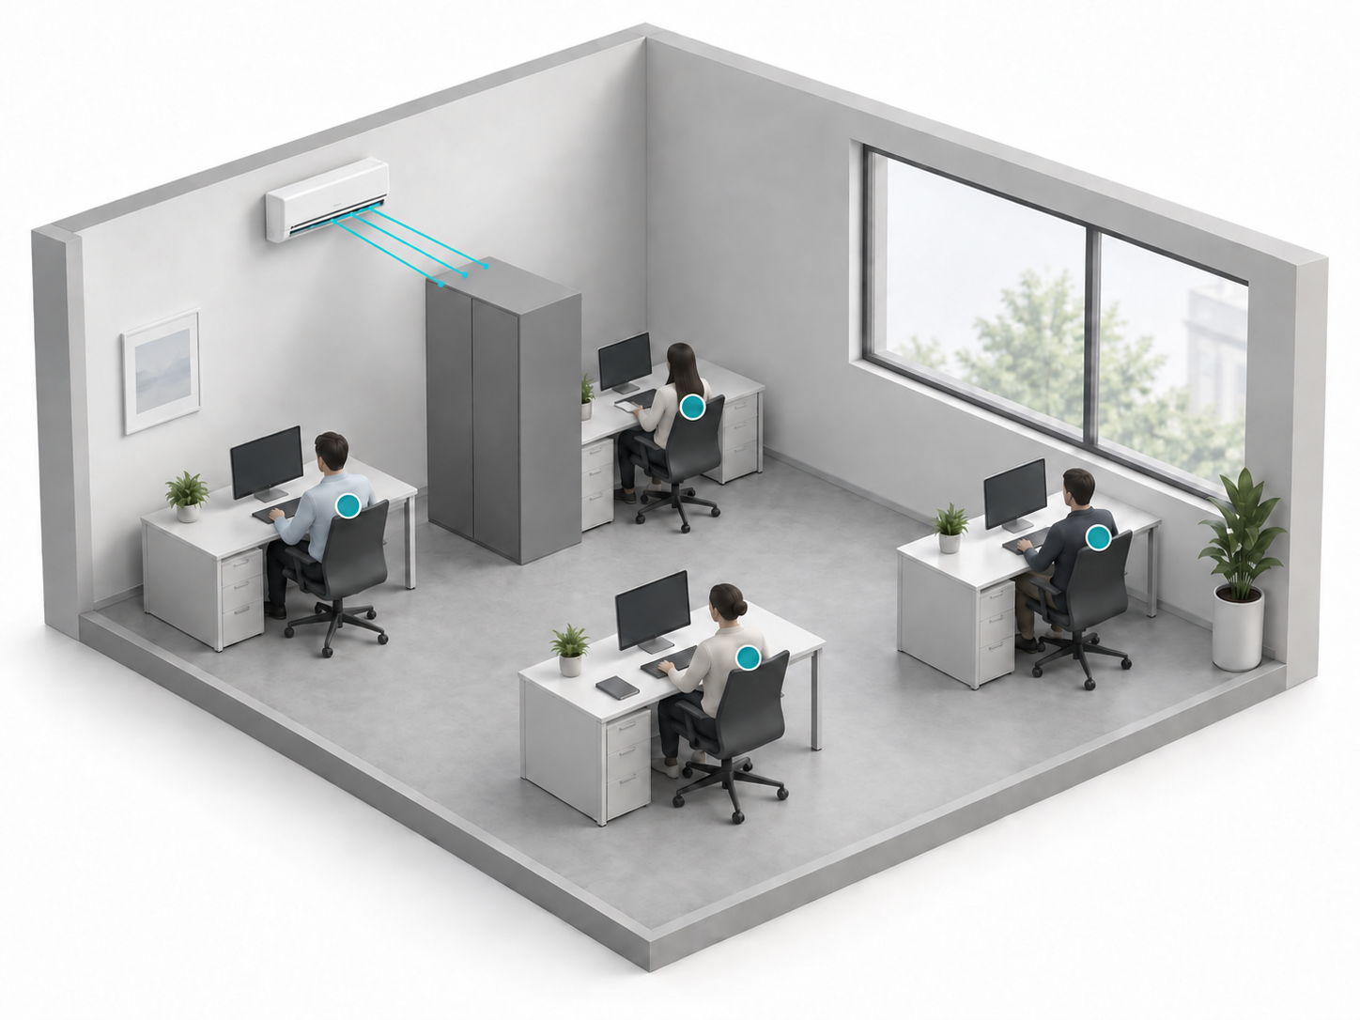
SimuNow
Local preview and scenario comparison
Explore room configurations with visible assumptions and transparent estimates
ONE OFFICE / GEOMETRIC PREVIEW
Room and airflow preview
Inspect the room in 3D. Adjust direction
and review rule-based paths, furniture
obstruction and occupied positions.
Transparent operating estimates
Electricity from stated power and time.
Cost from sourced tariffs.
Sensible heat from explicit thermal inputs.
Baseline and alternatives
Compare a baseline with two alternatives.
Review path differences and estimates
with the adopted inputs and assumptions.
Room concept. Paths stop at furniture; markers show occupied positions.
07
[4] Product under development. Rule previews and simplified estimates; numerical verification and full comfort evaluation are future extensions.
Notes:
Purpose: introduce the native local preview and scenario-comparison scope after the evaluation-method vision, then lead into the comparison page. Functional product concept under development, not a claim of completed platform acceptance or physical validation.
[4] SimuNow, AGENTS.md current native-scope snapshot, 3 October 2026. SHA-256 e6cf3a86907577879f16d95a17a1a789536bd7aaf45eb5ccc1cc6630d4cd6946. Source snapshot: Artifacts/PitchDeck-LocalPreview/AGENTS.source.md. Sections Project and priorities, Physical and result constraints, Data and task conventions. This is the CURRENT native-scope edition, distinct from the earlier AGENTS.md product-vision snapshot cited on slides 4–6. Supporting current scope: Plans/References/01-product-scope.md and 02-architecture.md.
Mac-first, with iPhone/iPad compatibility goals. Native Swift rules and non-AR RealityKit room viewing form the main development route. Three-dimensional capability has availability requirements and older supported systems use a two-dimensional fallback. Ordinary consumer preview does not require Python, Linux, Docker, EnergyPlus or OpenFOAM. External numerical analysis is a later optional verification path. N1–N4 code integration does not establish full platform, accessibility, GPU, minimum-OS or end-user acceptance.
Preview: geometric rule-based supply paths, first furniture obstruction and occupied-position relationships. The schematic rays indicate selected direction and termination at an obstacle. They provide no local physical air speed, local temperature, buoyancy, recirculation, CFD, PMV/PPD or measured comfort. Four seat markers locate hypothetical occupied positions; they are not measured data. This picture is a different illustrative room concept, not the dimensioned controlled A/B scenario on slide 5.
Estimates: electricity is an integral of explicit electrical power over defined operating time, with power basis and source stated. Setpoint, cooling capacity, electric input, airflow rate and air speed remain separate quantities. Rated power is an explicitly adopted continuous-rating scenario, not automatically actual average power. Cost additionally requires sourced tariffs and currency with compatible coverage. Unknown inputs remain missing, not zero. Sensible-heat scenarios use explicit envelope/UA, outdoor-exchange and internal/solar sensible inputs and source coverage. Sensible heat is distinct from latent heat, device electricity, a spatial temperature field and cooldown time. Estimates do not establish annual savings or equipment payback.
Comparison: one baseline and up to two candidate configurations, with adopted inputs, method, run identity and assumptions visible. Path differences and operating estimates remain separate. Direction changes alone do not automatically change the power/time estimate or generate a savings percentage. Compatible, complete and current fixed evidence is required for numeric differences. No optimized winner, recommendation/PDF release, savings percentage, PMV, measured satisfaction, compliance or confidence claim is made.
Image provenance: PitchAssets/local-preview-office.png, generated and edited with the built-in imagegen tool on 3 October 2026. Full prompt set: PitchAssets/local-preview-imagegen-prompts.json. Architectural concept and illustrative obstruction only, not a screenshot, measured room or computed output. All page text is native editable PowerPoint text. The generated three rays are illustrative and not a numeric solver or project-model result.

Slide 8
Let's validate
one real room
SimuNow
Seeking a pilot office
and measurement access.
Concept illustration · not a simulation result
13
Notes:
Source: Plans/References/01-product-scope.md; Plans/References/03-experience-design.md. All capabilities on this slide describe the planned product unless explicitly marked as implemented.
Closing invitation proposes a pilot space and measurement access. No existing pilot, customer or commercial partnership is claimed. Built-in imagegen cover asset reused as a background. Future content: confirmed pilot request and contact details.

Slide 9
SimuNow
References
Statistical sources, technical basis, project evidence and illustration provenance
[1] EMSD (2026)
[7] EnergyPlus Engineering Ref.
[3–5] INTERNAL SOURCES
Hong Kong Energy End-use Data 2026
2024 statistics. Tables 12 and 39
pp. 27 and 54. Definition: p. 78.
Engineering Reference
Zone Internal Gains
People, lights, equipment and loads
[3] Product and experience
Product scope and experience design
Plans/References/01 and 03
EMSD official report (PDF)
EnergyPlus official documentation
[2] IEA (2026)
[8] EnergyPlus Quick Start
[4] Architecture and physics
Cooling a hotter world: El Niño meets
strong growth in electricity demand
10 July 2026. CC BY 4.0.
Online documentation (26.2)
Building + weather model inputs
Output variables and meters
Architecture, contracts and physics
Plans/References/02, 04 and 05
AGENTS.md approved vision snapshot
IEA official commentary
EnergyPlus official guide
[6] ASHRAE (2023)
[9] OpenCFD (v2306 docs)
[5] Delivery and roadmap
ANSI/ASHRAE Standard 55-2023
Thermal Environmental Conditions
for Human Occupancy
OpenFOAM: buoyantSimpleFoam
Steady heat transfer
Temperature and velocity fields
README and delivery evidence
Plans/Delivery: status, verification
Roadmap and phase work packages
Standard 55 official overview
OpenFOAM official documentation
14
Accessed 3 Oct 2026. Full citations in notes. Concept illustrations: built-in imagegen. Assets and prompts in PitchAssets/.
Notes:
References for the presentation.
[1] Electrical and Mechanical Services Department, Government of the Hong Kong Special Administrative Region (2026). Hong Kong Energy End-use Data 2026. Tables 12 and 39, printed pp. 27 and 54. Chronology of Major Revisions item 21, printed p. 78. https://www.emsd.gov.hk/filemanager/en/content_762/HKEEUD2026.pdf
[2] International Energy Agency (2026). Cooling a hotter world: El Niño meets strong growth in global electricity demand. IEA, Paris. Commentary, 10 July 2026. Licence: CC BY 4.0. https://www.iea.org/commentaries/cooling-a-hotter-world-el-nino-meets-strong-growth-in-global-electricity-demand
[3] SimuNow (2026). Plans/References/01-product-scope.md and Plans/References/03-experience-design.md. Internal scope and experience sources for slides 1, 3–6, 8, 10 and 13.
[4] SimuNow (2026). Plans/References/02-architecture.md, Plans/References/04-data-contracts.md, Plans/References/05-computation-and-decision.md and AGENTS.md. Internal methodology and evidence constraints for slides 3, 4 and 6–9.
[5] SimuNow (2026). README.md; Plans/Delivery/status.md; Plans/Delivery/verification.md; Plans/References/06-roadmap-and-backlog.md; Plans/Phases/P1-physics-spike.md, P5-decision-and-report.md, P6-capture-and-calibration.md and P7-optimization-and-release.md. Internal maturity and milestones for slides 11–12.
[6] ASHRAE (2023). ANSI/ASHRAE Standard 55-2023, Thermal Environmental Conditions for Human Occupancy. Official public overview: https://www.ashrae.org/technical-resources/bookstore/standard-55-thermal-environmental-conditions-for-human-occupancy . Supports the basic environmental and personal comfort factors on slide 3. No claim of Standard 55 compliance is made.
[7] EnergyPlus (n.d.). Engineering Reference, Zone Internal Gains, Sources and Types of Gains. https://energyplus.readthedocs.io/en/latest/guides/engineering-reference/17.1-zone-internal-gains.html . Supports internal loads and the separation of convective, radiant and latent gains on slide 3.
Illustration provenance: cover-architecture-airflow.png, seat-airflow-study.png and room-model-exploded.png generated by the built-in imagegen tool on 2 October 2026. problem-hong-kong-office.png and room-decision-office.png generated on 3 October 2026. Prompt files: PitchAssets/imagegen-prompts.json, problem-imagegen-prompt.json and room-decision-imagegen-prompt.json. Artwork is concept material, not measured or simulated performance.
External sources accessed 3 October 2026. Internal paths are relative to the SimuNow project root. Shortened visible project names on this page expand to the full paths in this note. Numerical and comfort functionality is planned unless a delivery source explicitly establishes implemented behavior.
Slide 4 product source [4]: SimuNow (2026), AGENTS.md, sections Project and priorities, Swift and interface guidelines, Physical and result constraints, and Data and task conventions. This page presents the EnergyPlus/OpenFOAM product vision and a native app foundation. Numerical engines and decision evaluation are planned.
Additional illustration provenance: PitchAssets/product-workspace-concept.png, generated with the built-in imagegen tool on 3 October 2026. Full prompt: PitchAssets/product-imagegen-prompt.json. Planned interface concept only, not an actual application screenshot or numerical performance evidence.
Slide 5 office scenario: illustration and fixed inputs are internal hypothetical examples, not a measured office or computed comparison. Source [4] uses the user-approved AGENTS.md product-vision snapshot identified on slide 4; [6] ASHRAE Standard 55 official overview supports the thermal-comfort input factors. Illustration: PitchAssets/office-scenario-pair.png, built-in imagegen, 3 October 2026. Exact generation prompt: PitchAssets/office-scenario-imagegen-prompt.json. Both panels depict the same room with one intended AC-placement change. No numerical results, savings, compliance or preferred candidate are claimed.
Additional sources for slide 6. Existing citations and illustration provenance in these notes remain applicable.
[8] EnergyPlus, Quick Start Guide, online 26.2 documentation as accessed 3 October 2026. Sections What is EnergyPlus?, Running EnergyPlus and Adding an output variable. https://energyplus.readthedocs.io/en/stable/quick_start/quick_start.html . Supports energy/load analysis, building-system and weather inputs, output variables/meters. This documentation version is a citation, not a selected SimuNow runtime.
[9] OpenCFD Ltd., OpenFOAM v2306 documentation, buoyantSimpleFoam. Overview and Input requirements. https://doc.openfoam.com/2306/tools/processing/solvers/rtm/heat-transfer/buoyantSimpleFoam/ . Example steady-state heat-transfer solver with temperature T [K] and velocity U [m/s]. Accessed 3 October 2026 via official indexed documentation. This citation does not select, validate or integrate that solver into SimuNow.
Slide 6 reuses [4] the user-approved AGENTS.md product-vision snapshot, [6] ASHRAE environmental/personal factors, and [7] EnergyPlus internal gains. All diagram links and evaluation scopes describe a planned method. Current local-development implementation and this numerical product vision are separate. No computed field, savings, comfort, compliance, satisfaction or cost result is claimed.
Additional illustration: PitchAssets/method-seat-sampling.png, built-in imagegen, 3 October 2026. Full prompt in PitchAssets/method-imagegen-prompt.json. Hypothetical geometry and sampling markers only, not numerical evidence.
Expanded internal locators: [3] Plans/References/01-product-scope.md and 03-experience-design.md. [4] Plans/References/02-architecture.md, 04-data-contracts.md, 05-computation-and-decision.md and the approved AGENTS.md snapshot hash shown on slide 4. [5] README.md, Plans/Delivery/status.md, verification.md, Plans/References/06-roadmap-and-backlog.md and the previously cited historical P1/P5/P6/P7 phase packages. Short visible locators on the page expand to these paths.

