Slide 1

AWS VIRTUAL CLOUD INTERNSHIP
SESSION 2023-2024
PRESENTED BY :
STUDENT NAME :ABHISHEK KUMAR
ROLL NO: 2201920100016
BRANCH: CSE
SECTION: A(G1)
YEAR: 2nd
UNDER SUPERVISION OF :
SUPERVISOR’S NAME : DESIGNATION:
COURSE NAME:
ORGANIZATION:

Slide 2
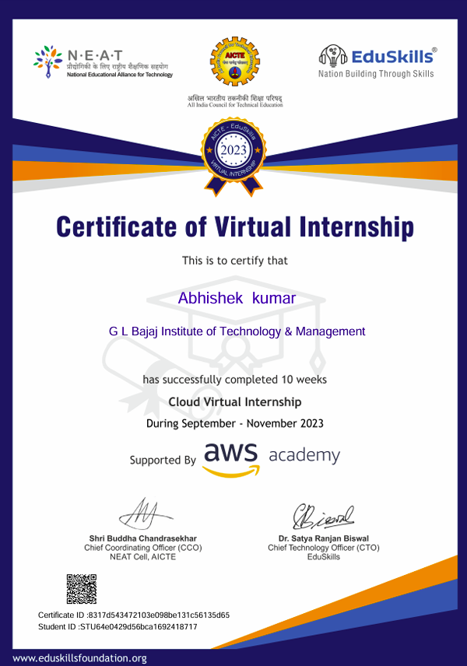
INTERNSHIP CERTIFICATE

Slide 3

AWS ACADEMY CLOUD FOUNDATIONS
COURSE INTRODUCTION

Slide 4

INTRODUCTION
AWS Foundational Course was an excellent learning curve for me that taught me cloud computing fundamentals.
Understanding the basic concepts of cloud computing.
Exploring the advantages and key characteristics of cloud services.
Overview of AWS infrastructure and global data center locations.
Understanding how to use AWS Management Console for service deployment
and management.
Overview of AWS security measures and compliance.
Securing data at rest and in transit using encryption services.
Department of Computer Science & Engineering

Slide 5
COURSE OUTLINE
Module 1: Cloud Concepts Overview
Module 2: Cloud Economics and Billings
Module 3: AWS Global Infrastructure Overview
Module 4: AWS Cloud Security
Module 5: Networking and Content Delivery
Module 6: Compute
Module 7: Storage
Module 8: Databases
Module 9: Cloud Architecture
Module 10: Automatic Scaling and Monitoring

Slide 6
ABOUT MODULES
Module:1
Introduction to cloud computing.
Advantage of cloud computing
Introduction to Amazon Web Services(AWS)
Moving to the AWS Cloud –The AWS Cloud adoption Framework (AWS CAF)
Module:2
Fundamental of pricing
Total Cost of ownership
AWS Organisation
AWS Billing and cost management
Technical support
Module: 3
AWS GLOBAL infrastructure
AWS services and service category overview
Department of Computer Science & Engineering

Slide 7
ABOUT MODULES
Module: 4
AWS shared responsibility model
AWS Identity and access management
Securing a new AWS account
Securing account
Securing data on AWS
Working on ensure compliance
Module: 5
Networking Basics
Amazon VPC
VPC networking
VPC security
Amazon Route 53
Amazon CloudFront
Module: 6
Compute services overview
Amazon EC2
Amazon EC2 cost optimization
Container services
Introduction to AWS Lambda
Introduction to AWS Elastic Beanstalk
Department of Computer Science & Engineering

Slide 8
ABOUT MODULES
Module: 7
Amazon Elastic Block Store(Amazon EBS)
Amazon Simple Storage services(Amazon S3)
Amazon Elastic File System(Amazon EFS)
Amazon Simple Storage Service Glacier
Module:8
Amazon Relational Database Services(Amazon RDS)
Amazon DynamoDB
Amazon Redshift
Amazon Aurora
Module:9
AWS Well-Architected Framework
Reliability and availability
AWS Trusted Advisor
Department of Computer Science & Engineering

Slide 9
ABOUT MODULES
Module: 10
Elastic Load Balancing
Amazon Cloud watch
Amazon EC2 Auto Scaling
Department of Computer Science & Engineering

Slide 10
COURSE PRE-REQUISITES
A foundational understanding of basic IT concepts.
Proficiency in using web browsers and navigating online interfaces is required.
For more technical roles or courses, basic programming skills is beneficial.
Preferred knowledge of cloud computing concepts.
Working knowledge of distributed systems.
Familiarity with general networking concepts.
Working knowledge of multi-tier architectures.
Department of Computer Science & Engineering

Slide 11
COURSE OBJECTIVES
After completing this course, you should be able to:
Define the AWS Cloud.
Explain the AWS pricing Philosophy.
Identify the global infrastructure components of AWS .
Describe security and compliance measures of the AWS Cloud including AWS Identity and Access Management.
Create an AWS Virtual Private Cloud(Amazon VPC).
Demonstrate when to use Amazon Elastic Compute Cloud(EC2), AWS Lambda
and AWS Elastic Beanstalk.
Differentiate between Amazon S3, Amazon EBS ,Amazon EFS
and Amazon S3 Glacier.
Explore key concepts related Elastic Load Balancer (ELB) , Amazon , CloudWatch and Auto Scaling.
Department of Computer Science & Engineering

Slide 12
CLOUD COMPUTING
Cloud computing refers to the use of hosted services, such as data storage, servers, databases, networking, and software over the internet. The data is stored on physical servers, which are maintained by a cloud service provider. Computer system resources, especially data storage and computing power, are available on-demand, without direct management by the user in cloud computing. Instead of storing files on a storage device or hard drive, a user can save them on cloud, making it possible to access the files from anywhere, as long as they have access to the web. The services hosted on cloud can be broadly divided into infrastructure-as-a-service (IaaS), platform-as-a-service (PaaS), and software-as-a-service (SaaS). Based on the deployment model, cloud can also be classified as public, private, and hybrid cloud.
12

Slide 13
FUTURE SCOPE OF INTERNSHIPS
Advanced AWS Certifications: After an internship, individuals can pursue advanced AWS certifications like Solutions Architect, Developer, SysOps Administrator, and more. These certifications validate expertise in specific AWS services and can boost career opportunities.
Specialization in AWS Services: AWS offers a wide array of services. Interns can delve deeper into specific services like AWS Lambda, Amazon S3, EC2, or AI/ML services. Specializing in one or more of these areas can lead to specialized roles and expertise highly sought after by companies.
Career in Cloud Architecture or Engineering: Interns can aim for roles as cloud architects or engineers, designing and implementing cloud solutions for organizations. These roles often require in-depth knowledge of AWS services and architectures. Data Analytics and Machine Learning: AWS provides powerful tools for data analytics and machine learning (ML) through services like AWS Glue, Amazon Redshift, SageMaker, etc. Interns can explore these areas and pursue careers in data science, analytics, or ML engineering.

Slide 14
FUTURE SCOPE OF INTERNSHIPS
Startups and Entrepreneurship: With the skills gained during an AWS internship, individuals might choose to start their own ventures or join startups focused on leveraging AWS services to create innovative solutions.
Consulting or Freelancing: Some individuals opt to work as consultants, offering their expertise in AWS services to various companies on a contract basis. This path allows for flexibility and exposure to different industries.
Research and Development: For those interested in pushing the boundaries of cloud technology, pursuing a career in research and development within AWS or related fields can be a rewarding option.
Continuous Learning and Upgradation: Cloud technology is constantly evolving. Engaging in continuous learning through courses, workshops, and staying updated with AWS advancements is crucial for career growth in this field.

Slide 15
COURSE OUTCOME
1.Technical Skills:
Gain hands-on experience with AWS services, infrastructure, and tools. This includes learning about cloud architecture, deployment, and management of applications on the AWS platform.
2. Real-World Projects:
Work on actual projects that can impact AWS services or help customers. This practical experience is invaluable and allows interns to apply theoretical knowledge in a real business environment.
3. Networking and Mentorship:
Interact with professionals and experts in the field. Networking opportunities can arise through mentorship programs, team collaborations, and company events. Building these connections can be beneficial for future career growth.
4. Resume Building:
Completing an AWS internship adds value to a resume, demonstrating practical experience in a high-demand field like cloud computing, which can be appealing to future employers.

Slide 16
RESOURCE REQUIREMENTS(H/W ,S/W,TOOLS )
Software Requirements:
Operating System:
Windows: Windows 10 or later versions.
macOS: macOS 10.12 or later versions.
Linux: Latest distributions of Ubuntu, CentOS, or other Linux distributions are often supported.
Web Browser:
Recommended Browsers: Google Chrome, Mozilla Firefox, or Safari for accessing the AWS Management Console.
Ensure browsers are up-to-date for compatibility.
Development Tools (Optional but Commonly Used):
Integrated Development Environments (IDEs)
Software development environments like Visual Studio Code, IntelliJ IDEA, Eclipse, etc., depending on your programming language and preferences.
Command Line Interface (CLI) Tools: AWS Command Line Interface (AWS CLI) for interacting with AWS services via the terminal or command prompt

Slide 17
STUDY SYSTEM APPROACH (METHODLOGY)
INTRODUCTION VIDEO
WRAP UP VIDEO
STUDENT GUIDE
MODULE KNOWLEDGE CHECK
Department of Computer Science & Engineering
17

Slide 18
Conclusion
Conclusion:
The base work aims to illustrate the development of a web application on AWS through defined stages, starting from planning and infrastructure setup to actual development, testing, and concluding with thorough documentation. The expected result is a fully functional web application deployed on AWS, supported by detailed documentation and insights gained during the process. This project provides hands-on experience with various AWS services and demonstrates the ability to create and deploy a scalable web application in a cloud environment.

Slide 19
REFERENCES
AWS Youtube Channel
Github -AWS Labs
AWS Online Training

Slide 20

THANK YOU!
20

