Slide 1
IBM University Engagement Project Submission
“Exploring the Power of Agentic AI with IBM Granite and LangFlow”

Slide 2

Project Tile – EmpowerLabor AI: Voice-First Agentic Job Mentor for Informal Workers
Domain of Project –Livelihood / Social Welfare / Career Education
Student Name | Recent Passport Photo | Email ID | Mobile number [WhatsApp]
KR Abishri |  | krabishri3@gmail.com | 9345547546

Slide 3
Problem Statement -
Problem Statement :Job Mentor for Informal Workers
The Challenge
Millions of daily wage laborers, artisans, and gig workers face extreme difficulty accessing local jobs, welfare resources, and skill programs. The severe lack of digital literacy and heavy language barriers in semi-urban communities further widens the opportunity gap.
The Objective
The goal is to develop an always-accessible, voice-first AI companion that provides conversational job placement and livelihood advisory services. By transforming structural barriers into a natural conversation, the platform allows workers to state their skills aloud and instantly receive localized opportunities matching their vicinity.
The application democratizes access to state aid by acting as a smart translator that converts complex policy documents into simple, actionable steps. By mapping recognized skills directly to open-source learning paths, the system creates an end-to-end economic progression engine tailored specifically for low-literacy communities.

Slide 4
Proposed Solution -
Proposed Solution: Core Architecture & RAG Pipeline
The proposed platform delivers an intelligent multi-agent environment managed visually through LangFlow and deployed securely on IBM Cloud infrastructure. At its base, the system uses a high-performance Retrieval-Augmented Generation (RAG) loop that scans verified municipal datasets, local construction notices, and updated welfare circulars. By parsing this information first, the underlying IBM Granite model stays strictly bounded by reality, preventing hallucinations regarding job vacancies or processing fees.
The Four Key Agents:
Welfare Knowledge Agent: This agent processes complex regional policies (e.g., PM-SVANidhi loans or pension updates), pulling out the exact eligibility parameters and presenting them to the user in clean, simplified summaries.
Job Recommendation Agent: This agent acts as a local dispatcher that parses incoming user requests, runs geospatial parameters, and extracts matching neighborhood contract or daily-wage vacancies within a reachable commuting distance.
Upskilling Advisor Agent: This agent evaluates user capabilities during chat sessions and dynamically suggests free, micro-certification modules on the IBM SkillsBuild platform to help the worker qualify for higher-paying roles.
Voice Log & Profile Agent: This agent converts spoken inputs into organized database attributes, tracking user history and adjusting the AI's recommendations over time without requiring a paper resume.

Slide 5
Technology Used
LangFlow Platform: Serves as the central nerve system, allowing developers to design complex text-routing logic and connect model inputs to vector data repositories via a visual node interface
IBM Grainte model -Employs the granite-3.2-8b-instruct or granite-4.0-8b-instruct enterprise models to manage multi-lingual reasoning, intent tracking, and contextual response generation.
IBM Watsonx.ai & Cloud Platform: Provides the secure cloud foundation needed to host the core logic, generate embeddings, and ensure that all user interaction logs comply with strict enterprise data safety rules.
Vector Database (ChromaDB / FAISS): Stores and indexes semantic mathematical vectors representing local job registries and state aid program requirements for rapid contextual search execution.

Slide 6
Langflow component Used -
Chat Input & Output Nodes: Controls the interface boundaries; the input node catches user voice inputs converted to text, while the output node returns clean markdown strings designed to feed text-to-speech voice tools.
IBM Watsonx AI Component: Hosts the system prompt wrapper and manages live API requests directly to the deployed IBM Granite instance using secure cloud tokens.
File Component & Directory Loader: Functions as the local database manager, feeding updated text files containing verified job openings and training course descriptions directly into the application.
Vector Store Retriever: Acts as an information filter, matching user search terms with indexed data blocks and forwarding the extracted facts straight to the LLM context window.

Slide 7

Role of Agentic AI in the solution
Autonomous Logic & Adaptation
Unlike traditional static chatbots that follow rigid script menus, Agentic AI introduces autonomous reasoning powered by IBM Granite. When a user describes a financial hardship, the system evaluates the root problem, separates it into sub-tasks, and schedules coordination across multiple specialized agents.
The system exhibits high contextual awareness, remembering details like localized dialects, regional constraints, and target daily wage minimums. Because these agents communicate with one another behind the scenes, the platform can automatically trigger a skill development recommendation the moment it detects a worker is missing a certification for a local job listing.

Slide 8
Novelty and Uniqueness
Value Proposition & Innovations-
The Voice-First RAG Framework: Most conversational AI portals return long blocks of text that overwhelm users. This solution passes filtered information into specialized text-to-speech layers, making the app function like a natural telephone call.
Granite-Driven Guardrails: Financial fraud targeting informal workers is common. By leveraging the strict safety and reasoning parameters of IBM Granite, the system ensures that information regarding government financial benefits stays factually accurate.
Integrated Growth Ecosystem: The platform breaks down the walls between job searching and education. It creates an active support cycle where an artisan can discover a job, find the exact skill gap they have, and start learning on IBM SkillsBuild within a single app session.

Slide 9
Future Scope
Scalability & Strategic Growth
WhatsApp & IVR Voice Integration: Expanding access to non-smartphone users via automated toll-free telephone dials and direct WhatsApp audio channels.
Automated Micro-Credentials: Auto-issuing digital skill badges to profiles as soon as the agent confirms course completion via IBM SkillsBuild.
Micro-Finance Linkage: Connecting pre-verified users straight to localized banking systems for direct welfare financial assistance.
·
·
·

Slide 10
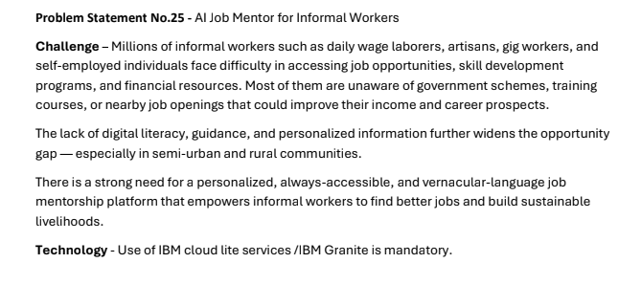
Git Hub Link
· Please create public github repository (Enable Add README button while creating repository) with format –
Please test and Paste the working Github URL – https://github.com/krabishri/EmpowerLabor-AI
·
·
·

Slide 11
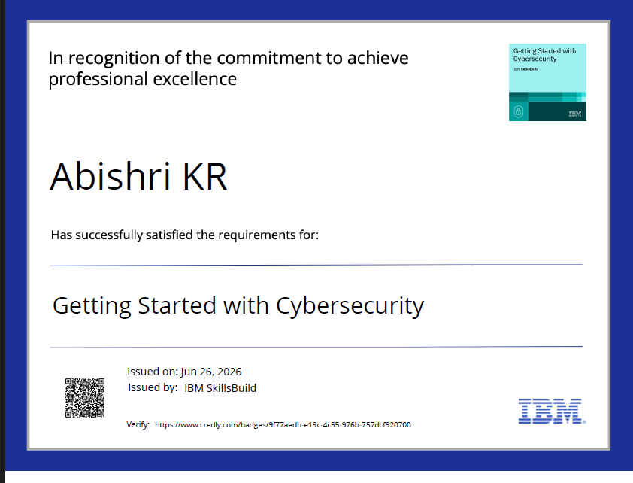
Certificates Earned:

Slide 12
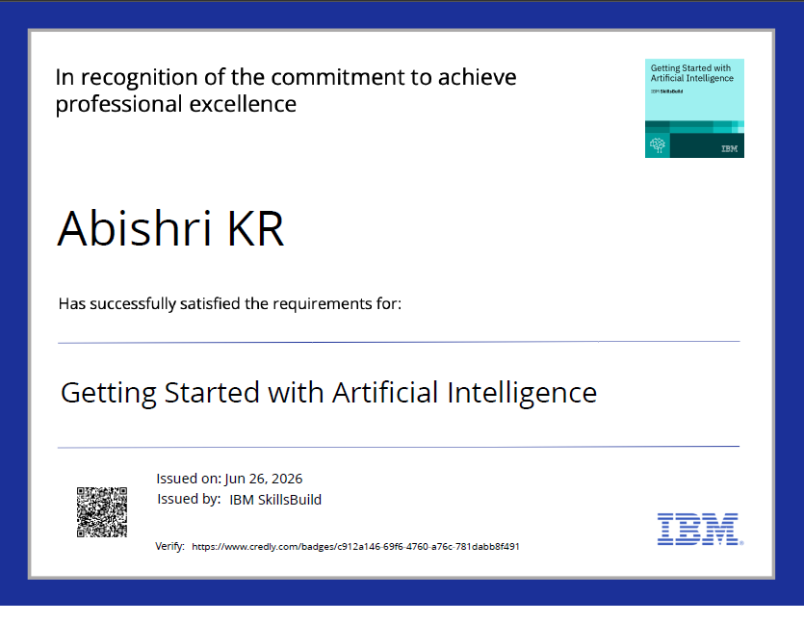

Slide 13
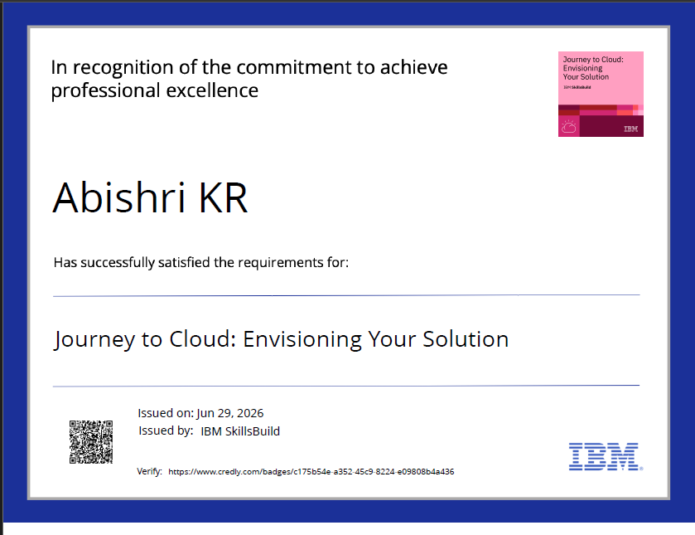

Slide 14
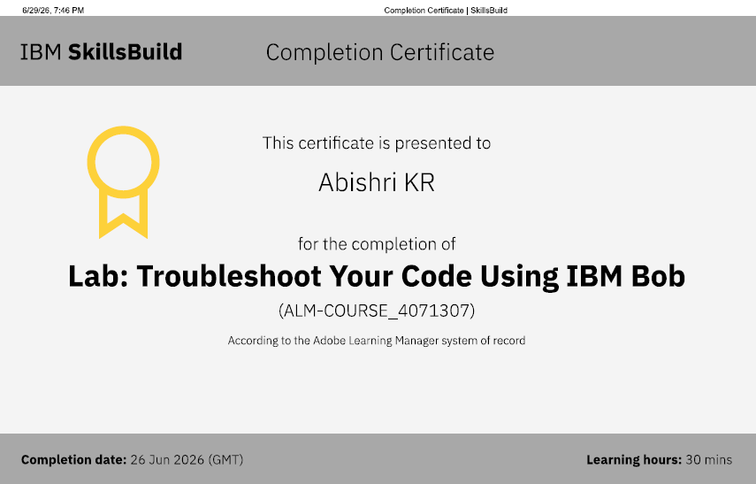
Certificates Earned:​
IBM BOB Certificate

Slide 15
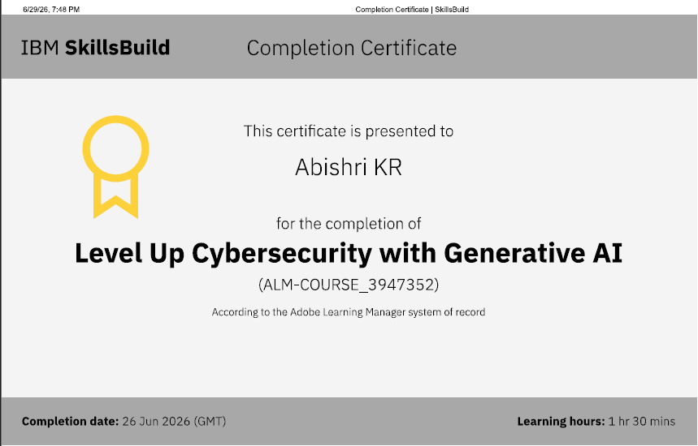

Slide 16
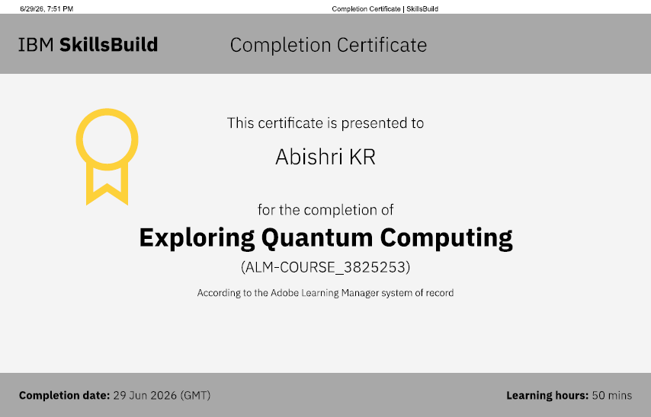

Slide 17
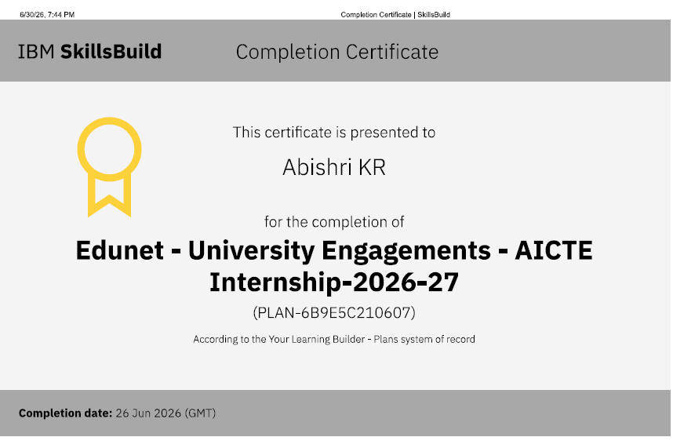

Slide 18


