Slide 1

Outline
FYP Interim Presentation
1 | Background
2 | Project Aims & Objectives
3 | Progress to Date
4 | Plan for Remainder
5 | Summary & Conclusion
Leveraging Low-Precision Hardware for High-Fidelity CFD: Integrating the Ozaki Scheme into Nektar++
Paul Kallarackel
02029025
11/03/2026
Project LRC001 – Paul Kallarackel - 02029025
1 / X
11/03/2026

Slide 2
1. Background
2. Objectives
3. Progress
4. Plan
5. Summary
Outline
FYP Interim Presentation
1 | Background
2 | Project Aims & Objectives
3 | Progress to Date
4 | Plan for Remainder
5 | Summary & Conclusion
Leveraging Low-Precision Hardware for High-Fidelity CFD: Integrating the Ozaki Scheme into Nektar++
Paul Kallarackel
02029025
11/03/2026

Slide 3
1. Background
2. Objectives
3. Progress
4. Plan
5. Summary
Outline
1 | Background
2 | Project Aims & Objectives
3 | Progress to Date
4 | Plan for Remainder
5 | Summary & Conclusion

Slide 4
1. Background
2. Objectives
3. Progress
4. Plan
5. Summary

Slide 5
1. Background
2. Objectives
3. Progress
4. Plan
5. Summary

Slide 6
1. Background
2. Objectives
3. Progress
4. Plan
5. Summary

Slide 7
1. Background
2. Objectives
3. Progress
4. Plan
5. Summary
Thank you for listening! Any Questions?

Slide 8
Thank you for listening! Any Questions?
1. Background
2. Objectives
3. Progress
4. Plan
5. Summary
Project LRC001 – Paul Kallarackel - 02029025
8 / X
11/03/2026

Slide 10
Problem
Emulating Double Precision

Slide 11
Problem
Emulating Double Precision
Modern HPC relies on GPUs, but NVIDIA's roadmap (e.g., Hopper, Blackwell) is overwhelmingly optimized for the AI market.
This has led to massive performance gains in low-precision formats (FP8, FP16, TF32) used for AI.
In contrast, double-precision (FP64), which is critical for scientific codes like Nektar++, is a low priority. Its performance is stagnating, and on some new architectures, it's even emulated.
Project Goal (Overall):
Investigate methods to emulate high-precision FP64 operators in Nektar++ (like Dgemm) using the faster, low-precision FP32 (Sgemm) hardware.
Short-Term Goal (Pre-Xmas):
Implement a POC that emulates a DGEMM call with SGEMM.
Success Criteria: The emulated result must match the machine error epsilon of 10^-15.
Metrics: Monitor performance (TFLOPS) and accuracy (max relative error) against the native FP64 baseline.

Slide 12
Current Literature
Ozaki Algorithm

Slide 13
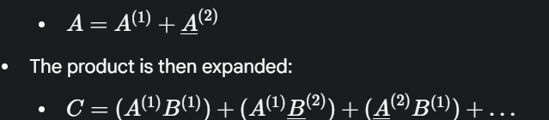
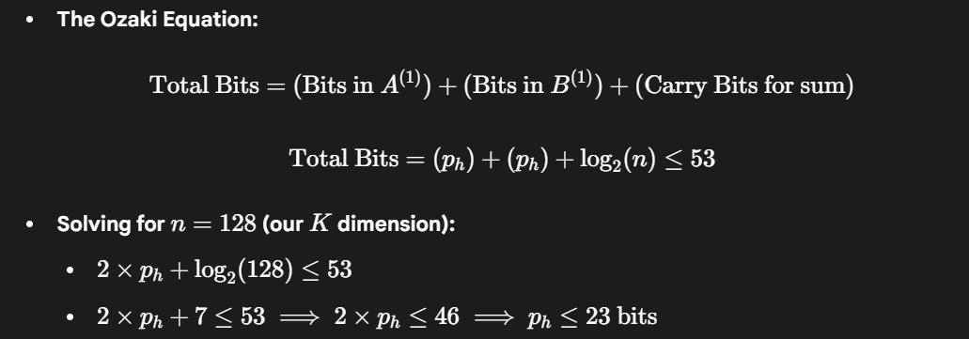
Current Literature
Ozaki Algorithm
This work focuses on increasing accuracy for FP64, not emulation. It's designed to compute results more accurately than a standard Dgemm by eliminating roundoff error. Key Technique: An "Error-Free Transformation" (EFT) that splits one double (FP64) into a sum of two other doubles.
The first term is error free since the beta (separator) is chosen strategically such that the bits from A and B including those required for carry fit inside a double

Slide 14
Our Approach
Adapting for FP32

Slide 15
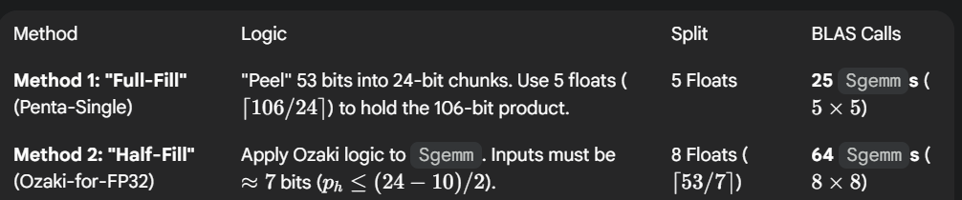
Our Approach
Adapting for FP32
Our goal is different: we want to use fast FP32 hardware.
We must split one FP64 (53 bits) into a sum of multiple FP32s (24 bits each).
Key Difference: In Method 1, the individual Sgemm calls have error, but the final 120-bit sum should be accurate. In Method 2, the Sgemm calls are error-free, but it's much more expensive.

Slide 16
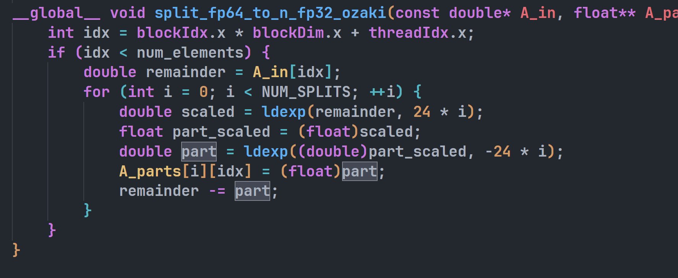
Our Approach
Adapting for FP32

Slide 17
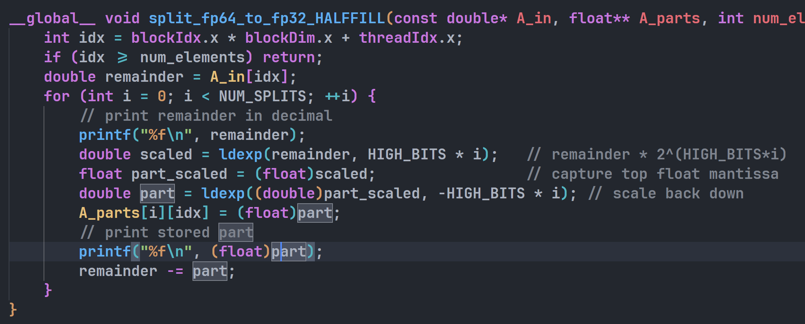
Our Approach
Adapting for FP32

Slide 18
Proof of Concept
Current Status

Slide 19
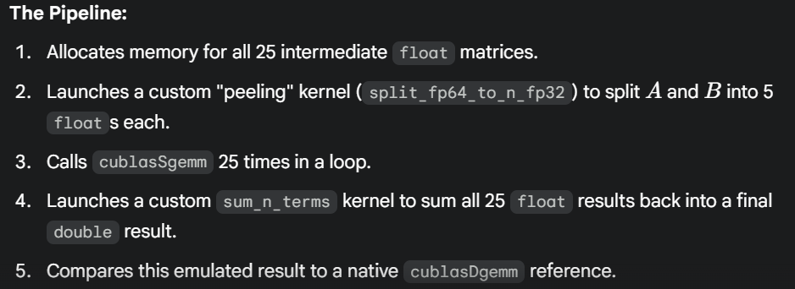
Proof of Concept
Current Status
PoC Goal: Have a working algorithm that emulates Dgemm precision ($\approx 10^{-15}$) before Christmas.
Current Status: I have successfully implemented Method 1 (the 25-call "Penta-Single" method) in a complete CUDA script.

Slide 20
Issues
My current blockers

Slide 21
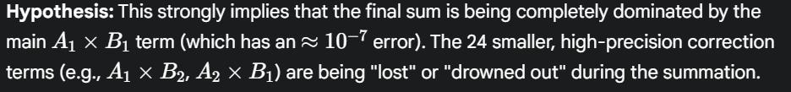
Issues
My current blockers
The Blocker: The PoC is currently failing its accuracy goal.
The Symptom: The max relative error is stuck at 10^-7
Analysis: This is exactly the machine epsilon for a single-precision float.
Uncertainties:
Is the split kernel wrong? (Unlikely, as unit tests pass, but is it numerically unstable?)
Is the "full-fill" (Method 1) idea fundamentally flawed? Does the $\approx 10^{-7}$ error from the $A_1 B_1$ Sgemm call irreversibly pollute the result, making it impossible to add back the smaller correction terms?

Slide 22
Next Steps
Solving blockers

Slide 23
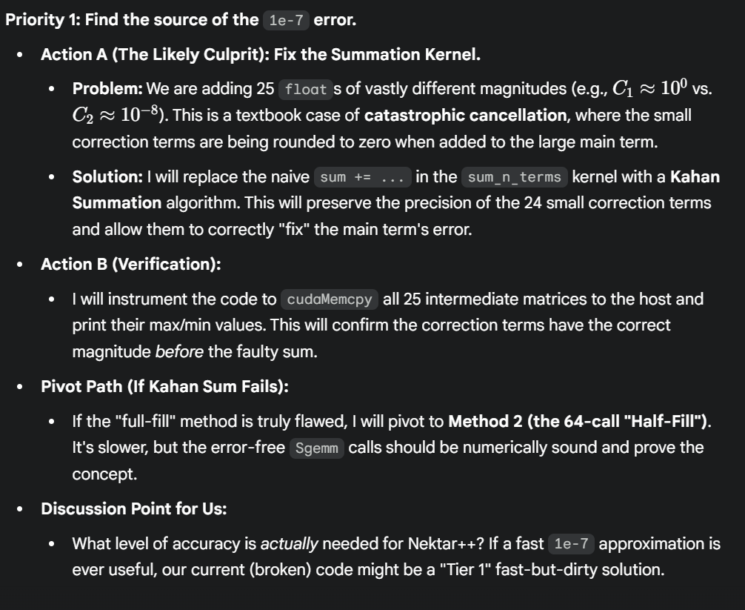
Next Steps
Solving Blockers

