Slide 1
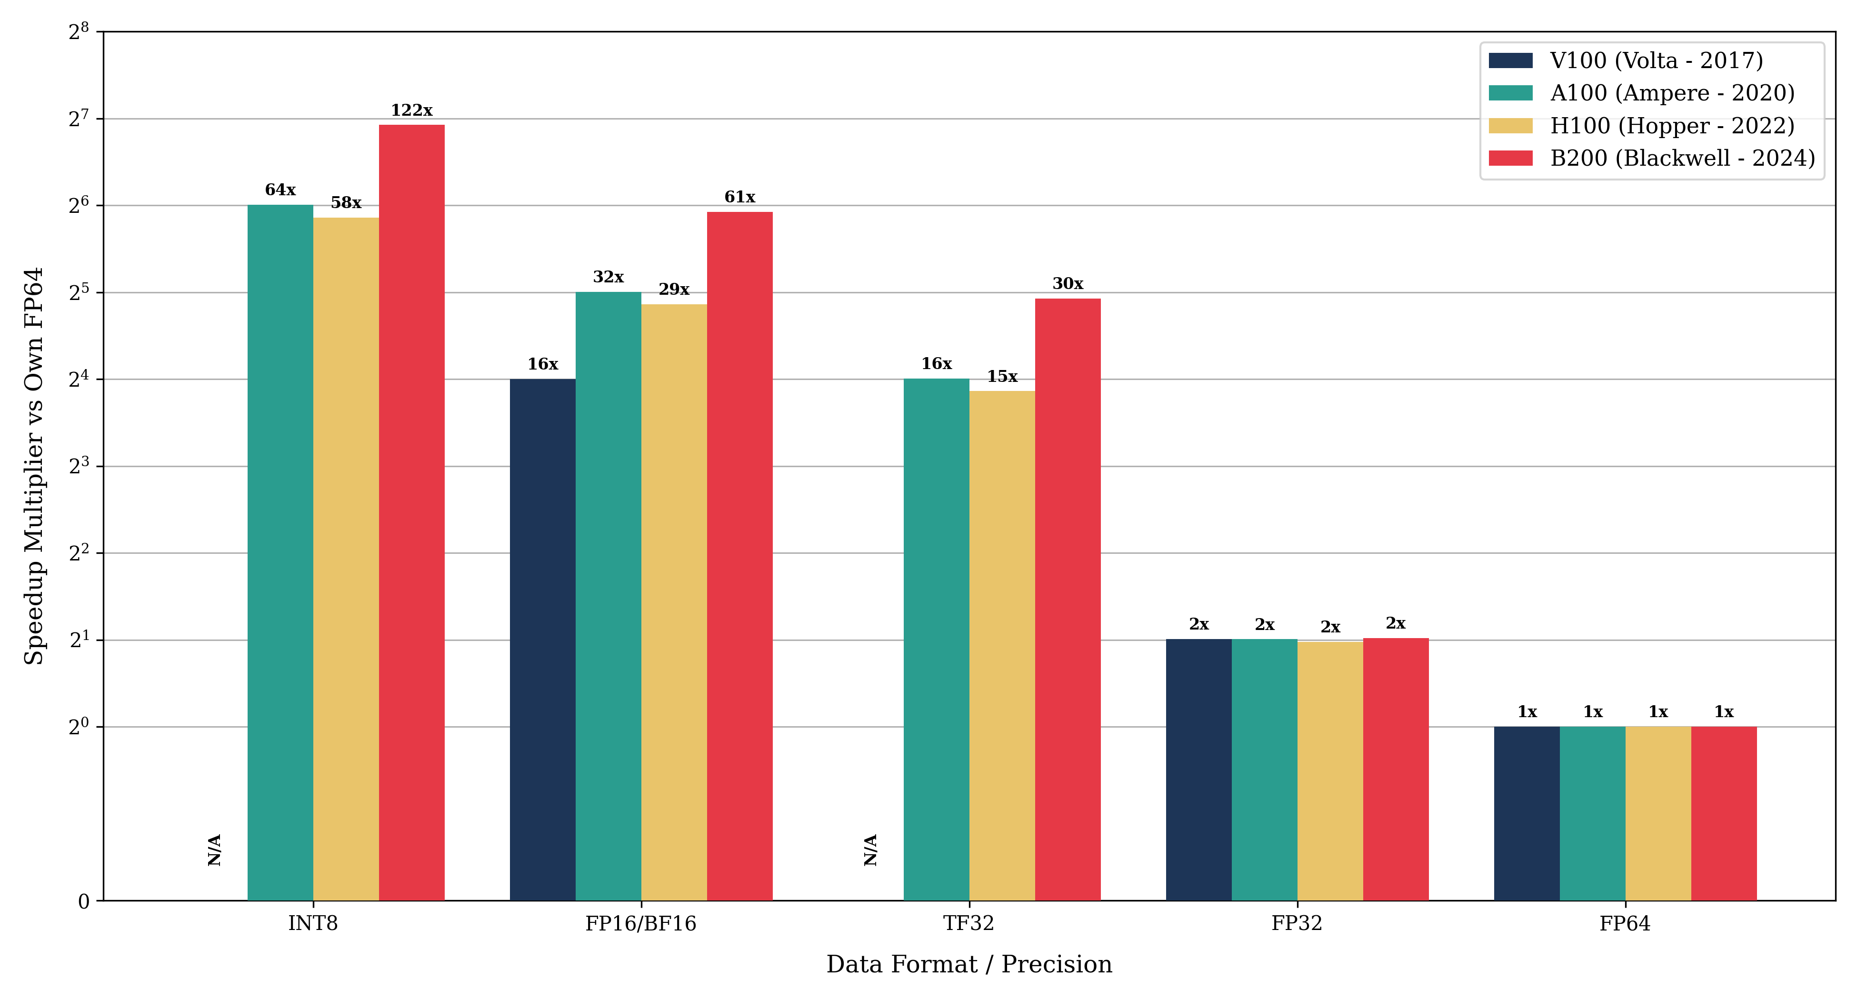
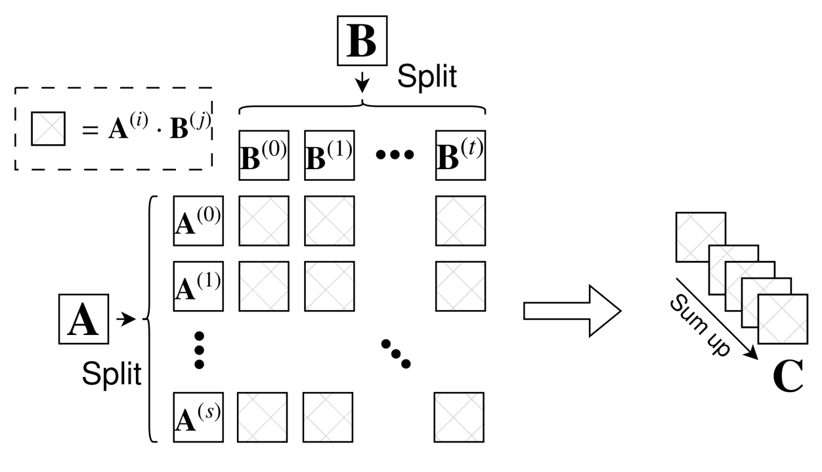
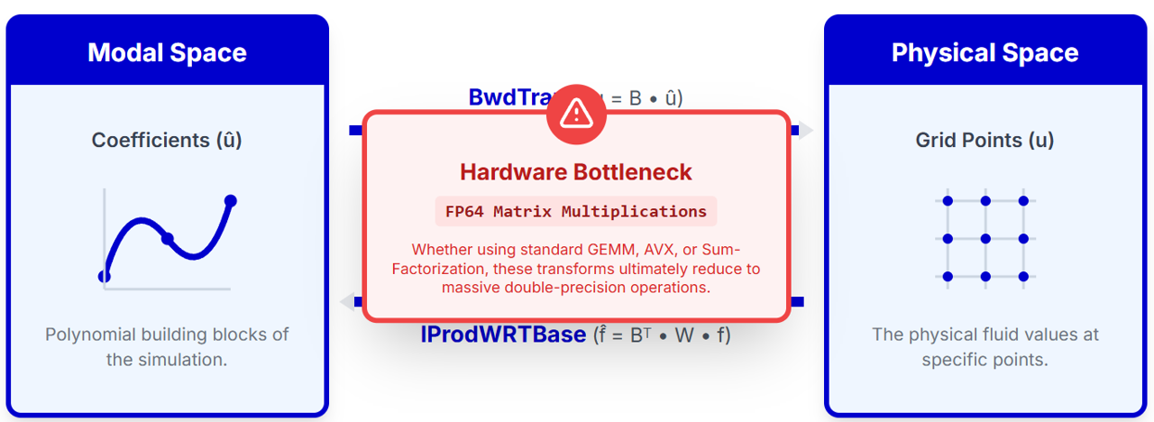

Outline
FYP Interim Presentation
1 | Background
2 | Project Aims & Objectives
3 | Progress to Date
4 | Plan for Remainder
5 | Summary & Conclusion
Leveraging Low-Precision Hardware for High-Fidelity CFD: Integrating the Ozaki Scheme into Nektar++
Paul Kallarackel
02029025
11/03/2026
Figure X: Relative performance speedup of mixed-precision data formats compared to native FP64 compute across four generations of NVIDIA datacenter architectures (Volta, Ampere, Hopper, Blackwell) [1,2,3,4].
Figure X: Diagram showcasing the bottleneck of core operators, such as BwdTrans and IProdWRTBase, in Nektar++ that use GEMM.
Figure X: The Ozaki algorithm: element splitting, partial product cross-multiplication, and final accumulation [1,2,3,4].
Project LRC001 – Paul Kallarackel - 02029025
1 / X
11/03/2026

Slide 2
1. Background
2. Objectives
3. Progress
4. Plan
5. Summary
Outline
FYP Interim Presentation
1 | Background
2 | Project Aims & Objectives
3 | Progress to Date
4 | Plan for Remainder
5 | Summary & Conclusion
Leveraging Low-Precision Hardware for High-Fidelity CFD: Integrating the Ozaki Scheme into Nektar++
Paul Kallarackel
02029025
11/03/2026

Slide 3
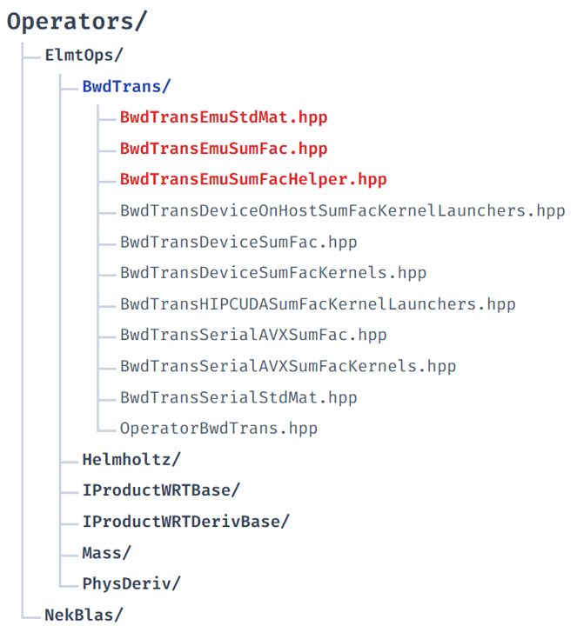
1.1 Current State
1. Background
2. Objectives
3. Progress
4. Plan
5. Summary
Outline
1.1.1 Specific topic
1 | Background
2 | Project Aims & Objectives
3 | Progress to Date
4 | Plan for Remainder
5 | Summary & Conclusion
Figure X: Relative performance speedup of mixed-precision data formats compared to native FP64 compute across four generations of NVIDIA datacenter architectures (Volta, Ampere, Hopper, Blackwell) [1,2,3,4].
Figure X: Diagram showcasing the bottleneck of core operators, such as BwdTrans and IProdWRTBase, in Nektar++ that use GEMM.
Figure X: The Ozaki algorithm: element splitting, partial product cross-multiplication, and final accumulation [1,2,3,4].
Figure X: Proposed integration of emulated operators into Nektar++.

Slide 4
1.1 Current State
1. Background
2. Objectives
3. Progress
4. Plan
5. Summary
1.1.1 Specific topic
Figure X: Relative performance speedup of mixed-precision data formats compared to native FP64 compute across four generations of NVIDIA datacenter architectures (Volta, Ampere, Hopper, Blackwell) [1,2,3,4].
Figure X: Diagram showcasing the bottleneck of core operators, such as BwdTrans and IProdWRTBase, in Nektar++ that use GEMM.
Figure X: The Ozaki algorithm: element splitting, partial product cross-multiplication, and final accumulation [5].
Figure X: Proposed integration of emulated operators into Nektar++.

Slide 5
1.1 Current State
1. Background
2. Objectives
3. Progress
4. Plan
5. Summary
1.1.1 Specific topic
2
Profiling & Benchmarking
Benchmark against highly optimized standard operators
Quantify actual hardware time-to-solution speedup
3
INT8 Algorithm Integration
Explore the extreme low-precision (INT8) variant
Leverage integer tensor cores for max acceleration
1
Priority
Nektar++ Integration
Implement the Ozaki scheme natively into the codebase
Target core backend operators (e.g., BwdTrans)
Figure X: Relative performance speedup of mixed-precision data formats compared to native FP64 compute across four generations of NVIDIA datacenter architectures (Volta, Ampere, Hopper, Blackwell) [1,2,3,4].
Figure X: Diagram showcasing the bottleneck of core operators, such as BwdTrans and IProdWRTBase, in Nektar++ that use GEMM.
Figure X: The Ozaki algorithm: element splitting, partial product cross-multiplication, and final accumulation [1,2,3,4].
Figure X: Proposed integration of emulated operators into Nektar++.

Slide 6
1.1 Current State
1. Background
2. Objectives
3. Progress
4. Plan
5. Summary
1.1.1 Specific topic
2
Profiling & Benchmarking
Benchmark against highly optimized standard operators
Quantify actual hardware time-to-solution speedup
3
INT8 Algorithm Integration
Explore the extreme low-precision (INT8) variant
Leverage integer tensor cores for max acceleration
1
Priority
Nektar++ Integration
Implement the Ozaki scheme natively into the codebase
Target core backend operators (e.g., BwdTrans)
Figure X: Relative performance speedup of mixed-precision data formats compared to native FP64 compute across four generations of NVIDIA datacenter architectures (Volta, Ampere, Hopper, Blackwell) [1,2,3,4].
Figure X: Diagram showcasing the bottleneck of core operators, such as BwdTrans and IProdWRTBase, in Nektar++ that use GEMM.
Figure X: The Ozaki algorithm: element splitting, partial product cross-multiplication, and final accumulation [1,2,3,4].
Figure X: Proposed integration of emulated operators into Nektar++.

Slide 7
1.1 Current State
1. Background
2. Objectives
3. Progress
4. Plan
5. Summary
1.1.1 Specific topic
1
Priority
Nektar++ Integration
Implement the Ozaki scheme natively into the codebase
Target core backend operators (e.g., BwdTrans)
2
Profiling & Benchmarking
Benchmark against highly optimized standard operators
Quantify actual hardware time-to-solution speedup
3
INT8 Algorithm Integration
Explore the extreme low-precision (INT8) variant
Leverage integer tensor cores for max acceleration
Figure X: Proposed integration of emulated operators into Nektar++.

Slide 8
1.1 Current State
1. Background
2. Objectives
3. Progress
4. Plan
5. Summary
1.1.1 Specific topic
1
Priority
Nektar++ Integration
Implement the Ozaki scheme natively into the codebase
Target core backend operators (e.g., BwdTrans)
2
Profiling & Benchmarking
Benchmark against highly optimized standard operators
Quantify actual hardware time-to-solution speedup
3
INT8 Algorithm Integration
Explore the extreme low-precision (INT8) variant
Leverage integer tensor cores for max acceleration
Figure X: Proposed integration of emulated operators into Nektar++.

Slide 9
1.1 Current State
1. Background
2. Objectives
3. Progress
4. Plan
5. Summary
1.1.1 Specific topic
1
Priority
Nektar++ Integration
Implement the Ozaki scheme natively into the codebase
Target core backend operators (e.g., BwdTrans)
2
Profiling & Benchmarking
Benchmark against highly optimized standard operators
Quantify actual hardware time-to-solution speedup
3
INT8 Algorithm Integration
Explore the extreme low-precision (INT8) variant
Leverage integer tensor cores for max acceleration
Figure X: Proposed integration of emulated operators into Nektar++.

Slide 10
1.1 Current State
0%
100%
1. Background
2. Objectives
3. Progress
4. Plan
5. Summary
1.1.1 Specific topic
1
Priority
Nektar++ Integration
Implement the Ozaki scheme natively into the codebase
Target core backend operators (e.g., BwdTrans)
2
Profiling & Benchmarking
Benchmark against highly optimized standard operators
Quantify actual hardware time-to-solution speedup
3
INT8 Algorithm Integration
Explore the extreme low-precision (INT8) variant
Leverage integer tensor cores for max acceleration
Figure X: Proposed integration of emulated operators into Nektar++.

Slide 11
1.1 Current State
1. Background
2. Objectives
3. Progress
4. Plan
5. Summary
1.1.1 Specific topic
0%
100%
1
Priority
Nektar++ Integration
Implement the Ozaki scheme natively into the codebase
Target core backend operators (e.g., BwdTrans)
2
Profiling & Benchmarking
Benchmark against highly optimized standard operators
Quantify actual hardware time-to-solution speedup
3
INT8 Algorithm Integration
Explore the extreme low-precision (INT8) variant
Leverage integer tensor cores for max acceleration

Slide 12
1.1 Current State
1. Background
2. Objectives
3. Progress
4. Plan
5. Summary
1.1.1 Specific topic
0%
100%
This will cover the conclusion of the presentation into 3 key points:
  Number 1
  2edsffsd
  fsdsdffd

Slide 13
1.1 Current State
1. Background
2. Objectives
3. Progress
4. Plan
5. Summary
1.1.1 Specific topic
0%
100%
This will cover the conclusion of the presentation into 3 key points:
  Number 1
  2edsffsd
  fsdsdffd

Slide 14
1.1 Current State
1. Background
2. Objectives
3. Progress
4. Plan
5. Summary
1.1.1 Specific topic
0%
100%
This will cover the conclusion of the presentation into 3 key points:
  Number 1
  2edsffsd
  fsdsdffd

Slide 15

4.1 Current State
0%
100%
1. Background
2. Objectives
3. Progress
4. Plan
5. Summary
On Track
4.1.1 Current Issues to Address
Fail / Alternate
Interim
(Today)
11th Mar
Aim 2
17th Apr
Finalise Thesis
25th May
Aim 1
20th Mar
Aim 3
18th May
Deadline
1st Jun
Optimise BWDTrans
SubTask 1
  Fjf
SubTask 1
  Fjfd
SubTask 1
  Fjfd
Implement Others
Contingency
SubTask 1
  Fjf
SubTask 1
  Fjfd
Benchmark
SubTask 1
  Fjf
Contingency
Integrate INT8
SubTask 1
  Fjf
First Draft
SubTask 1
  Fjf
Final Edits
SubTask 1

Slide 16
4.2 Gantt Chart
1. Background
2. Objectives
3. Progress
4. Plan
5. Summary
On Track
4.2.1 Current State
Fail / Alternate
Interim
(Today)
11th Mar
Aim 2
17th Apr
Finalise Thesis
25th May
Aim 1
20th Mar
Aim 3
18th May
Deadline
1st Jun
Optimise BWDTrans
SubTask 1
  Fjf
SubTask 1
  Fjfd
SubTask 1
  Fjfd
Implement Others
Contingency
SubTask 1
  Fjf
SubTask 1
  Fjfd
Benchmark
SubTask 1
  Fjf
Contingency
Integrate INT8
SubTask 1
  Fjf
First Draft
SubTask 1
  Fjf
Final Edits
SubTask 1

Slide 17
4.2 Gantt Chart
1. Background
2. Objectives
3. Progress
4. Plan
5. Summary
On Track
4.2.1 Current State
Fail / Alternate
Interim
(Today)
11th Mar
Aim 2
17th Apr
Finalise Thesis
25th May
Aim 1
20th Mar
Aim 3
18th May
Deadline
1st Jun
Optimise BWDTrans
SubTask 1
  Fjf
SubTask 1
  Fjfd
SubTask 1
  Fjfd
Implement Others
Contingency
SubTask 1
  Fjf
SubTask 1
  Fjfd
Benchmark
SubTask 1
  Fjf
Contingency
Integrate INT8
SubTask 1
  Fjf
First Draft
SubTask 1
  Fjf
Final Edits
SubTask 1

Slide 18
4.2 Gantt Chart
1. Background
2. Objectives
3. Progress
4. Plan
5. Summary
On Track
Fail / Alternate
4.2.1 Current State
Interim
(Today)
11th Mar
Aim 2
17th Apr
Finalise Thesis
25th May
Aim 1
20th Mar
Aim 3
18th May
Deadline
1st Jun
Optimise BWDTrans
SubTask 1
  Fjf
SubTask 1
  Fjfd
SubTask 1
  Fjfd
Implement Others
Contingency
SubTask 1
  Fjf
SubTask 1
  Fjfd
Benchmark
SubTask 1
  Fjf
Contingency
Integrate INT8
SubTask 1
  Fjf
First Draft
SubTask 1
  Fjf
Final Edits
SubTask 1

Slide 19
4.2 Gantt Chart
1. Background
2. Objectives
3. Progress
4. Plan
5. Summary
On Track
Fail / Alternate
4.2.1 Current State
Interim
(Today)
11th Mar
Aim 2
17th Apr
Finalise Thesis
25th May
Aim 1
20th Mar
Aim 3
18th May
Deadline
1st Jun
Optimise BWDTrans
SubTask 1
  Fjf
SubTask 1
  Fjfd
SubTask 1
  Fjfd
Implement Others
Contingency
SubTask 1
  Fjf
SubTask 1
  Fjfd
Benchmark
SubTask 1
  Fjf
Contingency
Integrate INT8
SubTask 1
  Fjf
First Draft
SubTask 1
  Fjf
Final Edits
SubTask 1

Slide 20
4.2 Gantt Chart
1. Background
2. Objectives
3. Progress
4. Plan
5. Summary
On Track
Fail / Alternate
4.2.1 Current State
Interim
(Today)
11th Mar
Aim 2
17th Apr
Finalise Thesis
25th May
Aim 1
20th Mar
Aim 3
18th May
Deadline
1st Jun
Optimise BWDTrans
SubTask 1
  Fjf
SubTask 1
  Fjfd
SubTask 1
  Fjfd
Implement Others
Contingency
SubTask 1
  Fjf
SubTask 1
  Fjfd
Benchmark
SubTask 1
  Fjf
Contingency
Integrate INT8
SubTask 1
  Fjf
First Draft
SubTask 1
  Fjf
Final Edits
SubTask 1

Slide 21
4.2 Gantt Chart
1
2
This is some text about point 1
First bullet point
  Second bullet point
This is some text about point 2
First bullet point
  Second bullet point
This is some text about point 3
First bullet point
  Second bullet point
Key Point 1
Key Point 2
Key Point 3
3
1. Background
2. Objectives
3. Progress
4. Plan
5. Summary
On Track
Fail / Alternate
4.2.1 Current State
Interim
(Today)
11th Mar
Aim 2
17th Apr
Finalise Thesis
25th May
Aim 1
20th Mar
Aim 3
18th May
Deadline
1st Jun
Optimise BWDTrans
SubTask 1
  Fjf
SubTask 1
  Fjfd
SubTask 1
  Fjfd
Implement Others
Contingency
SubTask 1
  Fjf
SubTask 1
  Fjfd
Benchmark
SubTask 1
  Fjf
Contingency
Integrate INT8
SubTask 1
  Fjf
First Draft
SubTask 1
  Fjf
Final Edits
SubTask 1

Slide 22
5.1 Conclusion
1. Background
2. Objectives
3. Progress
4. Plan
5. Summary
5.1.1 Overall
1
2
This is some text about point 1
First bullet point
  Second bullet point
This is some text about point 2
First bullet point
  Second bullet point
This is some text about point 3
First bullet point
  Second bullet point
Key Point 1
Key Point 2
Key Point 3
3
This will cover the conclusion of the presentation into 3 key points:
  Number 1
  2edsffsd
  fsdsdffd
Thank you for listening!
Any Questions?
On Track
Fail / Alternate
Interim
(Today)
11th Mar
Aim 2
17th Apr
Finalise Thesis
25th May
Aim 1
20th Mar
Aim 3
18th May
Deadline
1st Jun
Optimise BWDTrans
SubTask 1
  Fjf
SubTask 1
  Fjfd
SubTask 1
  Fjfd
Implement Others
Contingency
SubTask 1
  Fjf
SubTask 1
  Fjfd
Benchmark
SubTask 1
  Fjf
Contingency
Integrate INT8
SubTask 1
  Fjf
First Draft
SubTask 1
  Fjf
Final Edits
SubTask 1

Slide 23
5.1 Conclusion
1. Background
2. Objectives
3. Progress
4. Plan
5. Summary
5.1.2 Key Point 1
1
2
This is some text about point 1
First bullet point
  Second bullet point
This is some text about point 2
First bullet point
  Second bullet point
This is some text about point 3
First bullet point
  Second bullet point
Key Point 1
Key Point 2
Key Point 3
3
This will cover the conclusion of the presentation into 3 key points:
  Number 1
  2edsffsd
  fsdsdffd
Thank you for listening!
Any Questions?
On Track
Fail / Alternate
Interim
(Today)
11th Mar
Aim 2
17th Apr
Finalise Thesis
25th May
Aim 1
20th Mar
Aim 3
18th May
Deadline
1st Jun
Optimise BWDTrans
SubTask 1
  Fjf
SubTask 1
  Fjfd
SubTask 1
  Fjfd
Implement Others
Contingency
SubTask 1
  Fjf
SubTask 1
  Fjfd
Benchmark
SubTask 1
  Fjf
Contingency
Integrate INT8
SubTask 1
  Fjf
First Draft
SubTask 1
  Fjf
Final Edits
SubTask 1

Slide 24
5.1 Conclusion
1. Background
2. Objectives
3. Progress
4. Plan
5. Summary
5.1.2 Key Point 1
1
2
This is some text about point 1
First bullet point
  Second bullet point
This is some text about point 3
First bullet point
  Second bullet point
Key Point 1
This is some text about point 2
First bullet point
  Second bullet point
Key Point 3
This will cover the conclusion of the presentation into 3 key points:
  Number 1
  2edsffsd
  fsdsdffd
Key Point 2
3
Thank you for listening!
Any Questions?
On Track
Fail / Alternate
Interim
(Today)
11th Mar
Aim 2
17th Apr
Finalise Thesis
25th May
Aim 1
20th Mar
Aim 3
18th May
Deadline
1st Jun
Optimise BWDTrans
SubTask 1
  Fjf
SubTask 1
  Fjfd
SubTask 1
  Fjfd
Implement Others
Contingency
SubTask 1
  Fjf
SubTask 1
  Fjfd
Benchmark
SubTask 1
  Fjf
Contingency
Integrate INT8
SubTask 1
  Fjf
First Draft
SubTask 1
  Fjf
Final Edits
SubTask 1

Slide 25
5.1 Conclusion
1. Background
2. Objectives
3. Progress
4. Plan
5. Summary
5.1.2 Key Point 1
This is some text about point 3
First bullet point
  Second bullet point
Key Point 3
1
2
3
This is some text about point 1
First bullet point
  Second bullet point
This is some text about point 2
First bullet point
  Second bullet point
This will cover the conclusion of the presentation into 3 key points:
  Number 1
  2edsffsd
  fsdsdffd
Key Point 1
Key Point 2
Thank you for listening!
Any Questions?
On Track
Fail / Alternate
Interim
(Today)
11th Mar
Aim 2
17th Apr
Finalise Thesis
25th May
Aim 1
20th Mar
Aim 3
18th May
Deadline
1st Jun
Optimise BWDTrans
SubTask 1
  Fjf
SubTask 1
  Fjfd
SubTask 1
  Fjfd
Implement Others
Contingency
SubTask 1
  Fjf
SubTask 1
  Fjfd
Benchmark
SubTask 1
  Fjf
Contingency
Integrate INT8
SubTask 1
  Fjf
First Draft
SubTask 1
  Fjf
Final Edits
SubTask 1

Slide 26
Thank you for listening!
Any Questions?
1. Background
2. Objectives
3. Progress
4. Plan
5. Summary
Project LRC001 – Paul Kallarackel - 02029025
26 / X
11/03/2026

Slide 28
Bibliography
[1] Gregor Wernet, Christian Bauer, Bernhard Steubing, JÃ¼rgen Reinhard, Emilia Moreno-Ruiz, Bo Weidema. Product Carbon Footprint (PCF) Summary for NVIDIA HGX B200. The International Journal of Life Cycle Assessment, 2016.
[2] volta-architecture-whitepaper. 2017.
[3] nvidia-ampere-architecture-whitepaper. 2020.
[4] gtc22-whitepaper-hopper. 2022.
[5] Hiroyuki Ootomo, Katsuhisa Ozaki, Rio Yokota. DGEMM on Integer Matrix Multiplication Unit. arXiv, 2024.

Slide 29
Appendix

