Slide 1
Blazor / WebAssembly
Hack Night
Martin Kräuchi
Bern, Januar 2020

Slide 2
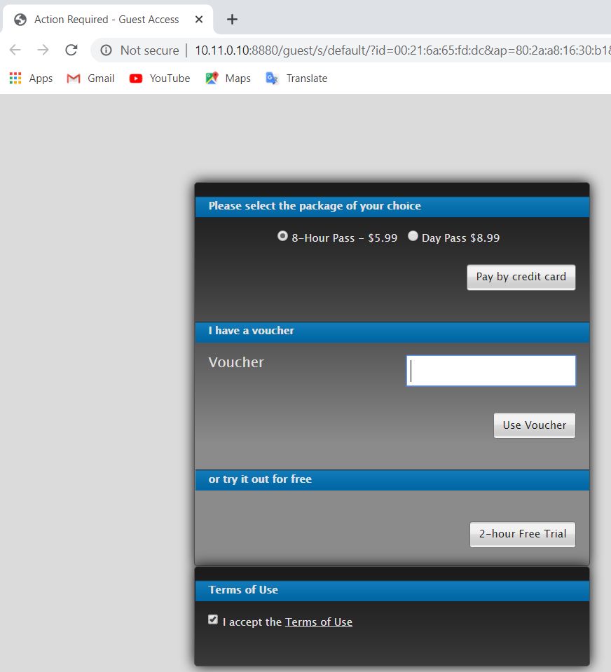
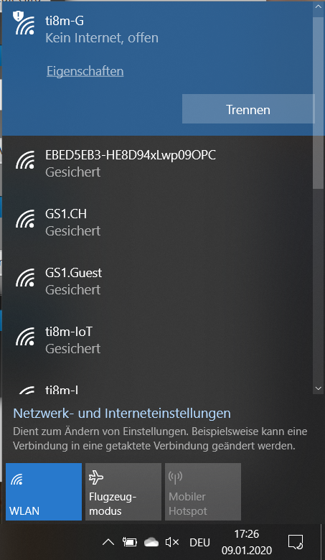
Voucher
33554-xxxxxx
Eingeben
+
Abstreichen

Slide 3
WebAssembly

Slide 4
WebAssembly https://webassembly.org/ https://developer.mozilla.org/en-US/docs/WebAssembly https://webassembly.github.io/spec/core/intro/introduction.html https://wasdk.github.io/WasmFiddle/ https://webassembly.studio/?f=ivzzdwn7fcn
Notes:
https://tutorialzine.com/2017/06/getting-started-with-web-assembly#

Slide 5
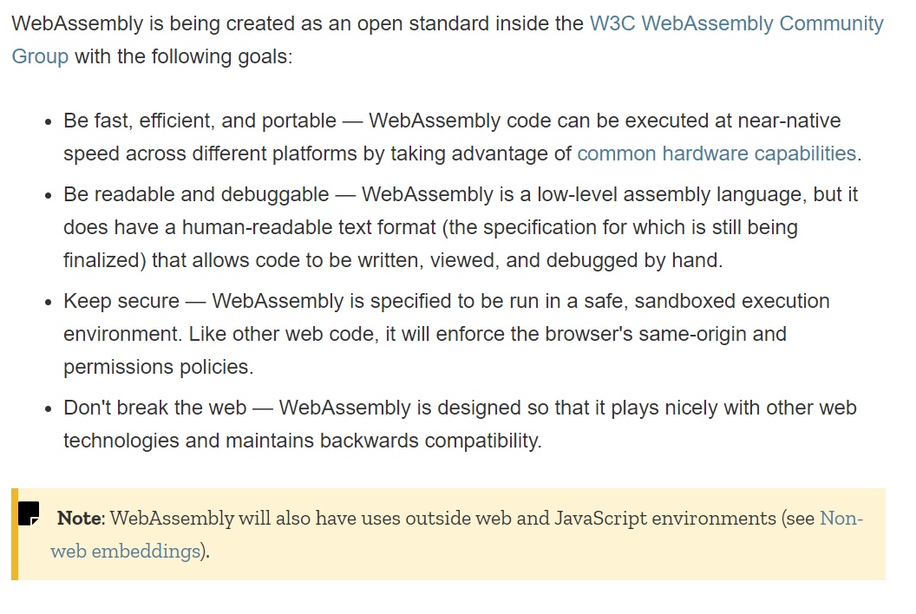
WebAssembly goals
https://developer.mozilla.org/en-US/docs/WebAssembly/Concepts
https://webassembly.org/docs/use-cases/
Notes:
https://tutorialzine.com/2017/06/getting-started-with-web-assembly#
https://wasdk.github.io/WasmFiddle/?10fxw8

Slide 6
WebAssembly – Basics 1
https://developer.mozilla.org/en-US/docs/WebAssembly/Understanding_the_text_format
There is a binary and a textual format.
Types
i32: 32-bit integer i64: 64-bit integer f32: 32-bit floating point f64: 64-bit floating point
Stack Maschine
(func (param $p i32)
local.get $p
local.get $p
i32.add)
https://pengowray.github.io/wasm-ops/
https://wasmweekly.news/
Simple ADD Function
(module
(func $add (param $lhs i32) (param $rhs i32) (result i32)
local.get $lhs
local.get $rhs
i32.add)
(export "add" (func $add))
)
Lets have a look at this:
https://mdn.github.io/webassembly-examples/understanding-text-format/add.html
How to call from Java Script:
WebAssembly.instantiateStreaming(fetch('add.wasm')) .then(obj => { console.log(obj.instance.exports.add(1, 2)); // "3" });
Notes:
https://tutorialzine.com/2017/06/getting-started-with-web-assembly#
https://wasdk.github.io/WasmFiddle/?10fxw8

Slide 7
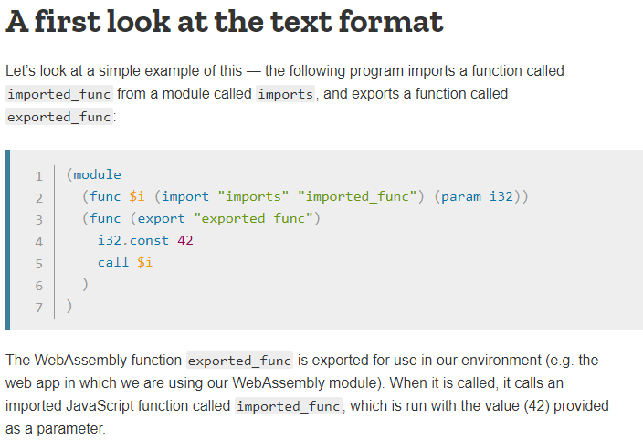

WebAssembly – Basics 1b
https://developer.mozilla.org/en-US/docs/WebAssembly/Understanding_the_text_format
Covert textual format to binary format:

Slide 8
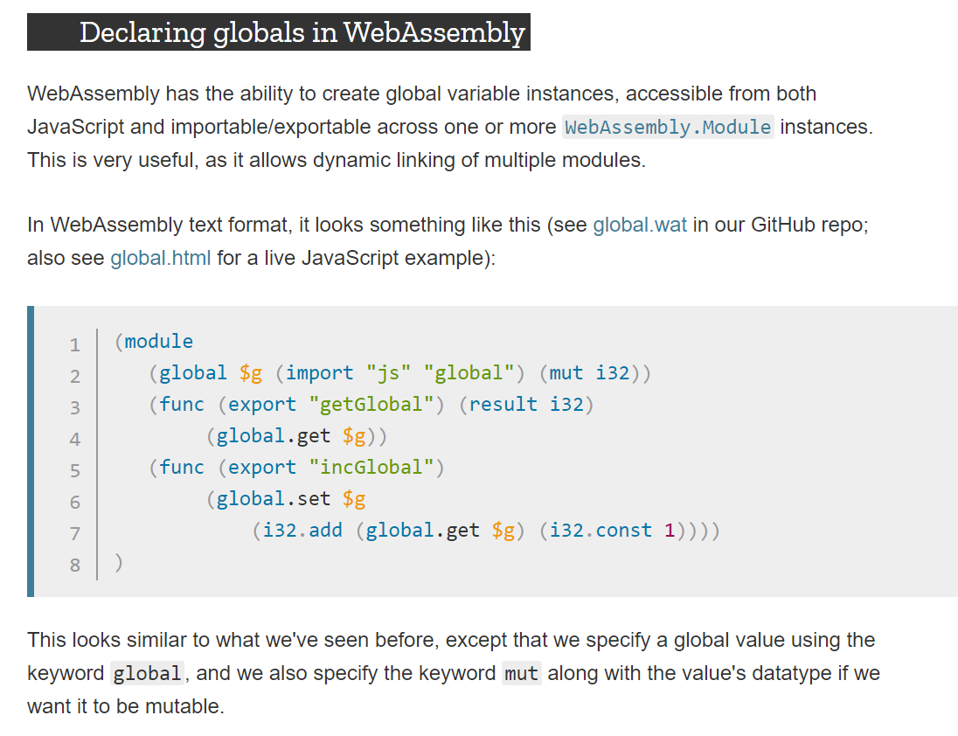
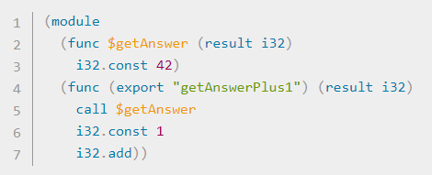
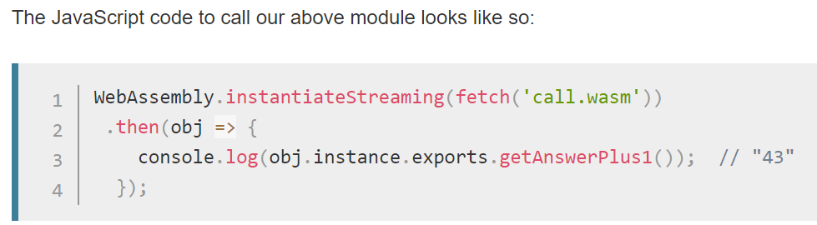
WebAssembly – Basics 2
https://developer.mozilla.org/en-US/docs/WebAssembly/Understanding_the_text_format
https://mdn.github.io/webassembly-examples/js-api-examples/global.html
Notes:
https://tutorialzine.com/2017/06/getting-started-with-web-assembly#

Slide 9
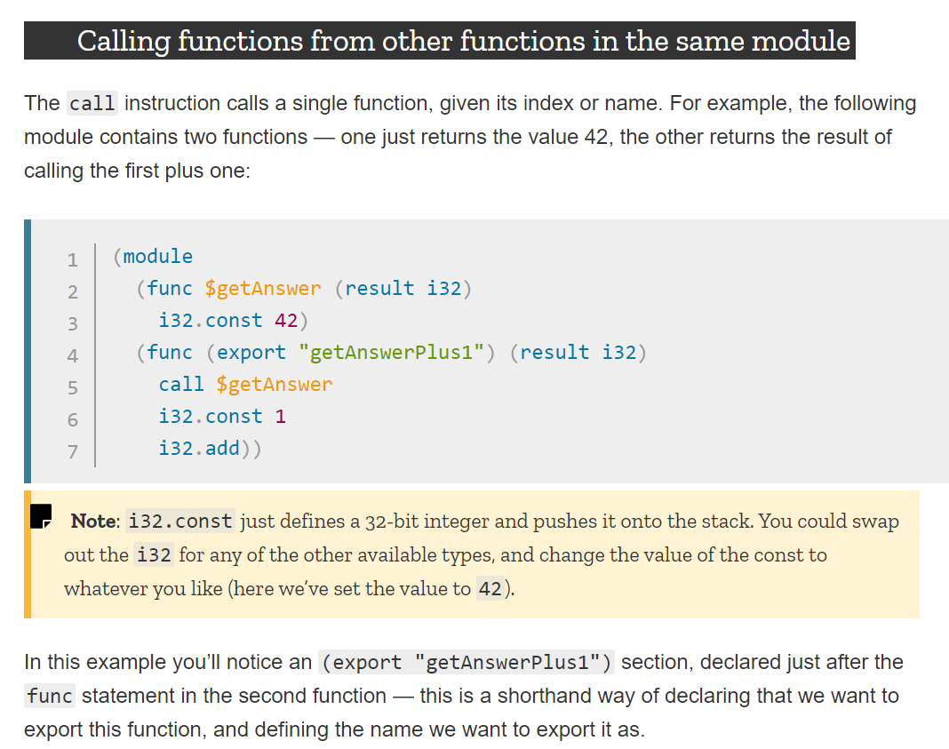
WebAssembly – Basics 3
https://developer.mozilla.org/en-US/docs/WebAssembly/Understanding_the_text_format
Notes:
https://tutorialzine.com/2017/06/getting-started-with-web-assembly#

Slide 10
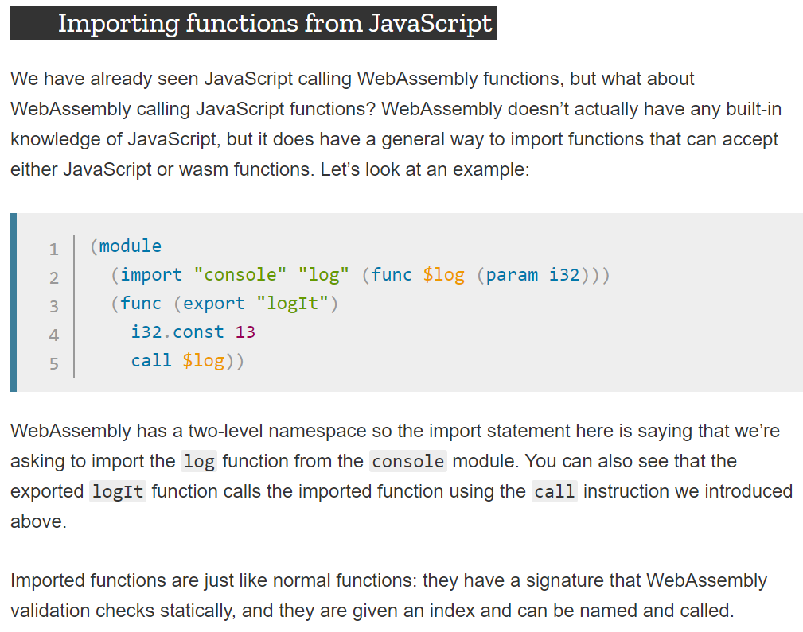
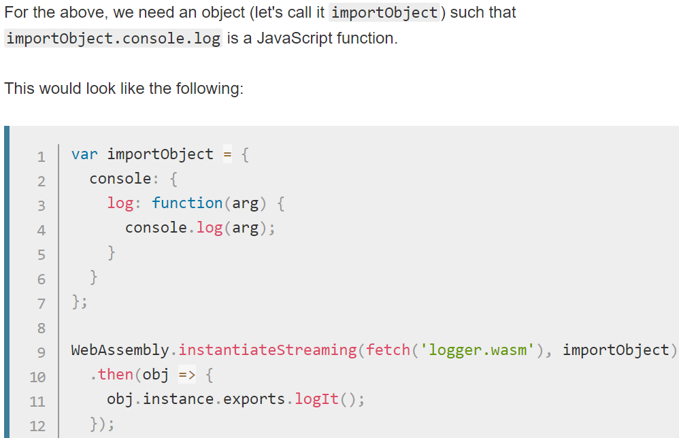
WebAssembly – Basics 4
https://developer.mozilla.org/en-US/docs/WebAssembly/Understanding_the_text_format
Notes:
https://tutorialzine.com/2017/06/getting-started-with-web-assembly#

Slide 11
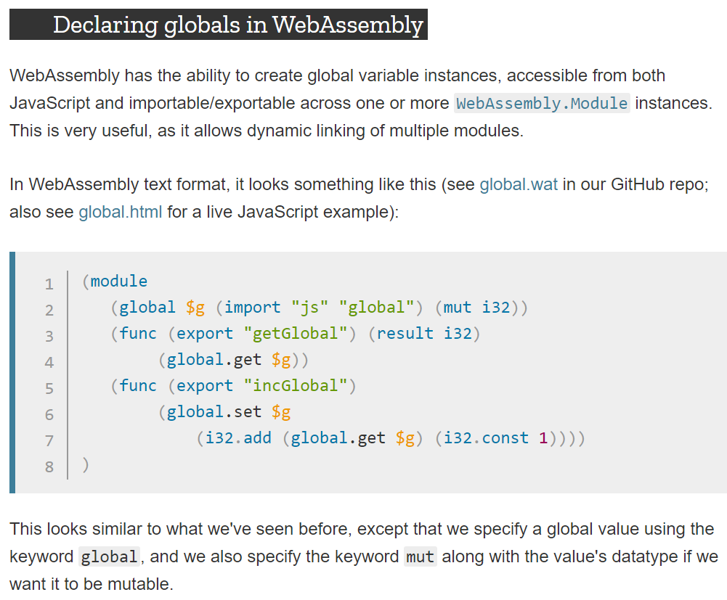
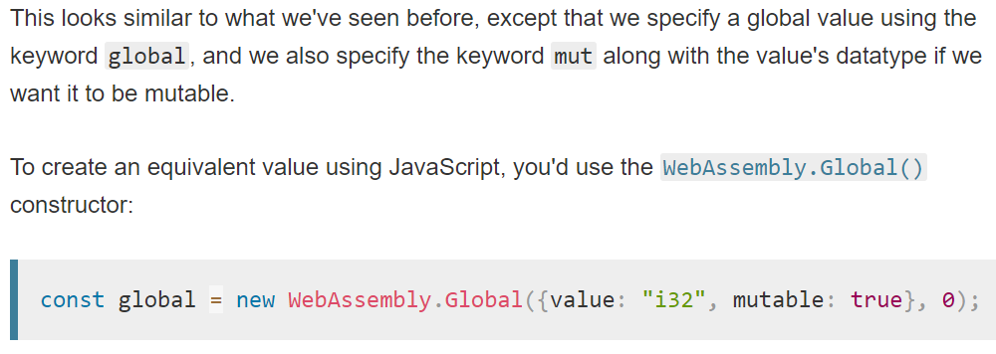
WebAssembly – Basics 5
https://developer.mozilla.org/en-US/docs/WebAssembly/Understanding_the_text_format
Notes:
https://tutorialzine.com/2017/06/getting-started-with-web-assembly#

Slide 12
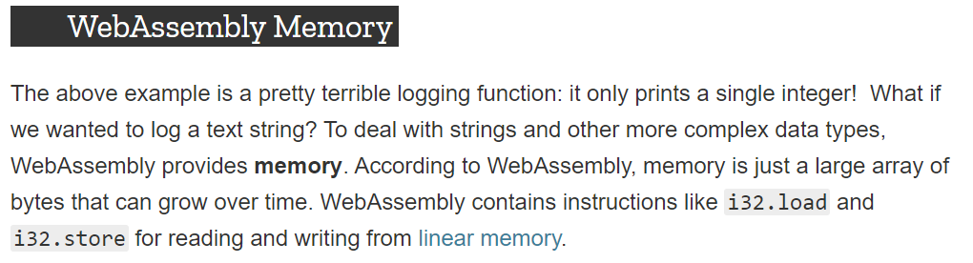
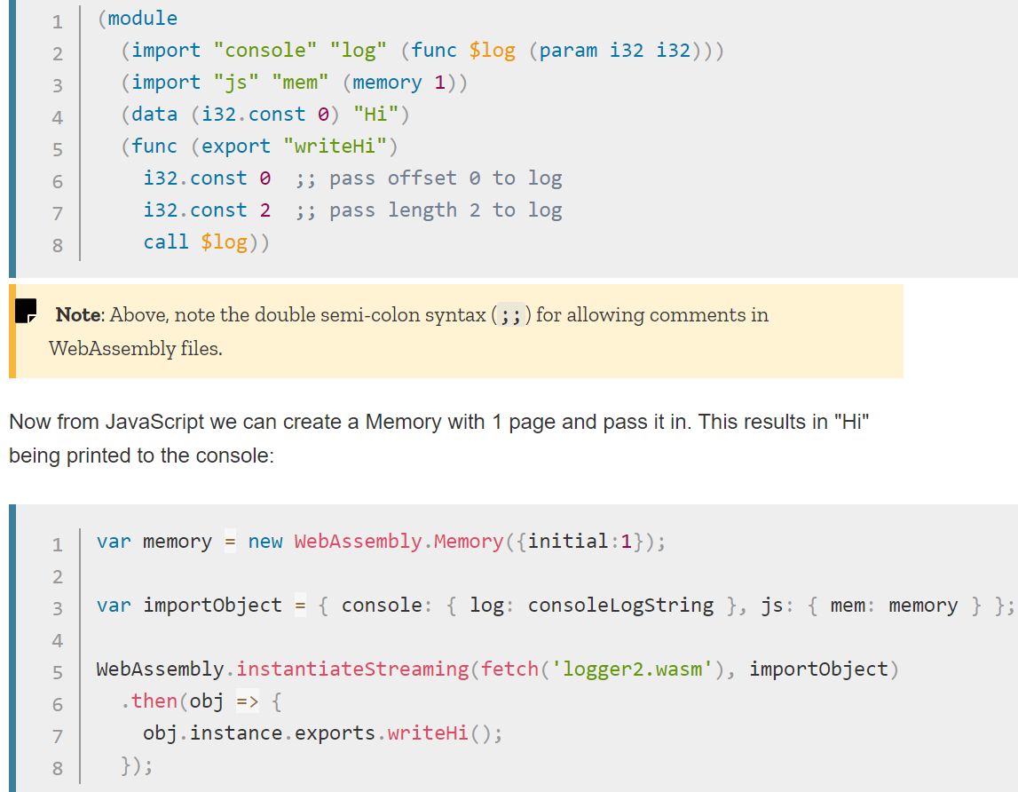
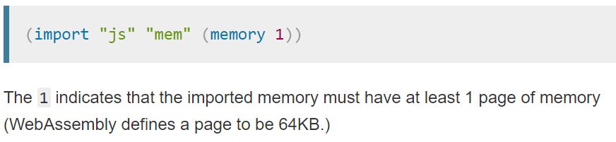
WebAssembly – Basics 6
https://developer.mozilla.org/en-US/docs/WebAssembly/Understanding_the_text_format
Notes:
https://tutorialzine.com/2017/06/getting-started-with-web-assembly#

Slide 13
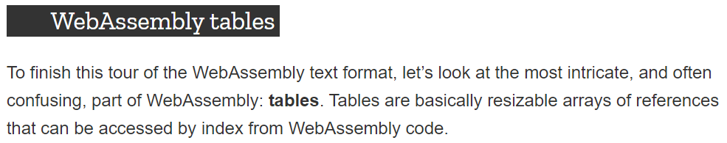
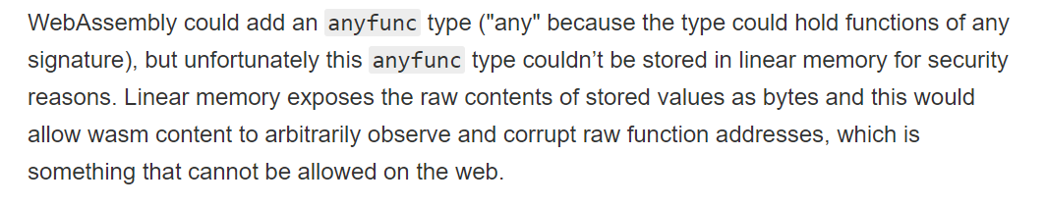
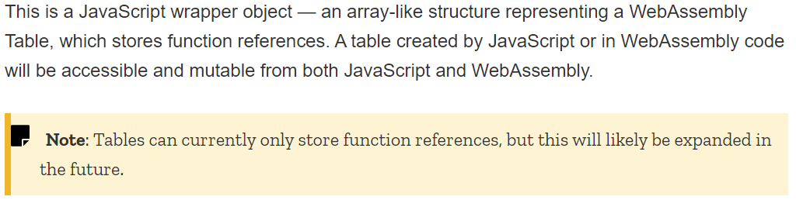
WebAssembly – Basics 7
https://developer.mozilla.org/en-US/docs/WebAssembly/Understanding_the_text_format
Notes:
https://tutorialzine.com/2017/06/getting-started-with-web-assembly#

Slide 14
Performance of WebAssembly
Speed: https://medium.com/@mbebenita/webassembly-is-30x-faster-than-javascript-c71ea54d2f96
https://wasdk.github.io/WasmFiddle/?warlb
https://github.com/JeremyLikness/blazor-wasm/tree/master/primes
https://jlikme.z13.web.core.windows.net/blazor-wasm/primes/primes.html
https://blog.jeremylikness.com/blog/2019-04-22_play-the-chaos-game-to-understand-webassembly-memory-management/
Notes:
https://tutorialzine.com/2017/06/getting-started-with-web-assembly#

Slide 15
How to handle Strings?
https://stackoverflow.com/questions/41353389/how-can-i-return-a-javascript-string-from-a-webassembly-function

Slide 16
Blazor

Slide 17
Overview
What is Blazor?
Blazor is a Single Page Application development framework. The name Blazor is a combination/mutation of the words Browser and Razor (the .NET HTML view generating engine). The implication being that instead of having to execute Razor views on the server in order to present HTML to the browser, Blazor is capable of executing these views on the client.
Blazor lets you build interactive web UIs using C# instead of JavaScript. Blazor apps are composed of reusable web UI components implemented using C#, HTML, and CSS. Both client and server code is written in C#, allowing you to share code and libraries.
Blazor is a feature of ASP.NET, the popular web development framework that extends the .NET developer platform with tools and libraries for building web apps.
Facts
Open Source, C# based, no transpilation
client-side (WebAssembly) / server-side (Communication over SignalR)
component based
implements .NET Standard 2.0.
Bootstrap (https://getbootstrap.com/)

Slide 18
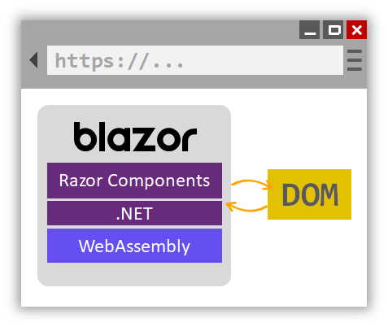
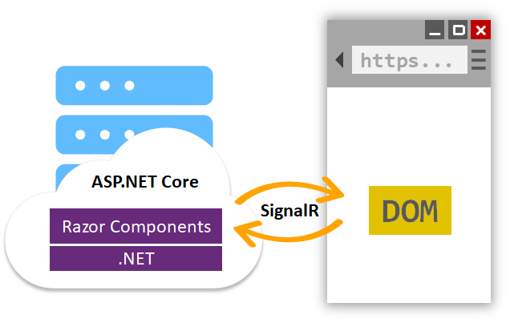
Blazor WebAssembly
(in preview)
Blazor Server
2x Modes: Blazor page files remain the same

Slide 19
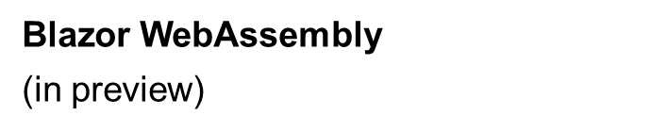
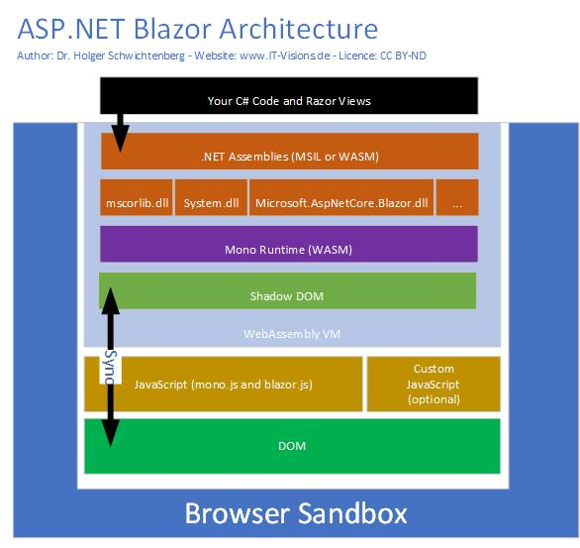
https://weblog.west-wind.com/posts/2018/jul/31/web-assembly-and-blazor-reassembling-the-web#how-blazor-works

Slide 20
Install Blazor on local machine
Follow these instructions to set up your machine:
https://docs.microsoft.com/en-us/aspnet/core/blazor/get-started?view=aspnetcore-3.1&tabs=visual-studio
Useful Commands
Dotnet watch run | Live updating
Dotnet run | Run
dotnet run --configuration Debug Aus <https://docs.microsoft.com/en-gb/aspnet/core/blazor/debug?view=aspnetcore-3.0> | Explict Debug
Dotnet -h | Get help
dotnet new blazorserver -o <Projectname> | Create Serverside App
dotnet new blazorwasm -o <Projectname> | Create Clientside App
Install-Package WindowsAzure.Storage Aus <https://www.red-gate.com/simple-talk/cloud/cloud-data/an-introduction-to-windows-azure-table-storage/> | Über den Package Manager
dotnet add package WindowsAzure.Storage --version 9.3.3 | Über das Terminal ohne Package Manager
git init git all . git commit . | Commands to create git repo using visual studio code (e.g.)
Easiest way: Install Visual Studio 2019 Preview

Slide 21
Get started with ASP.NET Core Blazor
https://docs.microsoft.com/en-us/aspnet/core/blazor/?view=aspnetcore-3.1
Some Demos: https://lupblazordemos.z13.web.core.windows.net/
https://github.com/kraeuchi/blazor-hacknight
We go along the tutorial:
https://studyblazor.com/

Slide 22
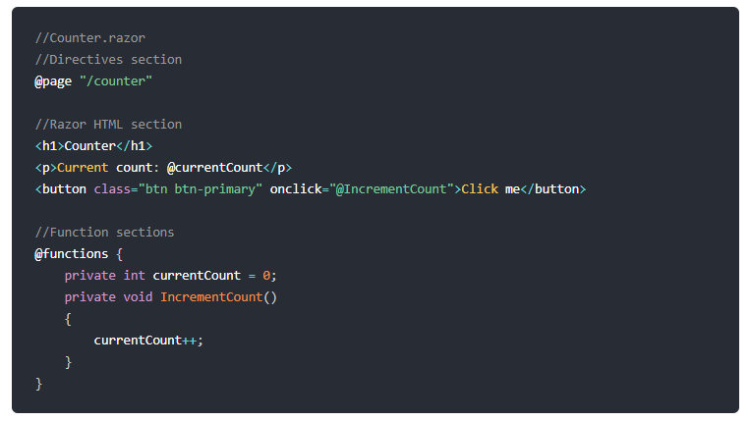
Structure of Razor - Pages

Slide 23
Example of ToDo - List
@code {
public class TodoItem
{
public string Title { get; set; }
public bool IsDone { get; set; }
}
IList<TodoItem> todos = new List<TodoItem>();
string newTodo;
void AddTodo()
{
if (!string.IsNullOrWhiteSpace(newTodo))
{
todos.Add(new TodoItem { Title = newTodo });
newTodo = string.Empty;
}
}
}
@page "/"
<h1>Todo (@todos.Where(todo => !todo.IsDone).Count())</h1>
<ul>
@foreach (var todo in todos)
{
<li>
<input type="checkbox" @bind="todo.IsDone" />
<input @bind="@todo.Title" />
</li>
}
</ul>
<input placeholder="Something todo" @bind="newTodo" />
<button @onclick="AddTodo">Add todo</button>

Slide 24
Extended ToDo – List with Handler
https://blazorfiddle.com/s/p6yzkyg3
Notes:
@page "/"
<h1>Todo (@hnd.Todos.Where(todo => !todo.IsDone).Count())</h1>
<ul>
@foreach (var todo in hnd.Todos)
{
<li>
<input type="checkbox" @bind="todo.IsDone" />
<input @bind="@todo.Title" />
@todo.Info
</li>
}
</ul>
<input placeholder="Something todo" @bind="newTodo" />
<button @onclick="AddTodo">Add todo</button>
@if (!string.IsNullOrEmpty(@hnd.GuidToDeleteStr))
{
<p> DELETE Todo = @hnd.GuidToDeleteStr </p>
}
@if (!string.IsNullOrEmpty(@hnd.GuidToUpdateStr))
{
<p> UPDATE Todo = @hnd.GuidToUpdateStr </p>
}
@code {
string newTodo; // title of todo
public TodosHandler hnd = new TodosHandler(); // handler to add, delete, update todo entries
void AddTodo()
{
if (!string.IsNullOrWhiteSpace(newTodo))
{
hnd.AddTodo(newTodo);
newTodo = string.Empty;
}
}
public class TodoItem
{
private string _title;
public string Title {
get { return _title; }
set {
_title = value;
if (Handler != null) Handler.UpdateToDo(this.Guid);
}
}
private bool _isDone;
public bool IsDone
{
get { return _isDone; }
set
{
_isDone = value;
if (Handler != null) Handler.DeleteToDo(this.Guid);
}
}
public TodosHandler Handler { get; set; }
private string _info = String.Empty;
public string Info { get { return " Guid =" + Guid.ToString(); } }
private Guid _guid = Guid.NewGuid();
public Guid Guid { get { return _guid; }}
}
public class TodosHandler
{
private IList<TodoItem> _todos = new List<TodoItem>();
public IList<TodoItem> Todos { get { return _todos; } }
public void AddTodo(string aTitle)
{
_todos.Add(new TodoItem { Title = aTitle, Handler = this });
// update persistence here ..
}
public String GuidToDeleteStr { get; set; }
public void DeleteToDo(Guid GuidToDelete)
{
// update persistence here ...
GuidToDeleteStr = GuidToDelete.ToString();
}
public String GuidToUpdateStr { get; set; }
public void UpdateToDo(Guid GuidToUpdate)
{
// update persistence here ...
GuidToUpdateStr = GuidToUpdate.ToString();
}
}
}

Slide 25
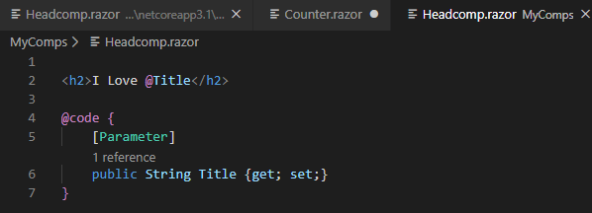
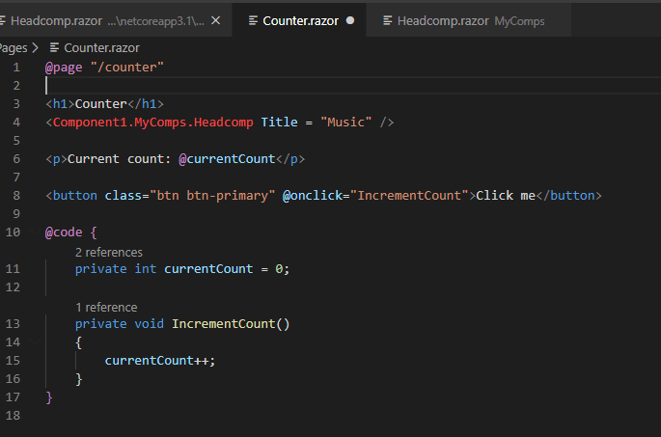
Creating a component

Slide 26
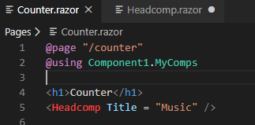
Creating a component
Definition
Use full qualified namespace or
… apply the @using directive
Hints: Component1 = name of the project
MyComps = name of the folder

Slide 27
Ideas for our hack night
Create an Application to Search CH-Adresses:
Ihr persönlicher API-Schlüssel: f94106b73f8d3d4b7de1ab55b8218a1d
Auf https://tel.search.ch/api/help finden Sie eine Anleitung zur Benutzung des APIs.
Improve the Chat-App
Extend the ToDo-List to save data in the IndexedDB

Slide 28
Links
https://blazor-university.com/
https://chrissainty.com/
https://csharp.christiannagel.com/2019/08/27/blazorserverandclient/
https://github.com/AdrienTorris/awesome-blazor
https://github.com/chanan/BlazorDB
http://learn-blazor.com/getting-started/
https://stackify.com/blazor-introduction/
https://studyblazor.com/
https://docs.microsoft.com/en-us/aspnet/core/mvc/views/razor?view=aspnetcore-3.1 Razor Syntax
https://blazorfiddle.com/

Slide 29
Annex

Slide 30
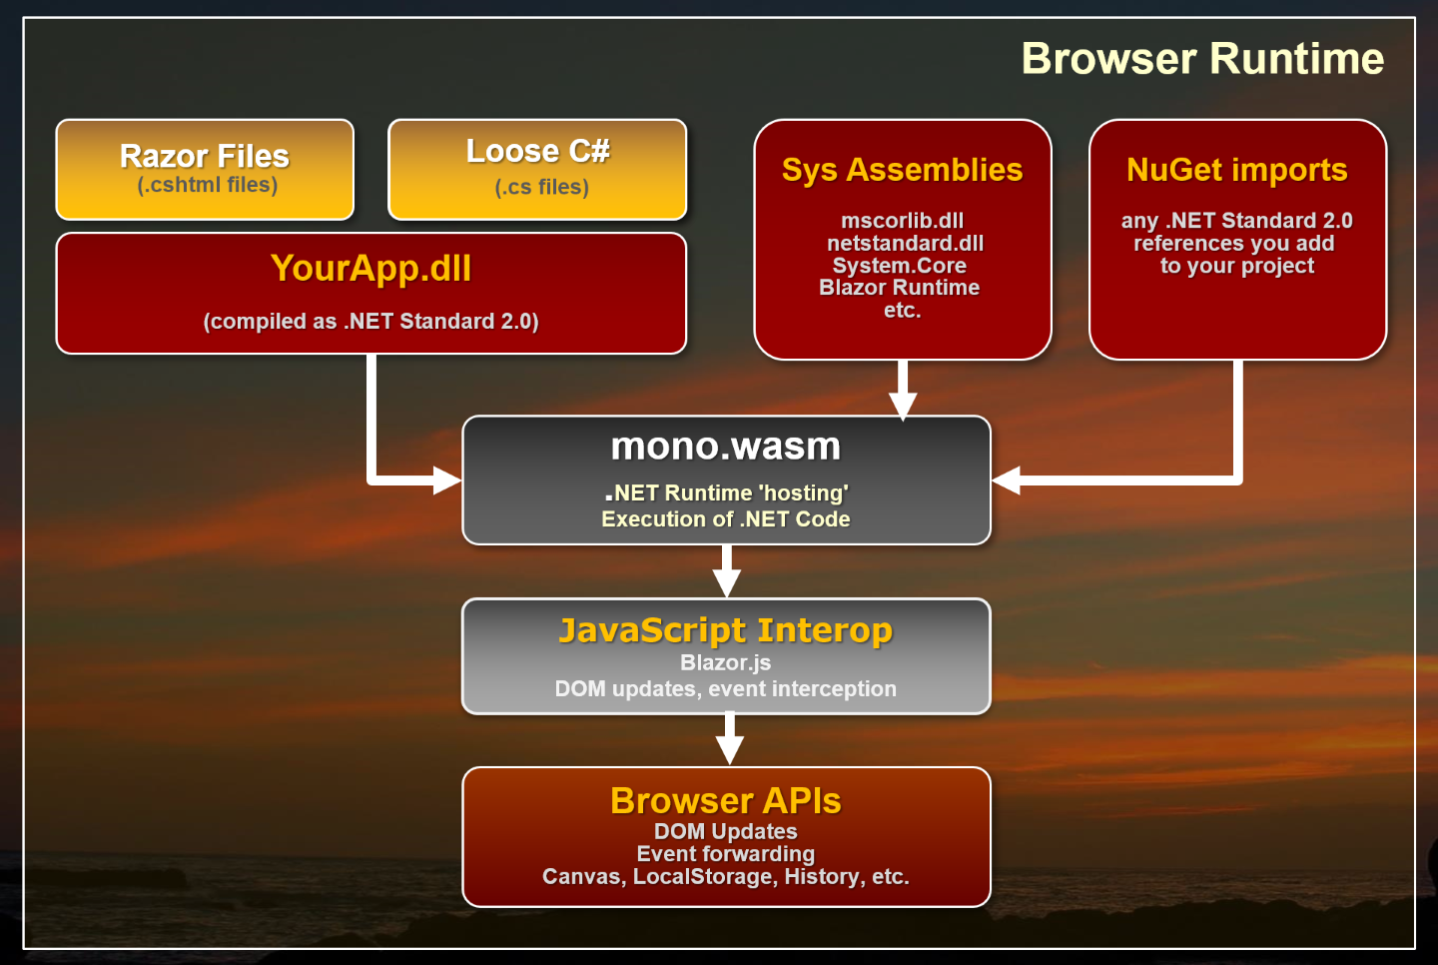
Notes:
https://weblog.west-wind.com/posts/2018/jul/31/web-assembly-and-blazor-reassembling-the-web#byte-code-representation----native-execution

Slide 31
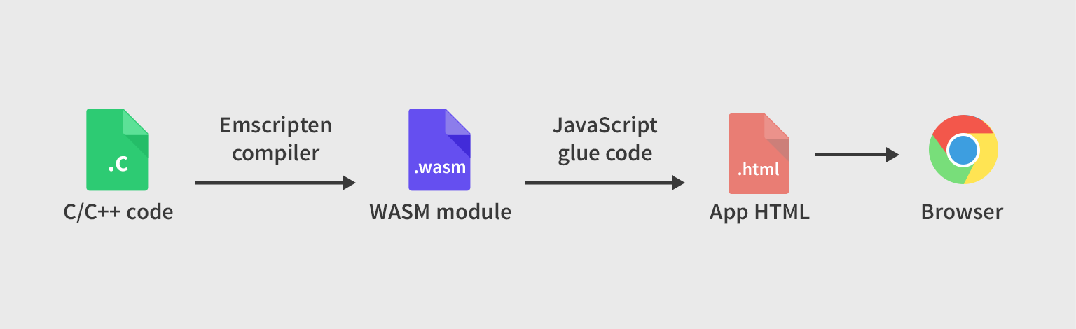
WebAssembly & Blazor
Notes:
https://stackoverflow.com/questions/57274230/is-it-possible-to-embed-a-blazor-component-in-a-non-net-website

Slide 32
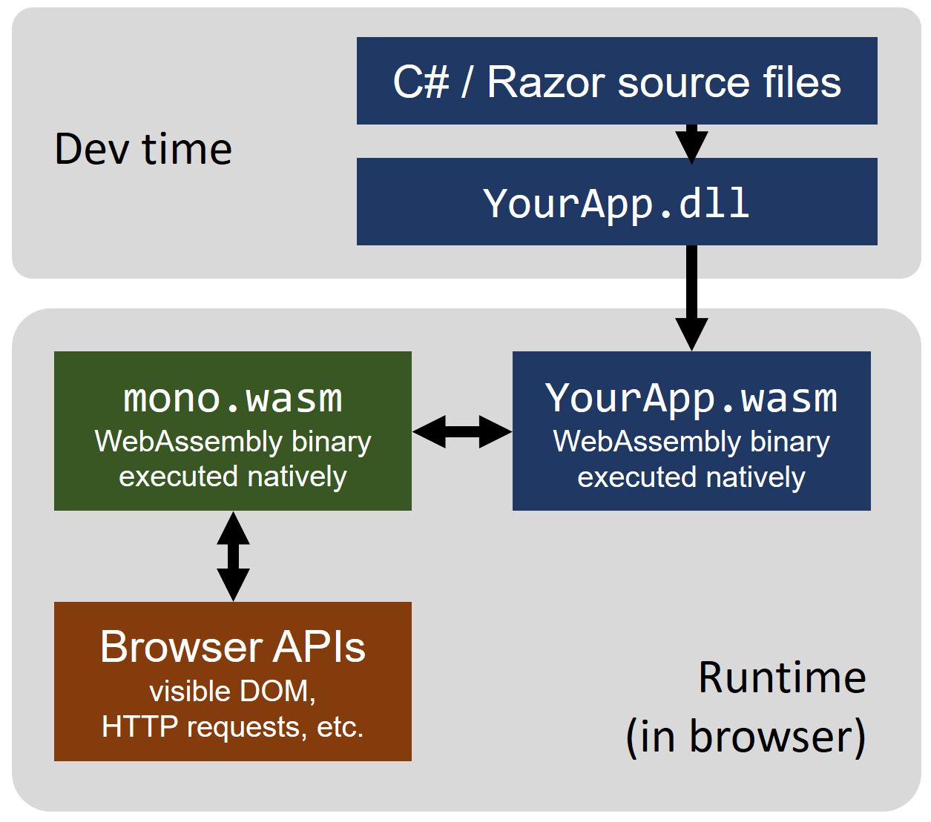
WebAssembly & Blazor
Notes:
https://stackoverflow.com/questions/57274230/is-it-possible-to-embed-a-blazor-component-in-a-non-net-website

Slide 33
Why WebAssembly Matters
First, a short primer on what WebAssembly is and why it needs to be on every web developer’s radar.
WebAssembly or wasm is a new portable, size- and load-time-efficient format suitable for compilation to the web.
You generally won’t write WebAssembly directly, but you will compile programs to wasm. If you’ve ever worked in any compiled language like C or C++, RUST, C#, Kotlin, Java, you know that you don’t sit there and write assembly code — you write in a higher level language that compiles to assembly.
Java: https://github.com/konsoletyper/teavm
C#: Blazor
Kotlin: https://superkotlin.com/kotlin-and-webassembly/
Notes:
https://tutorialzine.com/2017/06/getting-started-with-web-assembly#

