Slide 1
Knowledge Management
UE17CS342
Project Title : Project Management System Website
Project Guide : Dr. Jayashree
Project Team : Kethan MV - PES1201701085
Kaustubh R - PES1201700916
Suraj MM - PES1201701551
K Suhas - PES1201700816
Vihan Murthy - PES1201701603

Slide 2
Project Abstract
Project Management System is a web-based application developed using php.
It helps the users to manage their project work and review the work of the
ongoing projects. It offers a convenient and flexible way of searching and
uploading the projects.
It helps plan, organize, and handle resource pools and develop resource
estimates. Depending on the scope of the application, these resources may be
decision-making, planning and tracking, resource allocation, quality
management and communication.

Slide 3
Design Approach
It has a user-friendly interface which helps the user to login to the portal and
he can upload his own projects. There is an administrator who manages the
users and the projects and he can process the requests of the users if the user
asks for the source code of a particular project
All the users, projects are stored in MySQL database and the users
can upload, and download projects from the website and the
information is retrieved from the database.

Slide 4
Modules Used
Sign UP/Registration: New users can sign up into project management system application by providing details such as name, email, birthday, gender, and mobile number.
Admin: Admin is the main controller of this application. They are assigned with tasks such as manage projects, manage users, view uploaded projects, delete projects, delete users, etc.
Upload Projects: This module consists of project title, authors, acknowledgement, project abstract, year, programming language used, and domain. These options can be filled out to upload files of the project to the website.

Slide 5
Knowledge Management
The four knowledge management processes:
Capturing: Uploading of projects by faculty, students etc.
Organizing: Sorting of these projects based on the year, branch to which it belongs such as Computer Science, Electronics
etc.
Refining: Can communicate between multiple users within a chat
box so that it will be easier for the users to review the
projects.
Transfer: Sharing of these project information between students.

Slide 6
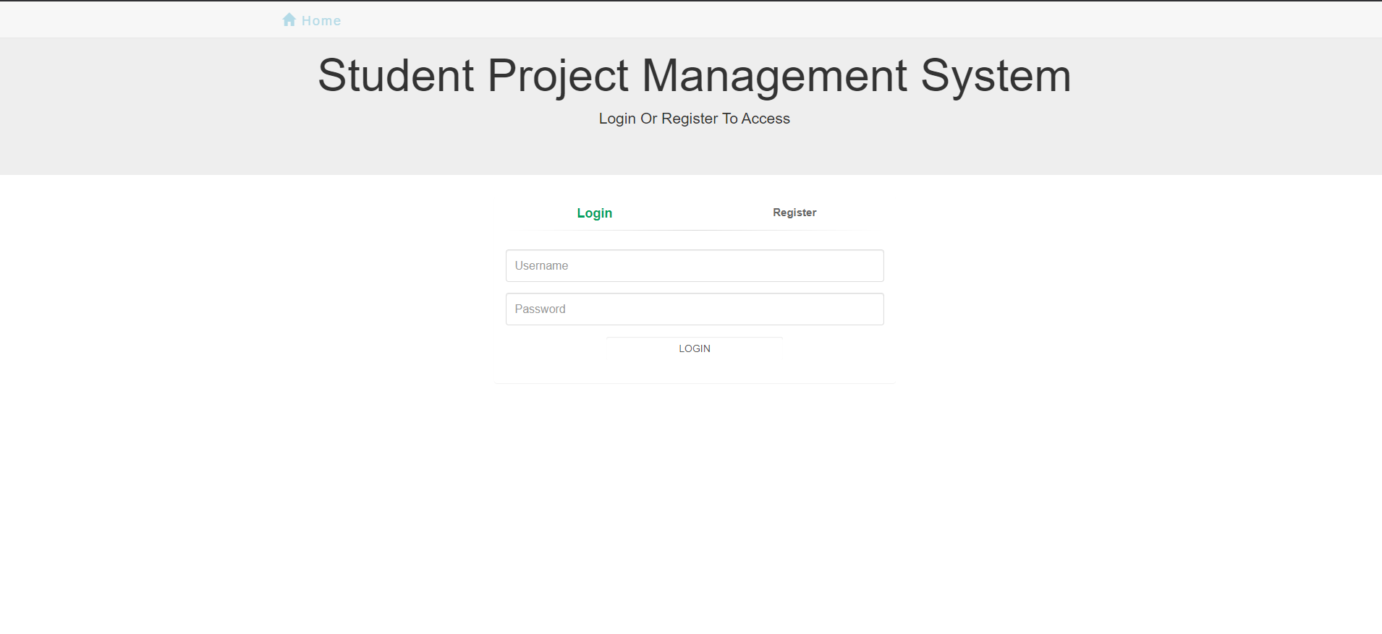
Design Description/UI Design
Login and Registration form

Slide 7
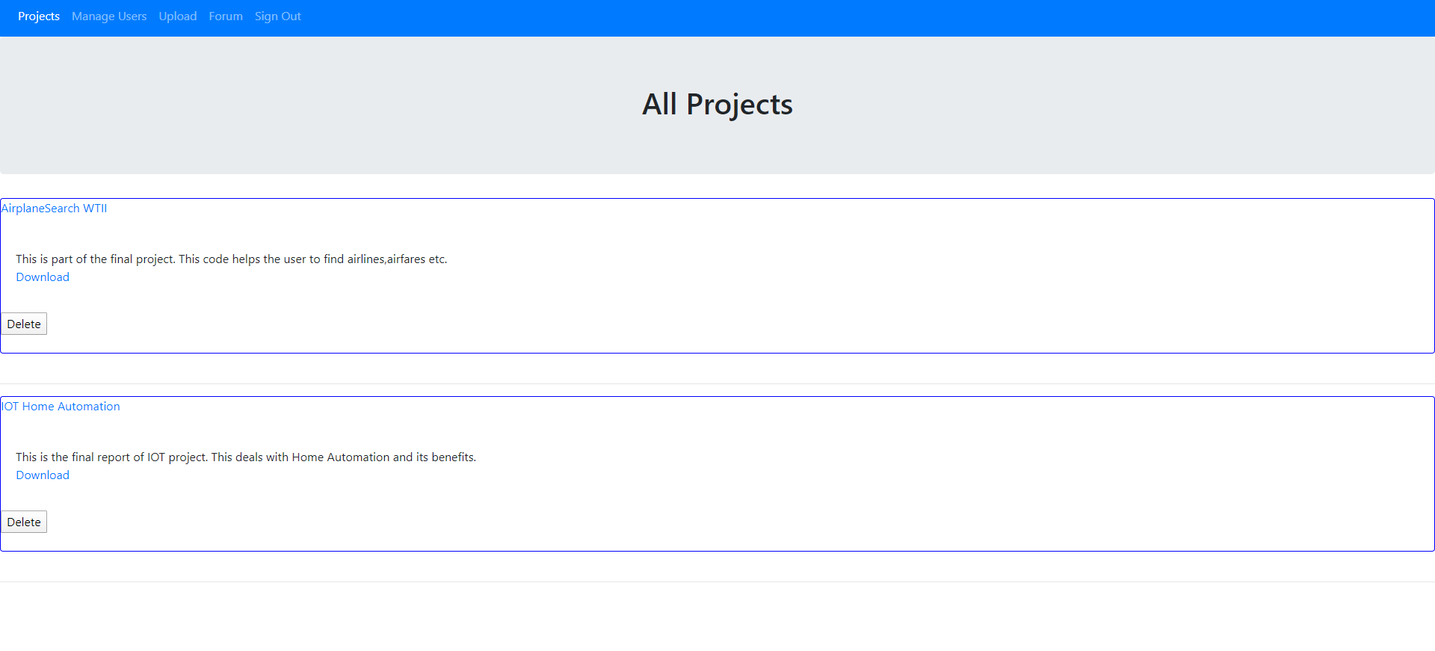
Design Description/UI Design
List of all the projects which are uploaded and can be managed
by the administrator.

Slide 8
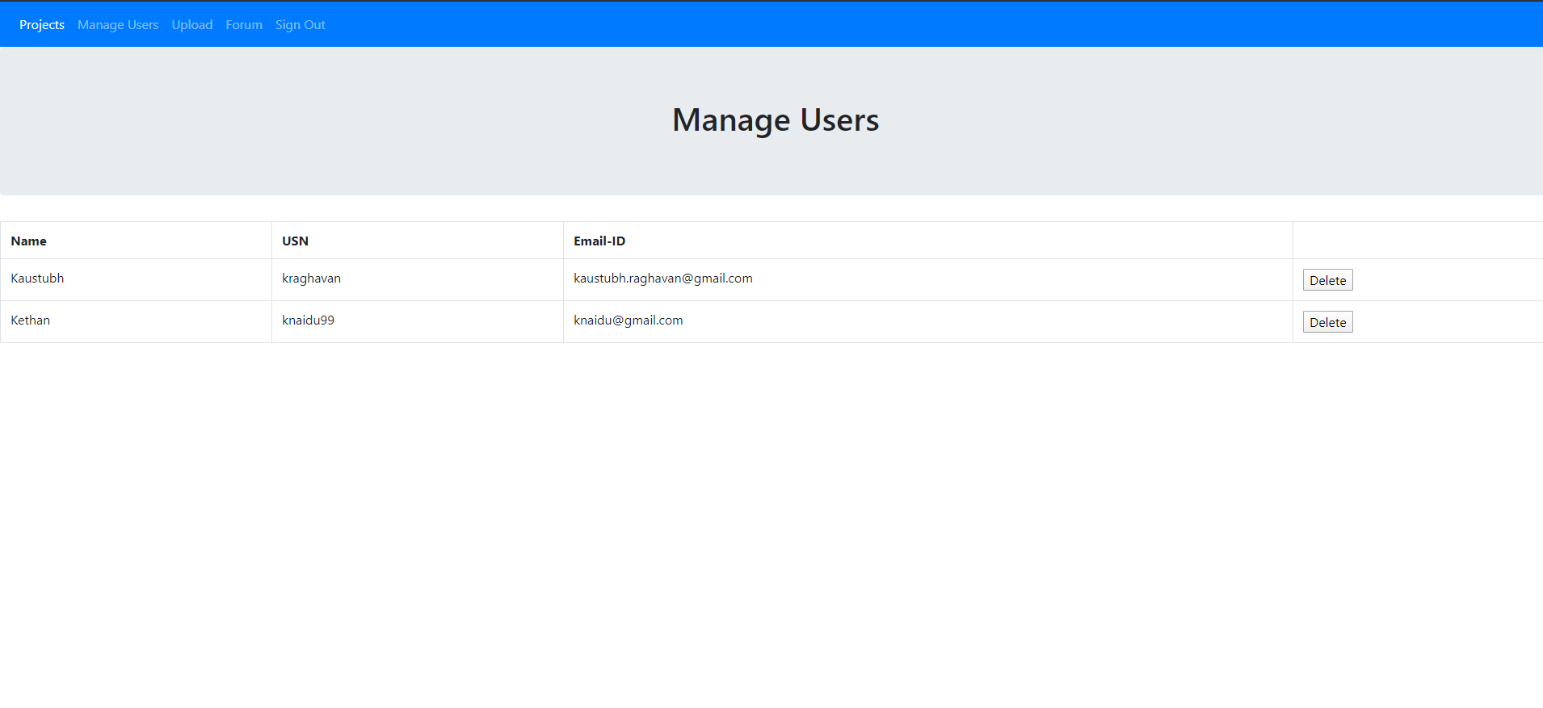
Design Description/UI Design
List of all the users who are registered and can be managed by the
administrator.

Slide 9
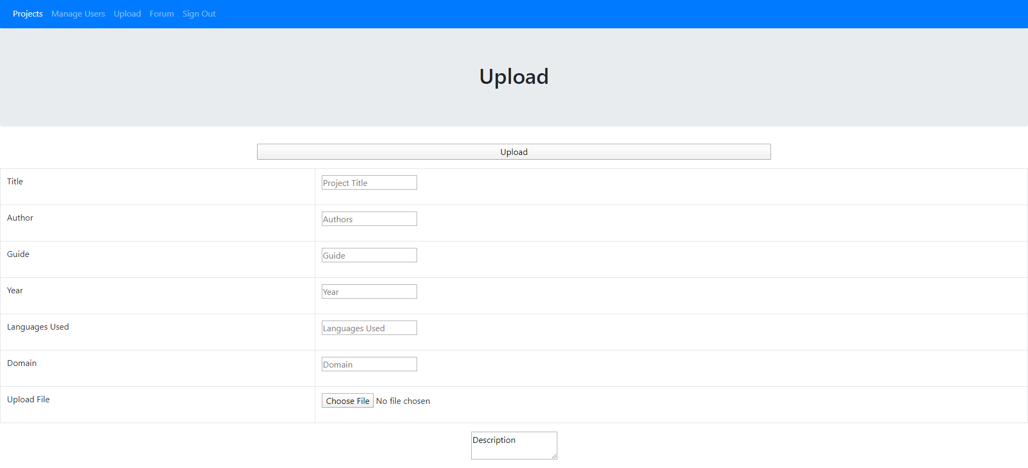
Design Description/UI Design
Form to upload the projects.

Slide 10
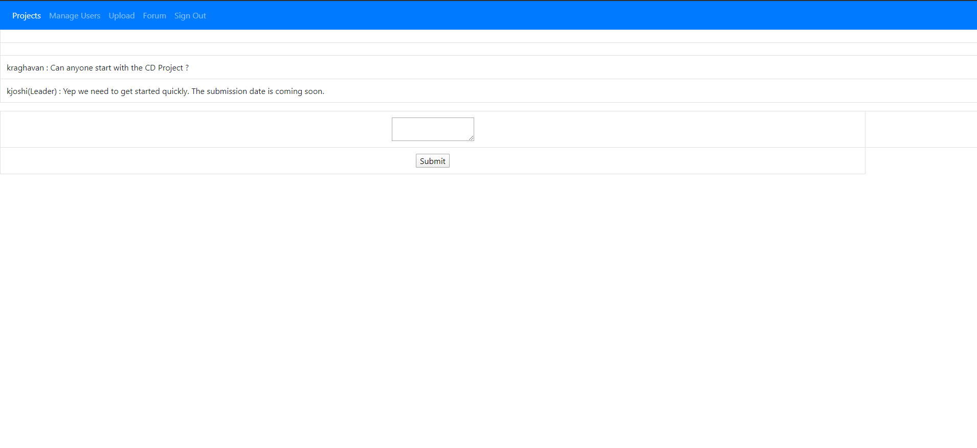
Design Description/UI Design
A forum where users and administrator can communicate with each
other.

Slide 11
Technologies Used
Front end:
HTML and CSS and JavaScript
Backend:
PHP
Database:
MySQL
Tables used:
Users
Project
Notes:
11

Slide 12
Thank You

