Slide 1


Introduction to Object Detection
Raghav Khajuria 2020PMD4213

Slide 2
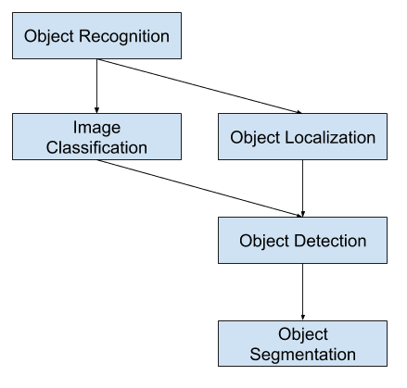

Slide 3
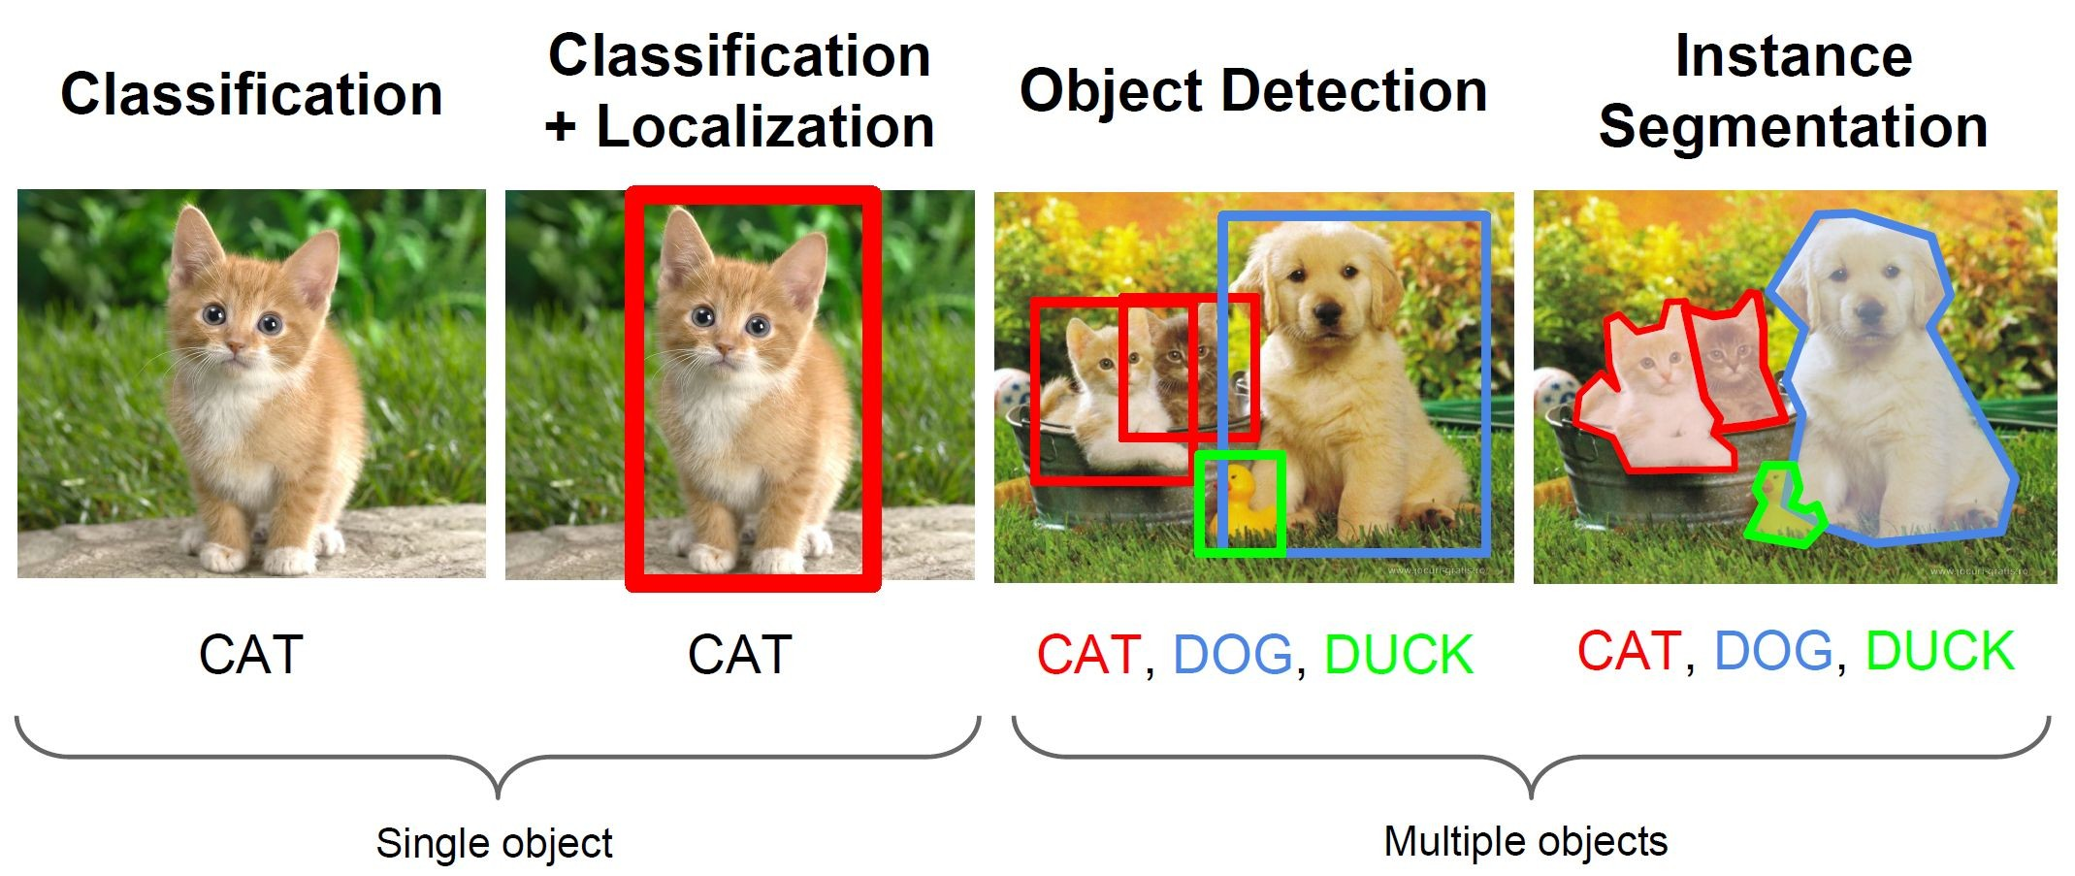
Computer Vision Tasks

Slide 4
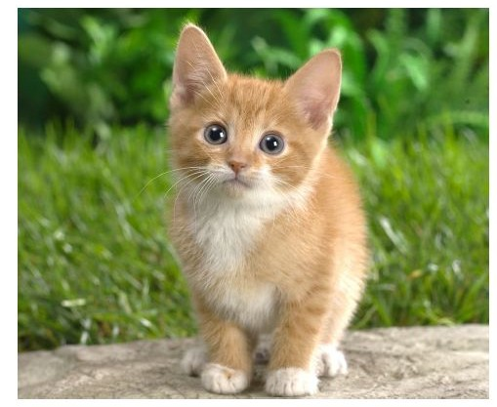
Classification + Localization
Classification:
Input: Image
Output: Class label
Loss: Cross entropy (Softmaxlog)
Evaluation metric: Accuracy
Localization:
Input: Image
Output: Box in the image (x, y, w, h)
Loss: L2 Loss (Euclidean distance)
Evaluation metric: Intersection over Union
Classification + Localization:
Input: Image
Output: Class label + box in the image
Loss: Sum of both losses

Slide 5
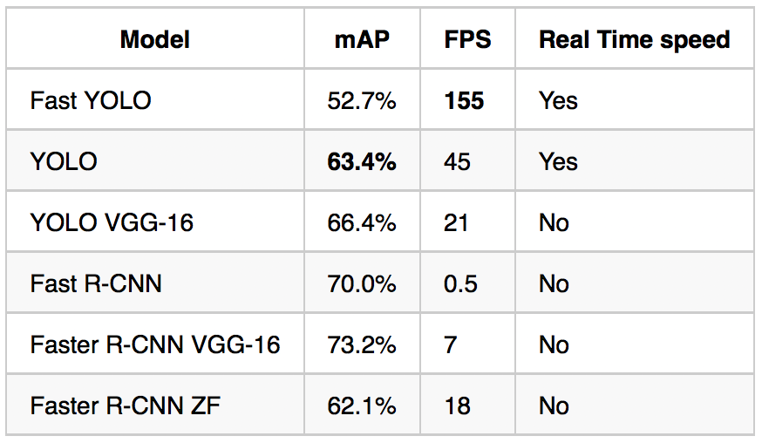

Slide 6
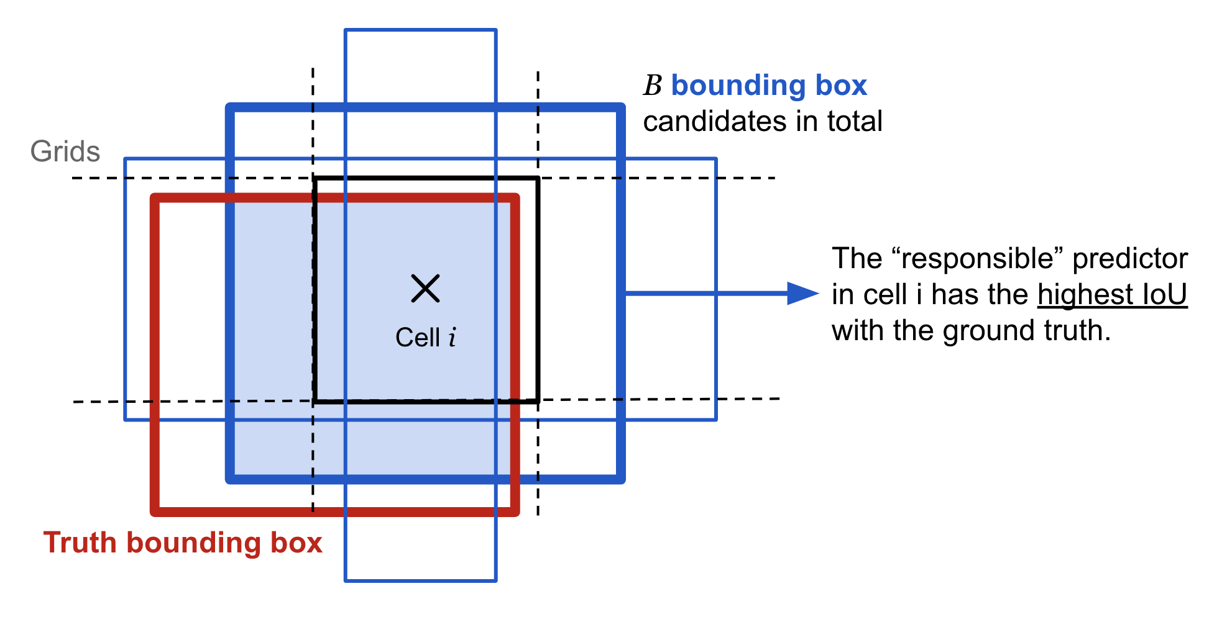
A bounding box is an imaginary rectangle that serves as a point of reference for object detection and creates a collision box for that object. Data annotators draw these rectangles over images, outlining the object of interest within each image by defining its X and Y coordinates.

Slide 7
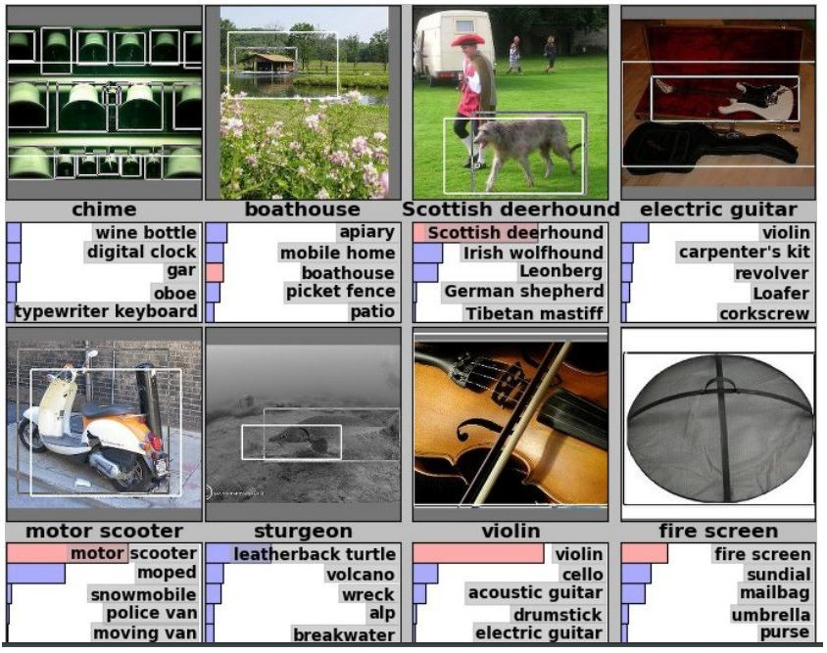

Classification + Localization: ImageNet Challenge
Dataset
1000 Classes.
Each image has 1 class with at least one bounding box.
~800 Training images per class.
Evaluation
Algorithm produces 5 (class + bounding box) guesses.
Example is correct if at least one of guess has correct class AND bounding box at least 50% intersection over union.

Slide 8
Intersection Over Union (IoU)
Important measurement for object localization.
Used in both training and evaluation.
Intersection(A,B)
IoU(A,B)
=
Union(A,B)

Slide 9
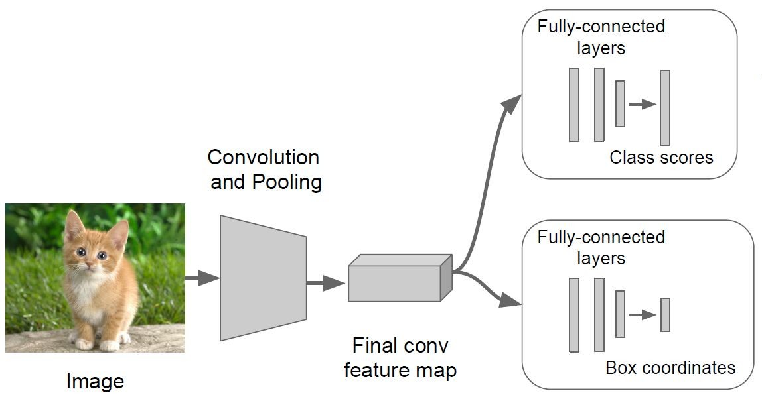
Classification + Localization: Model
Classification Head:
C Scores for C classes
Localization Head:
Class agnostic: (x,y,w,h)
Class specific: (x,y,w,h) X C

Slide 10
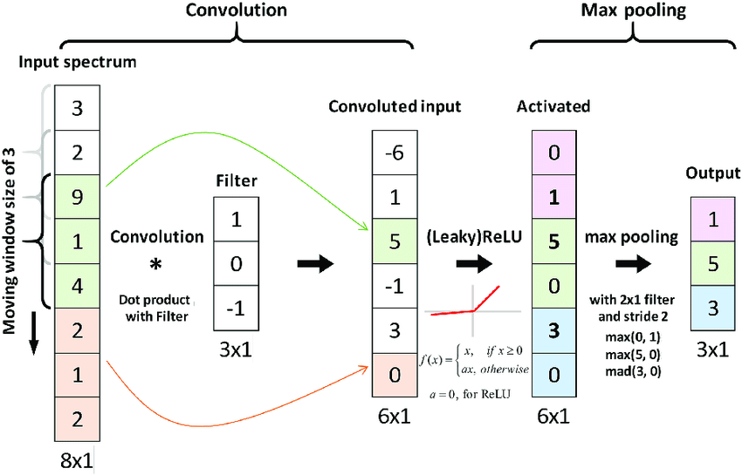

Slide 11
Computer Vision Tasks

Slide 12

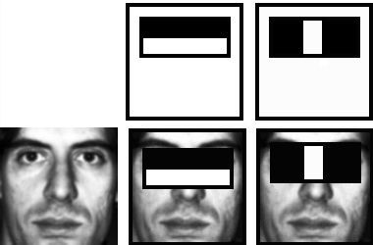
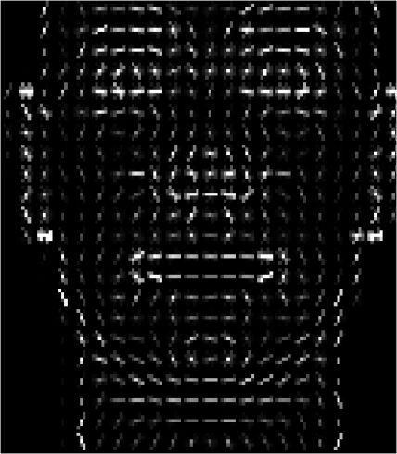
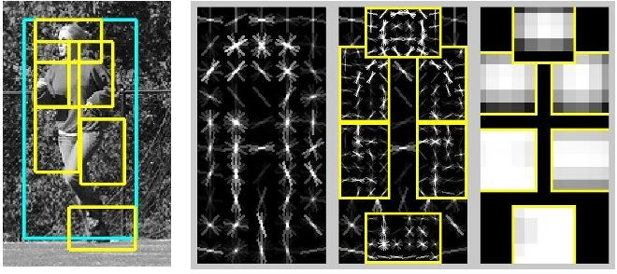
Object Detection 2001-2007
Rapid Object Detection using a Boosted Cascade of Simple Features (2001)
Viola & Jones
Histograms of Oriented Gradients for Human Detection (2005)
Dalal & Triggs
Object Detection with Discriminatively Trained Part Based Models (2010)
Felzenszwalb, Girshick, Ramanan
Fast Feature Pyramids for Object Detection (2014)
Dollar

Slide 13
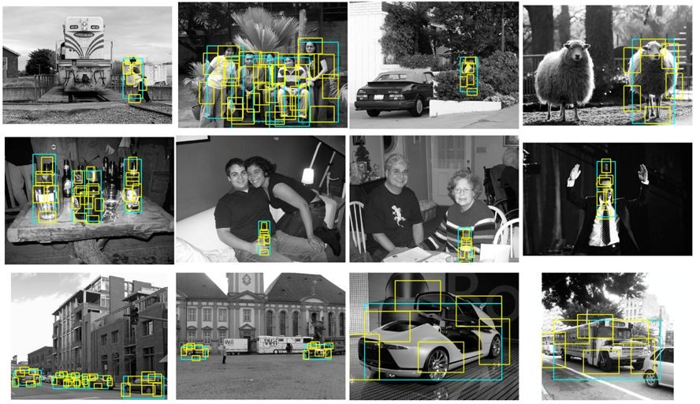
Object Detection 2007-2012

Slide 14
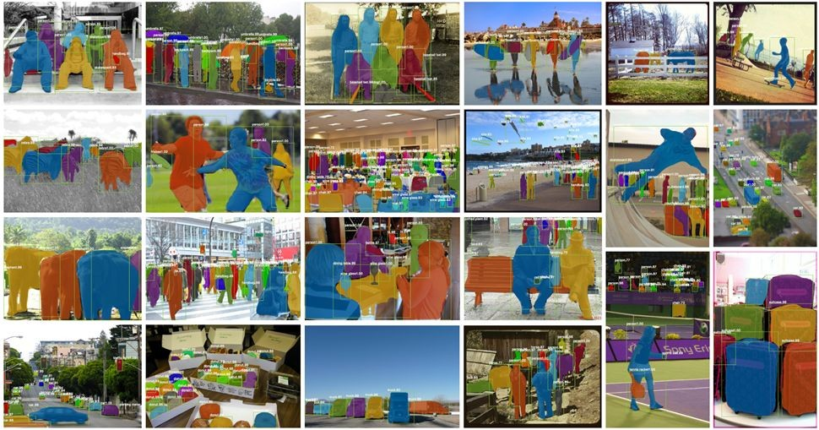
Object Detection Today

Slide 15
Object Detection: Datasets
2007
2013
2015
MS COCO
80 Classes
200K Training images
1.5M Training objects
Pascal VOC
20 Classes
11K Training images
27K Training objects
ImageNet ILSVRC
200 Classes
476K Training images
534K Training objects
Was de-facto standard, currently used as quick benchmark to evaluate new detection algorithms.
Essentially scaled up version of PASCAL VOC, similar object statistics.
More categories and more object instances in every image. Only 10% of images contain a single object category, 60% in Pascal. More small objects than large objects.

Slide 16
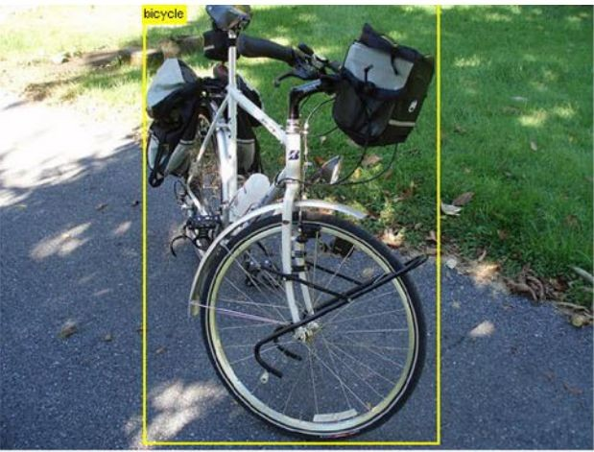
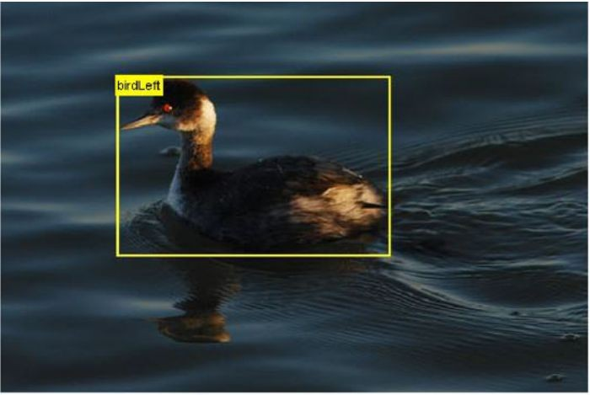
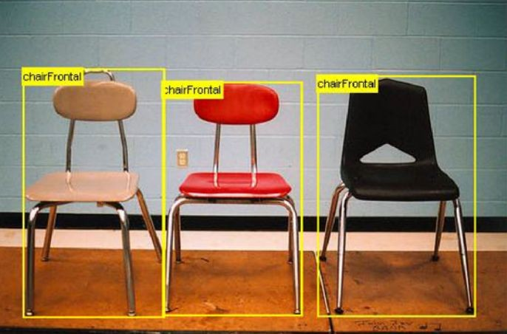
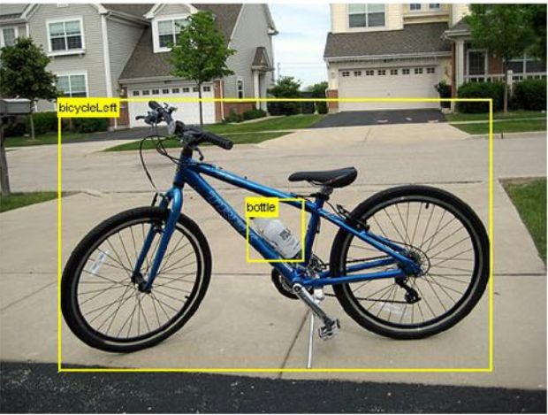
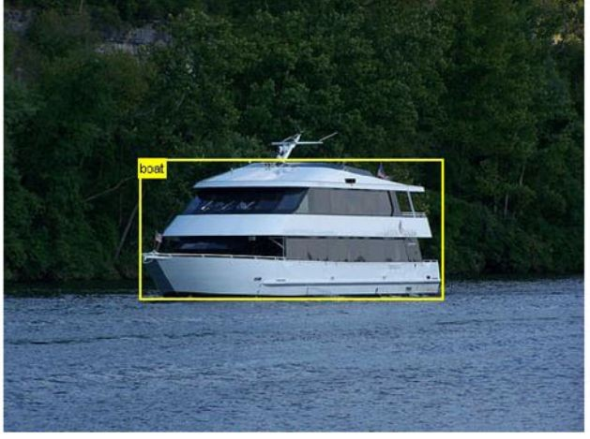
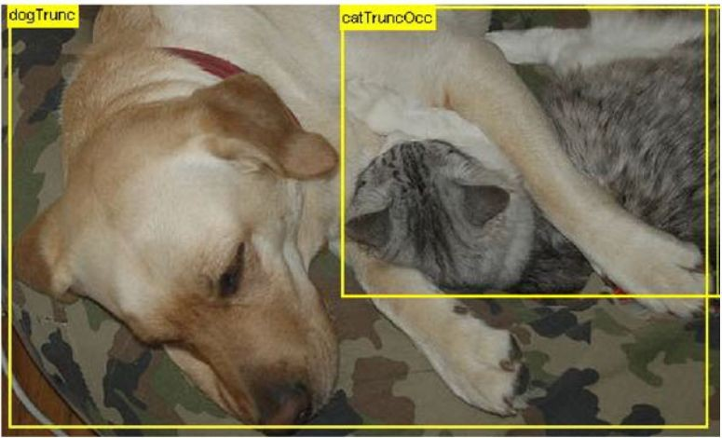
Pascal Examples

Slide 17
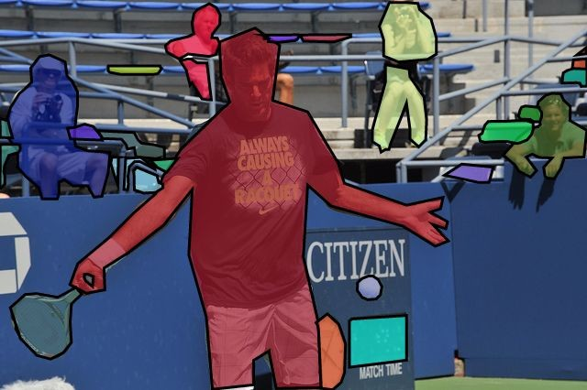
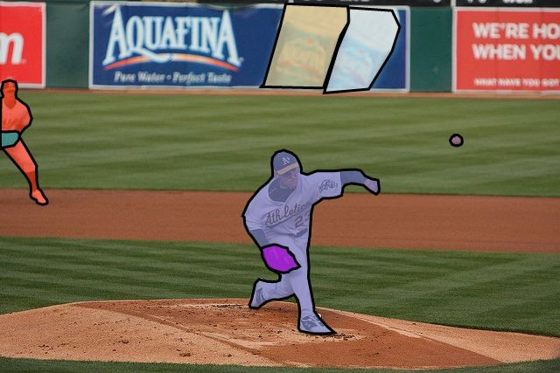
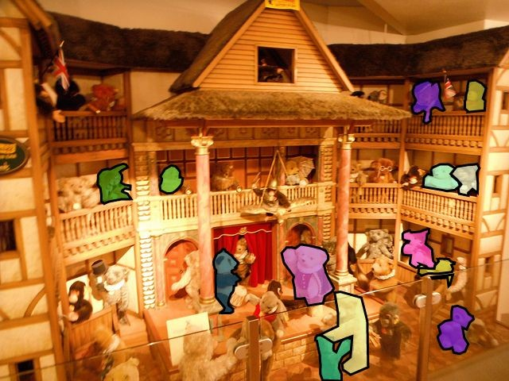
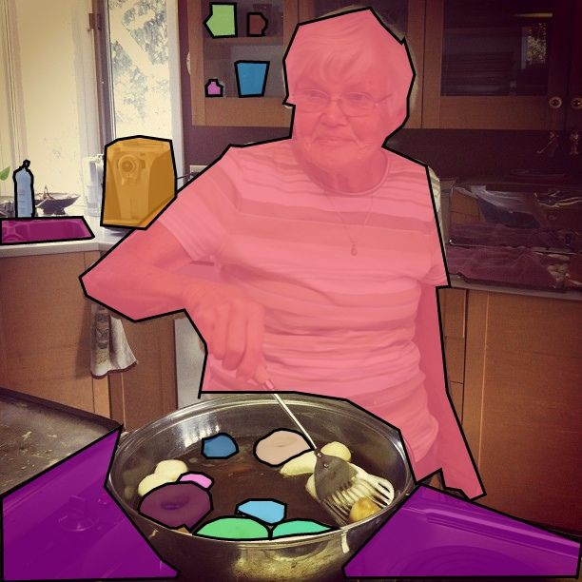
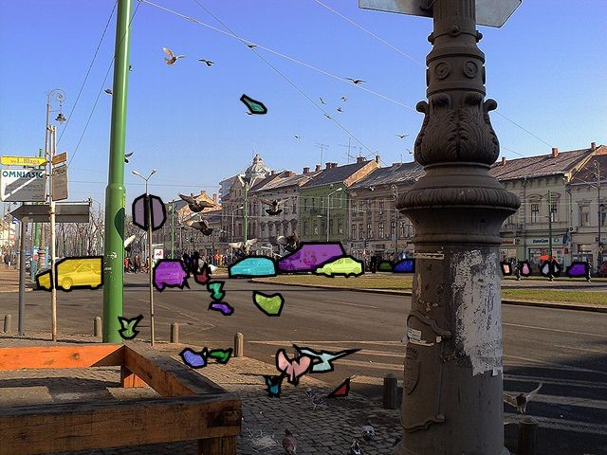
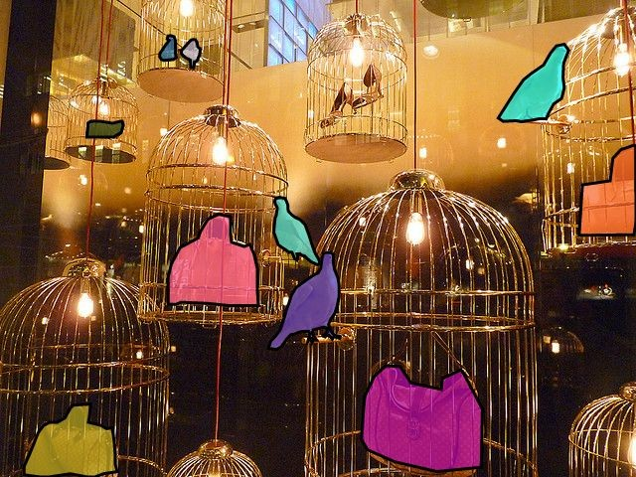
COCO Examples

Slide 18
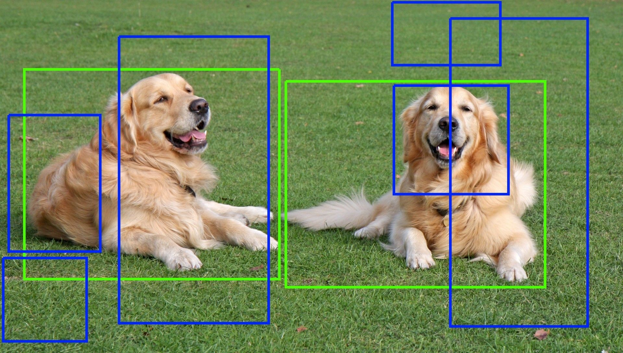
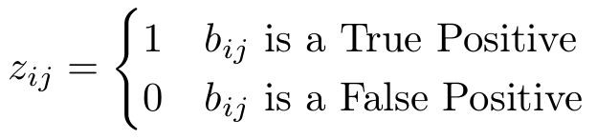
Object Detection: Evaluation
True positive: correct class prediction AND IoU > 50%.
False positive: wrong class or IoU < 50%.
False negative: missed (not detected) object
Only one detection can be matched to an object.
●

Slide 19
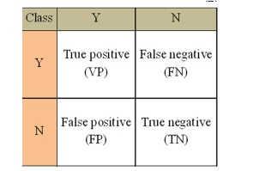
Confusion Matrix:A confusion matrix is a table that is often used to describe the performance of a classification model (or "classifier") on a set of test data for which the true values are known. The confusion matrix itself is relatively simple to understand, but the related terminology can be confusing.

Slide 20
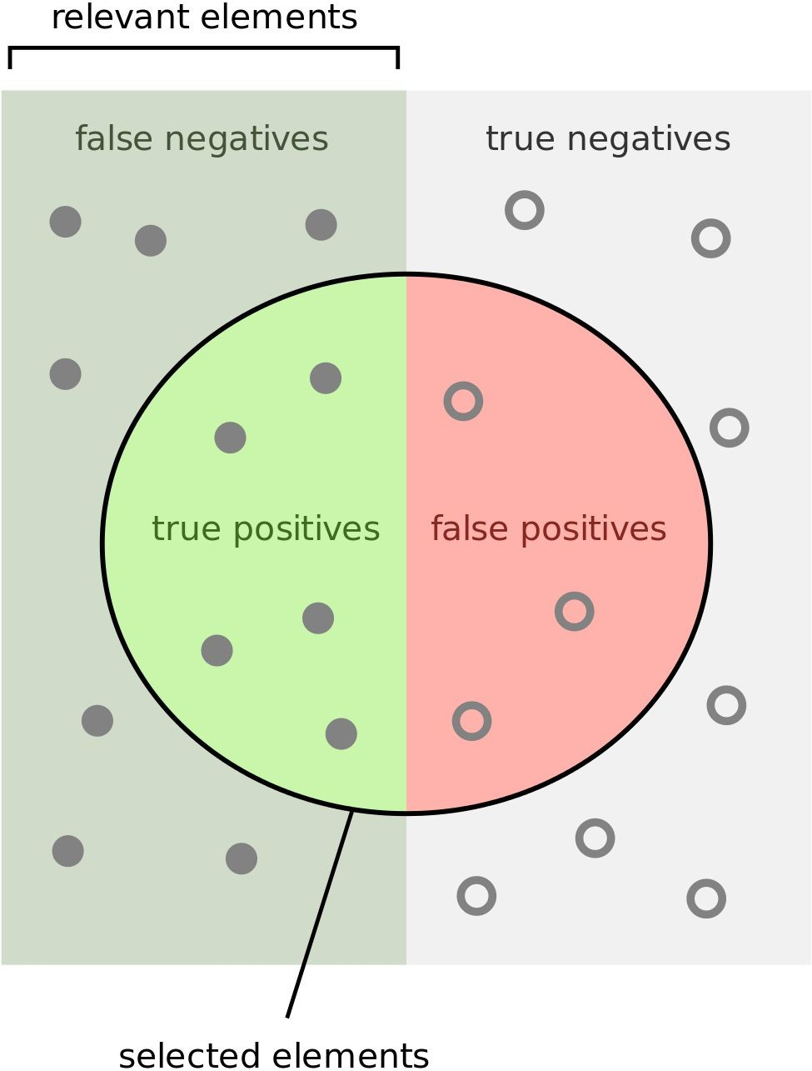
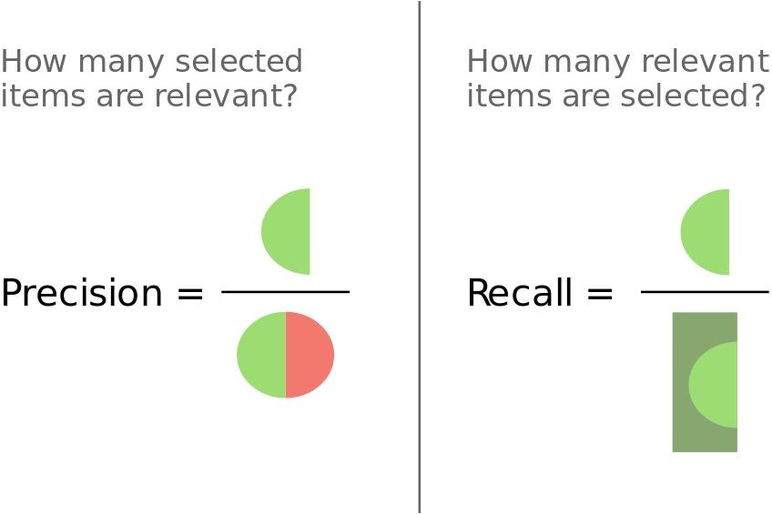
Object Detection: Evaluation
Mean Average Precision (mAP) across all classes, based on Average Precision (AP) per class, based on Precision and Recall.

Slide 21
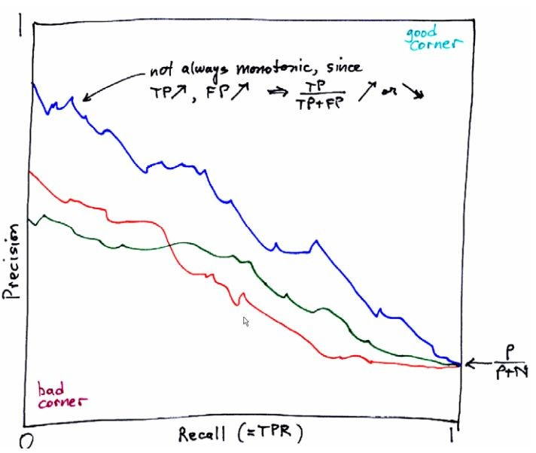
Precision-Recall Curve

Slide 22
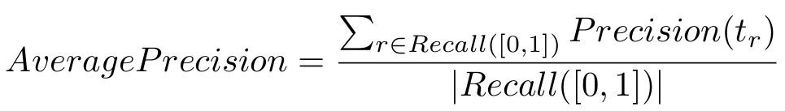
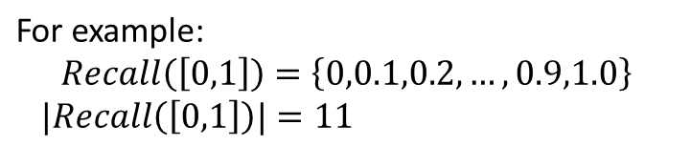
Average Precision (AP)
[In the vision community] AP is the estimated area under the PR curve

Slide 23
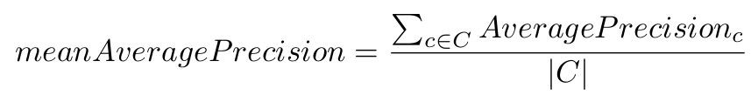
Mean Average Precision (mAP)
The winner of each object class is the team with the highest average precision
The winner of the challenge is the team with the highest mean Average Precision (mAP) across all classes.

Slide 24
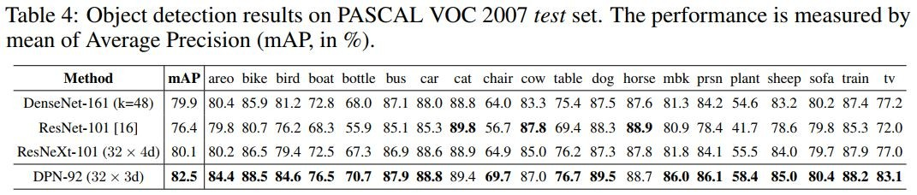
Object Detection: Evaluation
Mean Average Precision (mAP) across all classes, based on Average Precision (AP) per class, based on Precision and Recall.

Slide 25
Thank You

