Slide 1
Color2Gray: salience-preserving color removal
Amy A. Gooch ,Sven C. Olsen, Jack Tumblin , Bruce Gooch
Presented By:
Rahul Kumar

Slide 2
Contents
Need for Color to Gray Images.
Introduction
Previous work
About Color2Gray Algorithms
Parameters
Implementation
Results
Color2Gray+Color
Results
References

Slide 3
Need for Color to Gray Images
Color information of the images doesn’t help in identifying the important edges or other features.
Complexity of code: it need additional work to find edges based on luminance and chrominance.
Speed: Processing a three channel color images takes 3 times or 4 times as long as processing the grayscale images.

Slide 4
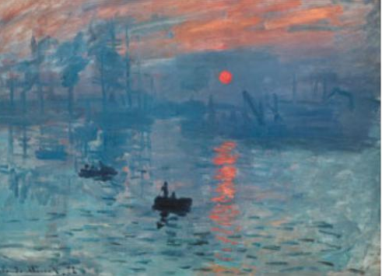
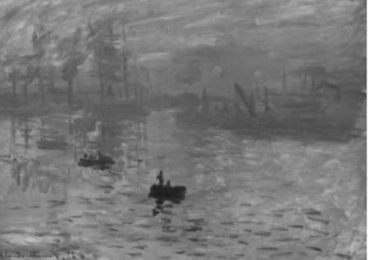
Introduction
When we try to convert color images to grayscale ,some visually important image features get lost.

Slide 5
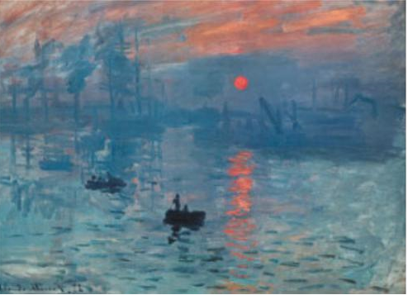
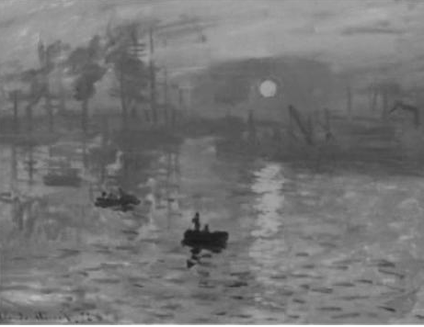
Introduction
So to overcome the losses ,a new algorithm has been introduced named Color2Gray Algorithm.

Slide 6
Previous Work
Earlier method for converting RGB images to grayscale used dot products or weighted sums to map a three dimensional color space to single dimension.
Other method used by program like Adobe Photoshop devised custom non-linear projections and required users to set image-dependent parameters by trial and error.
But these methods were ineffective to preserve luminance and chrominance.

Slide 7
About Color2Gray Algorithm
The Color2Gray Algorithm is a 3 Step process:
1) Convert RGB inputs to a perceptually uniform CIE L ∗ a ∗ b ∗ color space.
2)Compute target difference between nearby image pixels using chrominance and luminance differences.
3)Use a squares optimization technique to selectively modulate the source luminance differences in order to reflect changes in the source image’s chrominance.

Slide 8
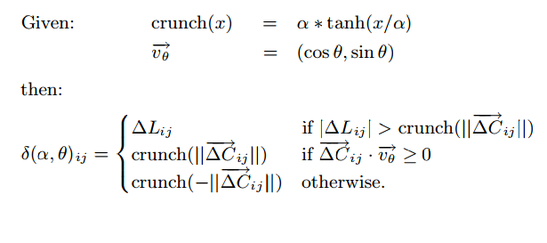
About Color2Gray Algorithm
The color differences between pixels in the color image is then expressed as a set of signed scalar values and then build a grayscale version of image with those values.
For each pixel i and neighbor pixel j ,we find a signed distance scalar δ_{ij} based on chrominance and luminance difference between i and j.

Slide 9

About Color2Gray Algorithm
Using these values ,value for grayscale image g is derived between pixel i and a neighboring pixel j as (g_{i} − g_{j} ).
Grayscale image g minimizes the given function f(g) in above equation
Here, K is set of ordered pixel pair(I,j).

Slide 10
Parameters
The Color2Gray Algorithms allows users to control the mapping of color differences to grayscale differences via three simple parameters:
φ :divides the chrominance plane and determines whether a chromatic difference will darken or lighten the source luminance difference.
α: controls the amount of chromatic variation applied to the source luminance values.
μ: controls the size of the neighborhood, indicating whether a user is more interested in preserving local or global changes.

Slide 11
Implementation
Code Blocks 13.12 as IDE
C++
OpenCV 2.4.9

Slide 12
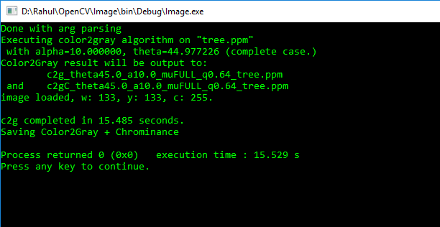
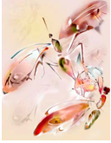
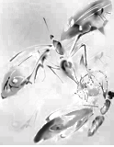
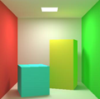
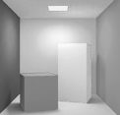
Results:
Input
Color2Gray

Slide 13
Color2Gray +Color
It makes color images more comprehensible .
Add the source image’s chrominance channels to Color2gray results and then convert image into RGB.
Adding color to Color2Gray result provides visual adjustments made to Color2Gray Algorithms.

Slide 14



Results:
Color2Gray+Color Output :
Input
Color2Gray
Color2Gray+color

Slide 15
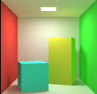
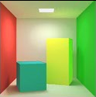
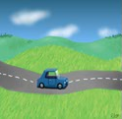
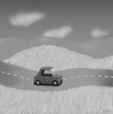
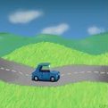
Results
Input
Color2Gray
Color2Gray+color

Slide 16
Conclusion & Future Works
Removal of dependency φ.
Optimization method to match both signed and unsigned difference.
Implement multiscale methods which would allow faster solutions on higher resolutions image.

Slide 17
References:
Adobe Photoshop, 2004. Photoshop: Converting color images to black and white. http://www.adobe.com/tips/phs8colorbw/ main.html
Brown, R., 2004. Photoshop tips: Seeing in black & white. http: //www.russellbrown.com/tips_tech.html.
Fattal, R., Lischinski, D., and Werman, M. 2002. Gradient domain high dynamic range compression. ACM Transactions on Graphics 21, 3 (July), 249–256.
Healey, C. G., and Enns, J. T. 1996. A perceptual colour segmentation algorithm. Tech. Rep. TR-96-09, UBC CS.
Levin, A., Lischinski, D., and Weiss, Y. 2004. Colorization using optimization. In ACM Transactions on Graphics.

Slide 18
Questions ?
Thank You.

