Slide 1
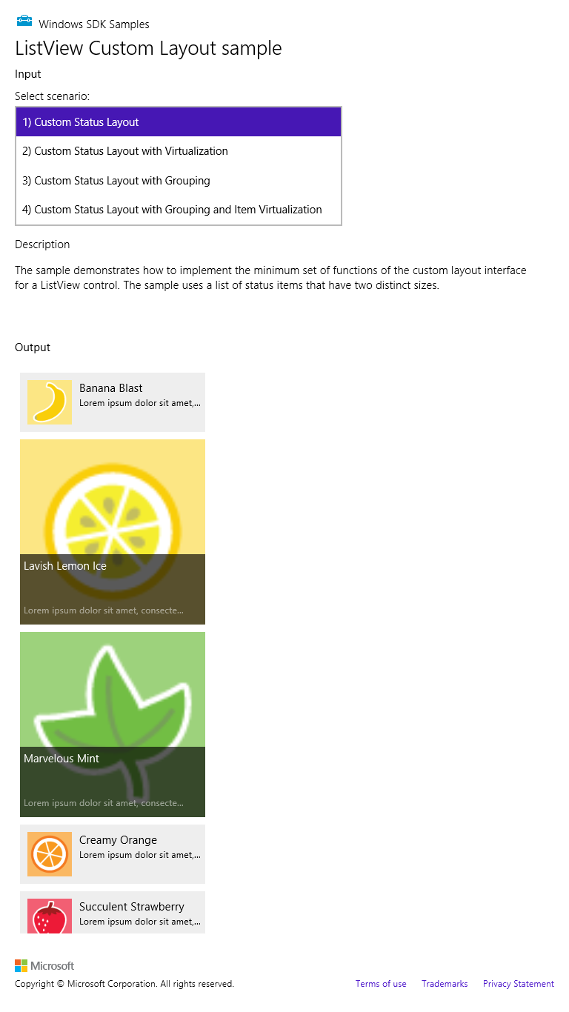
The ListView
Small item template:
<div class="statusTemplate smallListIconTextTemplate“ data-win-control="WinJS.Binding.Template" style="display: none">
<div class="smallListIconTextItem">
<img src="#" class="smallListIconTextItem-Image“ data-win-bind="src: picture" />
<div class="smallListIconTextItem-Detail">
<h4 data-win-bind="innerText: title"></h4>
<h6 class="win-type-ellipsis“ data-win-bind="innerText: text"></h6>
</div>
</div>
</div>
Large item template:
<div class="photoTemplate" data-win-control="WinJS.Binding.Template">
<div class="imageOverlayLanding">
<img class="imageOverlayLandingImage"
data-win-bind="src: picture" />
<div class="imageOverlayLandingOverlay">
<div class="imageOverlayLandingOverlayText win-type-ellipsis"
data-win-bind="innerText: title">
</div>
<h6 class="imageOverlayLandingOverlayTextLight win-type-ellipsis"
data-win-bind="innerText: text"></h6>
</div>
</div>
</div>

