Slide 1





Prasuthon
Exploring data to solve real world problems

Slide 2


Fraud Analysis
Team Name
Participant Name
khushirajpurohit2021
Khushi Rajpurohit

Slide 3
Problem Statement
Financial institutions face challenges in detecting and preventing fraudulent transactions, which can result in significant financial losses. Develop a machine learning model that analyses transaction patterns and user behaviors to detect and flag potentially fraudulent activities in real-time.
Objective
Enhance the security of financial transactions by providing an advanced fraud detection system that identifies suspicious activities quickly and accurately.

Slide 4
By the end of the lesson, we’ll be able to:
A high accuracy Machine learning Model

Slide 5
Dataset used
For this project I used Fraud dataset from Kaggle.

Slide 6
Data Exploration
head(),.shape(),.info(),.describe(), .duplicated() and .isnull().sum() methods are used to get an overview of dataset, its structure and missing values.

Slide 7

EXPLORATORY DATA ANALYSES

Slide 8
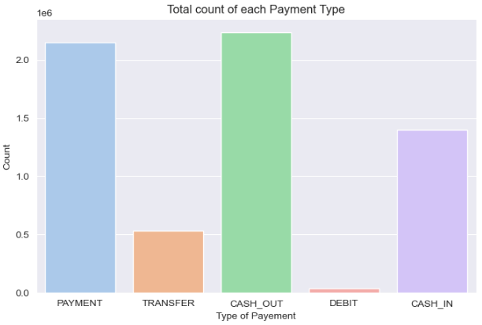
Total count of each Payment type
Most of the transaction was carried out by "cash _out " Payment type. and the least payment type for the transaction was "Debit".
Mostly people uses financial transaction for either getting the cash out or for the payment.

Slide 9
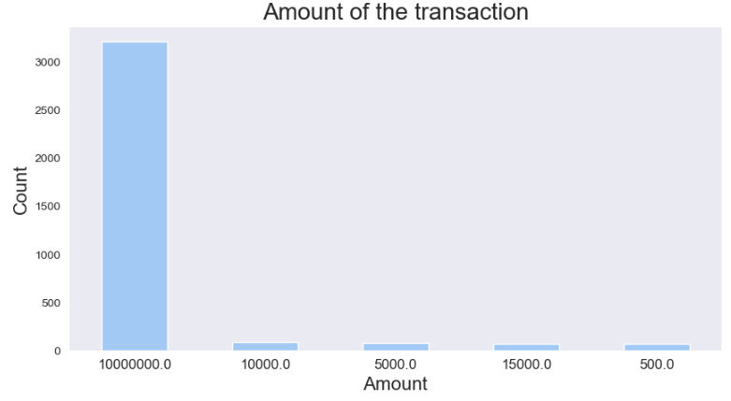
2. Amount of transaction
The most frequent transaction amount is 10,000,000,dollar occurring 3207 times. This suggests that there may be a common transaction size or a default value used for certain types of transactions.
The distribution of transaction amounts appears to be heavily skewed, with a significant number of transactions being of the dominant amount. This could indicate a specific type of transaction or a system-generated value.
While 10,000,000 dollar is the most common transaction amount, there are also other amounts occurring with lesser frequency. This indicates some variability in the transaction sizes, although they are less common compared to the dominant amount.

Slide 10
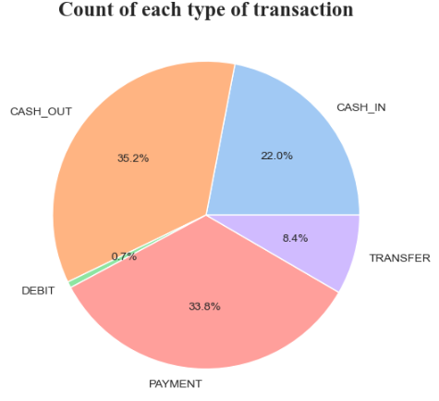
3. Percentage of amount for each Payment type
There are five types of transaction that includes CASH-OUT, CASH IN, DEBIT, TRANSFER, PAYMENT
CASH-OUT has the height count, followed by CASH-IN and PAYMENT. This shows that these types of payment are most common in making fraud.
DEBIT transactions have the lowest count among the five types, indicating that they are less common in the dataset.
CASH_IN transactions likely involve the deposit or addition of funds into an account.

Slide 11
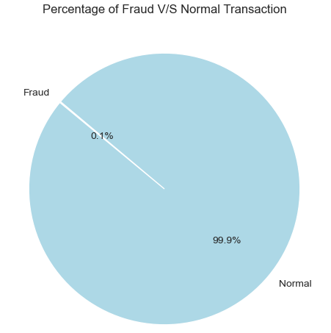
4. ·Percentage of fraud and Normal transaction
The frauds in financial transactions are very small in size as compared to the whole dataset, with a percentage of as least as 0.1. but if we count the values of fraudent transaction they are above 8000.
Fraud are rare but the detection of those must be efficient.

Slide 12
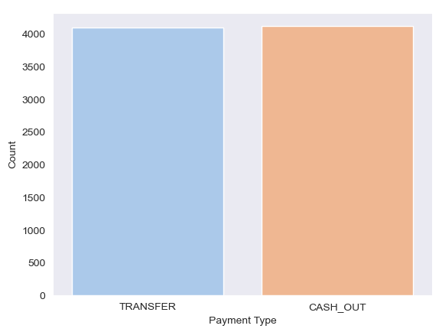
5. Fraud transaction V/S Payment types.
Fraud transaction happens only in "cash out" and "transfer".
As both cash out and transfer involves money to flow from users account to others.

Slide 13

Predictive Modeling
+
Median:
2

Slide 14
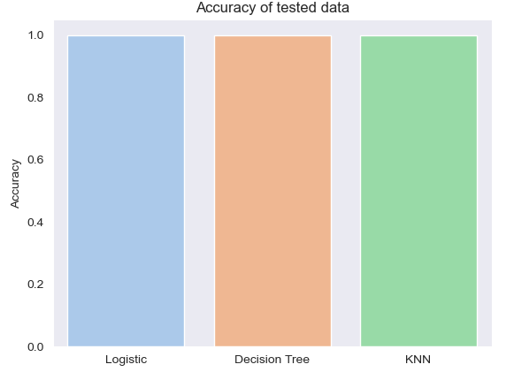
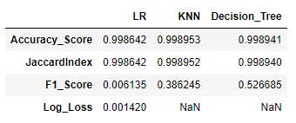
Classification Accuracy
Here we can see that the accuracy score of Decision Tree is Highest.

Slide 15
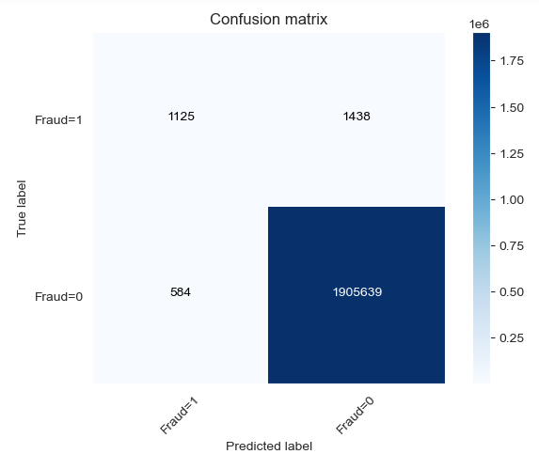
Confusion Matrix
Confusion Matrix of Decision Tree

Slide 16

Conclusions
We explored the data and found that fraud transaction only happens when there is a transfer of cash from the user account.
We predicted that Decision Tree is giving the highest accuracy among all machine learning model.
Thus we can use Decision Tree model for unseen data.

Slide 17

THANK YOU

