Slide 1




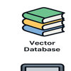
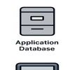
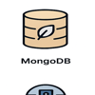
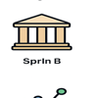

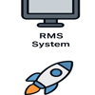
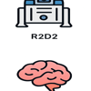

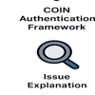
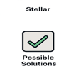
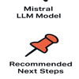
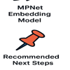
Branch Banker
Call Center Agent
Chat Interface
Prompt Orchestration Engine
Vector Database
Application Database
MongoDB
Oracle DB
Splunk
Chat History
GCIF System
RMS System
CMR System
R2D2
COIN Auth Framework
Stellar
Mistral LLM
MPNet Embedding
Issue Explanation
Possible Solutions
Next Steps

