Slide 1
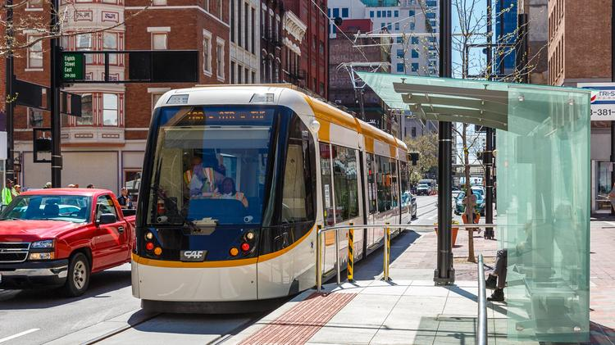
Forecasting TOTAL MARKET VALUE of Parcels
K. Rajesh Jagannath
Mentor : Anirban Ghosh
Introduction of a Street Car in Cincinnati

Slide 2
Motivation
In August of 2016, a streetcar was introduced in the downtown Cincinnati, OH.
The introduction of the Street car has an Economic impact
70,000 people work in the downtown
It provides easy access to business, work and home
It draws new business, permit fees, and property tax
It is disruptive to the neighborhood (crowding, transient population, noise)
QUESTION was – What is the impact on economic indicators ?negative or positive -

Slide 3
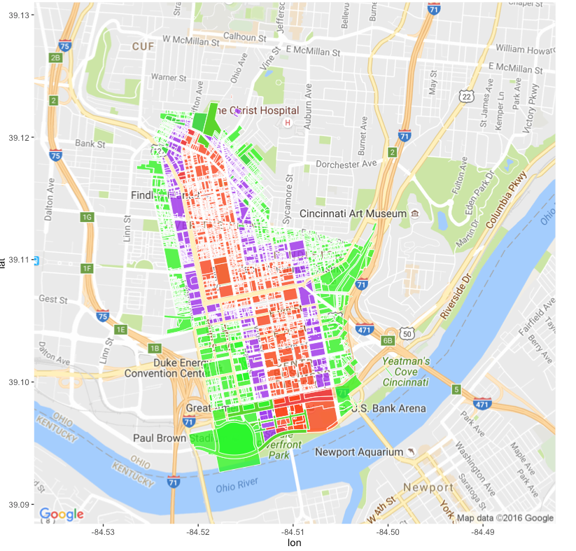
Introduction
A measure of economic impact is the Annual Taxes assessed on property parcels
Annual Taxes= f(TOTAL_MKT_VAL )
OBJECTIVE: Predict the MKT_TOTAL_VAL for 2015-2018
SCOPE : A Buffer Zone was established spatially around the Street car route
CORE
CENTER
EDGE

Slide 4
Data Sources and Data Challenges
Data sources were
Cincinnati Area Geographic Information Systems (CAGIS), City of Cincinnati, OH and
The Hamilton County Auditor Office, Cincinnati, OH
MKT_LAND_VAL
MKT_IMPR_VAL
ANNUAL_TAX
EXLU_CODE
TAXES_PAID
DELQ_TAXES
FORECL_FLAG
ACRE
SALE_AMT
SALE_DATE
MKT_TOTAL_VAL
VALID_SALE
NEW_COSNSTR
Taxinfo_2007.txt
…
Taxinfo_2012.txt
9 years Annual data on all the parcels in the Hamilton county ~ 290,000 observations/year
Data was extracted, transformed and loaded to form a data frame 2,190,994 x 13 predictors
MKT_TOTAL_VAL was the feature selected for study
Cleaning of data, fixed width format, and the sheer number of observations was a challenge
Training set
Taxinfo_2013.txt
…
Taxinfo_2014.txt
Test set

Slide 5
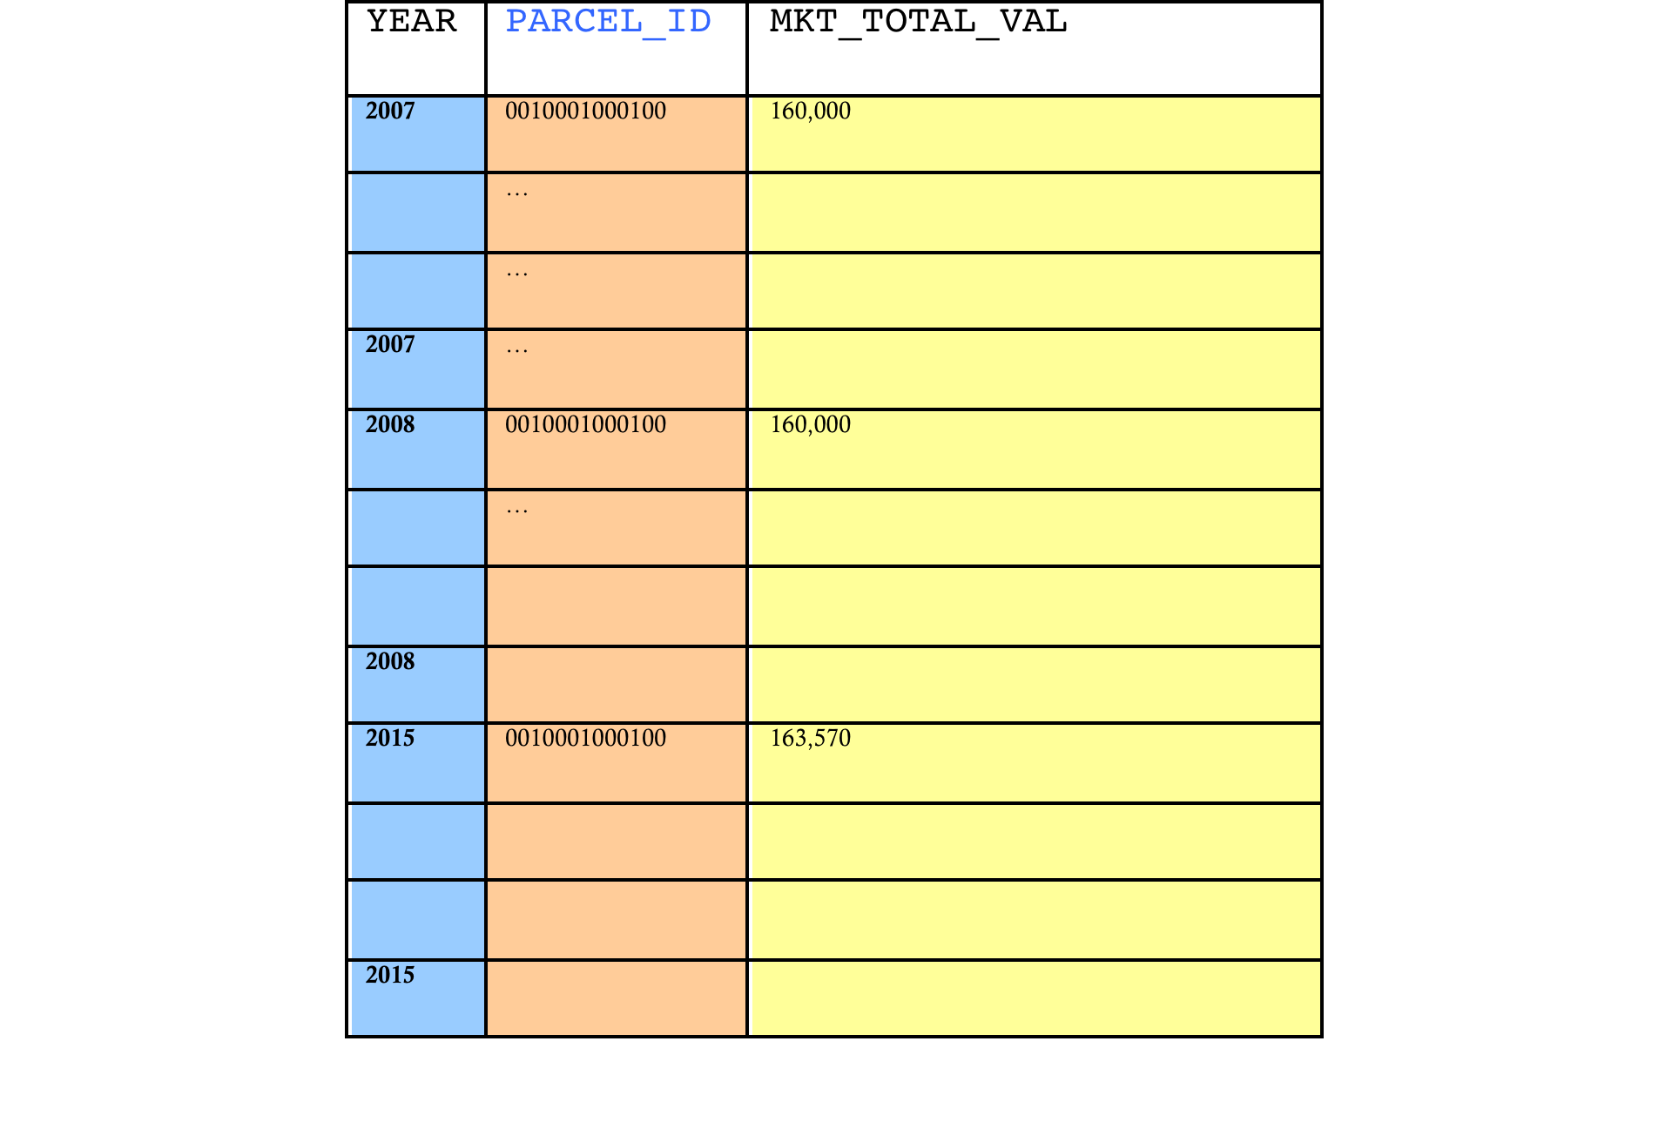
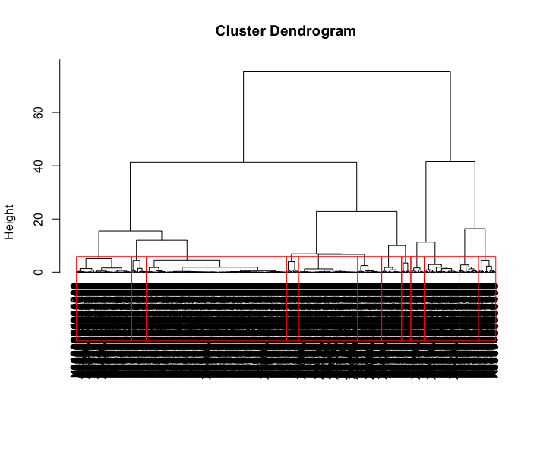
Clustering of Parcels
Clustering
Dimension Reduction
The data was reshaped into 2,190,994 X 3
Forecast on every parcel would have been time consuming and resource intensive
A random sample representative of the average number of parcels in EDGE, CORE, CENTER BUFFER Zones was created
This was used for comparing parcels in the non-Buffer Zone with EDGE, CORE and CENTER Zones
Further, using ClustOfVars library, strongly related parcel ids were clustered together
By plotting the dendogram as well as intuition, it was decided to cluster each zone into k=12 clusters

Slide 6
Prediction : polynomial regression
Polynomial Regression
Next, Polynomial non – linear regression was chosen for trend forecast of MKT_TOTAL_VAL
Linear, Quadratic, Cubic, 4th and 5th order of polynomial models were considered
SOURCE DATA
Years 2007-2012 – TRAINING
Years 2013-2014 – TEST SET
PREDICTED DATA
Years 2015-2018 - PREDICTION
HoltsWinters Time Series was initially assessed
due to variance of the forecast errors it was discarded

Slide 7

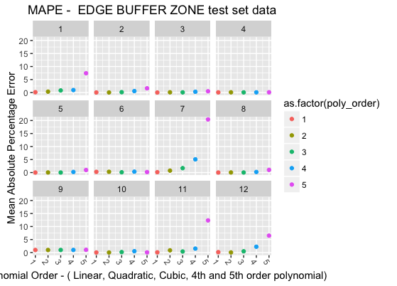
Accuracy of selected models
For Each Zone in {CORE, CENTER, EDGE, non-Buffer}
For each cluster in {1 ..12}
Mean Absolute Percentage Error(MAPE) was computed for polynomial order {1,2,3,4,5} polynomial regression model
Models with least MAPE were selected to perform prediction
Lower order models had Error within 5%

Slide 8
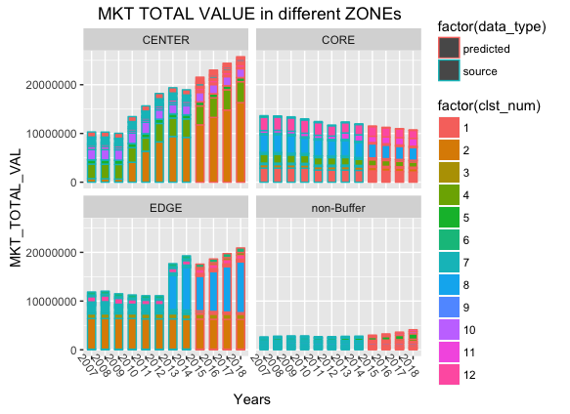
Vizualization : Prediction of 4 zones
INSIGHT :
CORE has declining trends
CENTER has increasing trends
OVERALL trend in Buffer-zone greater than non-BufferZone
Predicted MKT_TOTAL_VAL 2015-2018

Slide 9
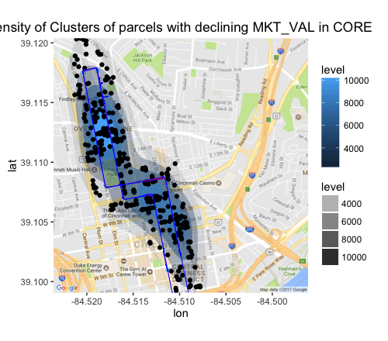
Core Zone
322 parcels of cluster 1 in the CORE dominate declining trends. There was a 10% decline of MKT_TOTAL_VAL from $748M to $670M. The spatial distribution appears evenly distributed along the route of the streetcar overall. However, there is a denser concentration of parcels bounded by E. Liberty St. and E. 14th St. and between Elm St. and Race St.

Slide 10
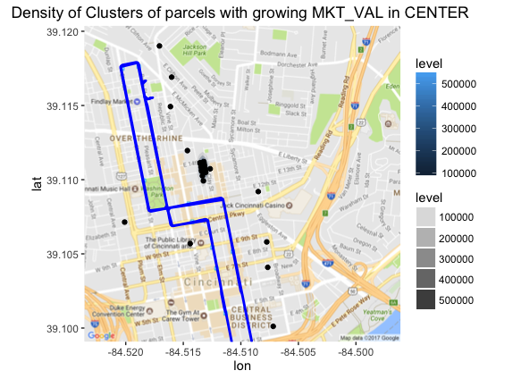
CENTER Zone
26 parcels of cluster 2 in the CENTER dominate increasing trends. There was a 38.78% increase of MKT_TOTAL_VAL from $305M(2015) to $424M(2018). The spatial distribution appears densely co-located around Walnut St and Clay St. and E 14th and E 13th St.

Slide 11
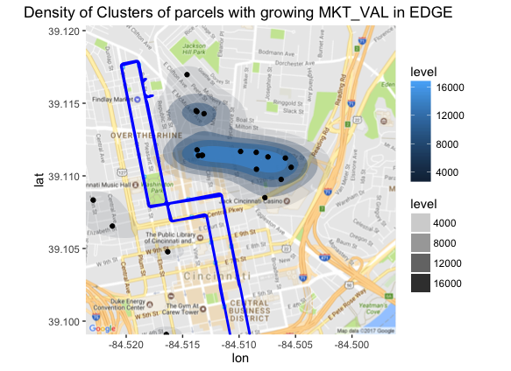
EDGE Zone
23 parcels of cluster 8 in the EDGE Zone dominate increasing trends. It seems that there is a 46% increase of MKT_TOTAL_VAL from $163M (2015) to $239M (2018)

Slide 12
Conclusions
ETL
Clustering
Training
Testing
Prediction
Visualization
For Descriptive Analysis, data was Extracted, Translated and Loaded in to data frames : A bulk of the effort and time was spent on getting clean data
The data from CAGIS was taken for 9 years ( 2007-2015) and filtered and reshaped into data frames with MKT_TOTAL_VAL selected as the primary predictor
For each buffer-zone, parcels were clustered into 12 clusters
For prediction, non-linear polynomial regression model was created for each of the 12 clusters using years 2007-2012 as training set
Accuracy of the model was calculated using the Mean Absolute Percentage on a test set for years 2013-2014. Most accurate models were selected.
Clusters of parcels with increasing and decreasing MKT_TOTAL_VAL trends in each of the areas under study were visualized on a ggplot with Google maps as one of the layer

Slide 13
Problems Encountered
Problems Encountered | Solution
Data was not clean i.e. not from a competition or academic data set | Needed insights and clean-up from staff at CAGIS
Using on-line geo-coding was not reliable to get Longitude and Latitude | Requested CAGIS to provide the location data
Data was in 3 distinct fixed width format | Different scripts were used to read in Data
Many observations for Test data for Year 2015 seemed exactly the same as observations in test data for 2014 | Data for 2015 was not used for testing the model instead test-data was for Years 2013-2014
Performing time series on every parcel required time and number crunching | Used Sampling, Dimension reduction, Clustering and limited the scope for convergence
I was unprepared for the time it took to clean the raw data | Reduced the scope to analysis on MKT_TOTAL_VAL
There was a file size limit on the upload of files to git-hub | I used git lfs – Large File Systems

Slide 14
Acknowledgments
People
and
Resources
Mr. Anirban Ghosh ( Springboard Mentor)
Mr. Raj Chundur ( Director, CAGIS)
Resources
http://www.cincinnati.com/story/news/2016/05/05/streetcar-nation-kc-opens-friday-cincy-next/83874740/
https://cran.r-project.org/web/packages/ClustOfVar/ClustOfVar.pdf
http://www.exegetic.biz/blog/2013/12/contour-and-density-layers-with-ggmap/
http://www.shanelynn.ie/massive-geocoding-with-r-and-google-maps/
http://stat405.had.co.nz/ggmap.pdf
A little book of R for Time-series, Avril Coghlan
An Introduction to Statistical Learning, Gareth James et al

Slide 15
Future Work
Other Predictors
More recent data
Analysis can be performed on other predictors such as business permits, building improvement permits, restaurant permits etc.
The Analysis has been performed using the years the Street car was not yet in service (only test runs had begun )
More recent data from Auditors office would improve the accuracy of the forecast

Slide 16
Widescreen Test Pattern (16:9)
Aspect Ratio Test
(Should appear circular)
4x3
16x9

