Slide 1
Sales Dashboard Analysis
K Rajeshwari

Slide 2
Objective
- Analyze sales data
- Identify trends
- Support business decisions

Slide 3
Dataset
- Superstore dataset
- Contains sales, category, and region data

Slide 4
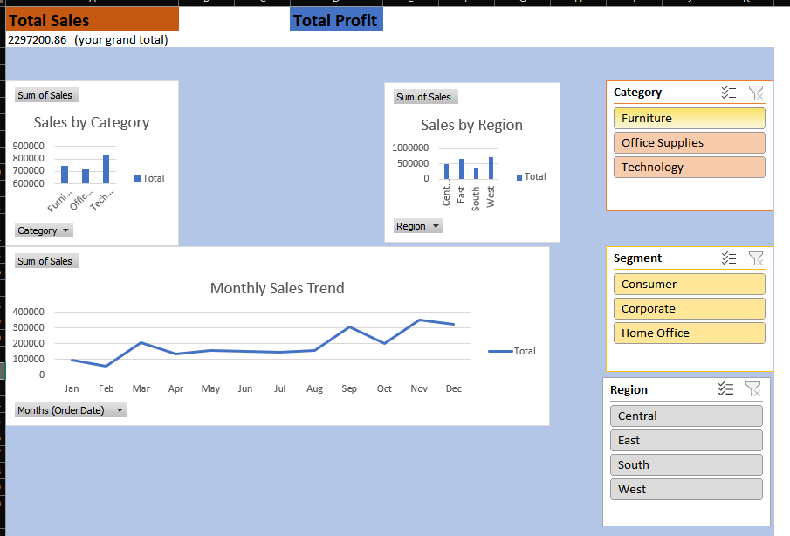
Dashboard

Slide 5
Insights
- Technology has highest sales
- West region performs best
- Sales peak in November and December

Slide 6
Conclusion
- Sales increase over time
- Technology drives revenue
- Sales are seasonal

Slide 7
Recommendations
- Increase marketing in peak months
- Focus on Technology category
- Expand in high-performing regions

Slide 8
Thank You

