Slide 1
BLUESTOCK
Mutual Fund Analytics Platform
Capstone Project — Data Analytics
Prepared By:
K. Rajeswari

Slide 2
Agenda
Problem & Objective
Data Sources & Datasets
Project Architecture and Pipeline
EDA Highlights – Market &SIP Trends
EDA Highlights – Investor Demographics
Fund Performance Analysis
Dashboard - Industry Overview and Fund Performance
Dashboard - Investor Analytics and SIP Trends
Key Findings and Recommendations

Slide 3
Problem & Objective
The Problem
Our Objectives
Mutual fund data is distributed across multiple datasets and lacks a unified analytical view. Investors and analysts need an efficient way to evaluate fund performance, monitor industry trends, and compare investment options. This project addresses the challenge by building an end-to-end analytics platform using Python, SQLite, and Power BI to generate actionable insights from mutual fund data.
Build end-to-end analytics on 10 datasets
ETL pipeline with Python + SQLite
EDA with 15+ charts in Jupyter
Interactive Power BI dashboard
Performance & risk benchmarking

Slide 4
Data Sources & Datasets
01
Fund Master
06
Folio Count
AMFI codes, categories, fund houses
Industry folio growth quarterly
02
NAV History
07
Scheme Performance
Daily NAV 2022–2026 all schemes
Returns, alpha, beta, Sharpe ratio
03
AUM by Fund House
08
Investor Transactions
Quarterly AUM per AMC 2022–2025
SIP/Lumpsum/Redemption by investor
04
Monthly SIP Inflows
r
09
Portfolio Holdings
Industry SIP data Jan 2022–Dec 2025
Stock-level weights per scheme
05
Category Inflows
10
Benchmark Indices
Net inflows by fund category
NIFTY50, BSE Sensex daily close

Slide 5
Project Architecture & Pipeline
DATA SOURCES
INGESTION
CLEANING
STORAGE
ANALYTICS
AMFI CSV Files
data_ingestion.py
data_cleaning.py
bluestock_mf.db
EDA_Analysis.ipynb
MFAPI.in Live NAV
▶
live_nav_fetch.py
▶
Null handling
▶
SQLite 10 tables
▶
15+ Charts
Manual Benchmarks
amfi_validation.py
Type validation
Star schema
Power BI Dashboard

Slide 6
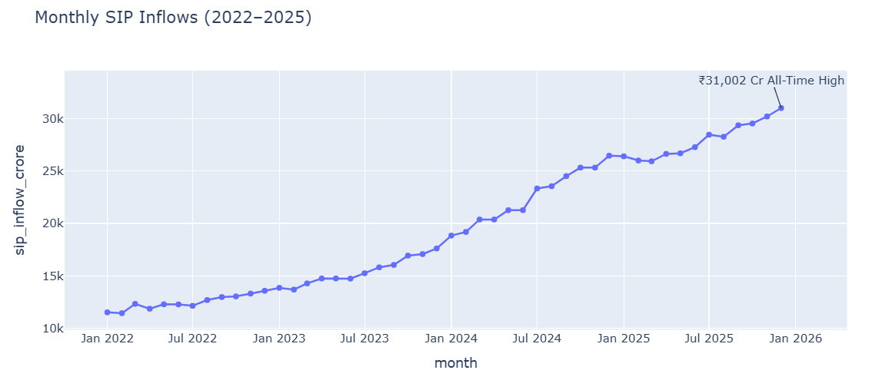
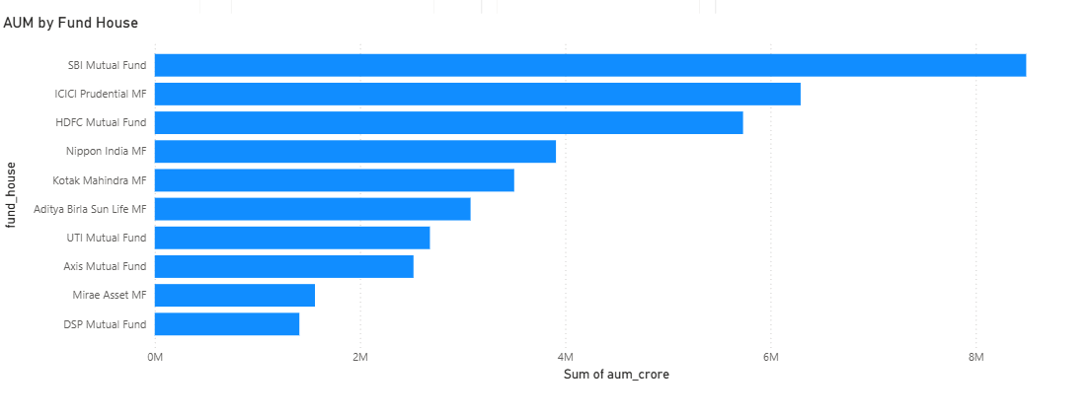
EDA Highlights — Market & SIP Trends

Slide 7
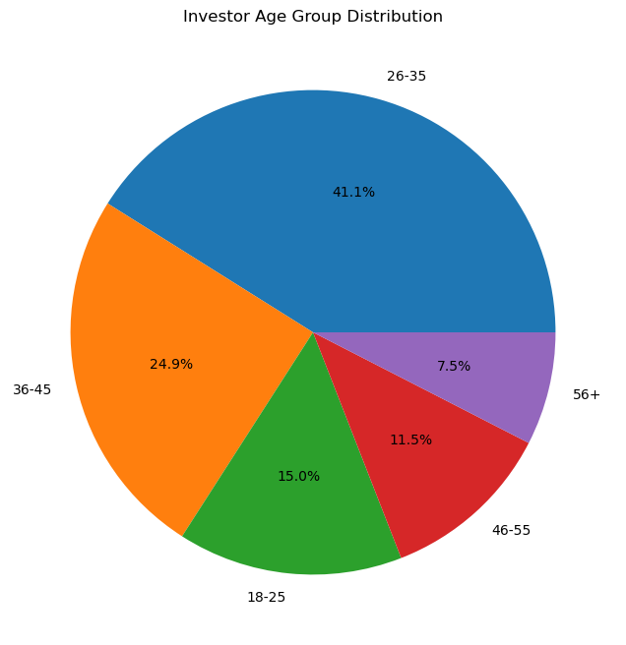
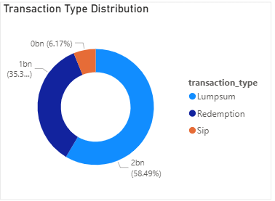
EDA Highlights — Investor Demographics

Slide 8
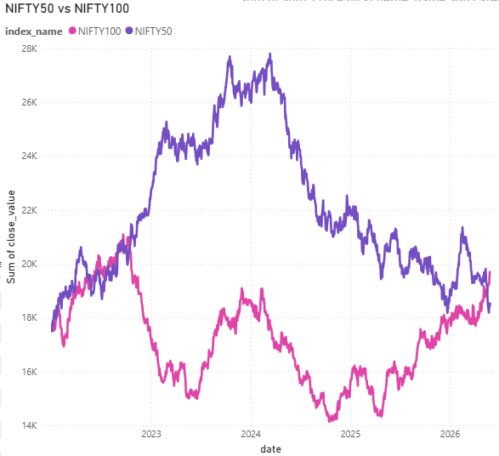
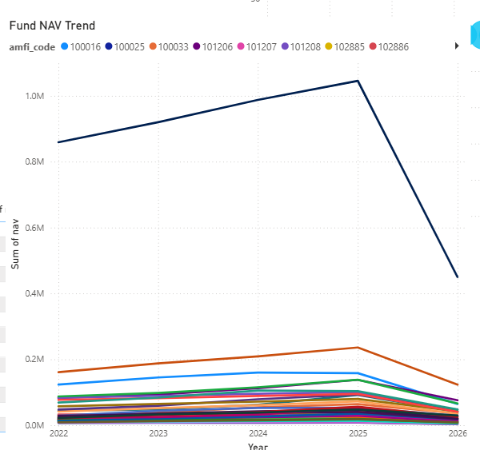
Fund Performance Analysis

Slide 9
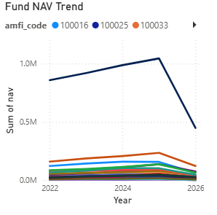
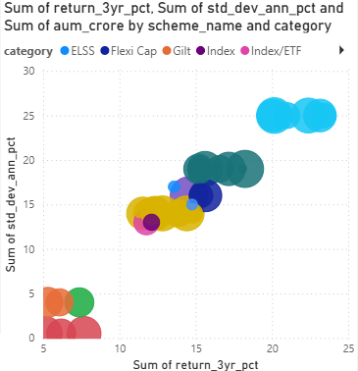
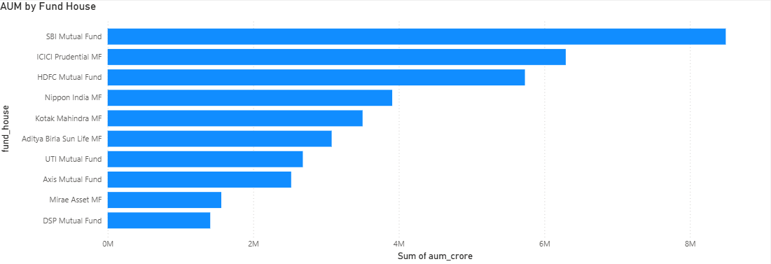
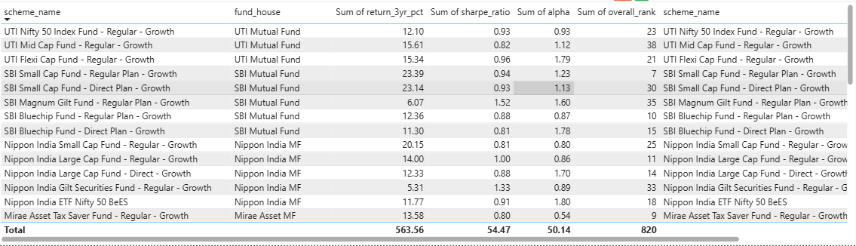
Dashboard — Industry Overview & Fund Performance
Page 1 — Industry Overview
Page 2 — Fund Performance
₹39M
₹940K
Total AUM
SIP Inflows
345.10
14k
Folios
Schemes
AUM by Fund House — Bar Chart

Slide 10
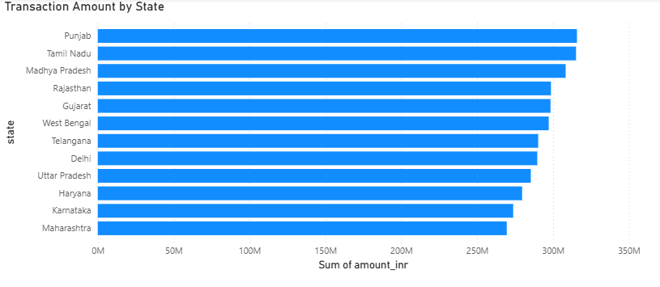
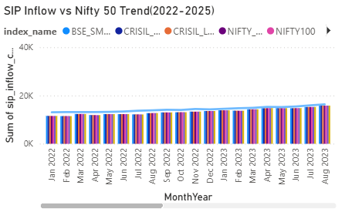
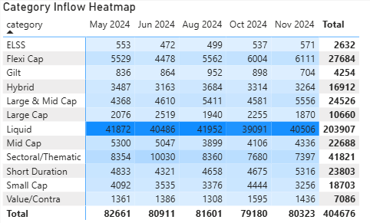
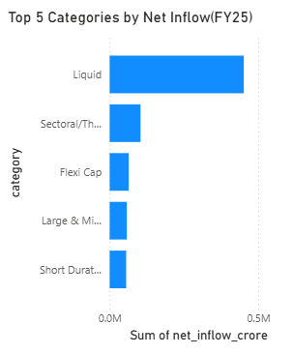
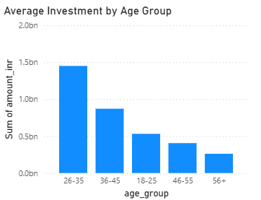
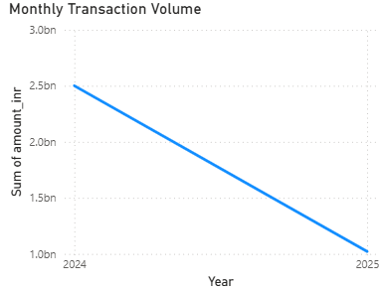
Dashboard — Investor Analytics & SIP Trends
Page 3 — Investor Analytics
Page 4 — SIP & Market Trends
Slicers: Fund House | Category | Plan | State | Age Group | City Tier

Slide 11
Key Findings & Recommendations
SBI Market Dominance
SIP at All-Time High
01
02
SBI Mutual Fund holds the highest market share among AMCs.
SIP inflows reached record highs, indicating strong investor participation.
Folio Count Doubled
HDFC Top 100 Outperforms
03
04
Folio count more than doubled, reflecting growing mutual fund adoption.
HDFC Top 100 Fund delivered strong long-term performance.
Equity Correlation Risk
Banking Sector Concentration
05
06
Equity funds show higher returns but carry market correlation risk.
Banking sector remains a major concentration in portfolio holdings.

Slide 12
Thank You
Bluestock Mutual Fund Analytics — Capstone Project
GitHub Repo :
https://github.com/krajeswari6305/bluestock_mf_capstone.git
Dashboard :
Power BI Service — Bluestock MF Dashboard
Open to questions and feedback!
Python 3.14
pandas / numpy
SQLite + SQLAlchemy
Power BI
Plotly / Seaborn
Git + GitHub

