Slide 1
Today’s topic
Derivatives of vector valued functions (Sec 10.7)

Slide 2
Practice 1: Find the maximum rate of change of f and direction in which it occurs.

Slide 3
Space Curves: We have discussed earlier. We also call them parametric curves
Examples: circle, ellipse, parabola, helix, straight line

Slide 4
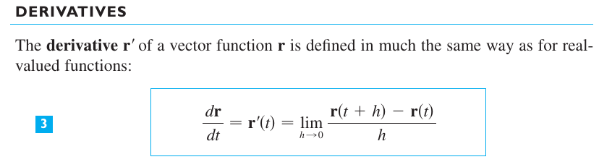
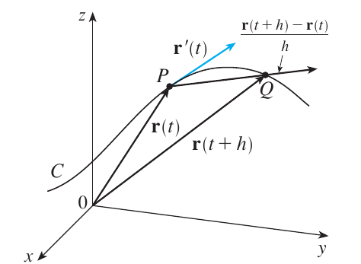



Slide 5
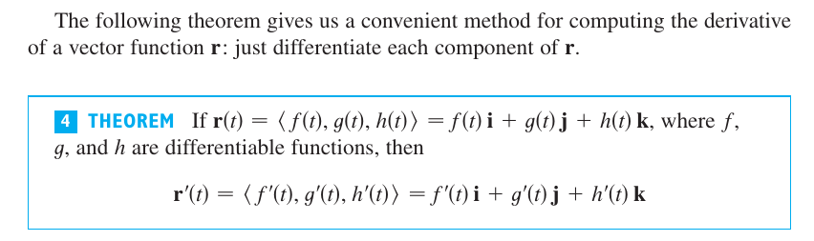

Slide 6
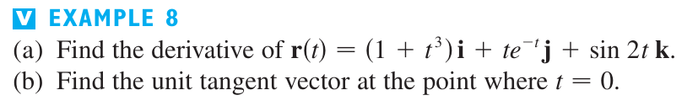

Slide 7
In fact, plot the curve on octave and all unit tangent vectors.

Slide 8
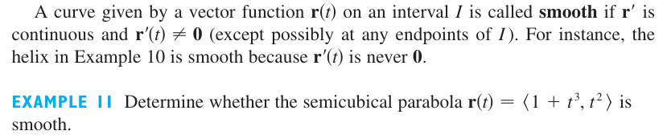
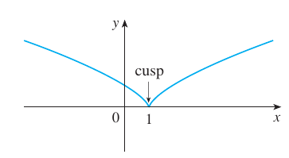

Slide 9
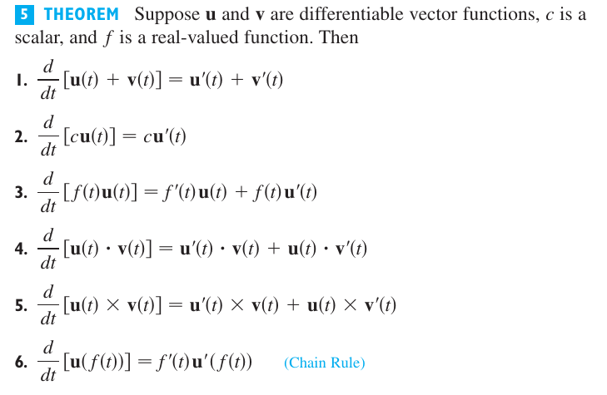

Slide 11
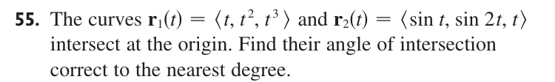

Slide 13
