Slide 1
Today’s topic
Arc Length and Curvature (Sec 10.8)
Q1. Whats the length of a curve?
Q2. How curved is the curve?

Slide 2
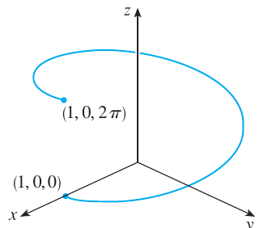

Slide 3
Suppose the curve is described by the formula
Length can be evaluated by integrating the speed

Slide 4
Q. Using this formula, verify that formula of circumference of a circle.

Slide 5



Slide 6

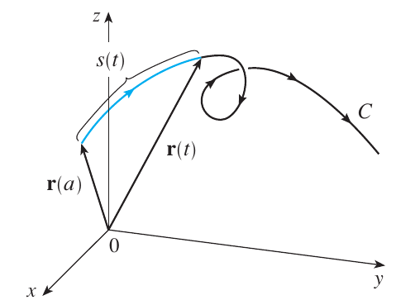



Slide 8
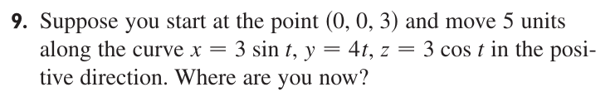

Slide 9

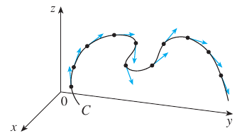

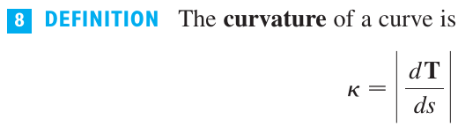


Slide 10
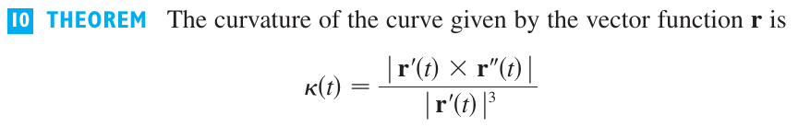

Slide 13


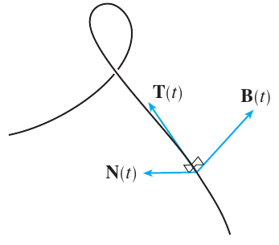

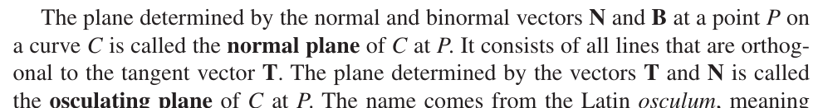


Slide 15
