Slide 1
Today’s topic
Derivatives of vector valued functions (Sec 10.7)
      Some more problems
Chain rule (Sec 11.5)

Slide 2
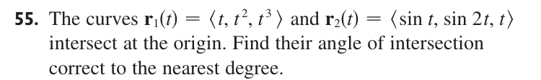

Slide 4
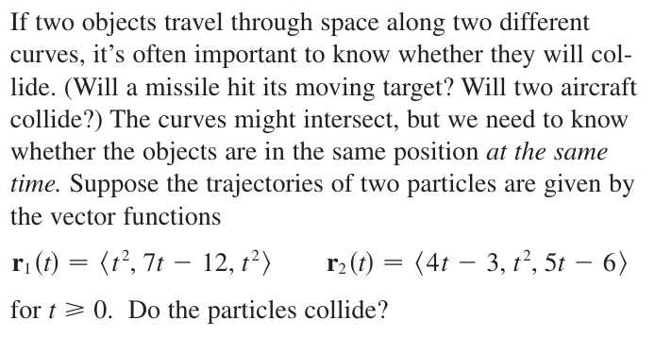

Slide 5


Slide 9


Slide 10


Slide 11
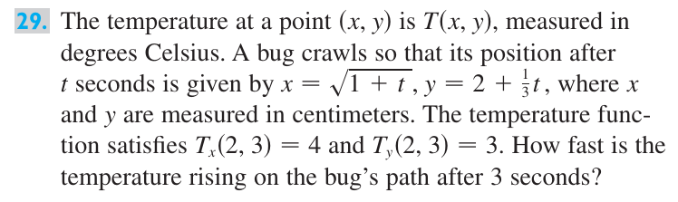

Slide 12
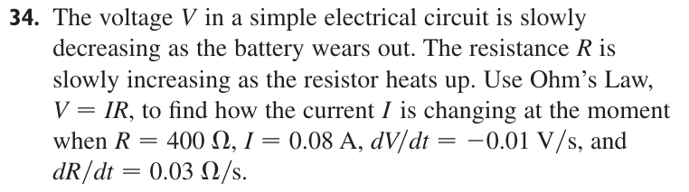

Slide 13
