Slide 1


Slide 2
I. Display current share value and PE ratio for randomly chosen 10 companies from SP500 II. Analyze last 6 month share values and display highest intraday share fall data.
Use Case:

Slide 3







Flow:
Source Mongo DB GCP

Slide 4
Yahoo Finance - Source data Pymongo – Data processing Mongo db Compass – View Data Dataflow – Data movement between Mongo DB To Big query Big query – Store Aggregated data Looker/Looker Studio – Visualize data
Technologies used:

Slide 5
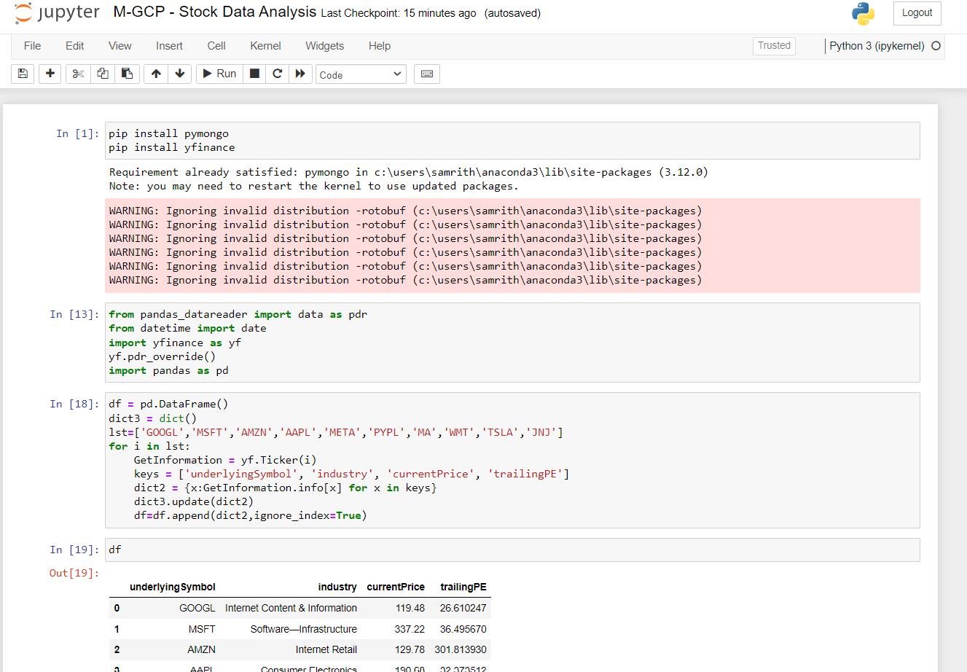
Data Processing:

Slide 6
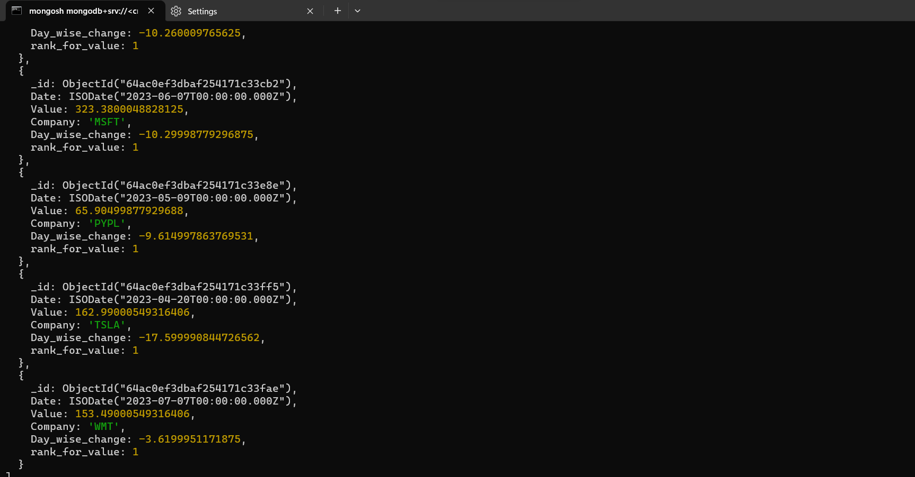
Contd:

Slide 7
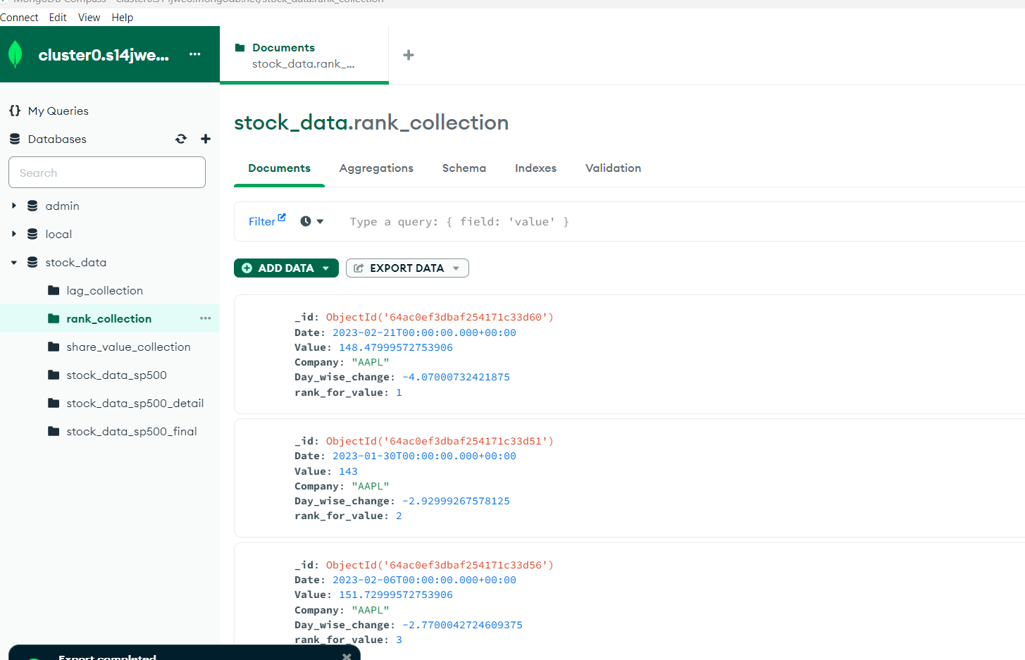
Mongo DB Compass – View Data:

Slide 8
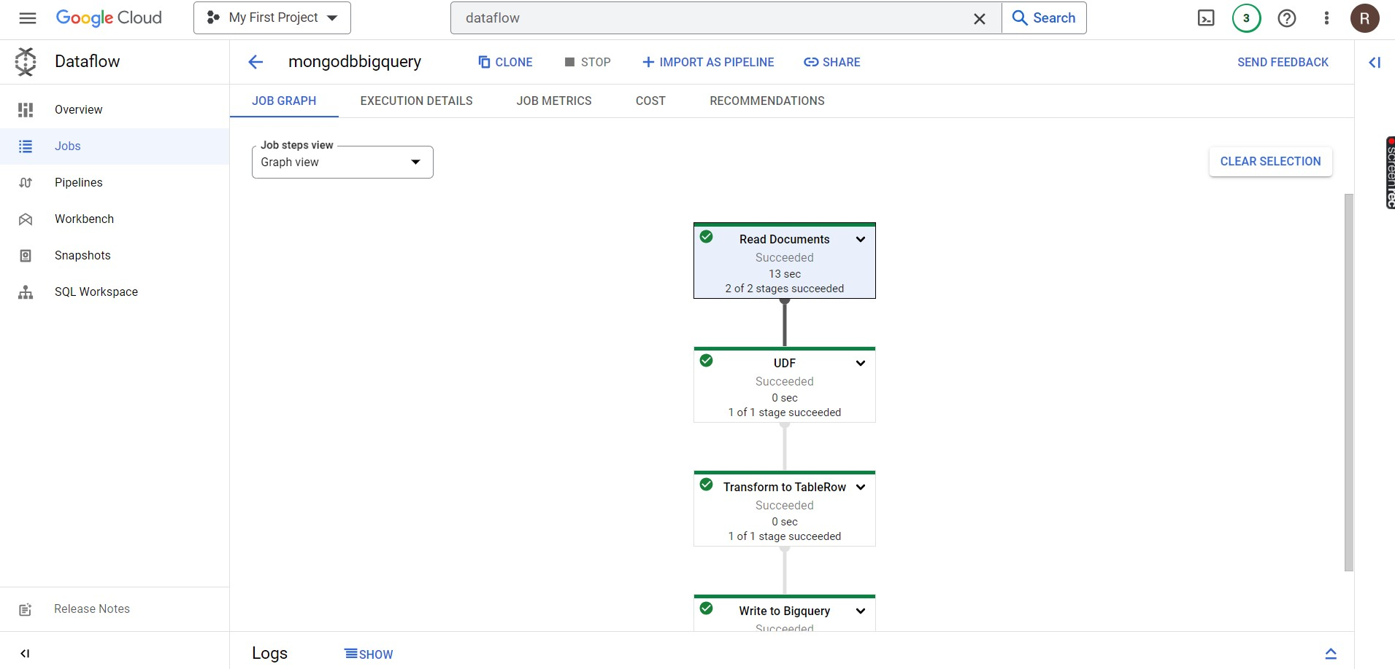
Dataflow – Move data:

Slide 9
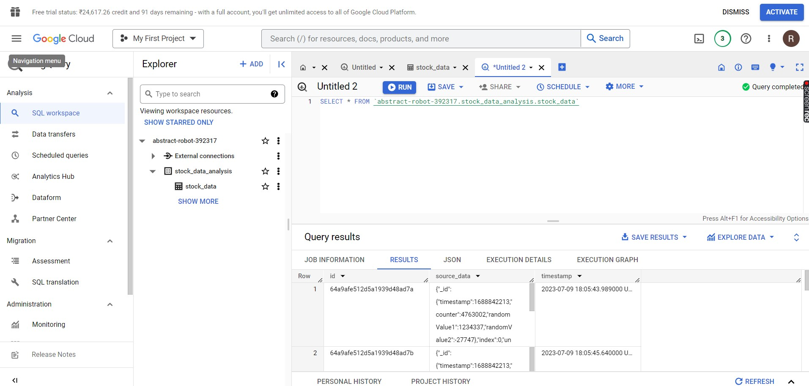
Big query – View Moved data:

Slide 10
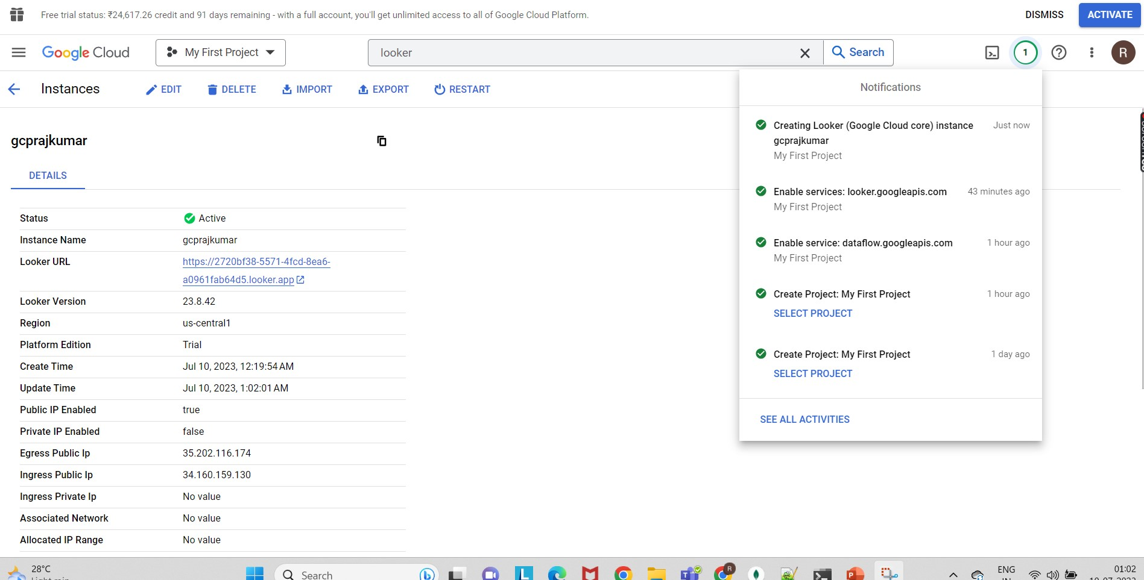
Looker – Instance Creation:

Slide 11
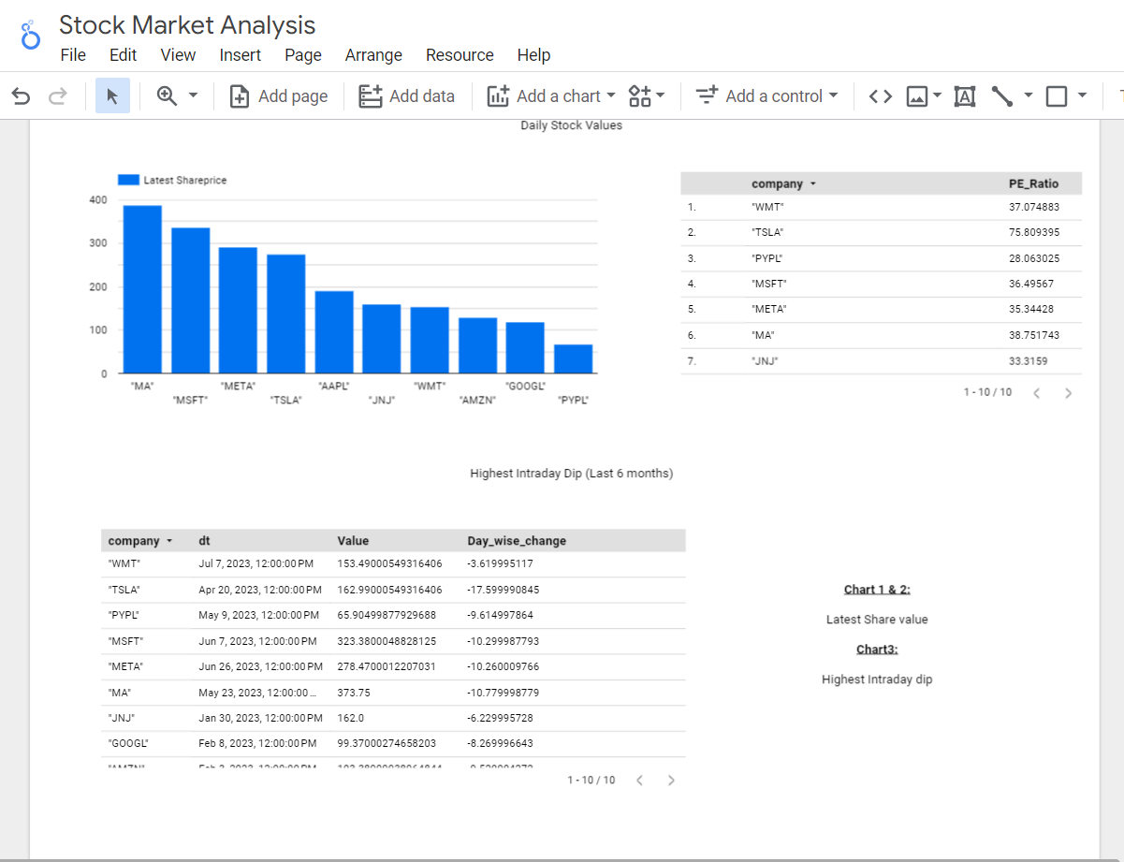
Looker – Report:

Slide 12
Files:

