Slide 1
PUM Converter

Slide 2
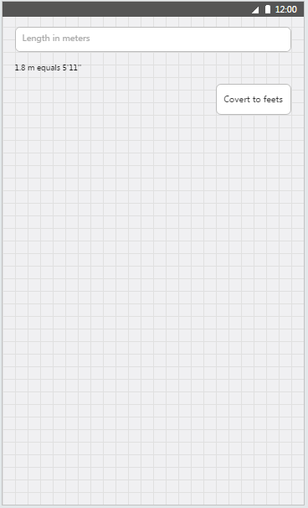
Exercise 1.01
Add controls to MainPage.xaml as shown in wire frames
Add button click handler
On button click you should convert number of meters provide to feet and inches in following format {number_of_feet}'{number_of_inches}'' (eg. "1.8 m equals 5'11''")

Slide 3
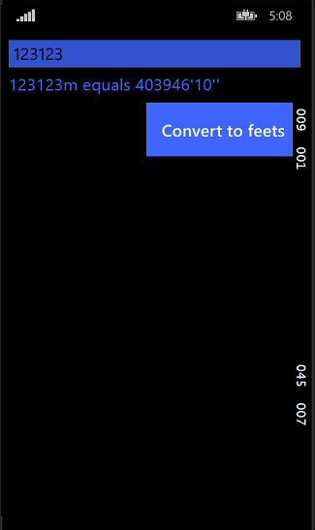
Exercise 1.02
Branch name: exercise-1.01
Using styles:
Set all controls’ and TextBlocks’ font size to 22
Set TextBlocks’ color to PhoneAccentBrush
Set Buttons’ and TextBoxes’ background to PhoneAccentBrush
Disable Buttons’ and textboxes’ borders
Set TextBoxes’ font color to black
Set Buttons’ font color to PhoneForegroundBrush
Set Padding of buttons to 20 pixels

Slide 4
Exercise 1.03
Branch name: exercise-1.02
Move the converting routine to separate method that accept string and returns string
Handle converting exceptions in this method
Implement INotifyProperty interface in MainPage class
Create EntryValue property in MainPage class which will call PropertyChanged event
Set DataContext of MainPage to itself
Bind TextBox text to EntryValue

Slide 5
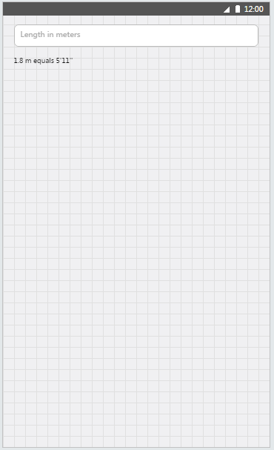
Exercise 1.04
Branch name: exercise-1.03
Remove convert button
Add MetersToFeetValueConverter class implementing IValueConverter interface
Move the converting routine to MetersToFeetValueConverter
Add MetersToFeetValueConverter to static resources
Bind TextBlock Text property to EntryValue using convererter from static resources

Slide 6
Exercise 1.05
Branch name: exercise-1.04
Create UnitConverterViewModel implementing INotifyPropertyChanged
Move EntryValue to created class
Create UnitConverterViewModel field in MainPage and change DataContext to this instance
Modify bindings so output TextBlock will update itself on each keystroke in TextBox

Slide 7
Exercise 1.06
Branch name: exercise-1.05
Create RelayCommand implelementing ICommand interface
RelayCommand constructor should accept delegate Action<object> execute as a routine to call, and optional Func<object,bool> canExecute returning bool telling if the routine can be executed
RelayCommand shoul also provide public method RaiseCanExecuteChanged() to raise CanExecuteChanged event

Slide 8
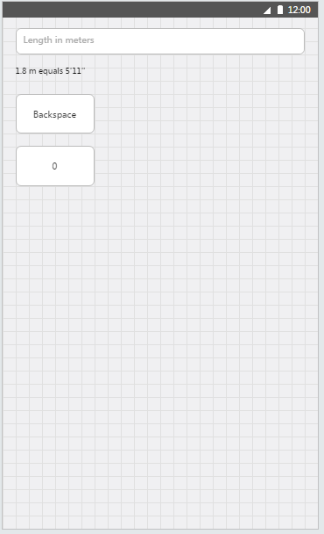
Exercise 1.07
Branch name: exercise-1.06
In UnitConverterViewModel create 2 RelayCommand properties: BackspaceCommand and ZeroCommand
ZeroCommand should add a ‚0’ digit to the end of the EntryValue
BackspaceCommand should remove last digit from EntryValue
BackspaceCommand should be disabled if EntryValue is null or empty
Add two buttons in MainPage, binding theirs Command property to BackspaceCommand and ZeroCommand
Copy backspace symbol  from charmap application and set it as a label of backspace buton. (Use Segoe UI Symbol font)

Slide 9
Exercise 1.08
Branch name: exercise-1.07
Create abstract BaseViewModel class implementing INotifyPropertyChanged
Add protected method RaisePropertyChanged(string name), which should use [CallerMemberName] attribute
Use BaseViewModel as a base class for all current and future view models
Optionally: move all the view model classes to ViewModels folder to structure the project. Remeber to fix namespaces.

