Slide 1
PUM Converter

Slide 2
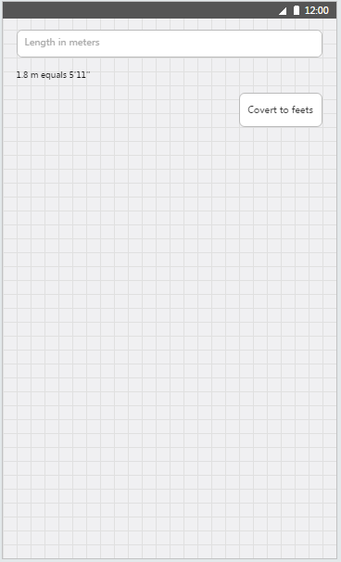
Exercise 1.01
Add controls to MainPage.xaml as shown in wire frames
Add button click handler
On button click you should convert number of meters provide to feet and inches in following format {number_of_feet}'{number_of_inches}'' (eg. "1.8 m equals 5'11''")

Slide 3
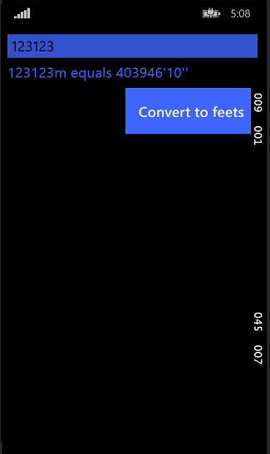
Exercise 1.02
Branch name: exercise-1.01
Using styles:
Set all controls’ and TextBlocks’ font size to 22
Set TextBlocks’ color to PhoneAccentBrush
Set Buttons’ and TextBoxes’ background to PhoneAccentBrush
Disable Buttons’ and textboxes’ borders
Set TextBoxes’ font color to black
Set Buttons’ font color to PhoneForegroundBrush
Set Padding of buttons to 20 pixels

Slide 4
Exercise 1.03
Branch name: exercise-1.02
Move the converting routine to separate method that accept string and returns string
Handle converting exceptions in this method
Implement INotifyPropertyChanged interface in MainPage class
Create EntryValue property in MainPage class which will call PropertyChanged event
Set DataContext of MainPage to itself
Bind TextBox text to EntryValue

Slide 5
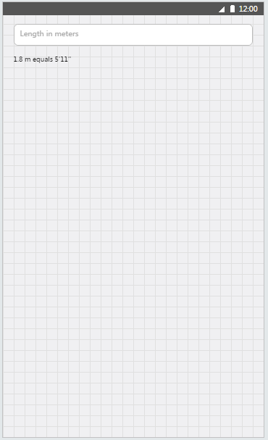
Exercise 1.04
Branch name: exercise-1.03
Remove convert button
Add MetersToFeetValueConverter class implementing IValueConverter interface
Move the converting routine to MetersToFeetValueConverter
Add MetersToFeetValueConverter to static resources
Bind TextBlock Text property to EntryValue using convererter from static resources

Slide 6
Exercise 1.05
Branch name: exercise-1.04
Create UnitConverterViewModel implementing INotifyPropertyChanged
Move EntryValue to created class
Create UnitConverterViewModel field in MainPage and change DataContext to this instance
Modify bindings so output TextBlock will update itself on each keystroke in TextBox

Slide 7
Exercise 1.06
Branch name: exercise-1.05
Create RelayCommand implelementing ICommand interface
RelayCommand constructor should accept delegate Action<object> execute as a routine to call, and optional Func<object,bool> canExecute returning bool telling if the routine can be executed
RelayCommand shoul also provide public method RaiseCanExecuteChanged() to raise CanExecuteChanged event

Slide 8
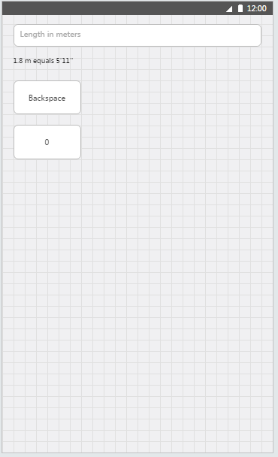
Exercise 1.07
Branch name: exercise-1.06
In UnitConverterViewModel create 2 RelayCommand properties: BackspaceCommand and ZeroCommand
ZeroCommand should add a ‚0’ digit to the end of the EntryValue
BackspaceCommand should remove last digit from EntryValue
BackspaceCommand should be disabled if EntryValue is null or empty
Add two buttons in MainPage, binding theirs Command property to BackspaceCommand and ZeroCommand
Copy backspace symbol  from charmap application and set it as a label of backspace buton. (Use Segoe UI Symbol font)

Slide 9
Exercise 1.08
Branch name: exercise-1.07
Create abstract BaseViewModel class implementing INotifyPropertyChanged
Add protected method RaisePropertyChanged(string name), which should use [CallerMemberName] attribute
Use BaseViewModel as a base class for all current and future view models
Optionally: move all the view model classes to ViewModels folder to structure the project. Remeber to fix namespaces.

Slide 10
Exercise 1.09
Branch name: exercise-1.08
Create abstract class BaseOnScreenButtonViewModel
Public constructor of should accept UnitConverterViewModel as a parameter
It should have Label and ExecuteCommand bindable properties
It should have virtual methods Execute() and CanExecute() used by ExecuteCommand
Create AppendButtonViewModel class extending BaseOnScreenButtonViewModel
AppendButtonViewModel should add AppendString property used to append EntryValue of UnitConverterViewModel

Slide 11
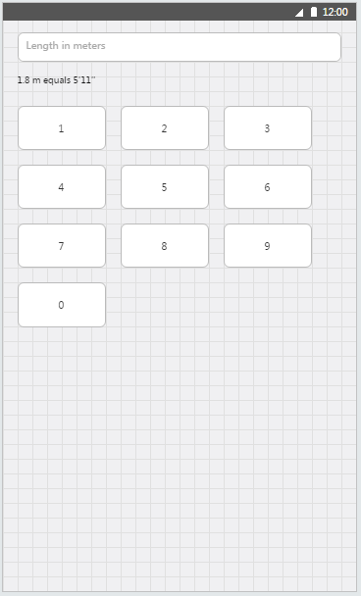
Exercise 1.10
Branch name: exercise-1.09
In UnitConverterViewModel add List<BaseOnScreenButtonViewModel> OnScreenKeyboardButtons property and fill it with AppendButtonViewModel instances for digits from 1 to 9 and 0 at the end
Add GridView to MainPage.xaml and bind its ItemsSource to OnScreenKeyboardButtons
Set the ItemTemplate of GridView to Button with Content and Command binded to BaseOnScreenButtonViewModel’s Label and ExecuteCommand properties
Clean up unnecessary buttons from MainPage and commands from UnitConverterViewModel

Slide 12
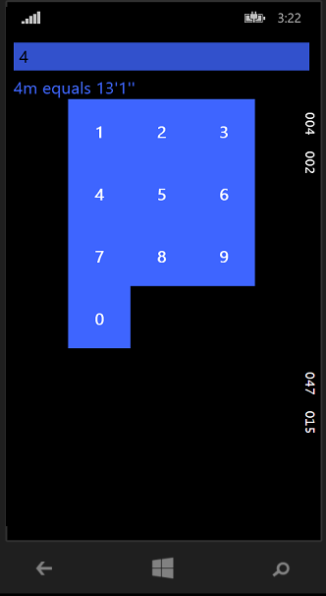
Exercise 1.11
Branch name: exercise-1.10
Make the screen looks like this
Digit buttons should have size 80x80 pixels
Digits should be centered in buton
Whole area should be clickable
There should be no black space around the buttons
HINT: this should be doable by setting some style on buttons and <GridView.ItemContainerStyle>

Slide 13
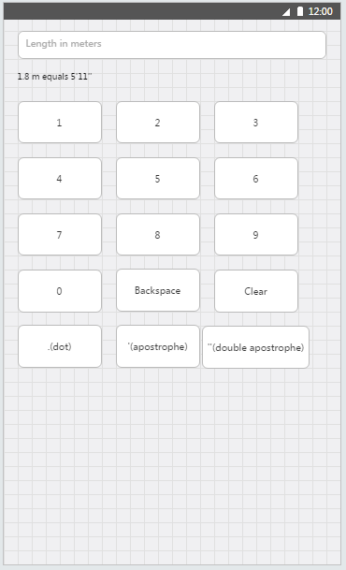
Exercise 1.12
Branch name: exercise-1.11
Add BaseNonEmptyEntryValueButtonViewModel abstract class that will listen if parent’s EntryValue is not empty and override CanExecute properly
Add BackspaceOnScreenButtonViewModel and ClearOnScreenButtonViewModel that will extend previously created class
Add buttons as shown in wireframes, use charmap application for backspace and clear buttons

Slide 14
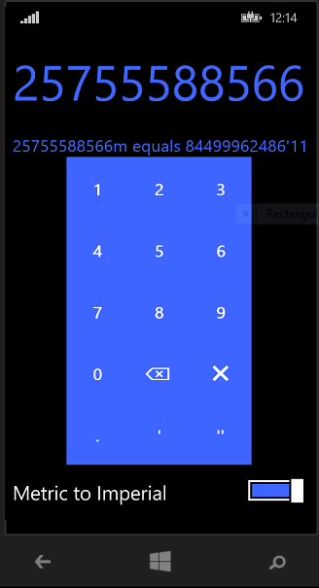
Exercise 1.13
Branch name: exercise-1.12
Change the entry TextBox to TextBlock
Make yout screen looks like this: (HINT: controls to use: Grid, ViewBox, ToggleSwitch)
Bind ToggleSwitch to newly created IsMetricToImperial property

Slide 15
Exercise 1.14
Branch name: exercise-1.13
Create IStringProvider interface containing string ProvidedString and ProvidedStringChanged event
Make UnitConverterViewModel implement IStringProvider
Move all the OnScreenKeyboard buttons’ view models to subdirectory, fix the namespaces
Get rid of a a UnitConverterViewModel reference from BaseOnScreenButtonViewModel
Make AppendButtonViewModel and BaseNonEmptyEntryValueButtonViewModel accept IStringProvider instance in the constructor

Slide 16
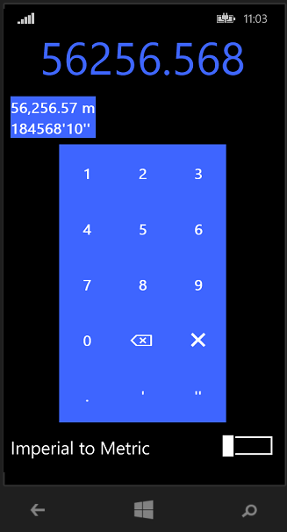
Exercise 1.15
Branch name: exercise-1.14
Create UnitConverterEntryViewModel
It should accept IStringProvider instance in the constructor, should have To and From string properties that should be computed values on IStringProvider event
Fill it with meter to feet logic and create a property in UnitConverterViewModel
Create a Button containing StackPanel with 2 TextBlocks instead of original converted TextBlock
Change the DataContext of Button to just created UnitConverterViewModel property and bind both TextBlocks to From and To properties

Slide 17
Exercise 1.16
Branch name: exercise-1.15
In Model\Units\ directory create the following types
Enum UnitCategory containing Weight, Volume and Length
Enum UnitSystem containing Metric and Imperial
Class NamedUnit that will convert given unit to SI and from Si value with following properties and methods:
UnitSystem System – system of unit converter
UnitCategory Category – category of unit
double ToSiMultiplier – the number you need to multiply the value to get this value in SI units
string FullName
string Abbreviation
FromSi()
ToSi()
ToString()

Slide 18
Exercise 1.17
Branch name: exercise-1.16
Create UnitsLibrary class that will contain all the weight NamedUnit available in application
This class should leverage Dictionary data structure to store all possible NamedUnit’s in the easy-to-retrive way
It should have public method IEnumerable<NamedUnit> NamedUnits(UnitSystem system, UnitCategory category), which will return the list of all NamedUnits for a given system and category
Fill it with data for Weight category:
Metric: gram, kilogram, ton
Imperial: ounce, pound, US ton

Slide 19
Exercise 1.18
Branch name: exercise-1.17
Update UnitConverterEntryViewModel class.
Constructor should also accept UnitSystem and UnitCategory
Class should store the list of input and output NamedUnits
Store the index of current NamedUnit displaying
Update function should update From and To fields according to current NamedUnit
There should be NextNamedUnitCommand command that will togle to another NamedUnit
Update UnitConverterViewModel class to use the new constructor with Weight and Metric system
Update MainPage.xaml to bind button command to NextNamedUnitCommand

Slide 20
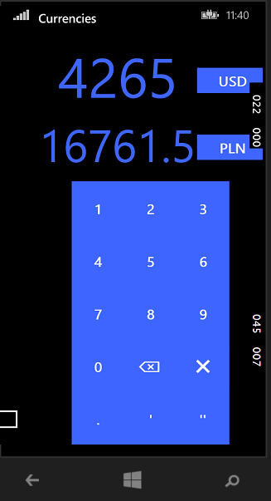
Exercise 2.01
Branch name: exercise-1.18
Rename MainPage to UnitConverterPage
Create HubPage and set it as a main page of the application
Add Hub control into the HubPage and add UnitConverterPage as an item in the first section
Create a copy of UnitConverterPage, rename it to CurrencyConverterPage and redesign it to look like in the image provided
Add CurrencyConverterPage as second section of Hub control in HubPage
Create CurrencyConverterViewModel handling this screen
Create and use CurrencyValueConverter to convert USD -> PLN

Slide 21
Exercise 2.02
Branch name: exercise-2.01
Create Microsoft account and redeem promo code on http://www.microsoftazurepass.com
Open azure portal http://portal.azure.com
Create Mobile Application Service
Add easy table: rates in this Mobile Application Service
Rates table should have 2 string columns: („first” and „second”) and one numeric colum „rate”
Using visual studio fill this table with some data

Slide 22
Exercise 2.03
Branch name: exercise-2.01
In Model\Currencies create CurrencyRate class with string properties First and Second and with decimal property Rate
Create CurrencyDataService class with RetrieveCurrencyRatesAsync() and LoadRatesAsync()
RetrieveCurrencyRatesAsync() should retrieved list of CurrrencyRate from webservice (https://pumconverter.azurewebsites.net/tables/rates?ZUMO-API-VERSION=2.0.0) HINT: use Windows.Web.Http.HttpClient, and newtonsoft json nuget package
LoadRatesAsync() should call RetrieveCurrencyRatesAsync() and instantiete properties:
List<string> Currencies
Dictionary<string, Dictonary<string, CurrencyRate>> Rates

Slide 23
Exercise 2.04
Branch name: exercise-2.03
Make sure that CurrencyConverterViewModel implements following:
String EntryValue and OutputValue containing the string diplayed in Textblocks
String InputCurrency and OutputCurrency shown in currency buttons
List<string> Currencies containing all the currencies downloaded
Update() method that will update OutputValue based on EntryValue and selected currencies
CurrencyConverterViewModel constructor should also Load currencies via CurrencyDataService, and after the load is done Currencies property should be setup

Slide 24
Exercise 2.05
Branch name: exercise-2.04
In CurrencyConvertedPage add ListPickerFlyout’s to currency buttons Flyout properties
ListPickerFlyouts should bind to Currencies property
Currency selection should be done using binding

Slide 25
Exam
Use StringBuilder for construction of EntryValue (0.25p)
Dot button should actually present correct label based on selected locale (0.25p)
OnScreenButtony:
Extract all the onscreen buttons to reusable KeyPad UserControl (0.5p)
Make the KeyPad use ItemsControl on Grid to show buttons (1p)
Implemente Metric/Imperial Toggle switch handling (0.5p)
Add converting buttons for Length and Volume (0.5p)
Make the UnitConverterEntryViewModel automatically choose the best unit to convert into (1.0p)
In Currency converter, update the viewmodel so only valid currencie convertion are available to choose for (1.5p)

