Slide 1

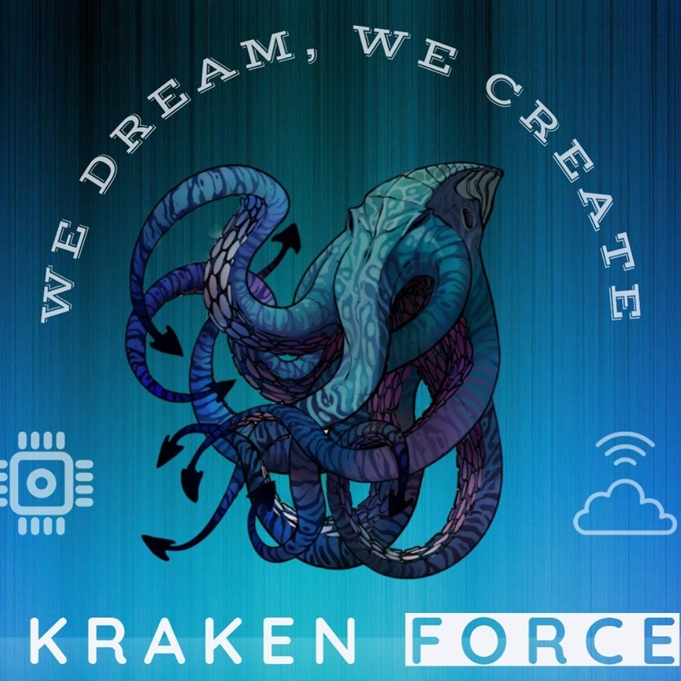

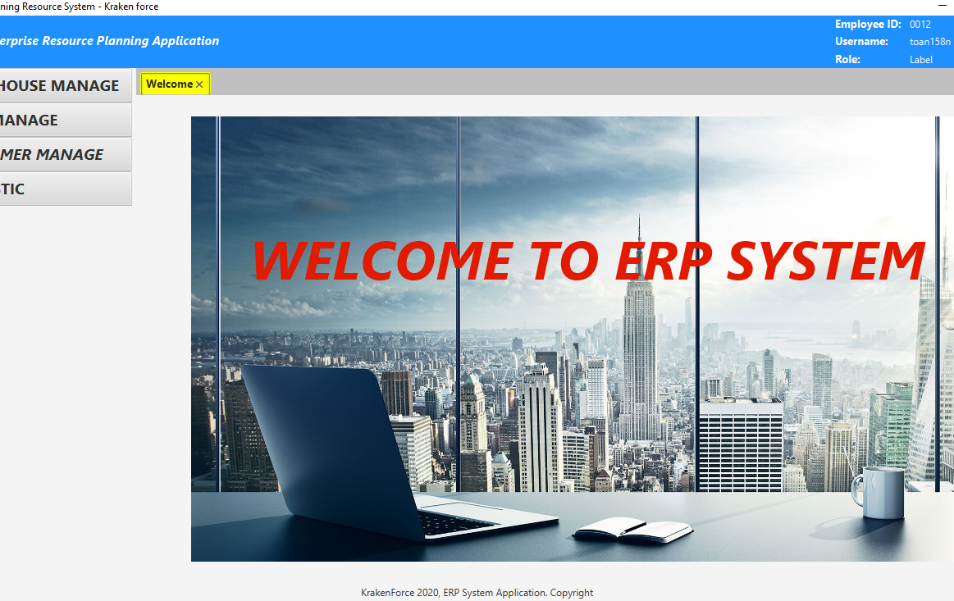
Aptech Computer Education - Aprotrain
ENTERPRISE RESOURCE PLANNING SYSTEM APPLICATION
KRAKEN FORCE
Advisor: Khiem Duy Bui
Class: C1812G
Member:
+ Toan Ngo Vu Thanh
+ Dat Do Tien
+ Tuan Doan Le Nha
+ Huy Ho Van

Slide 2
I. Acknowledgements
Enterprise resource planning (ERP) refers to a type of software that organizations use to manage day-to-day business activities such as accounting, procurement, project management, risk management and compliance, and supply chain operations. A complete ERP suite also includes enterprise performance management, software that helps plan, budget, predict, and report on an organization’s financial results.
ERP systems tie together a multitude of business processes and enable the flow of data between them. By collecting an organization’s shared transactional data from multiple sources, ERP systems eliminate data duplication and provide data integrity with a single source of truth.

Slide 3
II. Project Synopsis
This ERP system application is made available to small business users. With basic functions such as: user functions, warehouse management, customer management, sales management, statistics and related matters.
The application will cover the most essential requirements for small business management
With a simple, intuitive user interface, you can get acquainted quickly. We always want to give customers the best values
The project is created by KrakenForce Team with 4 members

Slide 4
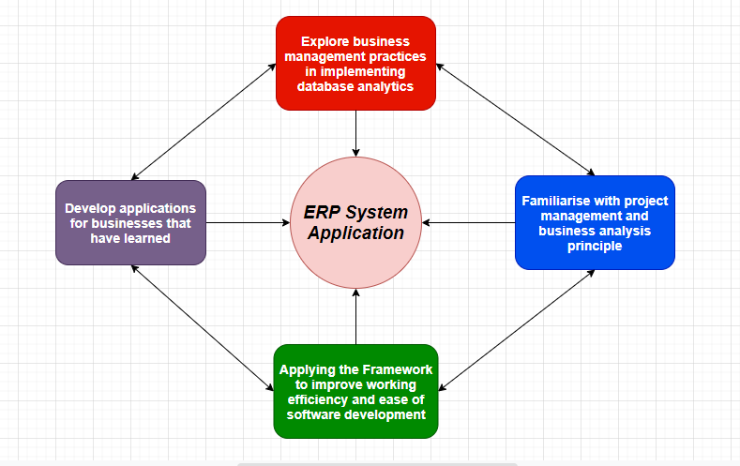
III. Project Analysis

Slide 5
IV. Project Design
1. DFD (Data Flow Diagram)
2. Flowcharts
3. Process Diagram
4. Database Design/ Structure

Slide 6
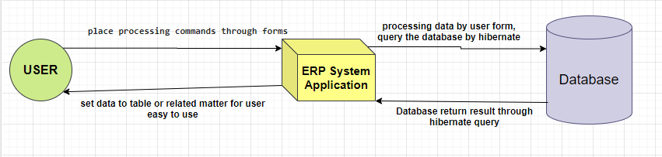
1. DFD (Data Flow Diagram)

Slide 7
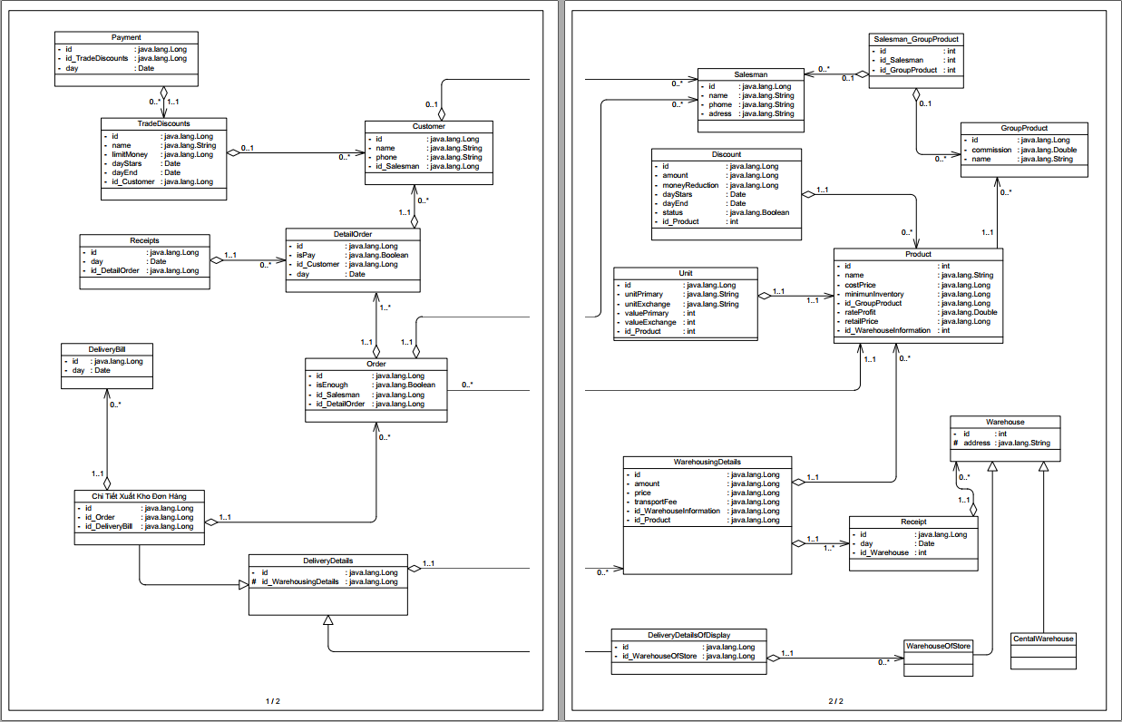
4. Database Design / Structure
Detail Info: ERP_System_Features

Slide 8
V. Screenshot
1. Authentication Module
2. Warehousing Manage Module
3. Customer Manage Module
4. Sales Manage Module
5. Statistic Module

Slide 9
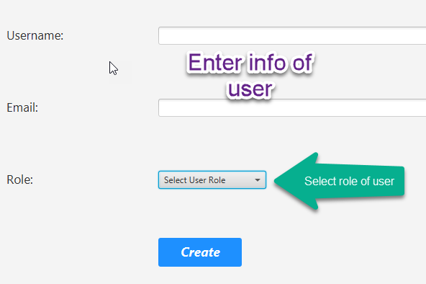
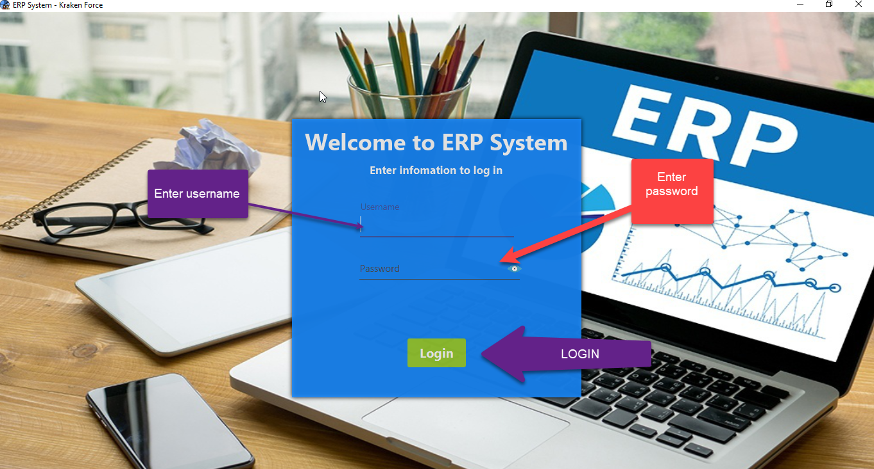
1. Authentication Module

Slide 10
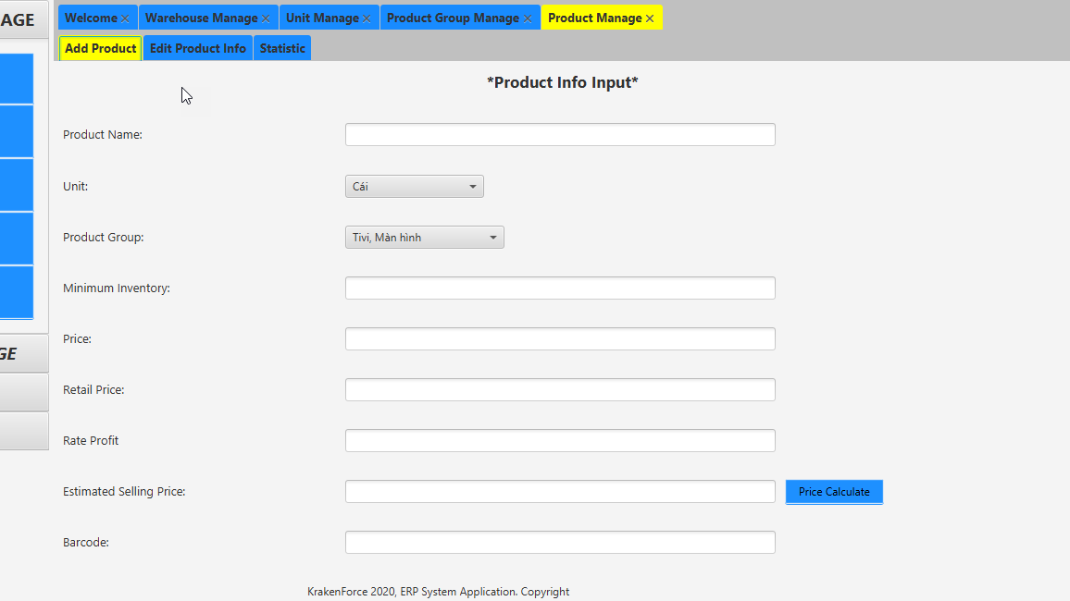
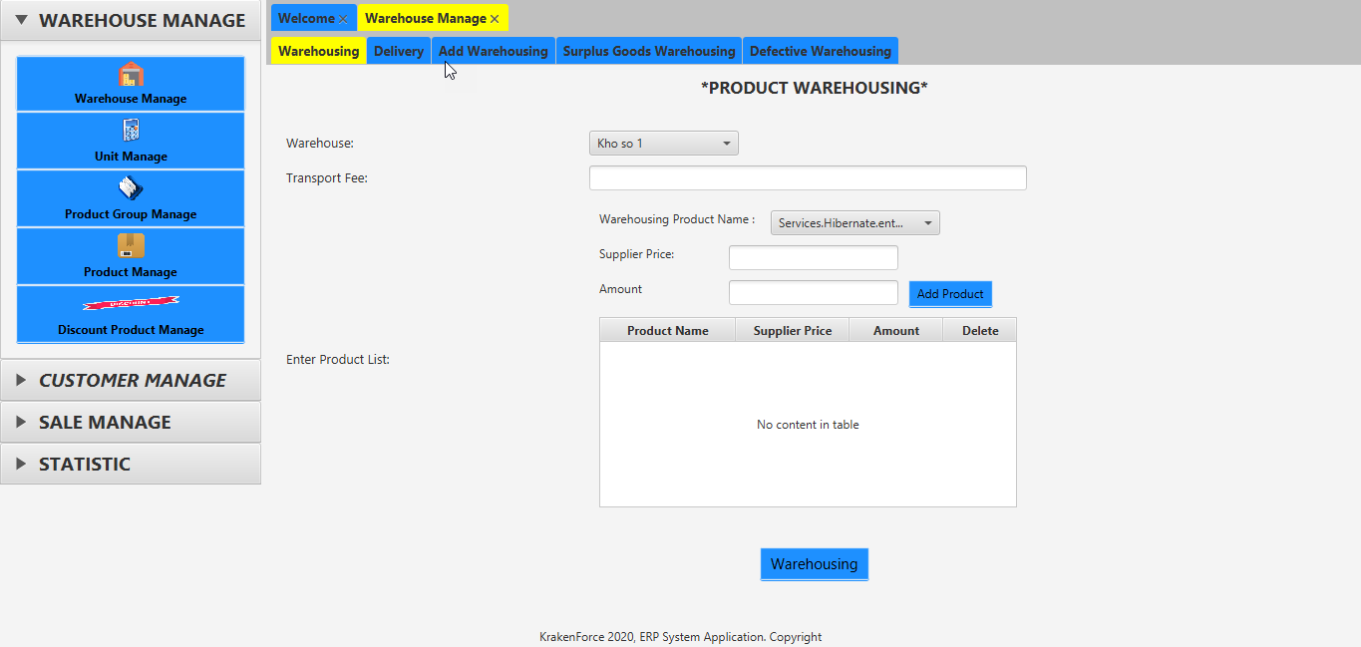
2. Warehousing Manage Module

Slide 11
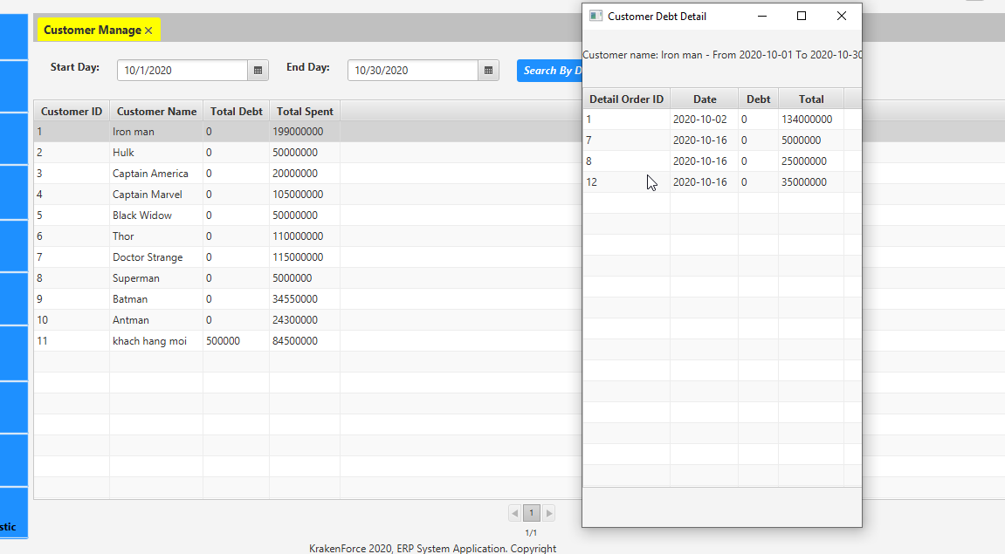
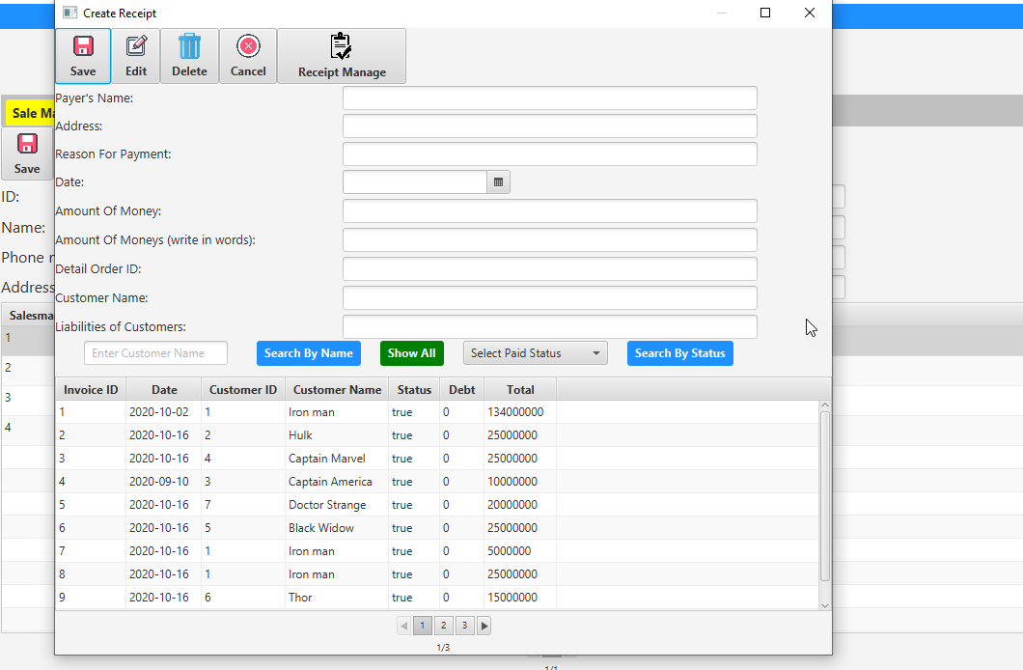
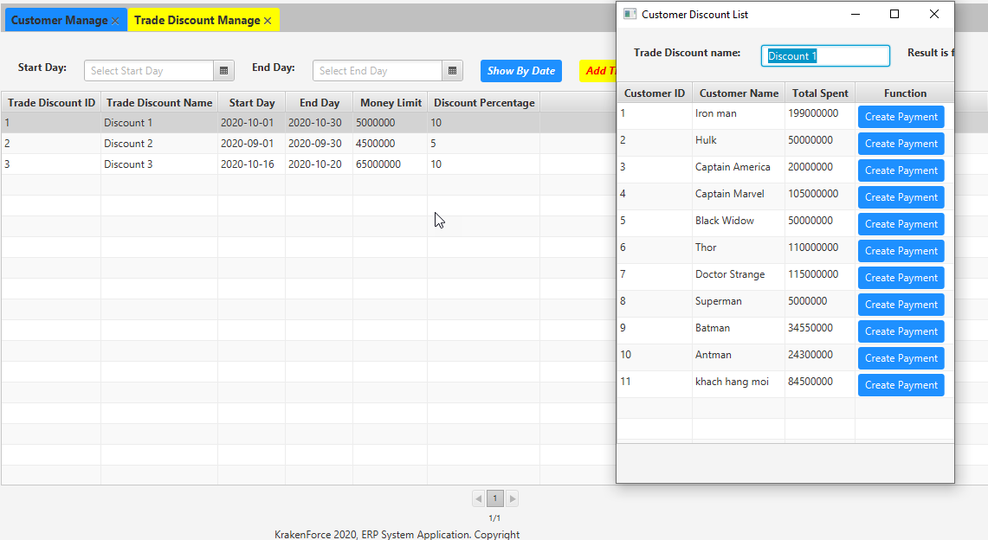
3. Customer Manage Module

Slide 12
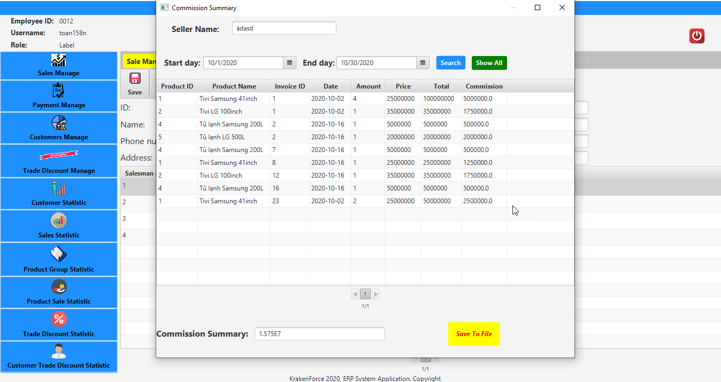
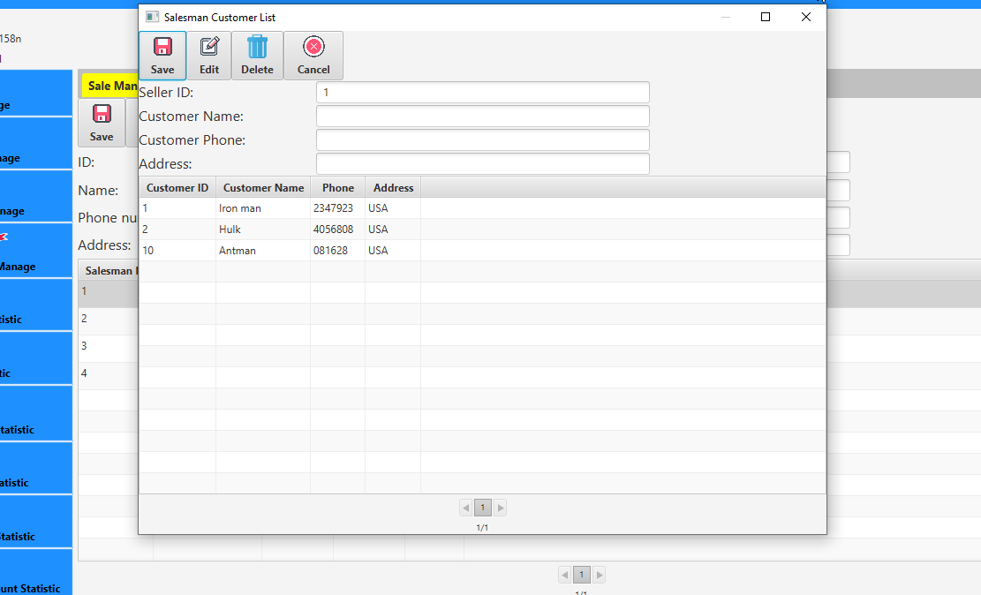
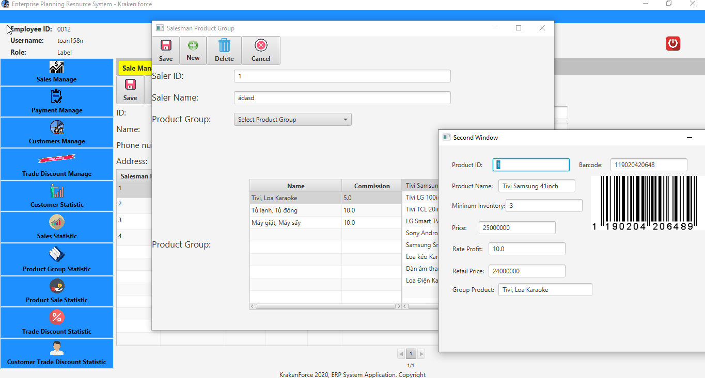
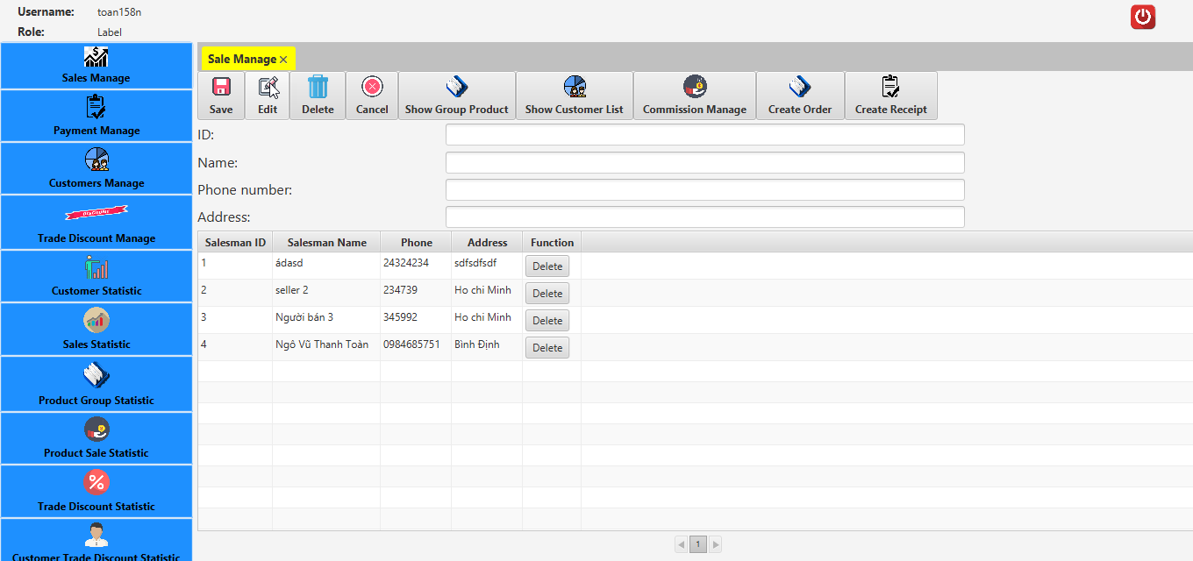
4. Sales Manage Module

Slide 13
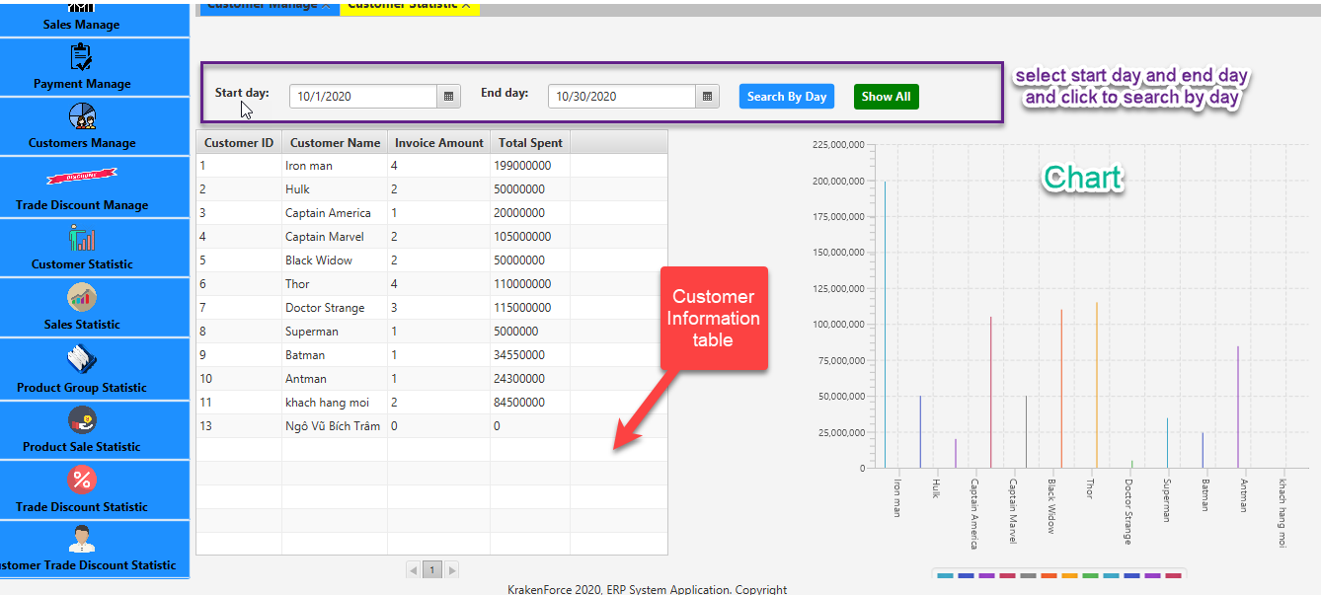
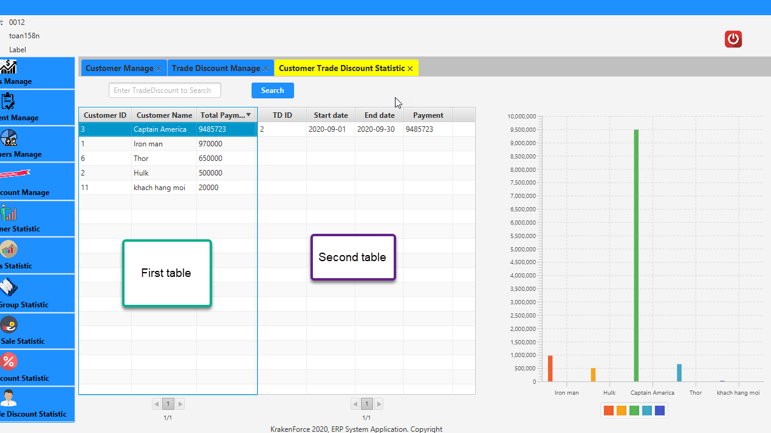
5. Statistic Module

