Slide 1
The Operator Pattern
Managing Stateful Services in Kubernetes
Jakob Karalus, @krallistic

Slide 2
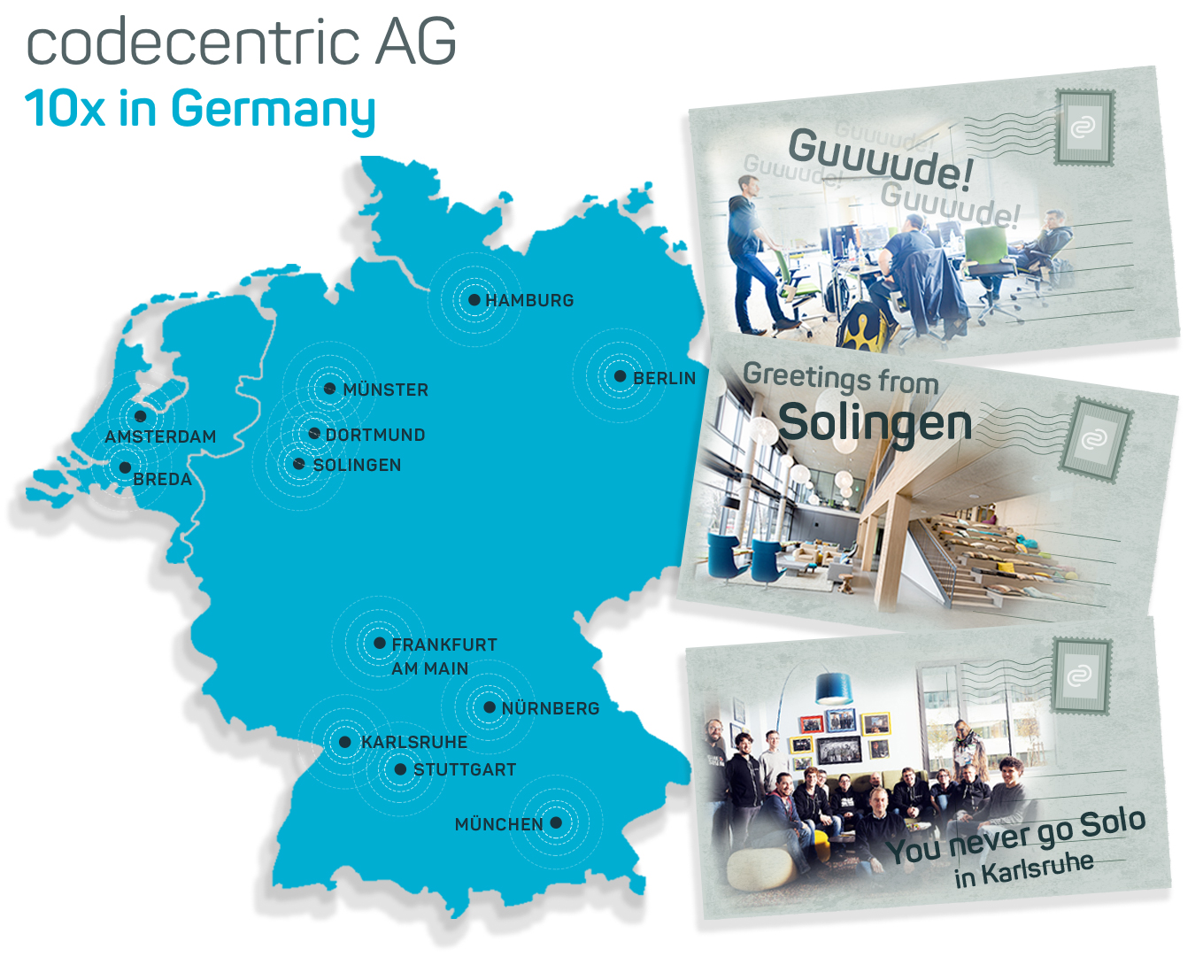
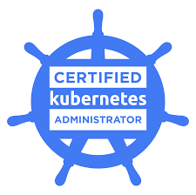
$whoami
Data Science + DevOps
Codecentric
CKA
Twiiter: @krallistic
Github: github.com/krallistic

Slide 3
Normal Kubernetes Deployment
Write some Deployment, Services, Configmaps etc
Deploy them to K8s
Maybe create a Helm Chart
YAML YAML YAML

Slide 4
Success?!

Slide 5
But Day 2 Operations?
Backups?
Upscaling? Reshuffle Data?
Downscaling? Without Dataloss?
Healing? Restore Backups?
Configuration? Tedious Templating?

Slide 6
If only we could automate this!
In a Kubernetes native way!

Slide 7



Operators
Kubernetes
Operator
Apache Kafka

Slide 8
Operators
Human Operational Software
Custom Software
Kubernetes Native:
CustomResourceDefinition
So lets write one:
High Level

Slide 9
CustomResourceDefinition
Defines a new API
Seamless integration with existing API
Kubectl support
apiVersion: apiextensions.k8s.io/v1beta1
kind: CustomResourceDefinition
metadata:
name: crontabs.stable.example.com
spec:
group: stable.example.com
version: v1
scope: Namespaced
names:
plural: crontabs
singular: crontab
kind: CronTab
shortNames:
- ct
validation:
# openAPIV3Schema is the schema for validating custom objects.

Slide 10
CustomResourceDefinition
Actual Object in new API
No functionality.
apiVersion: "stable.example.com/v1"
kind: CronTab
metadata:
name: my-new-cron-object
spec:
cronSpec: "* * * * */5"
image: my-awesome-cron-image
replicas: 5

Slide 11
Control Loop
Observe
Operator create WATCH on CR Objects
Analyze difference Actual vs Desired State
Act on changes
Analyze
Act

Slide 12
Kafka Basics
Broker 0
Broker 1
Broker 2
Topic: “test”
Partitions: 4
Replicas: 2
Partition 0 – Replica 0
Partition 1 – Replica 0
Partition 0 – Replica 1
Partition 2 – Replica 1
Partition 3 – Replica 0
Partition 1 – Replica 1
Partition 3 – Replica 1
Partition 2 – Replica 0
Topic: “hello”
Partitions: 8
Replicas: 3

Slide 13
Create Cluster
Create Pods
Kind: KafkaCluster
Name: analytics
Replicas: 3
POST
ADD Event
Kind: ConfigMap
Name: kafka
Data: |
Kind: Statefulset
Name: analytics
Replicas: 3
Image: Kafka

Slide 14
Downsize Cluster
Delete Pod
Kind: KafkaCluster
Name: analytics
Replicas: 2
Rebalance Topic
UPDATE
Update Event
Desired:
Kind: Statefulset
Name: analytics
Replicas: 2
Image: Kafka
Current:
Kind: Statefulset
Name: analytics
Replicas: 3
Image: Kafka
Cluster Rebalanced

Slide 15
Rebalance Topics with Hot Partitions

Slide 16



Other Operators
Elasticsearch
Postgres
Tensorflow

Slide 17

Take a step back
Are we reinventing the Wheel?
Helm?
Mesos Frameworks?
Nomad Custom Scheduler?
Docker Swarm Plugins?

Slide 18
Operators vs Helm vs Controller
Helm itself a Operator (somewhat, working on it https://github.com/kubernetes/helm/issues/3089) )
Controllers
Operator = Controller + CRD
Operator = External Software
Controller = Internal
Only do operators if you cant solve it with Helm.

Slide 19
Code!
Create API Spec
Generate some Objects needed by Informer etc (Since 1.8)
See: https://blog.openshift.com/kubernetes-deep-dive-code-generation-customresources/ (Excellent, by sttts)
Generator Controller
Informer
Main

Slide 20
Best Practice Operators
Microservices, single Deployment
Stateless, use CRD for States
Operations should be Idempotent
Leverage K8S Objects as most as possible
CRD should be versioned, backwards compatible

Slide 21
Questions? Discuss!

Slide 22
Kubernetes Extensibility
Custom Resource Definitions
API Aggregation
Initializers
Scheduler Extenders
Custom Schedulers
Flex Volumes
Cloud Provider
CRI & CNI
Admission Webhook

Slide 23
Comparison
Task | Mesos | Kuberentes
Custom Resource Placement | Write a framework | Write a custom scheduler
Special resource init | Write a framework | Initializer
API access | Every Framework has its own API | Unified API
Special lifecyle | Write a framework | Kubernetes Operator
Custom execution | Write a framework + executioner | CRI Interface + Scheduler

Slide 24

Stay connected
Address
codecentric AG
Hochstraße 11
42697 Solingen
Contact Info
E-Mail: info@codecentric.de
www.codecentric.de
Telephone
Telefon: +49 (0) 212. 23 36 28 0 Telefax: +49 (0) 212.23 36 28 79

