Slide 1
LOGIN PAGE
Username
Password
Submit

Slide 2
PLACE WAGER PAGE
Select Game
Bet Amount
209,150
199,500
Payout = 19
Payout = 210
MERON
WALA

Slide 3
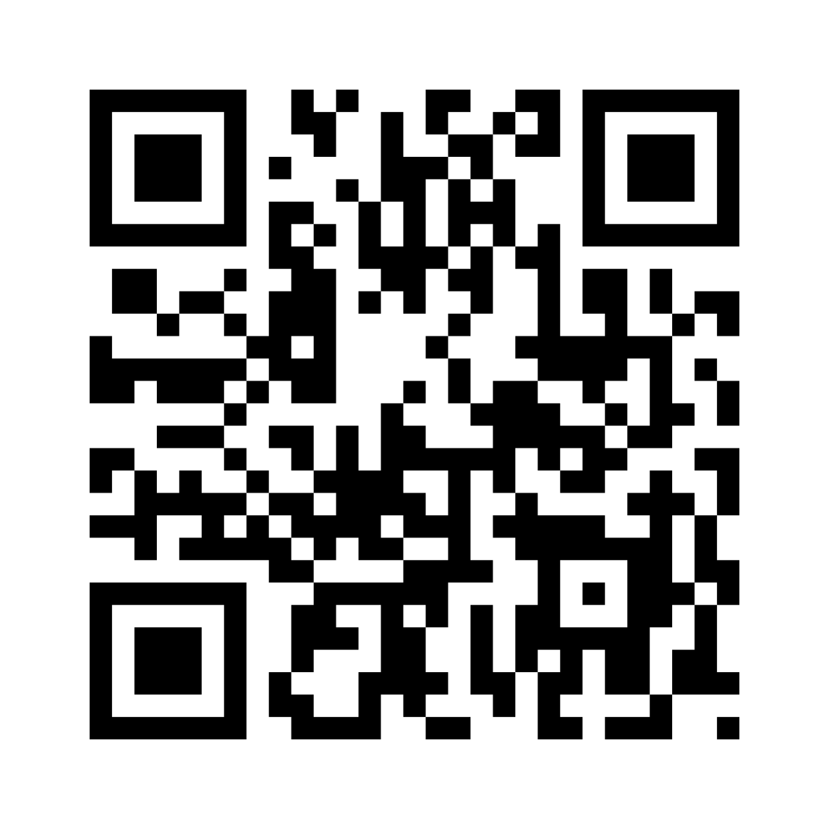
QR CODE GENERATOR PAGE
Game Code – 10020
Wager – Meron
Amount – PHP 500.00
20220209105222100202873782ZZS
Print QR Code

Slide 4
CASHOUT PAGE
Enter or Scan QR Code
20220209105222100202873782ZZS
Game Code – 10020
Wager – Meron
Amount – PHP 500.00
Status – WIN
Payment Released

Slide 5
GAME ADMIN PAGE
New Game Archive Games Reports
Game Code | Meron Vs Wala | Status | Winner | Total Bets | Action
10010 | Kimwong vs Bungot | Active |  | PHP 1,090,150 | Activate | Close | Cancel
10011 | Lungib vs Baktol | Queued |  |  | Activate | Close | Cancel
10009 | Idol Joseph vs Kagawad Mark | Completed | Meron | PHP 2,109,500 | Activate | Close | Cancel
10008 | Rodney vs Dagul | Completed | Draw | PHP 1,850,800 | Activate | Close | Cancel

