Slide 1
Trigonometry

Slide 2
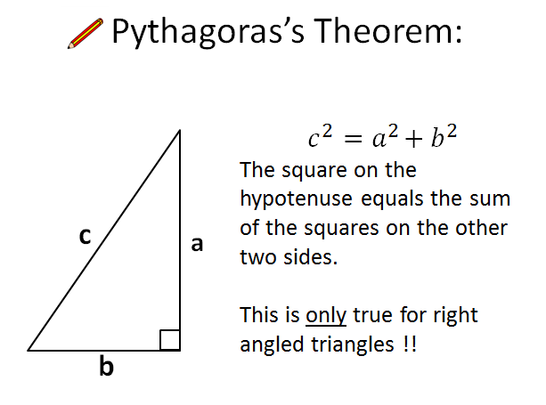
Review

Slide 3
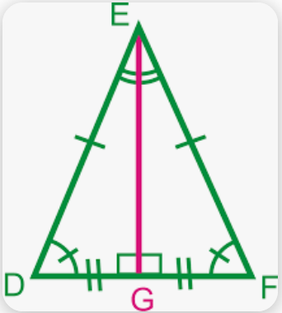
Isosceles Triangle Theorem
Review
An Important property of isosceles triangles is that the angle bisector of the vertex angle is also the perpendicular bisector of the base.

Slide 4
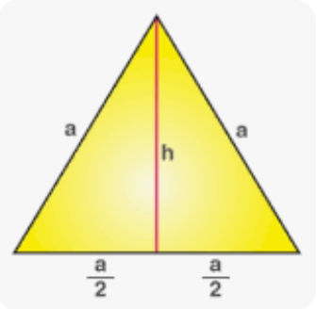
Properties of Equilateral Triangle - review
The perpendicular drawn from vertex of the equilateral triangle to the opposite side bisects it into equal halves.

Slide 5
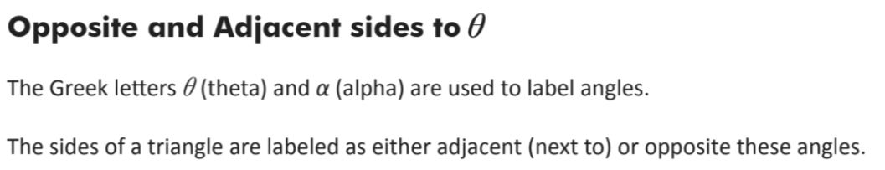
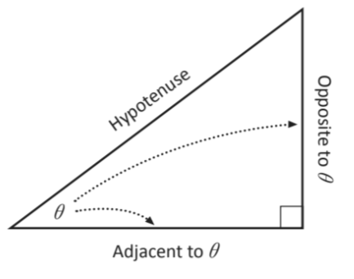
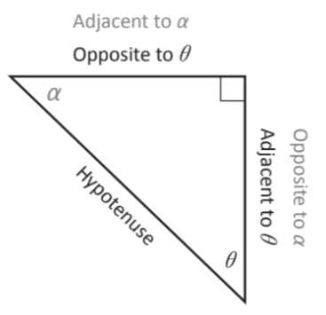
Key Terms

Slide 6
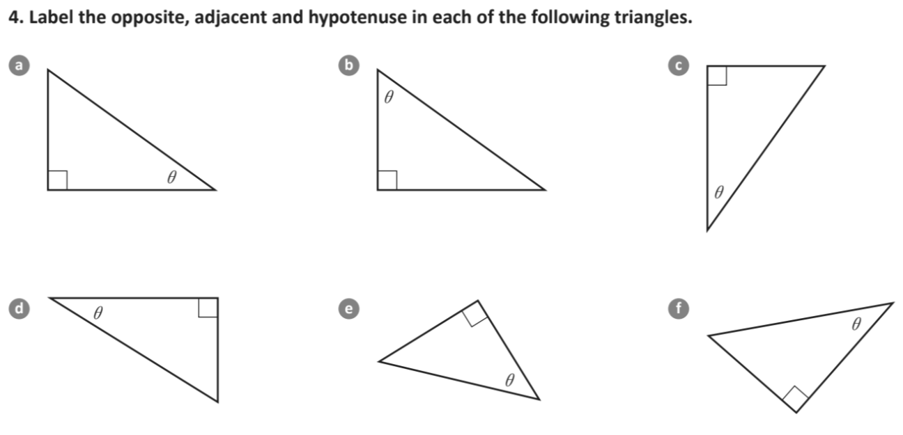

Slide 7
What is it? Why do we need it?
You have already established Pythagoras´Theorem and the principle of similarity with right triangles.
Relationships also exist between a right triangle´s sides and angles.
This is where TRIGONOMETRY begins.

Slide 8
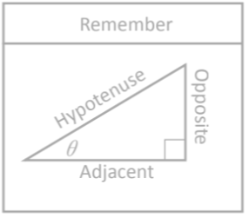
Trigonometric ratios (The sine ratio)
Trigonometric ratios: sine
Watch the video!

Slide 9
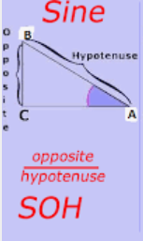
The Sine ratio
The sine ratio can be used to find the length of the side of a triangle and the size of the angle.

Slide 10
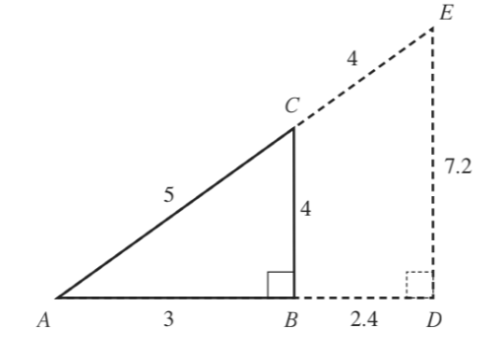
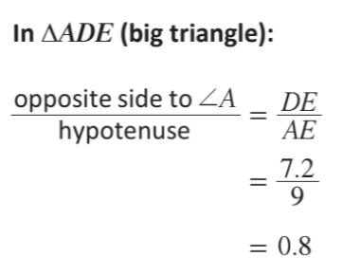
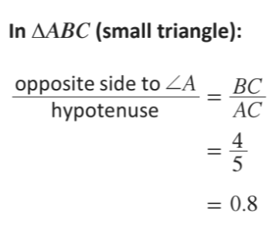
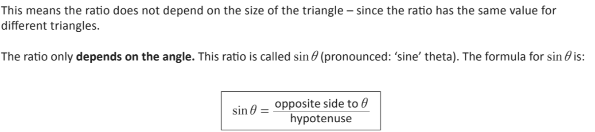
Example

Slide 11
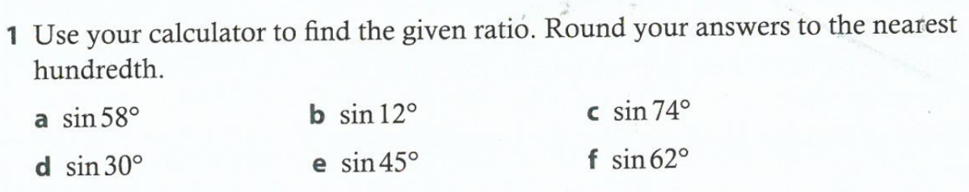
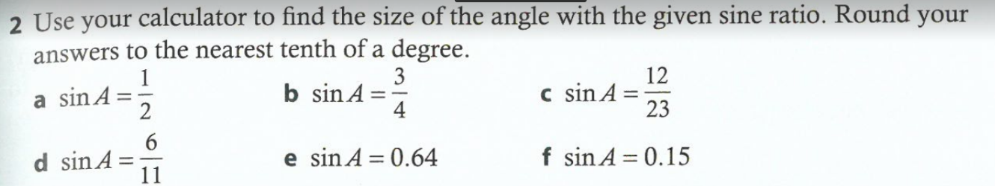
5
mins

Slide 12
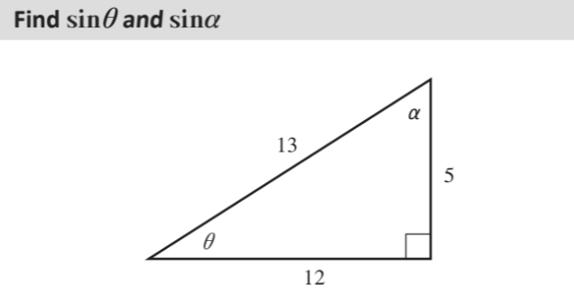
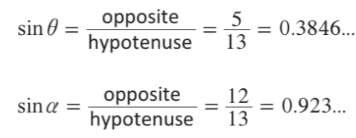
Example:

Slide 13
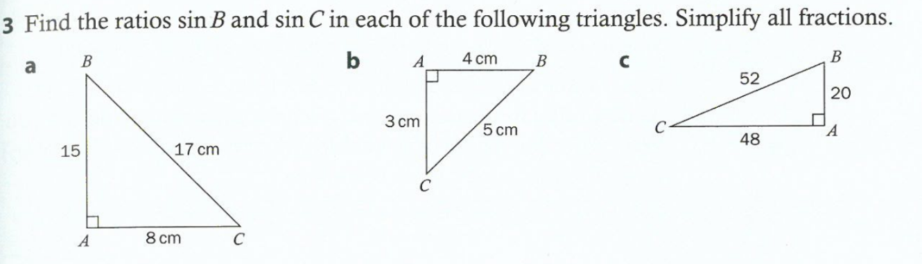
15 cm

Slide 14
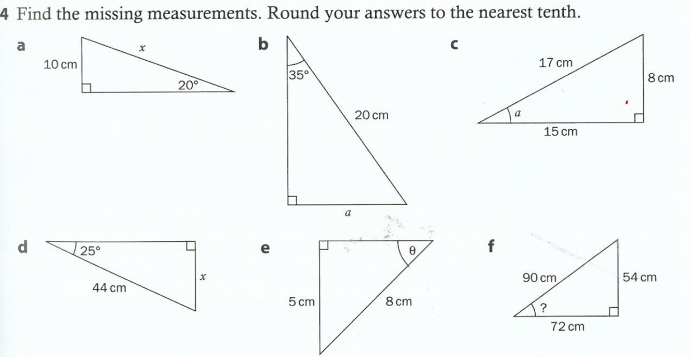

Slide 15
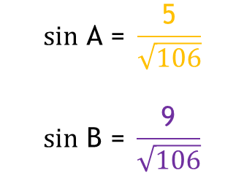
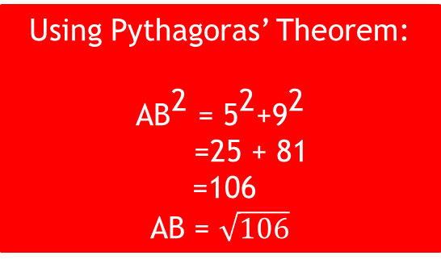
Example: Find the sine ratios of the given triangle
B
5
A
C
9

Slide 16
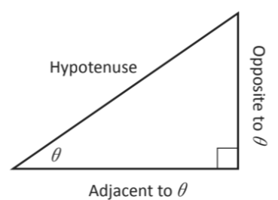

The Cosine ratio
The cosine ratio
Watch the video!

Slide 17
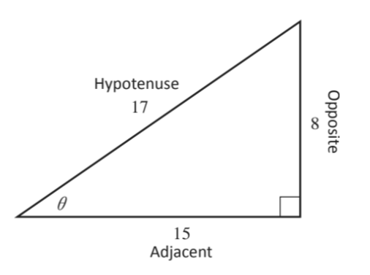
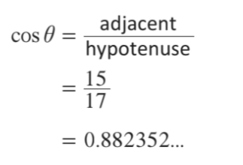
Find cos theta

Slide 18
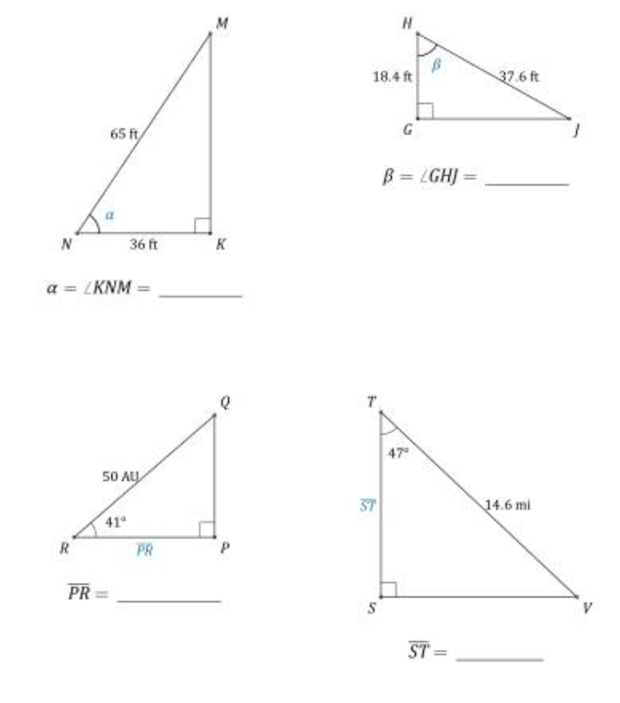
Calculate the angle or side value

Slide 19
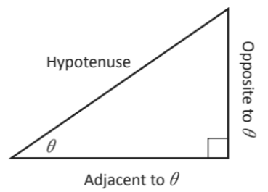

Trigonometric ratios (The tangent ratio)
The tangent ratio
Watch the video!

Slide 20
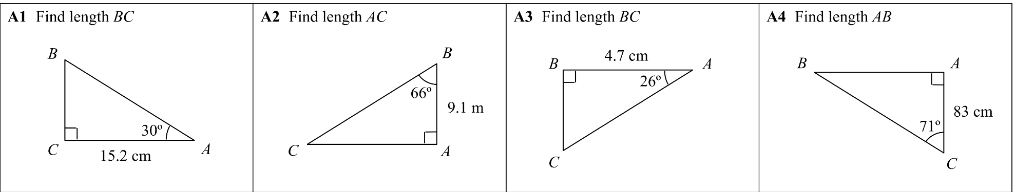
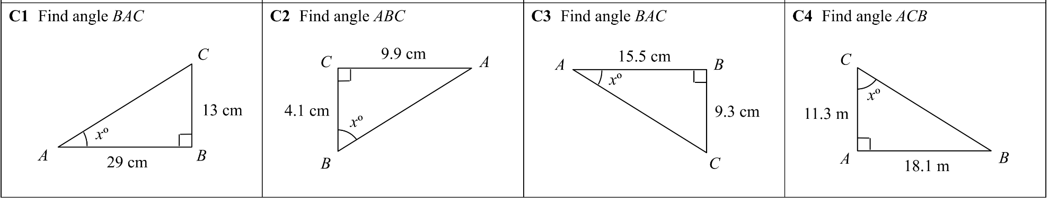
Find the side or angle value

Slide 21
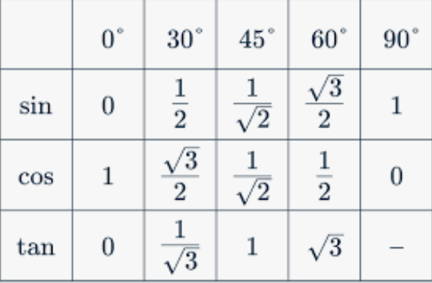
Common Sin, Cos and Tan angles
SOH
CAH
TOA

Slide 22
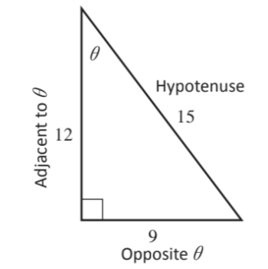
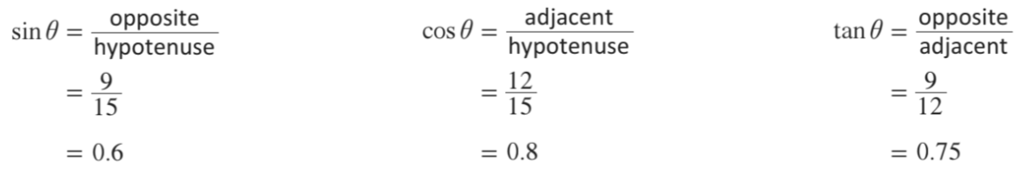

Slide 23
Questions
If tanθ = 2 draw a triangle and find cosθ and sinθ
If cosθ = 2/3 draw a triangle and find sinθ and tanθ
If sinθ = 3/5 draw a triangle and find cosθ and tanθ

Slide 24
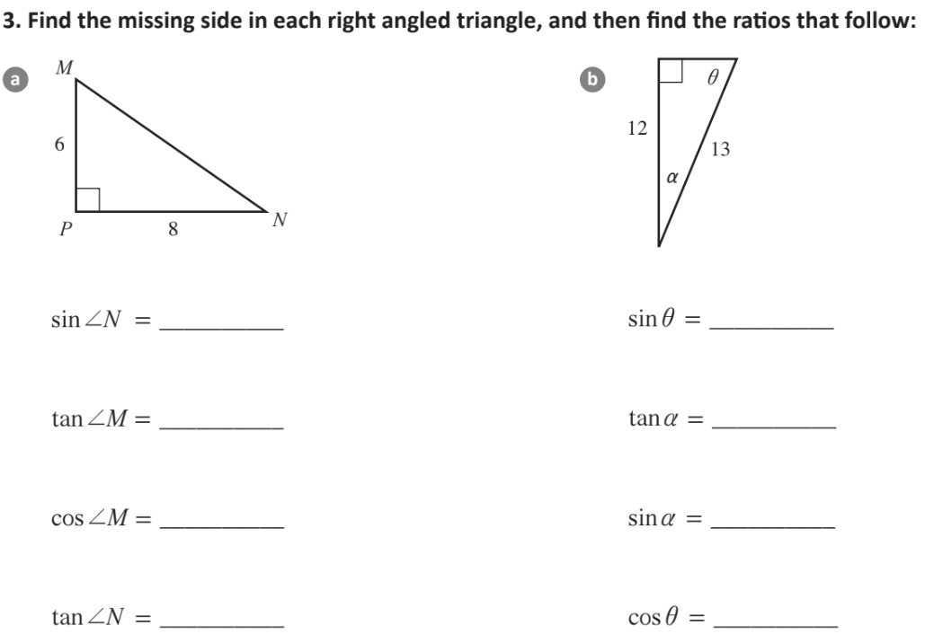

Slide 25
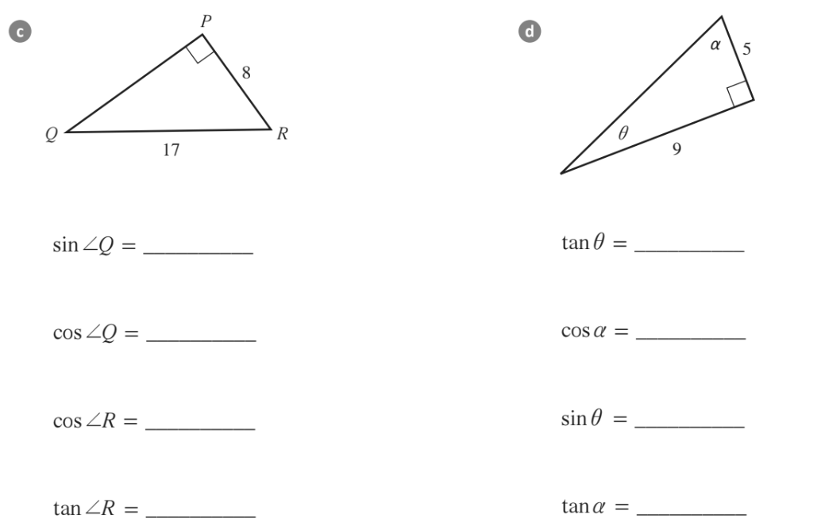

Slide 26
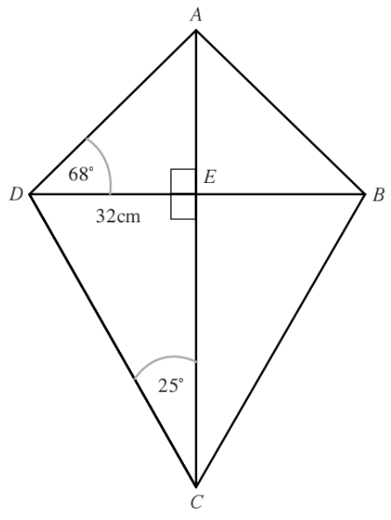
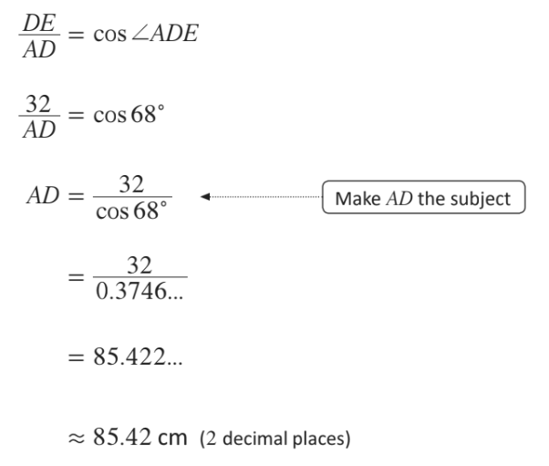
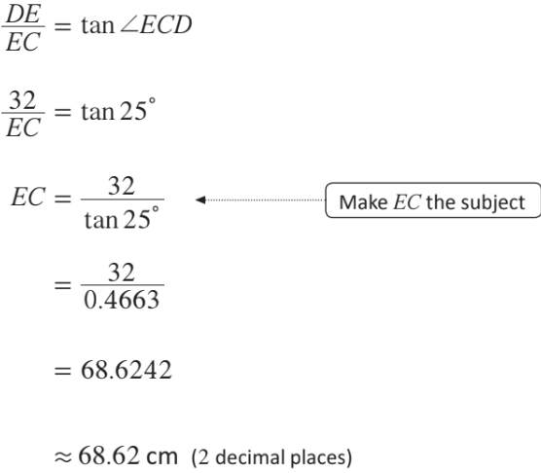

Slide 27
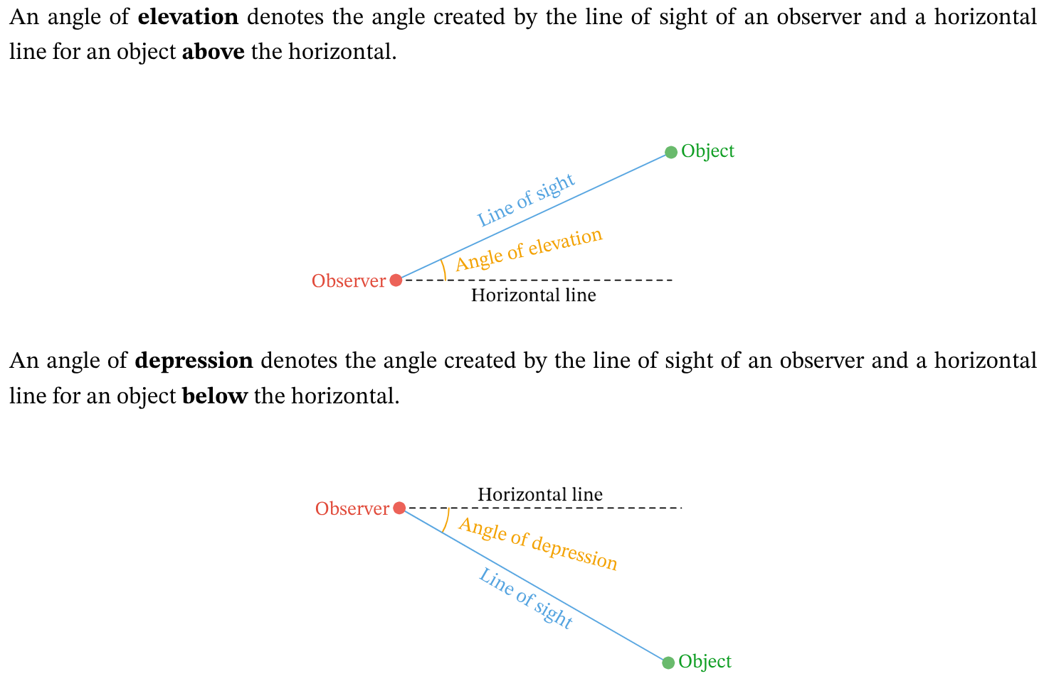
Angle of elevation and depression

Slide 28
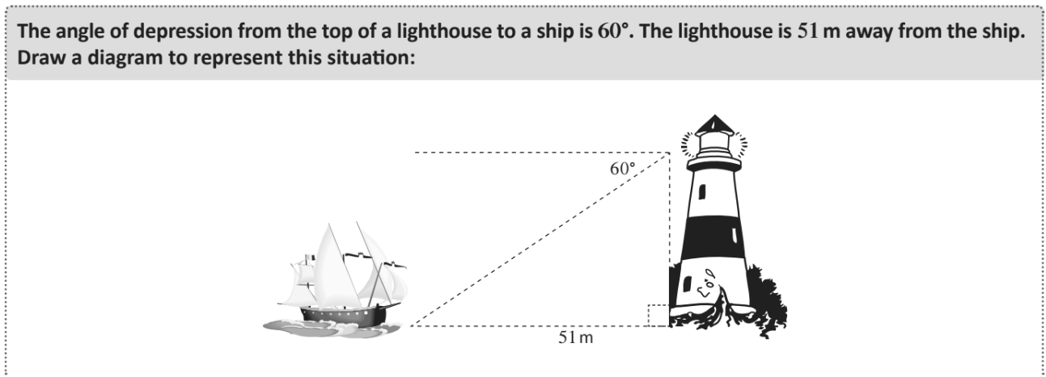

Slide 29
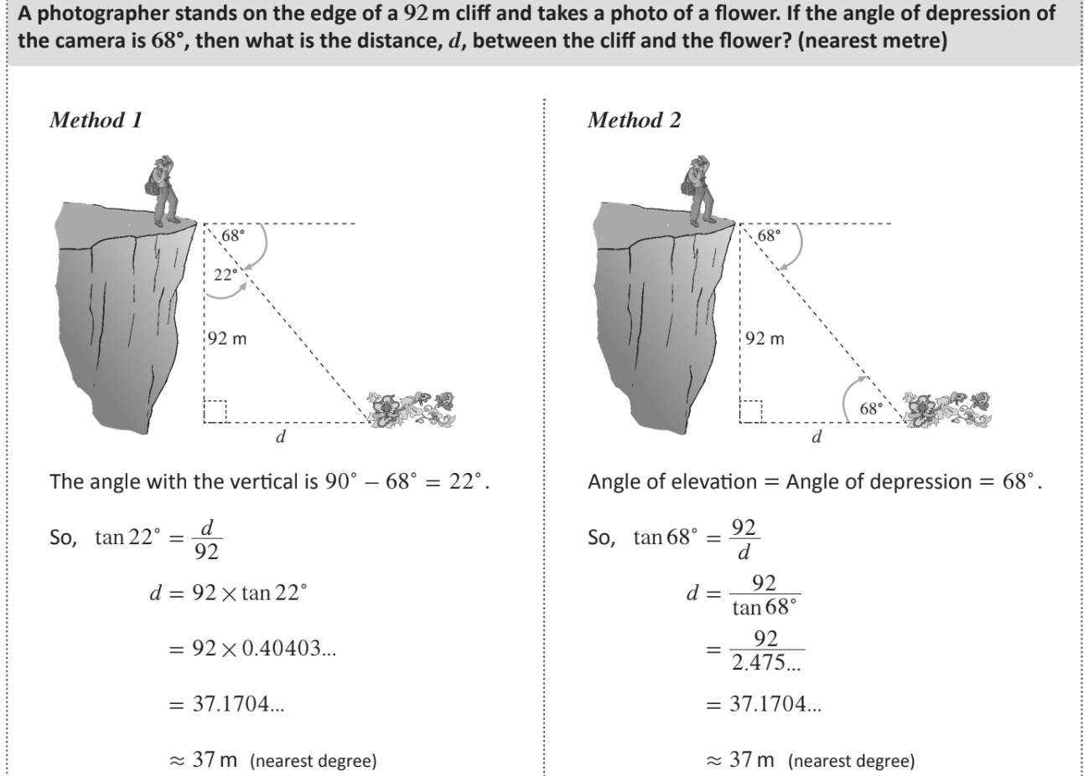

Slide 30
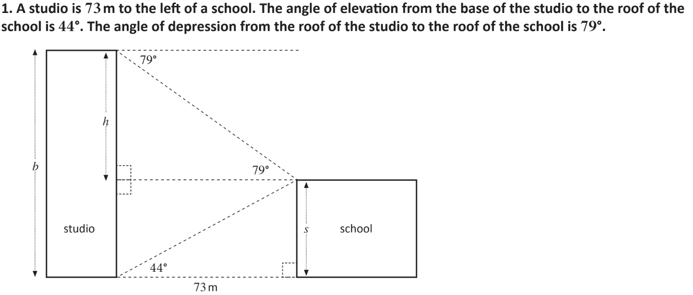

Slide 31
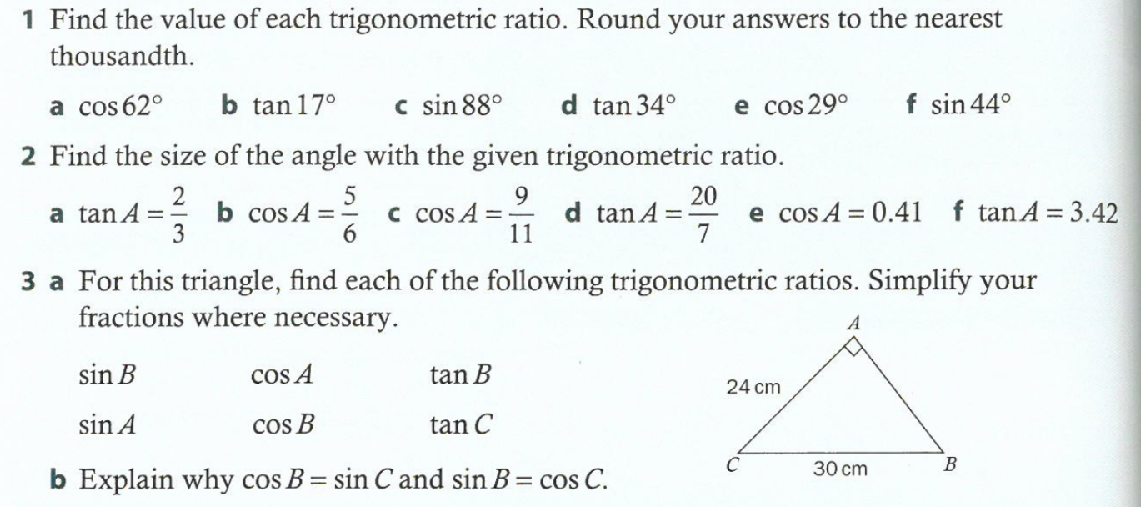

Slide 32
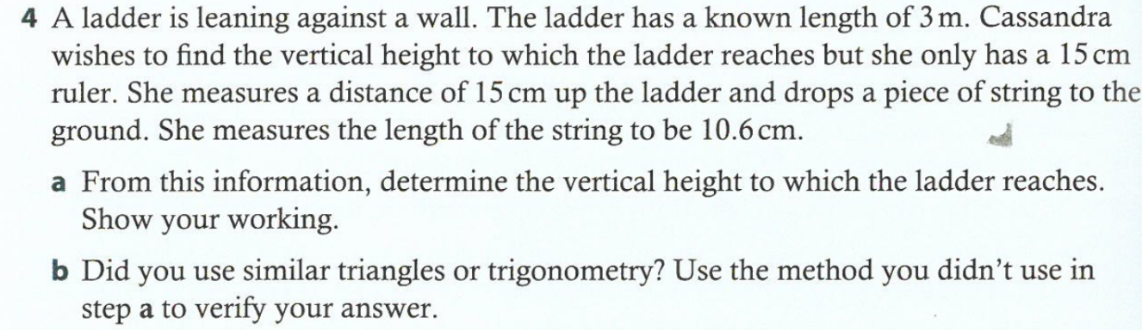
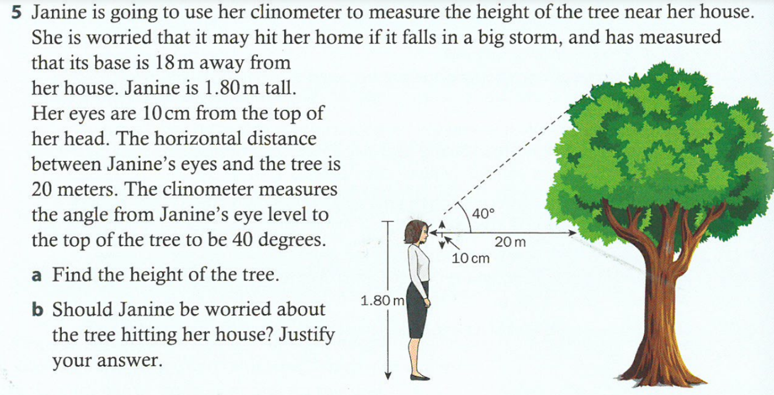

Slide 33
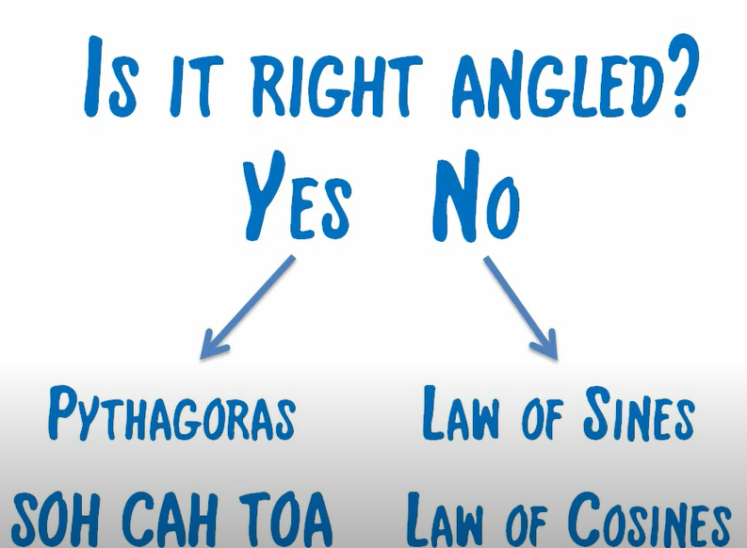
E. The sine rule

Slide 34
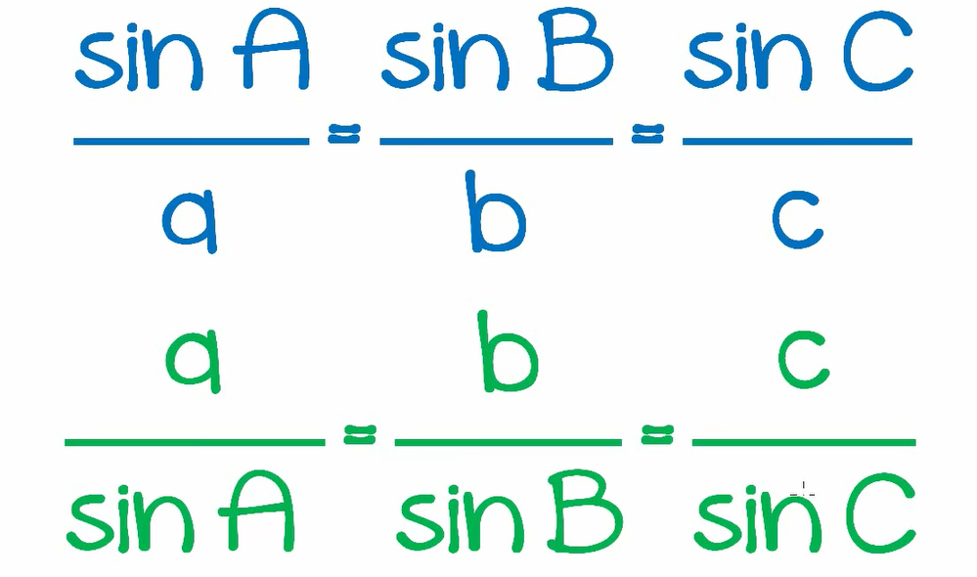
E. The sine rule for all triangles
The sine rule...where a, b, c are sides and A, B, C are angles.

Slide 35
E. The sine rule
The sine rule
Watch the video!
Proof for discussion - https://www.youtube.com/watch?v=5iOBirDp6ik

Slide 36
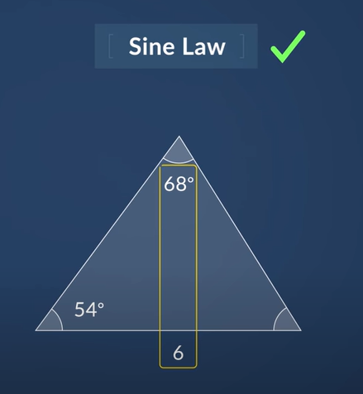
L. The sine rule
When do we use the sine law?
At least we have or looking for one dimension of a pair of opposite dimensions

Slide 37
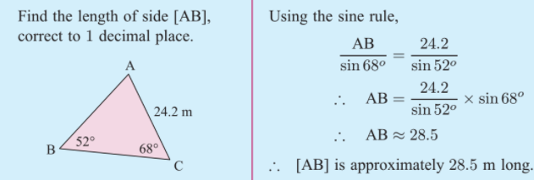
E. The sine rule

Slide 38
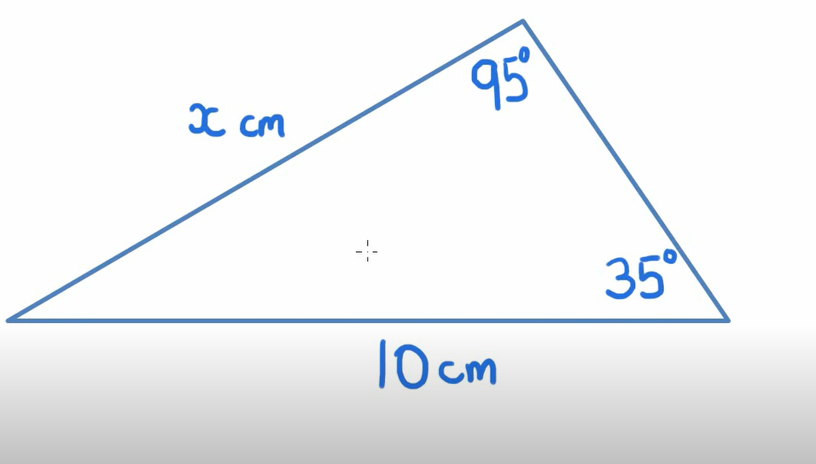
F. The sine rule
Let's take a look on an example

Slide 39
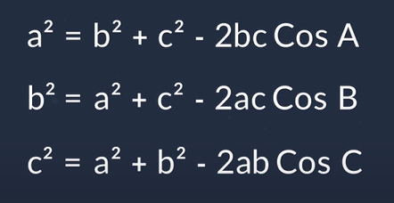
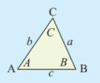
F. The cosine rule

Slide 40
F. The cosine rule
The cosine rule
Watch the video!
Proof for discussion.

Slide 41

F. The cosine rule
When do we use the cosine rule?
If the length of two sides and the angle in between them are given or the three sides are given

Slide 42

F. The cosine rule
Some other useful rearrangements of the cosine rule

Slide 43

F. The cosine rule

Slide 44

F. The cosine rule

Slide 45

Sine and Cosine laws

Slide 46


Slide 47
G. How to find the area of a triangle using sine
How to find the area of a triangle using sine
Watch the video!

Slide 48

G. How to find the area of a triangle using sine
Finding the area of a non-right angled triangle.

Slide 49

G. How to find the area of a triangle using sine

Slide 50

Heron’s formula
Video for Proof of the formula

Slide 51
Notes:
Solution:
Q3 = 235.15cm2
Q4 = 38.93cm2

