Slide 1
AIBEDO
AIBEDO is a hybrid AI framework to capture the effects of cloud properties on global circulation and regional climate patterns.
AIBEDO provides a robust framework to run multi-decadal climate scenarios that obviates the need to run ESM ensembles, saving millions of core computing hours. This tool therefore can be used for rapid generation of scenario analysis and for preparedness and climate resilience planning for military installations and operations.

Slide 2
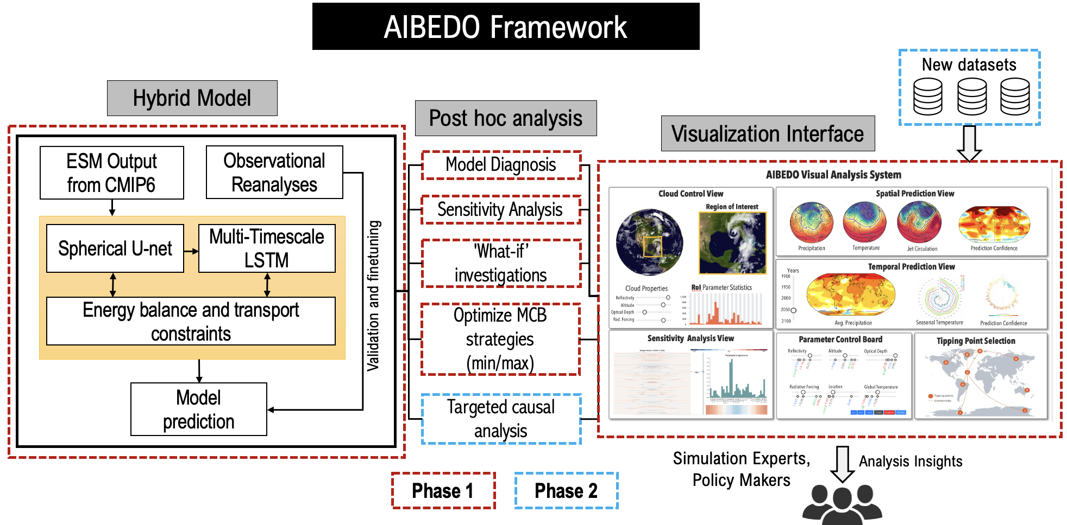
AIBEDO: A Hybrid AI Framework to Capture the Effects of Cloud Properties on Global Circulation and Regional Climate Patterns Palo Alto Research Center, Inc. (PARC); Dr. Kalai Ramea, PI, kramea@parc.com
Clouds play a vital role both in modulating Earth's radiation budget and shaping the coupled circulation of the atmosphere and ocean, driving regional changes in temperature and precipitation.
Clouds are, therefore, opportune for solar radiation management techniques such as Marine Cloud Brightening, and Stratospheric Aerosol Injections.
However, these techniques may have unintended consequences on regional climate patterns, which needs to be studied thoroughly.
AIBEDO is a hybrid AI model framework developed to resolve the weaknesses of Earth System Models by generating rapid and robust multi-decadal climate projections. We will demonstrate its utility using marine cloud brightening scenarios—to avoid climate tipping points, and consequences of ill-planned interventions.
Our hybrid model consists of a Spherical U-Net (spatial), and Multi-timescale LSTM (temporal) module bolstered by physics constraints. Our model will be trained on 20 CMIP6 model ensemble data, and validated against observational reanalysis data.
The interactive nature of AIBEDO with parameter controls provides a unique tool for policymakers and modelers alike to perform ‘what-if’ investigations, run climate related scenarios, or identify consequences of ill-planned, or rogue MCB experiments.

