Slide 1
AZ-104T00A Administer Data Protection

Slide 2
Learning Objectives - Administer Data Protection
Introduction to Azure Backup
Protect your virtual machines by using Azure Backup
Lab 10 – Implement Data Protection
Notes:
This content is part of the AZ-104: Monitor and back up Azure resources (https://learn.microsoft.com/learn/paths/az-104-monitor-backup-resources/) learning path.

Slide 3

Administer Data Protection whiteboard
Backup Policies
Resilient backups (LRS, (RA-) GRS
Multiple access tiers (snapshots and vaults)
Built-in security (RBAC, encryption, soft-delete)
HTTPS, Secure Azure Networks (NSG and Firewall)
Azure storage (Files, Disks, and Blobs)
Virtual machines
SQL in Azure VM
On-premises servers
Azure Database for PostgreSQL servers
SAP Hana in Azure VM
Notes:
Optional whiteboard slide to introduce the module or review the content. Use the whiteboard diagram directly or recreate the image during the class.

Slide 4
Introduction to Azure Backup

Slide 5
Learning Objectives – Introduction to Azure Backup
What is Azure Backup?
How Azure Backup works
Use the Azure Business Continuity Center
Demonstration – Backup Azure File Shares
Learning Recap
Monitor and maintain Azure resources (10–15%): Implement backup and recovery
Create a Recovery Services vault
Create an Azure Backup vault
Create and configure a backup policy
Configure and interpret reports and alerts for backups

Slide 6


What is Azure Backup?
Backup agents
Azure Backup Service
Built-in backup
Recovery Point Management
Resiliency and Availability
Azure Virtual Machines
Azure Managed Disks
Azure Files Shares
SQL Server in Azure VMs
SAP HANA databases in Azure VMs
Azure Database for PostgreSQL servers
Azure Blobs
On-premises files, folders, and system state
Storage Management
Data Tiering
Multi-user Authorization
Policy Management
Monitoring & Reporting
Multi-factor Authentication
Access Control
Notes:
What is the Azure Backup service?
https://learn.microsoft.com/azure/backup/backup-overview
Why use Azure Backup?
https://learn.microsoft.com/azure/backup/backup-introduction-to-azure-backup#why-use-azure-backup
✔️ What are some of the reasons your organization might choose Azure Backup?

Slide 7
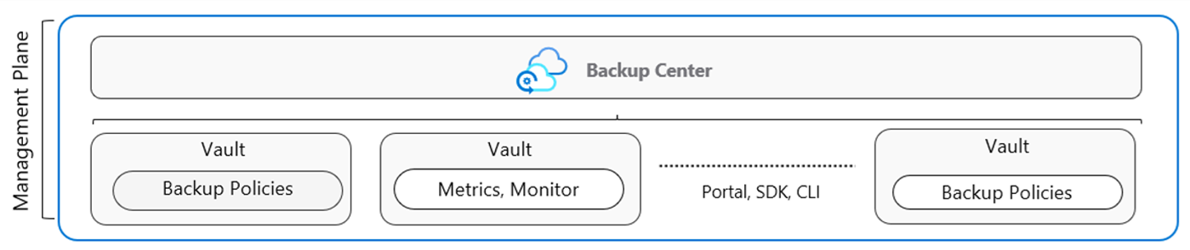
How Azure Backup works (vaults and policies)
Vaults store backup copies, recovery points, and backup policies
Two types of vaults: Backup vault and Recovery Service vault
Backup Policies define the data source, storage vault, and backup schedule
The Business Continuity Center provides a single unified management experience (next slide)
Notes:
Focus this discussion on the administrator tasks like types of vaults and the need to create backup policies. Introduce the Backup Center which is the next slide.
Backup cloud and on-premises workloads to cloud
https://learn.microsoft.com/azure/backup/guidance-best-practices

Slide 8
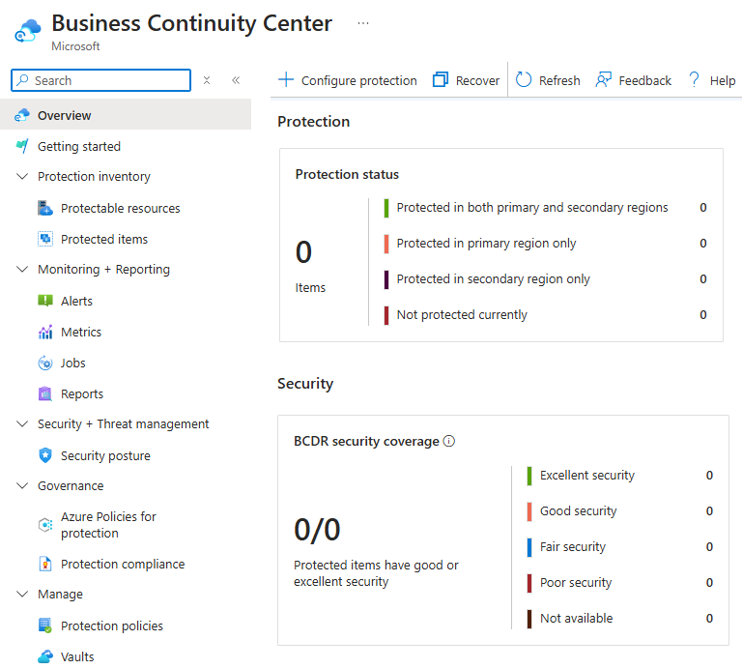
Use the Azure Business Continuity Center
Single pane of glass to manage BCDR protection
Action center to protect Azure, Hybrid, and Edge environments
At-scale unified monitoring capabilities across the solutions
Evaluates your current configuration and proactively notifies you of any gaps
View compliance against the applied policies
Notes:
The next section will go into the details for virtual machine backups.
Azure Business Continuity Center ccumentation- https://learn.microsoft.com/azure/business-continuity-center/business-continuity-center-overview

Slide 9
Demonstration – Backup Azure File Shares
Configure a storage account with file share
Create a Recovery Services vault
Configure file share backup
Verify and restore (optional) the backup
Notes:
Demonstration Backup Azure File Shares
https://microsoftlearning.github.io/AZ-104-MicrosoftAzureAdministrator/Instructions/Demos/10%20-%20Administer%20Data%20Protection.html#backup-azure-file-shares

Slide 10
Learning Recap – Introduction to Azure Backup
Introduction to Azure Backup
Notes:
Additional questions in Office Forms - https://forms.office.com/Pages/ShareFormPage.aspx?id=v4j5cvGGr0GRqy180BHbR5NEFZBpuAZBgxPOGXi_gX5UNFEwTzhFUTdTUTZBWFdDWUVMRkxDWTVBTC4u&sharetoken=mYk00FZIuUtj2z7QzeEU&wdLOR=cD67ACE90-C2B7-4D71-9B7E-1F000829BE34
What workloads can Azure Backup back up? Discuss both on-premises and Azure workloads.
Answer: Azure Backup is the main tool to backup and restore workloads. On-premises workloads include files and folders, Hyper-V virtual machines, VMware virtual machines, Microsoft SQL Server, Microsoft SharePoint, Microsoft Exchange, System State, and Bare Metal Recovery. Azure workloads include virtual machines, Azure file shares, SQL Server in Azure VM, and SAP HANA in Azure VM.
You need to configure on-premises file and folder backups. What are basic steps to configuring the backup?
Answer: First, you will need to create a recovery service vault. Next, download the agent on the on-premises machine. The agent will need a credential certificate. Next, install and register the agent with Azure. Lastly, configure the backup policies. The portal provides a wizard to help with the agent steps.

Slide 11
Protect your virtual machines by using Azure Backup

Slide 12
Learning Objectives – Protect your virtual machines with Azure Backup
Explore options to protect virtual machine data
​Create virtual machine snapshots in Azure Backup
Setup Recovery Services Vault backup options
Backup Virtual Machines
Restore Virtual Machines
Demonstration – Virtual Machine Backups
Manage soft delete (optional)
Implement Azure Site Recovery
Learning Recap
Monitor and maintain Azure resources (10–15%): Implement backup and recovery
Perform backup and restore operations by using Azure Backup
Configure Azure Site Recovery for Azure resources
Perform a failover to a secondary region by using Site Recovery

Slide 13
Explore options to protect virtual machine data
Snapshots
Azure Backup
Azure Site Recovery
Managed snapshots provide a quick and simple option for backing up VMs that use Managed Disks
Azure Backup supports application-consistent backups for both Windows and Linux VMs
Azure Site Recovery protects your VMs from a major disaster scenario when a whole region experiences an outage
Notes:
An overview of Azure VM backup
https://learn.microsoft.com/azure/backup/backup-azure-vms-introduction
✔️ Have you tried any of these backup methods? Do you have a backup plan?

Slide 14
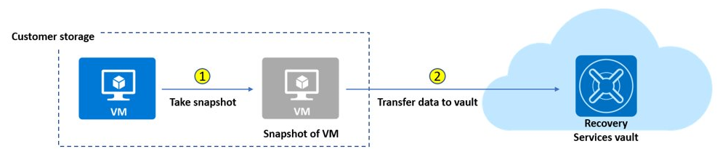
Create virtual machine snapshots in Azure Backup
Use snapshots taken as part of a backup job
Reduces recovery wait times – don’t wait for data transfer to the vault to finish
Configure Instant Restore retention (standard or enhanced)
Notes:
Create a snapshot
https://learn.microsoft.com/azure/virtual-machines/windows/snapshot-copy-managed-disk

Slide 15
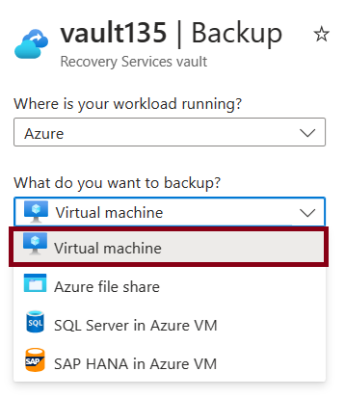
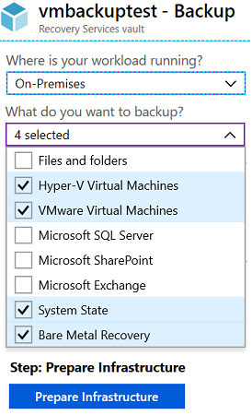
Set up Azure Recovery Services vault backup options
Multiple servers can be protected using the same Recovery Services vault
Azure Workloads
On-Premises Workloads

Slide 16
Backup Virtual Machines
Create a recovery services vault
Use the Portal to define the backup
Backup the virtual machine
1
2
3
Use a Recovery Services Vault in the region where you are performing your Virtual Machine backups and choose a replication strategy for Vault
Take snapshots (recovery points) of your data at defined intervals. These snapshots are stored in recovery services vaults
For the Backup extension to work, the Azure VM Agent must be installed on the Azure virtual machine
Notes:
Tutorial: Back up and restore files for virtual machines in Azure https://learn.microsoft.com/azure/virtual-machines/windows/tutorial-backup-vms

Slide 17
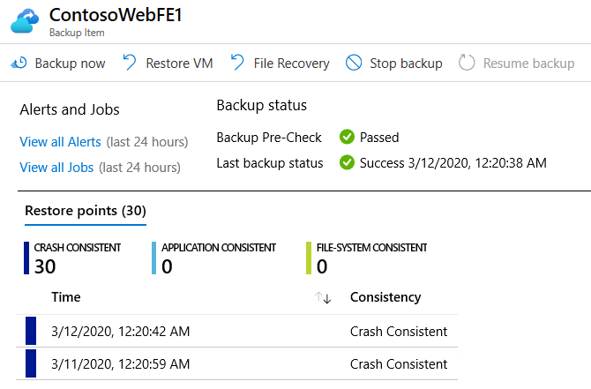
Restore Virtual Machines
Once you trigger the restore operation, the Backup service creates a job for tracking the restore operation
The Backup service also creates and temporarily displays notifications, so you monitor how the backup is proceeding

Slide 18
Demonstration – Virtual Machine Backups
Create a backup for virtual machines
Configure and review the backup policy
Notes:
Demonstration Backup Azure virtual machines
https://microsoftlearning.github.io/AZ-104-MicrosoftAzureAdministrator/Instructions/Demos/10%20-%20Administer%20Data%20Protection.html#backup-azure-virtual-machines

Slide 19
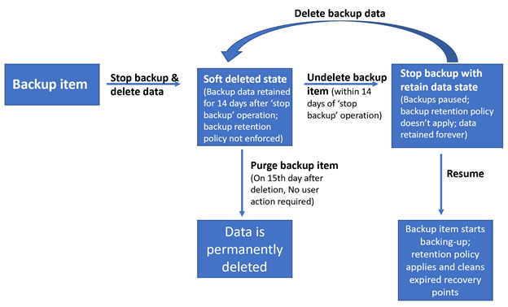
Manage Soft Delete
Backup data is retained for 14 additional days*
Recover soft deleted backup items using an ‘Undelete’ operation
Also available for storage account containers and file shares
Natively built-in for all the recovery services vaults
Notes:
Soft delete for virtual machines
https://learn.microsoft.com/azure/backup/soft-delete-virtual-machines
* Now soft delete number of days can be extended beyond 14 days, although it will have a fee associated to it.

Slide 20
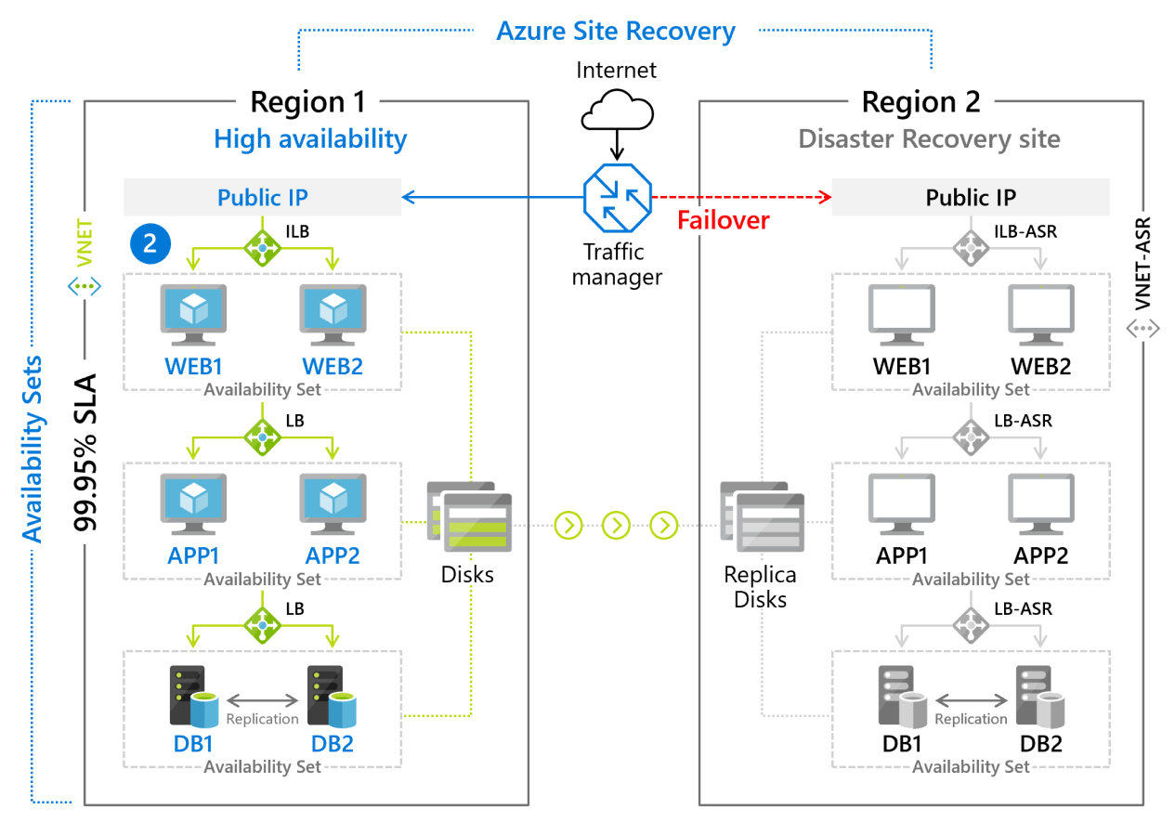
Implement Azure Site Recovery
Manages the orchestration of disaster recovery
Replicates workloads continuously from a primary location or region to a secondary location
Failover to shift to the secondary location; failback to return to the primary location
Notes:
Azure Site Recovery documentation
https://learn.microsoft.com/azure/site-recovery/
Concentrate on replication within Azure and not migration scenarios from on-premises.

Slide 21
Learning Recap – Protect your virtual machines by using Azure Backup
Protect your virtual machines by using Azure Backup
Monitor workload protection in Azure Backup
Implement hybrid backup and recovery with Windows Server IaaS
Notes:
Additional questions in Office Forms - https://forms.office.com/Pages/ShareFormPage.aspx?id=v4j5cvGGr0GRqy180BHbR5NEFZBpuAZBgxPOGXi_gX5UNFEwTzhFUTdTUTZBWFdDWUVMRkxDWTVBTC4u&sharetoken=mYk00FZIuUtj2z7QzeEU&wdLOR=cD67ACE90-C2B7-4D71-9B7E-1F000829BE34
Name at least two ways you can protect virtual machine data.
Answer: Virtual machine snapshots provide a quick and simple option for backing up VMs that use managed disks. Snapshots help capture information between formal backups. Azure Backup supports application-consistent backups for both Windows and Linux VMs. Azure Site Recovery protects your VMs from a major disaster scenario when a whole region experiences an outage.
Several of your virtual machine backups have been accidentally deleted. Is there are any way to recover the deleted backups?
Answer: Soft delete has the capability to protect cloud backups for IaaS virtual machines from accidental as well as malicious deletion of backups. Soft delete provides 14 days of extended retention, allowing recovery with no data loss. Soft delete is offered at no cost and is natively built-in for all recovery service vaults. To recover the deleted backups, use the undelete feature.
What is the difference between Azure Backup and Azure Site recovery?
Answer: Azure Backup allows for granular backups and restores specific data. Azure Site Recovery (ASR) allows for the protection of an entire production site. ASR provides automation and orchestration to make the failover and failback processes seamless.

Slide 22
Lab – Implement Data Protection

Slide 23
Lab 10 – Implement Data Protection resume at 2:10
Job Skills
Task 1: Use a template to provision an infrastructure.
Task 2: Create and configure a Recovery Services vault.
Task 3: Configure Azure virtual machine-level backup.
Task 4: Monitor Azure Backup.
Task 5: Enable virtual machine replication.
In this lab, you learn about backup and recovery of Azure virtual machines.
You learn to create a Recovery Service vault and a backup policy for Azure virtual machines.
You learn about disaster recovery with Azure Site Recovery for virtual machines.
Next slide for an architecture diagram
Notes:
This lab is focused on Azure virtual machines, backup and disaster recovery. It introduces Azure Backup, which can be used for many other resources.
Lab 10 - https://microsoftlearning.github.io/AZ-104-MicrosoftAzureAdministrator/Instructions/Labs/LAB_10-Implement_Data_Protection.html

Slide 24




Lab 10 – Architecture diagram
Region 1
Region 2
az104-rg-region1
az104-rg-region2
Task 1
Task 5
az104-10-vm0
replication
az104-rsv-region2
Task 2
az104-rsv-region1
Task 4
Task 3
Azure Backup
Monitor

Slide 25
End of presentation

