Slide 1
Module 1
Installing and configuring domain controllers
Notes:
Presentation: 75 minutes
Lab: 50 minutes
After completing this module, students should be able to:
Describe the structure of Active Directory Domain Services (AD DS).
Describe the purpose of domain controllers.
Install a domain controller.
Required materials
To teach this module, you need the Microsoft PowerPoint file 20742B_01.pptx.
Preparation tasks
To prepare for this module, you should:
Read all of this module’s materials.
Practice performing the demonstrations and the lab.
Work through the Module Review and Takeaways section to determine how you will use the information to reinforce student learning and promote knowledge transfer to on-the-job performance.
As you prepare for this class, it is imperative that you complete the lab yourself. This gives you an understanding of how the lab works, as well as the concepts that the lab covers, so that you can provide meaningful hints to students who might have issues. Furthermore, it will help guide your lecture to ensure that you discuss the concepts that the lab covers.
20742B
1: Installing and configuring domain controllers

Slide 2
Module Overview
Overview of AD DS Overview of AD DS domain controllers Deploying a domain controller
Notes:
20742B
1: Installing and configuring domain controllers

Slide 3
Lesson 1: Overview of AD DS
AD DS components What is the AD DS schema? What is an AD DS forest? What is an AD DS domain? What are OUs? What is new in AD DS in Windows Server 2016? What is Azure AD? Overview of AD DS administration tools Demonstration: Using the Active Directory Administrative Center to administer and manage AD DS
Notes:
It is important that students understand AD DS, as it is the foundation of Windows identity and authentication.
Question
What are the two main purposes of OUs?
Answer
The two main purposes of OUs are to provide a framework for the delegation of administration and to provide a structure that enables targeted GPO deployment.
Question
Why would you need to deploy an additional tree in the AD DS forest?
Answer
You would deploy an additional tree in the AD DS forest if you needed more than one Domain Name System (DNS) namespace.
20742B
1: Installing and configuring domain controllers

Slide 4
AD DS components
AD DS is composed of both logical and physical components
Logical components | Physical components
Partitions Schema Domains Domain trees Forests Sites OUs Containers | Domain controllers Data stores Global catalog servers RODCs
Notes:
Explain the logical and physical components that make up AD DS. Provide a brief description of each one.
20742B
1: Installing and configuring domain controllers

Slide 5
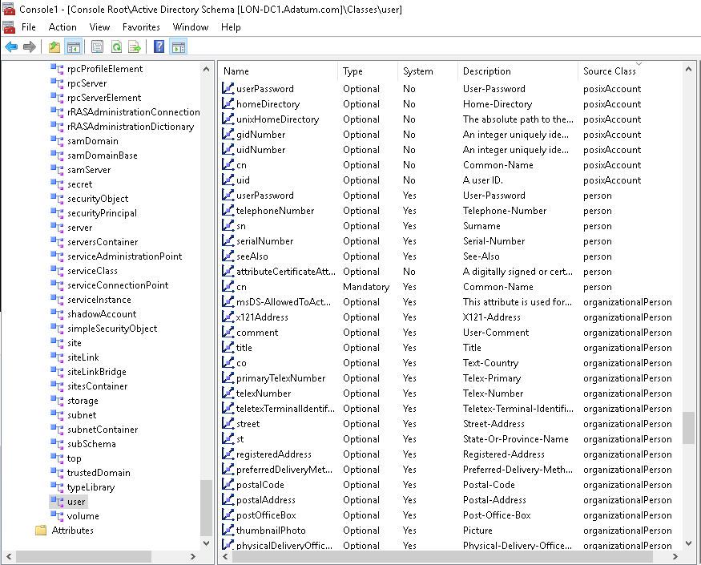
What is the AD DS schema?
Notes:
Reinforce the concept that the schema defines the rules and syntax of the AD DS database and provides the blueprint for the objects within it. Optionally, you can demonstrate the Active Directory Schema snap-in to show how the objects consist of attributes.
You also can show the hierarchy of objects and the inherited attributes. For example, the parent object for User is Organizational Person, the parent object for Organizational Person is Person, and the parent object for Person is an object called Top.
Point out that attributes are defined at each level in the hierarchy. This means that the User object contains all the attributes that are defined on the User class and all the attributes defined further up in the hierarchy (Organizational Person, Person, Top).
20742B
1: Installing and configuring domain controllers

Slide 6
What is an AD DS forest?
Forest root
domain
Tree root
domain
adatum.com
fabrikam.com
atl.adatum.com
Child domain
Notes:
Use this slide to explain the relationships among the forest root domain, a child domain, and another tree. Emphasize that there is no administrative difference between the child domain and the other tree, apart from the names.
20742B
1: Installing and configuring domain controllers

Slide 7


What is an AD DS domain?
AD DS requires one or more domain controllers
All domain controllers hold a copy of the domain database, which is continually synchronized
The domain is the context within which user accounts, computer accounts, and groups are created
The domain is a replication boundary
The domain is an administrative center for configuring and managing objects
Any domain controller can authenticate any sign-in
anywhere in the domain
The domain provides authorization
Users
AD DS
Computers
Groups
Notes:
Explain that a multimaster replication model means that every domain controller can make changes to most directory objects. Emphasize that the AD DS domain provides a structure for managing users and computers.
20742B
1: Installing and configuring domain controllers

Slide 8
What are OUs?
Use containers to group objects within a domain:
You cannot apply GPOs to containers
Containers are used for system objects and as the default location for new objects
Create OUs to:
Configure objects by assigning GPOs to them
Delegate administrative permissions
Notes:
Emphasize the difference between organizational units (OUs) and containers and explain that containers are not OUs. Although containers can hold objects, they cannot have Group Policy Objects (GPOs) linked to them. Therefore, if you want to assign a GPO other than a domain-level GPO to an object, it must be in an OU.
Explain to students that objects can become orphaned. This often occurs when an administrator on one domain controller deletes a container object, and an administrator on a different domain controller creates a child object in that container before the deletion replicates.
Remind students that the OU structure does not usually match the organizational chart. Rather, it supports the delegation of administration and should be a framework to support GPO linking. In a large organization—one with 50,000 users and computers, for example—it is much more practical to divide those objects into OUs than to manage them in one large unit.
Discuss some of the criteria that might drive the OU structure design, such as geographical location, department, object type, and cost center.
20742B
1: Installing and configuring domain controllers

Slide 9
What is new in AD DS in Windows Server 2016?
PAM
Azure AD Join
Microsoft Passport
Notes:
Briefly review the points on the slide.
20742B
1: Installing and configuring domain controllers

Slide 10
What is Azure AD?
Exchange
Online
SharePoint
Online
Skype for Business
Office 365
Azure
AD
Azure App Service
Internet
Synchronize
Internet-connected
apps
On-premises
AD DS
Notes:
Provide students with an overview of Microsoft Azure Active Directory (Azure AD). Stress that this does not replace an on-premises Active Directory solution but provides identity management for cloud-based applications. Explain that Microsoft hardware hosts Azure AD and that subscribers are responsible for managing only their users and not the underlying software or hardware.
To prepare for this topic, refer to: “Azure Active Directory documentation” at: https://aka.ms/nv03zg
20742B
1: Installing and configuring domain controllers

Slide 11
Overview of AD DS administration tools
You typically perform AD DS management by using the following tools:
Active Directory Administrative Center
Active Directory Users and Computers
Active Directory Sites and Services
Active Directory Domains and Trusts
Active Directory Schema snap-in
Active Directory module for Windows PowerShell
Notes:
Explain the different AD DS management tools and their usage and history.
20742B
1: Installing and configuring domain controllers

Slide 12
Demonstration: Using the Active Directory Administrative Center to administer and manage AD DS
In this demonstration, you will see how to:
Navigate within the Active Directory Administrative Center
Perform an administrative task within the Active Directory Administrative Center
Create objects
View all object attributes
Use the Windows PowerShell History viewer in the Active Directory Administrative Center
Notes:
When you complete this demonstration, leave the virtual machines running for subsequent demonstrations.
Before performing this demonstration, review the names of the user interface elements. Additionally, review “Active Directory Administrative Center Overview” at: http://aka.ms/Ah8978
Be sure to point out the visual difference between an OU and a container: a folder with a book (or square) on it represents an OU, and a blank folder represents an OU.
Preparation Steps
For this demonstration, you will need the 20742B-LON-DC1 virtual machine. Sign in as Adatum\Administrator with password Pa55w.rd.
Demonstration Steps
Navigate within the Active Directory Administrative Center
On LON-DC1, in Server Manager, click Tools, and then click Active Directory Administrative Center.
Click Adatum (local), click Dynamic Access Control, and then click Global Search.
In the navigation pane, click the Tree View tab, and then expand the Adatum (local) node to view the details of the Adatum.com domain.
Perform an administrative task within the Active Directory Administrative Center
In the Active Directory Administrative Center, click Overview.
In the Reset Password box, in the User name box, type Adatum\Adam.
In the Password and Confirm password boxes, type Pa55w.rd.
Clear the User must change password at next log on check box, and then click Apply.
In the Global Search box, in the Search box, type lon, and then press Enter.
20742B
1: Installing and configuring domain controllers
(More notes on the next slide)

Slide 13
Notes:
Create an object
In the Active Directory Administrative Center, in the navigation pane tree view, expand Adatum (local), and then click the Computers container.
In the Tasks pane, in the Computers section, click New, and then select Computer.
In the Create Computer dialog box, enter the following information, and then click OK:
Computer name: LON-CL4
Computer (NetBIOS) name: LON-CL4
Click OK.
View all object attributes
In the Active Directory Administrative Center, double-click Adatum (local), and then in the management list, double-click Computers.
Select LON-CL4, and then in the Tasks pane, in the LON-CL4 section, click Properties.
In the LON-CL4 window, scroll down to the Extensions section, click the Attribute Editor tab, and then note that all the attributes of the computer object are available here.
Click Cancel to close the LON-CL4 window.
Use the Windows PowerShell History viewer
In the Active Directory Administrative Center, click the Windows PowerShell History toolbar in the lower part of the screen.
View the details for the New-ADComputer cmdlet that you used to perform the most recent task.
On LON-DC1, close all open windows.
20742B
1: Installing and configuring domain controllers

Slide 14
Lesson 2: Overview of AD DS domain controllers
What is a domain controller? What is a global catalog? Overview of domain controller SRV records Demonstration: Viewing the SRV records in DNS AD DS sign-in process What are operations masters? Transferring and seizing roles
Notes:
Provide a brief overview of the lesson content.
Question
Should a domain controller be a global catalog?
Answer
Global catalog placement affects how long a user takes to sign in. Therefore, you must carefully plan how you place global catalogs. In a single-domain environment, every domain controller should host the global catalog, because every domain controller already holds a complete copy of the domain. In a multiple‑domain scenario, you need to consider user sign-in times, program dependencies, the need for high availability of the global catalog, and replication traffic when planning global catalog placement.
Question
In a multiple-domain forest, a copy of the global catalog should be stored on every domain controller.
( ) False
( ) True
Answer
(√ ) False
( ) True
Feedback
In a single domain, you should configure all domain controllers to hold a copy of the global catalog. However, in a multiple-domain environment, the infrastructure master should not be a global catalog server unless all the domain controllers in the domain are also global catalog servers.
20742B
1: Installing and configuring domain controllers

Slide 15
What is a domain controller?
Domain controllers:
Are servers that host the AD DS database (Ntds.dit) and SYSVOL
Host the Kerberos authentication service and KDC services to perform authentication
Have best practices for:
Availability:
Use at least two domain controllers in a domain
Security:
Use an RODC or BitLocker
Notes:
Ensure that students understand domain controllers—servers that perform the AD DS role. They host the AD DS database, SYSVOL, the Kerberos authentication service, and other AD DS services. For redundancy purposes, it is best to have at least two available domain controllers.
Explain that all the domain controllers in a domain are essentially equal. Each domain controller contains a copy of the directory store. You can make updates to the AD DS data on all domain controllers, except for read-only domain controllers (RODCs).
Emphasize the importance of having multiple domain controllers in each domain. This provides load balancing, but more importantly, it also provides recoverability if a server failure occurs.
Mention that all domain controllers engage in authentication and authorization. Therefore, the system has redundancy with fewer fail points.
This topic does not provide much information about best practices. If students are interested, you can provide more detail about installing domain controllers in remote sites to help protect against an unavailable wide area network (WAN) connection. You also can talk about increasing the number of domain controllers to account for redundancy and performance.
20742B
1: Installing and configuring domain controllers

Slide 16

What is a global catalog?
The global catalog:
Hosts a partial attribute set for other domains in the forest
Supports queries for objects throughout the forest
Schema
Configuration
Schema
Domain A
Configuration
Domain A
Schema
Configuration
Domain B
Global catalog server
Domain B
Schema
Configuration
Domain B
AD DS
Notes:
Describe the role of the global catalog server in searches for objects across domains in a forest. Define a global catalog as a domain controller that replicates the partial attribute set (PAS) for each domain in the forest. The domain controller does not need the PAS for its own domain because it already has the full copy of the domain database, and it needs only the changes made to other domains. That is why, in a single-domain environment, making every domain controller a global catalog server adds no significant replication.
20742B
1: Installing and configuring domain controllers

Slide 17
Overview of domain controller SRV records
Clients find domain controllers through DNS lookup
Domain controllers dynamically register their addresses with DNS
The results of DNS queries for domain controllers are returned in this order:
A list of domain controllers in the same site as the client
A list of domain controllers in the next closest site, if none are available in the same site
A random list of domain controllers in other sites, if no domain controller is available in the next closest site
Notes:
20742B
1: Installing and configuring domain controllers

Slide 18
Demonstration: Viewing the SRV records in DNS
In this demonstration, you will see how to use DNS Manager to view SRV records
Notes:
Spend as much time demonstrating the SRV records in DNS as is appropriate based on students’ experience or interest.
After showing the subdomains that start with an underscore (_), explain that domain controllers register several SRV records so that you can search them in multiple ways. Look for an SRV record in _tcp.Default‑First‑Site‑Name._sites.adatum.com that is offering the Kerberos authentication service. Examine the record, and show that the LON‑DC1.adatum.com server is offering the Kerberos authentication service over TCP port 88 and that the server is answering for the site Default‑First‑Site‑Name. This is the preferred domain controller, because the domain controller is in the same AD DS site as the client computer.
Point out that because domain controllers register SRV records in different ways, you can find an alternative if the preferred domain controller is not available. Alternatively, you can go to C:\windows\system32\config, open netlogon.dns in Notepad, and show all the SRV records that each domain controller will register in DNS.
Note that the Net Logon service that is running on each domain controller registers the SRV records in DNS. If it does so incorrectly, you can trigger the domain controller to reregister those records by restarting the Net Logon service on that domain controller. This reregisters only the SRV records. If you want to reregister the host record information in DNS, you must run ipconfig /registerdns from the command prompt, just as you would for any other computer.
After you complete the demonstration, revert the virtual machine.
Preparation Steps
Start the 20742B‑LON‑DC1 virtual machine.
Demonstration Steps
View the SRV records by using DNS Manager
On LON‑DC1, sign in with the user name Adatum\Administrator and the password Pa55w.rd.
In Server Manager, click the Tools menu.
In the Tools list, click DNS.
20742B
1: Installing and configuring domain controllers
(More notes on the next slide)

Slide 19
Notes:
In the DNS Manager window, on the tree menu, expand LON‑DC1, expand Forward Lookup Zones, and then click Adatum.com. Show the following four Domain Name System (DNS) subzones:
_msdcs
_sites
_tcp
_udp
Expand Adatum.com, expand _sites, expand Default‑First‑Site‑Name, expand _tcp, and then select the following record:
_ldap Service Location (SRV) [0][100][389] lon‑dc1.adatum.com
If students have sufficient expertise and interest, open c:\windows\system32\config, and then open the netlogon.dns file in Notepad. Show all the service records (SRV records) that this domain controller will register in DNS.
20742B
1: Installing and configuring domain controllers

Slide 20
AD DS sign-in process
The user account is authenticated to the domain controller
The domain controller returns a TGT back to client
The client uses the TGT to apply for access to the workstation
The domain controller grants access to the workstation
The client uses the TGT to apply for access to the server
The domain controller returns access to the server
Domain controller
Workstation
Server
Notes:
Use this slide to illustrate how the sign‑in process works:
In the first phase, the user account is authenticated to the domain controller.
In the second phase, the user account applies to the domain controller for a ticket to gain authorization to connect with the local computer.
A centralized directory service such as AD DS provides a single identity store, authentication service, and point of management for administration. Emphasize the advantages of a single identity store for security enhancement and manageability.
For more information that might help you to prepare for this topic, refer to:
“Security Identifiers Technical Reference” at: http://aka.ms/Y86bqa
“Well-known Security Identifiers” at: http://aka.ms/E2lons
20742B
1: Installing and configuring domain controllers

Slide 21
What are operations masters?
In the multimaster replication model, some operations must be single master operations
Many terms are used for single master operations in AD DS, including:
Operations master (or operations master role)
Single master role
Flexible single master operations (FSMO)
The five FSMOs
Forest:
Domain naming master
Schema master
Domain:
RID master
Infrastructure master
PDC emulator master
Notes:
Discuss each operations master role in as much depth as you think is appropriate for the students.
Be sure to point out that most master roles are so specific that the master can be offline for a short period without causing any problems. For example, you do not need the schema master until you make changes to the schema, and you do not need the domain naming master until you add or remove a domain in the forest.
Point out that other domain services might be slow or disrupted if a domain controller is offline and unavailable. Be sure to point out that these roles all run on domain controllers, so the loss of a domain controller can cause serious problems.
Domain operations master roles are needed on a more regular basis than those in the forest root domain, particularly the primary domain controller (PDC) emulator.
The relative ID (RID) master provides a pool of RIDs for each domain controller. If this master is not available, eventually a domain controller will attempt to create an account and be unable to do so.
Describe the three PDC functions at the level of detail that the student handbook provides. Emphasize that if the PDC emulator master is unavailable or slow to respond, problems in the domain are more likely.
You can find which domain controllers are operations master holders by using the netdom query fsmo command.
To prepare for this topic, refer to: “Operations master roles” at: https://aka.ms/ccusae
20742B
1: Installing and configuring domain controllers

Slide 22
Transferring and seizing roles
Transferring is:
Planned
Done with the latest data
Done through snap-ins, Windows PowerShell, or ntdsutil.exe
Seizing is:
Unplanned and a last resort
Done with incomplete or out-of-date data
Done through Windows PowerShell or ntdsutil.exe
Notes:
20742B
1: Installing and configuring domain controllers

Slide 23
Lesson 3: Deploying a domain controller
Installing a domain controller from Server Manager Installing a domain controller on a Server Core installation of Windows Server 2016 Upgrading a domain controller Installing a domain controller by installing from media Cloning domain controllers Demonstration: Cloning a domain controller Best practices for domain controller virtualization
Notes:
Depending on the students’ experience with AD DS, you might have to explain in more detail the implications of starting the Active Directory Domain Services Installation Wizard from Server Manager instead of using the dcpromo tool. In earlier versions of Windows Server, you start the Active Directory Domain Services Installation Wizard by using dcpromo. However, in Windows Server 2016, you use this tool only for an unattended installation while IT departments migrate their processes to Windows PowerShell.
Mention to the students that you can remotely promote a server to be a domain controller by using Server Manager running on Windows Server 2016.
Question
What is the fastest way to replicate domain controllers in a virtualized environment?
Answer
Cloning
Feedback
Cloning is the fastest way to deploy multiple computers with identical configurations, especially when those computers run in a virtualized environment such as Hyper V. Cloning copies the virtual hard disks of the computers, and changes minor configurations such as computer names and IP addresses to be unique. Then the computers are immediately operational.
Question
What are the two major considerations for deploying domain controllers to Azure?
Answer
The two major considerations are rollback and virtual machine limitations.
Rollback. Rolling back an AD DS system can create duplicate update sequence numbers (USNs). Because domain controller replication depends on USNs, duplicate numbers can cause problems. To prevent this, Windows Server 2016 Active Directory Domain Services has an identifier named VM-Generation ID. VM-Generation ID that can detect a rollback. It prevents the virtualized domain controller from replicating changes outbound until the virtualized AD DS has converged with the other domain controllers in the domain.
Virtual machine limitations. Azure virtual machines are limited to 14 gigabytes (GB) of random access memory (RAM) and one network adapter. Also, there is no support for checkpoint feature.
20742B
1: Installing and configuring domain controllers

Slide 24
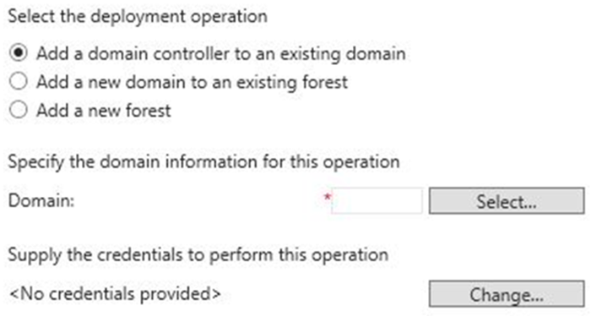
Installing a domain controller from Server Manager
The Deployment Configuration section of the
Active Directory Domain Services Configuration Wizard
Notes:
Use Server Manager to describe the initial process of installing an AD DS domain controller. Explain that the Active Directory Domain Services Installation Wizard is obsolete. However, you still can run the dcpromo command with an answer file. AD DS retained this functionality to allow companies that use automation to convert to Windows PowerShell deployments. Explain that the initial pass installs the files for AD DS and that you can then continue to configure the AD DS installation.
20742B
1: Installing and configuring domain controllers

Slide 25
Installing a domain controller on a Server Core installation of Windows Server 2016
Using Server Manager:
Install the AD DS role
Run the Active Directory Domain Services Configuration Wizard
Using Windows PowerShell:
Install the files by running the command Install-WindowsFeature AD-Domain-Services
Install the domain controller role by running the command Install-ADDSDomainController
Notes:
Explain the supported methods for remotely installing the domain controller role on servers running Windows Server 2016.
Additional Reading: For more information, refer to: “AD DS Deployment Cmdlets in Windows PowerShell” at: http://aka.ms/Lnxifx
20742B
1: Installing and configuring domain controllers

Slide 26
Upgrading a domain controller
You have two options for upgrading AD DS to Windows Server 2016:
Perform an in-place upgrade from Windows Server 2008 or later to Windows Server 2016:
Benefit: Except for the prerequisite checks, all the files and programs stay in place, and no additional work is required
Risk: It might leave obsolete files and dynamic-link libraries
Introduce a new server running Windows Server 2016 into the domain, and then promote it to be a domain controller (this option is usually preferred):
Benefit: The new server has no obsolete files and settings
Risk: It might require additional work to migrate administrators’ files and settings
Notes:
Describe the different methods for upgrading a forest and domain, and discuss the risks and benefits of each method. Explain that the process is the same for upgrading from any version of Windows Server starting with Windows Server 2008.
20742B
1: Installing and configuring domain controllers

Slide 27
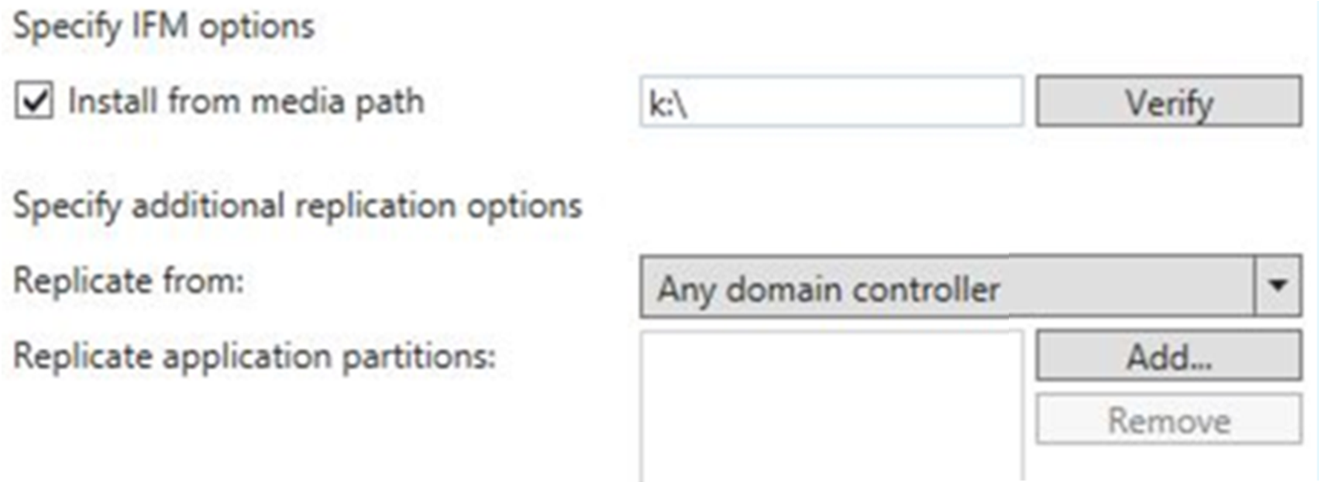
Installing a domain controller by installing from media
The Install from media section on the Additional Options page of the Active Directory Domain Services Configuration Wizard
Notes:
Point out to students that because they are installing the domain controller by using the Install from media method, they should select the Install from media path check box and then type the path to the snapshot file in the Install from media path box.
20742B
1: Installing and configuring domain controllers

Slide 28
Cloning domain controllers
You might clone domain controllers for:
Rapid deployment
Private clouds
Recovery strategies
To clone a source domain controller:
Add the domain controller to the Cloneable Domain Controllers group
Verify app and service compatibility
Create a DCCloneConfig.xml file
Export it once, and then create as many clones as needed
Start the clones
Notes:
Note: This topic has one additional slide.
20742B
1: Installing and configuring domain controllers

Slide 29
Cloning domain controllers
Start
Virtual machine
generation identifier exists?
No
No
Yes
DCCloneConfig
exists?
Normal
start
No
Virtual machine generation
identifier changed?
Yes
Yes
Yes
Rename
DDCloneConfig
No
Virtualization
safeguards
triggered
Rename
DDCloneConfig
Yes
Restart in
DSRM
Normal
start
DCCloneConfig
exists?
No
No
Duplicate IP
address?
Normal
start
Yes
Fail
Clone
Yes
Restart in
DSRM
Succeed
Restart in
DSRM
Restart
Notes:
Explain the process of how a newly cloned domain controller starts, describing each of the following steps:
The clone checks whether a virtual machine generation identifier exists. This is required, and if a virtual machine generation identifier does not exist, the computer either starts normally when no DCCloneConfig.xml exists or renames DCCloneConfig.xml and restarts in Directory Services Restore Mode (DSRM). Starting in DSRM is a safeguard, and a domain administrator must fix the issue to optimize the domain controller’s functionality.
The clone checks whether the virtual machine generation identifier changed, and takes one of the following actions accordingly:
If it did not change, it is the original source domain controller. If DCCloneConfig.xml exists, it is renamed. In both cases, a normal startup occurs, and the domain controller is functional again.
If it did change, the virtualization safeguards trigger, and the process continues.
The clone checks whether DCCloneConfig.xml exists. If not, a check for a duplicate IP address determines whether the computer starts normally or in DSRM. If the DCCloneConfig.xml file exists, the computer gets the new computer name and IP address settings from the file. The AD DS database is modified, and the initialization steps continue, thereby controlling a new domain controller.
20742B
1: Installing and configuring domain controllers

Slide 30
Demonstration: Cloning a domain controller
In this demonstration, you will see how to:
Prepare a source domain controller for cloning
Export the source virtual machine
Create and start the cloned domain controller
Notes:
Demonstrate how to prepare a domain controller to become a source domain controller for cloning, and then create a clone. Explain every step of the demonstration as instructed in the previous topics.
After completing this demonstration, delete the LON-DC3 virtual machine, and then revert all the virtual machines.
Preparation Steps
For this demonstration, you need to use the available virtual machine environment. Before you begin the demonstration, you must complete the following steps:
On the host computer, start Hyper‑V Manager.
In Hyper‑V Manager, click 20742B-LON-DC1, and then in the Actions pane, click Start.
In the Actions pane, click Connect. Wait until the virtual machine starts.
Sign in by using the following credentials:
User name: Adatum\Administrator
Password: Pa55w.rd
Note: You might not be able to perform this demonstration when using a cloud-based lab environment. This demonstration requires that you have local access to the Hyper‑V host.
Demonstration Steps
Prepare a source domain controller for cloning
On LON-DC1, in Server Manager, click Tools, and then click Active Directory Administrative Center.
In the Active Directory Administrative Center, double-click Adatum (local), and then in the management list, double-click the Domain Controllers OU.
In the management list, select LON-DC1, if it is not already selected, and then in the Tasks pane, in the LON-DC1 section, click Add to group.
20742B
1: Installing and configuring domain controllers
(More notes on the next slide)

Slide 31
Notes:
In the Select Groups dialog box, in the Enter the object names to select box, type Cloneable, and then click Check Names.
Ensure that the group name is expanded to Cloneable Domain Controllers, and then click OK.
On the Start menu, click Windows PowerShell.
At the Windows PowerShell command prompt, type the following command, and then press Enter.
Get-ADDCCloningExcludedApplicationList
Verify the list of critical apps. In production, you need to verify each app or use a domain controller that has fewer apps installed by default. Type the following command, and then press Enter.
Get-ADDCCloningExcludedApplicationList –GenerateXML
Type the following command to create the DCCloneConfig.xml file, and then press Enter.
New-ADDCCloneConfigFile
Type the following command to shut down LON-DC1, and then press Enter.
Stop-Computer
Wait for the virtual machine to shut down. You might be asked to confirm the shutdown.
Export the source virtual machine
On the host computer, in Microsoft Hyper‑V Manager, in the details pane, select the 20742B-LON-DC1 virtual machine.
In the Actions pane, in the 20742B-LON-DC1 section, click Export.
In the Export Virtual Machine dialog box, go to the location D:\Program Files \Microsoft Learning\20742, and then click Export. Wait until the export finishes.
In the Actions pane, in the 20742-LON-DC1 section, click Start.
(More notes on the next slide)
20742B
1: Installing and configuring domain controllers

Slide 32
Notes:
Create and start the cloned domain controller
On the host computer, in Hyper‑V Manager, in the Actions pane, in the section named for the host computer, click Import Virtual Machine.
In the Import Virtual Machine Wizard, on the Before You Begin page, click Next.
On the Locate Folder page, click Browse, browse to the folder D:\Program Files \Microsoft Learning\20742\20742B-LON-DC1, click Select Folder, and then click Next.
On the Select Virtual Machine page, select 20742B-LON-DC1 (if it is not already selected), and then click Next.
On the Choose Import Type page, select Copy the virtual machine (create a new unique ID), and then click Next.
On the Choose Folders for Virtual Machine Files page, select the Store the virtual machine in a different location check box. For each folder location, specify D:\Program Files \Microsoft Learning\20742\ as the path. Click Next.
On the Choose Folders to Store Virtual Hard Disks page, provide the path D:\Program Files \Microsoft Learning\20742\, and then click Next.
On the Completing Import Wizard page, click Finish.
In the management list, identify and select the newly imported virtual machine named 20742B-LON-DC1, which has the State shown as Off. In the lower section of the Actions pane, click Rename.
Type 20742B-LON-DC3 as the name, and then press Enter.
In the Actions pane, in the 20742B-LON-DC3 section, click Start, and then click Connect to see the virtual machine starting.
While the server is starting, you might see the message Domain Controller cloning is at x% completion.
20742B
1: Installing and configuring domain controllers

Slide 33
Best practices for domain controller virtualization
Avoid single points of failure
Use the time services
Use virtualization technology with the virtual machine generation identifier feature
Use Windows Server 2012 or later as virtualization guests
Avoid or disable checkpoints
Strive to improve security
Consider taking advantage of cloning in your deployment or recovery strategy
Start a maximum number of 10 new clones at the same time
Consider using virtualization technologies that allow virtual machine guests to move between sites
Adjust your naming strategy to allow for domain controller clones
Notes:
20742B
1: Installing and configuring domain controllers

Slide 34
Lab: Deploying and administering AD DS
Exercise 1: Deploying AD DS Exercise 2: Deploying domain controllers by performing domain controller cloning Exercise 3: Administering AD DS
Logon Information
Virtual machines: 20742B-LON-DC1
20742B-LON-SVR1
User name: Adatum\Administrator
Password: Pa55w.rd
Estimated Time: 45 minutes
Notes:
If the students receive messages about write operations to AD DS not performing—for example, in Exercise 3, if they receive a “Failed to create LON-CL4” message—ensure that they start and replicate both domain controllers once. Otherwise, the FSMO roles will not be validated, and every operation that requires a security identifier (SID) will fail.
Exercise 1: Deploying AD DS
As a part of the business expansion, A. Datum Corporation wants to deploy new domain controllers in remote sites with minimal engagement from the remote IT staff. You will use Windows PowerShell to deploy new domain controllers.
Exercise 2: Deploying domain controllers by performing domain controller cloning
An IT team at A. Datum Corporation wants to rapidly deploy new virtual domain controllers as needed. They are considering the domain controller clones in Windows Server 2016. You must perform a domain controller cloning procedure to verify that it is a valid option to speed up the deployment of domain controllers.
Note: You might not be able to perform this exercise in a cloud-based lab environment. This exercise requires you to have local access to the Hyper‑V host.
Instructor Note: If your classroom does use cloud-based virtual machines, it is likely that your students will not be able to perform this part of the lab and will need to move to the next exercise. This exercise requires access to the Hyper‑V host. Verify in advance that you can perform this lab.
If you perform this lab in class with the students, you will need to delete the files and folders that you created during the “Cloning a domain controller” demonstration before performing these steps. If students performed the demonstration steps during the class, they will also need to delete the files and folders that they created during the demonstration.
Exercise 3: Administering AD DS
The IT team at A. Datum Corporation is evaluating the tools that are available in Windows Server 2016 for AD DS administration. You should evaluate the use of both the Active Directory Administrative Center and Windows PowerShell for AD DS administration and management.
20742B
1: Installing and configuring domain controllers

Slide 35
Lab Scenario
You are an IT administrator at A. Datum Corporation. The company is expanding its business and has several new locations. The AD DS administration team is currently evaluating the methods available in Windows Server 2016 for a rapid and remote domain controller deployment. Also, the team is looking for a way to automate certain AD DS administrative tasks. The team wants a fast and seamless deployment of new domain controllers for new locations, and it wants to promote servers to domain controllers from a central location.
Notes:
20742B
1: Installing and configuring domain controllers

Slide 36
Module Review and Takeaways
Review Questions Common Issues and Troubleshooting Tips
Notes:
Review Questions
Question
Which deployment method would you use to install an additional domain controller in a remote location that had a limited WAN connection?
Answer
You would use the Install from media option, because it eliminates the need to copy the entire AD DS database over the WAN link.
Question
Which tool or tools can you use to promote a Server Core installation of Windows Server 2016 to be a domain controller?
Answer
To promote a Server Core installation of Windows Server 2016 to a domain controller, you can use the following tools:
Server Manager, which allows you to remotely install AD DS.
Windows PowerShell.
The command dcpromo /unattend, which you run on the server running the Server Core installation.
Question
If you want to run a domain controller in the cloud, which service should you consider using—Azure AD or infrastructure as a service (IaaS) Azure virtual machines?
Answer
Answers will vary depending on the students’ needs. Azure Active Directory (Azure AD) provides identity and access management for web-based applications. Using infrastructure as a service (IaaS) Azure virtual machines allows you to deploy a full-featured AD DS domain controller.
20742B
1: Installing and configuring domain controllers
(More notes on the next slide)

Slide 37
Notes:
Common Issues and Troubleshooting Tips
Common Issue: Syntax errors
Troubleshooting Tip: Syntax errors often result from mistyping or forgetting a parameter when typing Windows PowerShell cmdlets. Examine the console output for specifics about why a command failed.
Common Issue: Prerequisite problems
Troubleshooting Tip: Many serious errors are directly related to errors that the prerequisite checker finds. Be sure to carefully examine the results and follow any guidance provided.
Common Issue: Network and forest configuration problems
Troubleshooting Tip: Network configuration problems or other AD DS forest configuration issues might prevent the promotion of new domain controllers. Use the dcpromoui.log and dcpromo.log files to view specific promotion errors or the event log for errors that indicate configuration issues. You can also use dcdiag.exe and repadmin.exe to check overall forest health.
Point the students to the appropriate sections in the course so that they can answer the questions that this section presents.
Note: Ensure that you cover the common issues and the corresponding troubleshooting tips listed in this section. Encourage students to share tips from their own work environments.
20742B
1: Installing and configuring domain controllers

