Slide 1
Module 2
Managing objects in AD DS
Notes:
Presentation: 75 minutes
Lab: 70 minutes
After completing this module, students will be able to:
Manage user accounts in Active Directory Domain Services (AD DS).
Manage groups in AD DS.
Manage computer objects in AD DS.
Use Windows PowerShell for AD DS administration.
Implement and manage organizational units (OUs).
Administer AD DS.
Required materials
To teach this module, you need the Microsoft PowerPoint file 20742B_02.pptx.
Preparation tasks
To prepare for this module, you should:
Read all of this module’s materials.
Practice performing the demonstrations and labs.
Work through the Module Review and Takeaways section to determine how you will use the information to reinforce student learning and promote knowledge transfer to on-the-job performance.
As you prepare for this class, it is imperative that you complete the labs yourself. This gives you an understanding of how the labs work, as well as the concepts that each lab covers. This enables you to provide meaningful hints to students who might have issues while working in the labs. Furthermore, it will help guide your lecture to ensure that you discuss the concepts that the labs cover.
20742B
2: Managing objects in AD DS

Slide 2
Module Overview
Managing user accounts Managing groups in AD DS Managing computer objects in AD DS Using Windows PowerShell for AD DS administration Implementing and managing OUs
Notes:
Provide an overview of the module.
20742B
2: Managing objects in AD DS

Slide 3
Lesson 1: Managing user accounts
Creating user accounts Configuring user account attributes Demonstration: Managing user accounts Creating user profiles Managing inactive and disabled user accounts User account templates Demonstration: Using templates to manage accounts
Notes:
One way to approach this lesson’s content is to focus on the demonstrations. Start the demonstrations, and then discuss the content in the topics as you proceed. You might need to practice before you can perform the demonstrations without referring to the notes pages, but the lesson might be a more engaging experience for students.
Question
What is the purpose of a roaming profile?
Answer
It stores and synchronizes the user profile to a network share. This allows the user to roam between computers and still receive the same profile when they sign on to a new computer.
Question
What is the difference between disabling an account and an account being locked out?
Answer
Disabling an account is an intentional act by an administrator to prevent the use of an account. An account lockout can only be the result of too many bad logon attempts (assuming that the password policy is configured enforce that).
20742B
2: Managing objects in AD DS

Slide 4

Creating user accounts
Users accounts:
Allow or deny access to sign into computers
Grant access to processes and services
Manage access to network resources
User accounts can be created by using:
Active Directory Users and Computers
Active Directory Administrative Center
Windows PowerShell
Directory command line tool dsadd
Considerations for naming users include:
Naming formats
UPN suffixes
Notes:
Consider performing a demonstration of creating a user account, by using the steps that the student handbook provides.
Ask students about the account-naming strategies employed in their organizations and how they deal with duplicate user names and name changes.
20742B
2: Managing objects in AD DS

Slide 5
Configuring user account attributes
User properties include the following categories:
Account
Organization
Member of
Password Settings
Profile
Policy
Silo
Extensions
Notes:
Open a user’s account and view their account properties as you discuss this content with students. Quickly click through the properties tabs and briefly talk about each one.
Point out that when using Active Directory Users and Computers, not all property pages appear in the default view. You must enable Advanced Features in the View menu of Active Directory Users and Computers to see them.
20742B
2: Managing objects in AD DS

Slide 6
Demonstration: Managing user accounts
In this demonstration, you will see how to use Active Directory Administrative Center to:
Create a new user account
Delete a user account
Move a user account
Configure user attributes:
Change department
Change group membership
Notes:
Keep the virtual machines (VMs) running for the next demonstration.
Preparation Steps
Start the 20742B-LON-DC1 virtual machine (VM), and sign in to both as Adatum\Administrator with the password Pa55w.rd.
Demonstration Steps
Create a new user account
On LON‑DC1, in Server Manager, click Tools, and then click Active Directory Administrative Center.
In Active Directory Administrative Center, click Adatum (local), and then double-click Managers.
In the Tasks pane, click New, and then click User.
In the Create User dialog box, in the First name field, type Sales.
In the Last name field, type Manager.
In the User UPN logon text box, type SalesManager.
In the Password and Confirm password fields, type Pa55w.rd, and then click OK.
Delete a user account
Click the Art Odum account.
In the Tasks pane, under Art Odum, click Delete.
In the Delete Confirmation box, click Yes.
Move a user account
Click the Burton Bartels account.
In the Tasks pane, under Burton Bartels, click Move….
20742B
2: Managing objects in AD DS
(More notes on the next slide)

Slide 7
Notes:
Click the Development OU, and then click OK.
In the left pane, click Adatum (local).
In the right pane, double-click the Development OU, and then ensure that the Burton Bartels account is present.
Configure user attributes
Double-click the Burton Bartels account.
In the left pane, click Organization, and then change the Department field from Managers to Development.
In the left pane, click Member Of.
In the Member Of section, click Managers, and then click Remove.
Click Add. In the Select Groups dialog box, in the Enter the object names to select (example): window, type Development, and then click OK.
Click OK to close the Burton Bartels properties.
Close Active Directory Administrative Center. Leave Server Manager open for the next demonstration.
20742B
2: Managing objects in AD DS

Slide 8
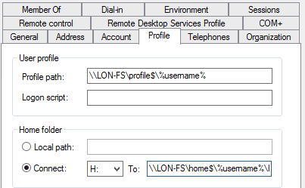
Creating user profiles
The Profile section of the User Properties window
Notes:
Consider demonstrating this procedure while you discuss the content with your students. Ask students if they are currently supporting roaming profiles or redirected folders. Mention that the Microsoft Desktop Optimization Pack (MDOP) provides a tool named Microsoft User Experience Virtualization (UE-V) that can synchronize application settings across multiple Windows 10 devices. MDOP is available to Microsoft Software Assurance customers.
20742B
2: Managing objects in AD DS

Slide 9
Managing inactive and disabled user accounts
Users accounts that will be inactive for a period of time should be disabled rather than deleted
To disable an account in Active Directory Users and Computers, right-click the account and click Disable Account from the menu
Notes:
20742B
2: Managing objects in AD DS

Slide 10

User account templates
User templates simplify the creation of new user accounts
Group memberships
Home directory path
Profile path
Logon scripts
Password settings
Department
Manager
Template account
New user account
Notes:
Do not spend much time on this topic because you will perform a demonstration next. Point out that you cannot use Active Directory Administrative Center to copy a user account. You can use Active Directory Users and Computers or Windows PowerShell. Mention that any existing user account can also act as a template that you can copy.
20742B
2: Managing objects in AD DS

Slide 11
Demonstration: Using templates to manage accounts
In this demonstration, you will see how to:
Create a template account
Create a new user based on the template
Notes:
Leave the VMs running for the next demonstration.
Preparation Steps
The VMs will still be running from the last demonstration.
Demonstration Steps
Create a user template
On LON-DC1, in Server Manager, click Tools, and then click Active Directory Users and Computers.
Expand Adatum.com, and then click the Sales OU.
Click the new user icon on the toolbar.
In the New Object – User dialog box, enter the following information, and then click Next:
First name: _sales
Last name: template
User logon name: salestemplate
In the Password and Confirm password fields, type Pa55w.rd.
Clear the User must change password at next logon check box, select the Password never expires check box, select the Account is disabled check box, and then click Next.
Click Finish.
Configure template properties
Double-click the _sales template account.
In the _sales template properties dialog box, click the Member Of tab, and then click Add.
In the Select Groups dialog box, type Sales, and then click OK.
Click the Organization tab. In the Department field, type Sales.
20742B
2: Managing objects in AD DS
(More notes on the next slide)

Slide 12
Notes:
In the Manager section, click Change. In the Select User or Contact dialog box, type Erin, and then click Check Names. Click OK.
Click the Profile tab. In the User profile section, in the Logon script field, type \\lon-dc1\netlogon\logon.bat, and then click OK.
Create a new user by copying the template
Right-click the _sales template account, and then click Copy.
In the Copy Object – User dialog box, type Sales in the First name field. Type User in the Last name field.
Type salesuser in the User logon name field, and then click Next.
In the Password and Confirm password fields, type Pa55w.rd.
Clear the Password never expires check box, clear the Account is disabled check box, select the User must change password at next logon check box, and then click Next.
Click Finish.
Double-click the Sales User account, and then click the Member Of tab. Ensure that the user is a member of the Sales group.
Click the Organization tab. Ensure that the Department is Sales and the Manager is Erin Bull.
Click the Profile tab. Ensure that the Logon script path is \\lon-dc1\netlogon\logon.bat. Click OK to close the dialog box.
Close Active Directory Users and Computers.
20742B
2: Managing objects in AD DS

Slide 13
Lesson 2: Managing groups in AD DS
Group types Group scopes Implementing group management Managing group membership by using Group Policy Default groups Special identities Demonstration: Managing groups in Windows Server
Notes:
Provide an overview of the lesson topics.
20742B
2: Managing objects in AD DS

Slide 14




Group types
Distribution groups
Used only with email applications
Not security enabled (no SID)
Cannot be given permissions
Security groups
Security principal with a SID
Can be given permissions
Can also be email-enabled
You can convert security groups to distribution groups and distribution groups to security groups
Notes:
Explain to students that they can use distribution groups to send email messages to collections of users, but only with messaging programs such as Microsoft Exchange Server. Stress that distribution lists are not security enabled, so discretionary access control lists (DACLs) cannot include them.
In addition, explain to students that they can use security groups to assign rights and permissions to both groups of users and groups of computers. A security group is security enabled, and you can use it to assign permissions to local and network resources.
20742B
2: Managing objects in AD DS

Slide 15
Group scopes
Local groups can contain users, computers, global groups, domain-local groups and universal groups from the same domain, domains in the same forest and other trusted domain and can be given permissions to resources on the local computer only
Domain-local groups have the same membership possibilities but can be given permission to resources anywhere in the domain
Universal groups can contain users, computers, global groups and other universal groups from the same domain or domains in the same forest and can be given permissions to any resource in the forest
Global groups can only contain users, computers and other global groups from the same domain and can be given permission to resources in the domain or any trusted domain
Notes:
Use the table to describe group scopes. Consider drawing a diagram with several domains that shows where you can create groups and the implications of each group scope.
20742B
2: Managing objects in AD DS

Slide 16



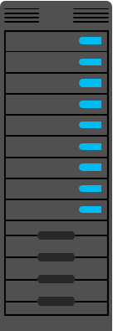

Implementing group management
This best practice for nesting groups is known as IGDLA
Sales
(global group)
Auditors
(global group)
I: Identities, users, or computers, which are members of
G: Global groups, which collect members based on members’ roles, which are members of
DL: Domain-local groups, which provide management such as resource access which are
A: Assigned access to a resource
ACL_Sales_Read (domain-local group)
Notes:
Note: There are five additional slides for this topic.
This slide summarizes the example from the student handbook, and the next five slides build up the example frame by frame. The five frames that follow are:
Identities
Global groups
Domain-local groups
Assigned resource access
A copy of the summary, as shown in the first slide above
Group nesting is a suggested best practice but not a requirement. Students who work in small environments might not see the value of group nesting, because it is easier to just put users into global groups and assign resource permissions directly to the global group. However, point out that as organizations grow tracking and troubleshooting resource permission issues becomes very difficult without group nesting.
20742B
2: Managing objects in AD DS

Slide 17

Implementing group management
I: Identities, users, or computers,
which are members of
Notes:
20742B
2: Managing objects in AD DS

Slide 18
Implementing group management
I: Identities, users, or computers, which are members of
G: Global groups, which collect members based on members’ roles, which are members of
Sales
(global group)
Auditors
(global group)
Notes:
The users and computers have been collected into two separate groups: Sales (global group) and Auditors (global group).
20742B
2: Managing objects in AD DS

Slide 19
Implementing group management
I: Identities, users, or computers, which are members of
G: Global groups, which collect members based on members’ roles, which are members of
DL: Domain-local groups, which provide management such as resource access which are
Sales
(global group)
Auditors
(global group)
ACL_Sales_Read (domain-local group)
Notes:
The two global groups have been combined into one domain-local group called ACL_Sales_Read.
20742B
2: Managing objects in AD DS

Slide 20
Implementing group management
I: Identities, users, or computers, which are members of
G: Global groups, which collect members based on members’ roles, which are members of
DL: Domain-local groups, which provide management such as resource access which are
A: Assigned access to a resource
Sales
(global group)
Auditors
(global group)
ACL_Sales_Read (domain-local group)
Notes:
The domain-local group has been given access to a resource.
20742B
2: Managing objects in AD DS

Slide 21
Implementing group management
This best practice for nesting groups is known as IGDLA
I: Identities, users, or computers, which are members of
G: Global groups, which collect members based on members’ roles, which are members of
DL: Domain-local groups, which provide management such as resource access which are
A: Assigned access to a resource
Sales
(global group)
Auditors
(global group)
ACL_Sales_Read (domain-local group)
Notes:
This is a summary of the example. It is the same as the slide in the student manual.
20742B
2: Managing objects in AD DS

Slide 22
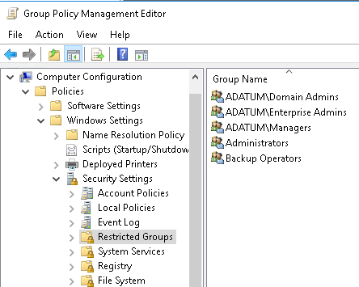
Managing group membership by using Group Policy
Restricted Groups can simplify group management
You use it to manage local and AD DS groups
Notes:
Note: There is one additional slide for this topic.
Point out the benefits of using Restricted Groups. Caution students that if they apply this setting to existing groups that already have many members, they will still have to add those existing members to the Group Policy Object (GPO) list. Otherwise, the members will be deleted from the group.
20742B
2: Managing objects in AD DS

Slide 23
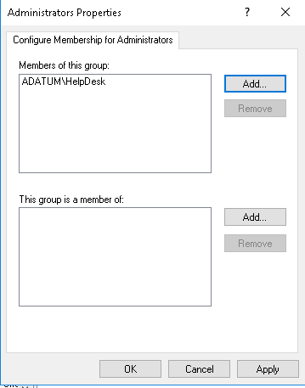
Managing group membership by using Group Policy
Members can be added to the group and the group can be nested into other groups
Notes:
20742B
2: Managing objects in AD DS

Slide 24
Default groups
Carefully manage the default groups that provide administrative privileges, because these groups:
Typically have broader privileges than are necessary for most delegated environments
Often apply protection to their members
Group | Location
Enterprise Admins | Users container of the forest root domain
Schema Admins | Users container of the forest root domain
Administrators | Built-in container of each domain
Domain Admins | Users container of each domain
Server Operators | Built-in container of each domain
Account Operators | Built-in container of each domain
Backup Operators | Built-in container of each domain
Print Operators | Built-in container of each domain
Cert Publishers | Users container of each domain
Notes:
Show students the groups mentioned on the slide as you discuss them.
20742B
2: Managing objects in AD DS

Slide 25
Special identities
Special identities:
Are groups for which the operating system controls membership
Can be used by the Windows Server operating system to provide access to resources based on the type of authentication or connection, not on the user account
Important special identities include:
Anonymous Logon Authenticated Users Everyone | Interactive Network Creator Owner
Notes:
Show your students the identities that the slide mentions, as you discuss them. Emphasize that you have no control over membership in these groups.
20742B
2: Managing objects in AD DS

Slide 26
Demonstration: Managing groups in Windows Server
In this demonstration, you will see how to:
Create a new group and add members to the group
Add users to the group
Change the group type and scope
Configure a manager for the group
Notes:
Leave the VMs running for the next demonstration.
Preparation Steps
The VMs will still be running from the last demonstration.
Demonstration Steps
Create a new group and add members
On LON-DC1, in Server Manager, click Tools, and then click Active Directory Administrative Center.
Expand Adatum (Local), and then double-click IT.
In the Tasks list, under IT, point to New, and then click Group.
In the Create Group dialog box, in the Group name field, type IT Managers. Notice that the default is a global security group.
In the left pane, click Members, and then click Add.
In the Select Users, Contacts, Computers, Service Accounts, or Groups dialog box, in Enter the object names to select (examples), type Beth; Logan, click Check Names, and then click OK.
Click OK to close the Create Group: IT Managers dialog box.
Add a user to the group
Right-click the user named Maj Hojski, and then click Add to group.
In the Select Groups dialog box, in Enter the object names to select (examples), type IT Managers.
Click Check Names, and then click OK.
20742B
2: Managing objects in AD DS

Slide 27
Notes:
Change the group type and scope
Double-click the IT Managers group.
In the IT Managers window, under Group type, click Distribution. Read the highlighted message. Under Group scope, click Universal, and then click OK.
Configure a manager for the group
Double-click the IT Managers group.
In the Managed By section, click Edit.
In the Select User, Contact or Groups dialog box, in Enter the object names to select (examples), type Parsa, click Check Names, and then click OK.
Select the check box beside the Manager can update membership list dialog box.
Click OK to close the IT Managers Properties dialog box.
Close Active Directory Administrative Center.
20742B
2: Managing objects in AD DS

Slide 28
Lesson 3: Managing computer objects in AD DS
What is the Computers container? Specifying the location of computer accounts Controlling permissions to create computer accounts Joining a computer to a domain Computer accounts and secure channels Resetting the secure channel Performing an offline domain join
Notes:
There are no demonstrations in this lesson. As you proceed through the content, consider performing small, impromptu demonstrations to help reinforce the content.
Question
What causes a computer to lose its trust relationship with the domain?
Answer
Typically, it is the result of a password mismatch between the local computer and what is stored in AD DS.
20742B
2: Managing objects in AD DS

Slide 29
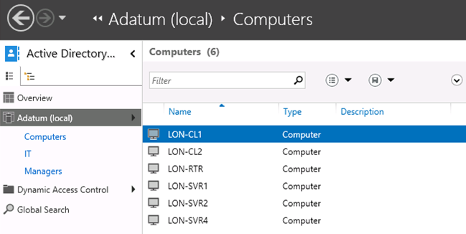
What is the Computers container?
Active Directory Administrative Center is opened to the Adatum (local)\Computers container
Distinguished Name is CN=Computers,DC=Adatum,DC=com
Notes:
Consider opening Active Directory Users and Computers or Active Directory Administrative Center and demonstrating the default location for computer objects.
Explain that the Distinguished Name "CN=Computers,DC=Adatum,DC=com” provides a full description of the Computers object. The common name (CN) object Computers is a container located in the domain component (DC) Adatum, which is in the domain component named com.
20742B
2: Managing objects in AD DS

Slide 30
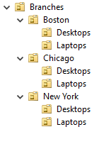
Specifying the location of computer accounts
Best practice is to create OUs for computer objects
Servers are typically subdivided by server role
Client computers are typically subdivided by region
Divide OUs:
By administration
To facilitate configuration with Group Policy
Notes:
Emphasize the best practice of creating custom OUs for computer objects, rather than relying on the default Computers container.
Help students understand enough about delegation (assigning permissions to OUs) and configuration (linking GPOs to OUs) to understand how they might design OU branches for clients and servers. Later modules provide more detail about Group Policy and delegation, and their impact on OU design. Do not provide much detail here, but use the opportunity to introduce students to these concepts.
20742B
2: Managing objects in AD DS

Slide 31
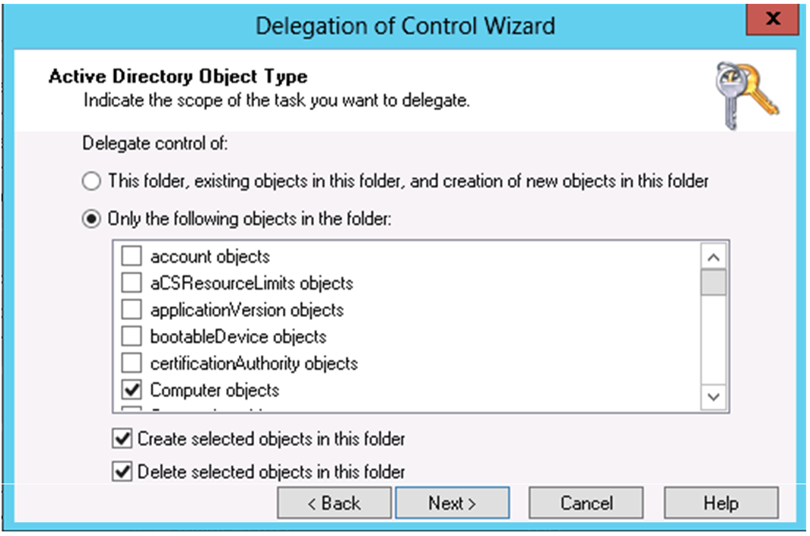
Controlling permissions to create computer accounts
In the Delegation of Control Wizard window,
the administrator is creating a custom delegation for computer objects
Notes:
Consider using the Delegation of Control Wizard to demonstrate the process of delegating control over computer creation and deletion.
20742B
2: Managing objects in AD DS

Slide 32
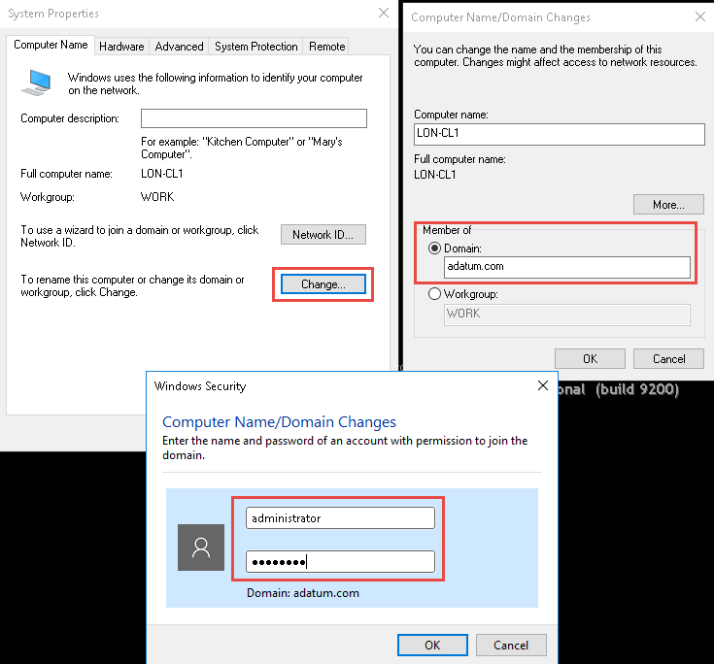
Joining a computer to a domain
Notes:
Show the various ways that you can reach the System applet.
Stress the importance of knowing the local admin password when you remove a computer from the domain.
20742B
2: Managing objects in AD DS

Slide 33
Computer accounts and secure channels
Computers have accounts:
SAMAccountName and password
Used to create a secure channel between the computer and a domain controller
Scenarios in which a secure channel might be broken:
Reinstalling a computer, even with same name, generates a new SID and password
Restoring a computer from an old backup or rolling back a computer to an old snapshot
The computer and domain disagreeing about what the password is
Notes:
Explain that all communication with the domain utilizes the secure channel between a computer and a domain controller, including user sign-in authentication to the computer. The secure channel is established when the computer authenticates to the domain by using its user name and password. Like users, computers have sign-in names and passwords. If the computer is unable to sign in successfully, the secure channel is not established. The effect is similar to when a user enters the wrong user name or password. In both circumstances, the user is not able to authenticate to the domain.
There are several scenarios in which the secure channel can be broken. The slide lists three such scenarios.
Ask students how often they have encountered the error message “The trust relationship between the workstation and the primary domain failed.” Discuss what they did to resolve it.
The slide does not list administrator errors in AD DS. These can include damaging Active Directory actions, such as rolling back a domain controller that runs a snapshot. Mention that there are several ways for an administrator to damage AD DS (manually, automatically, or accidentally), and damage might become apparent when broken secure channels appear.
20742B
2: Managing objects in AD DS

Slide 34
Resetting the secure channel
Do not delete a computer from the domain and then rejoin it; this creates a new account, resulting in a new SID and lost group memberships
Options for resetting the secure channel:
nltest
netdom
Active Directory Users and Computers
Active Directory Administrative Center
Windows PowerShell
dsmod
Notes:
A broken computer account reveals itself through a variety of symptoms, error messages, and event-log entries.
Mention that users might be able to sign in to a computer with a broken secure channel by using cached credentials. However, they will experience other strange behavior, because authentication cannot use Kerberos version 5 (V5) protocol without a functioning secure channel.
Because nltest and netdom reset the secure channel without requiring a restart, you should try these commands first. If you are not successful with those two commands, only then should you use dsmod, the Reset Account option in Active Directory Users and Computers, or Active Directory Administrative Center to reset the computer account.
Resetting the secure channel requires the Reset Password permission on the computer object.
20742B
2: Managing objects in AD DS

Slide 35
Performing an offline domain join
Use offline domain join to join computers to a domain when they cannot contact a domain controller
Create a domain-join file by using:
Import the domain join file by using:
djoin.exe /Provision /Domain <DomainName> /Machine <MachineName> /SaveFile <filepath>
djoin.exe /requestODJ /LoadFile <filepath> /WindowsPath <path to the Windows directory of the offline image>
Notes:
Explain that Microsoft introduced offline domain join to help with joining computers to the domain over unreliable connections. In Windows 8 and later and Windows Server 2012 and later, domain join expanded to include the DirectAccess feature. This feature enables computers to join the domain without communicating with a domain controller. After applying the DirectAccess settings, the computers can interact with the domain through any Internet connection.
Discuss the scenarios for offline domain join. Ask students how they might use this feature in their own environments. Students from organizations that do not have branch offices will find this feature less useful than students from organizations with remote branches.
20742B
2: Managing objects in AD DS

Slide 36
Lab A: Managing AD DS objects
Exercise 1: Creating and managing groups in AD DS Exercise 2: Creating and configuring user accounts in AD DS Exercise 3: Managing computer objects in AD DS
Logon Information
Virtual machines: 20742B-LON-DC1
20742B-LON-CL1
User name: Adatum\Administrator
Password: Pa55w.rd
Estimated Time: 45 minutes
Notes:
Before students begin the lab, read the lab scenario. Before each exercise, read the scenario associated with the exercise to the class. The scenarios give context to the lab and exercises, and reading them as you go will help you facilitate the discussion at the end of the lab. Remind students to complete the discussion questions after the last lab exercise.
Exercise 1: Creating and managing groups in AD DS
You need to create groups for the Research department. You require a distribution global group to facilitate email delivery to the Research users. Cai Chu will manage this group. You will also create a Research Managers group and add Cai Chu and Vera Pace as members of the group. You also need to create a universal group in the Managers OU that will contain all the departmental managers’ global groups. After creating the research distribution group, you realize that the group needs access to network resources, so you must convert the group to a security group.
Exercise 2: Creating and configuring user accounts in AD DS
You have a list of new users that you must create for the branch office. You have decided to create a template to facilitate the quick creation of users for the branch. You will validate that template by creating a new test user and checking the properties.
Exercise 3: Managing computer objects in AD DS
A user is unable to sign in, and a workstation has lost its connectivity to the domain and cannot authenticate users properly. When users attempt to access resources from this workstation, access is denied. You need to repair the trust relationship between the computer and the domain.
20742B
2: Managing objects in AD DS

Slide 37
Lab Scenario
You have been working for A. Datum Corporation as a desktop support specialist and have visited desktop computers to troubleshoot app and network problems. You recently accepted a promotion to the server support team. One of your first assignments is to configure the infrastructure service for a new branch office.
To begin deployment of the new branch office, you are preparing AD DS objects. As part of this preparation, you need to create users and groups for the new branch office that will house the Research department. Finally, you need to reset the secure channel for a computer account that has lost connectivity to the domain in the branch office.
Notes:
20742B
2: Managing objects in AD DS

Slide 38
Lab Review
What types of objects can be members of global groups? What credentials are necessary for any computer to join a domain?
Notes:
Question
What types of objects can be members of global groups?
Answer
Users and other roles (global groups) from the same domain can be members of global groups.
Question
What credentials are necessary for any computer to join a domain?
Answer
You must provide the credentials of a user who has permission to join computers to the domain. Typically, these would be the credentials of a domain administrator.
20742B
2: Managing objects in AD DS

Slide 39
Lesson 4: Using Windows PowerShell for AD DS administration
Using Windows PowerShell cmdlets to manage user accounts Using Windows PowerShell cmdlets to manage groups Using Windows PowerShell cmdlets to manage computer accounts Using Windows PowerShell cmdlets to manage OUs What are bulk operations? Demonstration: Using graphical tools to perform bulk operations Querying objects with Windows PowerShell Modifying objects with Windows PowerShell Working with CSV files Demonstration: Performing bulk operations with Windows PowerShell
Notes:
Question
What is Windows PowerShell Integrated Scripting Environment?
Answer
Windows PowerShell Integrated Scripting Environment provides an environment to write, run, and test Windows PowerShell scripts. It provides syntax coloring, tab completion, visual debugging, and context-sensitive Help that is not available in the standard Windows PowerShell window.
20742B
2: Managing objects in AD DS

Slide 40
Using Windows PowerShell cmdlets to manage user accounts
Cmdlet | Description
New-ADUser | Creates user accounts
Set-ADUser | Modifies properties of user accounts
Remove-ADUser | Deletes user accounts
Set-ADAccountPassword | Resets the password of a user account
Set-ADAccountExpiration | Modifies the expiration date of a user account
Unlock-ADAccount | Unlocks a user account after it has become locked after too many incorrect sign in attempts
Enable-ADAccount | Enables a user account
Disable-ADAccount | Disables a user account
New-ADUser "Sten Faerch" –AccountPassword (Read-Host –AsSecureString "Enter password") ‑Department IT
Notes:
Describe each of the cmdlets on the slide to students. In addition, describe the example that uses the New ADUser cmdlet. Consider demonstrating the cmdlets.
20742B
2: Managing objects in AD DS

Slide 41
Using Windows PowerShell cmdlets to manage groups
Cmdlet | Description
New-ADGroup | Creates new groups
Set-ADGroup | Modifies properties of groups
Get-ADGroup | Displays properties of groups
Remove-ADGroup | Deletes groups
Add-ADGroupMember | Adds members to groups
Get-ADGroupMember | Displays membership of groups
Remove-ADGroupMember | Removes members from groups
Add-ADPrincipalGroupMembership | Adds group membership to objects
Get-ADPrincipalGroupMembership | Displays group membership of objects
Remove-ADPrincipalGroupMembership | Removes group membership from an object
New-ADGroup –Name "CustomerManagement" –Path "ou=managers,dc=adatum,dc=com" –GroupScope Global –GroupCategory Security
Add-ADGroupMember –Name “CustomerManagement”
–Members "Joe"
Notes:
Describe each of the cmdlets on the slide to students. Be sure to explain the difference between the *‑ADGroupMember cmdlets and the *‑ADPrincipalGroupMembership cmdlets. The *‑ADGroupMember cmdlets are similar to modifying membership in the properties of a group, while the *‑ADPrincipalGroupMembership cmdlets are similar to modifying the Member Of property in the properties of an object, such as a user account.
20742B
2: Managing objects in AD DS

Slide 42
Using Windows PowerShell cmdlets to manage computer accounts
Cmdlet | Description
New-ADComputer | Creates new computer accounts
Set-ADComputer | Modifies properties of computer accounts
Get-ADComputer | Displays properties of computer accounts
Remove-ADComputer | Deletes computer accounts
Test-ComputerSecureChannel | Verifies or repairs the trust relationship between a computer and the domain
Reset-ComputerMachinePassword | Resets the password for a computer account
New-ADComputer –Name “LON-SVR8” -Path "ou=marketing,dc=adatum,dc=com" -Enabled $true
Test-ComputerSecureChannel -Repair
Notes:
Describe each of the cmdlets on the slide to students. Relate the use of these cmdlets back to the management information for computer accounts that the previous lessons discussed.
Be sure to mention that the New‑ADComputer cmdlet does not offer the option to delegate permissions to join a computer to the new computer account. If these permissions are necessary, students need to assign those permissions manually.
The AD DS permissions required on the computer account are:
Reset Password
Validated write to the Domain Name System (DNS) host name
Validated write to service principal name
Write Account Restrictions
Consider demonstrating the difference in permissions between creating a computer account in Active Directory Users and Computers with delegation and using the New‑ADComputer cmdlet.
20742B
2: Managing objects in AD DS

Slide 43
Using Windows PowerShell cmdlets to manage OUs
Cmdlet | Description
New-ADOrganizationalUnit | Creates OUs
Set-ADOrganizationalUnit | Modifies properties of OUs
Get-ADOrganizationalUnit | Views properties of OUs
Remove-ADOrganizationalUnit | Deletes OUs
New-ADOrganizationalUnit –Name “Sales” –Path "ou=marketing,dc=adatum,dc=com" –ProtectedFromAccidentalDeletion $true
Notes:
Describe each of the cmdlets on the slide to students. Mention that the default value for the ProtectedFromAccidentalDeletion parameter is $true.
Consider doing a demonstration in which you:
Create a new OU.
Attempt to remove the OU, which fails due to protection from accidental deletion.
Set the ProtectedFromAccidentalDeletion parameter to $false.
Again, attempt to remove the OU. This time you should be successful.
20742B
2: Managing objects in AD DS

Slide 44
What are bulk operations?
A bulk operation is a single action that changes multiple objects
Sample bulk operations:
Create user accounts based on data in a spreadsheet
Disable all accounts not used in six months
Rename the department for many users
You can perform bulk operations by using:
Graphical tools
Command-line tools
Scripts
Notes:
Define a bulk operation for students and provide some examples, such as:
Moving multiple user accounts to a new OU.
Changing the department name for a set of user accounts.
Disabling a set of user accounts.
20742B
2: Managing objects in AD DS

Slide 45
Demonstration: Using graphical tools to perform bulk operations
In this demonstration, you will see how to use Active Directory Users and Computers to change the Office attribute for users in the Research OU as a bulk operation
Notes:
Leave the VMs running for the next demonstration.
Preparation Steps
20742B-LON-DC1 should still be running from the last demonstration.
Demonstration Steps
On LON-DC1, in Server Manager, click Tools, and then click Active Directory Users and Computers.
Expand Adatum.com, and then click the Research OU.
In the details pane, click the top of the Type column to sort the object by type.
Click the first user object in the list (this should be Arturs Priede).
Scroll to the bottom of the list, hold the Shift key, and then click the last User object in the list (this should be Vera Pace).
Right-click the block of selected objects, and then click Properties.
In the Properties for Multiple Items dialog box, select the check box beside Office, type Winnipeg in the field, and then click OK.
Double-click any of the user objects and note that the Office field is now set to Winnipeg.
Click Cancel, and then close Active Directory Users and Computers.
20742B
2: Managing objects in AD DS

Slide 46
Querying objects with Windows PowerShell
Parameter | Description
SearchBase | Defines the AD DS path to begin searching
SearchScope | Defines at what level below the SearchBase a search should be performed
ResultSetSize | Defines how many objects to return in response to a query
Properties | Defines which object properties to return and display
Filter | Defines a filter by using Windows PowerShell syntax
LDAPFilter | Defines a filter by using LDAP query syntax
Descriptions of operators:
-eq | Equal to | -gt | Greater than
-ne | Not equal to | -ge | Greater than or equal to
-lt | Less than | -like | Uses wildcards for pattern matching
-le | Less than or equal to
Notes:
Note: There is one additional slide for this topic.
Use this slide to introduce the Filter parameter as a method for performing queries with the Get‑AD* cmdlets. Discuss the operators that you can use. Students might be expecting to use mathematical operators, such as the equal sign (=), less than sign (<), and greater than sign (>). Explain that they cannot use mathematical operators. Additionally, highlight that you can use ‑like only with the asterisk (*) wildcard for matching strings.
20742B
2: Managing objects in AD DS

Slide 47
Querying objects with Windows PowerShell
Show all the properties for a user account:
Show all the user accounts in the Marketing OU and all its subcontainers:
Show all of the user accounts with a last sign in date before a specific date:
Show all of the user accounts in the Marketing department that have a last sign in date before a specific date:
Get-ADUser –Name “Administrator” -Properties *
Get-ADUser –Filter * -SearchBase "ou=Marketing,dc=adatum,dc=com" -SearchScope subtree
Get-ADUser -Filter {lastlogondate -lt "January 1, 2016"}
Get-ADUser -Filter {(lastlogondate -lt "January 1, 2016") -and (department -eq "Marketing")}
Notes:
Use the examples to describe the parameters commonly used with the Get-ADUser cmdlet.
20742B
2: Managing objects in AD DS

Slide 48
Modifying objects with Windows PowerShell
Use the pipe character ( | ) to pass a list of objects to a cmdlet for further processing
Get‑ADUser ‑Filter {company ‑notlike "*"} | Set‑ADUser ‑Company "A. Datum"
Get‑ADUser ‑Filter {lastlogondate ‑lt "January 1, 2016"} | Disable‑ADAccount
Get-Content C:\users.txt | Disable-ADAccount
Notes:
Explain to students how they can use the pipe character ( | ) to pass objects to another cmdlet for further processing. Use the examples on the slide to show that they can use either the results of a query or the content of a text file.
Stress to students that you cannot pass random data to another cmdlet. The objects that you pass to a cmdlet must be of the correct type. For example, you can pass a list of user account objects to the Set‑ADUser cmdlet, but you cannot pass a list of groups to the Set‑ADUser cmdlet. The Help documentation for each Set‑AD* cmdlet defines how you should specify the identity of the object being modified. If you are using a list of objects from a text file, this tells you how you need to format the data in the text file. For example, the Set‑ADUser cmdlet allows you to identify user objects by distinguished name, globally unique identifier (GUID), security identifier (SID), or Security Accounts Manager (SAM) account name.
20742B
2: Managing objects in AD DS

Slide 49
Working with CSV files
The first line of a .csv file defines the names of the columns:
A foreach loop processes the contents of a .csv file that have been imported into a variable:
FirstName,LastName,Department
Greg,Guzik,IT
Robin,Young,Research
Qiong,Wu,Marketing
$users=Import-CSV –LiteralPath “C:\users.csv”
foreach ($user in $users) {
Write-Host "The first name is:" $user.FirstName
}
Notes:
Use the slide content to explain the following key points:
The header in the .csv file defines the name of each column.
Import‑Csv reads the contents of the .csv file.
A foreach loop processes each row from the .csv file.
The $user represents each row as it is processed.
20742B
2: Managing objects in AD DS

Slide 50
Demonstration: Performing bulk operations with Windows PowerShell
In this demonstration, you will see how to:
Create a new global group in the IT department
Add all users in the IT department to the group
Set the address attributes for all users in the Research department
Create a new OU
Run a script to create new users from a .csv file
Verify the accounts were modified and new accounts were created
Notes:
Leave the VMs running for the next demonstration.
Preparation Steps
20742B-LON-DC1 should still be running from the last demonstration.
Demonstration Steps
Create a new global group in the IT department
On LON-DC1, right-click the Start button, click Run, type PowerShell, and then press Enter.
In the Administrator: Windows PowerShell window, type the following command, and then press Enter:
New-ADGroup -Name Helpdesk -Path "ou=IT,dc=Adatum,dc=com" –GroupScope Global
Add all users in the IT department to the Helpdesk group
In the Administrator: Windows PowerShell window, type the following command, and then press Enter:
Get-ADUser -Filter "Department -eq 'IT'" | Foreach {Add-ADGroupMember "Helpdesk" -members $_}
Set the address for all users in the Research department
In the Administrator: Windows PowerShell window, type the following command, and then press Enter:
Get-ADuser -Filter {Department -eq "Research"} | Set-ADuser -StreetAddress "1530 Nowhere Ave." -City "Winnipeg" -State "Manitoba" -Country "CA"
Note: Notice that this command filters by using brackets rather than quotes and uses the Set-ADUser cmdlet rather than a foreach loop.
Create a new OU
In the Administrator: Windows PowerShell window, type the following command, and then press Enter:
New-ADOrganizationalUnit London -Path "dc=Adatum,dc=com”
20742B
2: Managing objects in AD DS
(More notes on the next slide)

Slide 51
Notes:
Run a script to create new users from a .csv file
Open File Explorer, type E:\Labfiles\Mod02 in the address bar, and then press Enter.
Right-click DemoUsers.csv, click Open with, and then click Notepad. Explain the structure of the file to students.
Close Notepad.
Switch back to the Windows PowerShell window, and then type cd E:\Labfiles\Mod02.
To run the script, type .\DemoUsers.ps1, and then press Enter.
Verify that the user accounts were created and that the accounts were modified
In Server Manager, click Tools, and then click Active Directory Users and Computers.
Ensure that the London OU exists.
Click the London OU. See that there are three users as defined in the .csv file. Notice that the users’ accounts are disabled. This is because there were no passwords provided.
Click the IT OU. Ensure that the Helpdesk group exists.
Double-click the Helpdesk group, and then in Helpdesk Properties, click the Members tab. Ensure that the members are populated with the IT department users, and then click Cancel.
Click the Research OU, and then double-click one of the user accounts.
In the user’s properties page, click the Address tab. Ensure that the address fields are populated as expected, and then click Cancel.
20742B
2: Managing objects in AD DS

Slide 52
Lesson 5: Implementing and managing OUs
Planning OUs OU hierarchy considerations Considerations for using OUs AD DS permissions Delegating AD DS permissions Demonstration: Delegating administrative permissions on an OU
Notes:
Provide an overview of the lesson.
Question
What is the advantage of using the Delegation of Control Wizard?
Answer
The Delegation of Control Wizard can simplify the delegation of administration by assigning permissions based on the selected task.
20742B
2: Managing objects in AD DS

Slide 53
Planning OUs
Location-based strategy | Static Delegation can be complicated
Organization-based strategy | Not static Easy to categorize
Resource-based strategy | Not static Easy to delegate administration
Multitenancy-based strategy | Static Easy to delegate administration Easy to include and separate new tenants
Hybrid strategy
Notes:
Discuss with students which OU strategy might be appropriate for their requirements. Remind students that they should use personalized administrative accounts only when performing administrative tasks. They should use regular accounts for performing nonadministrative tasks, such as reading email and updating documentation. Ensure that students understand that as a best practice, they should separate administrative accounts from regular accounts that might be administered through delegation.
20742B
2: Managing objects in AD DS

Slide 54
OU hierarchy considerations
Align OU strategy to administrative requirements, not the organizational chart, because organizational charts are more subject to change than your IT administration model
AD DS inheritance behavior can simplify Group Policy administration because it allows group polices to be set on an OU and flow down to lower OUs in the hierarchy
Plan to accommodate changes in the IT administration model
Notes:
Emphasize why it is important for the OU structure to meet administrative requirements. You must give highest priority to the administrative model, and then the GPO design.
20742B
2: Managing objects in AD DS

Slide 55
Considerations for using OUs
OUs can be created using AD DS graphical tools or command-line tools
New OUs are protected from accidental deletion by default
When objects are moved between OUs:
Directly assigned permissions remain in place
Inherited permissions will change
Appropriate permissions are required to move objects between OUs
Notes:
Consider creating a test OU by using a graphical tool. Show where to enable and disable protection.
Explain the effects of moving objects on permissions. Consider a quick demonstration to show permission results.
20742B
2: Managing objects in AD DS

Slide 56
AD DS permissions
Users receive their token (list of SIDs) during sign in
Objects have a security descriptor that describes:
Who (SID) has been granted or denied access
Which permissions (Read, Write, Create or Delete child)
What kind of objects
Which sublevels
When users browse the Active Directory structure, their token is compared to the security descriptor to evaluate their access rights
Notes:
Ensure that students understand the security model, how the system compares the sign-in token to the security descriptors, and how the default security settings in AD DS work.
20742B
2: Managing objects in AD DS

Slide 57
Delegating AD DS permissions
Permissions on AD DS objects can be granted to users or groups
Permission models are usually object-based or role-based
The Delegation of Control Wizard can simplify assigning common administrative tasks
The OU advanced security properties allow you to grant granular permissions
Notes:
Discuss the delegation control methods. Ask students how they delegate AD DS permissions in their organizations.
20742B
2: Managing objects in AD DS

Slide 58
Demonstration: Delegating administrative permissions on an OU
In this demonstration, you will see how to:
Create a new OU
Use the Delegation of Control Wizard to assign a task
Use advanced OU security to assign granular permissions to the Research Managers group
Notes:
When assigning the granular permissions, show the students some of the more common properties, such as the Department and Phone, and Mail options.
When you have finished this demonstration, revert the VMs.
Preparation Steps
20742B-LON-DC1 should still be running from the last demonstration.
Demonstration Steps
Create a new OU
On LON-DC1, in Active Directory Users and Computers, click Adatum.com.
Click the New OU icon on the toolbar.
In the New Object – Organizational Unit dialog box, type Human Resources in the Name field, and then click OK.
Use the Delegation of Control Wizard to assign a task
Right-click the Adatum.com domain object, and then click Delegate Control.
In the Delegation of Control Wizard, click Next.
On the Users or Groups page, click Add.
In the Select Users, Computers, or Groups dialog box, in Enter the object names to select (examples), type Helpdesk, click Check Names, click OK, and then click Next.
On the Tasks to Delegate page, select the check boxes beside Reset user passwords and force password change at next logon and Join a computer to the domain, and then click Next.
Click Finish.
20742B
2: Managing objects in AD DS
(More notes on the next slide)

Slide 59
Notes:
Assign the Research group the right to modify user addresses and job titles in the Research OU
In Active Directory Users and Computers, click View, and then click Advanced Features.
Right-click the Research OU, and then click Properties.
Click the Security tab, click Advanced, and then click Add.
In the Permission Entry for Research window, click Select a principal.
In the Select Users, Computers, or Groups dialog box, in Enter the object names to select (examples), type Research. Click Check Names, and then click OK.
In the Applies to drop-down list box, select Descendant User objects. (Hint: it is at the bottom of the list.)
In the Properties section, scroll down, and then select the check box beside Write Home Address.
Scroll down further, select the check box beside Write Job Title, and then click OK twice.
Click OK to close the Research Properties dialog box.
20742B
2: Managing objects in AD DS

Slide 60
Lab B: Administering AD DS
Exercise 1: Delegating administration for OUs Exercise 2: Creating and modifying AD DS objects with Windows PowerShell
Logon Information
Virtual machines: 20742B-LON-DC1
20742B-LON-SVR1
20742B-LON-CL1
User name: Adatum\Administrator
Password: Pa55w.rd
Estimated Time: 45 minutes
Notes:
Students will be installing the AD DS administration tools on LON-SVR1 to test permissions. Point out that they would normally do this by downloading the tools and installing them on a workstation. We are using a server in the lab for simplicity.
Exercise 1: Delegating administration for OUs
A. Datum Corporation delegates management of each branch office to a specific group. This allows IT employees who work onsite to be administrators for the branch. Each branch office has a branch administrators group that can perform full administration within the branch office OU. There is also a branch office helpdesk group that can manage users in the branch office OU, but not other objects. You need to create the OU and these groups for the new branch office and delegate permissions to the groups. You will also validate the permissions.
Exercise 2: Creating and modifying AD DS objects with Windows PowerShell
A. Datum Corporation has several scripts that administrators have used in the past to create user accounts by using command-line tools. However, an enterprise-wide mandate specifies that administrators will use Windows PowerShell to perform all future scripting. As the first step in creating scripts, you need to identify the syntax required to manage AD DS objects in Windows PowerShell.
You have a .csv file that contains a large list of new users for the branch office. It is inefficient to create these users individually with graphical tools, so you will use a Windows PowerShell script instead. A colleague who has experience with scripting has given you a script that she created. You need to sign in as branch administrator and modify the script to match the format of your .csv file.
20742B
2: Managing objects in AD DS

Slide 61
Lab Scenario
You have been working for the A. Datum Corporation as a desktop support specialist and have performed troubleshooting tasks on desktop computers to resolve application and network problems. You recently accepted a promotion to the server support team. One of your first assignments is to configure the infrastructure service for a new branch office.
To begin the deployment of the new branch office, you are preparing AD DS objects. As part of this preparation, you need to create an OU for the branch office and delegate permission to manage it. Also, you need to evaluate Windows PowerShell to manage AD DS more efficiently.
Notes:
20742B
2: Managing objects in AD DS

Slide 62
Lab Review
Why are the users that this script created enabled? What is the status of accounts that the New-ADUser cmdlet creates?
Notes:
Question
Why are the users that this script created enabled?
Answer
The script assigns a password to the users when creating them.
Question
What is the status of accounts that the New-ADUser cmdlet creates?
Answer
By default, those accounts will be disabled if you do not assign them passwords when you create them.
20742B
2: Managing objects in AD DS

Slide 63
Module Review and Takeaways
Real-world Issues and Scenarios Tools Best Practice Common Issues and Troubleshooting Tips
Notes:
Real-world Issues and Scenarios
Many organizations will create some user accounts based on job role rather than the user filling the role. For example, the organization will always have a receptionist. To provide continuity, the person filling that role uses a generic account named reception. That way, when a new person fills the position, the only required task is to change the password of the reception user. Apps, settings, documents, and emails will stay consistent.
Tools
The following table lists the tools that this module references.
20742B
2: Managing objects in AD DS

Slide 64
Notes:
Best Practice:
Consider the following best practices for AD DS administration:
Avoid using the built-in groups to delegate administrative access unless you understand all the permissions that the group membership grants.
Create specialized administrative groups and assign them only the rights and permissions required to complete the tasks assigned.
Develop Windows PowerShell scripts to perform repetitive tasks.
Do not sign in with your administrative account for day-to-day activities. Only use it when you need to perform an administrative task.
Common Issues and Troubleshooting Tips
Common Issue: Users are unable to access network resources.
Troubleshooting Tip: Check group memberships. Look for nested groups that are causing conflicts.
Common Issue: You have assigned a user some administrative rights in AD DS, but he says that he has no tool to perform the task.
Troubleshooting Tip: You must download and install Remote Server Administration Tools for Windows 10 and then install it on the user’s workstation to provide him with the administrative tools that he requires.
20742B
2: Managing objects in AD DS

