Slide 1
Module 5
Implementing Group Policy
Notes:
Presentation: 90 minutes
Lab: 80 minutes
After completing this module, students will be able to:
Explain what Group Policy is.
Implement and administer Group Policy Objects (GPOs).
Describe Group Policy scope and Group Policy processing.
Troubleshoot GPO application.
Required materials
To teach this module, you need the Microsoft Office PowerPoint file 20742B_05.pptx.
Preparation tasks
To prepare for this module:
Read all of the materials for this module.
Practice performing the demonstrations and labs.
Work through the Module Review and Takeaways section and determine how you will use the information to reinforce student learning and promote knowledge transfer to on-the-job performance.
As you prepare for this class, it is imperative that you complete the labs yourself. This gives you an understanding of how the labs work and the concepts that each covers, so that you can provide meaningful hints to students who might have issues. Furthermore, it will help guide your lecture to ensure that you discuss the concepts that the labs cover.
20742B
5: Implementing Group Policy

Slide 2
Module Overview
Introducing Group Policy Implementing and administering GPOs Group Policy scope and Group Policy processing Troubleshooting the application of GPOs
Notes:
Introduce the core components and functionality of the Group Policy infrastructure based on Windows operating systems. Prepare students for managing GPOs, GPO links, and GPO processing.
20742B
5: Implementing Group Policy

Slide 3
Lesson 1: Introducing Group Policy
What is configuration management? Overview of Group Policy tools and consoles Demonstration: Exploring Group Policy tools and consoles Benefits of using Group Policy Group Policy Objects Overview of GPO scope Overview of GPO inheritance The Group Policy Client service and client-side extensions New features in Group Policy in Windows Server 2016
Notes:
In this lesson, provide an overview of Group Policy. The goal of this lesson is to introduce the core concepts, terms, and components of Group Policy so that students have a big-picture understanding of Group Policy. They must see the overview and have a familiarity for the pieces and how they fit together. Do not go into too much detail about any one concept, term, or component. Remaining lessons in this module provide greater detail about each concept, term, and component.
We recommend that you read the text in the student manual for this lesson and use that text as a guide or even as a script for delivering this module. The text provides just enough detail to get students on the same page, regardless of their previous experience levels.
We also recommended that rather than stepping through the slides, you demonstrate functionalities as much as possible in the UI while you discuss policy settings, GPOs, and GPO links. Again, the text in the Workbook provides a guide for the demonstrations. You can use the policy setting that restricts access to the registry tools and then follow that through a GPO, linking the GPO to an organizational unit (OU), and then perhaps even showing the results of the GPO on a client.
Categorize Activity
Question
Categorize each item into the appropriate category. Indicate your answer by writing the category number to the right of each item.
Answer
Category 1: Can link GPOs to
Domain
Organizational unit
Site
20742B
5: Implementing Group Policy
(More notes on the next slide)

Slide 4
Notes:
Category 2: Cannot link GPOs to
User
Computer
Group
Users container
Computers container
20742B
5: Implementing Group Policy

Slide 5
What is configuration management?
Configuration management is a centralized approach to applying one or more changes to more than one user or computer
The key elements of configuration management are:
Setting
Scope
Application
Notes:
Because there are so many components within Group Policy, it is helpful to start by taking a step back from the technology. Make sure that students understand the broad concept and business value of configuration management.
By presenting configuration management as three elements—setting, scope, and application—you create a framework in the students’ minds for understanding the role of each Group Policy component. Explain that with configuration management, and Group Policy, in particular, information technology (IT) administrators can automate the management of users and computers. This simplifies administrative tasks and reduces IT costs. Administrators can implement security settings, enforce IT policies, and distribute software consistently for the local computer or across a given site, domain, or range of OUs.
The information assurance topic that builds the case for GPO usage is configuration management. This is an industry best practice that requires emphasis. Resultant Set of Policy (RSoP) also provides good documentation for the standardization of computers and user accounts. Furthermore, this is a good place to mention how an organization’s security posture improves with the effective use of Group Policy. GPOs also are a method for mitigating the risk associated with specific security threats that organizations face.
20742B
5: Implementing Group Policy

Slide 6
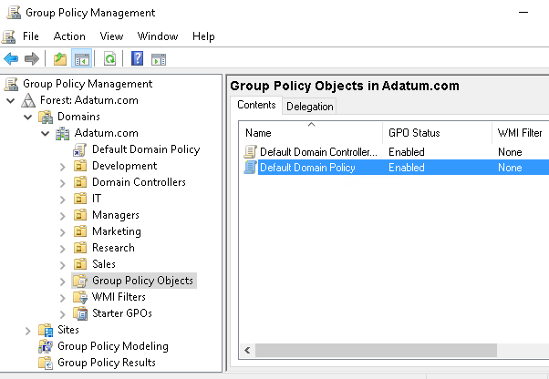
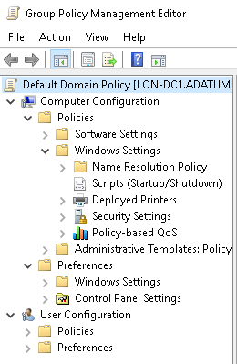
Overview of Group Policy tools and consoles
Group Policy Management Console
Group Policy Management Editor
Command-line utilities: GPUpdate and GPResult
Notes:
20742B
5: Implementing Group Policy

Slide 7
Demonstration: Exploring Group Policy tools and consoles
In this demonstration, you will learn how to:
Navigate the GPMC
Create a new GPO
Configure a setting
Perform a Group Policy refresh
Examine which GPOs apply to the computer and user
Notes:
Leave the virtual machines running for subsequent demonstrations.
Preparation Steps
For this demonstration, you will use the available virtual machine environment. Before you begin the demonstration, you must complete the following steps:
On the host computer, start Hyper-V Manager.
In Hyper-V Manager, click 20742B-LON-DC1, and then in the Actions pane, click Start.
In the Actions pane, click Connect. Wait until the virtual machine starts.
Sign in by using the following credentials:
User name: Administrator
Password: Pa55w.rd
Domain: Adatum
Repeat steps 2 to 3 for 20742B-LON-SVR1.
Demonstration Steps
On LON-DC1, in Server Manager, click Tools, and then click Group Policy Management.
If necessary, switch to the Group Policy Management window.
In Group Policy Management Console, in the navigation pane, expand Forest: Adatum.com, expand Domains, expand Adatum.com, and then click Group Policy Objects.
Right-click Group Policy Objects, and then click New.
In the New GPO dialog box, type Disable Control Panel, and then click OK.
In the details pane, right-click Disable Control Panel, and then click Edit.
20742B
5: Implementing Group Policy
(More notes on the next slide)

Slide 8
Notes:
In Group Policy Management Editor, in the navigation pane, under User Configuration, expand Policies, expand Administrative Templates, and then click Control Panel.
In the details pane, double-click Prohibit access to Control Panel and PC Settings.
In the Prohibit access to Control Panel and PC Settings dialog box, show the three possible values for a setting in Administrative Templates, show the Supported on text, and then show the Help text.
Click Enabled. In the Comment text box, type Enabled <date> by <your name>, where you replace <date> with today’s date and <your name> with your name, and then click OK.
In the navigation pane, under User Configuration, expand Preferences, and show the different categories under both Policies and Preferences.
Close the Group Policy Management Editor window.
In the Group Policy Management window, in the navigation pane, expand Group Policy Objects, and then click Disable Control Panel.
In the details pane, show the Scope, Details, and Settings tabs.
In the navigation pane, click and then right-click Adatum.com, and then click Link an Existing GPO.
In the Select GPO dialog box, click Disable Control Panel, and then click OK.
In the navigation pane, click Adatum.com.
In the details pane, show the Linked Group Policy Objects and Group Policy Inheritance tabs.
Click Start, and then click Windows PowerShell.
In the Administrator: Windows PowerShell window, type the following command, and then press Enter:
gpupdate
(More notes on the next slide)
20742B
5: Implementing Group Policy

Slide 9
Notes:
Verify that both the computer and user settings updated successfully.
At the Windows PowerShell command prompt, type the following command, and then press Enter:
gpresult /r
In the output from the command, in the User Settings section, in the Applied GPOs list, verify that the Disable Control Panel GPO is listed.
Close the Windows PowerShell window.
20742B
5: Implementing Group Policy

Slide 10
Benefits of using Group Policy
Group Policy is a very powerful administrative tool
You can use it to enforce various types of settings to a large number of users and computers
Typically, you use GPOs to:
Apply security settings
Manage desktop application settings
Deploy application software
Manage Folder Redirection
Configure network settings
Notes:
Consider demonstrating some of the settings that the slide lists.
20742B
5: Implementing Group Policy

Slide 11
Group Policy Objects
A GPO is:
A container for one or more policy settings
Managed with the GPMC
Stored in the GPOs container
Edited with Group Policy Management Editor
Applied to a specific level in the AD DS hierarchy
Notes:
Consider demonstrating each point in the slide to help reinforce student understanding.
20742B
5: Implementing Group Policy

Slide 12
Overview of GPO scope
The scope of a GPO is the collection of users and computers that will apply the settings in the GPO
You can use several methods to scope a GPO:
Link the GPO to a container, such as an OU
Filter by using security settings
Filter by using WMI filters
For Group Policy preferences:
You can filter or target the settings that you configure by Group Policy preferences within a GPO based on several criteria
Notes:
Mention that a GPO, and all of the settings that it contains, does not take effect until you have defined its scope. The first step to scoping a GPO is linking it to a site, domain, or OU. Introduce students to the mnemonic device: Site-Domain-OU (S-D-OU).
Emphasize that GPOs apply to users and computers only, and not to groups, despite the Group Policy name. If you choose to demonstrate the points on the slide, create a new GPO, and then link it to the domain. Emphasize the idea that the link or links define the maximum scope of the GPO.
Discussion prompt: Pose a question: What if you do not want the GPO settings to apply to all objects within the scope?
Use the question to transition to the concept of security group filtering, emphasizing that such filtering creates a subset of objects within the broader scope of the GPO link.
Important note:
Many experienced administrators rely too heavily on GPO links to manage the scope of GPOs. This often leads to less-than-ideal design of Active Directory Domain Services (AD DS) OUs at the expense of efficiently applied and managed security, such as with access control lists (ACLs) and delegation.
Continue with a very brief discussion of Windows Management Instrumentation (WMI) filtering, keeping the discussion at a high level. Use the example of a policy setting that you want to apply to a certain operating system only. Define WMI filtering as a way of querying the system and then determining whether to apply a GPO.
End the discussion with a mention of preferences targeting. The goal is simply to introduce the term and to prepare students for the idea that it is now possible to apply only part of a GPO to clients, as long as that part is only a segment of preferences.
20742B
5: Implementing Group Policy

Slide 13
Overview of GPO inheritance
GPOs are processed on a client computer in the following order:
Local GPOs
Site-level GPOs
Domain-level GPOs
OU GPOs, including any nested OUs
Notes:
While you explain that there are exceptions to the typical precedence in Group Policy processing, explain when you would use each of the following options:
Link Order. To ensure that a specific GPO linked to an OU has precedence at that OU.
Enforced. To apply standardized settings for an organization or department.
Block Inheritance. To allow a department to operate independently of the GPOs applied in the rest of the organization.
Link Enabled. To disable processing of a GPO during troubleshooting.
20742B
5: Implementing Group Policy

Slide 14
The Group Policy Client service and client-side extensions
Group Policy application process:
Group Policy Client retrieves GPOs
Client downloads and caches GPOs
Client-side extensions process the settings
Policy settings in the Computer Configuration node apply at system startup and every 90–120 minutes thereafter
Policy settings in the User Configuration node apply at sign-in and every 90–120 minutes thereafter
Notes:
Use this topic to introduce the fact that Group Policy is applied by using client-side pull processes. Introduce students to the idea that there are two major phases to an application. First, the Group Policy Client service asks AD DS which GPOs to apply. Then, enhanced GPOs go to the client-side extensions, which apply the settings.
Present the fact that most Group Policy client-side extensions apply settings only if the GPO has changed. This improves performance by eliminating unnecessary reapplications of the same settings.
You also might choose to discuss the Always Wait For Network At Startup And Logon policy setting as you discuss Group Policy refresh and application. Information about this setting is presented in the Workbook.
20742B
5: Implementing Group Policy

Slide 15
New features in Group Policy in Windows Server 2016
Windows Server 2016 introduces a few changes and improvements to Group Policy, including:
Importing the following types of policy settings on Nano Server:
Registry settings
Security settings
Audit settings
Including Windows 10 administrative templates
Notes:
Discuss the changes and improvements with students.
20742B
5: Implementing Group Policy

Slide 16
Lesson 2: Implementing and administering GPOs
What are domain-based GPOs? GPO storage What are starter GPOs? Common GPO management tasks Delegating administration of Group Policy Demonstration: Delegating administration of Group Policy
Notes:
In this lesson, you will discuss how to implement Group Policy. Stay focused on the fundamentals in this module. The next module will take the students’ knowledge a step further.
Question
Members of which built-in AD DS groups can create GPOs by default? (Select three.)
( ) Option 1: Domain Admins
( ) Option 2: Account Operators
( ) Option 3: Enterprise Admins
( ) Option 4: GPO Admins
( ) Option 5: Group Policy Creator Owners
Answer
(√ ) Option 1: Domain Admins
( ) Option 2: Account Operators
(√ ) Option 3: Enterprise Admins
( ) Option 4: GPO Admins
(√ ) Option 5: Group Policy Creator Owners
Feedback
The GPO Admins group does not exist. The Domain Admins and Enterprise Admins groups can perform all administrative tasks in the domain including create GPOs. Group Policy Creator Owners is the only group that you can add users to if you want them to be able to create GPOs without getting administrative rights on the domain or forest. Account Operators do not have any permissions regarding Group Policy. Only administering users, computers and groups in AD DS.
20742B
5: Implementing Group Policy

Slide 17
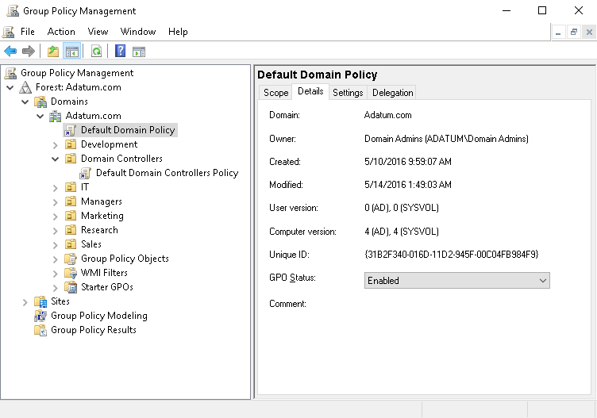
What are domain-based GPOs?
Notes:
Explain the purpose of the two default domain-based GPOs. Also, tell students that we do not recommend that they change settings in these GPOs. Rather, they should create new ones. Emphasize that Default Domain Controllers Policy is used only on domain controllers.
Briefly mention local GPOs, but do not focus much on them. Emphasize that domain-based GPOs take precedence because of the processing order.
20742B
5: Implementing Group Policy

Slide 18

GPO storage
Group Policy container
GPO
Stored in AD DS
Provides version information
Group Policy template
Contains Group Policy settings
Stores content in two locations
Stored in shared SYSVOL folder
Provides Group Policy settings
Notes:
Consider showing students the Group Policy template and Group Policy container.
20742B
5: Implementing Group Policy

Slide 19
What are starter GPOs?
A starter GPO:
Stores administrative template settings on which new GPOs will be based
Can be exported to .cab files
Can be imported into other areas of an organization
Exported to .cab file
Imported to the GPMC
Starter GPO
.cab file
Load .cab file
Notes:
Explain that you can store preconfigured administrative template settings in starter GPOs that act as templates for creating new GPOs. You can export these starter GPOs into .cab files that you can import easily into other areas of your organization. This can help provide consistency in large organizations. You can store comments about the starter GPO in the template itself.
20742B
5: Implementing Group Policy

Slide 20
Common GPO management tasks
You can manage GPOs by using GPMC or Windows PowerShell. These are some of the options for managing the state of GPOs:
Back up GPOs
Restore GPOs
Copy GPOs
Import GPOs
Notes:
Like critical data and AD DS–related resources, you must backup GPOs to protect the integrity of AD DS and GPOs. The GPMC not only provides the basic backup and restore options, but it also provides additional control over GPOs for administrative purposes, including that:
You can back up GPOs individually or as a whole with the GPMC.
The restore interface provides the ability for you to view the settings stored in the backed-up version before restoring it.
If you import a GPO, you can transfer settings from a backed-up GPO to an existing GPO. It does not modify the existing security or links on the destination GPO.
You can copy GPOs by using the GPMC, both in the same domain and across domains.
Consider demonstrating how to perform these tasks.
20742B
5: Implementing Group Policy

Slide 21
Delegating administration of Group Policy
Delegation of GPO-related tasks allows the administrative workload to be distributed across the enterprise
You can delegate the following Group Policy tasks independently:
Creating GPOs
Editing GPOs
Managing Group Policy links for a site, domain, or OU
Performing Group Policy modeling analysis in a domain or OU
Reading Group Policy results data in a domain or OU
Creating WMI filters in a domain
Notes:
Explain that you can delegate different aspects of GPO management. Emphasize that creating, linking, and editing GPOs are three separate operations and that having the right to perform one of these operations does not give you any rights to perform other operations. The administrator is the only user who has the rights to perform all of these actions by default.
You can use Delegation of Control Wizard or the GPMC to delegate linking GPOs and to enable the use of reporting tools. Explain that you can use membership in the Group Policy Creator Owners group or through the GPMC to delegate the right to create new group policies. You can configure each policy to allow users or groups to edit that policy.
Members of the Group Policy Creator Owners group can create new GPOs and edit or delete the GPOs that they create.
Consider demonstrating how to perform these tasks.
20742B
5: Implementing Group Policy

Slide 22
Demonstration: Delegating administration of Group Policy
In this demonstration, you will learn how to:
Delegate permissions to create GPOs
Delegate permissions to link GPOs
Delegate permissions to view Group Policy results
Notes:
Leave the virtual machines running for subsequent demonstrations.
Preparation Steps
The required virtual machines, 20742B-LON-DC1 and 20742B-LON-SVR1, should be running already after the preceding demonstration. You also need to be signed in as Adatum\Administrator with password Pa55w.rd.
Demonstration Steps
Make Beth a local administrator on LON-SVR1
Switch to LON-DC1.
On the taskbar, click the File Explorer icon.
In the File Explorer window, in the navigation pane, expand Allfiles (E:), expand Labfiles, and then click Mod05.
In the details pane, right-click the Set-LocalAdmin.ps1 file, and then click Run with Powershell. Type Y, if prompted, and then press Enter.
Check user permissions before delegation
Switch to LON-SVR1.
Sign in as Adatum\Beth with the password Pa55w.rd.
In Server Manager, click Add roles and features.
In Add Roles and Features Wizard, on the Before you begin page, click Next.
On the Select installation type page, click Next.
On the Select destination server page, click Next.
On the Select server roles page, click Next.
On the Select features page, select the Group Policy Management check box, and then click Next.
20742B
5: Implementing Group Policy
(More notes on the next slide)

Slide 23
Notes:
On the Confirm installation selections page, click Install.
When the installation completes, click Close.
In Server Manager, click Tools, and then click Group Policy Management.
If necessary, switch to the Group Policy Management window.
In Group Policy Management, expand Forest: Adatum.com, expand Domains, expand Adatum,com, and then click Group Policy Objects.
Right-click Group Policy Objects, and then notice that the New item is dimmed because Beth does not have permissions to create GPOs.
In the navigation pane, right-click the Adatum.com domain, and then notice that menu item Link an Existing GPO is dimmed because Beth does not have permissions to link GPOs to the domain.
In the navigation pane, right-click the IT OU, and then notice that menu item Link an Existing GPO is dimmed because Beth also does not have permissions to link GPOs to the IT OU.
Click Start, and then click Windows PowerShell.
In the Windows PowerShell window, type the following command, and then press Enter:
GPResult /r
In the output from the command, notice that only the User settings is displayed because Beth is not assigned the permissions view Group Policy results for computer settings.
Delegate permissions
On LON-DC1, switch to the Group Policy Management window.
In Group Policy Management, in the navigation pane, click the Group Policy Objects container, and then in the details pane, click the Delegation tab.
(More notes on the next slide)
20742B
5: Implementing Group Policy

Slide 24
Notes:
Click Add. In the Select User, Computer, or Group dialog box, type Beth, click Check Names, and then click OK.
In the navigation pane, click the IT OU, and then in the details pane, click the Delegation tab.
In the Permission dropdown list, ensure that Link GPOs is selected, and then click Add.
In the Select User, Computer, or Group dialog box, type Beth, click Check Names, and then click OK.
In the Add Group or User dialog box, click OK.
In the navigation pane, click the Adatum.com domain, and then in the details pane, click the Delegation tab.
In the Permission drop-down list, select Read Group Policy Results data, and then click Add.
In the Select User, Computer, or Group dialog box, type Authenticated Users, click Check Names, and then click OK.
In the Add Group or User dialog box, click OK.
Check permissions after delegation
Switch to LON-SVR1.
Switch to Group Policy Management.
In the Group Policy Management window, click and then right-click the Adatum.com domain, and then click Refresh.
In the navigation pane, right-click Group Policy Objects, and then click New.
In the New GPO dialog box, in the Name text box, type Beth’s GPO, and then click OK.
In the navigation pane, right-click Adatum.com, and then notice that Link an Existing GPO is still dimmed.
(More notes on the next slide)
20742B
5: Implementing Group Policy

Slide 25
Notes:
In the navigation pane, right-click IT, and then click Link an Existing GPO.
In the Select GPO dialog box, click Beth’s GPO, and then click OK.
Switch to the Windows PowerShell window.
In the Windows PowerShell window, type the following command and then press Enter:
GPResult /r
In the output from the command, notice that both the Computer and the User settings are displayed.
20742B
5: Implementing Group Policy

Slide 26
Lesson 3: Group Policy scope and Group Policy processing
What are GPO links? Demonstration: Linking GPOs Group Policy processing order Configuring GPO inheritance and precedence Using security filtering to modify Group Policy scope What are WMI filters? Demonstration: Filtering Group Policy application How to enable or disable GPOs and GPO nodes Loopback policy processing Considerations for slow links and disconnected systems Identifying when settings become effective
Notes:
Question
It is possible to link more than one WMI filter to a GPO.
( ) False
( ) True
Answer
(√ ) False
( ) True
Feedback
Although you cannot link more than one WMI filter to a GPO, you can create advanced WMI filters that include more than one WMI query.
20742B
5: Implementing Group Policy
(More notes on the next slide)

Slide 27
Notes:
Question
Which of the following options can you configure in the GPMC to change the default Group Policy processing order? (Select all that apply.)
( ) Option 1: WMI filters
( ) Option 2: Security filtering
( ) Option 3: Block inheritance
( ) Option 4: Enforce
( ) Option 5: Loopback processing
Answer
(√ ) Option 1: WMI filters
(√ ) Option 2: Security filtering
(√ ) Option 3: Block inheritance
(√ ) Option 4: Enforce
(√ ) Option 5: Loopback processing
Feedback
All the options are viable options to change the way Group Policy normally applies. You should use the different options sparingly because troubleshooting becomes increasingly difficult when you use these options.
20742B
5: Implementing Group Policy

Slide 28
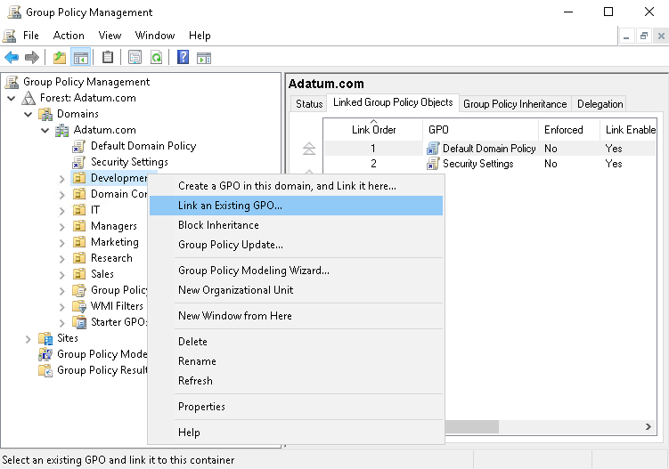
What are GPO links?
After you have linked a GPO, the users or computers in that container are within the scope of the GPO, including computers and users in child OUs
Notes:
The key point of this topic is to explain what students can do with GPO links. It is very important to emphasize that a GPO link actually connects Group Policy settings to a container in AD DS. Also, explain in which state the link can be and the differences between these states.
Consider demonstrating each of the activities described in the topic.
20742B
5: Implementing Group Policy

Slide 29
Demonstration: Linking GPOs
In this demonstration, you will learn how to:
Create and edit two GPOs
Link the GPOs to different locations
Disable a GPO link
Delete a GPO link
Notes:
Leave the virtual machine running for subsequent demonstrations.
Preparation Steps
The required virtual machine, 20742B-LON-DC1, should be running already after the preceding demonstration. You also need to be signed in as Adatum\Administrator with the password Pa55w.rd.
Demonstration Steps
Create and edit two GPOs
On LON-DC1, if necessary, open Server Manager.
In Server Manager, click Tools, and then click Group Policy Management.
In the Group Policy Management window, expand Forest: Adatum.com, Domains, and Adatum.com, right-click the Group Policy Objects container, and then click New.
In the New GPO dialog box, type Remove Run Command in the Name text box, and then click OK.
In the Group Policy Management window, right-click the Group Policy Objects container, and then click New.
In the New GPO dialog box, type Do Not Remove Run Command in the Name text box, and then click OK.
Expand Group Policy Objects, right-click the Remove Run Command GPO, and then click Edit.
In the Group Policy Management Editor window, under User Configuration, expand Policies, expand Administrative Templates, click Start Menu and Taskbar, and then double-click Remove Run menu from Start Menu.
In the Remove Run menu from Start Menu window, click Enabled, and then click OK.
Close the Group Policy Management Editor window.
20742B
5: Implementing Group Policy
(More notes on the next slide)

Slide 30
Notes:
In Group Policy Management, right-click the Do Not Remove Run Command GPO, and then click Edit.
In the Group Policy Management Editor window, under User Configuration, expand Policies, expand Administrative Templates, click Start Menu and Taskbar, and then double-click Remove Run menu from Start Menu.
In the Remove Run menu from Start Menu window, click Disabled, and then click OK. Close the Group Policy Management Editor window.
Link the GPOs to different locations
In the Group Policy Management window, right-click the Adatum.com domain node in the navigation pane, and then click Link an Existing GPO.
In the Select GPO window, click Remove Run Command, and then click OK. Now the Remove Run Command GPO is attached to the Adatum.com domain.
Click and drag the Do Not Remove Run Command GPO on top of the IT OU.
In the Group Policy Management window, click OK to link the GPO.
Click the IT OU in the navigation pane, and then click the Group Policy Inheritance tab in the details pane. The Group Policy Inheritance tab shows the order of precedence for the GPOs.
Disable a GPO link
In the left pane, right-click the Remove Run Command link that is listed under Adatum.com, and then click Link Enabled to clear the check mark. Refresh the Group Policy Inheritance pane for the information technology (IT) OU, and then notice the results in the details pane. The Remove Run Command GPO is no longer listed.
(More notes on the next slide)
20742B
5: Implementing Group Policy

Slide 31
Notes:
Delete a GPO link
In the left pane, expand the IT OU, right-click the Do Not Remove Run Command link, and then click Delete. Click OK in the pop-up window.
Click the IT OU in the left pane, and then click the Group Policy Inheritance tab in the details pane. Verify the removal of Do Not Remove Run Command and the absence of the Remove Run Command GPOs.
In the left pane, right-click the Remove Run Command GPO that is listed under Adatum.com, and then click Link Enabled to re-enable the link. Refresh the Group Policy Inheritance window for the IT OU, and then notice the results in the right pane.
Close Group Policy Management.
20742B
5: Implementing Group Policy

Slide 32
Group Policy processing order
GPO 1
Local group
. . .
Local group policies
GPO 2
Site
. . .
Site group policies
GPO 3
. . .
Domain group policies
Domain
GPO 4
OU
. . .
OU group policies
. . .
Child OU group policies
GPO 5
OU
Notes:
Illustration depicting the generic Group Policy application order. You can use it to modify and enforce the L-S-D-OU (L-S-D-OU) mnemonic.
20742B
5: Implementing Group Policy

Slide 33
Configuring GPO inheritance and precedence
The application of GPOs linked to each container results in a cumulative effect called policy inheritance:
Default precedence: Local → Site → Domain → OU → Child OU… (LSDOU)
Visible on the Group Policy Inheritance tab
Link order (attribute of GPO link):
Lower number → Higher on list → Precedence
Block Inheritance (attribute of OU):
Blocks the processing of GPOs from a higher level
Enforced (attribute of GPO link):
Enforced GPOs override Block Inheritance
Enforced GPO settings win over conflicting settings in lower GPOs
Notes:
While you discuss Group Policy inheritance and precedence, make sure that students understand that what is called inheritance is really just the effect of repeated, layered application of settings in GPOs, in a specific order.
Consider demonstrating this topic’s points by creating GPOs and then enforcing them. It is not necessary to show the effect of the enforcement. Also, demonstrate the procedure for blocking inheritance. Again, merely show the procedure.
20742B
5: Implementing Group Policy

Slide 34
Using security filtering to modify Group Policy scope
Apply Group Policy permission:
GPO has an ACL (Delegation tab → Advanced)
Members of the Authenticated Users group have Allow Apply Group Policy permissions by default
To scope only to users in selected global groups:
Remove the Authenticated Users group
Add appropriate global groups: Must be global groups (GPOs do not scope to domain local)
To scope to users except for those in selected groups:
On the Delegation tab, click Advanced
Add appropriate global groups
Deny the Apply Group Policy permission
Notes:
Many organizations struggle with how to maintain governance over Group Policy and, specifically, how to test a GPO effectively before using it in production. Talk through a simple but effective best practice: using security group filtering to manage the scope of a GPO during testing. Instead of creating a child OU to manage the GPO’s scope for testing, link the GPO to the location to which it belongs in production. But instead of allowing the GPO to apply to the Authenticated Users group, or to the production security group, configure a security group specifically designed to limit the scope of the GPO to appropriate users and computers. The benefit of this practice is that it gives a much more realistic picture of how the GPO will perform in production because you are not artificially limiting its scope or precedence by linking it to a separate test OU. In other words, you get a better picture for how the GPO interacts with other GPOs that are already in production. And yet, you still maintain full control over the specific users and computers that are within the test’s scope.
Tip: If you remove the Authenticated Users group, and then scope a GPO to a specific group, support personnel will not be able to read the policy to perform Group Policy management tasks. Be sure to assign appropriate support personnel the Read permission to the GPO, but do not assign them the Apply Policy permission.
Consider demonstrating the points raised in this topic as you discuss them.
20742B
5: Implementing Group Policy

Slide 35
What are WMI filters?
WMI queries can filter GPOs based on system characteristics, including:
RAM
Processor speed
Disk capacity
IP address
Operating system version
WMI queries are written by using WQL, for example
select * from Win32_OperatingSystem where Version like "10.%"
WMI filters can be expensive in terms of Group Policy processing performance
Notes:
Note: This topic has one additional slide.
You should be familiar with the basic functionality of WMI queries, which this section discusses.
Remember that WMI filters can query based on services and processes on a system, not just hardware.
Consider demonstrating the creation and application of a WMI filter. Use the example in the student manual for this purpose.
Mention to the students that depending on the specific WMI query, processing can be a performance issue. Also, use your own experience and mention any WMI filters that you have used in the past.
20742B
5: Implementing Group Policy

Slide 36
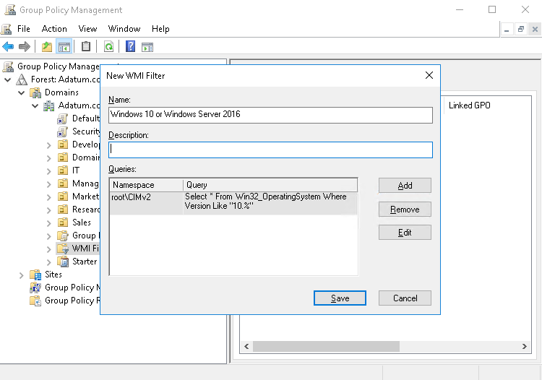
What are WMI filters?
Notes:
20742B
5: Implementing Group Policy

Slide 37
Demonstration: Filtering Group Policy application
In this demonstration, you will learn how to:
Create a new GPO, and link it to the IT OU
Filter Group Policy application by using security group filtering
Filter Group Policy application by using WMI filtering
Notes:
Leave the virtual machine running for subsequent demonstrations.
Preparation Steps
The required virtual machine, 20742B-LON-DC1, should be running after the preceding demonstration.
Demonstration Steps
Create a new GPO and link it to the IT OU
On LON-DC1, from Server Manager, click Tools, and then click Group Policy Management.
In the Group Policy Management window, expand Forest: Adatum.com, expand Domains, expand Adatum.com, and then click the IT OU.
Right-click IT, and then click Create a GPO in this domain, and Link it here.
In the New GPO window, type Remove Help menu in the Name text box, and then click OK.
In the Group Policy Management window, expand Group Policy Objects, right-click the Remove Help menu GPO, and then click Edit.
In the Group Policy Management Editor window, under User Configuration, expand Policies, expand Administrative Templates, click Start Menu and Taskbar, and then double-click Remove Help menu from Start Menu.
In the Remove Help menu from Start menu window, click Enabled, and then click OK.
Close the Group Policy Management Editor window.
Filter Group Policy application by using security group filtering
Expand IT, and then click the Remove Help menu GPO link.
In the GPMC message box, click OK.
In the details pane, under Security Filtering, click Authenticated Users, and then click Remove.
20742B
5: Implementing Group Policy
(More notes on the next slide)

Slide 38
Notes:
In the confirmation dialog box, click OK.
In the details pane, under Security Filtering, click Add.
In the Select User, Computer, or Group dialog box, in the Enter Object Names to select (Examples) text box, type Beth Burke, and then click OK.
In the details pane, under Security Filtering, click Add.
In the Select User, Computer, or Group dialog box, click Object Types.
In the Object Types dialog box, select the Computers check box, and then click OK.
In the Select User, Computer, or Group dialog box, in the Enter Object Names to select (Examples) text box, type LON-SVR1, and then click OK.
Note: LON-SVR1 is added to the security-filtering list because the computers where users sign in also need the Read permission to the GPO.
Filter the Group Policy application by using WMI filtering
In the Group Policy Management window, right-click WMI Filters, and then click New.
In the New WMI Filter dialog box, in the Name text box, type OS Version Filter.
In the Queries pane, click Add.
In the WMI Query dialog box, in the Query text box, type the following query, and then click OK:
select * from Win32_OperatingSystem where Version like "10.%"
If a Warning dialog box appears, click OK.
In the New WMI Filter dialog box, click Save.
Right-click the Group Policy Objects folder, and then click New.
In the New GPO window, type Software Updates in the Name text box, and then click OK.
(More notes on the next slide)
20742B
5: Implementing Group Policy

Slide 39
Notes:
Expand Group Policy Objects, and then click the Software Updates GPO.
In the details pane, on the Scope tab, under WMI Filtering, in the This GPO is linked to the following WMI filter list, select OS Version Filter.
In the confirmation dialog box, click Yes.
Close Group Policy Management.
20742B
5: Implementing Group Policy

Slide 40
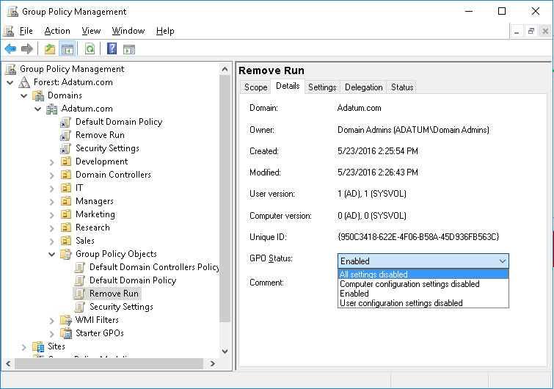
How to enable or disable GPOs and GPO nodes
Notes:
In addition to explaining the settings in the GPO Status drop-down list, mention the performance benefits gained specifically by disabling nodes of GPOs that have no settings.
Discussion Prompt: Ask students to consider what scenarios might lead to disabling a GPO that has settings. Answers might include GPOs that configure strict lockdown in the event of a security incident or GPOs that configure disaster recovery settings. In other words, those that are disabled until needed.
20742B
5: Implementing Group Policy

Slide 41
Loopback policy processing
Provides the ability to apply user Group Policy settings based on the computer to which the user is signing in
Replace mode:
Only the list of GPOs based on the computer object is used
Merge mode:
The list of the GPOs based on the computer have higher precedence than the list of GPOs based on the user
Useful in closely managed environments and special-use computers, such as:
Terminal servers, public-use computers, and classrooms
Notes:
Note: This topic has one additional slide.
Both the user objects and the computer objects potentially can have different Group Policy settings applied, depending on where each object resides in AD DS. Loopback processing ensures that the computer object’s policy takes precedence over the user object’s Group Policy settings.
Loopback processing operates by using the following two modes:
Merge mode applies the user’s normal Group Policy settings and the user settings associated with the location of the computer object. Both sets of policies will be merged, but in the case of a conflict between settings, it will apply the computer loopback policy settings.
Replace mode ignores the user’s normal Group Policy settings and instead applies the user settings associated with the policy that delivered the loopback settings.
For example, a public-access computer in the lobby might have a user policy that locks down the desktop completely and allows access only to certain software. Loopback processing in Replace mode would ensure that whoever signs in to the computer would be subject to those restrictions.
Give examples of when you might implement loopback processing.
This is often one of the harder topics regarding Group Policy to deliver to the students. Ideally, use an example to demonstrate. For example, you could change the CTRL-ALT-DEL options when users sign in to a server.
20742B
5: Implementing Group Policy

Slide 42
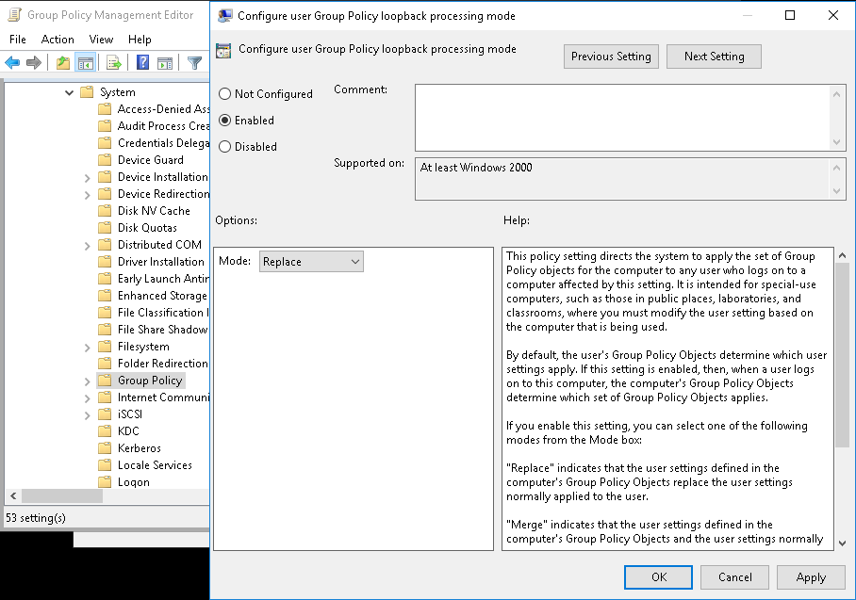
Loopback policy processing
Notes:
20742B
5: Implementing Group Policy

Slide 43
Considerations for slow links and disconnected systems
Slow link detection:
By default, connection speeds below 500 kbps
The following CSEs apply by default:
Security Settings
Administrative Templates
Disconnected computers:
Cache Group Policy so that settings still apply
Perform Group Policy refresh when reconnecting with the domain network if a background refresh has been missed
Notes:
Discuss the issues associated with slow links and disconnected systems. Make sure that students understand that when a computer is disconnected, the previously applied settings will continue to take effect. There are several exceptions to this rule—most notably that startup, shutdown, logon, and logoff scripts do not run when the system is disconnected.
20742B
5: Implementing Group Policy

Slide 44
Identifying when settings become effective
GPO replication must occur
Group changes must replicate
Group Policy refresh must occur
User must sign out and sign in or the computer must restart
You must perform a manual refresh
Most CSEs do not reapply unchanged GPO settings
Notes:
Use this slide to summarize the details regarding when GPO settings actually take effect. This should answer the question, “When I change a policy setting, when will that setting actually be applied to a user or computer?“
The Workbook contains a lot of information that will help you talk about the slide and answer questions from students.
Do not provide too much detail about the replication technologies themselves, but rather, point out that both the Group Policy container and Group Policy template must replicate to the domain controller from which a client obtains its policies. Also, point out that the Group Policy container and Group Policy template use two different replication technologies that are not always in sync.
Other points to make:
We highly recommend that organizations implement the Always Wait For Network At Startup And Logon policy setting. Without that, a change to a policy setting might take several sign out and sign in or restart cycles before it takes effect, and there is no good way to predict the exact timing. To truly manage the application of new policy settings, administrators should enable Always Wait For Network At Startup And Logon. Make sure that students understand that this does not slow down the startup or logon process significantly. Users will not complain that it is noticeably slower. Also, make sure that students understand that when a system is not connected to the network, it ignores this setting, so this setting is not a problem for disconnected laptop computers or tablet users.
Users cannot change most policy settings, particularly managed policy settings. However, if users are administrators of their computers, it is possible for them to change some settings. Those changes will never be reverted to match the settings specified by the GPOs, because most client-side extensions will reapply policy settings only when a GPO has changed. The exceptions to this rule are security settings, which are reapplied every 16 hours, regardless of whether the GPO has changed. If an organization is concerned about enforcing its policy settings, and if it is possible for users to change those settings, then administrators should configure the client-side extensions to reapply policy settings even if the GPO has not changed. They can use Group Policy to configure the policy processing behavior of each CSE.
20742B
5: Implementing Group Policy

Slide 45
Lab A: Implementing a Group Policy infrastructure
Exercise 1: Creating and configuring GPOs Exercise 2: Managing GPO scope
Logon Information
Virtual machines: 20742B-LON-DC1
20742B-LON-CL1
User name: Adatum\Administrator
Password: Pa55w.rd
Estimated Time: 40 minutes
Notes:
Exercise 1: Creating and configuring GPOs
Your manager asked you to use Group Policy to implement standardized security settings to lock computer screens when users leave computers unattended for 10 minutes or more. She also asked you to configure a policy setting that will prevent access to registry-editing tools on local computers.
Exercise 2: Managing GPO scope
You used Group Policy to implement standardized security settings to lock computer screens when users leave computers unattended for 10 minutes or more. However, after some time, an engineer informed you that a critical application used by the Research engineering team fails when the screen saver starts. He asked you to prevent the GPO setting from applying to any member of the Research security group. He also asked you to configure conference room computers to be exempt from corporate policy. However, you must ensure that the conference room computers always use a 2-hour time out.
20742B
5: Implementing Group Policy

Slide 46
Lab Scenario
Your manager asked you to use Group Policy to implement standardized security settings to lock computer screens when users leave computers unattended for 10 minutes or more. You also have to configure a policy setting that will prevent access to certain programs on local computers.
You configured Group Policy to lock computer screens when users leave computers unattended for 10 minutes or more. However, after some time, you were made aware that a critical application used by the Research engineering team fails when the screen saver starts. An engineer asked you to prevent the GPO setting from applying to any member of the Research security group. He also asked you to configure conference room computers to be exempt from corporate policy. However, you must ensure that the conference room computers use a 2-hour time out.
Create the policies that you need to evaluate the RSoPs for users in your environment. Make sure to optimize the Group Policy infrastructure and verify that all policies are applied as they were intended.
Notes:
20742B
5: Implementing Group Policy

Slide 47
Lab Review
Many organizations rely heavily on security group filtering to scope GPOs, rather than linking GPOs to specific OUs. In these organizations, GPOs typically are linked very high in the Active Directory logical structure—to the domain itself or to a first-level OU. What advantages do you gain by using security group filtering rather than GPO links to manage a GPO’s scope? Why might it be useful to create an exemption group—a group that is denied the Apply Group Policy permission—for every GPO that you create? Do you use loopback policy processing in your organization? In which scenarios and for which policy settings can loopback policy processing add value?
Notes:
Question
Many organizations rely heavily on security group filtering to scope GPOs, rather than linking GPOs to specific OUs. In these organizations, GPOs typically are linked very high in the Active Directory logical structure—to the domain itself or to a first-level OU. What advantages do you gain by using security group filtering rather than GPO links to manage a GPO’s scope?
Answer
The fundamental problem of relying on OUs to scope the application of GPOs is that an OU is a fixed, inflexible structure within AD DS; a single user or computer can exist within only one OU. As organizations get larger and more complex, configuration requirements become difficult to match in a one-to-one relationship with any container structure. With security groups, a user or computer can exist in as many groups as necessary, and you can add or remove them easily without impacting the security or management of the user or computer account.
Question
Why might it be useful to create an exemption group—a group that is denied the Apply Group Policy permission—for every GPO that you create?
Answer
There are very few scenarios in which you can guarantee that all of the settings in a GPO will always need to apply to all users and computers within its scope. By having an exemption group, you will always be able to respond to situations in which you must exclude a user or computer. This also can help in troubleshooting compatibility and functionality problems. Sometimes, specific GPO settings can interfere with the functionality of an application. To test whether the application works on a clean installation of the Windows operating system, you might need to exclude the user or computer temporarily from the scope of GPOs.
20742B
5: Implementing Group Policy
(More notes on the next slide)

Slide 48
Notes:
Question
Do you use loopback policy processing in your organization? In which scenarios and for which policy settings can loopback policy processing add value?
Answer
Answers will vary. Scenarios could include: in conference rooms and kiosks, on Virtual Desktop Infrastructure computers, and in other standard environments.
20742B
5: Implementing Group Policy

Slide 49
Lesson 4: Troubleshooting the application of GPOs
Refreshing GPOs What is RSoP? Generating RSoP reports Demonstration: Performing a what-if analysis with Group Policy Modeling Wizard Examining Group Policy event logs Detecting Group Policy health issues
Notes:
In this lesson, you will help students understand that in large, networked environments, Group Policy application can be problematic sometimes. It is important that students know how to use the provided tools to help solve Group Policy application issues.
20742B
5: Implementing Group Policy

Slide 50
Refreshing GPOs
When you apply GPOs, remember that:
Computer settings apply at startup
User settings apply at sign-in
Polices refresh at regular, configurable intervals
Security settings refresh at least every 16 hours
Policies refresh manually by using:
The gpupdate command-line utility
The Windows PowerShell cmdlet Invoke-gpupdate
With the Remote Group Policy Refresh feature, you can refresh policies remotely
Notes:
Emphasize that changing the refresh interval might affect the performance of both the client computer and the network and therefore should be tested before implementation.
Make sure that students understand the idea of users logging on with cached credentials and the effect that this has on Group Policy settings.
Point out the feature Remote Group Policy Refresh.
20742B
5: Implementing Group Policy

Slide 51
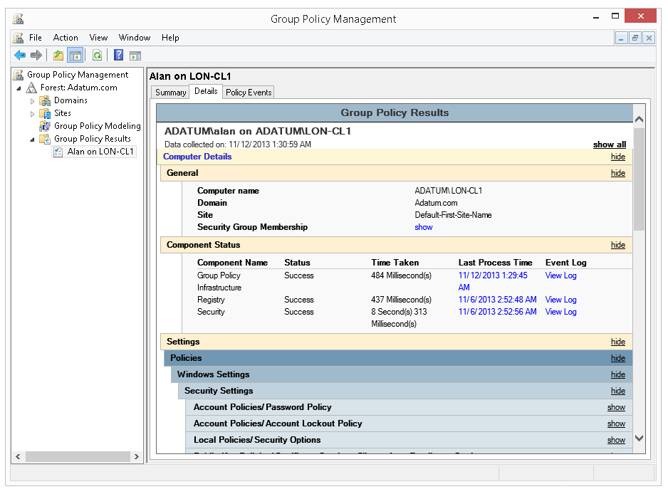
What is RSoP?
RSoP is the net effect of GPOs applied to a user or computer
Group Policy Management
Notes:
Note: this topic has one additional slide
Use this topic to introduce the term, concepts, and tools of RSoP. Remind students how complex it can become to evaluate RSoP with factors including inheritance, filters, loopback, the interaction between GPOs in client-side extensions and the large number of policy settings.
Help students understand that RSoP is both a descriptor that means the end result of policy application and also the name of a collection of tools and processes.
20742B
5: Implementing Group Policy

Slide 52
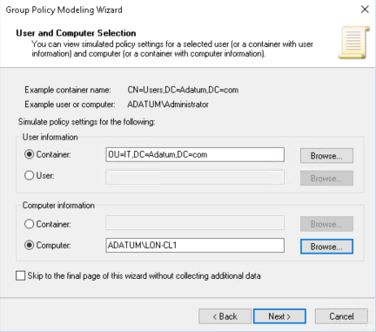
What is RSoP?
Group Policy Modeling Wizard
Notes:
20742B
5: Implementing Group Policy

Slide 53
Generating RSoP reports
RSoP reports show the actual settings being applied to the user and computer
Might show the time taken to apply Group Policy
You can generate RSoP reports by using:
Group Policy Results Wizard
GPResults
Get-GPResultantSetOfPolicy
Target computer must be online
Remote WMI must be enabled
Notes:
Note: This topic has one additional slide.
Talk in detail about RSoP reports, preferably with demonstrations. Make sure that students understand how to generate, interpret, and save RSoP reports created by Group Policy Results Wizard in the GPMC or by the GPResult command.
Emphasize the critical importance of RSoP reports in analyzing and troubleshooting Group Policy application in an enterprise.
20742B
5: Implementing Group Policy

Slide 54
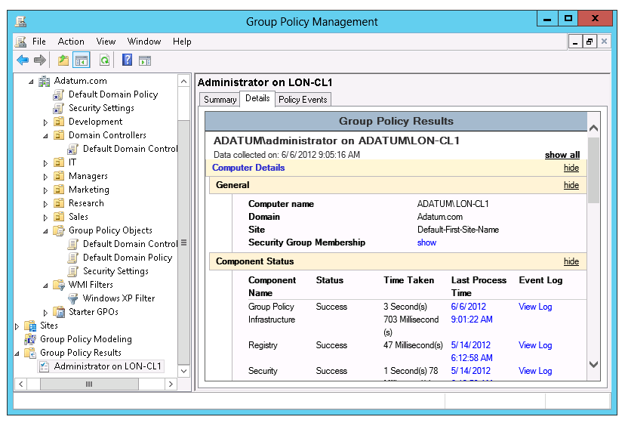
Generating RSoP reports
Group Policy Results Wizard
Notes:
20742B
5: Implementing Group Policy

Slide 55
Demonstration: Performing a what-if analysis with Group Policy Modeling Wizard
In this demonstration, you will learn how to:
Use GPResult.exe to create a report
Use Group Policy Reporting Wizard to create a report
Use Group Policy Modeling Wizard to create a report
Notes:
Emphasize that Group Policy Modeling Wizard is not reporting actual application of Group Policy, but rather, it is analyzing and reporting anticipated Group Policy application.
Ask students what types of scenarios would lend themselves to using Group Policy modeling. Among the answers should be scenarios in which users or computers will be moved or in which group memberships will be changed to evaluate potential changes to their configuration from Group Policy. Also, you can use modeling to evaluate the impact of a new GPO prior to rolling it into production.
When you are finished with this demonstration, you can revert all virtual machines unless you want to demonstrate event logs and Group Policy health.
Preparation Steps
The required virtual machine, 20742B-LON-DC1, should be running already after the preceding demonstration. You also need to be signed in as Adatum\Administrator with the password Pa55w.rd.
Demonstration Steps
Use GPResult.exe to create a report
On LON-DC1, click Start, type cmd, and then press Enter.
In the Administrator: Command Prompt window, type cd \, and then press Enter.
Type the following command, and then press Enter:
GPResult /r
Review the output in the Command Prompt window.
Type the following command, and then press Enter:
GPResult /h results.html
Close the Command Prompt window.
20742B
5: Implementing Group Policy
(More notes on the next slide)

Slide 56
Notes:
Click Start, click Windows Accessories, and then click Internet Explorer.
In the Internet Explorer window, press the Alt key, click File, and then click Open.
In the Open dialog box, in the Open text box, type C:\results.html, and then click OK.
In the warning message, click Allow blocked content.
View the results of the report.
Close Microsoft Internet Explorer.
Use Group Policy Reporting Wizard to create a report
Open Server Manager, click Tools, and then click Group Policy Management.
In the Group Policy Management window, in the navigation pane, right-click Group Policy Results, and then click Group Policy Results Wizard.
In Group Policy Results Wizard, click Next.
On the Computer Selection page, click Next.
On the User Selection page, click Next.
On the Summary of Selections page, click Next.
On the Completing the Group Policy Results Wizard page, click Finish.
Review the Group Policy results.
Expand Group Policy Results, right-click Administrator on LON-DC1, and then click Save Report.
In the Save GPO Report dialog box, click Desktop, and then click Save.
(More notes on the next slide)
20742B
5: Implementing Group Policy

Slide 57
Notes:
Use Group Policy Modeling Wizard to create a report
Right-click Group Policy Modeling, and then click Group Policy Modeling Wizard.
In Group Policy Modeling Wizard, click Next.
On the Domain Controller Selection page, click Next.
On the User and Computer Selection page, under User information, click User, and then click Browse.
In the Select User dialog box, in the Enter object names to select (Examples) text box, type Beth, and then click OK.
Under Computer information, verify that the Container option is selected, and then click Browse.
In the Choose Computer Container dialog box, expand Adatum, click IT, and then click OK.
On the User and Computer Selection page, click Next.
On the Advanced Simulation Options page, click Next.
On the Alternate Active Directory Paths page, click Next.
On the User Security Groups page, click Next.
On the Computer Security Groups page, click Next.
On the WMI Filters for Users page, click Next.
On the WMI Filters for Computers page, click Next.
On the Summary of Selections page, click Next.
On the Completing Group Policy Modeling Wizard page, click Finish.
Review the report.
Close all open windows.
20742B
5: Implementing Group Policy

Slide 58
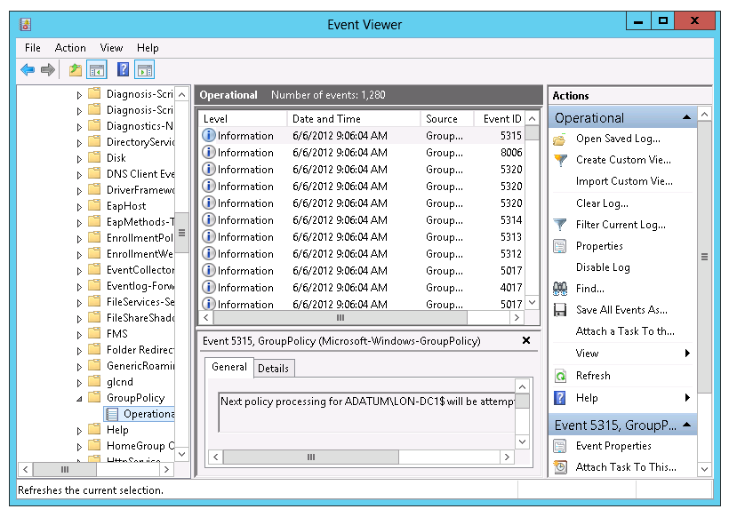
Examining Group Policy event logs
Notes:
Consider demonstrating the three major logs in which you can find Group Policy events. Also, point out that RSoP reports expose Group Policy events, particularly in Advanced View.
Mention that the Group Policy Operational log is a great way to learn exactly how Group Policy is applied in Windows operating systems. You can trace every step of Group Policy application described in the previous lesson.
20742B
5: Implementing Group Policy

Slide 59
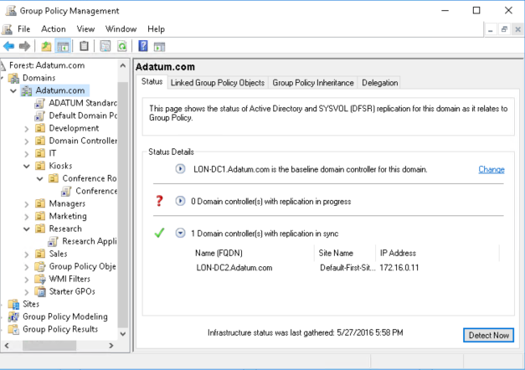
Detecting Group Policy health issues
Group Policy health check in Group Policy Management Console
Notes:
Note: This topic has one additional slide.
Some students might have used the gpotool.exe previously. The health status performed by Group Policy Management Console is more extensive. Consider demonstrating the health check. There is no longer a second domain controller, but you can still demonstrate where to perform this action.
20742B
5: Implementing Group Policy

Slide 60
Detecting Group Policy health issues
In Group Policy Management Console:
The Status tab displays information that indicates the health of the Group Policy infrastructure:
Domain
GPO
Information displayed includes:
Domain controllers
Permissions on the Group Policy container and the Group Policy template
GPO replication
GPO versioning
Domain controllers not reachable or inconsistent with the baseline domain controller are added to the Domain controller(s) with replication in progress list
Notes:
If you want to demonstrate this, you can show where this is done in the GPMC. There is no second domain controller. Mention that this feature was introduced with Windows Server 2012.
20742B
5: Implementing Group Policy

Slide 61
Lab B: Troubleshooting Group Policy infrastructure
Exercise 1: Verifying GPO application Exercise 2: Troubleshooting GPOs
Logon Information
Virtual machines: 20742B-LON-DC1
20742B-LON-CL1
User name: Adatum\Administrator
Password: Pa55w.rd
Estimated Time: 40 minutes
Notes:
Exercise 1: Verifying GPO application
After configuring settings for the Research department and computers in the conference rooms, to make sure that all settings apply as intended, you need to create RSoP reports from both Group Policy Management Console and a client. You do not have access to a computer in the conference rooms, so you have to simulate how settings will apply by using Group Policy modeling analyses. You also need to investigate what events are stored in Event Viewer regarding Group Policy.
Exercise 2: Troubleshooting GPOs
A user has opened a Help desk ticket because the screen saver settings do not apply as intended. You have to investigate the issue and make sure that the correct settings apply to the user.
You must resolve the reported GPO application problem that Tier 1 help desk staff could not resolve.
20742B
5: Implementing Group Policy

Slide 62
Lab Scenario
After configuring settings for the Research department and computers in the conference rooms, you want to make sure that all settings apply as intended. You want to do this by creating RSoP reports from both Group Policy Management Console and a client. You do not have access to a computer in the conference rooms, so you have to simulate how settings will apply by using Group Policy modeling analyses. You want to investigate what events are stored in Event Viewer regarding Group Policy.
After some time, you receive a Help desk ticket opened by a user. The issue is that the Screen Saver settings that was applied is not the correct settings for the user. You have to investigate the issue and make sure that the correct settings apply to the user.
Notes:
20742B
5: Implementing Group Policy

Slide 63
Lab Review
In what situations have you used RSoP reports to troubleshoot Group Policy application in your organization? In what situations have you used Group Policy modeling? If you have not done this yet, in what situations can you anticipate using Group Policy modeling?
Notes:
Question
In what situations have you used RSoP reports to troubleshoot Group Policy application in your organization?
Answer
Answers will vary based on students’ experiences and situations. Possible answers might include:
Solved a Group Policy issue where one GPO did not apply because of security filtering.
Solved a Group Policy issue where one client-side extension took 20 seconds to apply because of a Domain Name System (DNS) issue.
Located a GPO setting that was configured in the wrong GPO.
Located a Group Policy issue where the incorrect user settings were applied because of loopback processing.
Question
In what situations have you used Group Policy modeling? If you have not done this yet, in what situations can you anticipate using Group Policy modeling?
Answer
Answers will vary based on students’ experiences and situations. Possible answers might include:
Managed to configure Group Policy correctly based on Group Policy modeling simulations.
Tested the result of adding a user to a security group.
Tested the result of moving a user to another OU.
Tested the result of configuring loopback processing for a computer.
20742B
5: Implementing Group Policy

Slide 64
Module Review and Takeaways
Review Questions Common Issues and Troubleshooting Tips
Notes:
Review Questions
Question
You have assigned a logon script to an OU via Group Policy. The script is located in a shared network folder named Scripts. Some users in the OU receive the script and others do not. What might be the possible causes?
Answer
Security permissions might be a problem. If some users do not have Read access to the Scripts folder, they will not be able to apply policy. Also, security filtering on a GPO might be the cause of this problem.
Question
What GPO settings apply across slow links by default?
Answer
Registry policy processing and security policy apply even when a slow link is detected. You cannot change this setting.
Question
You must ensure that a domain-level policy is enforced, but the Managers group must be exempt from the policy. How would you accomplish this?
Answer
Set the link to be enforced at the domain level and use security group filtering to deny the Apply Group Policy permission to the Managers group.
20742B
5: Implementing Group Policy
(More notes on the next slide)

Slide 65
Notes:
Common Issues and Troubleshooting Tips
Common Issue: Group Policy settings are not applied to all users or computers in an OU where a GPO is applied.
Troubleshooting Tip:
Check security filtering on the GPO.
Check WMI filters on the GPO.
Common Issue: Group Policy settings sometimes require two restarts to apply.
Troubleshooting Tip: Enable the Always Wait For Network At Startup and Logon policy setting.
Note: Ensure that you cover the common issues and the corresponding troubleshooting tips listed in this section. Encourage students to share tips from their own work environments.
20742B
5: Implementing Group Policy

