Slide 1
Module 13
Monitoring, managing, and recovering AD DS
Notes:
Presentation: 60 minutes
Lab: 60 minutes
After completing this module, students will be able to:
Monitor Active Directory Domain Services (AD DS).
Manage the Active Directory database.
Understand backup and recovery options for AD DS and other identity and access solutions.
Required materials
To teach this module, you need the Microsoft PowerPoint file 20742B_13.pptx.
Preparation tasks
To prepare for this module:
Read all of the materials for this module.
Practice performing the demonstrations and labs.
Work through the Module Review and Takeaways section to determine how you will use the information to reinforce student learning and promote knowledge transfer to on-the-job performance.
As you prepare for this class, it is imperative that you complete the labs yourself. This gives you an understanding of how the labs work and the concepts that each covers, so that you can provide meaningful hints to students who might have issues. Furthermore, it will help guide your lecture to ensure that you discuss the concepts that the labs cover.
20742B
13: Monitoring, managing, and recovering AD DS

Slide 2
Module Overview
Monitoring AD DS Managing the Active Directory database Active Directory backup and recovery options for AD DS and other identity and access solutions
Notes:
Provide a quick overview of each lesson.
20742B
13: Monitoring, managing, and recovering AD DS

Slide 3
Lesson 1: Monitoring AD DS
Understanding performance and bottlenecks Overview of monitoring tools What is Performance Monitor? What are data collector sets? Demonstration: Monitoring AD DS
Notes:
Provide a lesson overview.
20742B
13: Monitoring, managing, and recovering AD DS

Slide 4
Understanding performance and bottlenecks
A bottleneck is a resource that is currently at peak utilization
Key system resources:
CPU
Disk
Memory
Network
Notes:
Before you display the slide, ask students to identify the key resources in a Windows-based server. Write these on the whiteboard and then explain the four key system resources.
Define bottleneck, emphasizing that removing one bottleneck (for example, adding more memory to a server) might then lead to another bottleneck (for example, disk utilization).
List some of the tools that are available to help students with performance monitoring.
20742B
13: Monitoring, managing, and recovering AD DS

Slide 5
Overview of monitoring tools
Windows Server provides the following tools to help with monitoring performance issues:
Task Manager
Resource Monitor
Event Viewer
Performance Monitor
Windows PowerShell
Notes:
Consider demonstrating each of the tools in this lesson while you discuss them.
Ask students which of these tools they use to monitor AD DS. Ask them to discuss alternatives and write them on the whiteboard for consideration by the class.
20742B
13: Monitoring, managing, and recovering AD DS

Slide 6
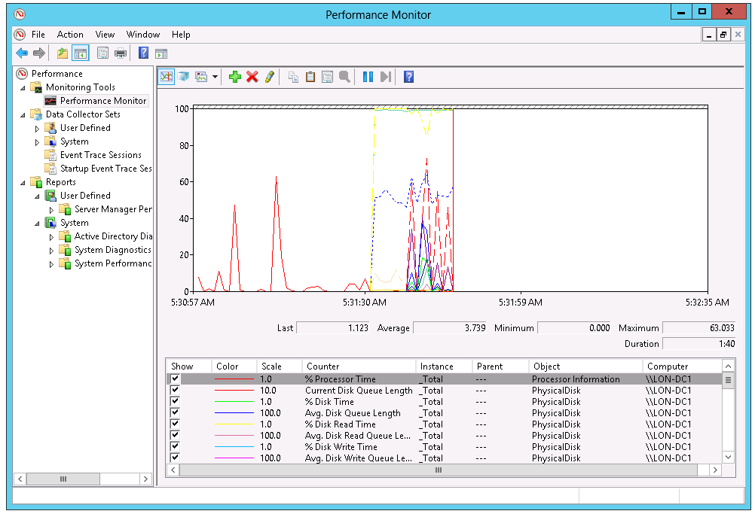
What is Performance Monitor?
You can use Performance Monitor to view current performance statistics or historical data gathered by using data collector sets
Notes:
Note: This topic has one additional slide.
Explain to students that you can use Performance Monitor to examine how the programs that you run affect your server’s performance, both in real time and by collecting log data for later analysis.
To access Performance Monitor, on the Performance Information and Tools page, click Advanced Tools.
The three ways of viewing data through Performance Monitor are:
Monitoring tools
Data collector sets
Reports
Briefly mention that you also can access Resource Monitor from Performance Monitor.
20742B
13: Monitoring, managing, and recovering AD DS

Slide 7
What is Performance Monitor?
Important performance counters include:
CPU
Memory
Disk
Network
AD DS:
NTDS\ DRA Inbound Bytes Total/sec
NTDS\ DRA Inbound Object
NTDS\ DRA Outbound Bytes Total/sec
NTDS\ DRA Pending Replication Synchronizations
Security System-Wide Statistics\ Kerberos Authentications/sec
Security System-Wide Statistics\ NTLM Authentications
Notes:
20742B
13: Monitoring, managing, and recovering AD DS

Slide 8
What are data collector sets?
You can use data collector sets to gather performance-related information
Data collector sets can contain the following types of data collectors:
Performance counters
Event trace data
System configuration information
Notes:
Describe data collector sets. In the next topic, you will demonstrate data collector sets.
20742B
13: Monitoring, managing, and recovering AD DS

Slide 9
Demonstration: Monitoring AD DS
In this demonstration, you will learn how to:
Configure Performance Monitor to monitor AD DS
Create a data collector set
Start the data collector set
Analyze the resulting data in a report
Notes:
Emphasize to students that these steps show the generic process of using Performance Monitor to gather and analyze performance-related data. The lab will use specific directory-related counters.
When you have completed the demonstration, leave the virtual machines running for the subsequent demonstrations.
Preparation Steps
You require the 20742B-LON-DC1 and 20742B-LON-SVR1 virtual machines to perform this demonstration. Sign in as Adatum\Administrator with the password Pa55w.rd.
Demonstration Steps
Configure Performance Monitor to monitor AD DS
Switch to LON-DC1.
In Server Manager, click Tools, and then click Performance Monitor.
Under the Monitoring Tools node, click Performance Monitor.
Click the Add button—the green Plus Sign (+) on the toolbar—to add objects and counters.
In the Add Counters dialog box, in the Available Counters list, expand the Directory Services object.
Click the DRA Inbound Bytes Total/sec counter, and then click Add.
Repeat the previous step (step 6) to add the following counters:
DirectoryServices\DRA Outbound Bytes Total/sec
DirectoryServices\DS Threads In Use
DirectoryServices\DS Directory Reads/sec
DirectoryServices\DS Directory Writes/sec
DirectoryServices\DS Directory Searches/sec
NTDS\DRA Inbound Objects/sec
20742B
13: Monitoring, managing, and recovering AD DS
(More notes on the next slide)

Slide 10
Notes:
NTDS\DRA Pending Replication Synchronizations
Security System-Wide Statistics\NTLM Authentications
Security System-Wide Statistics\Kerberos Authentications
Click OK, and then wait for a few moments.
In the counter list below the graph, select DS Directory Searches/sec.
On the toolbar, click Highlight. The selected counter is highlighted, making it easier to see that counter's performance.
On the toolbar, click Highlight to turn off the highlight.
Create a data collector set
In the console tree, expand Performance, expand Monitoring Tools, and then click Performance Monitor. Right-click Performance Monitor, point to New, and then click Data Collector Set.
In the Create new Data Collector Set dialog box, in the Name text box, type Custom ADDS Performance Counters, and then click Next.
Make a note of the default root directory in which the data collector set will be saved, click Next, and then click Finish.
Start the data collector set
In the console tree, expand Data Collector Sets, expand User Defined, and then click User Defined.
Right-click Custom ADDS Performance Counters, and then click Start. Point out that the Custom ADDS Performance Counters node is selected automatically.
Note: You can identify the individual data collectors in the data collector set. In this case, the data collector set contains only one data collector—the System Monitor Log performance counter. You also can identify where the output from the data collector is being saved.
In the console tree, right-click the Custom ADDS Performance Counters data collector set, and then click Stop.
(More notes on the next slide)
20742B
13: Monitoring, managing, and recovering AD DS

Slide 11
Notes:
Analyze the resulting data in a report
In the console tree, expand Reports, expand User Defined, expand Custom ADDS Performance Counters, and then click System Monitor Log.blg.
Verify that the graph of the log's performance counters displays.
20742B
13: Monitoring, managing, and recovering AD DS

Slide 12
Lesson 2: Managing the Active Directory database
Overview of the AD DS database What is NtdsUtil? Understanding restartable AD DS Demonstration: Performing database management Managing Active Directory snapshots
Notes:
Provide a lesson overview.
20742B
13: Monitoring, managing, and recovering AD DS

Slide 13
Overview of the AD DS database
The directory database stores Active Directory information
Four Active Directory partitions on each domain controller are: domain, configuration, schema, and application (optional)
File-level components of the AD DS database are
File | Description
Ntds.dit | Main AD DS database file Contains Active Directory partitions and objects
Edb*.log | Transaction logs
Edb.chk | Database checkpoint file
Edbres00001.jrs Edbres00002.jrs | Reserve transaction log file that allows the directory to process transactions if the server runs out of disk space
Notes:
Introduce the key concepts of the AD DS database:
It has four partitions.
It is stored in a database file called Ntds.dit, which is located on each domain controller.
Changes to the AD DS database replicate to all domain controllers.
20742B
13: Monitoring, managing, and recovering AD DS

Slide 14
What is NtdsUtil?
You can use NtdsUtil to:
Manage and control single-master operations
Perform Active Directory database maintenance:
Perform offline defragmentation
Create and mount snapshots
Move database files
Clean domain-controller metadata:
Domain-controller removal or demotion while not connected to a domain
Reset DSRM:
Password
set dsrm
Notes:
Describe NtdsUtil.exe, and then describe some of the scenarios in which students can use it.
20742B
13: Monitoring, managing, and recovering AD DS

Slide 15
Understanding restartable AD DS
Use the Services console to start or stop AD DS
Three states of AD DS:
AD DS Started
AD DS Stopped
DSRM
It is not possible to perform a system state restoration while AD DS is in Stopped state
Notes:
Introduce restartable AD DS, and explain how it saves administrative time when performing AD DS maintenance.
20742B
13: Monitoring, managing, and recovering AD DS

Slide 16
Demonstration: Performing database management
In this demonstration, you will learn how to:
Stop AD DS
Perform an offline defragmentation of the Active Directory database
Check the integrity of the offline Active Directory database
Start AD DS
Notes:
After completing the demonstration, revert the virtual machines.
Preparation Steps
You require the 20742B-LON-DC1 virtual machine to perform this demonstration. If not already signed in, sign in as Adatum\Administrator with the password Pa55w.rd.
Demonstration Steps
Stop AD DS
If necessary, on LON-DC1, on the taskbar, click the Server Manager icon.
In Server Manager, click Tools, and then click Services.
In the Services console, right-click Active Directory Domain Services, and then click Stop.
In the Stop Other Services dialog box, click Yes.
Perform an offline defragmentation of the Active Directory database
On LON-DC1, click Start, and then click Windows PowerShell.
At the Windows PowerShell command prompt, type the following command, and then press Enter:
NtdsUtil.exe
At the NtdsUtil.exe: prompt, type the following command, and then press Enter:
activate instance NTDS
At the NtdsUtil.exe: prompt, type the following command, and then press Enter:
files
At the file maintenance: prompt, type the following command, and then press Enter:
compact to C:\
20742B
13: Monitoring, managing, and recovering AD DS
(More notes on the next slide)

Slide 17
Notes:
Check the integrity of the offline Active Directory database
At the file maintenance: prompt, type the following command, and then press Enter:
Integrity
At the file maintenance: prompt, type the following command, and then press Enter:
quit
At the NtdsUtil.exe: prompt, type the following command, and then press Enter:
Quit
Close the Windows PowerShell window.
Start AD DS
On the taskbar, click the Server Manager icon.
In Server Manager, click Tools, and then click Services.
In the Services console, right-click Active Directory Domain Services, and then click Start.
Confirm that the Status column for Active Directory Domain Services lists a status of Running.
20742B
13: Monitoring, managing, and recovering AD DS

Slide 18
Managing Active Directory snapshots
Create a snapshot of AD DS with NtdsUtil
Mount the snapshot with NtdsUtil
View the snapshot:
Right-click the root node of Active Directory Users and Computers, and then click Connect to Domain Controller
Type serverFQDN:port
View read-only snapshot:
Cannot directly restore data from the snapshot
Recover data:
Connect to the mounted snapshot, and then export/reimport objects’ attributes with Ldifde
Restore a backup from the same date as the snapshot
Notes:
Explain the purpose of Active Directory snapshots. Describe the process of capturing, mounting, viewing, and unmounting an AD DS snapshot.
20742B
13: Monitoring, managing, and recovering AD DS

Slide 19
Lesson 3: Active Directory backup and recovery options for AD DS and other identity and access solutions
Deleting and restoring objects from AD DS Configuring Active Directory Recycle Bin Demonstration: Implementing Active Directory Recycle Bin Additional backup and recovery tools Active Directory backup and recovery
Notes:
Provide a brief overview of the lesson content.
20742B
13: Monitoring, managing, and recovering AD DS

Slide 20
Deleting and restoring objects from AD DS
Deleted objects are recovered through tombstone reanimation
When an object is deleted, most of its attributes are cleared
Authoritative restore requires Active Directory downtime
Delete
Garbage collection
Physically deleted
Live
Tombstoned
Reanimate
tombstone/
authoritative restore
Notes:
Take the students through the process of restoring Active Directory objects without using Active Directory Recycle Bin.
Consider demonstrating the steps in this topic to give students a good idea of how the process works. The authoritative restore process is discussed later in this module, but it appears on this slide as an alternative to the outlined process; however, it requires downtime to facilitate. Explain to students that you will discuss it later.
20742B
13: Monitoring, managing, and recovering AD DS

Slide 21
Configuring Active Directory Recycle Bin
Active Directory Recycle Bin provides a way to restore deleted objects without Active Directory downtime
Uses Active Directory module for Windows PowerShell or the Active Directory Administrative Center to restore objects
Delete
Garbage collection
Recycle
Physically
deleted
Live
Deleted
Recycled
Authoritative
restore
Deleted
object
lifetime
Recycled
object
lifetime
Notes:
Introduce Active Directory Recycle Bin. Compare its functionality by reanimating a tombstoned object from Active Directory backup. Introduce the new graphical interface that Active Directory Administrative Center provides.
20742B
13: Monitoring, managing, and recovering AD DS

Slide 22
Demonstration: Implementing Active Directory Recycle Bin
In this demonstration, you will learn how to:
Enable Active Directory Recycle Bin
Create and then delete test accounts
Restore deleted accounts
Notes:
After completing the demonstration, revert all virtual machines.
Preparation Steps
You require the 20742B-LON-DC1 virtual machines to perform this demonstration. If you are not signed in already, sign in as Adatum\Administrator with the password Pa55w.rd.
Demonstration Steps
Enable the Active Directory Recycle Bin
On LON-DC1, in Server Manager, click Tools, and then click Active Directory Administrative Center.
Click Adatum (local).
In the Tasks pane, click Enable Recycle Bin. In the warning message box, click OK, and then click OK again in the Refresh Active Directory Administrative Center window.
Press the F5 key to refresh Active Directory Administrative Center.
Create and then delete test accounts
In Active Directory Administrative Center, double-click the Research organizational unit (OU).
In the Tasks pane, click New, and then click User.
Under Account, type the following information, and then click OK:
Full name: Test1
User UPN logon: Test1
Password: Pa55w.rd
Confirm password: Pa55w.rd
Repeat the previous steps to create a second user, Test2.
In the Accounts box, select both Test1 and Test2, right-click the selection, and then click Delete.
At the confirmation prompt, click Yes.
20742B
13: Monitoring, managing, and recovering AD DS
(More notes on the next slide)

Slide 23
Notes:
Restore deleted accounts
In Active Directory Administrative Center, click Adatum (Local), and then double-click Deleted Objects.
Right-click Test1, and then click Restore.
Right-click Test2, and then click Restore To.
In the Restore To window, click the IT OU, and then click OK.
Confirm that Test1 is now located in the Research OU, and that Test2 is in the IT OU.
20742B
13: Monitoring, managing, and recovering AD DS

Slide 24
Additional backup and recovery tools
Windows Server Backup
Microsoft Azure Backup
Data Protection Manager
Notes:
Describe each of the backup and recovery tools listed on the slide.
20742B
13: Monitoring, managing, and recovering AD DS

Slide 25
Active Directory backup and recovery
Nonauthoritative or normal restore:
Restore domain controller to previously known good state
Domain controller updates by using standard replication from partners
Authoritative restore:
Restore domain controller to previously known good state
Mark objects that you want to be authoritative
Domain controller updates from its up-to-date partners
Domain controller sends authoritative updates to its partners
Full server restore:
Typically perform in Windows RE
Alternate location restore
Notes:
Describe backup and recovery options for AD DS.
20742B
13: Monitoring, managing, and recovering AD DS

Slide 26
Lab: Recovering objects in AD DS
Exercise 1: Backing up and restoring AD DS Exercise 2: Recovering objects in AD DS
Logon Information
Virtual machine: 20742B-LON-DC1
User name: Adatum\Administrator
Password: Pa55w.rd
Estimated Time: 60 minutes
Notes:
Performing a System state backup in Exercise 1 can be time consuming. Try to schedule a break during the time when this process is running. If you are short on time, consider skipping the last part of the exercise.
Exercise 1: Backing up and restoring AD DS
You notice that AD DS has not been backed up recently. You decide to create a backup schedule and perform a one-time interactive backup, to be safe. Shortly after the interactive backup, someone deletes an AD DS object inadvertently. You must restore this object authoritatively.
Exercise 2: Recovering objects in AD DS
Several user accounts have recently been deleted in error. You decide to enable the Active Directory Recycle Bin feature to help with future account recovery.
20742B
13: Monitoring, managing, and recovering AD DS

Slide 27
Lab Scenario
Yesterday, you discovered that one user account was deleted by accident. A few days ago, additional user accounts were deleted accidentally. You want to recover these accounts.
It is your responsibility to ensure that the directory service is backed up. Today, you notice that last night's backup did not run as scheduled. You therefore decide to perform an interactive backup. Shortly after the backup, a domain administrator accidentally deletes the IT OU. You must recover this OU.
Notes:
20742B
13: Monitoring, managing, and recovering AD DS

Slide 28
Lab Review
When you restore a deleted user or an OU with user objects by using authoritative restore, will the objects be exactly the same as before? Which attributes might not be the same? In the lab, would it be possible to restore the deleted objects if they were deleted before you enabled Active Directory Recycle Bin?
Notes:
Question
When you restore a deleted user or an OU with user objects by using authoritative restore, will the objects be exactly the same as before? Which attributes might not be the same?
Answer
Answers might vary, but the question should frame a discussion about group membership. A user’s group membership is not an attribute of the user object but of the group object. When you authoritatively restore a user, you are not restoring the user’s membership in groups. The user was removed from the member attribute of groups when it was deleted. Therefore, the restored user will not be a member of any groups other than the user’s primary group. To restore group memberships, consider authoritatively restoring groups. This might not always be desirable—when you authoritatively restore groups, you return their membership to the date of the backup.
Question
In the lab, would it be possible to restore the deleted objects if they were deleted before you enabled Active Directory Recycle Bin?
Answer
Yes, but only as tombstone objects without most attributes, or by using authoritative restore of AD DS.
20742B
13: Monitoring, managing, and recovering AD DS

Slide 29
Module Review and Takeaways
Review Question Best Practices
Notes:
Review Question
Question
What kind of restoration can you perform with AD DS?
Answer
You can perform authoritative restore, nonauthoritative restore, and restoration of single objects with Active Directory Recycle Bin.
Best Practices
Back up your domain controllers regularly.
Consider AD DS database recovery as one restore scenario for domain controllers.
Enable Active Directory Recycle Bin to allow for simplified recovery of deleted objects.
Use restartable AD DS when performing database-maintenance tasks.
20742B
13: Monitoring, managing, and recovering AD DS

Slide 30
Course Evaluation
Your evaluation of this course will help Microsoft understand the quality of your learning experience.
Please work with your training provider to access the course evaluation form.
Microsoft will keep your answers to this survey private and confidential and will use your responses to improve your future learning experience. Your open and honest feedback is valuable and appreciated.
Notes:
Remind students to complete the course evaluation.

