Slide 1
MS-101T00 Microsoft 365 Mobility and Security

Slide 2
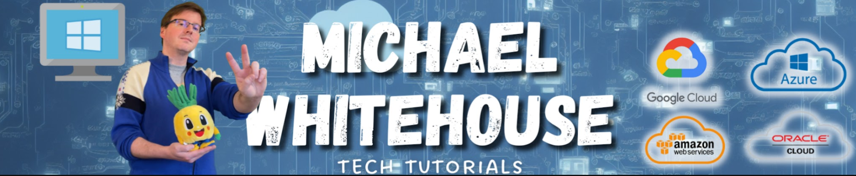
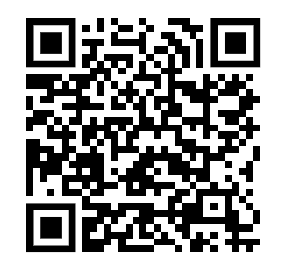
Hello! Instructor introduction
Instructor: Michael Whitehouse
mike@michaelwhitehouse.com
Github.com/kramit (useful for notes from the courses)

Slide 3

Hello! Student introductions
Let’s get acquainted:
Your name
Company affiliation
Title/function
Microsoft 365 experience
Your expectations for the course

Slide 4
Course agenda
Learning Path 1
Explore security metrics in Microsoft 365 Defender
Learning Path 2
Manage your security services in Microsoft Defender for Office 365
Examine threat vectors and data breaches
Examine Exchange Online Protection
Explore the Zero Trust security model
Examine Microsoft Defender for Office 365
Explore security solutions in Microsoft 365 Defender
Manage Safe Attachments
Examine Microsoft Secure Score
Lab 2-Exercise 1 – Implement a Safe Attachments policy
Examine Privileged Identity Management
Manage Safe Links
Examine Azure Identity Protection
Lab 2-Exercise 2 – Implement a Safe Links policy
Lab 1-Exercise 1 – Initialize your Microsoft 365 Tenant
Lab 1-Exercise 2 – PIM Resource Workflows

Slide 5
Course agenda (continued)
Learning Path 3
Implement threat protection by using Microsoft 365 Defender
Learning Path 4
Explore data governance and compliance in Microsoft 365
Explore threat intelligence in Microsoft 365 Defender
Examine governance and compliance solutions in Microsoft Purview
Lab 3-Exercises 1 through 4 – Implement Threat Intelligence
Explore archiving and records management in Microsoft 365
Implement app protection by using Microsoft Defender for Cloud Apps
Explore retention in Microsoft 365
Implement endpoint protection by using Microsoft Defender for Endpoint
Explore Microsoft Purview Message Encryption
Implement threat protection by using Microsoft Defender for Office 365
Lab 4-Exercises 1 and 2 – Implement Message Encryption
Lab 3-Exercises 5 and 6– Implement Threat Intelligence

Slide 6
Course agenda (continued)
Learning Path 5
Implement compliance in Microsoft 365
Learning Path 6
Manage compliance in Microsoft 365
Explore compliance in Microsoft 365
Implement data classification of sensitive information
Implement Microsoft Purview insider risk management
Explore sensitivity labels
Create information barriers in Microsoft 365
Implement sensitivity labels
Explore Data Loss Prevention in Microsoft 365
Lab 6 -Exercises 1 – Implement sensitivity labels
Implement data loss prevention policies
Lab 5-Exercises 1 and 2 – Implement Data Governance

Slide 7
Course agenda (continued) agenda
Learning Path 7
Manage content search and investigations in Microsoft 365
Learning Path 8
Prepare for device management in Microsoft 365
Search for content in the Microsoft Purview compliance portal
Explore device management using Microsoft Endpoint Manager
Lab 7-Exercise 1 – Conduct a data search
Prepare your Windows devices for Co-management
Manage Microsoft Purview Audit (Standard)
Plan for mobile application management
Manage Microsoft Purview Audit (Premium)
Manage Microsoft Purview eDiscovery (Standard)
Manage Microsoft Purview eDiscovery (Premium)
Lab 7-Exercise 2 – Investigate Your Microsoft 365 Data

Slide 8
Course agenda (continued)
Learning Path 9
Plan your deployment strategy for Windows devices
Learning Path 10
Implement Mobile Device Management in Microsoft 365
Examine Windows client deployment scenarios
Explore Mobile Device Management
Explore Windows Autopilot deployment models
Deploy Mobile Device Management
Plan your Windows client subscription activation strategy
Lab 9- Exercise 1 through 3 - Manage Devices with Intune
Enroll devices to Mobile Device Management
Lab 9- Exercise 4 - Enroll a Windows Device
Manage device compliance
Implement endpoint security in Microsoft Intune
Lab 9- Exercise 5 - Manage and Monitor a Device in Intune

Slide 9

Preparing for the labs
Your lab activities will be centered around a fictitious company named Adatum Corporation
In the lab exercises, you’ll take on the role of Holly Dickson, Adatum’s Enterprise Administrator
You’ll work in a virtual machine environment to complete the labs. The virtual machines used for this course are hosted by an authorized lab hosting provider
The detailed lab instructions will be included in your lab environment rather than in the student manual

Slide 10

WARNING – You may experience UI lab discrepancies
Given the dynamic nature of Microsoft cloud tools, you may experience Microsoft 365 user interface (UI) changes that were made following courseware development that don’t match up with lab instructions
While Microsoft World-Wide Learning (WWL) will make every attempt to keep lab instructions current with the latest UI changes, you may run into Microsoft 365 changes that occur before WWL becomes aware of them
If this occurs, you’ll have to adapt to the UI changes and work through them in the labs, as necessary

Slide 11

Post-course access to the labs
Once you’ve completed this course, you can continue to access its labs within GitHub for personal self-study
The GitHub link can be found on the Course Introduction page of your student manual

Slide 12
WARNING – Do NOT perform Interactive Demonstrations in class
Selected topics in the student manual include links to interactive demonstrations.
These are click-thru simulations designed for both classroom students, such as yourselves, and self-paced learners.
Self-paced learners do not have access to the labs that you perform in class. These simulations provide alternative, hands-on exercises they can perform in lieu of the labs.
Classroom students should NOT perform these simulations in class.
The simulations perform the same steps as their corresponding lab exercises.
However, not every lab exercise has a simulation. There are only a select number of simulations scattered throughout the course.
Therefore, skip the simulations and complete the labs instead during class.
After completing this class, you can perform the interactive demonstrations in preparation for the certification exam, should you decide to take it. The simulations will provide an additional form of review.

Slide 13
Closing Slide

