Slide 1
Learning Path 4: Explore data governance and compliance in Microsoft 365

Slide 2
Learning Path agenda
Examine governance and compliance solutions in Microsoft Purview
Explore archiving and records management in Microsoft 365
Explore retention in Microsoft 365
Lab 4-Exercises 1-2 - Implement Data Governance
Explore Microsoft Purview Message Encryption
Lab 4-Exercise 3 - Implement Message Encryption
Learning Path Review

Slide 3
Module 1: Examine governance and compliance solutions in Microsoft Purview

Slide 4
Introduction
Microsoft Purview provides a comprehensive set of solutions that help organizations govern, protect, and manage their entire data estate
This module examines the following Microsoft Purview features:
Data governance and compliance
Microsoft Purview Information Protection
Microsoft Purview Data Lifecycle Management
Microsoft Purview Insider Risk Management
Microsoft Purview eDiscovery solutions

Slide 5
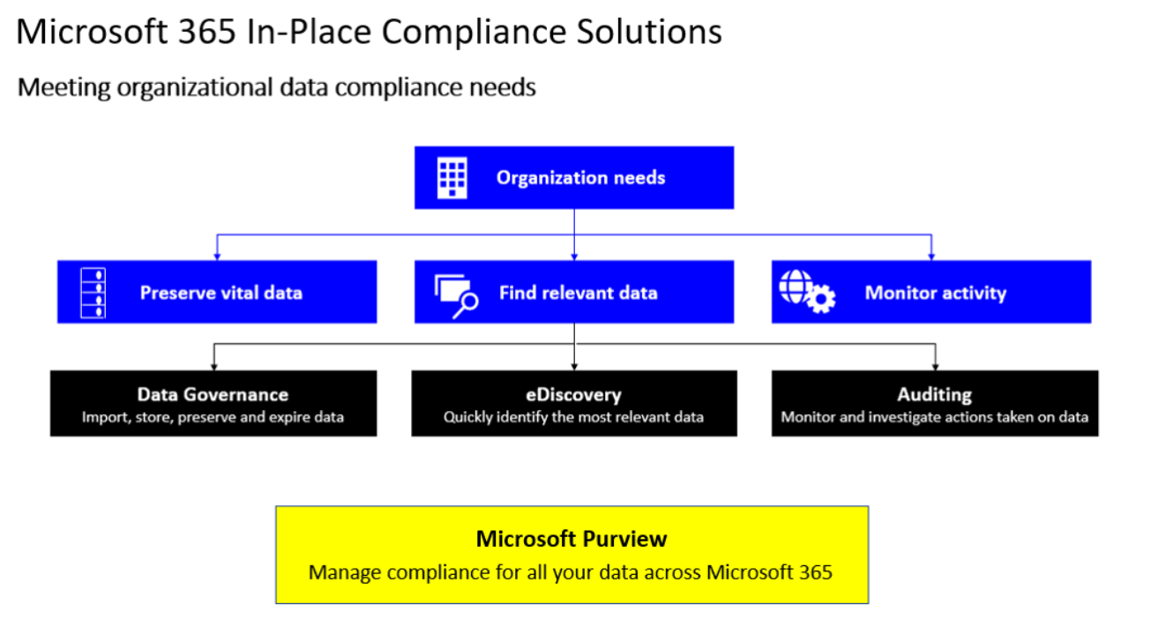
Explore data governance and compliance in Microsoft Purview
The amount of data that organizations around the world are required to manage and care for is staggering
On average, companies are experiencing a 50% year-over-year growth of electronic data
Managing such a large volume of data can be challenging, especially in today’s information age when the data includes email, documents, video files, instant messaging, and so on
Microsoft Purview provides state-of-the-art compliance solutions to meet organizational data compliance needs

Slide 6
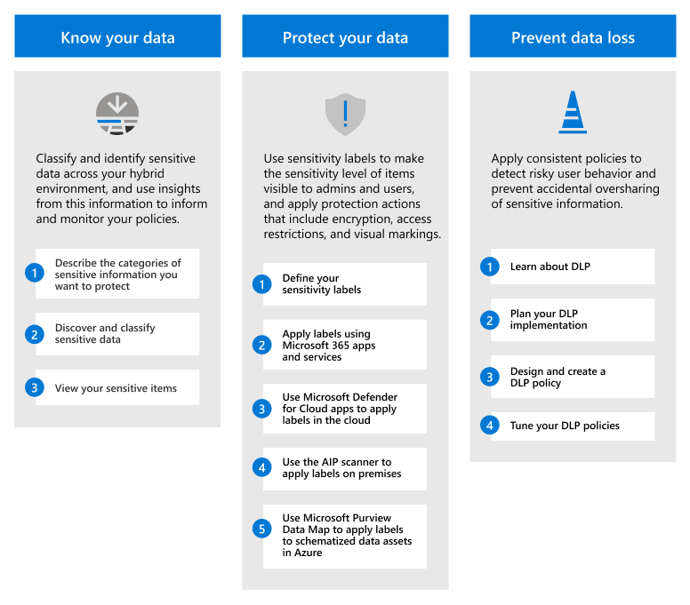
Protect sensitive data with Microsoft Purview Information Protection
Organizations can implement capabilities from Microsoft Purview Information Protection to help discover, classify, and protect sensitive information wherever it lives or travels
Steps that organizations must take when implementing Microsoft Purview Information Protection include:
Know your data
Protect your data
Prevent data loss

Slide 7
Govern organizational data using Microsoft Purview Data Lifecycle Management
Microsoft Purview Data Lifecycle Management provides organizations with tools and capabilities to retain the content they need to keep, and delete the content they don't
Retention policies are the cornerstone for data lifecycle management
These policies should be used for Microsoft 365 workloads that include Exchange, SharePoint, OneDrive, Teams, and Yammer
When an organization configures a retention policy, it can target one of the following instances:
All instances in the organization
Individual instances
Notes:
Other data lifecycle management capabilities to help organizations keep what they need and delete what they don't include:
Mailbox archiving. Provides users with extra mailbox storage space. Also provides auto-expanding archiving for mailboxes that need more than 100 GB of storage. A default archiving policy automatically moves email to the archive mailbox. If necessary, you can customize this policy.
Inactive mailboxes. They retain mailbox content after employees leave the organization.
Import service for PST files. To do so, use network upload or drive shipping.

Slide 8
Minimize internal risks with Microsoft Purview Insider Risk Management
Microsoft Purview Insider Risk Management is a compliance solution that helps minimize internal risks
It does so by enabling organizations to detect, investigate, and act on malicious and inadvertent activities
Managing and minimizing risk in an organization starts with understanding the types of risks found in the modern workplace
Some risks are driven by internal events and user activities that can be minimized and avoided
Insider risk management uses the full breadth of service and third-party indicators to help organizations quickly identify, triage, and act on risk activity
Insider risk management is centered around the following principles:
Transparency
Configurable
Integrated
Actionable
Notes:
Modern risk pain points
Managing and minimizing risk in your organization starts with understanding the types of risks found in the modern workplace. Some risks are driven by external events and factors that are outside of direct control. Other risks are driven by internal events and user activities that can be minimized and avoided. Some examples are risks from illegal, inappropriate, unauthorized, or unethical behavior and actions by users in your organization. These behaviors include a broad range of internal risks from users:
Leaks of sensitive data and data spillage
Confidentiality violations
Intellectual property (IP) theft
Fraud
Insider trading
Regulatory compliance violations
Identify potential risks with analytics
Insider risk analytics enables organizations to conduct an evaluation of potential insider risks without configuring any insider risk policies. This evaluation can help an organization identify potential areas of higher user risk. It can also help determine the type and scope of insider risk management policies it may consider configuring. This evaluation may also help an organization determine needs for extra licensing or future optimization of existing insider risk policies.
Get started with recommended actions (preview)
Whether an organization is setting up insider risk management for the first time or getting started with creating new policies, the new recommended actions experience can help it get the most out of insider risk management capabilities.
Workflow
Policies
Alerts
Triage
Investigate
Action
Scenarios
Data theft by departing users
Intentional or unintentional leak of sensitive or confidential information
Intentional or unintentional security policy violations (preview)
Policies for users based on position, access level, or risk history (preview)
Actions and behaviors by disgruntled users (preview)

Slide 9
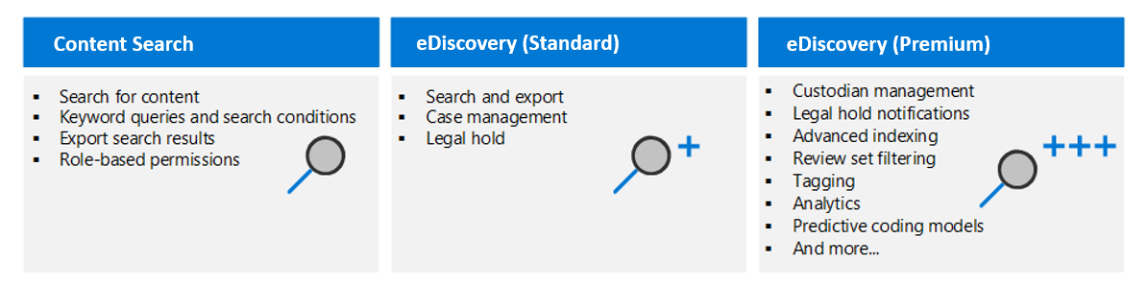
Explore Microsoft Purview eDiscovery solutions
Microsoft Purview provides three eDiscovery solutions:
Content search
eDiscovery (Standard)
eDiscovery (Premium)
Notes:
Electronic discovery, or eDiscovery, is the process of identifying and delivering electronic information that can be used as evidence in legal cases. You can use eDiscovery tools in Microsoft Purview to search for content in Exchange Online, OneDrive for Business, SharePoint Online, Microsoft Teams, Microsoft 365 Groups, and Yammer teams. In fact, you can:
Search mailboxes and sites in the same eDiscovery search, and then export the search results.
Use Microsoft Purview eDiscovery (Standard) cases to identify, hold, and export content found in mailboxes and sites.
Manage custodians and analyze content by using the feature-rich Microsoft Purview eDiscovery (Premium) solution. To do so, an organization must have an Office 365 E5 or Microsoft 365 E5 subscription (or related E5 add-on subscriptions).
eDiscovery solutions in Microsoft Purview
Content search. The Content search tool searches for content across Microsoft 365 data sources. It then exports the search results to a local computer.
eDiscovery (Standard). eDiscovery (Standard) builds on the basic search and export functionality of Content search. It enables you to create eDiscovery cases and assign eDiscovery managers to specific cases. eDiscovery managers can only access the cases of which they're members. eDiscovery (Standard) also lets you associate searches and exports with a case. It then lets you place an eDiscovery hold on content locations relevant to the case.
eDiscovery (Premium). The eDiscovery (Premium) tool builds on the existing case management, preservation, search, and export capabilities in eDiscovery (Standard). eDiscovery (Premium) provides an end-to-end workflow to identify, preserve, collect, review, analyze, and export content that's responsive to an organization's internal and external investigations. It lets legal teams manage custodians and the legal hold notification workflow to communicate with custodians involved in a case. It allows you to collect and copy data from the live service into review sets. From there, you can filter, search, and tag content to remove non-relevant content from further review. By doing so, your workflow can identify and focus on content that's most relevant. eDiscovery (Premium) provides analytics and machine learning-based predictive coding models to further narrow to scope of your investigation to the most relevant content.

Slide 10

Knowledge Check
Test your knowledge of this module by reviewing the Knowledge Check questions in your student manual

Slide 11
Summary
This module examined the following items related to archiving in Microsoft Purview:
Explore data governance and compliance
Microsoft Purview Information Protection
Microsoft Purview Data Lifecycle Management
Microsoft Purview Insider Risk Management
Microsoft Purview eDiscovery solutions

Slide 12
Module 2: Explore archiving and records management in Microsoft 365

Slide 13
Introduction
Microsoft 365 supports data governance by providing tools to import, store, preserve, retire, and expire data as it leaves an organization's data retention window
This module examines:
Archive mailboxes in Microsoft 365
Records management in Microsoft 365
Restore deleted data in Exchange and SharePoint

Slide 14
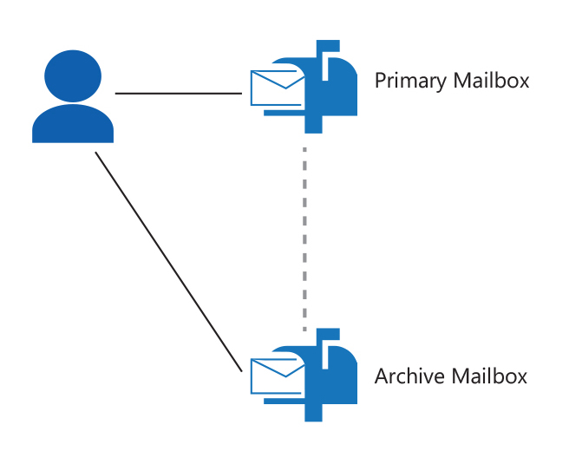
Explore archive mailboxes in Microsoft 365
When an administrator enables the user’s mailbox for archiving, another mailbox is created and displayed in the user’s Outlook and Outlook on the web.
Mail from the primary mailbox can then be moved to the archive mailbox
The archive mailbox is not cached on the client computer
To protect from accidental or malicious deletion and to facilitate discovery efforts, Exchange uses the Recoverable Items folder
The Recoverable Items folder replaces the feature that was known as the dumpster in earlier versions of Exchange
While the primary mailbox and the archive mailbox are separate mailboxes, they are both connected to a single user

Slide 15
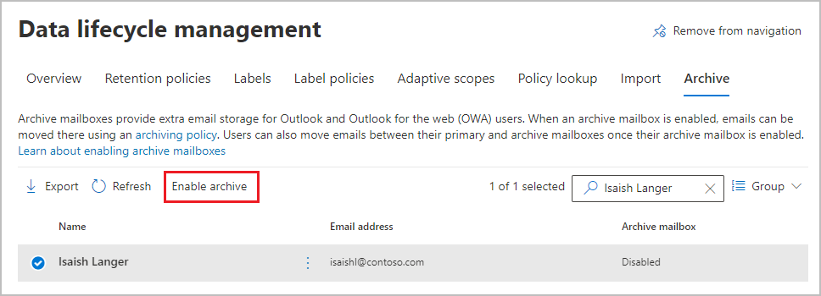
Enable archive mailboxes in Microsoft 365
Archiving in Microsoft 365 provides users with more mailbox storage space
Archive mailboxes can be enabled and disabled using either the Microsoft Purview portal or Windows PowerShell
Administrators can quickly diagnose and resolve issues in Exchange Online and Outlook by using the Microsoft 365 admin center to run diagnostics on archive mailboxes
Notes:
Enable an archive mailbox
Complete the following steps to enable an archive mailbox in the Microsoft Purview compliance portal:
Go to Microsoft Purview compliance portal and sign in.
In the Microsoft Purview compliance portal, select Data lifecycle management in the navigation pane.
On the Data lifecycle management page, the Overview tab is displayed by default. Select the Archive tab.
On the Archive tab, the Archive mailbox column identifies whether an archive mailbox is enabled or disabled for each user.
In the list of mailboxes, select the user whose mailbox you want to archive. Then select the Enable archive option on the menu bar.

Slide 16
Explore records management in Microsoft 365
The records management solution in Microsoft 365 enables organizations to manage their high-value content for legal, business, or regulatory obligations
An organization must complete the following steps to implement the Microsoft 365 records management solution:
Identify whether it must use retention policies to supplement retention labels that manage documents and emails at the item level
If necessary, create retention policies for baseline governance of data across Microsoft 365 workloads
Learn how retention labels can be used to allow or block actions when documents and emails are declared records
Create a file plan for retention and deletion settings and actions
Determine when items should be marked as records by importing an existing plan (if you already have one), or create new retention labels
Publish and apply the retention labels
Notes:
The records management solution in Microsoft 365 enables organizations to manage their high-value content for legal, business, or regulatory obligations. Organizations that plan to implement the Microsoft 365 records management solution should complete the following steps to get started:
Understand how retention and deletion works in Microsoft 365. Then identify whether you must use retention policies to supplement retention labels that manage documents and emails at the item level. If necessary, create retention policies for baseline governance of data across Microsoft 365 workloads.
Understand the records management solution. Learn how retention labels can be used to allow or block actions when documents and emails are declared records.
Create your file plan for retention and deletion settings and actions. Determine when items should be marked as records by importing an existing plan (if you already have one), or create new retention labels. For more information, see Use file plan to create and manage retention labels.
Publish and apply your retention labels. Retention labels are reusable building blocks that can be used in multiple policies and can be incorporated into user workflows:
Publish retention labels and apply them in apps.
Apply a retention label to content automatically.

Slide 17
Implement records management in Microsoft 365
An organization can use the following capabilities to support its records management solution for Microsoft 365 services and apps:
Create and configure retention labels to mark content as a record
Migrate and manage its retention requirements with a file plan
Configure retention and deletion settings with retention labels
Start different retention periods when an event occurs with event-based retention
Review and validate disposition with disposition reviews and proof of records deletion
Export information about all disposed items with the export option
Set specific permissions for records manager functions in your organization to have the right access
When content is declared a record:
Restrictions are placed on the items in terms of what actions are allowed or blocked
Other activities about the item are logged
Proof of disposition exists when the items are deleted at the end of their retention period
Notes:
Organizations of all types require a records management solution to manage regulatory, legal, and business-critical records across their corporate data. Records management for Microsoft Purview:
Helps an organization manage their legal obligations.
Demonstrates compliance with regulations.
Increases efficiency with regular disposition of items that are:
no longer required to be retained.
no longer of value.
no longer required for business purposes.
What's a record?
When content is declared a record:
Restrictions are placed on the items in terms of what actions are allowed or blocked.
Other activities about the item are logged.
You have proof of disposition when the items are deleted at the end of their retention period.

Slide 18
Restore deleted data in Exchange Online
Restoring deleted email messages is a two-step process:
Recover the deleted data into a target (discovery) mailbox
Use either the Exchange admin center (EAC) or Exchange Online PowerShell to recover the deleted data
Restore the recovered data
Use Exchange Online PowerShell to restore the recovered data
You can't use the EAC to restore recovered data
Soft deletion
A user deletes a mailbox item, the item is moved to the Recoverable Items folder, and into a subfolder named Deletions
An Exchange Online mailbox keeps deleted items for 14 days by default
An administrator can change this period to a max of 30 days
Hard deletion
A user purges a deleted item by using the Recover Deleted Items feature in Outlook or Outlook on the web
An administrator can recover hard-deleted items before the deleted item retention period expires
Notes:
Recover deleted email messages
Administrators can search for and recover deleted email messages in a user's mailbox. This process includes items that are:
Permanently deleted (purged) by a person. These items are recovered by using the Recover Deleted Items feature in Outlook or Outlook on the web.
Deleted by an automated process. An example of an automated process is a retention policy assigned to user mailboxes. In this case situation, the purged items can't be recovered by a user. However, administrators can recover purged messages if the deleted item retention period for the item hasn't expired.
To search for and recover items, you must have the following information:
Source mailbox. The source mailbox is the mailbox being searched.
Target mailbox. This target mailbox is the discovery mailbox in which messages will be recovered. Exchange Setup creates a default discovery mailbox. In Exchange Online, a discovery mailbox is also created by default. If necessary, you can create other discovery mailboxes. For more information, see Create a discovery mailbox.
Search criteria. Criteria can include the sender, recipient, or keywords (words or phrases) in the message.

Slide 19
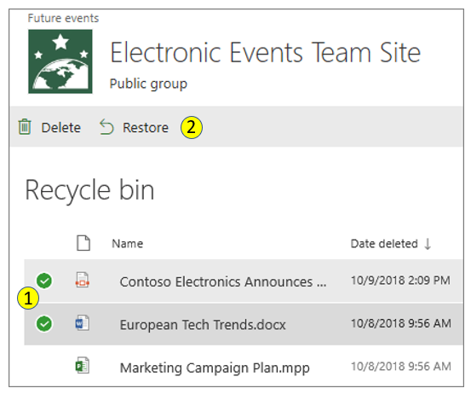
Restore deleted data in SharePoint Online
SharePoint Online uses two recycle bins:
Site recycle bin
Deleted items go into the Site recycle bin for 93 days or until they're emptied from the Site recycle bin
Site Collection recycle bin
When items are deleted from a Site recycle bin, they're sent to the Site Collection recycle bin
The items then stay in the Site Collection recycle bin for the remainder of the 93 days
A SharePoint site collection administrator can view and restore deleted items from the Site Collection recycle bin to their original locations
Notes:
SharePoint Online uses two recycle bins:
Site recycle bin. In SharePoint Online, items are retained for 93 days from the time you delete them from their original location. They stay in the Site recycle bin the entire time, unless someone deletes them from there or empties that recycle bin.
Site Collection recycle bin. If an item is deleted from the Site recycle bin or someone empties that bin, the items go to the Site Collection recycle bin. The items then stay in the Site Collection recycle bin for the remainder of the 93 days.
Note: The recycle bin retention time isn't configurable in SharePoint Online.
When you delete a site collection, you're also deleting the hierarchy of sites in the collection, and all content within them. This content can include:
Documents and document libraries.
Lists and list data.
Site configuration settings.
Role and security information that's related to the site or its subsites.
Subsites of the top-level website, their contents, and user information.
Restore deleted items from the Site recycle bin
When you delete items from a document library or list in Microsoft Teams or SharePoint Online, they aren't immediately removed. Deleted items go into the Site recycle bin for a period of time or until they're emptied from the recycle bin. The Site recycle bin isn't the same as the Windows recycle bin that you see on your desktop.
While deleted items are in the Site recycle bin, you can restore them to their original location. If you're using SharePoint Online in Microsoft 365, you can even view and restore items that were deleted by someone else, as long as you have edit permissions.
Restore deleted items from the Site Collection recycle bin
When you delete items (including OneDrive files) from a SharePoint site, they're sent to the Site recycle bin (also called the first-stage recycle bin). From this Site recycle bin, you can restore them if needed. When you delete items from a Site recycle bin, they're sent to the Site Collection recycle bin (also called the second-stage recycle bin).
A SharePoint site collection administrator can view and restore deleted items from the Site Collection recycle bin to their original locations. An item will be permanently deleted in either of the following scenarios:
The item is deleted from the Site Collection recycle bin.
The item exceeds the retention time in the Site Collection recycle bin.
Keep in mind the following considerations when restoring items from the Site Collection recycle bin:
Securable objects bring all their content back with them.
Most objects can’t be restored if their container objects aren’t present.
Exception: An object deleted from a folder can be restored without first restoring the folder.

Slide 20
Knowledge Check
Test your knowledge of this module by reviewing the Knowledge Check questions in your student manual

Slide 21
Summary
This module examined the following items related to archiving in Microsoft 365:
Archive mailboxes in Microsoft 365
Records management in Microsoft 365
Restore deleted data in Exchange and SharePoint

Slide 22
Module 3: Explore retention in Microsoft 365

Slide 23
Introduction
Organizations should establish policies to control the life cycle of all messaging data and SharePoint content that’s saved across their different Microsoft 365 locations
This module examines the following features related to data preservation in Microsoft 365:
Retention policies and retention labels
Principles of retention
How organizations use Preservation Lock to restrict users

Slide 24
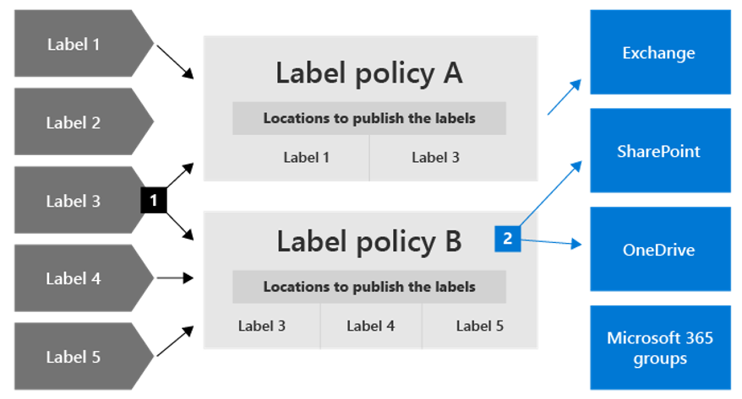
Explore retention by using retention policies and retention labels
Organizations can configure retention settings for the following outcomes:
Retain-only
Delete-only
Retain and then delete
Retention policies apply retention settings to locations, such as:
Exchange email SharePoint site
Exchange public folders OneDrive accounts
Microsoft 365 groups Teams chats
Yammer messages Teams messages
A single retention label can be included in multiple retention label policies
Retention label policies specify the locations to publish the retention labels The same location can be included in multiple retention label policies
Retention labels apply retention settings at the item level (document or email)
Notes:
How retention settings work with content in place
Organizations use retention policies to implement retention settings. Retention policies enable organizations to proactively decide whether to retain content, delete content, or retain and then delete the content. A retention policy enables organizations to efficiently manage their data. It does so by assigning the same retention settings at the container level to be automatically inherited by content in that container.
When content has retention settings assigned to it, users can continue to edit and work with the content as if nothing’s changed.
For SharePoint and OneDrive sites, a copy of the original content is kept in the Preservation Hold library when users edit or delete it.
For Exchange mailboxes, the copy is retained in the Recoverable Items folder.
For Teams and Yammer messages, the copy is retained in a hidden folder named SubstrateHolds. This folder is a subfolder in the Exchange Recoverable Items folder.
Retention policies and retention labels
An organization can assign its retention settings to content by using retention policies and retention labels with label policies. Just one of these methods can be used, or they can be combined together.
A retention policy can assign the same retention settings for content at a site or mailbox level. It can also use a retention label to assign retention settings at an item level, such as a folder, document, or email.
Unlike retention policies, retention settings from retention labels travel with the content if it's moved to a different location within a company's Microsoft 365 tenant.
Classifying content without applying any actions
Although the main purpose of retention labels is to retain or delete content, you can also use retention labels without turning on any retention or other actions. In this case, you can use a retention label simply as a text label, without enforcing any actions.
Using a retention label as a condition in a DLP policy
You can specify a retention label as a condition in a Microsoft Purview Data Loss Prevention (DLP) policy for documents in SharePoint. For example, you can configure a DLP policy to prevent documents from being shared outside the organization if they have a specified retention label applied to it.
Retention labels and policies that apply them
When you publish retention labels, they're included in a retention label policy. By doing so, the labels become available for admins and users to apply to content:
A single retention label can be included in multiple retention label policies.
Retention label policies specify the locations to publish the retention labels. The same location can be included in multiple retention label policies.
You can also create one or more auto-apply retention label policies, each with a single retention label. With this policy, a retention label is automatically applied when conditions that you specify in the policy are met.
Only one retention label at a time
An email or document can only have a single retention label applied to it at a time.

Slide 25
Compare capabilities in retention policies and retention labels
Capability | Retention policy | Retention label
Retention settings that can retain and then delete, retain-only, or delete-only | Yes | Yes
Workloads supported: - Exchange - SharePoint - OneDrive - Microsoft 365 groups - Skype for Business - Teams - Yammer | Yes Yes Yes Yes Yes Yes Yes | Yes, except public folders Yes Yes Yes No No No
Retention applied automatically | Yes | Yes
Automatically apply different retention settings at the end of the retention period | No | Yes
Retention applied based on conditions: - sensitive info types - KQL queries and keywords - trainable classifiers - cloud attachments | No | Yes

Slide 26
Compare capabilities in retention policies and retention labels (Continued)
Capability | Retention policy | Retention label
Retention applied manually | No | Yes
End-user interaction | No | Yes
Persists if the content is moved | No | Yes, within your Microsoft 365 tenant
Declare item as a record | No | Yes
Start the retention period when labeled or based on an event | No | Yes
Disposition review | No | Yes
Proof of disposition for up seven years | No | Yes, when you use disposition review or item is marked a record
Audit admin activities | Yes | Yes
Audit retention actions | No | Yes
Identify items subject to retention: - Content Search - Data classification page, content explorer, activity explorer | No No | Yes Yes
Notes:
Combining retention policies and retention labels
Organizations don't have to choose between only using retention policies or only using retention labels. Both methods can be used together. In fact, when they're used together, they complement each other for a more comprehensive solution.

Slide 27
Define the scope of a retention policy
When an organization creates a retention policy or retention label policy, it must define the scope of the policy as either Adaptive or Static
Adaptive scope
An adaptive scope uses a query that a user specifies; as such, the membership is dynamic rather than static
It's dynamic is because it runs daily against the attributes or properties the user specified for the selected locations
Multiple adaptive scopes can be used with a single policy
Static scope
A static scope doesn't use queries
It's limited in configuration in that it can apply to all instances for a specified location, or it can use inclusion and exclusions for specific instances for that location
These three choices are sometimes referred to as org-wide, includes, and excludes, respectively
Notes:
Advantages of using adaptive scopes
Retention policies and retention label policies enjoy the following advantages when using adaptive scopes:
No limits on the number of items per policy.
More powerful targeting for your retention requirements.
Query-based membership provides resilience against business changes that may not be reliably reflected in group membership.
A single retention policy can include locations for both Microsoft Teams and Yammer.
You can only apply specific retention settings to inactive mailboxes.
Advantages of using static scopes
Retention policies and retention label policies enjoy the following advantages when using adaptive scopes:
Simpler configuration if you want all instances automatically selected for a workload.
Adaptive scopes aren't supported by Skype for Business public folder locations and Exchange public folder locations. For these locations, you must use a static scope.

Slide 28
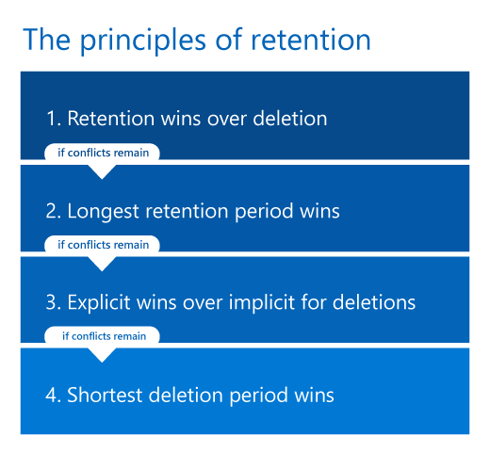
Examine the principles of retention
Principles of retention
Two simple rules always decide how long an item will be retained:
Retention always takes precedence over permanent deletion
The longest retention period wins
The following rule determines when an item will be permanently deleted:
The delete action from a retention label always takes precedence over the delete action from a retention policy
Notes:
Unlike retention labels, an organization can apply more than one retention policy to the same item. Each retention policy can result in a retain action and a delete action. And even though an item may have a retention policy applied to it, the item could also be subject to these actions from a retention label.
So what happens when an item is subject to multiple retention settings that could conflict with one another? What takes precedence to determine the outcome?
The outcome isn't which single retention policy or single retention label wins, but how long an item is retained (if applicable) and when an item is deleted (if applicable). From all the retention settings that are applied to an item, these two actions are calculated independently from each other.

Slide 29
Implement retention using retention policies, retention labels, and eDiscovery holds
Retention settings and holds that you create with an eDiscovery case can both prevent data from being permanently deleted
Retention settings
The settings that are specified in retention policies and retention labels are designed for a long-term data lifecycle management strategy
The purpose of these settings is to retain or delete data for compliance requirements
Holds for eDiscovery
eDiscovery holds can be created for eDiscovery (Standard) and eDiscovery (Premium) cases
In both instances, they're designed for a limited duration to preserve data for a legal investigation
Notes:
Use retention policies and retention labels instead of older features
For organizations that must proactively retain or delete content in Microsoft 365 for data lifecycle management, it's recommended they use retention policies and retention labels instead of the following older features.
Older features from Exchange Online:
Retention tags and retention policies, also known as messaging records management (MRM) (deletion only).
Litigation holds (retention only). Although Litigation holds are still supported, it's recommended that organizations use Microsoft 365 retention or eDiscovery holds, as appropriate.
Older features from SharePoint and OneDrive:
Document deletion policies (deletion only)
Configuring in place records management (retention only)
Use policies for site closure and deletion (deletion only)
Information management policies (deletion only)

Slide 30
Restrict retention changes by using preservation lock
Preservation Lock can be applied after a retention policy or retention label policy is created
It locks a retention policy or retention label policy so that no one, including global administrators, can turn off the policy, delete the policy, or make it less restrictive
When a retention policy is locked:
No one can disable the policy or delete it
Locations can be added but not removed
The retention period can be extended but not decreased
When a retention label policy is locked:
No one can disable the policy or delete it
Locations can be added but not removed
Labels can be added but not removed

Slide 31
Knowledge Check
Test your knowledge of this module by reviewing the Knowledge Check questions in your student manual

Slide 32
Summary
This module examined the following data retention features in Microsoft 365:
Retention policies and retention labels
Principles of retention
How organizations use Preservation Lock to restrict users

Slide 33
Lab 4 – Implement Data Governance

Slide 34
Lab exercises
Exercise 1 – Initialize Compliance
Task 1
Create a security group for compliance testing
Task 2
Configure Mobile Device Management for compliance testing
Exercise 2 – Configure In-Place Archiving and Retention Policies
Task 1
Activate In-Place Archiving for a new user’s mailbox
Task 2
Create an email retention policy for test users
Task 3
Create an email retention policy for all users

Slide 35
Module 4: Explore Microsoft Purview Message Encryption

Slide 36
Introduction
Microsoft Purview Message Encryption is an online service that's built on Microsoft Azure Rights Management (Azure RMS)
This module examines:
Microsoft Purview Message Encryption
Mail flow rules to encrypt email messages
Organizational branding on encrypted email messages
Microsoft Purview Advanced Message Encryption

Slide 37
Examine Microsoft Purview Message Encryption
Microsoft Purview Message Encryption includes encryption, identity, and authorization policies to help organizations secure their email. Messages can be encrypted by using:
Rights Management templates. These default templates make it easy for organizations to immediately start protecting their sensitive data
Do Not Forward option. When this option is applied to an email, the email is encrypted and recipients must be authenticated. Encrypted emails can’t be forwarded, printed, or copied from
Encrypt-only option. This option enables organizations to encrypt data without other restrictions. The recipients have all usage rights except Save As, Export and Full Control
Notes:
Users can encrypt email messages and various attachments by using these options. Administrators can define mail flow rules to apply this protection. For example, an administrator can create mail flow rules that:
Require the encryption of all messages addressed to a specific recipient.
Contain specific words in the subject line.
Restrict recipients from copying or printing the contents of the message.
All Microsoft 365 end users that use Outlook clients to read mail will receive native, first-class reading experiences for encrypted and rights-protected mail. And they do so even if they aren't in the same organization as the sender. Supported Outlook clients include:
Outlook desktop
Outlook Mac
Outlook mobile on iOS and Android
Outlook on the web (formerly known as Outlook Web App)
Recipients of encrypted messages who receive encrypted or rights-protected mail sent to their Outlook.com, Gmail, and Yahoo accounts receive a wrapper mail that directs them to the message encryption portal where they can easily authenticate using a Microsoft account, Gmail, or Yahoo credentials.
Sending, viewing, and replying to encrypted email messages
With Microsoft Purview Message Encryption, users can send encrypted email from Outlook and Outlook on the web clients. Additionally, admins can set up mail flow rules in Microsoft 365 to automatically encrypt emails based on keyword matching or other conditions.

Slide 38
Configure Microsoft Purview Message Encryption
Verify that Azure Rights Management is active
Microsoft Purview Message Encryption applies the protection features in Azure Rights Management Services (Azure RMS)
Azure RMS is also activated automatically for most eligible plans
Manually activating Azure Rights Management
If you disabled Azure RMS, or if it wasn't automatically activated for any reason, you can manually activate it in either of the following portals:
Microsoft 365 admin center
Azure portal
Configure management of your Azure Information Protection tenant key
This step is optional. The default setting allows Microsoft to manage the root key for Azure Information Protection

Slide 39
Define mail flow rules to encrypt email messages
An administrator that manages Exchange Online can create mail flow rules (also known as transport rules) to help protect email messages that are sent and received
For example, an administrator can:
Set up rules to encrypt outgoing email messages
Remove encryption from encrypted messages coming from inside the organization
Remove encryption from replies to encrypted messages sent from inside the organization
Notes:
Note: You can't encrypt inbound mail from senders outside of your organization.
If you recently migrated from Active Directory RMS to Azure Information Protection, you must:
Set up Microsoft Purview Message Encryption. For more information, see the prior unit in this training.
Review your existing mail flow rules to ensure they continue to work in your new environment.
Update your existing mail flow rules so that you can use Microsoft Purview Message Encryption with Azure Information Protection. Otherwise, your users will continue to receive encrypted mail that uses the previous HTML attachment format instead of the new, seamless experience.
For hybrid Exchange environments, on-premises users can send and receive encrypted mail using message encryption only if email is routed through Exchange Online. To configure message encryption in a hybrid Exchange environment, you should complete the following steps:
Configure hybrid using the Hybrid Configuration wizard.
Configure mail to flow from Office 365 to your email server.
Configure mail to flow from your email server to Office 365.

Slide 40
Add organizational branding to encrypted email messages
An administrator can apply their company branding to customize the look of their organization's email messages and the encryption portal
Global administrator permissions are required to add organizational branding to encrypted email messages
A global admin can use the Get-OMEConfiguration and Set-OMEConfiguration Windows PowerShell cmdlets to customize the following parts of encrypted email messages:
Introductory text
Disclaimer text
URL for the organization's privacy statement
Text in the message encryption portal
Logo that appears in the email message and encryption portal, or whether to use a logo at all
Background color in the email message and encryption portal
Notes:
Work with Microsoft Purview Message Encryption branding templates
You can modify several features within a branding template. You can modify, but not remove, the default template. If you have Microsoft Purview Advanced Message Encryption, you can also create, modify, and remove custom templates.
To work with one branding template at a time, use the following Windows PowerShell cmdlets:
Set-OMEConfiguration. Modify the default branding template or a custom branding template that you created.
New-OMEConfiguration. Create a new branding template.
Remove-OMEConfiguration. Remove a custom branding template. You can't delete the default branding template. This cmdlet only works with Microsoft Purview Advanced Message Encryption.
Modify a Microsoft Purview Message Encryption branding template
Organizations must use Windows PowerShell to modify one branding template at a time. If you have Advanced Message Encryption, you can also create, modify, and remove custom templates. Complete the following steps to modify a branding template:
Using a work or school account that has global administrator permissions in your organization, start a Windows PowerShell session and connect to Exchange Online.
Use the Set-OMEConfiguration cmdlet. Refer to the following graphic and table for guidance on what parameters to include in this command. The parameters are based on the type of customization you want to make.

Slide 41
Explore Microsoft Purview Advanced Message Encryption
Create multiple branding templates
Revoke encrypted email
Set an expiration date for email encrypted by Microsoft Purview Advanced Message Encryption
Ensure all external recipients use the message encryption portal to read encrypted mail
Microsoft Purview Advanced Message Encryption licensing
Notes:
Advanced Message Encryption helps customers meet compliance obligations that require more flexible controls over external recipients and their access to encrypted emails. With Advanced Message Encryption in Microsoft 365, you can:
Control sensitive emails shared outside the organization with automatic policies.
Track those activities through the encrypted message portal access logs.
Configure these policies to identify sensitive information types such as customer content, Financial, or Health IDs.
Use keywords to enhance protection.
Once you've configured the policies, you pair policies with custom branded email templates. You can then add an expiration date for extra control of emails that fit the policy. Admins can further control encrypted emails accessed externally through a secure web portal. They can do so by revoking access to the mail at any time.
Note: You can only revoke and set an expiration date for emails sent to external recipients.
To use Microsoft Purview Advanced Message Encryption, an organization must have:
A subscription that includes Microsoft Purview Advanced Message Encryption.
Microsoft Purview Message Encryption already set up.

Slide 42
Explore Microsoft Purview Advanced Message Encryption
Microsoft Purview Advanced Message Encryption helps customers meet compliance obligations that require more flexible controls over external recipients and their access to encrypted emails
Advanced Message Encryption enables organizations to:
Control sensitive emails shared outside the organization with automatic policies
Track those activities through the encrypted message portal access logs
Configure these policies to identify sensitive information types such as customer content, Financial, or Health IDs
Use keywords to enhance protection
Key features in Microsoft Purview Advanced Message Encryption include:
Create multiple branding templates
Revoke encrypted email that has a custom branding template applied
Set an expiration date for encrypted email
Notes:
Advantages of using adaptive scopes
Retention policies and retention label policies enjoy the following advantages when using adaptive scopes:
No limits on the number of items per policy.
More powerful targeting for your retention requirements.
Query-based membership provides resilience against business changes that may not be reliably reflected in group membership.
A single retention policy can include locations for both Microsoft Teams and Yammer.
You can only apply specific retention settings to inactive mailboxes.
Advantages of using static scopes
Retention policies and retention label policies enjoy the following advantages when using adaptive scopes:
Simpler configuration if you want all instances automatically selected for a workload.
Adaptive scopes aren't supported by Skype for Business public folder locations and Exchange public folder locations. For these locations, you must use a static scope.

Slide 43
Knowledge Check
Test your knowledge of this module by reviewing the Knowledge Check questions in your student manual

Slide 44
Summary
In this module you examined the following items:
Microsoft Purview Message Encryption
Mail flow rules to encrypt email messages
Organizational branding on encrypted email messages
Microsoft Purview Advanced Message Encryption

Slide 45
Lab 4 – Implement Data Governance (continued)

Slide 46
Lab exercises (continued)
Exercise 3: Create message encryption rules
Task 1
Create a mail flow encryption rule using the Exchange admin center
Task 2
Create a mail flow encryption rule using Windows PowerShell

Slide 47
Module 5: Learning Path review

Slide 48
Discussion – Learning Path review
What are your key takeaways from this learning path, and why?
What are the key features discussed in this learning path that you foresee implementing at your organization?

Slide 49
Closing Slide

