Slide 1
Learning Path 6: Manage compliance in Microsoft 365

Slide 2
Learning Path agenda
Implement data classification of sensitive information
Explore sensitivity labels
Implement sensitivity labels
Lab 6-Exercise 1 – Implement sensitivity labels
Learning Path Review

Slide 3
Module 1: Implement data classification of sensitive information

Slide 4
Introduction
Data classification is a means of protecting an organization's data from unauthorized disclosure, alteration, or destruction based on how sensitive or impactful it is
This module examines:
Data classification in Microsoft 365
Trainable classifiers
Viewing sensitive data
Document fingerprinting

Slide 5
Explore data classification of sensitive information
Data classification describes the process of identifying, categorizing, and protecting content according to its sensitivity or impact level
Data is classified in an organization in many ways, including:
Sensitivity labels Sensitive information types
Retention labels Trainable classifiers
Data classification frameworks are typically comprised of three to five classification levels. Two types of examples include:
Example 1 | Example 2
Public | Restricted
Internal | Unrestricted
Confidential | Consumer Protected
Highly Confidential
To protect content, data classification frameworks define the controls that should be in place for each data classification level

Slide 6
Implement data classification in Microsoft 365
The data classification features in Microsoft 365 help an organization gain insight into what's being classified
Data classification in Microsoft 365 scans an organization's sensitive content and labeled content before the organization creates any policies
This process is called zero change management
It enables an organization to see the effect that all the retention and sensitivity labels are having in its environment
Sensitivity labels can help an organization protect its data by enforcing various protections, such as encryption and content marking
In Microsoft 365, visibility into tagged content is provided on the Data classification page in the Microsoft Purview compliance portal
This information enables administrators to discover, classify, review, and monitor their data in accordance with their data classification framework

Slide 7
Explore trainable classifiers
Microsoft 365 has three ways to classify content so it can be protected and handled:
Manually Automated pattern-matching Trainable classifiers
A trainable classifier is a tool that an organization can "train" to recognize various types of content
Classifiers can be trained by giving them samples to look at
Once a classifier is trained, the organization can use it to identify items for application of Office sensitivity labels, communications compliance policies, and retention label policies
Training a classifier involves:
Giving it anywhere from 50-500 samples that are manually picked and positively match the category
After the trainable classifier tool has processed those samples, you test the classifiers' ability to predict by giving it a mix of positive and negative samples
Retrain a classifier over its lifetime to improve performance
There are two types of trainable classifiers:
Pre-trained classifiers
Custom trainable classifiers

Slide 8
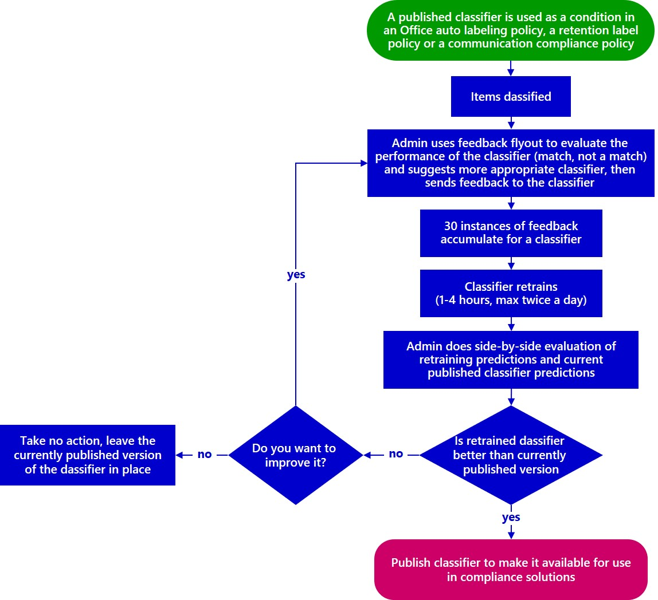
Create and retrain a trainable classifier
As an organization uses its custom trainable classifiers, it may want to increase the precision of the classifications the classifiers are making
Precision can be increased by evaluating the quality of the "match" and "not a match" classifications made by the classifier
After 30 evaluations are made for a classifier, it takes that feedback and automatically retrains itself
Pre-trained classifiers that are provided with a Microsoft 365 tenant can't be retrained
Custom trainable classifiers are retrained in the Data classification feature in the Microsoft Purview compliance portal

Slide 9
View sensitive data using Content explorer and Activity explorer
The Data classification page within the Microsoft Purview compliance portal provides data classification analytics
These capabilities are provided through the Content explorer and Activity explorer tools
There's a separate tab for each tool on the Data classification page
Content Explorer
This tab provides visibility into the amount and types of sensitive data in an organization
It also enables users to filter by label or sensitivity type
Doing so displays a detailed view of locations where the sensitive data is stored.
Activity explorer
This tab shows the activities related to sensitive data and labels
For example, label downgrades, or external sharing that could expose content to risk
Activity Explorer displays the activities that are related to sensitive information that's being used by end users

Slide 10
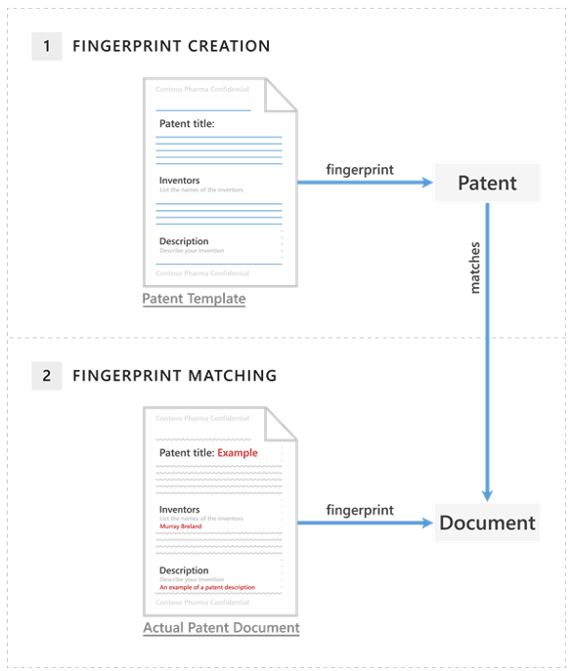
Detect sensitive information documents using Document Fingerprinting
In the same way that a person's fingerprints have unique patterns, documents have unique word patterns
When an organization uploads a file, Microsoft Purview DLP:
Identifies the unique word pattern in the document
Creates a document fingerprint based on that pattern
Uses that document fingerprint to detect outbound documents containing the same pattern
Once a document fingerprint is created, the organization can create a new data classification rule that uses the document fingerprint
The organization will then set up a DLP policy, and it will add the rule to the policy
Based on the DLP policy, the Microsoft Purview DLP service will detect any documents in outbound email that match that fingerprint

Slide 11

Knowledge Check
Test your knowledge of this module by reviewing the Knowledge Check questions in your student manual

Slide 12
Summary
In this module, you examined the following items:
Data classification in Microsoft 365
Trainable classifiers
Viewing sensitive data
Document fingerprinting

Slide 13
Module 2: Explore sensitivity labels

Slide 14
Introduction
Sensitivity labels from the Microsoft Purview Information Protection solution enable organizations to classify and protect their data, while making sure that user productivity and their ability to collaborate isn't hindered
This module examines:
Data protection using sensitivity labels
Sensitivity label scope
Sensitivity label policies

Slide 15
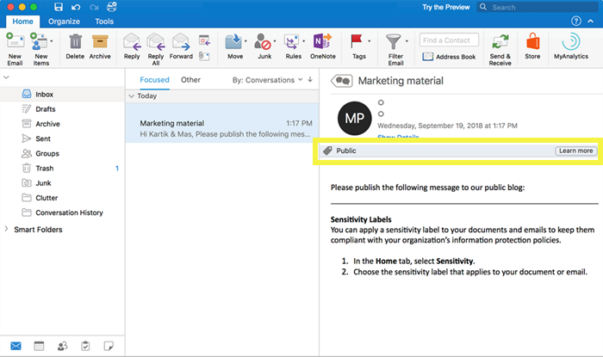
Manage data protection using sensitivity labels
Customizable
Specific to your organization and business needs, you can create categories for different levels of sensitive content in your organization
Clear text
Because a label is stored in clear text in the metadata for files and emails, third-party apps and services can read it and then apply their own protective actions, if required
Persistent
Because the label is stored in metadata for files and emails, the label roams with the content, no matter where it's saved or stored

Slide 16
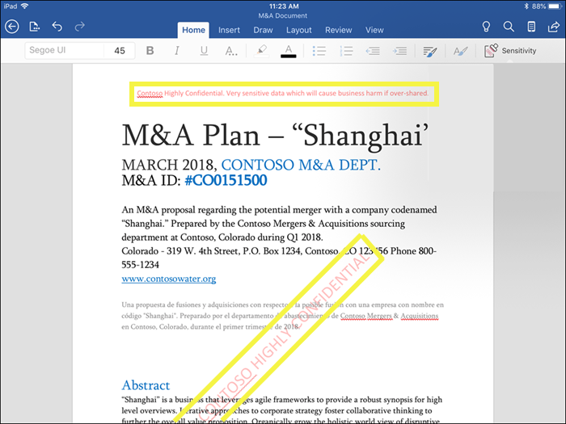
Explore what sensitivity labels can do
Encrypt emails and documents
Mark the content
Protect content in containers such as sites and groups
Apply the label automatically to files and emails, or recommend a label

Slide 17
Determine a sensitivity label's scope
Label scopes
When you create a sensitivity label, you're asked to configure the label's scope. It determines:
Which label settings you can configure for that label
Where the label will be visible to users
Label priority (order matters)
When you create your sensitivity labels in the admin center, they appear in a list on the Sensitivity tab on the Labels page. In this list, the order of the labels is important because it reflects their priority.
Your least restrictive label, such as Public, should appear at the top of the list
Your most restrictive sensitivity label, such as Highly Confidential, should appear at the bottom of the list
Sublabels (grouping labels)
With sublabels, you can group one or more labels below a parent label that a user sees in an Office app.
Sublabels are simply a way to present labels to users in logical groups. Sublabels don't inherit any settings from their parent label. When you publish a sublabel for a user, that user can then apply that sublabel to content but can't apply just the parent label.

Slide 18
Explore sensitivity label policies
Choose which users and groups see the labels.
Specify a default label for new documents, unlabeled emails, and new containers.
Require a justification for changing a label.
Require users to apply a label for documents and emails, just documents, and for containers
Provide help link to a custom help page.

Slide 19
Knowledge Check
Test your knowledge of this module by reviewing the Knowledge Check questions in your student manual

Slide 20
Summary
In this module, you examined the following items:
Data protection using sensitivity labels
Sensitivity label scope
Sensitivity label policies

Slide 21
Module 3: Implement sensitivity labels

Slide 22
Introduction
Organizations must first develop a Data Classification framework that provides the foundation upon which their sensitivity labels will later be built
This module examines:
Sensitivity label requirements
Developing a data classification framework
How to create and publish sensitivity labels
How to remove and delete sensitivity labels

Slide 23
Plan your deployment strategy for sensitivity labels
To successfully deploy sensitivity labels, an organization should create a project team that identifies and manages:
Business and technical requirements
Proof of concept testing
Internal checkpoints and approvals
Final deployment for the production environment
See the chart of common sensitivity label scenarios in the training manual
Organizations should study the documentation links for the scenarios that map to their most impactful business requirements
The most effective end-user documentation that an organization can provide will be customized guidance and instructions for the label names and configurations it chooses
Organizations can use the label policy setting “Provide users with a link to a custom help page” to specify an internal link for this documentation

Slide 24
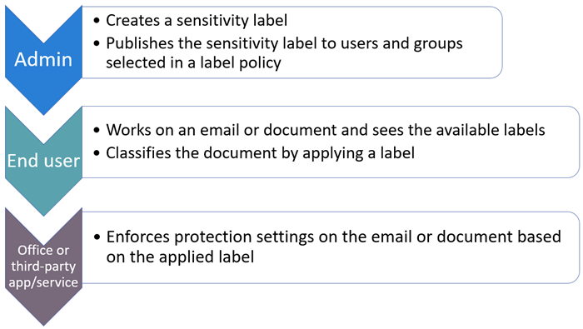
Examine the requirements to create a sensitivity label
Use sensitivity labels to protect your organization's data :
Create the labels
Define what each label can do
Publish the labels
Subscription and licensing requirements for sensitivity labels
Several different subscriptions support sensitivity labels
The licensing requirements for users depend on the features an organization uses
.

Slide 25
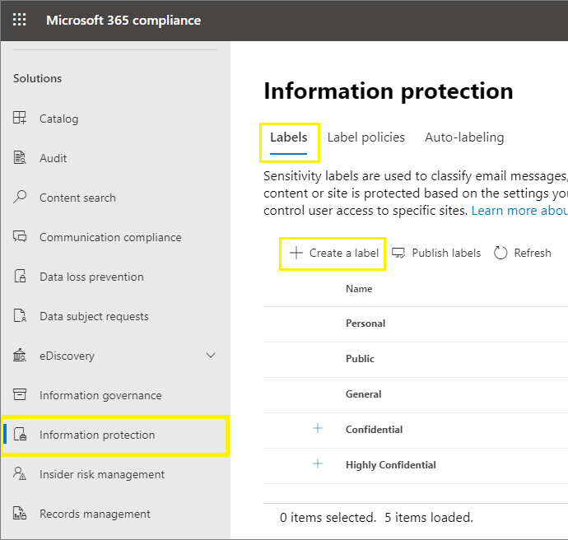
Create sensitivity labels
To implement sensitivity labels, an organization must first create and configure the labels that it wants to make available for apps and other services
Once an organization has created its sensitivity labels, it must create one or more label policies
In doing so, it will assign the appropriate sensitivity labels to each policy, and it will configure policy settings
An organization only requires multiple label policies if its users need different labels or different policy settings
As a best practice, organizations should have as few label policies as possible; in fact, it's not uncommon for an organization to have just one label policy for the entire company

Slide 26
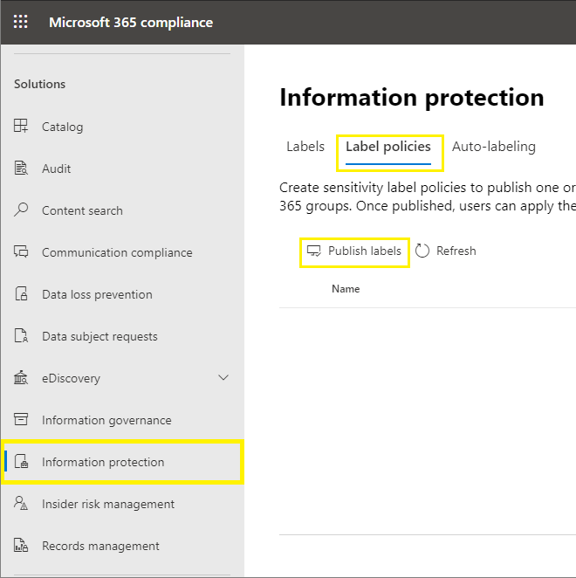
Publish sensitivity labels
Sensitivity labels are published by creating a label policy
By default, tenants don't have any label policies; organizations must create them
The label policy is published when you complete the Create policy wizard
To make changes to a published policy, you just need to edit it; there's no specific publish or republish action for you to select
For labels and label policy settings, allow 24 hours for the changes to propagate through the services before you troubleshoot labels and label policies for recent changes

Slide 27
Remove and delete sensitivity labels
Removing a label from a label policy
When you remove a label from a label policy, the next time the label policy is refreshed, users no longer see that label to select in their Office app
For labels that are removed but have previously been applied to content, users who are using built-in labeling for Word, Excel, and PowerPoint still see the applied label name on the status bar
Delete a label
If the label applied encryption, the underlying protection template is archived so that previously protected content can still be opened.
For desktop apps: The label information in the metadata remains, but because a label ID to name mapping is no longer possible, users don't see the applied label name displayed.
For Office on the web: Users don't see the label name on the status bar or in the Sensitivity column. The label information in the metadata remains only if the label didn't apply encryption.

Slide 28
Knowledge Check
Test your knowledge of this module by reviewing the Knowledge Check questions in your student manual

Slide 29
Summary
In this module, you examined the following items:
Sensitivity label requirements
Developing a data classification framework
Creating and publishing sensitivity labels
Removing and deleting sensitivity labels

Slide 30
Lab 6 – Implement information protection

Slide 31

Lab exercises
Exercise 1: Implement Sensitivity labels
Task 1
Install the Azure Information Protection Unified Labeling client
Task 2
Create a sensitivity label
After finishing Task 2, you must wait at least 24 hours before you can perform Tasks 3 and 4. This is the time needed for the new sensitivity label and the updated default policy to propagate through the system.
After finishing Task 2, proceed to the next module.
Task 3
Assign your Sensitivity Label to a document
Task 4
Verify your Sensitivity Label policy

Slide 32
Module 4: Learning Path review

Slide 33
Discussion – Learning Path review
What are your key takeaways from this learning path, and why?
What are the key features discussed in this learning path that you foresee implementing at your organization?

Slide 34
Closing Slide

