Slide 1
Learning Path 7: Manage content search and investigations in Microsoft 365

Slide 2
Learning Path agenda
Search for content in the Microsoft Purview compliance portal
Lab 7-Exercise 1 – Conduct a data search
Manage Microsoft Purview Audit (Standard)
Manage Microsoft Purview Audit (Premium)
Manage Microsoft Purview eDiscovery (Standard)
Manage Microsoft Purview eDiscovery (Premium)
Lab 7-Exercise 2 – Investigate Your Microsoft 365 Data
Learning Path Review

Slide 3
Module 1: Search for content in the Microsoft Purview compliance portal

Slide 4
Introduction
One of the key features in the Microsoft 365 Compliance center is Content Search, which is designed for times when the full-fledged search case management of eDiscovery is not required
This module examines how to:
Plan for a search
View and export search results
Configure search permissions filtering
Search for items from a third-party data source

Slide 5
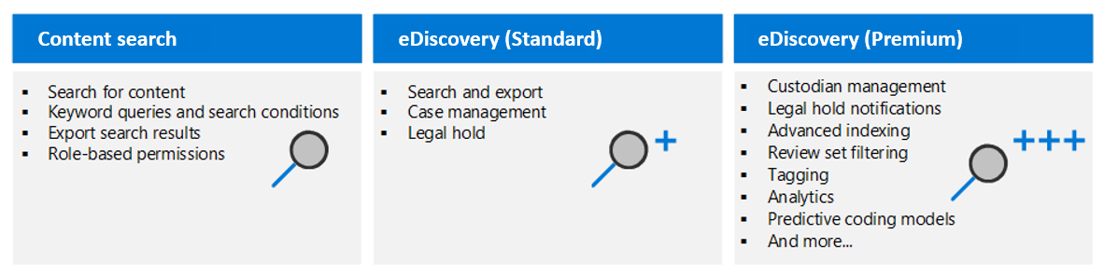
Explore Microsoft Purview eDiscovery solutions
An organization can search mailboxes and sites in the same eDiscovery search, and then export the search results
Microsoft Purview eDiscovery (Standard) cases can identify, hold, and export content found in mailboxes and sites
Microsoft Purview provides three eDiscovery solutions:
Content search, eDiscovery (Standard), and eDiscovery (Premium)

Slide 6
Create a content search
Consider the following questions when designing a content search:
Who should create and run the content search?
What type of content search do you want to create (for example, New search, Guided search, and Search by ID list)?
What keywords should be used for the search?
What conditions should be used (for example, type of data, sender, date, and subject)?
Do you want to search all locations or only specific locations (for example, SharePoint and Microsoft Teams)?

Slide 7
View the search results and statistics
When you run a content search, you can preview a sample of the search results to determine if the search is returning the expected results
A maximum of 1,000 randomly selected items are available to preview
A maximum of 100 items from a single content location (a mailbox or site) can be previewed
For mailbox items, only email messages are available to preview
For site items, only documents are available to preview
After running a content search, an organization can view the following statistics about the estimated search results:
A summary of the search results
The query statistics
The number of content locations with items that match the search query
The identity of content locations that have the most matching items
If an organization uses a keyword list when it creates or edits a search query, it can get enhanced statistics that show how many items match each keyword or keyword phrase
These statistics can help it quickly identify which parts of the query are the most (and least) effective

Slide 8
Export the search results and search report
After an organization successfully runs a Content search, it can export the search results to a local computer
When you export email results, they're downloaded to your computer as PST files
When you export content from SharePoint and OneDrive for Business sites, copies of the native Office documents are exported
Prerequisites to exporting search results include:
The user exporting the search results must be assigned the Export management role
Microsoft Edge must be used to run the eDiscovery Export Tool (Internet Explorer 11 is no longer supported to export search results)
Organizations should ensure they can connect to the endpoint in Azure, which temporarily stores the exported data before it’s downloaded to the local computer
Additional export considerations include:
Automating the export or download processes isn’t supported by Microsoft and should be avoided
To improve performance when downloading search results, consider dividing searches that return a large set of results into smaller searches

Slide 9
Configure search permissions filtering
Filtered search permissions can be configured to allow an eDiscovery manager to search only a subset of mailboxes and sites in a Microsoft 365 organization
Permissions filtering allow the eDiscovery manager to search only for mailbox or site content that meets a specific search criterion
Search permissions filtering is configured by creating a filter that uses a supported recipient filter to limit which mailboxes can be searched
Filters can be created to specify what mailbox or site content can be searched
See the student manual for the list of PowerShell cmdlets used for configuring and managing search permission filters

Slide 10
Search for and delete email messages
An organization can use the Content search feature to search for and delete email messages from all mailboxes in its Exchange deployment
This process can help you find and remove potentially harmful or high-risk email, such as:
Messages that contain dangerous attachments or viruses
Phishing messages
Messages that contain sensitive data
When deleting email messages:
A maximum of 10 items per mailbox can be removed at one time
50,000 is the maximum number of mailboxes in a content search that you can use to delete items by doing a search and purge action
Deleting email messages requires the following steps:
Connect to the Security and Compliance PowerShell module
Create a Content Search to find the message to delete
Delete the message

Slide 11

Knowledge Check
Test your knowledge of this module by reviewing the Knowledge Check questions in your student manual

Slide 12
Summary
In this module, you examined the following items related to Content Search:
Content Search is one of the key features in the Microsoft 365 Compliance Center that’s designed for times when the full-fledged search case management of eDiscovery is not required
Content Search is ideal for quick searches across content in Microsoft 365
Content Search is useful when you must perform large searches across all your mailboxes and SharePoint sites that exceed the limitations of using eDiscovery search
Filtered search permissions, which can be configured to allow an eDiscovery manager to search only a subset of mailboxes and sites in a Microsoft 365 organization

Slide 13
Lab 7 – Manage Search and Investigations

Slide 14
Lab exercises
Exercise 1: Conduct a data search
Task 1
Run a content search
Task 2
Export the search report
Task 3
Export the search results

Slide 15
Module 2: Manage Microsoft Purview Audit (Standard)

Slide 16
Introduction
Microsoft Purview provides two auditing solutions: Audit (Standard) and Audit (Premium). This module explores Microsoft Purview Audit (Standard)
This module examines:
The differences between Microsoft Purview Audit (Standard) and Audit (Premium)
How to search for audited activities using the Microsoft Purview Audit (Standard)
How to implement audit log searching using the Audit (Standard) solution
How to use audit log searching to investigate common support issues reported to Microsoft Support

Slide 17
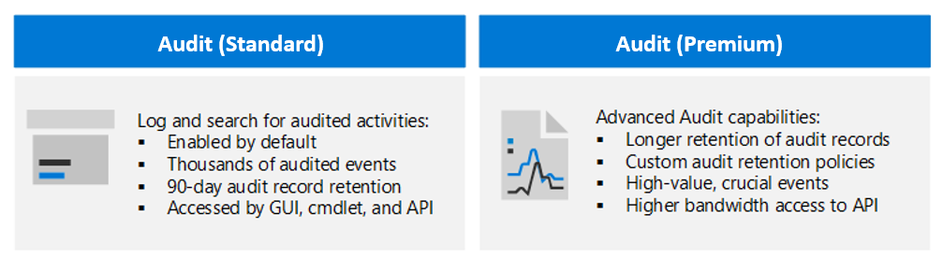
Explore Microsoft Purview Audit solutions
Audit (Standard)
Microsoft Purview Audit (Standard) provides organizations with the ability to log and search for audited activities
It enables an organization to power its forensic, IT, compliance, and legal investigations
Audit (Premium) Audit (Premium) builds on the capabilities of Microsoft Purview Audit (Standard) by adding advanced auditing functionality

Slide 18
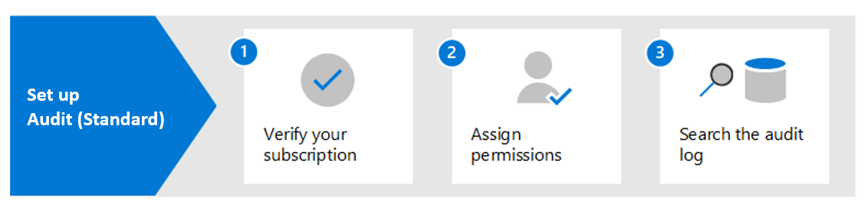
Implement Microsoft Purview Audit (Standard)
Audit (Standard) is enabled by default for most Microsoft 365 organizations
As a result, there's only a few things an organization must do before it can search the audit log
When an audited activity is performed by a user or admin, an audit record is generated and stored in the audit log for the organization
In Audit (Standard), audit records are retained and searchable in the audit log for 90 days

Slide 19
Search the audit log
Microsoft 365 supports an audit log so that organizations can search it for activities performed in different Microsoft 365 services
The following steps are required to search the audit log within the Microsoft Purview compliance portal:
Run an audit log search. When doing so, configure the following search criteria:
Start date and End date
Type of activities to search for
Users to display search results for
File name or folder name containing activities with the specified keyword
URL of a file or folder
View the search results. A maximum of 50,000 events will be displayed in increments of 150 events
Export the search results to a file. The results can be exported to a comma-separated value (CSV) file on a local computer

Slide 20
Export, configure, and view audit log records
Step 1: Export audit log search results
The first step is to search the audit log and then export the results in a comma-separated value (CSV) file to your local computer
Step 2: Format the exported audit log using the Power Query Editor
The next step is where the JSON transform feature in the Power Query Editor in Excel comes into play
This feature will split each property in the JSON object in the AuditData column into its own column
Use PowerShell to search and export audit log records
You can use the Search-UnifiedAuditLog cmdlet in Exchange Online PowerShell to export the results of an audit log search to a CSV file
Follow the same procedure described in Step 2 in the student training manual to format the audit log using the Power Query editor

Slide 21
Use audit log searching to investigate common support issues
Organizations can use the audit log search tool to help them investigate the following common support issues:
Find the IP address of the computer used to access a compromised account
Investigate why there was a successful sign-in by a user outside your organization
Determine who set up email forwarding for a mailbox
Search for mailbox activities performed by users with non-E5 licenses
Determine if a user deleted email items in their mailbox
Search for mailbox activities performed by delegate users
Determine if a user created an inbox rule

Slide 22
Knowledge Check
Test your knowledge of this module by reviewing the Knowledge Check questions in your student manual

Slide 23
Summary
In this module, you examined the following items:
The differences between Microsoft Purview Audit (Standard) and Audit (Premium)
How to search for audited activities using the Microsoft Purview Audit (Standard)
How to implement audit log searching using the Audit (Standard) solution
How to use audit log searching to investigate common support issues reported to Microsoft Support

Slide 24
Module 3: Manage Microsoft Purview Audit (Premium)

Slide 25
Introduction
Microsoft Purview Audit (Premium) builds on the capabilities of Audit (Standard) by providing:
Audit log retention policies
Longer retention of audit records
High-value crucial events
Higher bandwidth access to the Office 365 Management Activity API
This module examines how to:
Implement Microsoft Purview Audit (Premium)
Create audit log retention policies
Perform forensic investigations of compromised user accounts

Slide 26
Explore Microsoft Purview Audit (Premium)
Microsoft Purview Audit (Premium) provides the following advanced features designed specifically for organizations that conduct forensic and compliance investigations:
Increased audit log retention (audit records are retained for one year versus 90 days for Audit (Standard)
Access to crucial events that help determine scope of compromise
Higher bandwidth access, and thus, faster access to Office 365 Management Activity API
Audit (Premium) is available for organizations with an Office 365 E5/A5/G5 or Microsoft 365 Enterprise E5/A5/G5 subscription
Audit (Premium) helps organizations conduct forensic and compliance investigations by providing access to important events
Users must be assigned an Audit (Premium) license so that audit logs will be generated when users perform these events

Slide 27
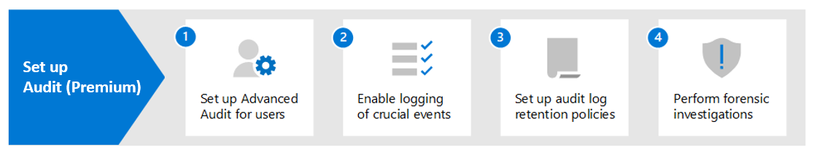
Implement Microsoft Purview Audit (Premium)
Step 1. When this step is complete, the logging of audit records for the MailItemsAccessed and Send events will begin within 24 hours
Step 2. You must enable the following Audit (Premium) events to be logged so that users can perform searches in Exchange Online and SharePoint Online:
SearchQueryInitiatedExchange
SearchQueryInitiatedSharePoint
Step 3. The default retention policy in Audit (Premium) retains Exchange, SharePoint, and Azure AD audit records for one year. This retention period can be modified by creating customized retention policies
Step 4. After completing Steps 1 and 2, you can search the audit log for Audit (Premium) events and other activities during forensic investigations of compromised accounts and other types of security or compliance investigations

Slide 28
Manage audit log retention policies
Audit log retention policies enable organizations to specify how long they want to retain audit logs
Audit logs can be retained for up to 10 years
Microsoft Purview Audit (Premium) provides a default audit log retention policy for all organizations
Retention policies can be created based on the following criteria:
All activities in one or more Microsoft 365 services
Specific activities (in a Microsoft 365 service) performed by all users or by specific users
A priority level that specifies which policy takes precedence when multiple policies exist in an organization
To create retention policies, a user must be assigned the Organization Configuration role in the Microsoft Purview compliance portal

Slide 29
Investigate compromised email accounts
A compromised user account is where an attacker gains access to a user account and operates as the user
To help organizations investigate compromised email accounts, Microsoft 365 audits access to mail data by mail protocols and clients
It does so by using the MailItemsAccessed mailbox-auditing action, which can help investigators:
better understand email data breaches
identify the scope of compromises to specific mail items that may have been compromised
Organizations should complete the following steps when conducting an investigation:
Identify the mailboxes that have been compromised
Determine the time frame when the attacker had access to those mailboxes
Use the Search-UnifiedAuditLog or Search-MailboxAuditLog cmdlets in Exchange Online PowerShell to search audit records that correspond to the data breach

Slide 30
Knowledge Check
Test your knowledge of this module by reviewing the Knowledge Check questions in your student manual

Slide 31
Summary
In this module, you learned:
Microsoft Purview Audit (Premium) builds on the capabilities of Audit (Standard) by providing:
Audit log retention policies
Longer retention of audit records
High-value crucial events
Higher bandwidth access to the Office 365 Management Activity API
How to implement Microsoft Purview Audit (Premium)
How to create audit log retention policies
How to perform forensic investigations of compromised user accounts

Slide 32
Module 4: Manage Microsoft Purview eDiscovery (Standard)

Slide 33
Introduction
Microsoft 365 enables organizations to use electronic discovery, or eDiscovery, to identify and deliver electronic information that can be used as evidence in legal cases
Microsoft Purview provides three eDiscovery solutions, each of which builds upon its predecessor:
Content search - covered in the first module in this learning path
eDiscovery (Standard) – covered in this module
eDiscovery (Premium) – covered in the next module
This module examines:
The basic workflow of eDiscovery (Standard)
How to create and manage an eDiscovery case
How to search for content in a case and then export that content

Slide 34
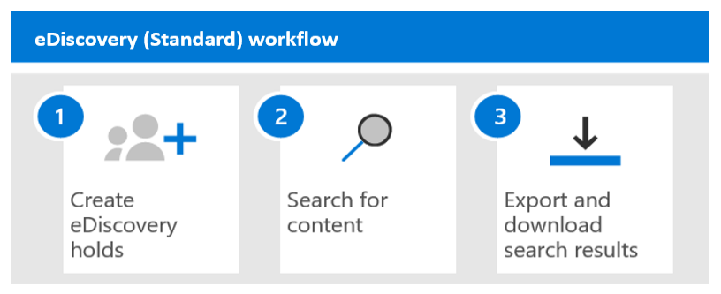
Explore Microsoft Purview eDiscovery solutions
Microsoft Purview eDiscovery (Standard)
Enables organizations to create cases to identify, hold, and export content found in mailboxes and sites
Microsoft Purview eDiscovery (Premium)
Enables organizations to manage custodians and analyze content associated with cases
eDiscovery (Standard) builds on Content search functionality by:
Enabling organizations to create eDiscovery cases and assign eDiscovery managers to specific case
Associating searches and exports with a case
Placing an eDiscovery hold on content locations relevant to a case

Slide 35
Implement Microsoft Purview eDiscovery (Standard)
Nothing is needed to deploy eDiscovery (Standard)
However, the following prerequisite tasks must be completed by an IT admin or eDiscovery manager before users can use eDiscovery (Standard) to search, export, and preserve content:
Step 1: Verify and assign appropriate licenses
Step 2: Assign eDiscovery permissions
Step 3: Create an eDiscovery (Standard) case
Step 4 (optional): Add members to an eDiscovery (Standard) case

Slide 36
Create eDiscovery holds
An organization can use a Microsoft Purview eDiscovery (Standard) case to create holds
Holds preserve content that may be relevant to a case, such as:
Exchange mailboxes and OneDrive for Business accounts of people being investigated in a case
The mailboxes and sites that are associated with Microsoft Teams, Microsoft 365 Groups, and Yammer Groups
When content locations are placed on hold, the content is preserved until the organization either:
Removes the content location from the hold
Deletes the hold
When creating a hold, you must define the scope of the content being placed on hold by selecting one of the following options:
Create an infinite hold where all content in the specified locations is placed on hold
Create a query-based hold where only the content in the specified locations that matches a search query is placed on hold
Specify a date range to preserve only the content that was sent, received, or created within that date range

Slide 37
Search for content in a case
To search for content in a case, you must first:
Create the case in the Microsoft Purview compliance portal
Place the people of interest in the case on hold
You can then create and run one or more searches for content relevant to the case
Searches associated with an eDiscovery (Standard) case are NOT listed on the Content search page in the Microsoft Purview compliance portal
Instead, they’re listed on the Searches page of the eDiscovery (Standard) case the searches are associated with
As a result, searches associated with a case can only be accessed by case members
When defining the conditions of your search, you can:
Specify keywords, message properties such as sent and received dates, or document properties such as file names or the date that a document was last changed
Select the Show keyword list option and type a keyword in each row in order to display statistics showing how many items match each keyword
Add search conditions to narrow a search and return a more refined set of results

Slide 38
Export content from a case
After successfully running a search that’s associated with a Microsoft Purview eDiscovery (Standard) case, you can export the search results
When search results are exported, mailbox items are downloaded in PST files or as individual messages
When content from SharePoint and OneDrive for Business sites are exported, copies of native Office documents and other documents are exported
The following additional files are exported:
A Results.csv file that contains information about every item that's exported
A manifest file (in XML format) that contains information about every search result
After the export is started, the search results are transferred to a Microsoft-provided Azure storage location in the Microsoft cloud
Exported search results must be downloaded within 14 days after the export job was created

Slide 39
Close, reopen, and delete a case
When the legal case or investigation supported by an eDiscovery (Standard) case is completed, the case can be closed
When a case is closed:
If the case contains any eDiscovery holds, they'll be turned off
Closing a case only turns off the holds that are associated with that case
You can edit a case after it's closed
When an organization reopens a closed case, any eDiscovery holds that were in place when the case was closed aren't automatically reinstated
If an organization wants to reinstate any of these holds, it must manually turn them back on after reopening the case
Before you can delete a case (whether it's active or closed), you must first delete all eDiscovery holds associated with the case
When an organization deletes a case, all searches and exports in the case are deleted
You can't reopen a deleted case

Slide 40
Knowledge Check
Test your knowledge of this module by reviewing the Knowledge Check questions in your student manual

Slide 41
Summary
In this module, you learned:
How organizations can use electronic discovery, or eDiscovery, to identify and deliver electronic information that can be used as evidence in legal cases
The basic workflow of Microsoft Purview eDiscovery (Standard)
How to create and manage an eDiscovery case
How to search for content in a case and then export that content

Slide 42
Module 5: Manage Microsoft Purview eDiscovery (Premium)

Slide 43
Introduction
Microsoft Purview eDiscovery (Premium) builds on the existing set of eDiscovery capabilities in Microsoft Purview eDiscovery (Standard)
This module examines how to:
Set up Microsoft Purview eDiscovery (Premium)
Create and manage cases in Microsoft Purview eDiscovery (Premium)
Manage custodians and non-custodial data sources
Analyze case content and use analytical tools to reduce the size of search result sets

Slide 44
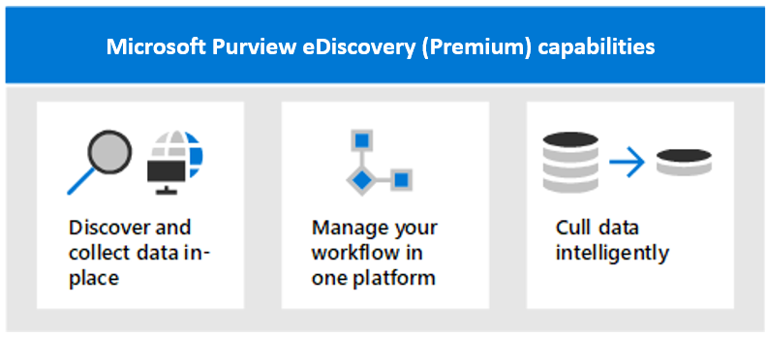
Explore Microsoft Purview eDiscovery (Premium)
Microsoft 365's advanced discovery solution, Microsoft Purview eDiscovery (Premium), enables organizations to discover data at the source and stay within their Microsoft 365 security and compliance boundary
eDiscovery (Premium) can help organizations reduce the number of eDiscovery solutions they need to rely on
eDiscovery (Premium) provides an end-to-end workflow to preserve, collect, review, analyze, and export content that’s responsive to your organization’s internal and external investigations
eDiscovery (Premium) enables legal teams to manage the entire legal hold notification workflow to communicate with custodians involved in a case

Slide 45
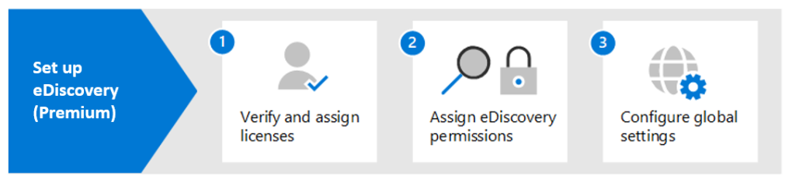
Implement Microsoft Purview eDiscovery (Premium)
Microsoft Purview eDiscovery (Premium) provides an end-to-end workflow to preserve, collect, review, analyze, and export data that's responsive to an organization's internal and external investigations

Slide 46
Create and manage an eDiscovery (Premium) case
Microsoft Purview eDiscovery (Premium) is typically used for critical eDiscovery processes
eDiscovery (Premium) cases are designed to help accommodate significant increases in case size, both for total data volume and the total number of items
It can manage cases that contain over 40 million items
The benefits of creating and managing cases in eDiscovery (Premium) include:
Collection. In the eDiscovery (Premium) case format, organizations can collect up to 1 TB of data for a single collection
Review. Each review set will support up to 1 TB of pre-expansion content. Other metadata is available for filters and queries including Team name, channel name, and conversation name for Teams content
Export. An organization can export large sets of content in a single export job. The eDiscovery (Premium) case format can export 5 million documents or 500 GB, whichever is smaller in an export job

Slide 47
Manage custodians and non-custodial data sources
When an organization responds to a legal investigation, the people who are responsible for identifying, preserving, and collecting potentially relevant content are known as custodians
An organization can use the built-in custodian management tool in Microsoft Purview eDiscovery (Premium) to coordinate its workflows around managing custodians and identifying relevant, custodial data sources associated with a case
Custodians can be added to and managed in eDiscovery (Premium) cases in four steps:
Identify the custodians
Choose custodian data locations
Configure hold settings
Review the custodians and complete the process

Slide 48
Analyze case content
When the number of collected documents is large, it can be difficult to review them all
Microsoft Purview eDiscovery (Premium) provides the following tools to analyze the documents:
Near duplicate detection
Groups textually similar documents together to help an organization make its review process more efficient
Enables a reviewer to take just a fraction of the time that it would have taken to read all documents cover to cover
Email threading
The last message in an email thread typically includes the contents of all the preceding messages
Email threading identifies such messages so that reviewers can review a fraction of collected documents (i.e. the last message) without losing any context
Themes
Themes functionality analyzes documents with text in a review set to parse out common themes that appear across all the documents. It identifies:
Which ideas are present in the sets
Which documents talk about those ideas

Slide 49
Knowledge Check
Test your knowledge of this module by reviewing the Knowledge Check questions in your student manual

Slide 50
Summary
In this module, you examined how to complete the following eDiscovery (Premium) tasks:
Set up Microsoft Purview eDiscovery (Premium)
Create and manage cases in Microsoft Purview eDiscovery (Premium)
Manage custodians and non-custodial data sources
Analyze case content and use analytical tools to reduce the size of search result sets

Slide 51
Lab 7 – Manage Search and Investigations (continued)

Slide 52
Lab exercises
Exercise 2: Investigate Your Microsoft 365 Data
Task 1
Perform a content search for data in user mailboxes
Task 2
Create an eDiscovery case and search for data in mailboxes on hold

Slide 53
Module 6: Learning Path review

Slide 54
Discussion – Learning Path review
What are your key takeaways from this learning path, and why?
What are the key features discussed in this learning path that you foresee implementing at your organization?

Slide 55
Closing Slide

