Slide 1

Learning Path 8: Prepare for device management in Microsoft 365

Slide 2
Learning Path agenda
Explore device management using Microsoft Endpoint Manager
Prepare your Windows devices for Co-management
Plan for mobile application management
Learning Path Review

Slide 3
Module 1: Explore device management using Microsoft Endpoint Manager

Slide 4
Introduction
This module examines the device management features of Microsoft Endpoint Manager, including:
Co-management of Windows devices in EndPoint Manager using Configuration Manager and Intune
Managing devices using Configuration Manager
Managing devices using Microsoft Intune
Creating device profiles in Microsoft Intune

Slide 5
Explore device management in Microsoft Endpoint Manager
Endpoint Manager includes the following device management services:
Microsoft Intune
Configuration Manager
Co-management
Desktop Analytics
Endpoint Manager is integrated with the following features:
Windows Autopilot
Azure Active Directory (AD)
Endpoint Manager admin center
Which device management solution in Endpoint Manager is right for you?
There are a few ways to determine what's right for an organization
An organization's next steps depend on what it's trying to achieve

Slide 6
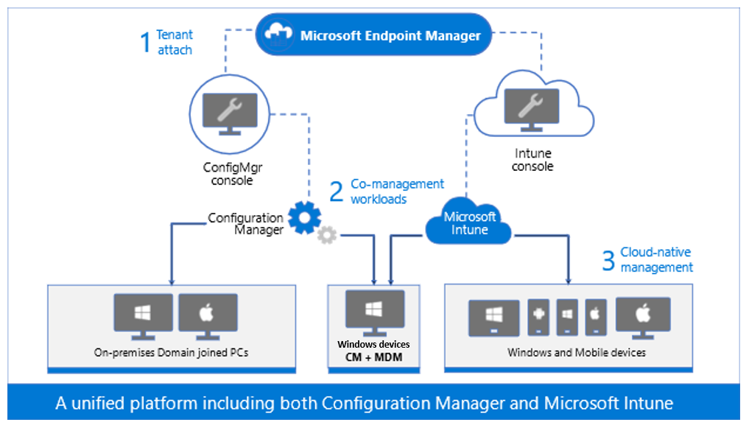
Explore Co-management of Windows devices
Co-management is the integration between Configuration Manager and Microsoft Intune, which enables Windows 10 and later devices to be managed by both services at the same time
Paths to co-management Path 1: Auto-enroll existing Configuration Manager-managed devices into Intune
Path 2: Bootstrap the Configuration Manager client with modern provisioning
Co-management provides the ability to continue using traditional management (Configuration Manager), but also benefit from modern management (Intune)

Slide 7
Explore Co-management of Windows devices(continued)
Key benefits of implementing Co-management include:
Conditional access with device compliance
Intune-based remote actions, such as restart, remote control, and factory reset
Centralized visibility of device health
Link users, devices, and apps with Azure Active Directory (Azure AD)
Modern provisioning with Windows Autopilot
Remote actions

Slide 8
Manage devices using Configuration Manager
Configuration Manager (Current Branch) provides a unified management console with an automated set of administrative tools to deploy software, protect data, monitor health, and enforce compliance across all devices in an organization
Configuration Manager includes the following features:
Asset management
Change management
Administrative features
Configuration Manager (Current Branch) can be integrated with cloud services such as Microsoft 365, Intune, and Microsoft Store for Business

Slide 9
Manage devices using Microsoft Intune
Microsoft Intune provides mobile device management (MDM) and mobile application management (MAM) services
It can control how devices are used, including mobile phones, tablets, and laptops
It enables people to use their personal devices for work
When an organization wants full control over company-owned devices, users must “enroll” their devices in Intune
Once enrolled, they receive the organization’s rules and settings through policies configured in Intune
For example, policies can be used to:
Set password and PIN requirements
Create a VPN connection
Configure threat protection
For bring-your-own (BYOD) devices, users may not want administrators to have full control over their personal devices
Intune provides this option, but by not enrolling their personal devices, users won’t have full access to the organization’s resources

Slide 10
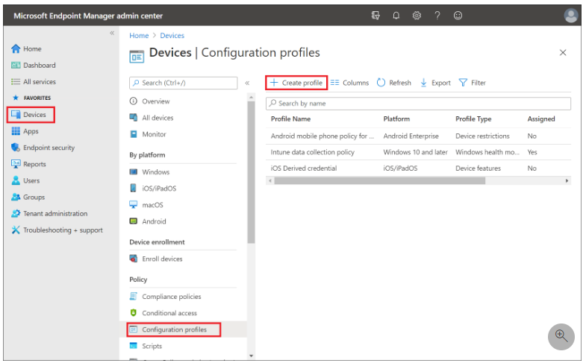
Create device profiles in Microsoft Intune
Profiles are created in the Microsoft Endpoint Manager admin center
After an organization adds the profile settings, it can also add a scope tag to the profile
Applicability rules apply to Windows 10 and later devices. They enable administrators to target a group of devices that meets specific criteria
Intune uses different refresh cycles to check for updates to configuration profiles

Slide 11

Discussion – Device Management method
Discuss the following questions regarding device management within your organizations:
Which device management solution in Endpoint Manager is right for your organization?
Do you think your organization will implement Co-management? Why or why not?
Do you think your organization will implement Microsoft Intune? Why or why not?
15 minutes…Go!

Slide 12

Knowledge Check
Test your knowledge of this module by reviewing the Knowledge Check questions in your student manual

Slide 13
Summary
In this module, you examined the following items:
The device management features of Microsoft Endpoint Manager
Co-management of Windows devices in EndPoint Manager using Configuration Manager and Microsoft Intune
Managing devices using Configuration Manager
Managing devices using Microsoft Intune
Creating device profiles in Microsoft Intune

Slide 14
Module 2: Prepare your Windows devices for Co-management

Slide 15
Introduction
This module examines how to prepare your Windows 10 and later devices for Co-management, including:
Co-management prerequisites
Configuring Microsoft Endpoint Configuration Manager for Co-management
Enrolling Windows 10/11 devices to Intune
Configuring co-management settings
Transferring workload management from Configuration Manager to Intune

Slide 16
Plan your Co-management strategy
Co-management enables companies to take advantage of the new features and capabilities, such as compliance policies, selective wipe, and provisioning new Windows 10 and later devices
Configuration Manager managed devices
ConfigMgr agent
AD Domain Joined
ConfigMgr agent
AD Domain Joined
AAD Joined
Co-management
ConfigMgr agent
Intune MDM
AD Domain Joined
AAD Joined
Intune managed devices
Intune MDM
Workgroup or AAD Joined
ConfigMgr agent
AD Domain Joined
AAD Joined
ConfigMgr agent
Intune MDM
AD Domain Joined
AAD Joined
New devices
Windows AutoPilot
Intune MDM
AD Domain Joined
AAD Joined
ConfigMgr agent
Intune MDM
AD Domain Joined
AAD Joined

Slide 17
Explore the prerequisites for using Co-management
To be able to configure Co-management, your infrastructure must include the following features:
On-premises AD DS, which is synced with Azure AD
Configuration Manager (Current Branch) version 1709 or newer
Intune (either separate subscription or part of Enterprise Mobility + Security (EM+S))
Co-management can only be used with devices that meet the following prerequisites:
The device must be running Windows 10 version 1709 (Fall Creators Update) or newer
The device must be joined to on-premises AD DS and to Azure AD
The user of the device must be assigned an Intune license

Slide 18
Discussion – Prerequisites for Using Co-management
Discuss the following questions regarding Co-management prerequisites within your organizations:
Could you configure co-management in your current company environment?
Would you need to perform any actions or implement additional product(s) before you could implement Co-management?
Could you use Co-management with all your company devices?
15 minutes…Go!

Slide 19
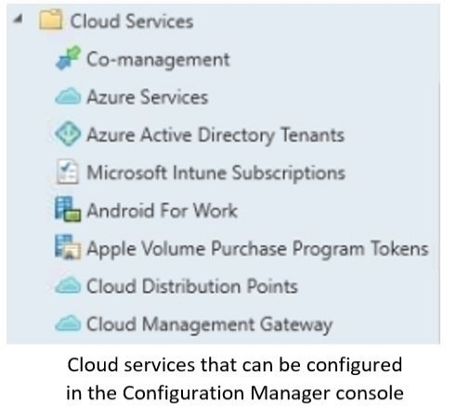
Configure Configuration Manager for Co-management
You can enable Co-management in the Configuration Manager console by running the Co-management Configuration Wizard
You can configure the following settings in the wizard:
Automatic enrollment in Intune
Workloads
Roll-out collections

Slide 20
Enroll Windows devices to Intune
User self-enrollment in Intune
Users can self-enroll their Windows device by using any of these methods:
Bring your own device (BYOD)
Azure Active Directory (Azure AD) Join
Windows Autopilot
Administrator-based enrollment in Intune
Administrators can set up the following methods of enrollment that require no user interaction:
Hybrid Azure AD Join
Configuration Manager Co-management
Device enrollment manager (DEM)
Bulk enrollment
Windows IoT Core device enrollment

Slide 21
Modify your Co-management settings
When your infrastructure meets the prerequisites, you can enable Co-management without introducing any changes in the way that devices are managed
You can enable Co-management for all Configuration Manager managed devices or for a subset of their devices
After you enable Co-management, you can use the Configuration Manager console to modify the Co-management settings
You can modify the following Co-management settings:
Pilot collection
Automatic enrollment in Intune
Workloads

Slide 22
Transfer workload management from Configuration Manager to Intune
With co-management, you can control who manages the following workloads:
Compliance policies
Resource access policies
Windows Update policies
Endpoint Protection
You can also configure where every workload will be managed:
Configuration Manager
Pilot Intune
Intune

Slide 23
Knowledge Check
Test your knowledge of this module by reviewing the Knowledge Check questions in your student manual

Slide 24
Summary
In this module you examined the following items:
There are two ways to prepare the Windows 10 devices in your existing environment for Co-management:
If your devices are currently managed by Configuration Manager but not yet by Intune, you must enroll them to Intune
If your devices are currently managed by Intune but not yet by Configuration Manager, you must install the Configuration Manager client on the devices
New devices can include the Configuration Manager client, and they can be automatically enrolled to Intune during deployment

Slide 25
Module 3: Plan for mobile application management

Slide 26
Introduction
This module examines how to use Microsoft Intune to manage mobile applications, including how to:
Configure specific policies to control applications and protect company data
Add apps to Intune to configure, assign, protect, and monitor them
Implement app protection policies to protect company data
Implement app configuration policies to eliminate app setup problems
Troubleshoot app protection policy deployment

Slide 27
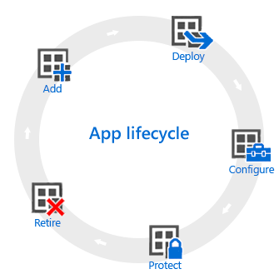
Explore mobile application management in Microsoft Intune
Intune mobile application management refers to the suite of Intune management features
Diagram showing the stages in the app lifecycle, including, add, deploy, configure, protect, and retire
Intune offers a range of capabilities to help organizations get the apps they need on the devices they want to run them on
Organizations can find most app-related information in the Apps workload within the Microsoft Endpoint Manager admin center
Mobile application management (MAM) in Intune is designed to protect organization data at the application level

Slide 28
Add apps to Microsoft Intune
To add apps in Intune, organizations must determine:
App requirements that are needed by the users at the company
Whether to use Intune to manage the devices (including apps), or have Intune manage the apps without managing the devices.
The apps and capabilities that its workforce needs, and who needs them
Who will use each app
The type of app for its solution
For each app, organizations must determine:
The platforms needed
The groups of users that need the app
The configuration policies to apply for those groups
The protection policies to apply

Slide 29
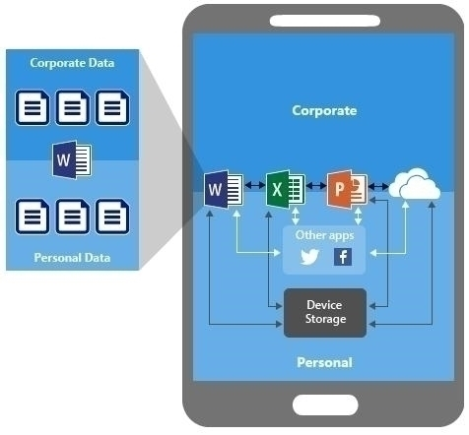
Protect company data by using app protection policies
Mobile Application Management (MAM) is a suite of management features that enables you to publish, push, configure, secure, monitor, and update mobile apps
MAM is configured in Intune by using app protection policies
The benefits of using App protection policies include:
Protecting your company data at the app level
End-user productivity is not impacted
Policies aren’t applied when using the app in a personal context
App protection policies can be applied to mobile apps on iOS and Android devices that support MAM

Slide 30
Explore app configuration policies for Intune
Apps that support app configuration
Managed devices
Managed apps
You can account for certificate profiles that are based on enrollment type:
All Profile Types
Fully Managed, Dedicated, and Corporate-Owned Work Profile Only.
Personally Owned Work Profile Only
Organizations can validate the app configuration policy using the following methods:
Verify the app configuration policy visibly on the device
Verify the app configuration policy through Diagnostic Logs
Verify the app configuration policy in the Microsoft Endpoint Manager admin center

Slide 31
Troubleshoot app protection policy deployment in Intune
The recommended flow for investigating common issues with Intune app protection policies includes:
Verify you've met the prerequisites for deploying app protection policies
Check app protection policy status and check targeting
Verify the user is targeted
Verify the managed app is targeted
Collect device data
Verify the user signed in to the affected application using their targeted corporate account

Slide 32
Knowledge Check
Test your knowledge of this module by reviewing the Knowledge Check questions in your student manual

Slide 33
Summary
In this module, you examined the following items:
How to use Microsoft Intune to manage mobile applications
How to configure specific policies to control applications and protect company data
How to add apps to Intune to configure, assign, protect, and monitor them
How to implement app protection policies to protect company data
How to implement app configuration policies to eliminate app setup problems
How to troubleshoot app protection policy deployment

Slide 34
Module 4: Learning Path review

Slide 35
Discussion – Learning Path Review
What are your key takeaways from this learning path, and why?
What are the key features discussed in this learning path that you foresee implementing at your organization?

Slide 36
Closing slide

