Slide 1
Learning Path 10: Implement Mobile Device Management in Microsoft 365

Slide 2
Learning Path agenda
Explore Mobile Device Management
Deploy Mobile Device Management
Lab 9-Exercises 1 through 3 – Manage devices with Microsoft ntune
Enroll devices to Mobile Device Management
Lab 9-Exercise 4 – Enroll a Windows 10 Device
Manage device compliance
Implement endpoint security in Microsoft Intune
Lab 9-Exercise 5 – Manage and Monitor a Device in Intune
Learning Path Review

Slide 3
Module 1: Explore Mobile Device Management

Slide 4
Introduction
This module introduces Mobile Device Management (MDM), which provides the ability to manage all popular devices without joining them to on-premises AD DS
This module examines:
MDM in Microsoft 365
MDM services in Microsoft 365
MDM policy settings in Microsoft 365
Control of email and document access on MDM-managed devices

Slide 5
Explore Mobile Device Management in Microsoft 365
Mobile Device Management (MDM) is an industry standard for managing mobile devices, such as smart phones, tablets, laptops, and desktop computers
MDM is implemented by using an MDM authority and MDM clients
Microsoft offers two MDM authority options:
Intune
Basic Mobility and Security
An MDM authority such as Intune provides the following capabilities:
Device enrollment
Configuring devices
Monitoring and reporting
Application Management
Selective delete data

Slide 6
Explore the MDM services in Microsoft 365
Microsoft 365 includes two MDM services:
Basic Mobility and Security
Microsoft Intune
Basic Mobility and Security
Provides the core device management features available in Microsoft 365
It’s hosted by Intune, but is NOT an “Intune-lite” solution
Sets device security policies and access rules
Can be used to wipe mobile devices if they’re lost or stolen
Manages many types of mobile devices, such as Windows Phone, Android, iPhone, and iPad
To manage users’ mobile devices:
Each person must have an applicable Microsoft 365 license
Their device must be enrolled in Basic Mobility and Security

Slide 7
Explore the MDM services in Microsoft 365 (continued)
Microsoft Intune
Provides the core features found within Basic Mobility and Security, plus more advanced device management features
Includes not only mobile device management (MDM), but also mobile application management (MAM) features
Enables an organization to control how its devices are used, including mobile phones, tablets, and laptops
Enables users to use their personal devices for school or work
Ensures that organization data stays protected on personal devices
Isolates organizational data from personal data
Helps secure and monitor data access by including:
device and app configuration policies
software update policies
installation statuses (charts, tables, and reports)

Slide 8
Examine the MDM policy settings in Microsoft 365
MDM policies and profiles are groups of settings that control features on mobile devices
When you create policies or profiles, you can only deploy them by assigning them to groups
In Basic Mobility and Security and Intune, you can manage the following mobile devices settings:
Organization-wide device access settings
Device security policies
In Microsoft Intune you can manage additional settings:
Device enrollment and restrictions
Device compliance policies
Device configuration policies
Conditional access
Software updates

Slide 9
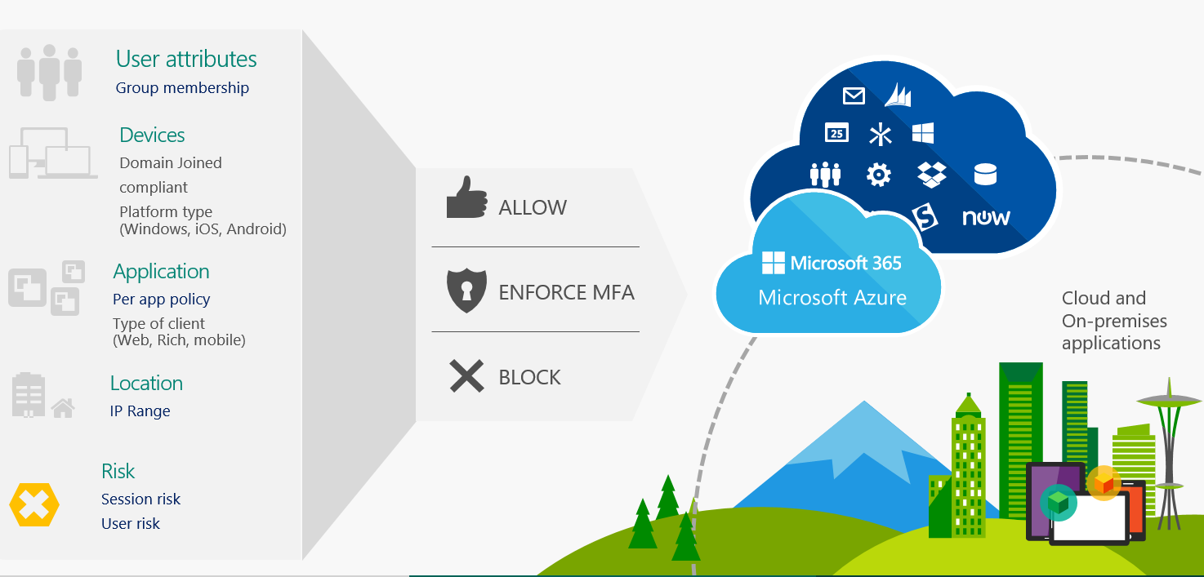
Examine how email and document access are controlled on MDM-managed devices
An important benefit of using MDM for managing devices is that you can allow access to e-mail and documents only from devices that are managed by MDM and comply with company policy
Company policies can be defined by using Conditional Access policies in Microsoft 365
If a device is not enrolled to MDM, you can prevent access to mailboxes, documents, and cloud apps from such devices

Slide 10

Knowledge Check
Test your knowledge of this module by reviewing the Knowledge Check questions in your student manual

Slide 11
Summary
In this module, you examined the following items:
Mobile Device Management (MDM) provides the ability to manage all popular devices, without joining them to on-premises AD DS
To be able to manage a device by MDM, you must first enroll it to MDM, such as Microsoft Intune or Basic Mobility and Security
Before deploying MDM, enrolling devices, and managing device compliance, you should first plan your MDM deployment

Slide 12
Module 2: Deploy Mobile Device Management

Slide 13
Introduction
This module examines the following features that are essential to successfully deploying MDM:
Activating Mobile Device Management services
Deploying Mobile Device Management
Configuring domains for MDM
Configuring an APNs certificate for iOS devices
Managing device security policies
Defining corporate device enrollment policy

Slide 14
Activate the MDM services in Microsoft 365
After configuring MDM authority in Intune or activating the Mobile Device Management service for Microsoft 365, you must perform the following tasks before you can successfully deploy MDM and begin enrolling and managing devices:
Configure domains for MDM
Configure an APNs certificate for iOS devices
Set up multi-factor authentication (MFA)
Manage device security policies
Ensure users enroll their devices

Slide 15
Configure domains for MDM
If you want to enable users to enroll their Windows 10 and 11 devices to MDM by using auto-discovery, you must configure the domain by adding a DNS record to the domain DNS zone
If your company is using Azure AD Premium, you can integrate Azure AD with Intune to configure automatic MDM enrollment
You can configure auto-discovery by creating an alias (CNAME resource record type) in the DNS zone that automatically redirects enrollment requests to Intune servers
Host name | Record type | Address | TTL
Enterprise Enrollment | CNAME | EnterpriseEnrollment.manage.microsoft.com | 3,600
Enterprise Registration | CNAME | EnterpriseRegistration.windows.net | 3,600

Slide 16
Obtain an APNs certificate for iOS devices
If you want to manage iPad, iPhone, and Mac devices by using MDM, you need an Apple Push Notification (APNs) certificate to communicate securely with those devices
After you add the certificate to Intune or Basic Mobility and Security, your users can enroll their iOS and macOS devices by using:
The Company Portal app
Apple’s bulk enrollment methods, such as the Device Enrollment Program, Apple School Manager, or Apple Configurator
By default, the APNs certificate is valid for one year
If your APNs certificate expires, enrollment of new iOS devices will fail

Slide 17
Manage security policies for MDM-managed devices
Security policies can be implemented by configuring device configuration profiles, device compliance policies, and conditional access policies
Microsoft Intune enables you to create and deploy different types of device configuration profiles, including device restrictions, endpoint protection, and Microsoft Defender for Endpoint
A Device Compliance policy specifies the device configuration that must be met for the device to be considered compliant, such as the use of PIN or device encryption
Conditional access policies enable you to control access to company apps and resources, such as Exchange Online or OneDrive for Business, only if prerequisites are met

Slide 18
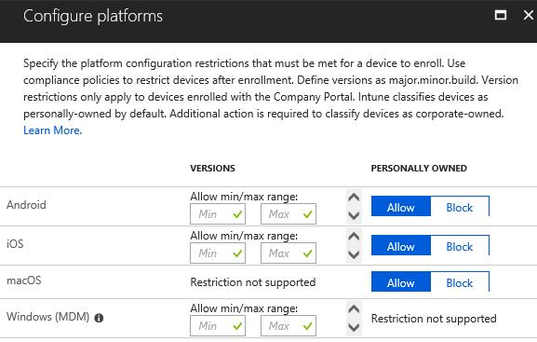
Define a corporate device enrollment policy
By default, users can enroll all supported device types to Intune or Basic Mobility and Security
You can configure enrollment restrictions and use the following criteria:
Maximum number of devices that a user can enroll
Device platforms that can be enrolled
Required operating system version for iOS, Android, Android work profile, and Windows devices
You can restrict enrollment of personally owned devices

Slide 19
Knowledge Check
Test your knowledge of this module by reviewing the Knowledge Check questions in your student manual

Slide 20
Summary
In this module, you examined the following items:
Activating Mobile Device Management services
Deploying Mobile Device Management
Configuring domains for MDM
Configuring an APNs certificate for iOS devices
Managing device security policies
Defining corporate device enrollment policy

Slide 21
Lab 9 – Manage devices with Microsoft Intune

Slide 22
Lab exercises
Exercise 1: Prepare for Mobile Device Management in Microsoft 365
Task 1
Verify and assign Enterprise Mobility + Security licenses
Task 2
Review MDM features in Microsoft Endpoint Manager
Exercise 2: Configure Azure AD for Intune
Task 1
Integrate Azure AD with Intune
Task 2
Configure Azure AD join
Task 3
Create dynamic Azure AD device group
Exercise 3 is on the next slide

Slide 23
Lab exercises
Exercise 3: Create Intune Policies
Task 1
Create a noncompliant email message template
Task 2
Create and apply a compliance policy
Task 3
Create an App Protection Policy
Task 4
Create a packaged App rule for the store apps
Task 5
Import a list of protected apps using Microsoft Intune
Task 6
Configure enrollment restrictions
Task 7
Review device configuration profiles

Slide 24
Module 3: Enroll devices to Mobile Device Management

Slide 25
Introduction
This module explores device enrollment in an MDM authority such as Microsoft Intune and Basic Mobility and Security
This module examines:
How to enroll devices to MDM in Microsoft Intune
The use of Azure AD joined and hybrid Azure AD joined devices
How users can enroll their personal devices
Best practices for each device enrollment method
How to set up enrollment for Windows devices

Slide 26
Review device enrollment methods
This unit introduces you to four of the seven methods of enrolling devices for Mobile Device Management (MDM) (the remaining methods are examined in later units):
Bulk enrollment
Bulk deployment is restricted to Windows 10 and 11 devices. Organizations can join large numbers of new Windows devices to Azure Active Directory and Intune
Device enrollment manager (DEM)
A device enrollment manager (DEM) is a non-administrator user who can enroll devices in Intune
Group policy objects (GPO)
Starting with Windows 10, version 1709, organizations can use Group policy objects (GPO) to trigger auto-enrollment to Mobile Device Management (MDM) for Active Directory (AD) domain-joined devices
Co-management
Co-management is one of the primary ways for an organization to attach its existing Configuration Manager deployment to the Microsoft 365 cloud. It helps organizations unlock more cloud-powered capabilities like Conditional Access

Slide 27
Examine Azure AD registered devices
The goal of Azure AD registered devices (also known as Workplace joined devices) is to provide an organization's users with support for Bring Your Own Device (BYOD) and mobile device scenarios
Azure AD registered devices are signed in to using a local account, such as a Microsoft account on an Android phone
These devices have an Azure AD account for access to organizational resources
Access to resources in the organization can be limited based on that Azure AD account and Conditional Access policies applied to the device identity.
Administrators can secure and further control these Azure AD registered devices using Mobile Device Management (MDM) tools like Microsoft Intune
MDM provides a means to enforce organization-required configurations, such as:
Requiring storage to be encrypted
Password complexity
Security software kept updated
Azure AD registration can be accomplished when accessing a work application for the first time or manually using the Windows 10 or 11 Settings menu.

Slide 28
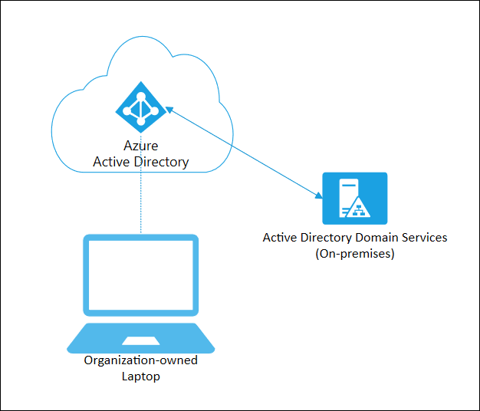
Explore Azure AD joined devices
Users can sign-in to Azure AD joined devices using an organizational Azure AD account
Administrators can secure and further control Azure AD joined devices using either:
Mobile Device Management (MDM) tools like Microsoft Intune.
Co-management scenarios using Microsoft Endpoint Configuration Manager.
Azure AD join can be accomplished using self-service options like the Out of Box Experience (OOBE), bulk enrollment, or Windows Autopilot
Azure AD joined devices can still maintain single sign-on access to on-premises resources when they're on the organization's network
Devices that are Azure AD joined can still authenticate to on-premises servers such file servers, print servers, and other application servers

Slide 29
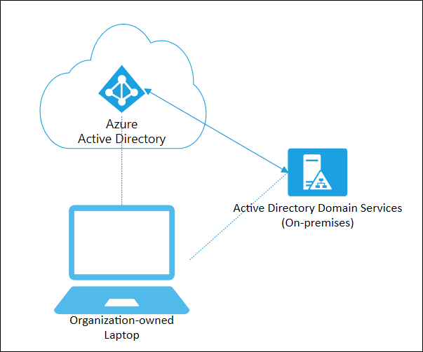
Explore hybrid Azure AD joined devices
Organizations with existing Active Directory implementations can benefit from some of the functionality provided in Azure Active Directory (Azure AD) by implementing hybrid Azure AD joined devices
These devices are joined to an organization's on-premises Active Directory and registered with Azure Active Directory
Hybrid Azure AD joined devices require periodic network line of sight to an organization's on-premises domain controllers
Without this connection, devices become unusable
Bringing devices to Azure AD maximizes user productivity through single sign-on (SSO) across an organization's cloud and on-premises resources

Slide 30
Examine device enrollment in Intune
Organizations that use Microsoft Intune as their mobile device management (MDM) provider must enroll devices in Intune using a supported enrollment method
Enrollment sets up and secures the device so that it aligns with an organization's policies
Some enrollment methods require IT administrators to initiate enrollment
Other methods require an organization's employees to initiate them
Intune deploys and enforces policies through a management profile
The profile is installed on a device during enrollment
Enrollment is enabled for all platforms by default
Microsoft Intune supports Android, macOS, iOS, and Windows devices
Microsoft Intune enables mobile device management for:
Personal devices
Corporate-owned devices
Organizations can use the following methods to enroll Windows devices in Intune
Bring your own device Device enrollment manager Automatic enrollment through MDM or Group Policy
Windows Autopilot Bulk enrollment Co-management with Intune and Config Manager

Slide 31
Examine device enrollment capabilities
Best practices by enrollment method
Best practices | Azure AD joined | Azure AD joined with Autopilot (User-driven mode) | Azure AD joined with Autopilot (Self-deploying mode) | Bulk | Device Enrollment Manager (DEM) | Bring Your Own Device (BYOD) | Group Policy Object (GPO) | Co-management
Commonly used in Education | No | Yes | No | Yes | Yes | No | No | No
Devices can be used as shared devices | No | No | Yes | Yes | Yes | No | No | No
Personal devices must access company resources | No | No | No | No | No | Yes | No | No
Self-servicing of apps | Yes | Yes | Yes | No | No | Yes | Yes | Yes

Slide 32
Examine device enrollment capabilities (continued)
Capabilities by enrollment method
Capabilities | Azure AD joined | Azure AD joined with Autopilot (User-driven mode) | Azure AD joined with Autopilot (Self-deploying mode) | Bulk | Device Enrollment Manager (DEM) | Bring Your Own Device (BYOD) | Group Policy Object (GPO) | Co-management
Conditional Access | Yes | Yes | Yes | Yes | Yes | Yes | Yes | Yes
User gets associated with the device | Yes | Yes | No | No | No | Yes | Yes | Yes
Requires Azure AD Premium | No | Yes | Yes | Yes | No | No | Yes | Yes
Device can assess resources protected by Certificate Authority | Yes | Yes | Yes | Yes | No | Yes | Yes | Yes

Slide 33
Examine device enrollment capabilities (continued)
Capabilities by enrollment method (continued)
Capabilities | Azure AD joined | Azure AD joined with Autopilot (User-driven mode) | Azure AD joined with Autopilot (Self-deploying mode) | Bulk | Device Enrollment Manager (DEM) | Bring Your Own Device (BYOD) | Group Policy Object (GPO) | Co-management
Users must not be admins on their devices | No | Yes | Yes | Yes | No | No | No | No
Ability to configure the device setup experience | No | Yes | Yes | No | No | No | No | No
Ability to enroll devices without user interaction | No | No | Yes | Yes | Yes | No | Yes | Yes
Ability to run PowerShell scripts | Yes | Yes | Yes | Yes | Yes | No | Yes | Yes*

Slide 34
Examine device enrollment capabilities (continued)
Capabilities by enrollment method (continued)
Capabilities | Azure AD joined | Azure AD joined with Autopilot (User-driven mode) | Azure AD joined with Autopilot (Self-deploying mode) | Bulk | Device Enrollment Manager (DEM) | Bring Your Own Device (BYOD) | Group Policy Object (GPO) | Co-management
Supports automatic enrollment after AD domain join | No | No | No | No | No | No | Yes | Yes
Supports automatic enrollment after Hybrid Azure AD join | No | No | No | No | No | No | Yes | Yes
Supports automatic enrollment after Azure AD join | Yes | Yes | Yes | Yes | Yes | Yes | No | No

Slide 35
Set up enrollment for Windows devices
Enrollment can be simplified in the following ways:
Enable automatic enrollment (Azure AD Premium required)
CNAME registration
Enable bulk enrollment (Azure AD Premium and Windows Configuration Designer required)
Two factors that organizations should consider to help simplify Windows device enrollment:
Do you use Azure Active Directory Premium? Azure AD Premium is included with Enterprise Mobility + Security and other licensing plans
What versions of Windows clients will users enroll? Devices running Windows 10 or 11 can automatically enroll by adding a work or school account Devices running earlier versions must enroll using the Company Portal app
 | Azure AD Premium | Azure AD Premium
Windows 10/11 | Automatic enrollment | User enrollment
Earlier Windows versions | User enrollment | User enrollment

Slide 36
Knowledge Check
Test your knowledge of this module by reviewing the Knowledge Check questions in your student manual

Slide 37
Summary
In this module, you examined the following items:
How to enroll devices to MDM in Microsoft Intune
The use of Azure AD joined and hybrid Azure AD joined devices
How users can enroll their personal devices
Best practices for each device enrollment method
How to set up enrollment for Windows devices

Slide 38
Lab 9 – Manage devices with Microsoft Intune (continued)

Slide 39
Lab exercises (continued)
Exercise 4: Enroll a Windows device
Task 1
Verify the device is not enrolled
Task 2
Enroll the device to Azure AD and Intune
Task 3
Verify the device is enrolled to Azure AD and Intune

Slide 40
Module 4: Manage device compliance

Slide 41
Introduction
This module explores how organizations manage device compliance
This module examines:
Defining the rules and settings that must be configured on a device for it to be considered compliant
Configuring conditional users and groups for deploying profiles, policies, and apps
Creating Conditional Access policies to implement automated access control decisions for accessing cloud apps
Monitoring enrolled devices to control their Intune activities and compliance status

Slide 42
Plan for device compliance
Compliance policies define the rules and settings that should be configured on a device for it to be considered compliant
A device must first be enrolled to Intune before you can apply a compliance policy to it
A compliance policy is platform specific, but you can create compliance policies for all supported device types
Some of the more commonly used device compliance settings include:
Require a password to access devices
Local data encryption
Whether the device is jail-broken or rooted
Minimum OS version required
Maximum OS version allowed
Requiring the device to be at, or under, the Mobile Threat Defense level

Slide 43
Implement compliance policies for Intune managed devices
Devices must be enrolled in Microsoft Intune to be eligible for compliance management
Compliance policies in Intune:
Define the rules and settings that users and devices must meet to be compliant
Include actions that apply to devices that are noncompliant
Actions for noncompliance can alert users to the conditions of noncompliance and safeguard data on noncompliant devices
Can be combined with Conditional Access, which can then block users and devices that don't meet the rules
There are two types of noncompliant actions:
Notify end users through email
Mark device noncompliant

Slide 44
Monitor results of your Intune device compliance policies
Organizations can use the Intune Device compliance dashboard to monitor the results of its device compliance policies
The dashboard displays an overview with all the compliance reports that enable organizations to check for:
Overall device compliance
Per-policy device compliance
Per-setting device compliance
Threat agent status
Device protection status
Organizations can use these reports to view information on:
The overall compliance states of devices
The compliance status for an individual setting
The compliance status for an individual policy
Drill down into individual devices to view specific settings and policies that affect the device

Slide 45
Implement user and device groups to monitor device compliance
After you enroll a device to Intune, a built-in device MDM agent automatically begins to sync the device details to Intune
You can view a device’s information in Microsoft Endpoint Manager or when generating reports
In Azure Active Directory (Azure AD), you can create user and device groups with static and dynamic membership
These Azure AD user groups and device groups are used by Intune
A group membership rule is used to automatically populate a group with users or devices

Slide 46
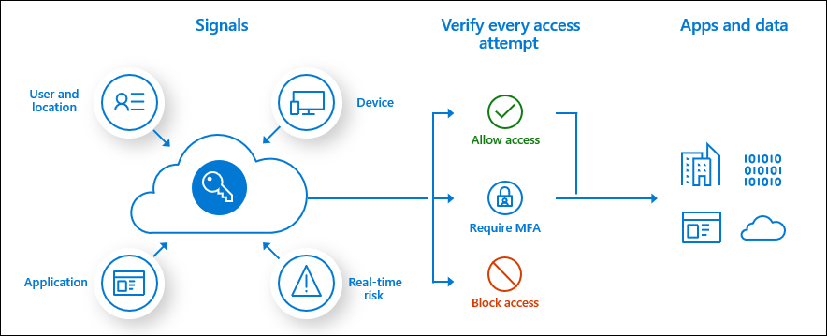
Explore Conditional Access policies
Conditional Access is an Azure AD premium feature that provides a policy based mechanism to address these challenges.
Conditional Access policies enable organizations to make decisions to enforce their security policies.
Organizations can use Conditional Access policies to apply the right access controls when needed to remain secure.

Slide 47
Build Conditional Access policies
A Conditional Access policy is an if-then statement of assignments and access controls
A Conditional Access policy brings signals together to make decisions and enforce organizational policies
Conditional Access policies include:
Assignments. The assignments portion controls the who, what, and where of the Conditional Access policy
Access controls. The access controls portion controls how the policy is enforced
All policies are enforced in two phases:
Phase 1: Collect session details
Gather information such as network location and device identity that will be necessary for policy evaluation
Phase 2: Enforcement
Use the session details gathered in phase 1 to identify any requirements that haven't been met
If there's a policy that's configured to block access with the block grant control, enforcement will stop here and the user will be blocked
The user will be prompted to complete more grant control requirements that weren't satisfied during phase 1
Once all grant controls have been satisfied, session controls are applied (App Enforced, Microsoft Defender for Cloud Apps, and token Lifetime)

Slide 48
Monitor enrolled devices
Basic device monitoring can be performed in Microsoft Endpoint Manager
Intune stores audit logs of all activities that generated changes in Microsoft Intune
Audit logs include activities such as:
Create
Update
Delete
Assign
In Intune, you can trigger a device action and view history of the remote actions that were run on different devices
You can use also Basic Mobility and Security to monitor enrolled devices and to perform device management tasks

Slide 49
Knowledge Check
Test your knowledge of this module by reviewing the Knowledge Check questions in your student manual

Slide 50
Summary
In this module, you examined the following items:
If your devices are managed by Intune, you can define how devices should be configured by using device compliance policies
You can use device compliance status for reporting, for example:
Which Windows 10 devices are using BitLocker?
Which Windows 10 devices don’t have Windows Firewall enabled?
You can also use compliance information as a criteria for conditional access

Slide 51
Module 5: Implement endpoint security in Microsoft Intune

Slide 52
Introduction
This module focuses on how organizations use Microsoft Intune to implement endpoint security:
Protecting data and devices with Microsoft Intune
Exploring endpoint security in Microsoft Intune
Managing devices with endpoint security in Intune
Using security baselines to configure Windows devices in Intune
Managing security baseline profiles in Microsoft Intune
Implementing attack surface reduction rules

Slide 53
Protect data and devices with Microsoft Intune
An organization can deploy Intune's device configuration and device compliance policies to configure devices to meet its security goals.
Intune-managed apps and Intune's app protection policies can help stop data leaks and keep your organization's data safe
These protections can apply to devices that are enrolled with Intune and to devices that aren't
From the Microsoft Endpoint Manager admin center, an organization can run device actions that help keep a selected device protected
You can run a subset of these actions as bulk device actions to affect multiple devices at the same time
Several remote actions from Intune can also be used with co-managed devices

Slide 54
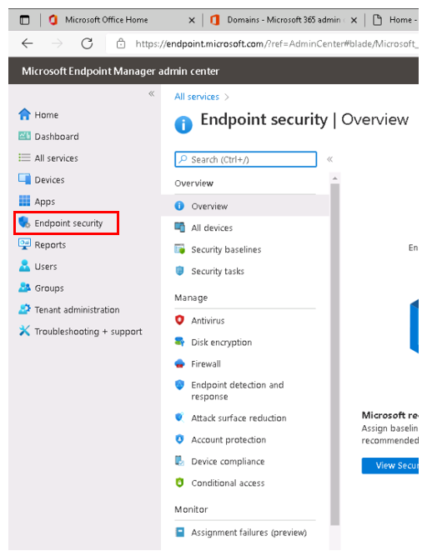
Explore endpoint security in Microsoft Intune
Microsoft Endpoint security policies are designed to help organizations focus on the security of their devices and mitigate risk
The available tasks can help them:
Identify at-risk devices
Remediate those devices
Restore them to a compliant or more secure state
Security and enterprise administrators can use the Endpoint security node in the Microsoft Endpoint Manager admin center to:
Configure device security
Manage security tasks for devices when those devices are at risk
Security baselines in Microsoft Endpoint Manager are pre-configured groups of settings
Organizations can use security baselines to rapidly deploy best practice configurations of device and application settings to protect their users and devices

Slide 55
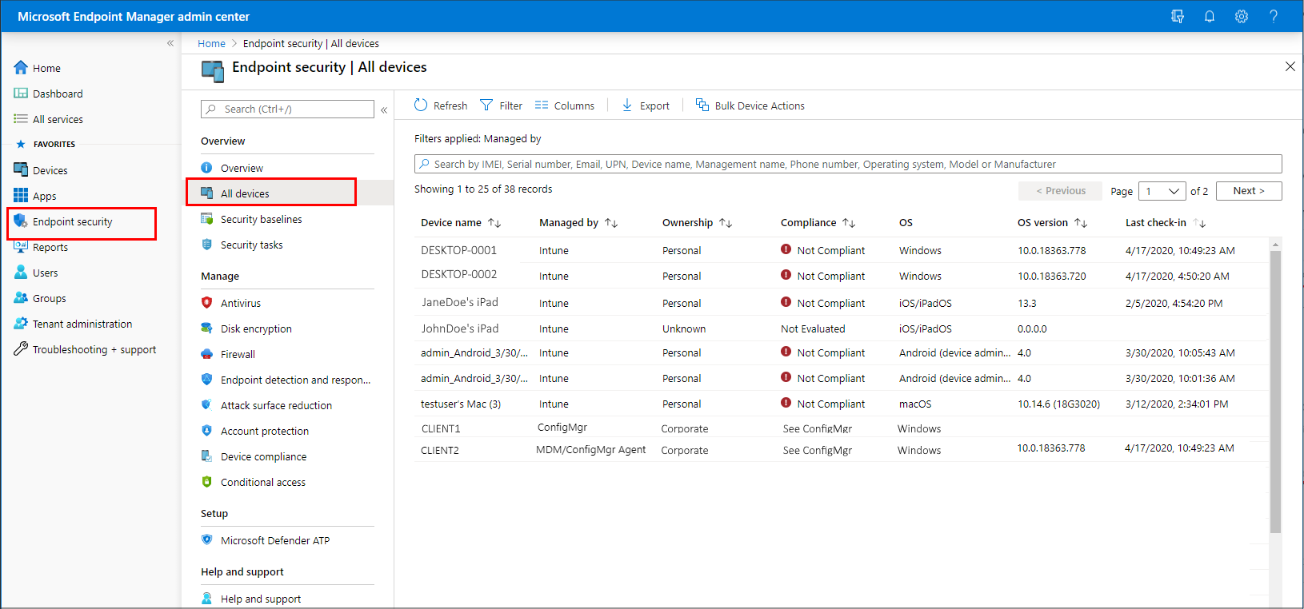
Manage devices with endpoint security in Intune
An organization can use the All devices view in the Microsoft Endpoint Manager admin center to review and manage its devices
The view displays a list of a company's devices from its Azure Active Directory, including devices managed by:
Intune
Configuration Manager
Co-management (by both Intune and Configuration Manager)
Devices can be in the cloud and from an organization's on-premises infrastructure when integrated with its Azure AD

Slide 56
Use security baselines to configure Windows devices in Intune
A security baseline is a group of Microsoft-recommended configuration settings that help organizations apply and enforce granular security settings that are recommended by Microsoft’s security teams
Security baselines are an essential benefit to customers because they bring together expert knowledge from Microsoft, partners, and customers
Available security baselines include:
Security Baseline for Windows 10 and later
Microsoft Defender for Endpoint baseline
Microsoft Edge Baseline and Microsoft Edge Baseline
An organization can view more information about the baseline versions by selecting a baseline type, such as MDM Security Baseline to open its Profiles pane
An organization can change the version of a baseline that's in use with a given profile.

Slide 57
Manage security baseline profiles in Microsoft Intune
Organizations should manage profiles for security baselines to secure and protect their users and their Windows 10 and later devices
An organization can deploy a default (unmodified) baseline or create a customized profile to enforce the settings it requires for its environment
When an organization creates a security baseline profile in Intune, it's creating a template that consists of multiple device configuration settings
Common tasks performed by organizations when working with security baselines include:
Create a profile
Change the baseline version for a profile
Remove a security baseline assignment

Slide 58
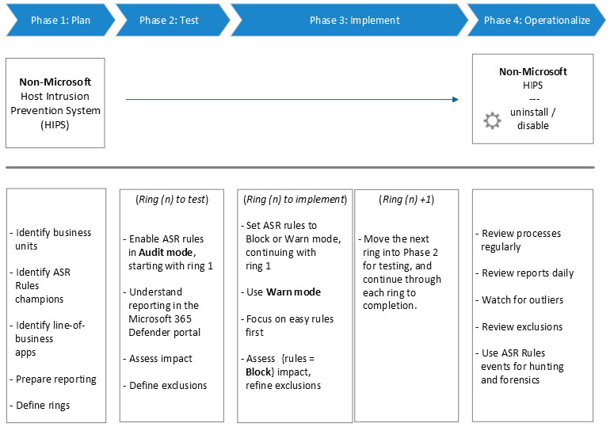
Implement attack surface reduction rules
An organization's attack surfaces include all the places where an attacker could compromise the organization's devices or networks
Attack surface reduction rules can constrain software-based risky behaviors and help keep organizations safe
By reducing the different attack surfaces, organizations can help prevent attacks from happening in the first place
For attack surface reduction rules to work, organizations must plan, test, implement, and operationalize attack surface reduction rules carefully

Slide 59
Knowledge Check
Test your knowledge of this module by reviewing the Knowledge Check questions in your student manual

Slide 60
Summary
In this module, you examined the following items related to endpoint security in Microsoft Intune :
How organizations use Microsoft Intune to implement endpoint security.
How Microsoft Endpoint security policies help organizations focus on the security of their devices and mitigate risk.
Delved into the world of security baselines.
How to implement attack surface reduction rules.

Slide 61
Lab 9 – Manage devices with Microsoft Intune (continued)

Slide 62
Lab exercises (continued)
Exercise 5: Manage and Monitor a Device in Intune
Task 1
Create device categories
Task 2
Create a configuration profile
Task 3
Manage the enrolled devices
Task 4
Create dynamic groups for the device categories
Task 5
Create a conditional access policy

Slide 63
Module 6: Learning Path review

Slide 64
Discussion – Learning Path review
What are your key takeaways from this learning path, and why?
What are the key features discussed in this learning path that you foresee implementing at your organization?

Slide 65
Closing slide

