Slide 1
AZ-040 Automating Administration with PowerShell
Author name Date

Slide 2
Module 5: Querying management information by using CIM and WMI

Slide 3
Module overview
Windows Management Instrumentation (WMI) and Common Information Model (CIM) provide local and remote access to a repository of management information, including robust information available from the operating system, from computer hardware, and from installed software. In this module, you’ll learn about these two technologies.
Lessons:
Lesson 1: Understand CIM and WMI
Lesson 2: Query data by using CIM and WMI
Lesson 3: Making changes by using CIM and WMI

Slide 4
Section break 1

Slide 5
Lesson 1: Understand CIM and WMI

Slide 6
Lesson 1 overview
In this lesson, you’ll learn about the architecture of CIM and WMI. Both technologies connect to a common information repository that contains management information that you can query and manipulate. The repository contains information about a computer system or device, including hardware, software, hardware drivers, components, roles, services, user settings, and just about every configurable item and the current state of that item. Familiarity with the framework and syntax of CIM and WMI will help you know and control many aspects of an operating system environment.
Topics:
Architecture and technologies
Understanding the repository
Finding documentation
Demonstration: Finding documentation for classes

Slide 7
Architecture and technologies
CIM cmdlets
Local connections use COM.
Ad hoc remote connections use WS-MAN.
CIM sessions for remote connections can use WS-MAN or DCOM.
WMI cmdlets
Local connections use COM.
Ad hoc remote connections use DCOM.
CIM or WMI?
CIM is preferred because it’s current.
CIM cmdlets provide easier network connectivity.
Notes:
Explain to students that in most cases the CIM and WMI cmdlets provide equivalent functionality.

Slide 8
Understanding the repository
The repository used by CIM and WMI is organized into namespaces.
Namespaces organize related classes:
Use tab completion in the -Namespace parameter of the Get-CimInstance cmdlet to browse the namespace structure.
Classes represent manageable components.
An instance is an actual occurrence of a class.
An instance has:
Properties that describe the instance’s attributes.
Methods that cause the instance to perform an action.
Notes:
As you explain the difference between namespaces, classes, and instances, you can use the following analogy:
Namespaces are similar to folders in the file system. They’re used to organize data in the repository.
Classes are similar to different file types in the file system such as TXT files or EXE files. They have different data, and you can do different things with them.
Instances are similar to specific files in the file system. Executable (EXE) is a class, but WinWord.exe is an instance of that class.

Slide 9
Finding documentation
The fastest way to find documentation is to enter a repository class name into an internet search engine.
Classes in the root\CIMv2 namespace are typically well-documented.
Classes from other namespaces are typically not well-documented.
You can get some information by using Get-Member.
Notes:
The key takeaway from this topic is to use an internet search to find the documentation for classes.

Slide 10
Demonstration: Finding documentation for classes
In this demonstration, you will learn how to use a search engine to locate the online documentation for the Win32_BIOS class.
Notes:
Preparation steps
To complete this demonstration, you need internet access. The virtual machines for this course don't have internet access. Therefore, perform this demonstration on the host machine, and ensure that internet access is available.
Detailed demonstration steps
On the host computer, in a web browser, refer to the Microsoft Bing website (or use your preferred internet search engine). In the Search box, enter Win32_BIOS.
In the search results, select Win32_BIOS class - Win32 apps | Microsoft Docs.
Explain that this webpage is the documentation page for the class. Review some of the class properties.

Slide 11
Section break 2

Slide 12
Lesson 2: Query data by using CIM and WMI

Slide 13
Lesson 2 overview
One of the most common uses for WMI and CIM is querying configuration information from computers. In this lesson, you’ll learn more about the structure of the namespaces that contain classes and how to query instances of a class. You’ll also learn how to query remote computers by using ad hoc connections and CIM sessions.
Topics:
Listing namespaces
Demonstration: Listing local repository namespaces by using WMI
Listing classes
Demonstration: Listing and sorting the classes from a CIM namespace
Querying instances
Demonstration: Querying class instances
Connecting to remote computers
Using CIM sessions
Demonstration: Using CIMSession objects

Slide 14
Listing namespaces
By listing namespaces, you can discover the contents of the repository on your computer.
To list the namespaces, run the following command:
Get-WmiObject -Namespace root -List -Recurse | Select -Unique __NAMESPACE
CIM commands offer tab completion for the -Namespace parameter.
Notes:
The CIM command set has no easy, direct equivalent to this Get-WmiObject WMI command. However, you can run Get-WmiObject locally on any computer to produce a list of its namespaces.

Slide 15
Demonstration: Listing local repository namespaces by using WMI
In this demonstration, you will learn how to use the Get-WmiObject cmdlet to list namespaces.
Notes:
Preparation steps
Start the virtual machines LON-DC1 and LON-CL1.
Sign in to LON-CL1 as Adatum\Administrator with the password Pa55w.rd.
Detailed demonstration steps
On LON-CL1, open the Windows PowerShell console as an administrator.
In the Windows PowerShell console, enter the following command, and then select Enter:
Get-WmiObject -Namespace root -List -Recurse | Select -Unique __NAMESPACE
Note the root\CIMV2 namespace and the root\SecurityCenter2 namespace. You'll use these in the next demonstration.

Slide 16
Listing classes
List classes for a namespace by using WIM or CIM:
Get-WmiObject -Namespace root\CIMv2 -List
Get-CimClass -Namespace root\CIMv2
Search for classes with wildcards:
Get-CimClass *network*
Notes:
Mention that the process of finding the class that is required is difficult, time-consuming, and error-prone. Many newcomers to WMI and CIM become frustrated with the guesswork. Unfortunately, guessing is the only technique that’s currently available.
Various third-party WMI Explorer tools are available that can make exploring the repository easier. These graphical tools allow you to quickly validate guesses. An internet search for WMI Explorer or CIM Explorer will return several results.

Slide 17
Demonstration: Listing and sorting the classes from a CIM namespace
In this demonstration, you will learn how to:
List the classes in root\SecurityCenter2.
List the classes in root\CIMv2 and sort by CimClassName.
List the classes in root\CIMv2 that have network in the class name.
Notes:
Preparation steps
Start the virtual machines LON-DC1 and LON-CL1.
Sign in to LON-CL1 as Adatum\Administrator with the password Pa55w.rd. Perform the demonstration on LON-CL1.
Detailed steps
In the Windows PowerShell console, enter the following command, and then select Enter:
Get-CimClass -Namespace root\SecurityCenter2
Note the values returned. Point out the CimClassName, CimClassMethods, and CimClassProperties column names and the values returned in each row.
In the Windows PowerShell console, enter the following command, and then select Enter:
Get-CimClass -Namespace root\CIMv2
Explain that the class names starting with two underscores (__) are system classes. You can typically ignore system classes.
In the Windows PowerShell console, enter the following command, and then select Enter:
Get-CimClass -Namespace root\CIMv2 | Sort CimClassName
Explain that an alphabetical list is useful when you have to validate a guess about a class name. For example, if you think a class named Win32_Network might be useful, you can more easily discover whether the class exists by using an alphabetical list.
To find all the classes in the root\CIMv2 namespace that have network in the class name, enter the following command in the Windows PowerShell console, and then select Enter:
Get-CimClass *network* | Sort CimClassName
Note: This technique can't search class descriptions, because that information isn't stored in the repository.

Slide 18
Querying instances
Query instances by using WMI or CIM:
Get-WmiObject -Class Win32_LogicalDisk
Get-CimInstance -ClassName Win32_LogicalDisk
Use filtering with CIM or WMI commands to return only matching instances:
Get-CimInstance -ClassName Win32_LogicalDisk -Filter "DriveType=3"
Use a WQL query with CIM or WMI commands to return only matching instances:
Get-CimInstance -Query "SELECT * FROM Win32_LogicalDisk WHERE DriveType = 3"
Notes:
Explain that filtering during a query is more efficient than retrieving all instances of a class and then filtering with the Where-Object cmdlet.

Slide 19
Demonstration: Querying class instances
In this demonstration, you will learn how to:
Use Get-WmiObject to query all instances of Win32_Service.
Use Get-CimInstance to query all instances of Win32_Process.
Use Get-CimInstance to query instances of Win32_LogicalDisk with a DriveType property of 3.
Use Get-Ciminstance with a WQL query to display all instances of Win32_NetworkAdapter.
Notes:
Preparation steps
Start the virtual machines LON-DC1 and LON-CL1.
Sign in to LON-CL1 as Adatum\Administrator with the password Pa55w.rd. Perform the demonstration on LON-CL1.
Detailed steps
In the Windows PowerShell console, enter the following command, and then select Enter:
Get-WmiObject -Class Win32_Service
In the Windows PowerShell console, enter the following command, and then select Enter:
Get-CimInstance -ClassName Win32_Process
In the Windows PowerShell console, enter the following command, and then select Enter:
Get-CimInstance -ClassName Win32_LogicalDisk -Filter "DriveType=3"
In the Windows PowerShell console, enter the following command, and then select Enter:
Get-CimInstance -Query "SELECT * FROM Win32_NetworkAdapter"

Slide 20
Connecting to remote computers
CIM and WMI cmdlets provide ad hoc reconnections to remote computers by using -ComputerName
Get-CimInstance -ClassName Win32_BIOS -ComputerName LON-DC1
You can specify multiple computer names.
Only WMI cmdlets support using –Credential
Get-WmiObject -ComputerName LON-DC1 -Credential ADATUM\Administrator -Class Win32_BIOS
Credentials can be stored in a variable to avoid password prompts.
Ad hoc connection protocol
WMI: DCOM
CIM: WS-MAN
Notes:
Make students aware that using alternate credentials can be useful for running scripts as a scheduled task.

Slide 21
Using CIM sessions
A CIM session:
Is a persistent configuration object for remote connections.
Can be reused for multiple commands.
Has settings not available for ad-hoc connections.
Store a CIM session in a variable:
$sessions = New-CimSession -ComputerName LON-CL1,LON-CL2
Use the variable when running CIM commands:
Get-CimInstance -CimSession $sessions -ClassName Win32_OperatingSystem
Configure session options
$opt = New-CimSessionOption -Protocol Dcom
$DcomSession = New-CimSession -ComputerName LON-DC1 -SessionOption $opt
Remove sessions
$DcomSession | Remove-CimSession
Notes:
Inform students that CIM sessions are only required when there are unique settings for a CIM connection that are not supported by ad-hoc connections. Also, remind student that CIM sessions don’t maintain a connection to the remote computer.

Slide 22
Demonstration: Using CIMSession objects
In this demonstration, you will learn how to:
Create a CIM session to LON-DC1.
Query the Win32_OperatingSystem class by using the CIM session.
Remove the CIM session.
Notes:
Preparation steps
Start the virtual machines LON-DC1 and LON-CL1.
Sign in to LON-CL1 as Adatum\Administrator with the password Pa55w.rd. Perform the demonstration steps on LON-CL1.
Detailed steps
In the Windows PowerShell console, enter the following command, and then select Enter:
$s = New-CimSession -ComputerName LON-DC1
In the Windows PowerShell console, enter the following command, and then select Enter:
Get-CimInstance -CimSession $s -ClassName Win32_OperatingSystem
In the Windows PowerShell console, enter the following command, and then select Enter:
$s | Remove-CimSession

Slide 23
Section break 3

Slide 24
Lesson 3: Making changes by using CIM and WMI

Slide 25
Lesson 3 overview
In this lesson, you’ll learn to use CIM and WMI to make changes by using methods. The methods available to you vary depending on the type of object. Discovering and understanding these methods is an important step in querying and manipulating the repository information.
Topics:
Discovering methods
Finding documentation for methods
Demonstration: Finding methods and documentation
Invoking methods
Demonstration: Invoking methods of repository objects

Slide 26
Discovering methods
A method is an action you can perform on an object.
The methods available vary depending on the class.
Review methods for an object instance:
Get-WmiObject -Class Win32_Service | Get-Member -MemberType Method
Get-CimInstance -Class Win32_Service | Get-Member -MemberType Method
Review methods for a specific class:
Get-CimClass -Class Win32_Service | Select-Object -ExpandProperty CimClassMethods
Notes:
Note to students that after finding which methods are available, it’s likely they’ll still want to find documentation to ensure that they know how to use the methods rather than trial and error.

Slide 27
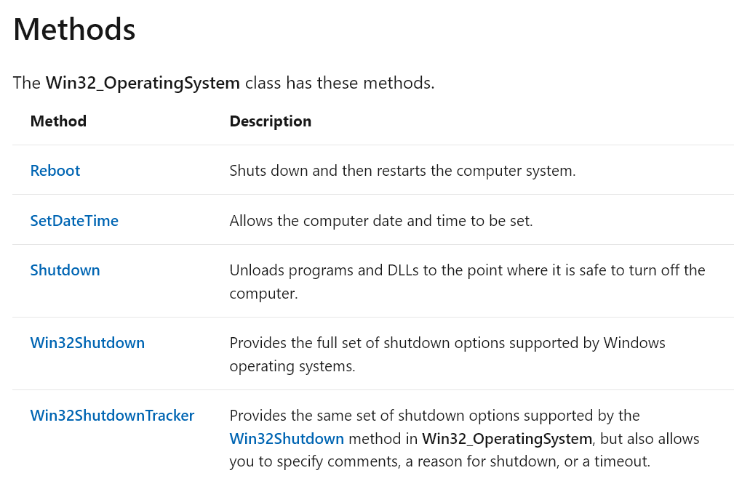
Finding documentation for methods
Documentation for methods is part of the class documentation.
Use an internet search to find the documentation for a class.
Notes:
The methods listed on this slide are from the Win32_OperatingSystem class documentation on Microsoft Docs.

Slide 28
Demonstration: Finding methods and documentation
In this demonstration, you will learn how to:
Use Get-WmiObject to display members for the Win32_Service class.
Use Get-CimClass to display the CimClassMethods property for the Win32_Service class.
Use Get-CimClass to display members for the Win32_Service class.
Find documentation for the Change method of the Win32_Service class.
Notes:
Preparation steps
Start the virtual machines LON-DC1 and LON-CL1.
Sign in to LON-CL1 as Adatum\Administrator, with the password Pa55w.rd.
Detailed steps
On LON-CL1, in the Windows PowerShell console, enter the following command, and then select Enter:
Get-WmiObject -ClassName Win32_Service | Get-Member
Note: Explain that the Change method is one member of the class. The output might be duplicated because of the command returning objects with differing properties or methods.
In the Windows PowerShell console, enter the following command, and then select Enter:
Get-CimClass -Class Win32_Service | Select-Object -ExpandProperty CimClassMethods
In the Windows PowerShell console, enter the following command, and then select Enter:
Get-CimClass -Class Win32_Service | Get-Member
Note: This doesn't return the methods that the previous CIM and WMI commands did. Instead, it returns five additional methods. These methods are from the Microsoft.Management.Infrastructure.CimClass namespace and not from Win32_Service.
In a web browser on the host computer, refer to your preferred search engine.
Enter Win32_Service docs.microsoft.com as the search term.
In the search results, select Win32_Service class - Win32 apps | Microsoft Docs.
On the webpage, scroll to the Methods section, and then select Change.
Note: Explain that this method has 11 parameters. Review the parameters with the class.

Slide 29
Invoking methods
Direct invocation works only for WMI objects.
$WmiSpoolerService = Get-WmiObject -Class Win32_Service -Filter “Name=‘Spooler’”
$WmiSpoolerService.ChangeStartMode(“Manual”)
For WMI objects, method parameters are ordinal.
$WmiSpoolerService | Invoke-WmiMethod -Name ChangeStartMode -Argument “Manual”
For CIM objects, method parameters are named.
Invoke-CimMethod -ClassName Win32_Process -MethodName Create -Arguments @{CommandLine=‘Mspaint.exe’}
Notes:
A key difference between CIM and WMI objects is how parameters are managed for methods. For WMI objects, the parameters are ordinal and must be presented in the correct order. For CIM objects, parameters are named and can be in any order.
The ChangeStartMode method on the slide has only one parameter. So, order is not a factor. It is common for methods to have only one parameter or none.

Slide 30
Demonstration: Invoking methods of repository objects
In this demonstration, you will learn how to:
Use Invoke-CimMethod and the Reboot method of the Win32_OperatingSystem class remotely on LON-DC1.
Use the Create method of the Win32_Process class to start mspaint.exe.
Use the Terminate method of the Win32_Process class to close Microsoft Paint.
Notes:
Preparation steps
Start the virtual machines LON-DC1 and LON-CL1.
Sign in to LON-CL1 as Adatum\Administrator, with the password Pa55w.rd.
Detailed steps
On LON-CL1, in the Windows PowerShell console, enter the following command, and then select Enter:
Invoke-CimMethod -ComputerName LON-DC1 -ClassName Win32_OperatingSystem -MethodName Reboot
In the Windows PowerShell console, enter the following command, and then select Enter:
Invoke-CimMethod -ClassName Win32_Process -MethodName Create -Arguments @{CommandLine='mspaint.exe'}
In the Windows PowerShell console, enter the following command, and then select Enter:
Get-CimInstance -Class Win32_Process -Filter "Name='mspaint.exe'" | Invoke-CimMethod -Name Terminate

Slide 31
Section break 4

Slide 32
Lab: Querying information by using WMI and CIM
Exercise 1: Querying information by using WMI
Exercise 2: Querying information by using CIM
Exercise 3: Invoking methods
Sign-in information for the exercises:
Virtual machines: AZ-040T00A-LON-DC1 and AZ-040T00A-LON-CL1
Username: Adatum\Administrator
Password: Pa55w.rd

Slide 33
Lab scenario
You have to query management information from several computers. You start by querying the information from your local computer and from one test computer in your environment.

Slide 34
Lab-review questions
Which class do you query to review IP addresses?
When would you prefer to use WMI instead of CIM?
When might you want to remotely reboot a computer by using the Win32_OperatingSystem class?

Slide 35
Lab-review answers
Which class do you query to review IP addresses?
The Win32_NetworkAdapterConfiguration class contains IP address information.
When would you prefer to use WMI instead of CIM?
You’d use WMI instead of CIM if there were any features not available in CIM that you required. This is rare.
When might you want to remotely reboot a computer by using the Win32_OperatingSystem class?
If you’ve made configuration changes that require a reboot to take effect, you can trigger a reboot at the end of your configuration process.

Slide 36
References
Win32 Provider
CIM Classes (WMI)
Event log message indicates that the Windows Installer reconfigured all installed applications
WQL (SQL for WMI)

